Slide 1
Dual Wedge Confocal Microscope
Christopher Carr
Thomas Aites
Christopher Marinis
Jeffrey Guziejka
Notes:
Speaker:
Jeff G.
Introduce Group

Slide 2
Problem Statement
Current confocal microscopes too large
Solution:
A method is required to reduce the size of confocal microscopes to help in clinical use
Notes:
Speaker:
Jeff G.
Explain what we are doing.

Slide 3
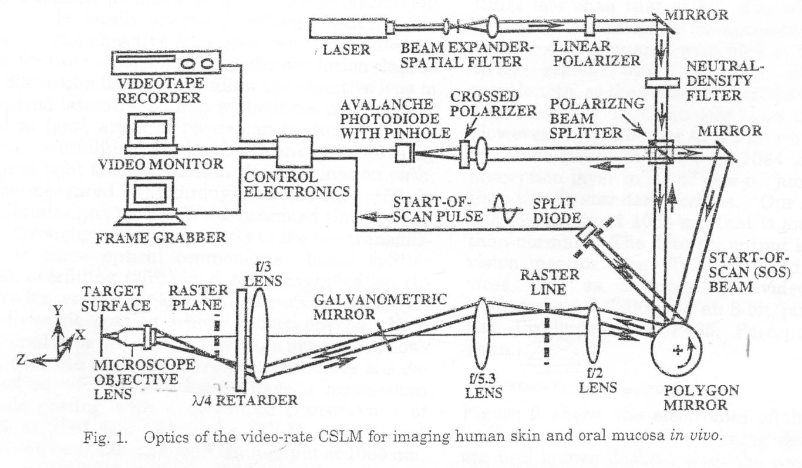
Current Confocal Microscope Design
Notes:
Speaker:
Jeff G.

Slide 4
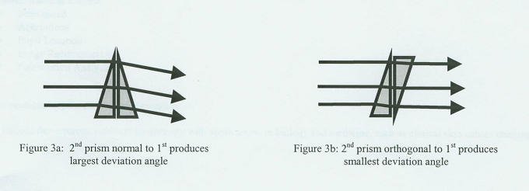
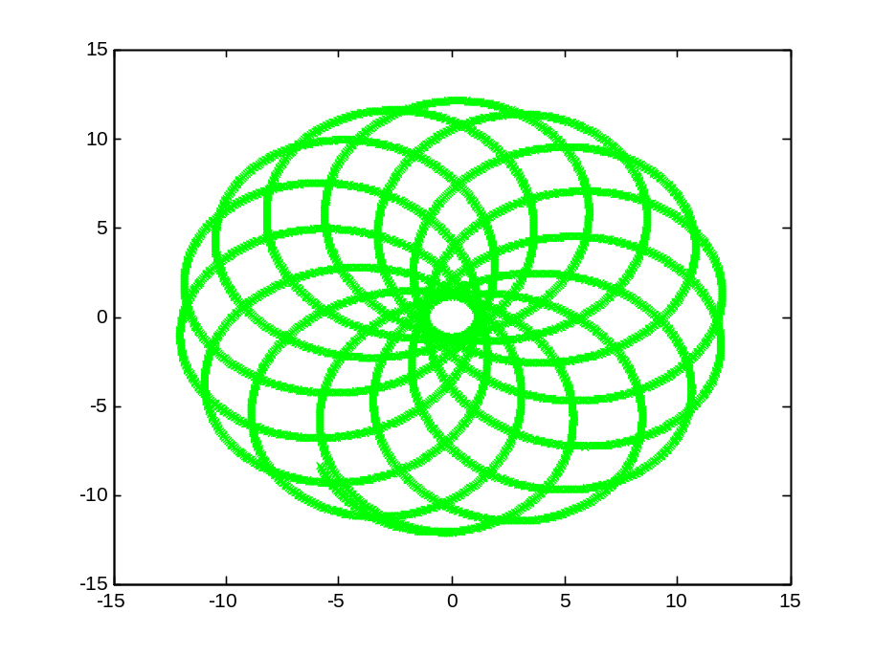
Prisms
Notes:
Speaker:
Tom A.
Anti-Reflection for

Slide 5
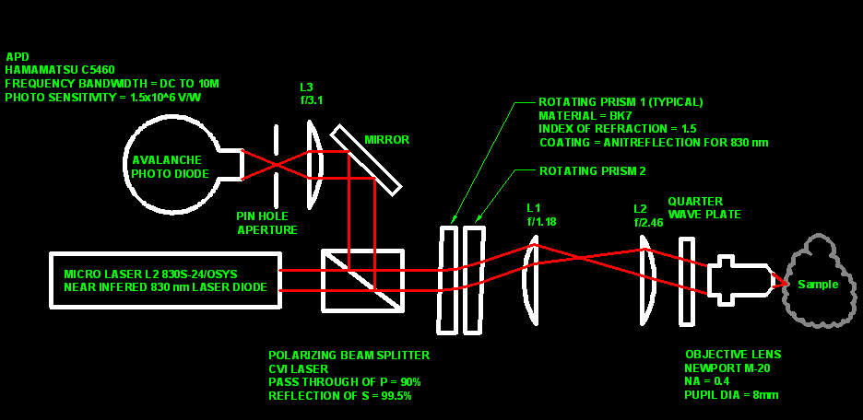
New Optical Design
Notes:
Speaker:
Chris C.

Slide 6
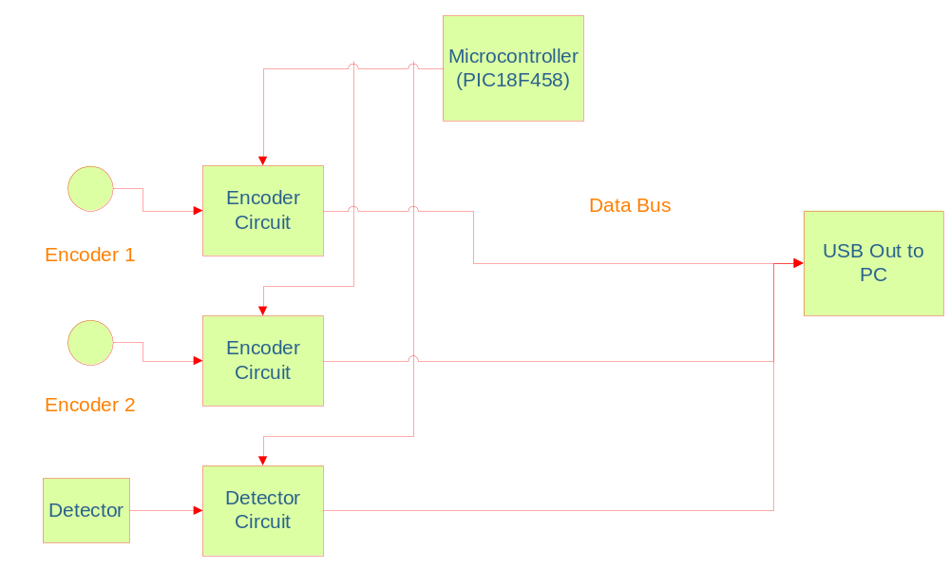
Data Acquisition System
Top Down Description
Notes:
Speaker:
Chris M.

Slide 7
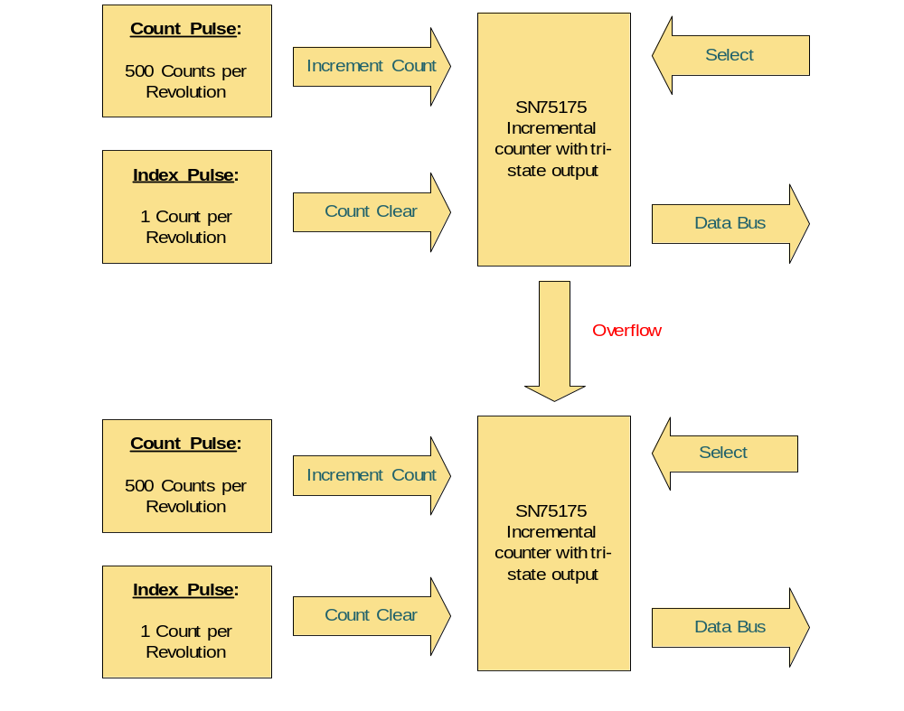
Encoder Circuit Design

Slide 8
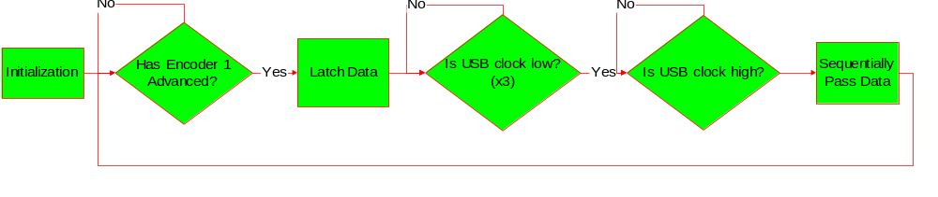
Microcontroller Flow Diagram

Slide 9
Method of Data Transfer
USB 2.0 development board
  USBee ex2 CWAV
5 unsigned characters per transfer
  Bytes 1 & 2 create encoder 1 position
  Bytes 3 & 4 create encoder 2 position
  Byte 5 is intensity value
Placed in protected queue

Slide 10
Data Analysis
4 thread process
  Data Retrieval
  Color and Position analysis
  Interpolation
  Pixel Placement
Encoder to pixel conversion handled by Matlab code generated into dll

Slide 11
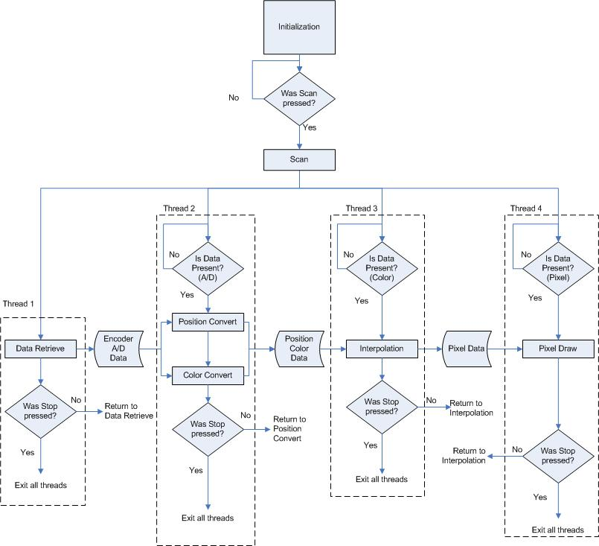
Data Analysis

Slide 12
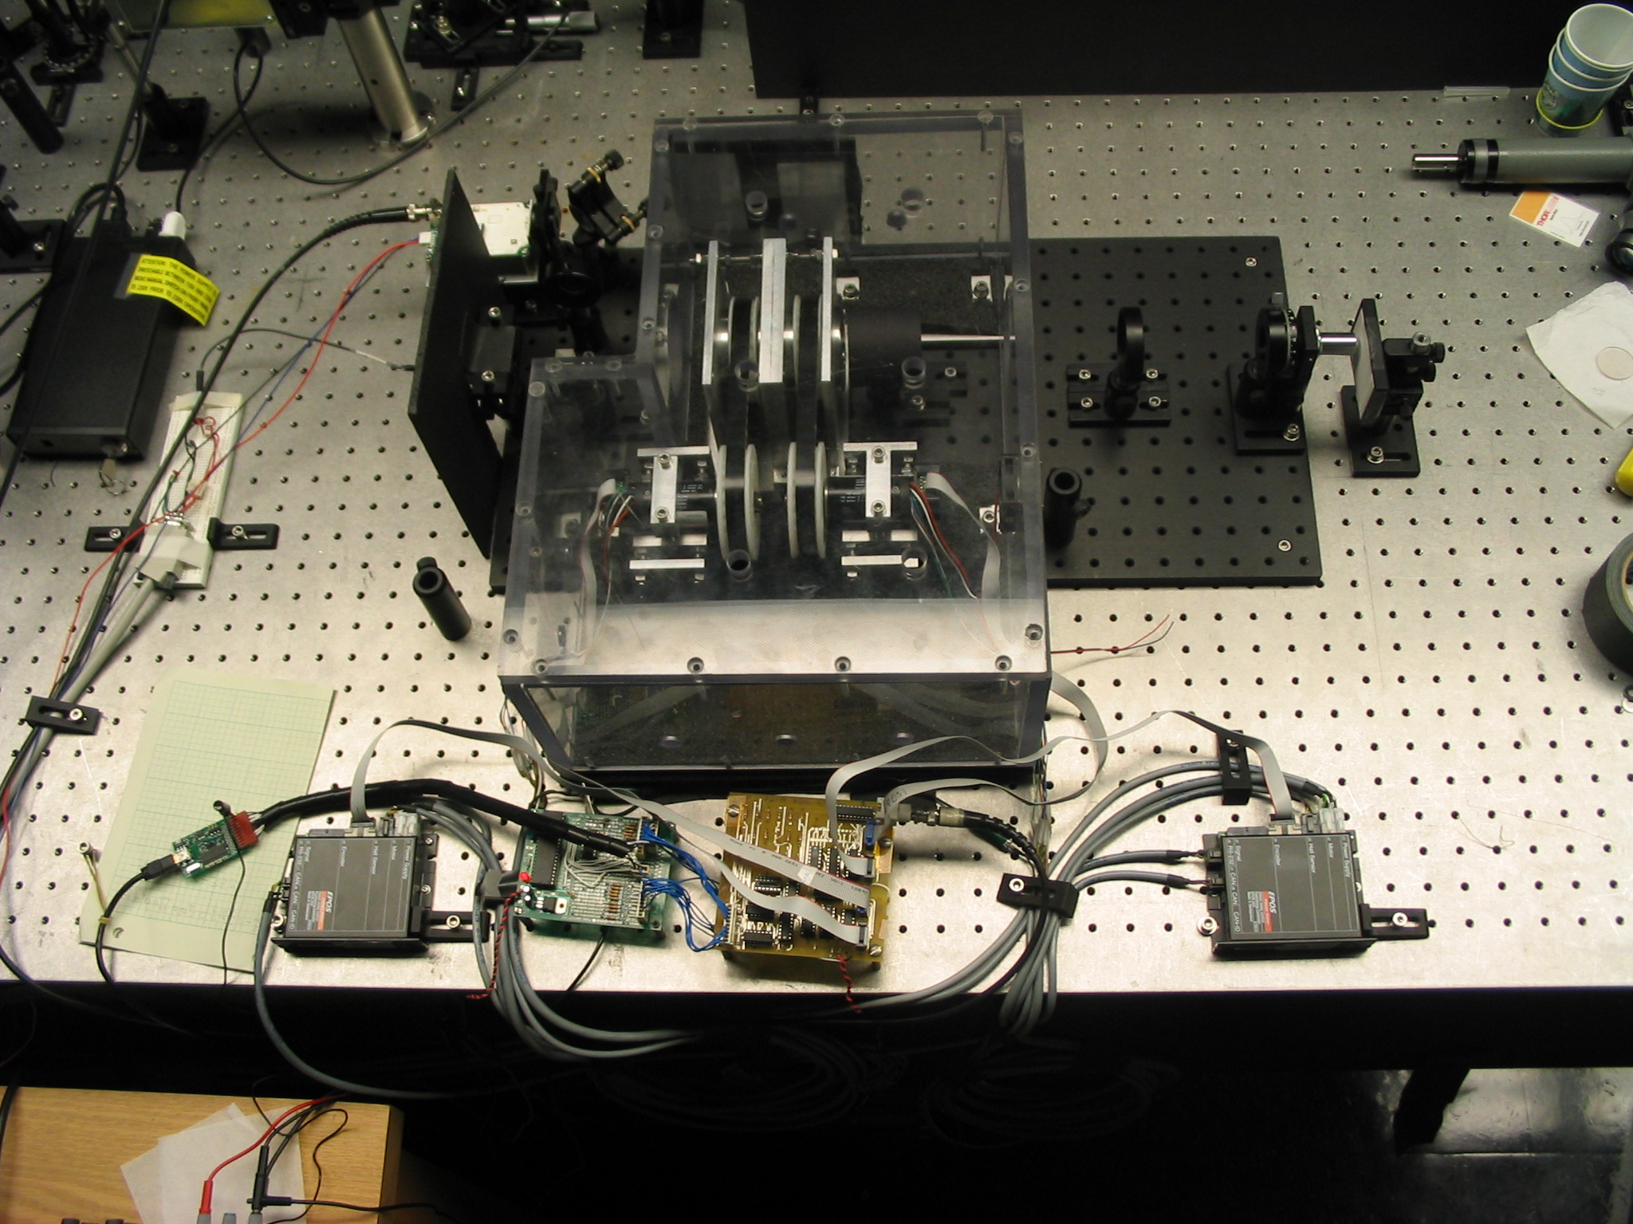
Results

Slide 13
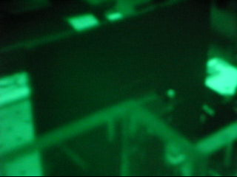
Results

Slide 14
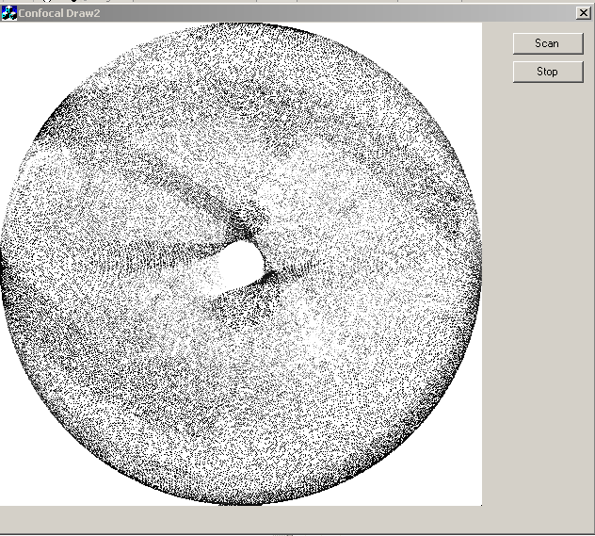
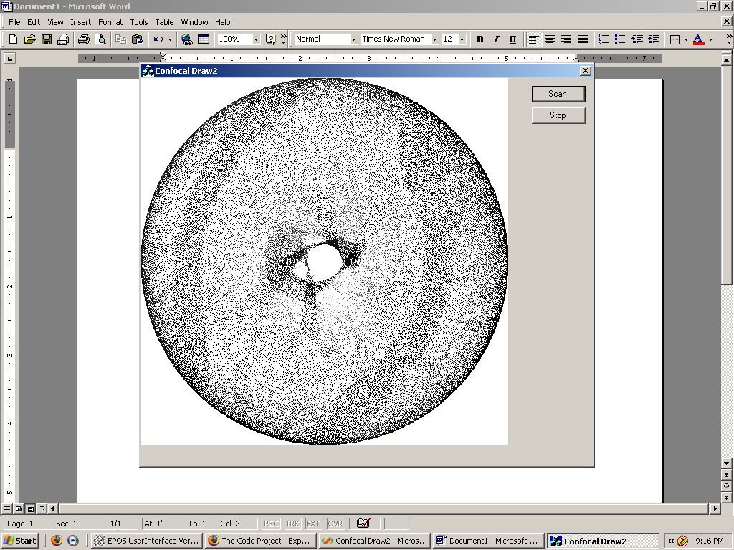
Scans

Slide 15
Improvements/Unexpected Problems
Increase the number of encoder values to enhance resolution.
Save image as Bitmap file and array of values.
Investigate transformation calculations / need for a third prism to remove hole in center of image.
Motor control via microcontroller

Slide 16
Questions and
Invitation to 334 Egan Research
Notes:
?

Slide 17
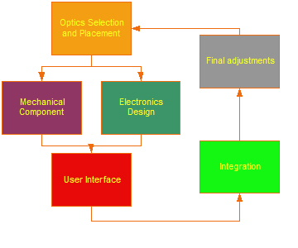
Purposed Design Improvements
Notes:
Speaker:
Chris C.

Slide 18
Imaging Software
Computer used for signal processing
C++ program
  Process raw data
GUI
  Interface to control microscope
Interpolation
Notes:
Speaker:
Tom A.

Slide 19
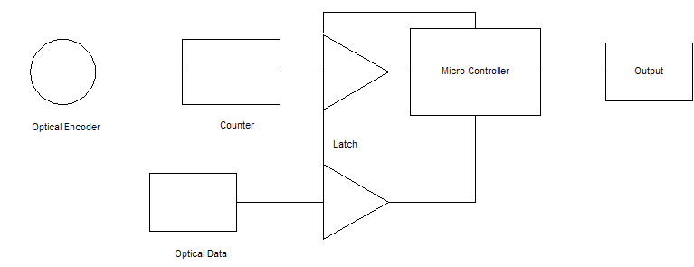
Data Acquisition System
Notes:
Speaker:
Chris M.

Slide 20
Data Acquisition System
Encoders
  BEI H25
  512 samples per revolution
Microprocessor
  Motorola MPC535
  63 MIPS
Counter
Latch
A/D
USB 2.0
Notes:
Speaker:
Chris M.

Slide 21
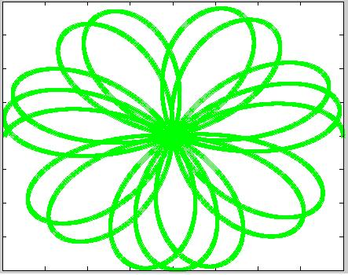
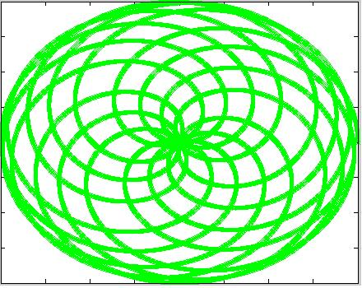
Scan Methods
Flower scan
  Prisms spin in opposite directions
Spiral Scan
  Prisms spin in same direction
Notes:
Speaker:
Tom A.

Slide 22
New Optical Design
Beam Splitter
Objective lens
  30x
Laser
  Micro Laser L2 830S-24/OSYS
Rotating Prisms
Notes:
Speaker:
Chris C.

