Slide 1

Sample Page
For a sample handout
From a sample author
With sample images

Slide 2
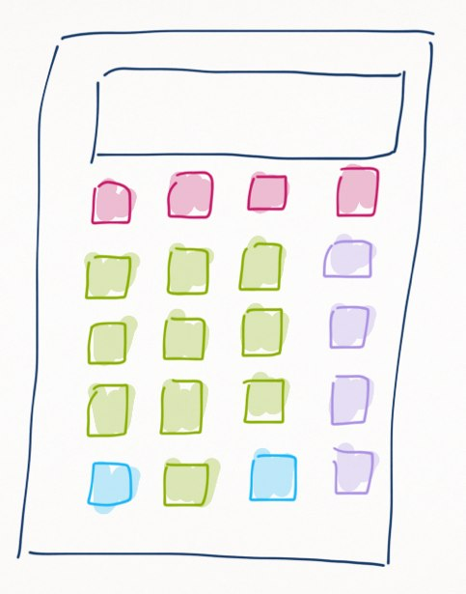
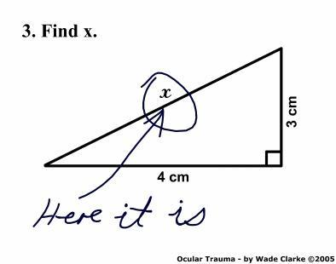
Slide: 2

Slide 3

Slide: 3

Slide 4

Slide: 4

Slide 5
Slide: 5

