Slide 1
Curious Computation Models
CONNECTIONS workshop 2019
by fuzzy binaires
Gidon Ernst

Slide 2


Slide 3
an algorithm is
a sequence of instructions
to be executed
by a computer

Slide 4
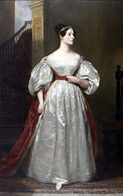
Ada Lovelace

Slide 5
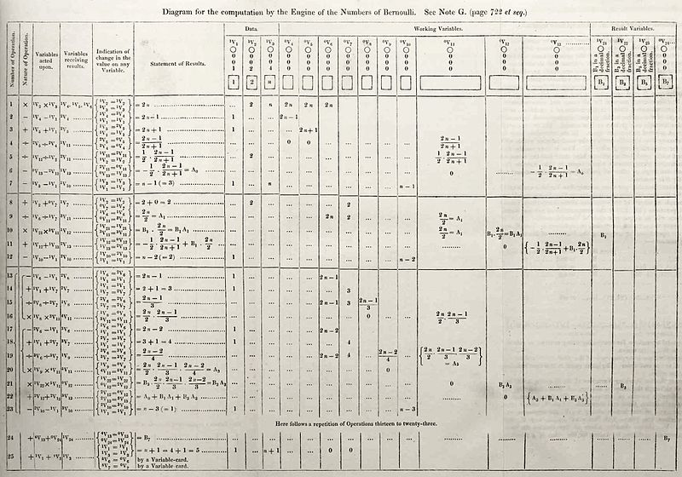

Slide 6
an algorithm is
a sequence of instructions
to be executed
by a computer
which problems can be solved by algorithms?

Slide 7
A simple game
Goal: at least one green symbol in each box
Rules
two colors: red, green
if a hollow symbol is red, then the same solid symbol must be green and vice versa
example: means

Slide 8
A simple game: possible solution
Goal: at least one green symbol in each box
Rules
two colors: red, green
if a hollow symbol is red, then the same solid symbol must be green and vice versa
example: means

Slide 9

This game solves logical formulas!
Goal: at least one green symbol in each box
Corresponds to:
(P or ~Q or S) and (~P or Q or R) and (~S)
Credit: Martina Seidl (Uni Linz)

Slide 10
Solving the game
Goal: at least one green symbol in each box
An example algorithm:
  guess the correct answer if one exists
  check that the answer solves the game

Slide 11
Solving the game
Goal: at least one green symbol in each box
Another algorithm:
  pick arbitrary colors for the hollow symbols,
  then set the colors for solid symbols by the rules
  check if each box contains a green symbol
  repeat if necessary

Slide 12
an algorithm is
a sequence of instructions
to be executed
by a computer
which problems can be solved by algorithms?
answer depends on model of computation!

Slide 13
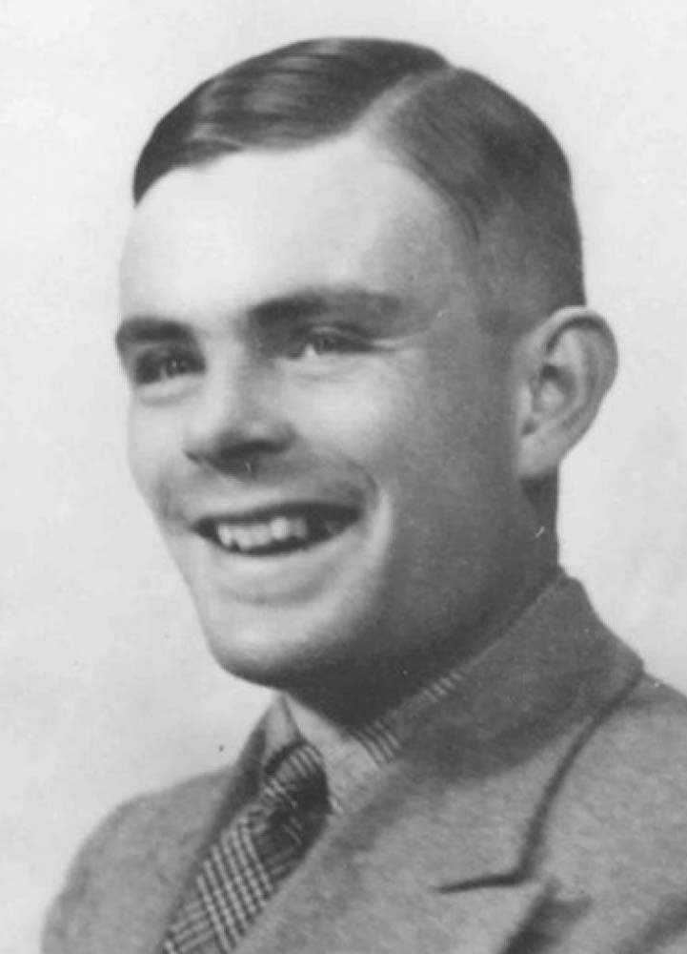
Alan Turing

Slide 14
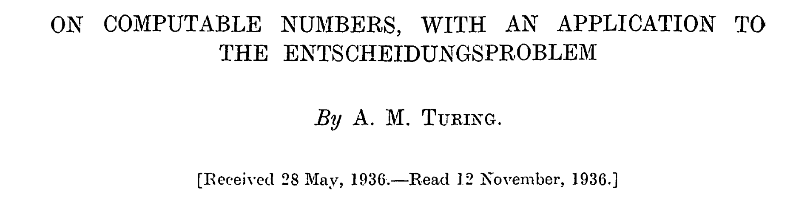

Slide 15
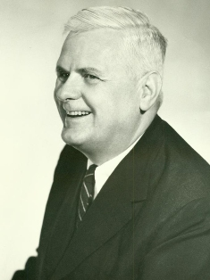
Alonzo Church

Slide 16
Computation
step
(“draw”)
...
initial state
(“setup”)
states
states

Slide 17
Game of Life

Slide 18
Game of Life

Slide 19
Game of Life

Slide 20
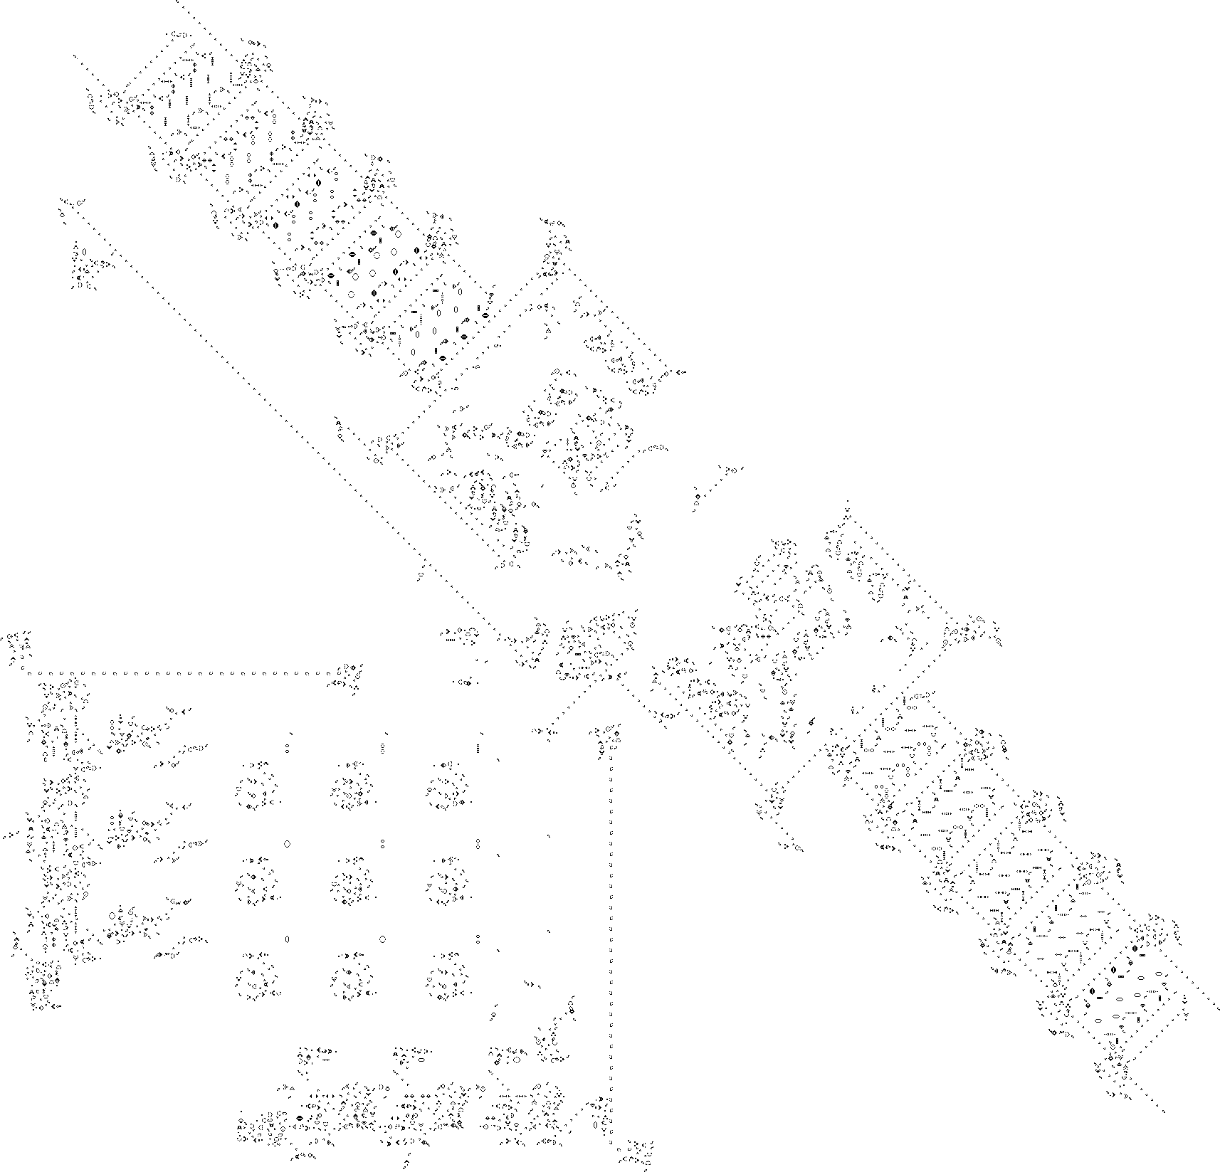
http://www.rendell-attic.org/gol/tm.htm

