Slide 1


Korn
A C verifier based on Horn-clauses https://github.com/gernst/korn
Gidon Ernst
gidon.ernst@lmu.de

Slide 2
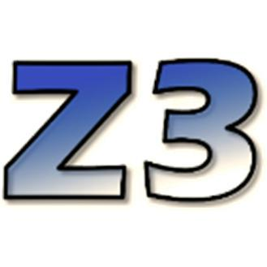
Synopsis
SPACER
Korn
C source
Horn clauses
&
Eldarica
witness
model/CEX
infer loop invariants
and function summaries

Slide 3
Korn - Background
Goal: investigate different loop encodings
(contracts & invariants, arxiv.org/abs/2010.05812)
For SV-COMP (4 categories)
  validate counterexamples (encoding limitations)
  cheap random fuzzing (surprisingly effective)
⊕ easy to hack (Scala) ⊖ many C features missing

Slide 4
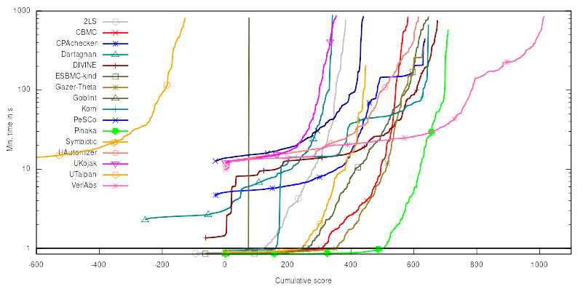
ReachSafety-Loops (#5)
(646 of 768 tasks supported)
portfolio pays off
fuzzing
Z3
Eldarica

Slide 5
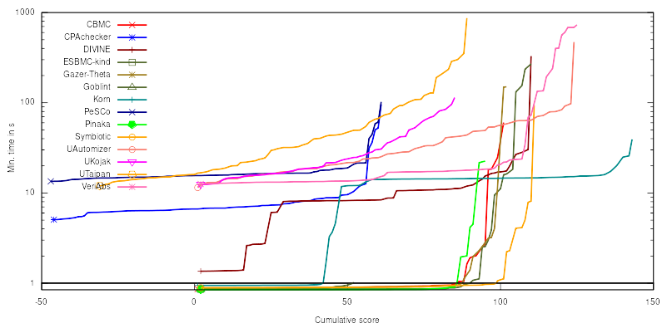
ReachSafety-Recursive (#1)
(99 of 106 tasks supported)
many “simple”
function summaries
many obvious bugs
fuzzing
Z3

Slide 6
Cheap Random Fuzzing compile and run for the fun
Many sv-benchmarks falsify with
__VERIFIER_nondet_*() small
Heuristic: uniform choice between a value in
0 [0,1] [0,31] [0,1023]
⊕ > 100 problems solved in < 10s
⊕ Avoids 1 unsound verdict (unsigned overflow)

Slide 7
Counterexample Validation don’t trust encoding and solvers
Horn-clauses track __VERIFIER_nondet_*()
0: FALSE -> 1
1: $main_ERROR(8, 21, 8, 21) -> 2, 28
2: fibonacci(8, 21) -> 4, 3, 27
[..]
11: $fibonacci_pre(0) -> 12
12: $__VERIFIER_nondet_int(0)
[..]
27: $fibonacci_pre(8) -> 28
28: $__VERIFIER_nondet_int(8)
compile to
test harness
and run
+
encode trace
into witness
execution trace
⊕ avoids a handful of incorrect false verdicts

Slide 8
Summary
https://github.com/gernst/korn
Korn: experiment with Horn-clause encoding
Solvers effective for arithmetic, bad with arrays
Future: heap model, more of C,
evaluate polynomial abstract domain

Slide 9
Horn-clause based Verification
(well-known, e.g. [Bjørner, Gurfinkel, McMillan, Rybalchenko 2015])
second order
Horn: monotone in inv
assume(i <= 0);
int i = 0;
while(i < n) {
i++;
}
assert(i == n);
∃ inv.
0<=n /\ i=0 ==> inv(i,n)
i<n /\ inv(i,n) ==> inv(i+1,n)
¬(i<n) /\ inv(i,n) ==> i=n

