Slide 1




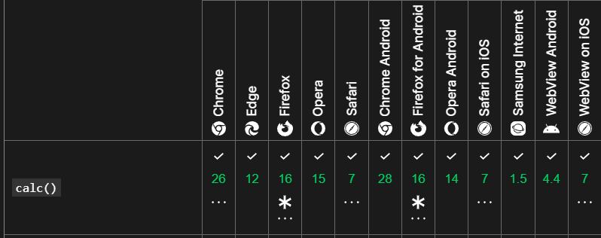
https://developer.mozilla.org/en-US/docs/Web/CSS/max

