Slide 1




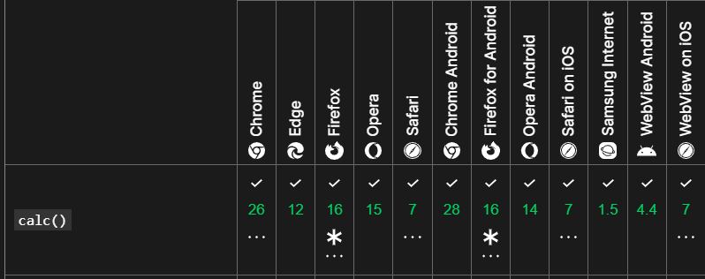

https://developer.mozilla.org/en-US/docs/Web/CSS/max
HUAWEI p6-u06 Chrome 34.0.1847.114 max, min y var con problemas…

