Slide 1

FOOTBALL RECRUITMENT · BUSINESS INTELLIGENCE
Brentford FC
Head of Recruitment Dashboard
Finding players who perform above what their price suggests
Gerry O'Brien · 18 June 2026

Slide 2
The Problem
INTRODUCTION
Talent is easy to spot - value is hard.
Mid-tier clubs can't outspend the giants.
Budgets of €15–40M - Brentford, Atalanta level.
You win by finding value before the market prices it.
THE CENTRAL QUESTION
Which players perform above what their market value suggests?
Brentford FC · Head of Recruitment Dashboard
Notes:
Good afternoon, I'm Gerry O'Brien. This is the recruitment dashboard I built for Brentford. Mid-tier clubs like ours can't outspend the giants. With a fifteen-to-forty-million budget, you win by finding players who outperform their price tag. The hard part isn't spotting good players — it's spotting good value before the market does. That's the gap this fills.

Slide 3
Data Sources & Scope
INTRODUCTION
1,962
5
16
3
players
leagues
performance metrics
FIFA seasons
Transfermarkt
FBref
FIFA 19 · 21 · 23
Identity, age, club, market value
Global coverage
Ground truth for player & price
All on-pitch performance metrics
Big 5 leagues, 2024-25 season
Per-90, 450-minute minimum
Reputation & rating proxy
Global, all leagues
Overall, potential, value over time
Key limitation: performance is Big 5 only - market value is global, so the verified player analysis lives inside the Big 5.
Brentford FC · Head of Recruitment Dashboard
Notes:
It runs on three sources. Transfermarkt for identity, age and market value — global. FBref for on-pitch performance — the Big Five leagues, 2024-25. And FIFA ratings for global reputation across three editions. After cleaning and matching, that’s almost 2000 players, five leagues, sixteen metrics. The key honesty point: performance is Big Five only, value is global — so the verified analysis lives in the Big Five, and I'm upfront about that.

Slide 4
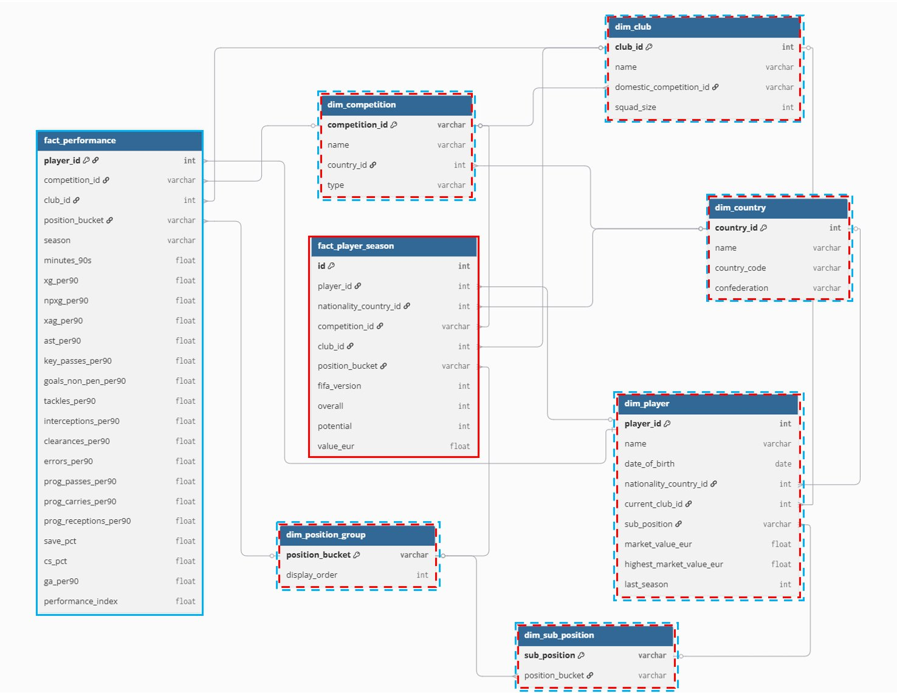
The Data Model - Galaxy Schema
GALAXY SCHEMA
Two fact tables
fact_performance (FBref) · fact_player_season (FIFA)
Six shared dimensions
player · club · competition · country · position group · sub-position
Brentford FC · Head of Recruitment Dashboard
Notes:
The model is a galaxy schema — two fact tables sharing six dimensions. One holds performance, one row per player per season, from FBref. The other holds FIFA ratings and value over time. They share player, club, competition, country and position. The payoff: I can slice performance and value through the same lens without duplicating data.
Why a Galaxy Schema and not a Star Schema?
We have two fact tables because the data comes from two completely different sources measuring different things. FBref measures how players performed on the pitch in 2024-25. FIFA measures how players were rated across three game versions. They cannot be combined into one table because they have different rows, different columns, and cover different sets of players. A galaxy schema is the standard approach when two fact tables share the same dimensions.
Why is performance data Big 5 only?
FBref only publishes detailed statistics for the top five European leagues. This was outside our control. We acknowledged it as a limitation and worked around it on Page 2 by using FIFA market values to show a broader global picture.
Degenerate dimensions
Some fields like position_bucket, league_name and fifa_version were stored directly in the fact table rather than in their own separate dimension table. This is because they are simple short values with no extra information attached to them. Creating a whole separate table just to store six position names would add complexity with no benefit.
Player matching
FBref and Transfermarkt use different player name formats so they could not be joined directly. We used fuzzy string matching to link them, requiring a similarity score of at least 90 out of 100. About 60 players (3.1%) could not be matched and were excluded from the market value analysis. This is documented as a known limitation.
Market value in two places
There are two different market value columns and they mean different things. The Transfermarkt value is the current real-world valuation used on the scatter plot. The FIFA value is what the game estimated the player was worth in 2019, 2021 or 2023. Both are kept because they answer different questions.
Slowly changing dimensions
We only store the current market value, not the full history of how it changed over time. Storing the full history would require a much more complex setup and the data source does not provide it cleanly. We partially capture historical values through the three FIFA versions.
Null rates
There are three types of null values, each for a different reason. Some players have no nationality ID because their country is not in Transfermarkt's database. Some players have no player ID because their name could not be matched between FBref and Transfermarkt. Some players have no FIFA rating because they were too young or unknown to appear in the game. None of these gaps affect the main analysis.
Pre-computing percentile ranks in Python
Tableau cannot rank a player against all players at their position while also allowing the dashboard to be filtered. If we tried to do it inside Tableau the rankings would change every time a filter was applied, which would be wrong. By computing the ranks in Python before loading into Tableau we guarantee they are always correct and consistent.
Position bucket in multiple tables
The official position mapping lives in one dimension table. The copies in other tables are there purely to avoid slow queries in Tableau. This is a standard practice in dashboard design where speed matters more than perfect normalisation.
Mid-season transfers
When a player moved clubs during the season they appeared on multiple rows in FBref. We added up all their stats across both clubs and divided by their total minutes to get correct per-90 values. Their primary club was set to whichever team they played the most minutes for.

Slide 5
The Performance Index
KEY METRIC
One number, 0–100. The mean of a player's position-relevant percentile ranks. 50 = average for the position; 75 = top quarter.
1
2
3
4
Bucket
Five metrics
Percentile rank
Average
Six position groups
Role-relevant per-90 stats
0–100 vs the same position
Mean of the five = Index
Striker metrics: npxG/90 · Non-Pen Goals/90 · xAG/90 · Assists/90 · Progressive Receptions/90
Per-90, not totals · 450-minute minimum · deliberately simple, so it's explainable to a non-technical recruiter.
Brentford FC · Head of Recruitment Dashboard
Notes:
Everything keys off one metric — the Performance Index. Four steps: bucket every player into one of six positions; score them on the five metrics that matter for that role — for a striker, expected goals, goals, assists and getting into dangerous areas; rank each against their own position; then average those ranks. Fifty is average, seventy-five is top quarter. It's deliberately simple, so I can explain it to a non-technical recruitment head in one breath.

Slide 6
THE BRIEF · DEMO SCENARIO
Two strikers
26 or younger
≤ €40M combined
The coach's request - answered with the dashboard.
12+ games last season
Performing above their price
Notes:
So let's use it. The coach wants two strikers: twenty-six or younger, no more than forty million for the pair, and both with real minutes behind them — at least a dozen games last season.

Slide 7
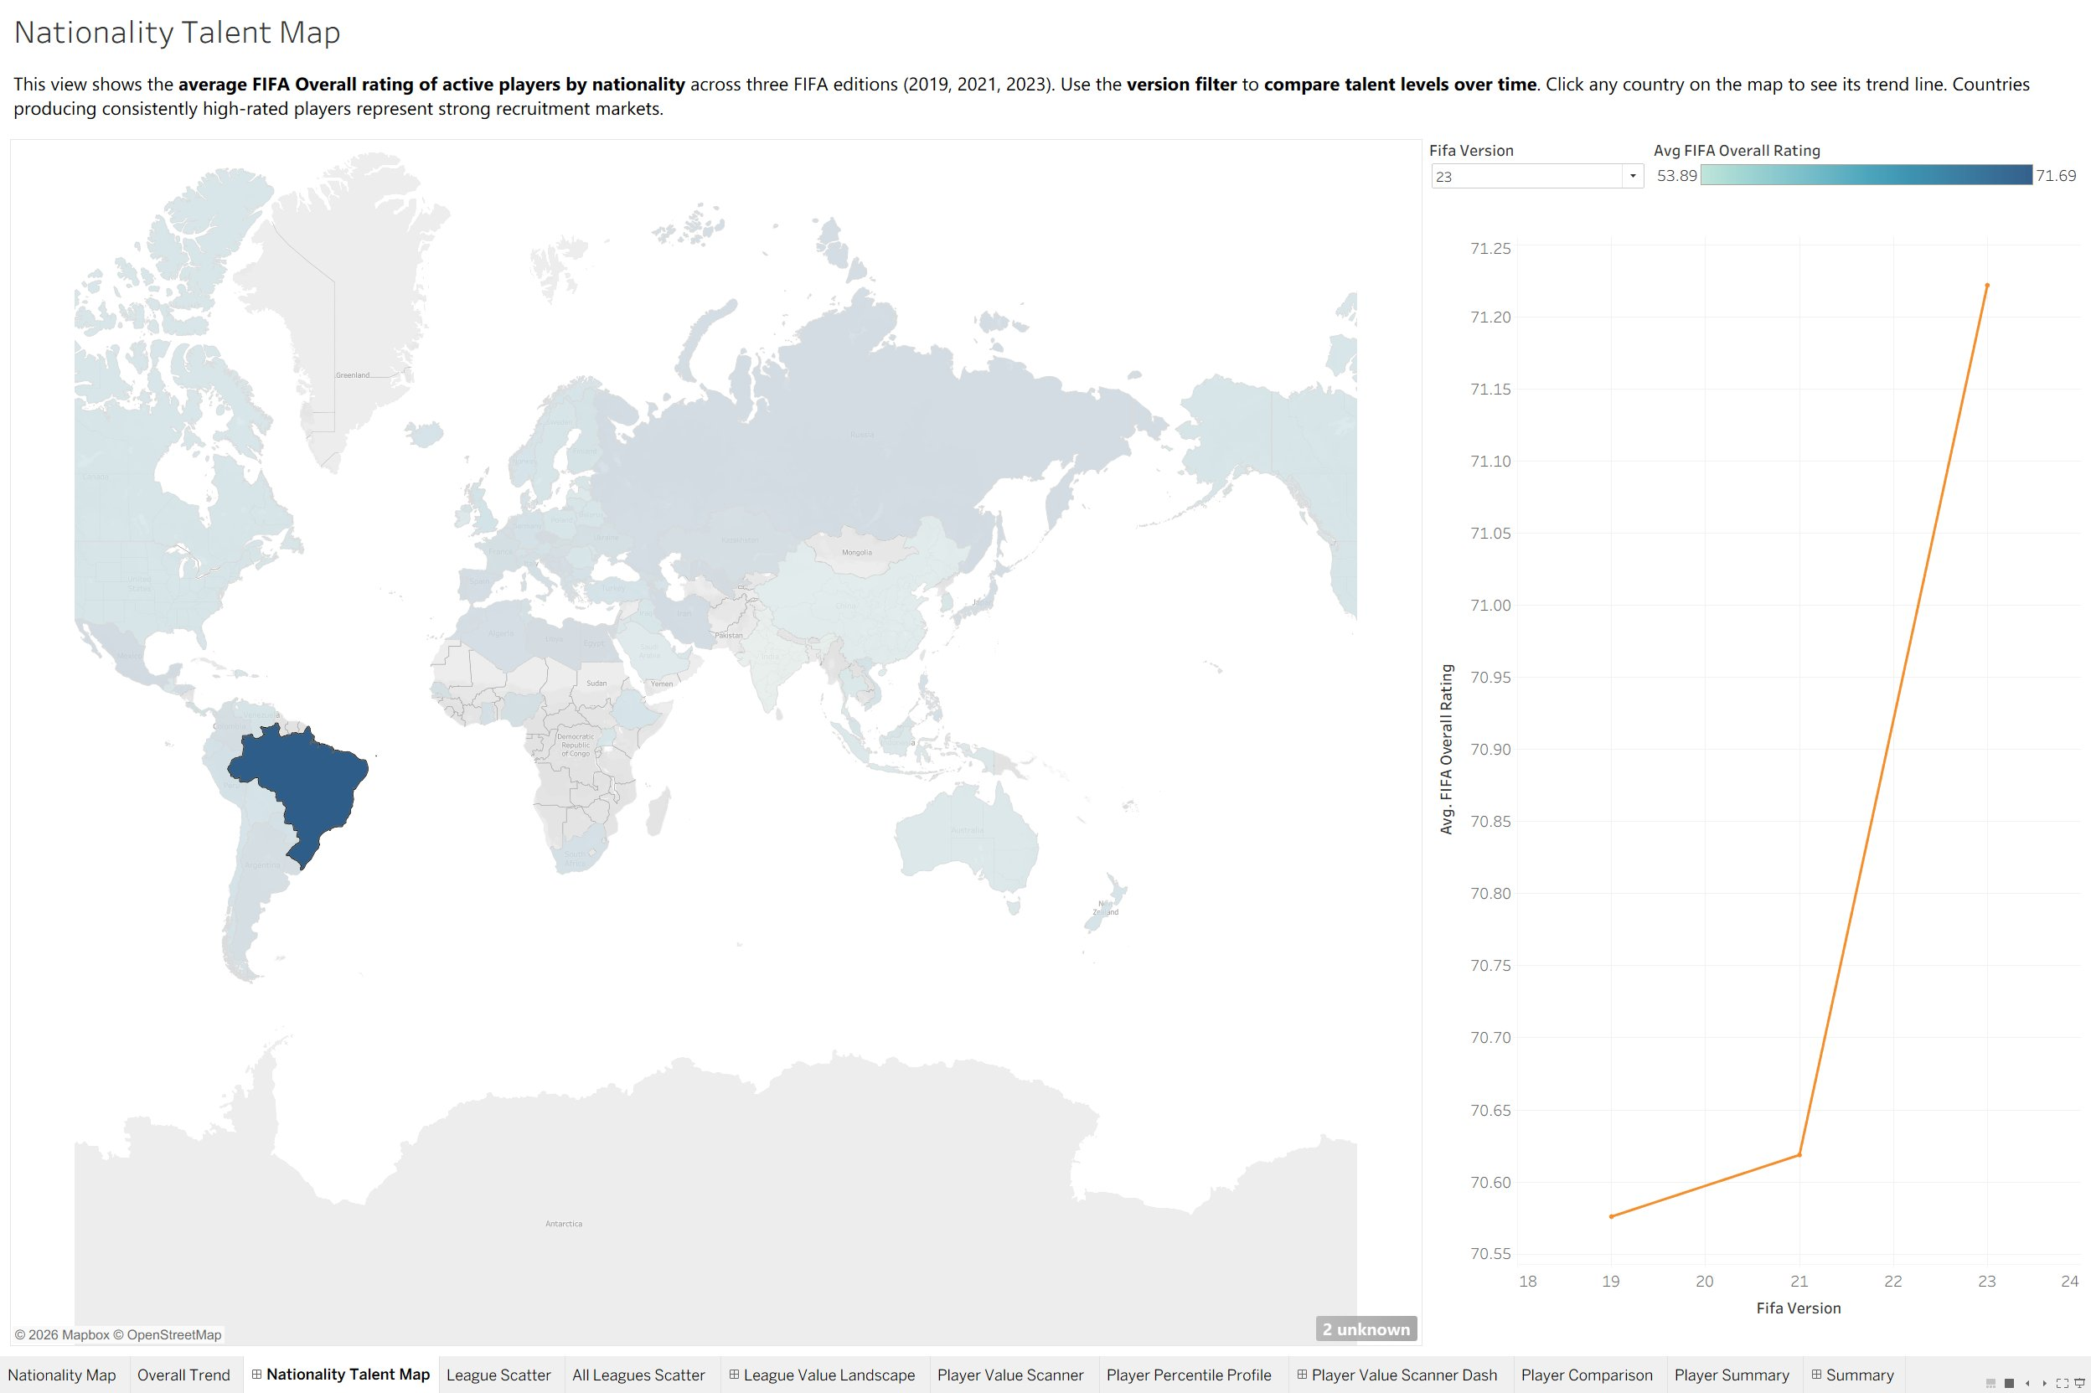
Demo · Where's the talent?
NATIONALITY TALENT MAP
Click a country → see its trend
Brazil: top-tier and rising
A hunch, not yet proof
Brentford FC · Head of Recruitment Dashboard
Notes:
Where do I start? Instinct. I open the talent map and click Brazil — one of the darkest on the map, top-tier ratings, and its trend climbs across all three FIFA editions. High and rising. But the honest bit: this is a hunch, not proof, and it doesn't carry through — my performance data only covers the Big Five. The map points me somewhere; the proof currently comes from players already in those top 5 leagues.

Slide 8
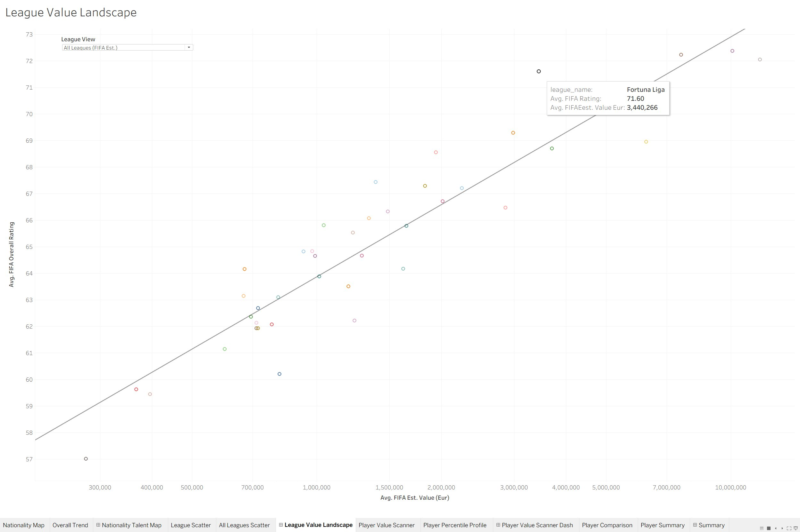
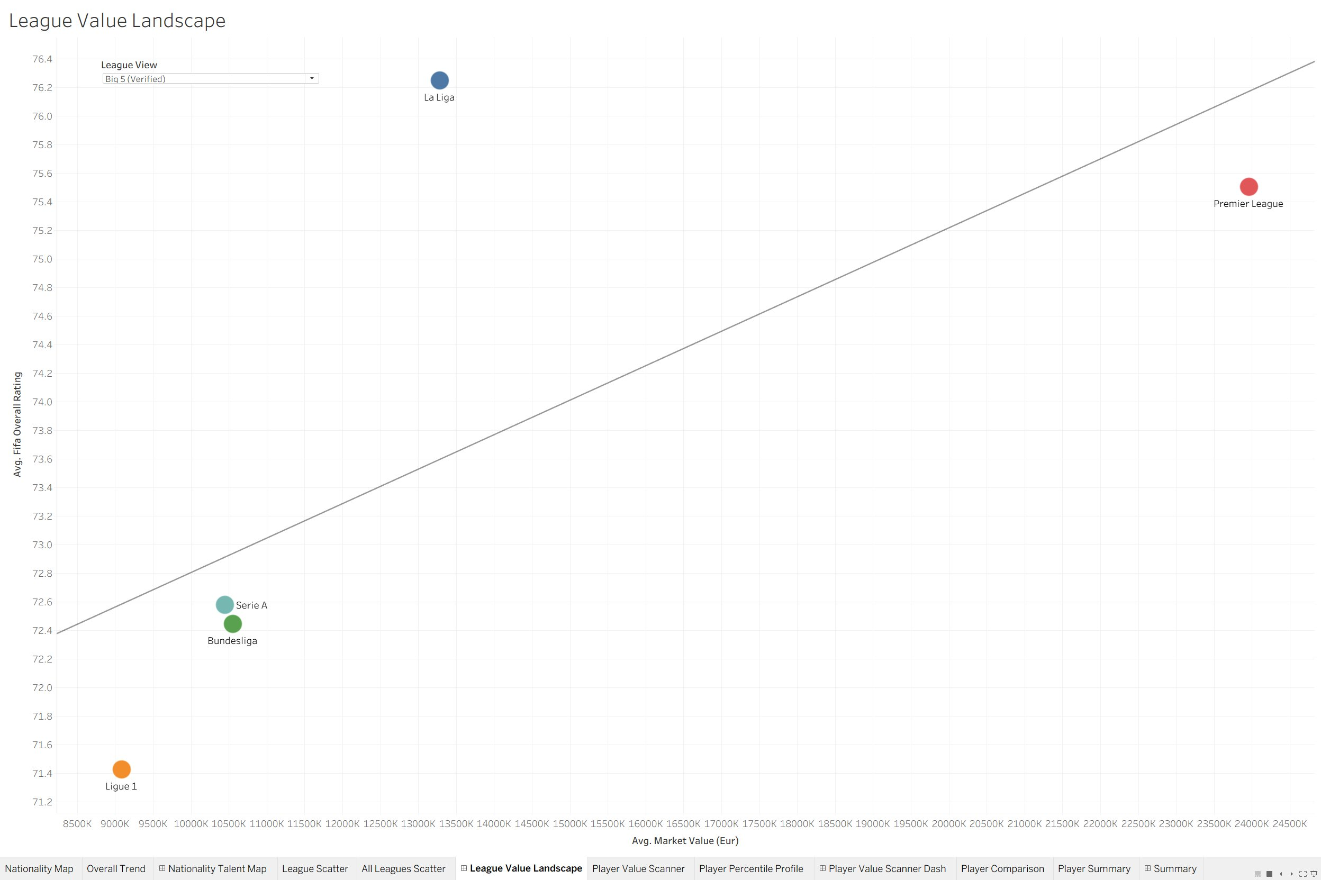
Demo · Where can I afford quality?
LEAGUE VALUE LANDSCAPE
All leagues - FIFA estimate (rough)
Big 5 - verified
Above the line beats its price. Look wide, trust narrow - La Liga gives Premier-League quality at half the average price.
Brentford FC · Head of Recruitment Dashboard
Notes:
Where can I afford quality? This plots a league's quality against its cost — above the line beats its price. The all-leagues view is broad but runs on rough FIFA estimates, so it's just a pointer. I trust the Big Five view since this uses accurate performance data from fbref, and La Liga jumps out — as good as the Premier League at half the average price, while the Premier League sits below the line. So I aim at La Liga.

Slide 9
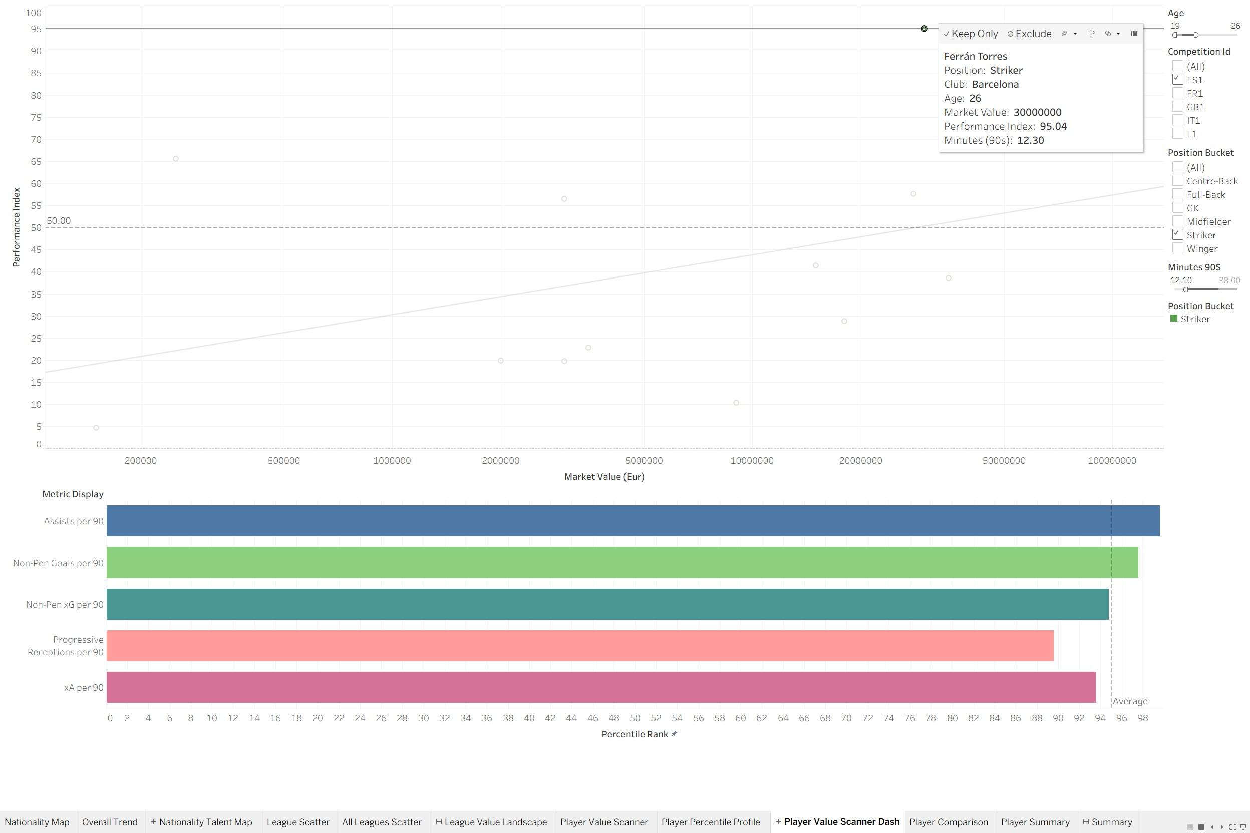
Demo · Who's underpriced?
PLAYER VALUE SCANNER
Apply the brief → a handful remain
Click → percentile profile
Ferrán Torres: 95, well above price
Brentford FC · Head of Recruitment Dashboard
Notes:
Now the proof — real FBref performance, Big Five only. Every dot's a player: price across the bottom on a log scale, performance up the side. I apply the brief and the cloud collapses to a handful of strikers. I click the standout — Ferrán Torres, index ninety-five, elite on all five metrics, and at thirty million he's miles above the line. And down in the corner, a quarter-million-euro striker still above average — Pablo Durán.

Slide 10
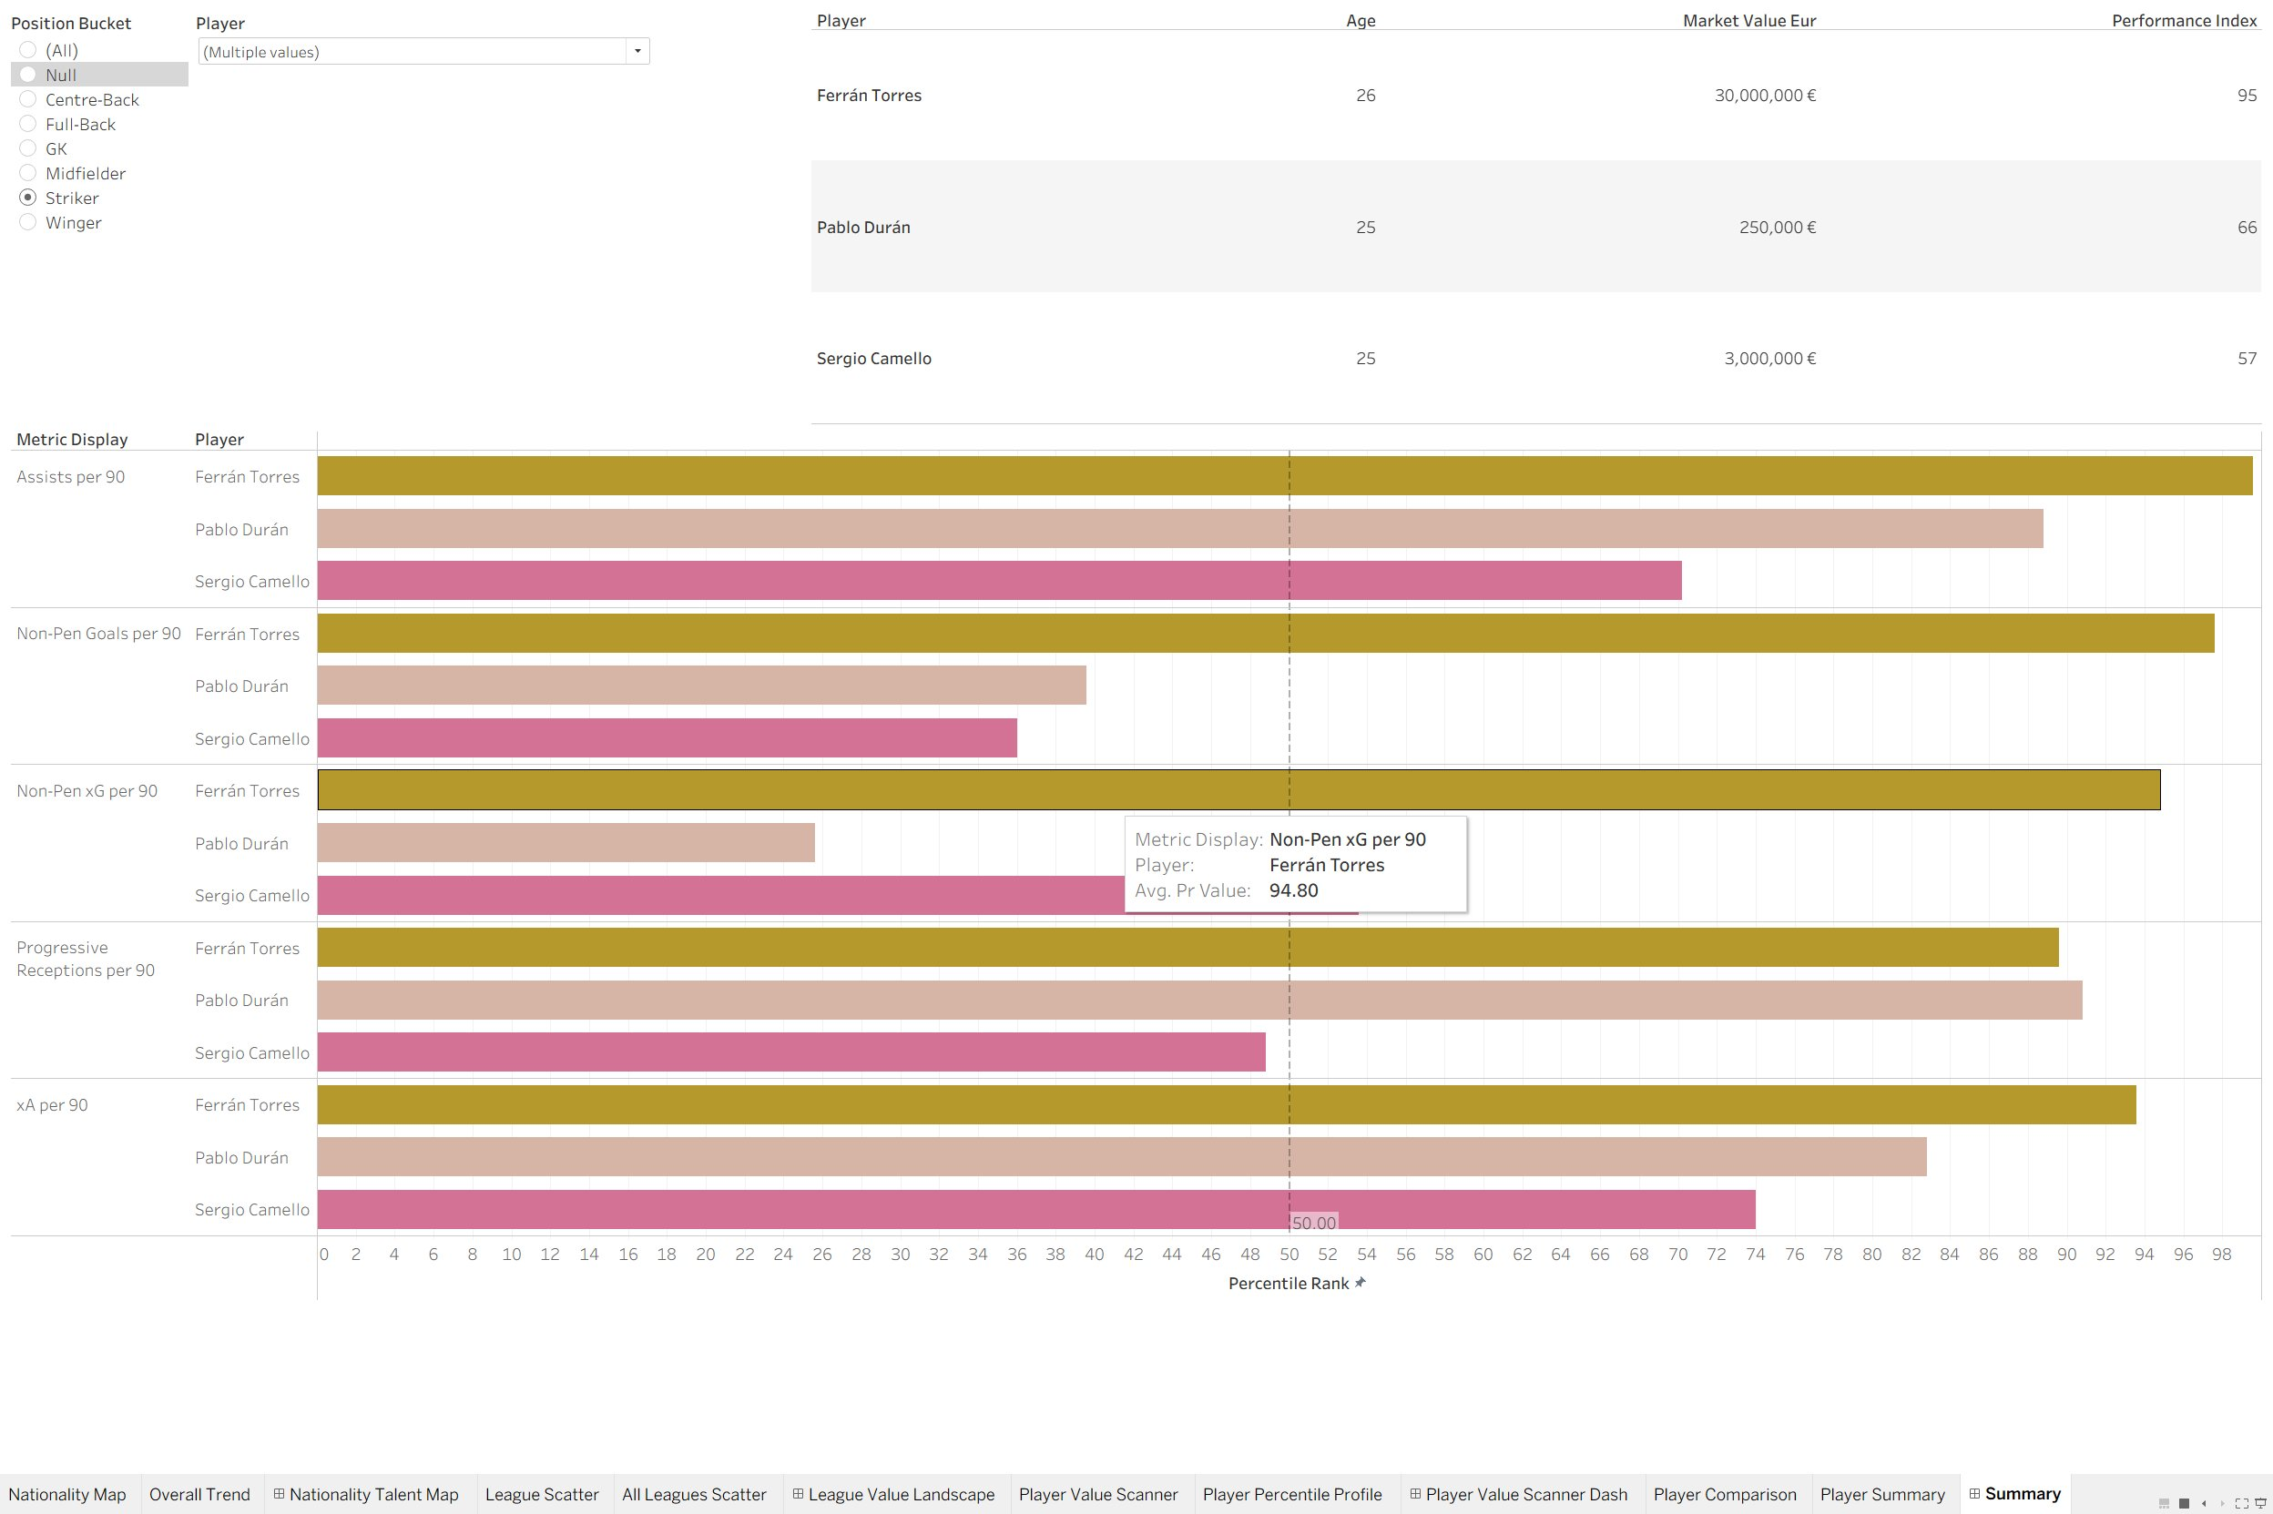
Demo · The head-to-head
PLAYER COMPARISON
Shortlist, side by side
Ferrán: the complete finisher
Budget picks: creators, not scorers
Brentford FC · Head of Recruitment Dashboard
Notes:
Final step — the shortlist side by side. The comparison reveals what the price can't: Ferrán is the complete forward, elite on goals and creation. The two budget options, Pablo and Sergio, are creators, not finishers — strong on assists and receptions, light on actual goals. So the recommendation writes itself: pair the elite finisher with the best-value creator — Ferrán and Pablo, thirty million all-in, under budget, profiles that complement. Sergio is the fallback with slightly poorer stats than Duran and a higher price tag.

Slide 11
CONCLUSION
From hunch to shortlist - in minutes
1
2
3
The workflow
Honest about its edges
Where it goes next
A hunch from the map, narrowed to a league I trust, down to a data-backed two.
Verified performance is Big 5 only; market values are point-in-time.
Connect the worldwide map to the verified performance layer.
Thank you - happy to take questions.
Notes:
So that's the workflow — a hunch from the map, narrowed to a league I trust, down to a data-backed shortlist in minutes. It's honest about its edges: the proof holds for the Big Five only, and values are point-in-time. Connecting that worldwide map to the verified performance layer is exactly where this goes next. Thank you — happy to take questions.

Slide 12
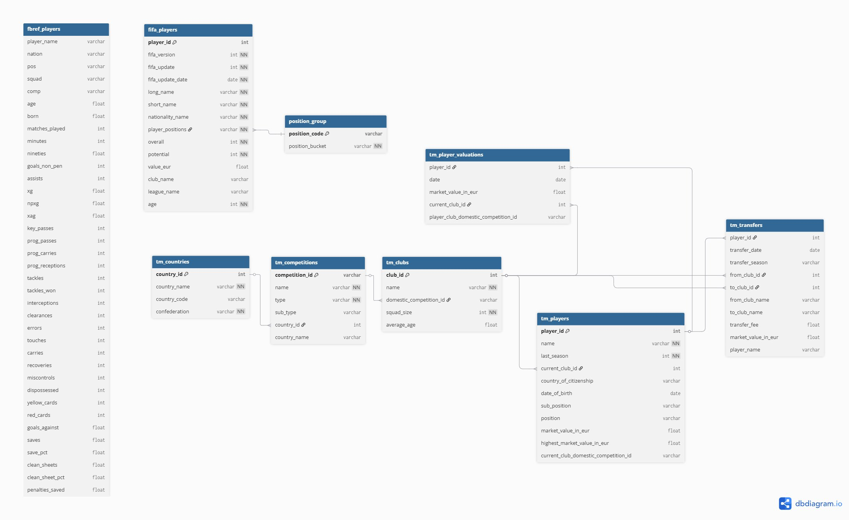
Appendix · Raw Relational Sources
BACKUP
The raw FBref, FIFA and Transfermarkt tables, cleaned and modelled into the galaxy schema by four Python scripts.
Notes:
Backup slide for questions: the raw relational source tables behind the galaxy schema — FBref, FIFA and Transfermarkt — cleaned and joined by four Python scripts.

