Slide 1

Frequent Itemset Mining & Association Rules
Note to other teachers and users of these slides: We would be delighted if you found this our material useful in giving your own lectures. Feel free to use these slides verbatim, or to modify them to fit your own needs. If you make use of a significant portion of these slides in your own lecture, please include this message, or a link to our web site: http://www.mmds.org
Mining of Massive Datasets
Jure Leskovec, Anand Rajaraman, Jeff Ullman Stanford University
http://www.mmds.org

Slide 2
Association Rule Discovery
Supermarket shelf management – Market-basket model:
Goal: Identify items that are bought together by sufficiently many customers
Approach: Process the sales data collected with barcode scanners to find dependencies among items
A classic rule:
If someone buys diaper and milk, then he/she is likely to buy beer
Don’t be surprised if you find six-packs next to diapers!

Slide 3
The Market-Basket Model
A large set of items
e.g., things sold in a supermarket
A large set of baskets
Each basket is a small subset of items
e.g., the things one customer buys on one day
Want to discover association rules
People who bought {x,y,z} tend to buy {v,w}
Amazon!
Input:
Output:
Rules Discovered:
{Milk} --> {Coke}
{Diaper, Milk} --> {Beer}

Slide 4
Applications – (1)
Items = products; Baskets = sets of products someone bought in one trip to the store
Real market baskets: Chain stores keep TBs of data about what customers buy together
Tells how typical customers navigate stores, lets them position tempting items
Suggests tie-in “tricks”, e.g., run sale on diapers and raise the price of beer
Need the rule to occur frequently, or no $$’s
Amazon’s people who bought X also bought Y

Slide 5
Applications – (2)
Baskets = sentences; Items = documents containing those sentences
Items that appear together too often could represent plagiarism
Notice items do not have to be “in” baskets
Baskets = patients; Items = drugs & side-effects
Has been used to detect combinations of drugs that result in particular side-effects
But requires extension: Absence of an item needs to be observed as well as presence

Slide 6
More generally
A general many-to-many mapping (association) between two kinds of things
But we ask about connections among “items”, not “baskets”
For example:
Finding communities in graphs (e.g., Twitter)

Slide 7
Example:
Finding communities in graphs (e.g., Twitter)
Baskets = nodes; Items = outgoing neighbors
Searching for complete bipartite subgraphs K_{s,t} of a big graph
How?
View each node i as a basket B_{i} of nodes i it points to
K_{s,t} = a set Y of size t that occurs in s buckets B_{i}
Looking for K_{s,t} → set of support s and look at layer t – all frequent sets of size t
s nodes
t nodes
…
…
…
A dense 2-layer graph

Slide 8
Outline
First: Define
Frequent itemsets
Association rules:
Confidence, Support, Interestingness
Then: Algorithms for finding frequent itemsets
Finding frequent pairs
A-Priori algorithm
PCY algorithm + 2 refinements

Slide 9
Frequent Itemsets
Simplest question: Find sets of items that appear together “frequently” in baskets
Support for itemset I: Number of baskets containing all items in I
(Often expressed as a fraction of the total number of baskets)
Given a support threshold s, then sets of items that appear in at least s baskets are called frequent itemsets
Support of {Beer, Bread} = 2

Slide 10
Example: Frequent Itemsets
Items = {milk, coke, pepsi, beer, juice}
Support threshold = 3 baskets
B₁ = {m, c, b} B₂ = {m, p, j}
B₃ = {m, b} B₄ = {c, j}
B₅ = {m, p, b} B₆ = {m, c, b, j}
B₇ = {c, b, j} B₈ = {b, c}
Frequent itemsets: {m}, {c}, {b}, {j},
{m,b}
, {b,c}
, {c,j}.

Slide 11
Association Rules
Association Rules: If-then rules about the contents of baskets
{i₁, i₂,…,i_{k}} → j means: “if a basket contains all of i₁,…,i_{k} then it is likely to contain j”
In practice there are many rules, want to find significant/interesting ones!
Confidence of this association rule is the probability of j given I = {i₁,…,i_{k}}

Slide 12
Interesting Association Rules
Not all high-confidence rules are interesting
The rule X → milk may have high confidence for many itemsets X, because milk is just purchased very often (independent of X) and the confidence will be high
Interest of an association rule I → j: difference between its confidence and the fraction of baskets that contain j
Interesting rules are those with high positive or negative interest values (usually above 0.5)
Notes:
If confidence is high then interest cannot be negative

Slide 13
Example: Confidence and Interest
B₁ = {m, c, b} B₂ = {m, p, j}
B₃ = {m, b} B₄= {c, j}
B₅ = {m, p, b} B₆ = {m, c, b, j}
B₇ = {c, b, j} B₈ = {b, c}
Association rule: {m, b} →c
Confidence = 2/4 = 0.5
Interest = |0.5 – 5/8| = 1/8
Item c appears in 5/8 of the baskets
Rule is not very interesting!

Slide 14
Finding Association Rules
Problem: Find all association rules with support ≥s and confidence ≥c
Note: Support of an association rule is the support of the set of items on the left side
Hard part: Finding the frequent itemsets!
If {i₁, i₂,…, i_{k}} → j has high support and confidence, then both {i₁, i₂,…, i_{k}} and {i₁, i₂,…,i_{k}, j} will be “frequent”

Slide 15
Mining Association Rules
Step 1: Find all frequent itemsets I
(we will explain this next)
Step 2: Rule generation
For every subset A of I, generate a rule A → I \ A
Since I is frequent, A is also frequent
Variant 1: Single pass to compute the rule confidence
confidence(A,B→C,D) = support(A,B,C,D) / support(A,B)
Variant 2:
Observation: If A,B,C→D is below confidence, so is A,B→C,D
Can generate “bigger” rules from smaller ones!
Output the rules above the confidence threshold

Slide 16
Example
B₁ = {m, c, b} B₂ = {m, p, j}
B₃ = {m, c, b, n} B₄= {c, j}
B₅ = {m, p, b} B₆ = {m, c, b, j}
B₇ = {c, b, j} B₈ = {b, c}
Support threshold s = 3, confidence c = 0.75
1) Frequent itemsets:
{b,m} {b,c} {c,m} {c,j} {m,c,b}
2) Generate rules:
b→m: c=4/6 b→c: c=5/6 b,c→m: c=3/5
m→b: c=4/5 … b,m→c: c=3/4
b→c,m: c=3/6

Slide 17
Compacting the Output
To reduce the number of rules we can post-process them and only output:
Maximal frequent itemsets: No immediate superset is frequent
Gives more pruning
or
Closed itemsets: No immediate superset has the same count (> 0)
Stores not only frequent information, but exact counts

Slide 18
Example: Maximal/Closed
Frequent, but
superset BC
also frequent.
Support Maximal(s=3) Closed
A 4 No No
B 5 No Yes
C 3 No No
AB 4 Yes Yes
AC 2 No No
BC 3 Yes Yes
ABC 2 No Yes
Frequent, and
its only superset,
ABC, not freq.
Superset BC
has same count.
Its only super-
set, ABC, has
smaller count.

Slide 19
Finding Frequent Itemsets

Slide 20
Itemsets: Computation Model
Back to finding frequent itemsets
Typically, data is kept in flat files rather than in a database system:
Stored on disk
Stored basket-by-basket
Baskets are small but we have many baskets and many items
Expand baskets into pairs, triples, etc. as you read baskets
Use k nested loops to generate all sets of size k
Item
Item
Item
Item
Item
Item
Item
Item
Item
Item
Item
Item
Etc.
Items are positive integers, and boundaries between baskets are –1.
Note: We want to find frequent itemsets. To find them, we have to count them. To count them, we have to generate them.

Slide 21
Computation Model
The true cost of mining disk-resident data is usually the number of disk I/Os
In practice, association-rule algorithms read the data in passes – all baskets read in turn
We measure the cost by the number of passes an algorithm makes over the data

Slide 22
Main-Memory Bottleneck
For many frequent-itemset algorithms, main-memory is the critical resource
As we read baskets, we need to count something, e.g., occurrences of pairs of items
The number of different things we can count is limited by main memory
Swapping counts in/out is a disaster (why?)

Slide 23
Finding Frequent Pairs
The hardest problem often turns out to be finding the frequent pairs of items {i₁, i₂}
Why? Freq. pairs are common, freq. triples are rare
Why? Probability of being frequent drops exponentially with size; number of sets grows more slowly with size
Let’s first concentrate on pairs, then extend to larger sets
The approach:
We always need to generate all the itemsets
But we would only like to count (keep track) of those itemsets that in the end turn out to be frequent

Slide 24
Naïve Algorithm
Naïve approach to finding frequent pairs
Read file once, counting in main memory the occurrences of each pair:
From each basket of n items, generate its n(n-1)/2 pairs by two nested loops
Fails if (#items)² exceeds main memory
Remember: #items can be 100K (Wal-Mart) or 10B (Web pages)
Suppose 10⁵ items, counts are 4-byte integers
Number of pairs of items: 10⁵(10⁵-1)/2 = 5*10⁹
Therefore, 2*10¹⁰ (20 gigabytes) of memory needed

Slide 25
Counting Pairs in Memory
Two approaches:
Approach 1: Count all pairs using a matrix
Approach 2: Keep a table of triples [i, j, c] = “the count of the pair of items {i, j} is c.”
If integers and item ids are 4 bytes, we need approximately 12 bytes for pairs with count > 0
Plus some additional overhead for the hashtable
Note:
Approach 1 only requires 4 bytes per pair
Approach 2 uses 12 bytes per pair (but only for pairs with count > 0)

Slide 26
Comparing the 2 Approaches
4 bytes per pair
12 per
occurring pair
Triangular Matrix
Triples

Slide 27
Comparing the two approaches
Approach 1: Triangular Matrix
n = total number items
Count pair of items {i, j} only if i<j
Keep pair counts in lexicographic order:
{1,2}, {1,3},…, {1,n}, {2,3}, {2,4},…,{2,n}, {3,4},…
Pair {i, j} is at position (i –1)(n– i/2) + j –1
Total number of pairs n(n –1)/2; total bytes= 2n²
Triangular Matrix requires 4 bytes per pair
Approach 2 uses 12 bytes per occurring pair (but only for pairs with count > 0)
Beats Approach 1 if less than 1/3 of possible pairs actually occur

Slide 28
Comparing the two approaches
Approach 1: Triangular Matrix
n = total number items
Count pair of items {i, j} only if i<j
Keep pair counts in lexicographic order:
{1,2}, {1,3},…, {1,n}, {2,3}, {2,4},…,{2,n}, {3,4},…
Pair {i, j} is at position (i –1)(n– i/2) + j –1
Total number of pairs n(n –1)/2; total bytes= 2n²
Triangular Matrix requires 4 bytes per pair
Approach 2 uses 12 bytes per pair (but only for pairs with count > 0)
Beats Approach 1 if less than 1/3 of possible pairs actually occur
Problem is if we have too many items so the pairs do not fit into memory.
Can we do better?

Slide 29
A-Priori Algorithm

Slide 30
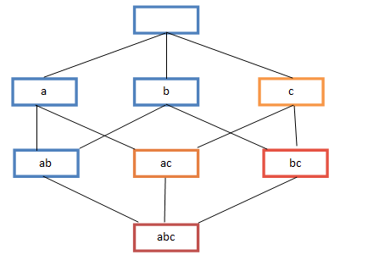
A-Priori Algorithm – (1)
A two-pass approach called A-Priori limits the need for main memory
Key idea: monotonicity
If a set of items I appears at least s times, so does every subset J of I
Contrapositive for pairs: If item i does not appear in s baskets, then no pair including i can appear in s baskets
So, how does A-Priori find freq. pairs?

Slide 31
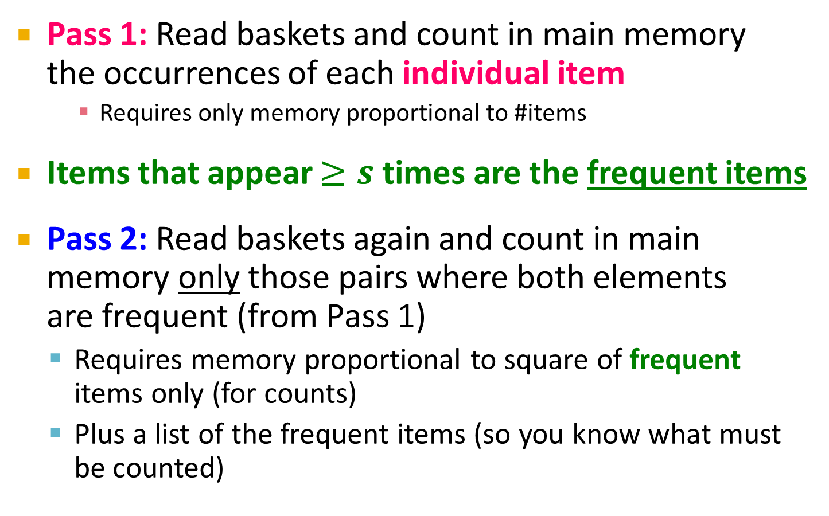
A-Priori Algorithm – (2)
Pass 1: Read baskets and count in main memory the occurrences of each individual item
Requires only memory proportional to #items
Items that appear $≥s$ times are the frequent items
Pass 2: Read baskets again and count in main memory only those pairs where both elements are frequent (from Pass 1)
Requires memory proportional to square of frequent items only (for counts)
Plus a list of the frequent items (so you know what must be counted)

Slide 32
Main-Memory: Picture of A-Priori
Item counts
Frequent items
Counts of pairs of frequent items (candidate pairs)
Main memory
Pass 1
Pass 2

Slide 33
Detail for A-Priori
You can use the triangular matrix method with n = number of frequent items
May save space compared with storing triples
Trick: re-number frequent items 1,2,… and keep a table relating new numbers to original item numbers
Item counts
Frequent items
Old item #s
Counts of pairs of frequent items
Counts of pairs of frequent items
Main memory
Pass 1
Pass 2

Slide 34
Frequent Triples, Etc.
For each k, we construct two sets of k-tuples (sets of size k):
C_{k} = candidate k-tuples = those that might be frequent sets (support > s) based on information from the pass for k–1
L_{k} = the set of truly frequent k-tuples
Count
the items
All pairs
of items
from L₁
Count
the pairs
All
items
To be
explained
Filter
Construct
Filter
Construct
C₁
L₁
C₂
L₂
C₃

Slide 35
Example
** Note here we generate new candidates by generating C_{k} from L_{k-1} and L₁. But that one can be more careful with candidate generation. For example, in C₃ we know {b,m,j} cannot be frequent since {m,j} is not frequent
Hypothetical steps of the A-Priori algorithm
C₁ = { {b} {c} {j} {m} {n} {p} }
Count the support of itemsets in C₁
Prune non-frequent: L₁ = { b, c, j, m }
Generate C₂ = { {b,c} {b,j} {b,m} {c,j} {c,m} {j,m} }
Count the support of itemsets in C₂
Prune non-frequent: L₂ = { {b,m} {b,c} {c,m} {c,j} }
Generate C₃ = { {b,c,m} {b,c,j} {b,m,j} {c,m,j} }
Count the support of itemsets in C₃
Prune non-frequent: L₃ = { {b,c,m} }
**

Slide 36
A-Priori for All Frequent Itemsets
One pass for each k (itemset size)
Needs room in main memory to count each candidate k–tuple
For typical market-basket data and reasonable support (e.g., 1%), k = 2 requires the most memory
Many possible extensions:
Association rules with intervals:
For example: Men over 65 have 2 cars
Association rules when items are in a taxonomy
Bread, Butter → FruitJam
BakedGoods, MilkProduct → PreservedGoods
Lower the support s as itemset gets bigger

Slide 37
PCY (Park-Chen-Yu) Algorithm

Slide 38
PCY (Park-Chen-Yu) Algorithm
Observation: In pass 1 of A-Priori, most memory is idle
We store only individual item counts
Can we use the idle memory to reduce memory required in pass 2?
Pass 1 of PCY: In addition to item counts, maintain a hash table with as many buckets as fit in memory
Keep a count for each bucket into which pairs of items are hashed
For each bucket just keep the count, not the actual pairs that hash to the bucket!

Slide 39
PCY Algorithm – First Pass
FOR (each basket) :
FOR (each item in the basket) :
add 1 to item’s count;
FOR (each pair of items) :
hash the pair to a bucket;
add 1 to the count for that bucket;
Few things to note:
Pairs of items need to be generated from the input file; they are not present in the file
We are not just interested in the presence of a pair, but we need to see whether it is present at least s (support) times
New in PCY

Slide 40
Observations about Buckets
Observation: If a bucket contains a frequent pair, then the bucket is surely frequent
However, even without any frequent pair, a bucket can still be frequent ☹
So, we cannot use the hash to eliminate any member (pair) of a “frequent” bucket
But, for a bucket with total count less than s, none of its pairs can be frequent ☺
Pairs that hash to this bucket can be eliminated as candidates (even if the pair consists of 2 frequent items)
Pass 2: Only count pairs that hash to frequent buckets

Slide 41
PCY Algorithm – Between Passes
Replace the buckets by a bit-vector:
1 means the bucket count exceeded the support s (call it a frequent bucket); 0 means it did not
4-byte integer counts are replaced by bits, so the bit-vector requires 1/32 of memory
Also, decide which items are frequent and list them for the second pass

Slide 42
PCY Algorithm – Pass 2
Count all pairs {i, j} that meet the conditions for being a candidate pair:
Both i and j are frequent items
The pair {i, j} hashes to a bucket whose bit in the bit vector is 1 (i.e., a frequent bucket)
Both conditions are necessary for the pair to have a chance of being frequent

Slide 43
Main-Memory: Picture of PCY
Hash
table
Item counts
Frequent items
Bitmap
Hash table for pairs
Counts of
candidate
pairs
Main memory
Pass 1
Pass 2
Notes:
Why hash table takes full space?
We want to make it as large as possible.
Why hash table bigger than bitmap?
Hash table contains counts

Slide 44
Main-Memory Details
Buckets require a few bytes each:
Note: we do not have to count past s
#buckets is O(main-memory size)
On second pass, a table of (item, item, count) triples is essential (we cannot use triangular matrix approach, why?)
Thus, hash table must eliminate approx. 2/3 of the candidate pairs for PCY to beat A-Priori
Notes:
Why? While we were able to use the triangular-matrix
method on the second pass of A-Priori if we wished, because the frequent items
could be renumbered from 1 to some m, we cannot do so for PCY. The reason
is that the pairs of frequent items that PCY lets us avoid counting are placed
randomly within the triangular matrix; they are the pairs that happen to hash
to an infrequent bucket on the ﬁrst pass. There is no known way of compacting
the matrix to avoid leaving space for the uncounted pairs.

Slide 45
Refinement: Multistage Algorithm
Limit the number of candidates to be counted
Remember: Memory is the bottleneck
Still need to generate all the itemsets but we only want to count/keep track of the ones that are frequent
Key idea: After Pass 1 of PCY, rehash only those pairs that qualify for Pass 2 of PCY
i and j are frequent, and
{i, j} hashes to a frequent bucket from Pass 1
On middle pass, fewer pairs contribute to buckets, so fewer false positives
Requires 3 passes over the data

Slide 46
Main-Memory: Multistage
First
hash table
Item counts
Freq. items
Freq. items
First hash table
Bitmap 1
Bitmap 1
Second hash table
Main memory
Bitmap 2
Counts of
candidate
pairs
Counts of
candidate
pairs
Pass 1
Pass 2
Pass 3
Hash pairs {i,j} into Hash2 iff:
i,j are frequent, {i,j} hashes to
freq. bucket in B1
Count pairs {i,j} iff:
i,j are frequent, {i,j} hashes to
freq. bucket in B1
{i,j} hashes to
freq. bucket in B2
Count items
Hash pairs {i,j}

Slide 47
Multistage – Pass 3
Count only those pairs {i, j} that satisfy these candidate pair conditions:
Both i and j are frequent items
Using the first hash function, the pair hashes to a bucket whose bit in the first bit-vector is 1
Using the second hash function, the pair hashes to a bucket whose bit in the second bit-vector is 1

Slide 48
Important Points
The two hash functions have to be independent
We need to check both hashes on the third pass
If not, we would end up counting pairs of frequent items that hashed first to an infrequent bucket but happened to hash second to a frequent bucket

Slide 49
Refinement: Multihash
Key idea: Use several independent hash tables on the first pass
Risk: Halving the number of buckets doubles the average count
We have to be sure most buckets will still not reach count s
If so, we can get a benefit like multistage, but in only 2 passes

Slide 50
Main-Memory: Multihash
First hash
table
Second
hash table
Item counts
Freq. items
First hash table
Bitmap 1
Main memory
Bitmap 2
Counts of
candidate
pairs
Counts of
candidate
pairs
Second hash table
Pass 1
Pass 2

Slide 51
PCY: Extensions
Either multistage or multihash can use more than two hash functions
In multistage, there is a point of diminishing returns, since the bit-vectors eventually consume all of main memory
For multihash, the bit-vectors occupy exactly what one PCY bitmap does, but too many hash functions makes all counts > s

Slide 52
Chart
Example of a chart

Slide 53
Table
 | 2021 | 2022 | 2023 | 2024 | 2025
Versione | 1.0 | 1.0 | 2.0 | 2.0 | 2.0
Numero Clienti | 10 | 100 | 250 | 390 | 450
Abbonamento mensile | 25€ | 25€ | 32€ | 32€ | 32€
Costi Totali (€) | 23 K | 61 K | 110 K | 138 K | 137.5 K
Ricavi (€) | 7.2 K | 68 K | 148 K | 257 K | 275 K
Utile/Perdita (€) | (14 K) | 3.5 K | 31 K | 89 K | 104 K
I dati esposti sono estratti da una Forecast Analysis effettuata in fase di progettazione del business model su base quinquennale

Slide 54

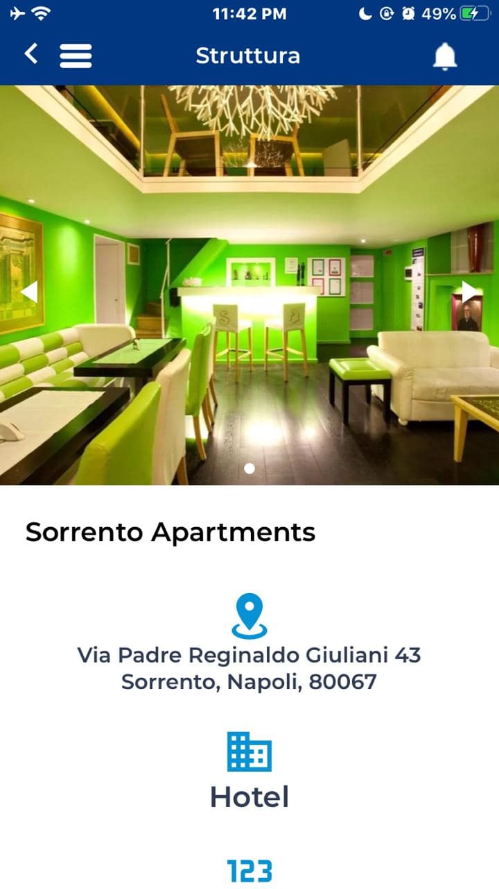
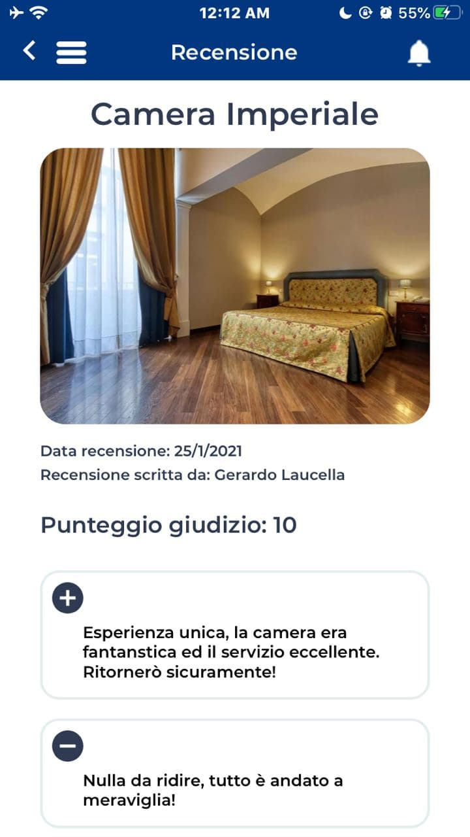
Video content
Hostify

Slide 55
Frequent Itemsets in < 2 Passes

Slide 56
Frequent Itemsets in < 2 Passes
A-Priori, PCY, etc., take k passes to find frequent itemsets of size k
Can we use fewer passes?
Use 2 or fewer passes for all sizes, but may miss some frequent itemsets
Random sampling
SON (Savasere, Omiecinski, and Navathe)
Toivonen (see textbook)

Slide 57
Random Sampling (1)
Take a random sample of the market baskets
Run a-priori or one of its improvements in main memory
So we don’t pay for disk I/O each time we increase the size of itemsets
Reduce support threshold proportionally to match the sample size
Copy of
sample
baskets
Main memory
Space
for
counts

Slide 58
Random Sampling (2)
Optionally, verify that the candidate pairs are truly frequent in the entire data set by a second pass (avoid false positives)
But you don’t catch sets frequent in the whole but not in the sample
Smaller threshold, e.g., s/125, helps catch more truly frequent itemsets
But requires more space

Slide 59
SON Algorithm – (1)
Repeatedly read small subsets of the baskets into main memory and run an in-memory algorithm to find all frequent itemsets
Note: we are not sampling, but processing the entire file in memory-sized chunks
An itemset becomes a candidate if it is found to be frequent in any one or more subsets of the baskets.

Slide 60
SON Algorithm – (2)
On a second pass, count all the candidate itemsets and determine which are frequent in the entire set
Key “monotonicity” idea: an itemset cannot be frequent in the entire set of baskets unless it is frequent in at least one subset.

Slide 61
SON – Distributed Version
SON lends itself to distributed data mining
Baskets distributed among many nodes
Compute frequent itemsets at each node
Distribute candidates to all nodes
Accumulate the counts of all candidates

Slide 62
SON: Map/Reduce
Phase 1: Find candidate itemsets
Map?
Reduce?
Phase 2: Find true frequent itemsets
Map?
Reduce?

Slide 63
Clustering
Note to other teachers and users of these slides: We would be delighted if you found this our material useful in giving your own lectures. Feel free to use these slides verbatim, or to modify them to fit your own needs. If you make use of a significant portion of these slides in your own lecture, please include this message, or a link to our web site: http://www.mmds.org
Mining of Massive Datasets
Jure Leskovec, Anand Rajaraman, Jeff Ullman Stanford University
http://www.mmds.org

Slide 64
High Dimensional Data
High dim. data
Locality sensitive hashing
Clustering
Graph data
PageRank, SimRank
Community Detection
Infinite data
Filtering data streams
Web advertising
Dimensionality reduction
Spam Detection
Queries on streams
Machine learning
SVM
Decision Trees
Perceptron, kNN
Apps
Recommender systems
Association Rules
Duplicate document detection

Slide 65
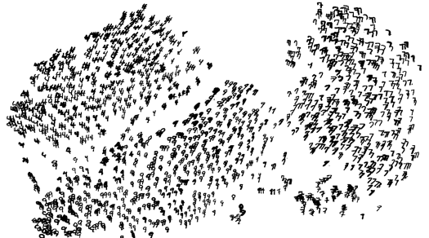
High Dimensional Data
Given a cloud of data points we want to understand its structure

Slide 66
The Problem of Clustering
Given a set of points, with a notion of distance between points, group the points into some number of clusters, so that
Members of a cluster are close/similar to each other
Members of different clusters are dissimilar
Usually:
Points are in a high-dimensional space
Similarity is defined using a distance measure
Euclidean, Cosine, Jaccard, edit distance, …

Slide 67
Example: Clusters & Outliers
x
xx x
x x
x x x
x
x x x
x
x
xx x
x x
x x x
x
x x x
x
x
x x
x x x x
x x x x
x x x
x x
x x
x x x x
x x x x
x x x
x x
x x
x x x x
x x x
x
x x
x x x x
x x x
x
x
Outlier
Cluster

Slide 68
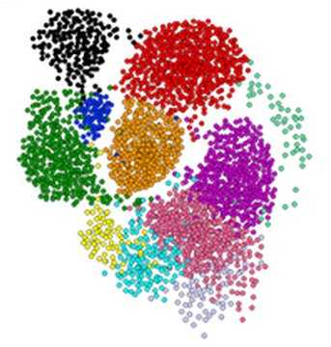
Clustering is a hard problem!

Slide 69
Why is it hard?
Clustering in two dimensions looks easy
Clustering small amounts of data looks easy
And in most cases, looks are not deceiving
Many applications involve not 2, but 10 or 10,000 dimensions
High-dimensional spaces look different: Almost all pairs of points are at about the same distance

Slide 70
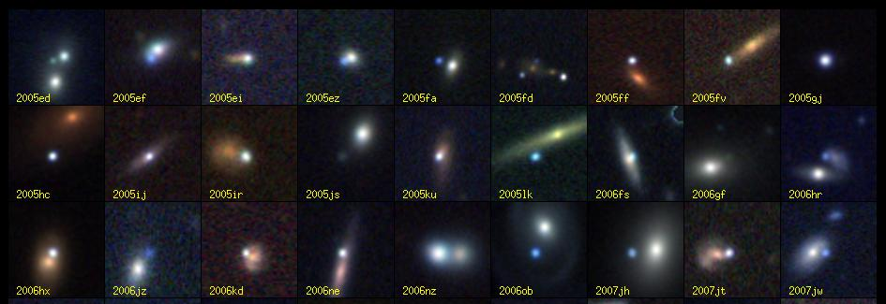
Clustering Problem: Galaxies
A catalog of 2 billion “sky objects” represents objects by their radiation in 7 dimensions (frequency bands)
Problem: Cluster into similar objects, e.g., galaxies, nearby stars, quasars, etc.
Sloan Digital Sky Survey

Slide 71
Clustering Problem: Music CDs
Intuitively: Music divides into categories, and customers prefer a few categories
But what are categories really?
Represent a CD by a set of customers who bought it:
Similar CDs have similar sets of customers, and vice-versa

Slide 72
Clustering Problem: Music CDs
Space of all CDs:
Think of a space with one dim. for each customer
Values in a dimension may be 0 or 1 only
A CD is a point in this space (x₁, x₂,…, x_{k}), where x_{i} = 1 iff the i ^{th} customer bought the CD
For Amazon, the dimension is tens of millions
Task: Find clusters of similar CDs

Slide 73
Clustering Problem: Documents
Finding topics:
Represent a document by a vector (x₁, x₂,…, x_{k}), where x_{i} = 1 iff the i ^{th} word (in some order) appears in the document
It actually doesn’t matter if k is infinite; i.e., we don’t limit the set of words
Documents with similar sets of words may be about the same topic

Slide 74
Cosine, Jaccard, and Euclidean
As with CDs we have a choice when we think of documents as sets of words or shingles:
Sets as vectors: Measure similarity by the cosine distance
Sets as sets: Measure similarity by the Jaccard distance
Sets as points: Measure similarity by Euclidean distance

Slide 75
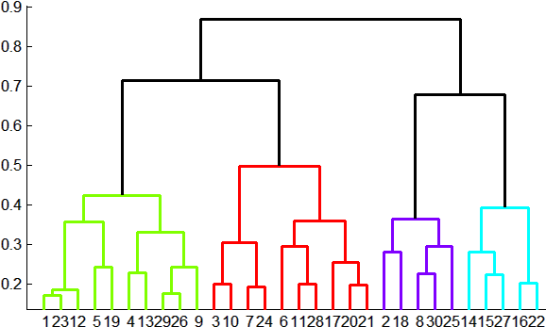
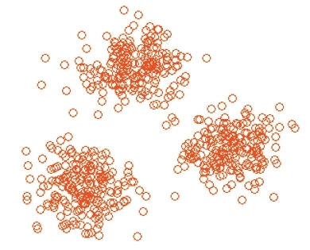
Overview: Methods of Clustering
Hierarchical:
Agglomerative (bottom up):
Initially, each point is a cluster
Repeatedly combine the two “nearest” clusters into one
Divisive (top down):
Start with one cluster and recursively split it
Point assignment:
Maintain a set of clusters
Points belong to “nearest” cluster

Slide 76
Hierarchical Clustering
Key operation: Repeatedly combine two nearest clusters
Three important questions:
1) How do you represent a cluster of more than one point?
2) How do you determine the “nearness” of clusters?
3) When to stop combining clusters?

Slide 77
Hierarchical Clustering
Key operation: Repeatedly combine two nearest clusters
(1) How to represent a cluster of many points?
Key problem: As you merge clusters, how do you represent the “location” of each cluster, to tell which pair of clusters is closest?
Euclidean case: each cluster has a centroid = average of its (data)points
(2) How to determine “nearness” of clusters?
Measure cluster distances by distances of centroids

Slide 78
Example: Hierarchical clustering
(5,3)
o
(1,2)
o
o (2,1) o (4,1)
o (0,0) o (5,0)
x (1.5,1.5)
x (4.7,1.3)
x (1,1)
x (4.5,0.5)
Data:
o … data point
x … centroid
Dendrogram

Slide 79
And in the Non-Euclidean Case?
What about the Non-Euclidean case?
The only “locations” we can talk about are the points themselves
i.e., there is no “average” of two points
Approach 1:
(1) How to represent a cluster of many points? clustroid = (data)point “closest” to other points
(2) How do you determine the “nearness” of clusters? Treat clustroid as if it were centroid, when computing inter-cluster distances

Slide 80
“Closest” Point?
(1) How to represent a cluster of many points? clustroid = point “closest” to other points
Possible meanings of “closest”:
Smallest maximum distance to other points
Smallest average distance to other points
Smallest sum of squares of distances to other points
For distance metric d clustroid c of cluster C is:
Datapoint
Centroid
X
Centroid is the avg. of all (data)points in the cluster. This means centroid is an “artificial” point.
Clustroid is an existing (data)point that is “closest” to all other points in the cluster.
Clustroid
Cluster on 3 datapoints

Slide 81
Defining “Nearness” of Clusters
(2) How do you determine the “nearness” of clusters?
Approach 2: Intercluster distance = minimum of the distances between any two points, one from each cluster
Approach 3: Pick a notion of “cohesion” of clusters, e.g., maximum distance from the clustroid
Merge clusters whose union is most cohesive

Slide 82
Cohesion
Approach 3.1: Use the diameter of the merged cluster = maximum distance between points in the cluster
Approach 3.2: Use the average distance between points in the cluster
Approach 3.3: Use a density-based approach
Take the diameter or avg. distance, e.g., and divide by the number of points in the cluster

Slide 83
Implementation
Naïve implementation of hierarchical clustering:
At each step, compute pairwise distances between all pairs of clusters, then merge
O(N³)
Careful implementation using priority queue can reduce time to O(N² log N)
Still too expensive for really big datasets that do not fit in memory

Slide 84
k-means clustering

Slide 85
k–means Algorithm(s)
Assumes Euclidean space/distance
Start by picking k, the number of clusters
Initialize clusters by picking one point per cluster
Example: Pick one point at random, then k-1 other points, each as far away as possible from the previous points

Slide 86
Populating Clusters
1) For each point, place it in the cluster whose current centroid it is nearest
2) After all points are assigned, update the locations of centroids of the k clusters
3) Reassign all points to their closest centroid
Sometimes moves points between clusters
Repeat 2 and 3 until convergence
Convergence: Points don’t move between clusters and centroids stabilize

Slide 87
Example: Assigning Clusters
x
x
x
x
x
x
x
x
x
x
x
x … data point
… centroid
Clusters after round 1

Slide 88
Example: Assigning Clusters
x
x
x
x
x
x
x
x
x
x
x
x … data point
… centroid
Clusters after round 2

Slide 89
Example: Assigning Clusters
x
x
x
x
x
x
x
x
x
x
x
x … data point
… centroid
Clusters at the end

Slide 90
Getting the k right
How to select k?
Try different k, looking at the change in the average distance to centroid as k increases
Average falls rapidly until right k, then changes little
Best value
of k
Average
distance to
centroid
k

Slide 91
Example: Picking k
x
xx x
x x
x x x
x
x x x
x
Too few;
many long
distances
to centroid.
x
x x
x x x x
x x x x
x x x
x x
x x
x x x x
x x x
x
x

Slide 92
Example: Picking k
x
xx x
x x
x x x
x
x x x
x
x
Just right;
distances
rather short.
x x
x x x x
x x x x
x x x
x x
x x
x x x x
x x x
x
x

Slide 93
Example: Picking k
Too many;
little improvement
in average
distance.
x
xx x
x x
x x x
x
x x x
x
x
x x
x x x x
x x x x
x x x
x x
x x
x x x x
x x x
x
x

Slide 94
The BFR Algorithm
Extension of k-means to large data

Slide 95
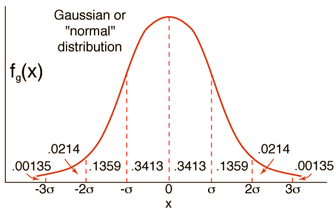
BFR Algorithm
BFR [Bradley-Fayyad-Reina] is a variant of k-means designed to handle very large (disk-resident) data sets
Assumes that clusters are normally distributed around a centroid in a Euclidean space
Standard deviations in different dimensions may vary
Clusters are axis-aligned ellipses
Efficient way to summarize clusters (want memory required O(clusters) and not O(data))

Slide 96
BFR Algorithm
Points are read from disk one main-memory-full at a time
Most points from previous memory loads are summarized by simple statistics
To begin, from the initial load we select the initial k centroids by some sensible approach:
Take k random points
Take a small random sample and cluster optimally
Take a sample; pick a random point, and then k–1 more points, each as far from the previously selected points as possible

Slide 97
Three Classes of Points
3 sets of points which we keep track of:
Discard set (DS):
Points close enough to a centroid to be summarized
Compression set (CS):
Groups of points that are close together but not close to any existing centroid
These points are summarized, but not assigned to a cluster
Retained set (RS):
Isolated points waiting to be assigned to a compression set

Slide 98
BFR: “Galaxies” Picture
Points in
the RS
Compressed sets.
Their points are in
the CS.
A cluster. Its points
are in the DS.
The centroid
Discard set (DS): Close enough to a centroid to be summarized
Compression set (CS): Summarized, but not assigned to a cluster
Retained set (RS): Isolated points

Slide 99
Summarizing Sets of Points
For each cluster, the discard set (DS) is summarized by:
The number of points, N
The vector SUM, whose i^{th} component is the sum of the coordinates of the points in the i^{th} dimension
The vector SUMSQ: i^{th} component = sum of squares of coordinates in i^{th} dimension
A cluster. All its points are in the DS.
The centroid

Slide 100
Summarizing Points: Comments
2d + 1 values represent any size cluster
d = number of dimensions
Average in each dimension (the centroid) can be calculated as SUM_{i} / N
SUM_{i} = i^{th} component of SUM
Variance of a cluster’s discard set in dimension i is: (SUMSQ_{i} / N) – (SUM_{i} / N)²
And standard deviation is the square root of that
Next step: Actual clustering
Note: Dropping the “axis-aligned” clusters assumption would require storing full covariance matrix to summarize the cluster. So, instead of SUMSQ being a d-dim vector, it would be a d x d matrix, which is too big!

Slide 101
The “Memory-Load” of Points
Processing the “Memory-Load” of points (1):
1) Find those points that are “sufficiently close” to a cluster centroid and add those points to that cluster and the DS
These points are so close to the centroid that they can be summarized and then discarded
2) Use any main-memory clustering algorithm to cluster the remaining points and the old RS
Clusters go to the CS; outlying points to the RS
Discard set (DS): Close enough to a centroid to be summarized.
Compression set (CS): Summarized, but not assigned to a cluster
Retained set (RS): Isolated points

Slide 102
The “Memory-Load” of Points
Processing the “Memory-Load” of points (2):
3) DS set: Adjust statistics of the clusters to account for the new points
Add Ns, SUMs, SUMSQs
4) Consider merging compressed sets in the CS
5) If this is the last round, merge all compressed sets in the CS and all RS points into their nearest cluster
Discard set (DS): Close enough to a centroid to be summarized.
Compression set (CS): Summarized, but not assigned to a cluster
Retained set (RS): Isolated points

Slide 103
BFR: “Galaxies” Picture
Points in
the RS
Compressed sets.
Their points are in
the CS.
A cluster. Its points
are in the DS.
The centroid
Discard set (DS): Close enough to a centroid to be summarized
Compression set (CS): Summarized, but not assigned to a cluster
Retained set (RS): Isolated points

Slide 104
A Few Details…
Q1) How do we decide if a point is “close enough” to a cluster that we will add the point to that cluster?
Q2) How do we decide whether two compressed sets (CS) deserve to be combined into one?

Slide 105
How Close is Close Enough?
Q1) We need a way to decide whether to put a new point into a cluster (and discard)
BFR suggests two ways:
The Mahalanobis distance is less than a threshold
High likelihood of the point belonging to currently nearest centroid

Slide 106
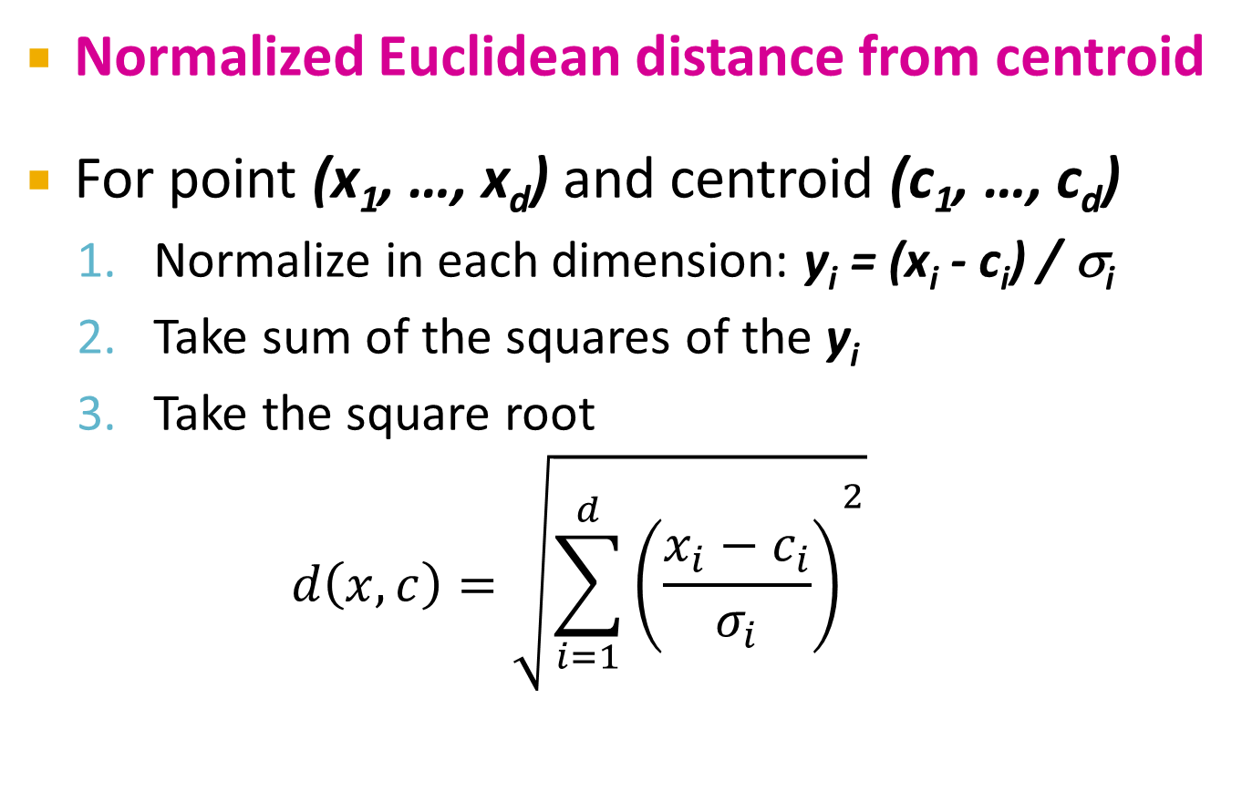
Mahalanobis Distance
Normalized Euclidean distance from centroid
For point (x₁, …, x_{d}) and centroid (c₁, …, c_{d})
Normalize in each dimension: y_{i} = (x_{i} - c_{i}) / σ_{i}
Take sum of the squares of the y_{i}
Take the square root
$$d\left(x,c\right)=\sqrt{{\sum_{i=1}^{d}{\left(\frac{x_{i}−c_{i}}{σ_{i}}\right)}}^{2}}$$
σ_{i} … standard deviation of points in the cluster in the i^{th} dimension

Slide 107
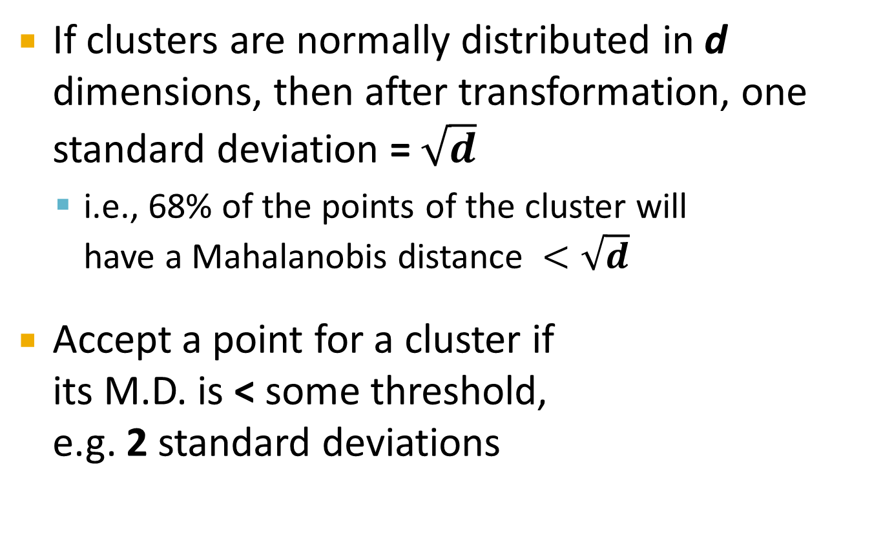
Mahalanobis Distance
If clusters are normally distributed in d dimensions, then after transformation, one standard deviation = $\sqrt{d}$
i.e., 68% of the points of the cluster will have a Mahalanobis distance $<\sqrt{d}$
Accept a point for a cluster if its M.D. is < some threshold, e.g. 2 standard deviations

Slide 108
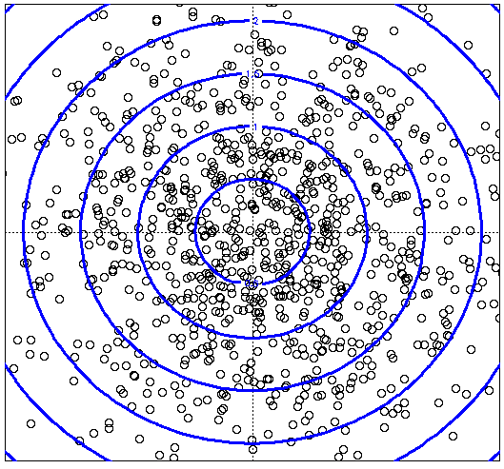
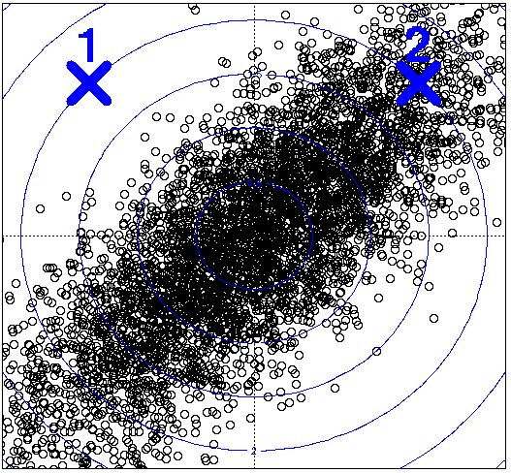
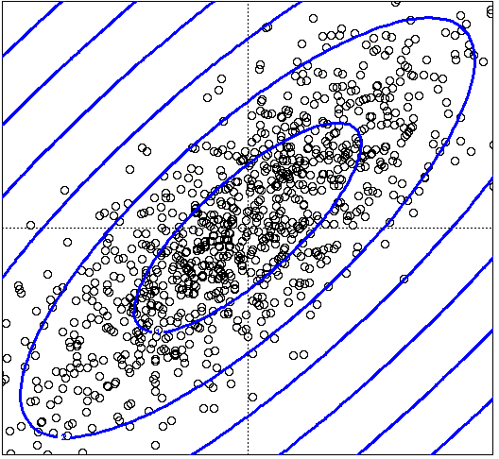
Picture: Equal M.D. Regions
Euclidean vs. Mahalanobis distance
Contours of equidistant points from the origin
Uniformly distributed points, Euclidean distance
Normally distributed points, Euclidean distance
Normally distributed points, Mahalanobis distance

Slide 109
Should 2 CS clusters be combined?
Q2) Should 2 CS subclusters be combined?
Compute the variance of the combined subcluster
N, SUM, and SUMSQ allow us to make that calculation quickly
Combine if the combined variance is below some threshold
Many alternatives: Treat dimensions differently, consider density

Slide 110
The CURE Algorithm
Extension of k-means to clusters of arbitrary shapes

Slide 111
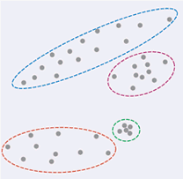
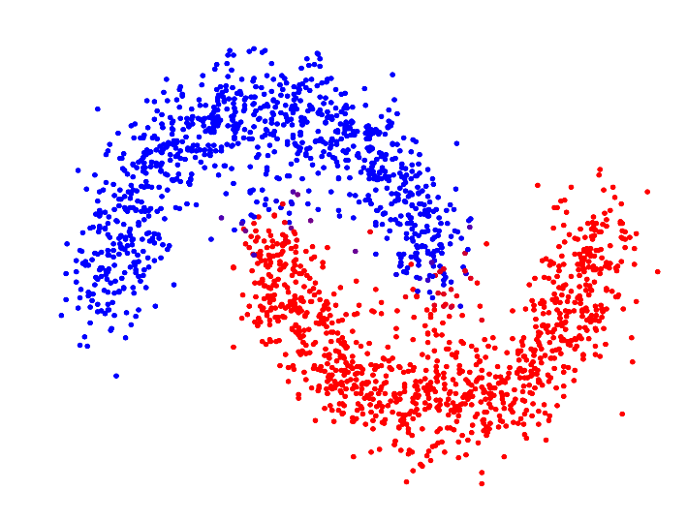
The CURE Algorithm
Vs.
Problem with BFR/k-means:
Assumes clusters are normally distributed in each dimension
And axes are fixed – ellipses at an angle are not OK
CURE (Clustering Using REpresentatives):
Assumes a Euclidean distance
Allows clusters to assume any shape
Uses a collection of representative points to represent clusters

Slide 112
Example: Stanford Salaries
h
h
h
e
e
e
h
e
e
e
h
e
e
e
e
salary
h
e
h
h
h
h
h
h
h
age

Slide 113
Starting CURE
2 Pass algorithm. Pass 1:
0) Pick a random sample of points that fit in main memory
1) Initial clusters:
Cluster these points hierarchically – group nearest points/clusters
2) Pick representative points:
For each cluster, pick a sample of points, as dispersed as possible
From the sample, pick representatives by moving them (say) 20% toward the centroid of the cluster

Slide 114
Example: Initial Clusters
h
h
h
e
e
e
h
e
e
e
h
e
e
e
e
h
salary
e
h
h
h
h
h
h
h
age

Slide 115
Example: Pick Dispersed Points
h
h
h
e
e
e
h
e
e
e
h
e
e
e
e
h
salary
e
Pick (say) 4
remote points
for each
cluster.
h
h
h
h
h
h
h
age

Slide 116
Example: Pick Dispersed Points
h
h
h
e
e
e
h
e
e
e
h
e
e
e
e
h
salary
e
Move points
(say) 20%
toward the
centroid.
h
h
h
h
h
h
h
age

Slide 117
Finishing CURE
Pass 2:
Now, rescan the whole dataset and visit each point p in the data set
Place it in the “closest cluster”
Normal definition of “closest”: Find the closest representative to p and assign it to representative’s cluster
p

Slide 118
Summary
Clustering: Given a set of points, with a notion of distance between points, group the points into some number of clusters
Algorithms:
Agglomerative hierarchical clustering:
Centroid and clustroid
k-means:
Initialization, picking k
BFR
CURE

