Slide 1

Digital Forensics: Tools and Techniques

Slide 2
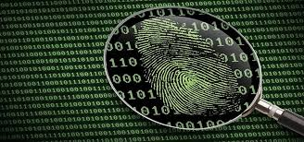
What is Digital Forensics?
In short, digital forensics is the investigation and recovery of material found in digital devices.
Digital forensics is often used for the investigations of crimes that involve technology.
As technology has evolved, so have the techniques of digital forensics.
Digital forensics is now a broad term, with many sub-branches.

Slide 3
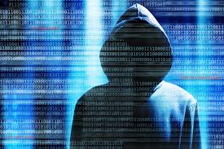
Why Digital Forensics?
Digital forensics is used to investigate a wide variety of crimes.
The first practical application of digital forensics was in 1986 and was used to capture hacker Markus Hess.
Since then, more applications have been found for digital forensics. Other examples of digital forensics:
Cyberbullying and cyberstalking
Issues with copyright infringement
Cybercrimes involving the sale of illegal items, such as drugs and credit card numbers
Cyberwarfare and cyberterrorism

Slide 4
Markus Hess: Early Example of Digital Forensics
Markus Hess was a German citizen who is known for his hacking in the late 1980s. He hacked into military networks in the US, Europe, and East Asia, and sold the information to the Soviet KGP. (Sold the information for $54,000)
Hess used a transatlantic cable to the Tymnet International gateway, which routed him to any computer that also used the Tymnet service.
Clifford Stoll, a systems admin for a laboratory in California, traced the call made to a Tymnet switch in Oakland, CA. By tracing various calls, they traced Hess to Hanover, Germany.
Stoll created fake military project records on computers that would be hacked by Hess, to keep him connected long enough to trace his connection.

Slide 5
Branches of Digital Forensics
Computer forensics
Used to explain the current state of a digital artifact(computer, hard drive, electronic document)
Deals with emails, files, internet logs
Mobile device forensics
Used for the investigation and recovery of digital evidence from mobile devices.
Deals with phone records, text records, gps location
Network forensics
Used to monitor computer network traffic, usually intercepted at the packet level
Forensic data analysis
Aims to discover and analyze patterns of fraudulent crimes, usually financial crimes.
Database forensics
Used to study databases and their metadata.

Slide 6
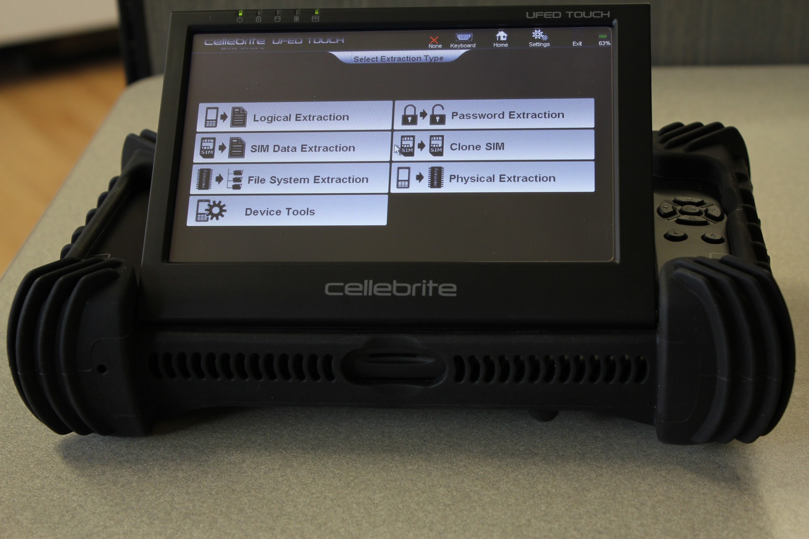
Tools for Digital Forensics
There are many different tools for digital forensics, such as:
CAINE(Computer Aided INvestigative Environment)
A Linux distro that offers user-friendly tools and UI.
NetworkMiner
Detects OS, hostname and open ports of network hosts through packet sniffing/PCAP parsing
ProDiscover
Allows you to image, analyze evidence found on a drive.
CryptHunter
Notifies the user if active encryption is running on a system so investigators can act to preserve evidence that would be lost if the system shut down.

Slide 7
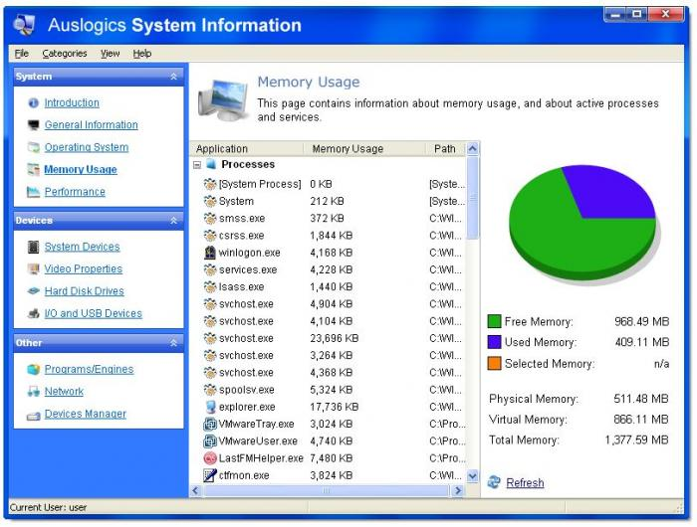
Methods to Digital Forensics
There have been many attempts to develop a process model for digital forensics, but none so far have been universally accepted. The general process is as followed:
Verification
System description
Evidence acquisition
Timeline analysis
Media and artifact analysis
String or byte search
Data recovery
Reporting results

Slide 8
Methods to Digital Forensics cont.
Verification: verify that the incident has taken place, and gather specifics about it to figure out the best approach.
System Description: gather data about the system you are going to analyze. Outline information such as OS, disk format, amount of ram, and location of evidence.
Evidence Acquisition: Identify possible sources of data, acquire volatile and nonvolatile data. Volatile data should be gathered first, as it changes over time. Next create a bit stream image from the hard drive. Then verify the data’s integrity.

Slide 9
Methods to Digital Forensics cont.
Timeline Analysis: gather information about what time target files were accessed, changed, or created, if applicable. This can be automatically done with a variety of tools.
Media and Artifact Analysis: figure out what programs were executed, or what files were downloaded/clicked/deleted. Do memory analysis to be able to examine rogue processes, process paths, user handles, mutex, and more.
String or Byte Search: this step will consist into using tools that will search the low level raw images. You will be doing string searches using regular expressions.

Slide 10
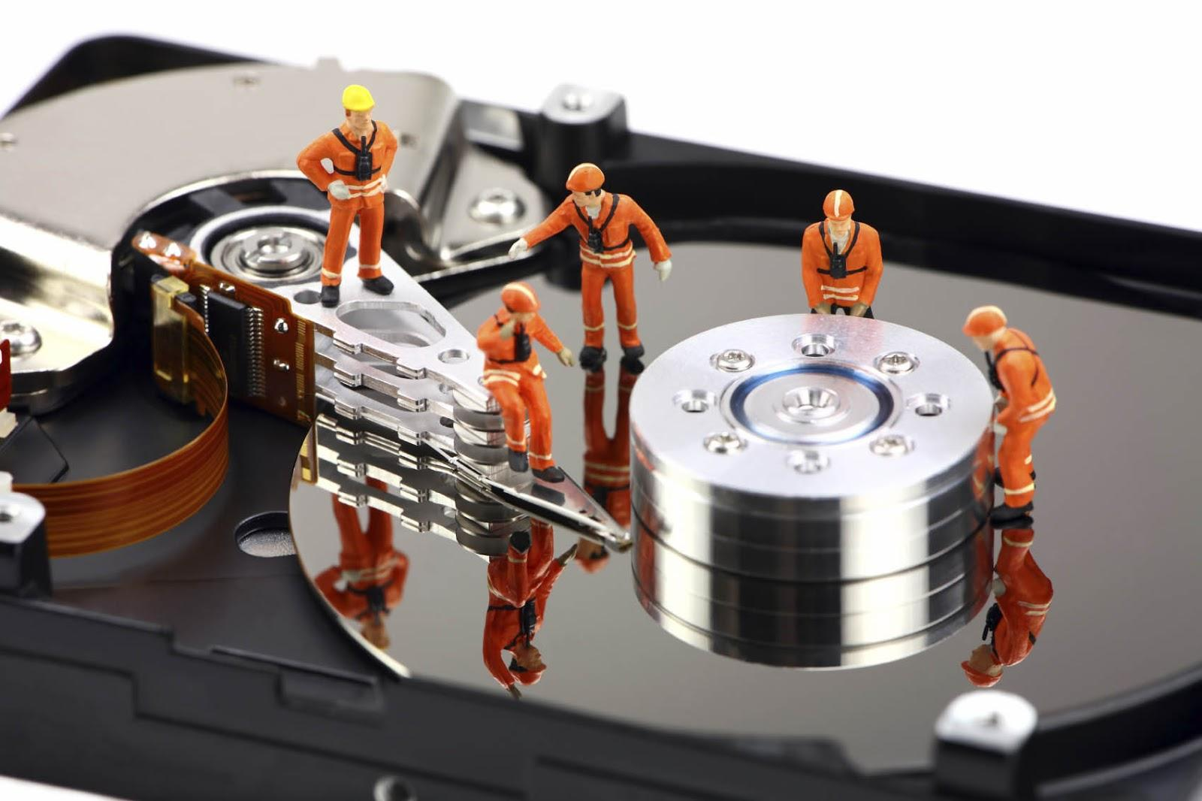
Methods to Digital Forensics cont.
Data Recovery: you will look to recover data from the file system. There are several tools that can be used to analyze the file system, data layer, and metadata layer. Use this to find files of interest.
Reporting Results: the step or reporting the steps and results of the analysis.

Slide 11
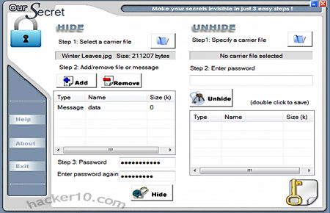
Steganalysis
This is the art of detecting and decoding hidden data.
There are many different ways to detect the hidden data
Software analysis: programs can detect modifications though changes in hash values. Disk analysis utilities can be used to detect hidden tracks/sectors/data.
Firewall/Routing Filters: can be used to search for hidden or invalid data in the IP datagram headers.
Statistical Analysis: there are steganalysis algorithms that work on images to see if data is hidden in images or audio files.
There are also many ways to recover data
Recovery of watermarked data(data hidden in pictures, video, or audio) is very difficult.
Data hidden on a disk is easier to recover. Decryption may be difficult depending on the type of encryption.
Deleted data can be reconstructed, even if a disk has been wiped.

Slide 12
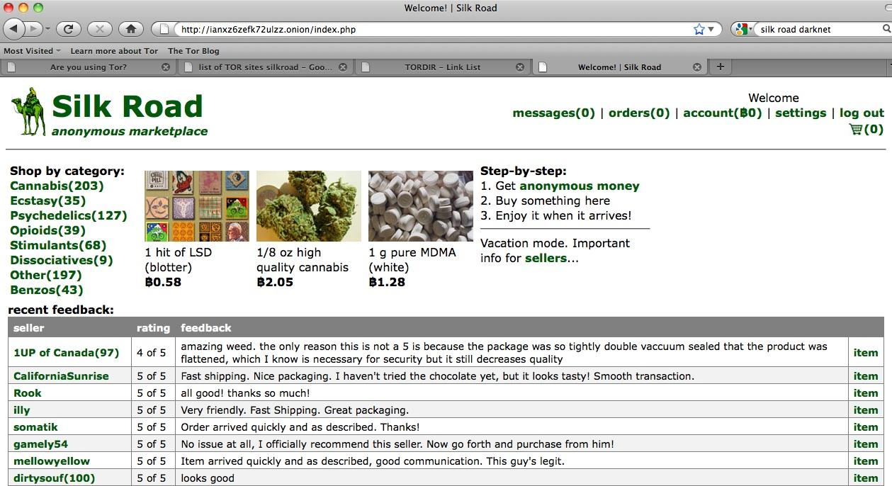
Silk Road: A Modern Example in Digital Forensics
Silk Road was an online black market, and the first modern dark web market, which was used for selling many different illegal goods such as drugs.
The dark web is the encrypted network that exists between Tor servers and their clients.
Tor(The Onion Router) is a free software and open network that is used to improve one’s privacy on the internet.

Slide 13
How Tor Works

Slide 14
How Does Digital Forensics Tie in?
Because of the hidden nature of Silk Road, or all sites in the dark web in general, it was extremely difficult to track the IP addresses of the computers that operate on it.
What caused the discovery of the IP address was a leak through network traffic.
A server hosting the site was not specifically configured for the purpose of operating on Tor, meaning an IP address leak(human error).
Each individual packet of data being sent back from the website contained an IP address not known to be a Tor node.
By analyzing packets and network traffic, ultimately officials were able to take down the site.

Slide 15
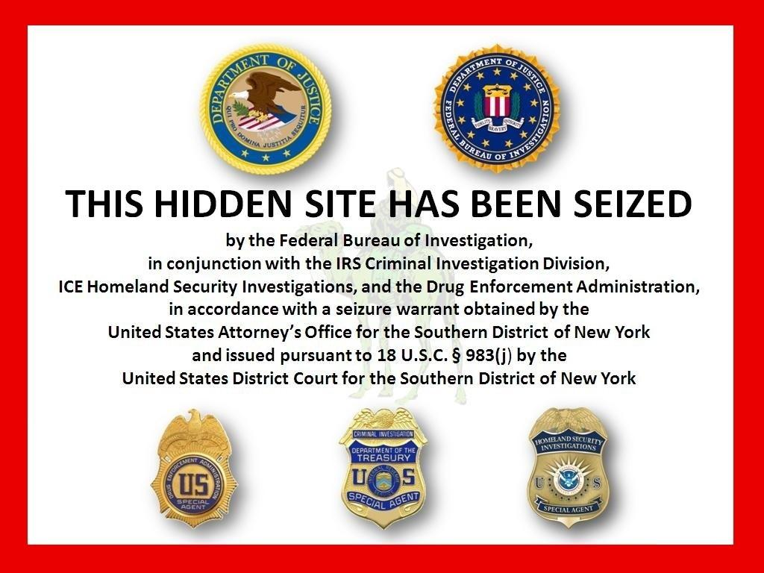
How Does Digital Forensics Apply to Everyday Life?
Although you may not directly use digital forensics, it still affects your everyday life.
From a corporate standpoint, digital forensics can help catch anyone who may be suspected of data theft.
Digital forensics can help catch someone who is guilty of identity theft.
Digital forensics can keep a country safe, by detecting breaches of security and helping trace who is responsible for them.

Slide 16

What About (almost)Complete Anonymity?
There are currently many tools available to help secure systems and provide anonymity. These tools can make a the job harder. Such tools and methods for anonymity are:
Web Browsing: Tor Browser, as mentioned earlier, is a good start to retain privacy on the internet. Add a VPN between your computer and Tor, and it makes tracing your internet actions very difficult.
Email: Using encryption while sending emails helps, but you are still linked to that account. Using a service such as Guerrilla Mail, you can set up a temporary, disposable email address.

Slide 17
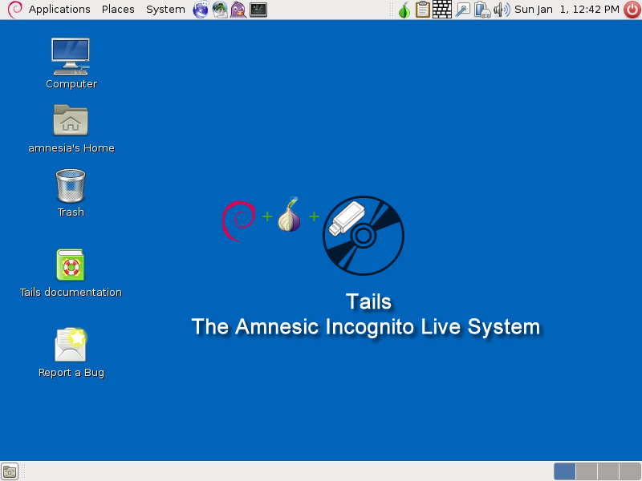
What About (almost)Complete Anonymity?
Mobile Devices: There are a few tools that are help one remain anonymous. An app called Orbot runs the Tor browser on Android. Currently anonymity tools for phones are far behind desktop tools. Setting up a passcode(as long and random as possible) with auto factory reset after a number of incorrect attempts is also a good start.
OS: For someone who really wants as much security as possible, operating systems such as Tails can be booted from a USB stick and leaves no trace of the session, and anonymizes all information.

Slide 18
So Can I Be Invisible to Digital Forensics?
Although there are many tools available make you more secure and anonymous, there are also many tools available for digital forensics.
In many cases, traces of information may be left behind in places such as registries.
Data can usually be recovered, even if a hard drive was magnetically wiped.
On Tor, it is possible for someone to check where traffic enters and exits the network, and it is possible to connect the dots and identify the user.
User error is always a problem. There is always ways to identify yourself even when in a secure environment, such as simply using your login for a mail application, or in the same way that caused Silkroad’s downfall.

Slide 19
Digital Forensics: Applied Example
All environments are subject to intrusion. In this example, we will look at ways to detect intrusion in a Linux environment.
Digital forensics does not always require expensive tools. Simple commands on Linux can help you detect if there has been an intrusion, such as the last command or netstat.
There are host based detection tools available, such as Tripwire. Tripwire is a file integrity checker. It works by encrypting information(checksums, file sizes, ect) for important files and directories, and stores them in a database. The program then will compare the stored information with the current, and any large difference may mean an intrusion. You can add a crontab entry to schedule tripwire to run at certain times.

Slide 20
Digital Forensics: Applied Example cont.
Intruders often either modify, delete, or replace existing files in order to either cover their tracks, assist them in gaining access, or to gather further information.
There are simple ways that you can check integrity of files, such as /usr/bin/find / -ctime -1 -print. This will show you the most recently modified files on your system.
If an intruder was in your system, they probably will leave behind some telltale traces.
If the system has been compromised, gather information as soon as you can as logs may expire.

Slide 21
last and netstat command
last command is used to find out when a particular user last logged in. This can help you verify which users have logged in and may have compromised a system.
netstat is a very useful tool to see various network information.
-a will list all ports
-at will list all tcp ports
-l will list only listening ports
-lt will list only listening tcp ports
-s shows statistics about all ports

Slide 22
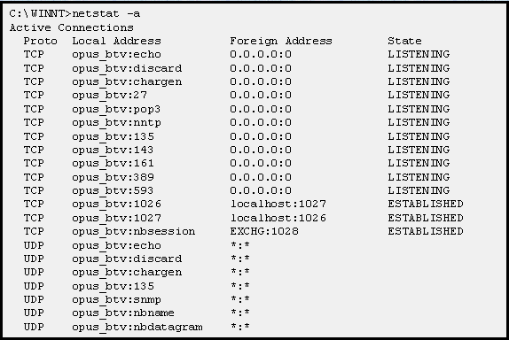
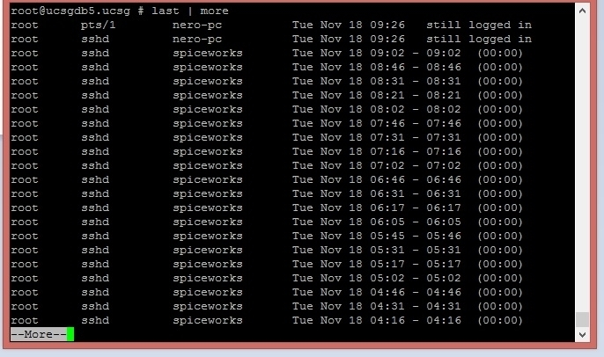
last and netstat command

Slide 23
Challenges of Digital Forensics
From a legal and technical standpoint, there are several challenges of digital forensics
The reliability of digital forensic tools may be questioned in court.
The detectives in some investigations may not understand the computer system and what can be accomplished from the investigation, and some digital forensic examiners may not fully understand the investigation and overlook relevant information.
Evolving privacy and data protection regulations may add to the complexity of obtaining digital evidence.
Technology is constantly evolving, so digital forensic examiners need to constantly be up to date on current technology.

Slide 24
Challenges of Digital Forensics cont.
One of the main problems that digital forensics may face is full disk encryption.
One problem is that someone can turn a computer off during transportation, without realizing it’s encrypted, and can’t get the data back.
Some hardware-level encryption can cause the device to erase the data in the case of tampering.
One way around this is ripping unencrypted data from volatile, live memory, but they does not get all the information the investigation may need.
Brute forcing strong passwords can take hundreds of years, which is obviously not an option.

Slide 25
Digital Forensics vs. Data Extraction
The two terms may be related, but there is a difference between the two.
Data extraction is what it sounds like, simply extracting data from a device, view it, and report on it.
Digital forensics goes beyond that, and looks at all available evidence with an open mind, looking specifically to prove or disprove a case. Digital forensics involves looking below the surface level and checking everywhere possible for information.
https://forensic4cast.com/2015/07/digital-forensics-vs-data-extraction/

Slide 26
Table
 | 2021 | 2022 | 2023 | 2024 | 2025
Versione | 1.0 | 1.0 | 2.0 | 2.0 | 2.0
Numero Clienti | 10 | 100 | 250 | 390 | 450
Abbonamento mensile | 25€ | 25€ | 32€ | 32€ | 32€
Costi Totali (€) | 23 K | 61 K | 110 K | 138 K | 137.5 K
Ricavi (€) | 7.2 K | 68 K | 148 K | 257 K | 275 K
Utile/Perdita (€) | (14 K) | 3.5 K | 31 K | 89 K | 104 K
I dati esposti sono estratti da una Forecast Analysis effettuata in fase di progettazione del business model su base quinquennale

Slide 27
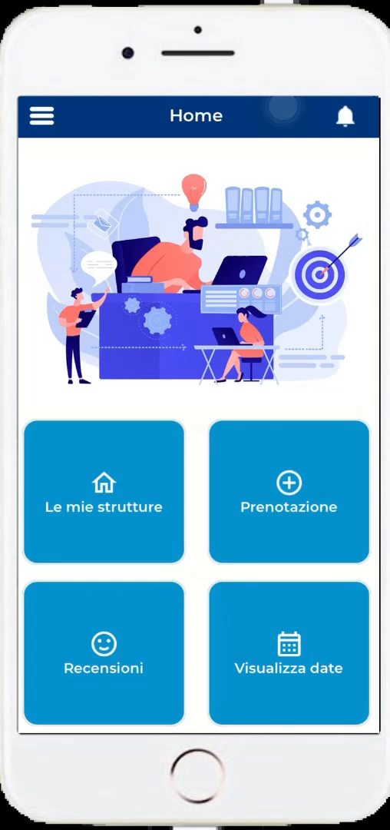

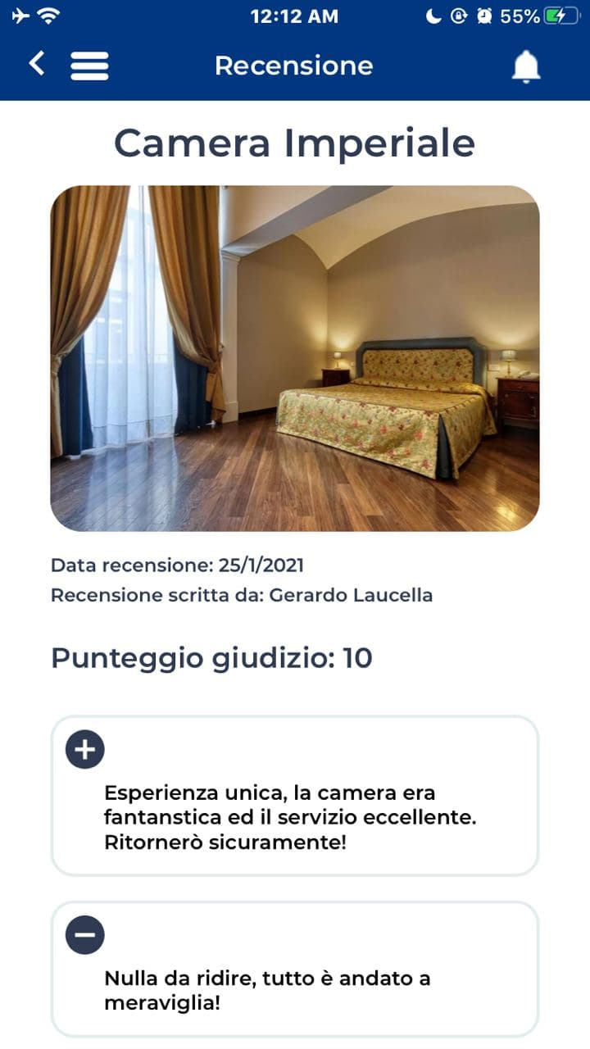
Video content example
(not insert by creator) – this is only an example

Slide 28
Sources
http://www.usatoday.com/story/news/nation/2013/10/21/fbi-cracks-silk-road/2984921/
https://www.countuponsecurity.com/2014/08/06/computer-forensics-and-investigation-methodology-8-steps/
http://www.linuxsecurity.com/docs/SecurityAdminGuide/SecurityAdminGuide-7.html
http://www.linux-magazine.com/Issues/2008/93/Tracing-Intruders-Intro/%28offset%29/3
https://www.digitalocean.com/community/tutorials/how-to-use-tripwire-to-detect-server-intrusions-on-an-ubuntu-vps

