Slide 1
Adequate Infosoft

Slide 2
Digital Marketing Plane
SEO
On Page
SMM
Social Connectivity
User Engagement
SEM
PPC Management
SEO
Off Page

Slide 3
INDEX of Digital Marketing
SEO (Search Engine Optimization)
ON Page Optimization
OFF Page Optimization
SMM (Social Media Marketing)
Social Sites (Facebook, Twitter, LinkedIn, etc)
Social Page Creation & Promotion
Ads Management (Traffic & Analysis)
SEM (Search Engine Marketing)
AdWords setup
Landing Page Creation & Connectivity
Campaign Management

Slide 4
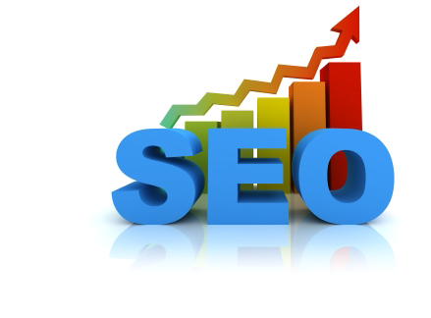

Slide 5
Firstly Check Your Website, If Website will available:
Strength
Complete Meta tags
Scope of Work
UI and Clicks
Opportunities
Keyword Research & Analysis
No Broken Links
All On page file (Site Map, Robots, URL
Mobile Friendly
Link management can be improved a lot
Few online verification pending
Individual websites
No Indian content on YouTube
Social Media and Blogging can be more active.
Content Strategy
Technical SEO and Platform
Architecture
Link Development

Slide 6
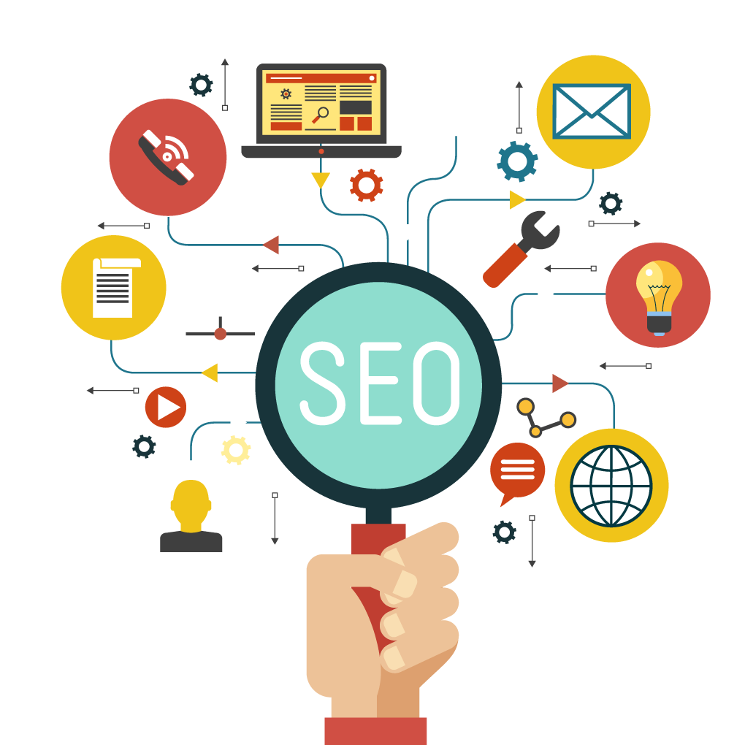
Search Engine Optimization
SEO is the process of improving the visibility of a Website on organic ("natural" or un-paid) Search Engine Result Pages (Google, Yahoo & Bing) by incorporating search engine friendly elements into a Website.
SEO based on two points:
a). ON Page Optimization
b). OFF Page Optimization

Slide 7
On Page
On Page :- On-Page SEO refers to all the things that you can do ON your website to help you rank higher, such as page titles, internal linking, meta tags & descriptions, etc.
Off Page
Off Page :- Getting backlinks is the first approach in OFF Page Optimization that helps to increase ranking of keywords (directly/indirectly) in Search Engine Results Page (Google, Yahoo & Bing). Through depth analysis on website promoting keywords + submission high quality links and trusted domains submissions, your website visibility will enlarge among other competitors.

Slide 8
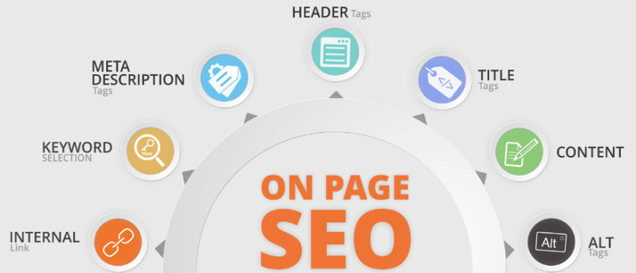
On Page Optimization for Website
keeping a track of white label SEO and all latest Google algorithms updates like Google Panda, Penguin and Hummingbird.
We’ll do following things for you:
On Page Activity Includes:
Optimizing Title Tags & Meta Tags
Robots.txt Optimization
Site Directory Structure & Navigation
H1 / H2 Tag Optimization
Image Optimization
Anchor Tag Optimization
URL Mapping
URL Rewriting
Existing Content Optimization

Slide 9
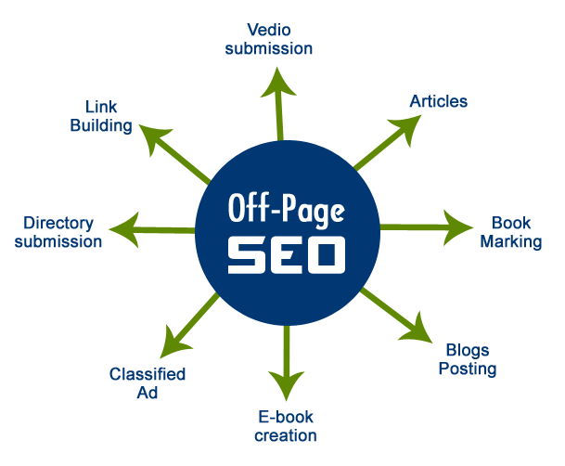
Off Page Optimization for Website
OFF Page Activity includes:
Keyword Research & Analysis
“No follow” Links check
Social Bookmarking
Article Submission & Bookmarking
Gust Blogging
Listing the Website service in Google Merchant & Bing
Blog Commenting Etc.
Blog Optimization:
Blog Setup & Optimization
Blog Writing
Forum Posting

Slide 10
Phase 1
Key word analysis report
Phase 2
PR News Submissions in Education portals
Phase 3
Premium Guest-Post on Education Portals
Competitive Analysis Report of Ranking Colleges
Website On-Page Status Report
Creating A/c’s on all education submission portals
TG Analysis on all social media Platform
High PR Social Bookmarking
TG Analysis & Focus on Education Blogs
High PR Education Directories Submission
E-Books & PDF presentations.
Competitive Link Audit
Content Optimization
Slide share presentation of school latest updates and education updates.

Slide 11
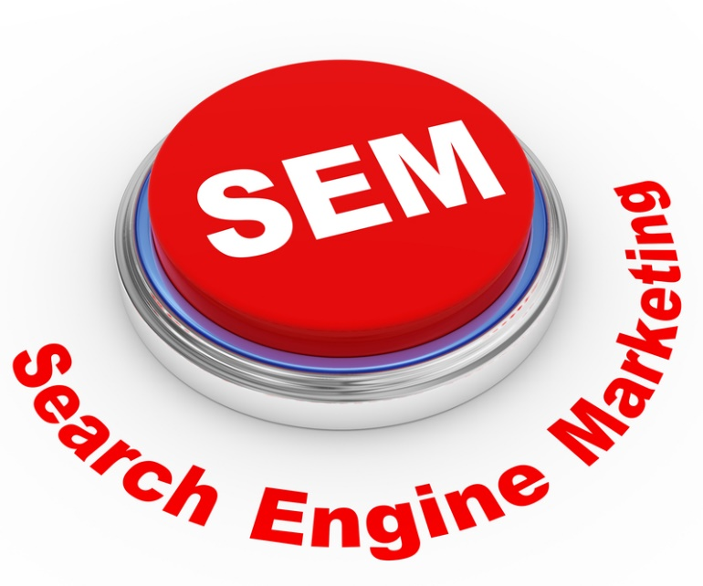

Slide 12
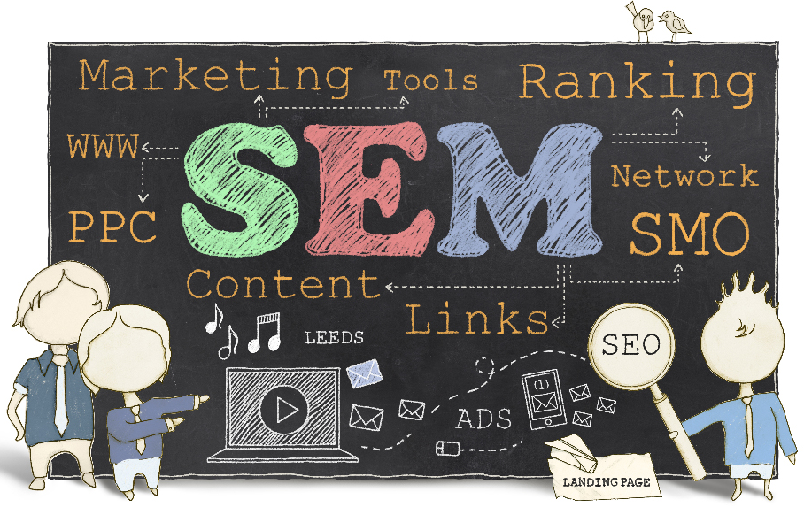
Search Engine Marketing ( SEM)
Our SEM Process
Optimized Ad Creation
Keyword Selection
Ad Copy optimization
Budget Optimization
Bid Optimization
Behavioural Re-Targeting
Post Campaign Optimization/Tracking

Slide 13
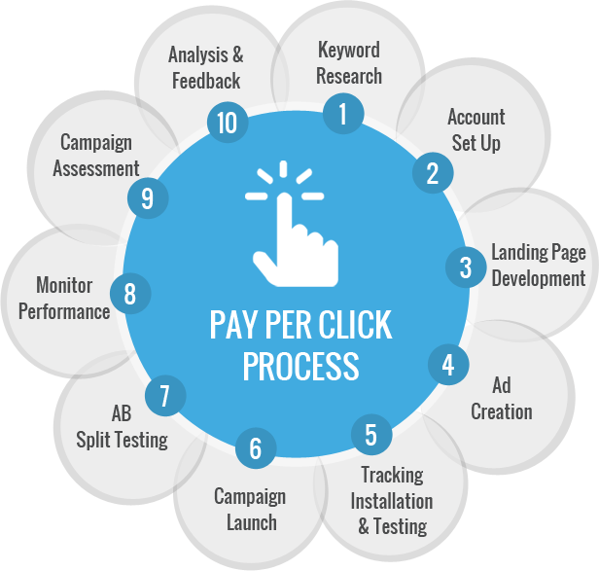
Strategies
The PPC strategy is to develop and
manage campaigns using targeted
keywords and placements to drive
qualified and relevant traffic to your
website to increase profitability.
During our engagement, the paid
media team will analyse historical
PPC campaign data and identify
successions to develop more effective
campaign architecture within Google
AdWords and Bing AdCenter to
maximize results and efficiency.

Slide 14
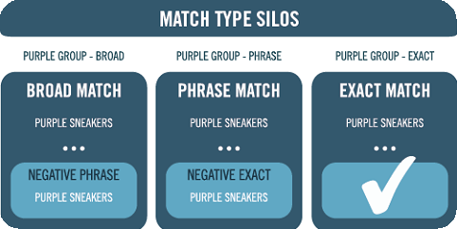
Strategies…For Keyword
As data is collected and core metrics trend positive, our search management platform will be identifying more granular trends (locations, time of day, day of week) and adjust bid prices accordingly.
Match Typed Campaign Structure :
We‘ll use tier match type campaign structure, we would structure campaigns on BMM, Phrase & exact; these campaigns will mirror each other. The purpose of utilizing match type campaigns is to find long tail terms and add them as Exact match keywords.

Slide 15



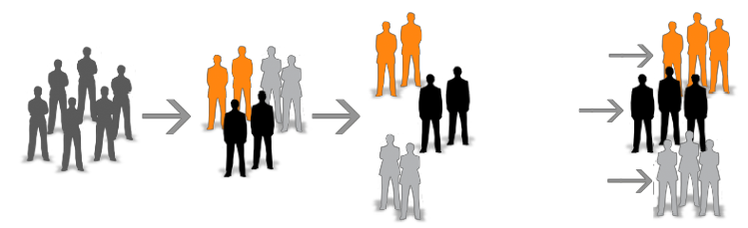

Display Advertisings
Combines Search and Display Advertising to will Boost the overall conversion
numbers as well as display Advertising helps in Branding, View-through
conversions, Target Audience by interests.
CLUSTER
TARGET
ANALYZE
Internet Audience
Google Ad
Planner
Interest/Behavioral
Segmentation
Parents
Privacy Advocates

Slide 16
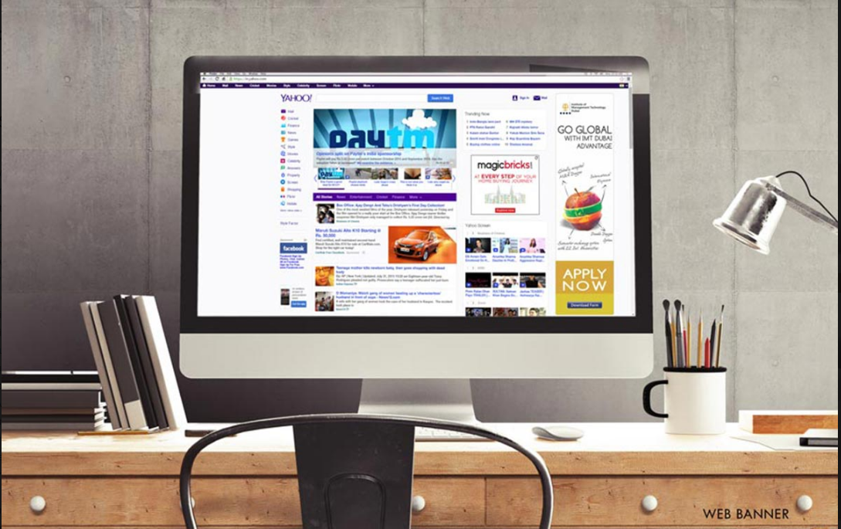
Banner Ads
Banner ads are image-based advertisements that often appear in the side, top, and bottom sections of websites.
They can range widely in terms of size, design, and function.
You'll typically find them in all sorts of news-based websites, blogs, and specialized web communities.
Many websites brokerage their ad space with ad exchanges such as Google's Display Network, or you can buy the ad space in the same manner you'd buy an ad on a newspaper.

Slide 17
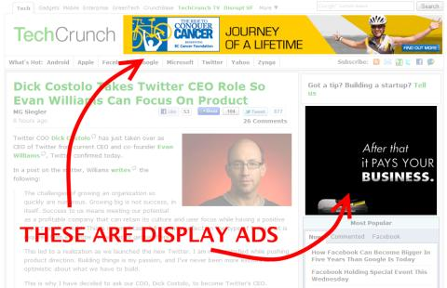
Google Display Ads
Google Display Ads are a form of contextual banner ads used in the Google Display Network, Google’s collection of network sites that agree to host display ads.
The Google Display Network also includes Google properties such as YouTube, Gmail, Blogger, etc.
Google Display ads can be text, images, and even video based.
To serve online ads on the Google Display Network, you need to start by using Google AdWords.

Slide 18
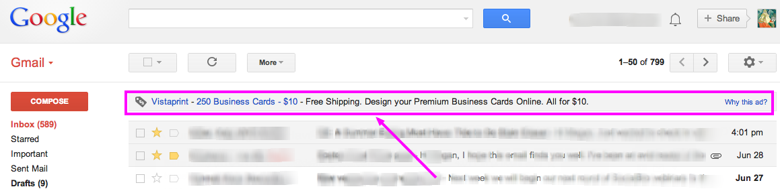
Gmail Ads
Gmail ads in Google’s online email service are contextual ads that are generated by an automated process that scans a user’s emails to discover interests and topics that are relevant to the user.
If a user is writing and receiving many emails about air conditioners, that user may see ads about air conditions appear within the Gmail client.

Slide 19
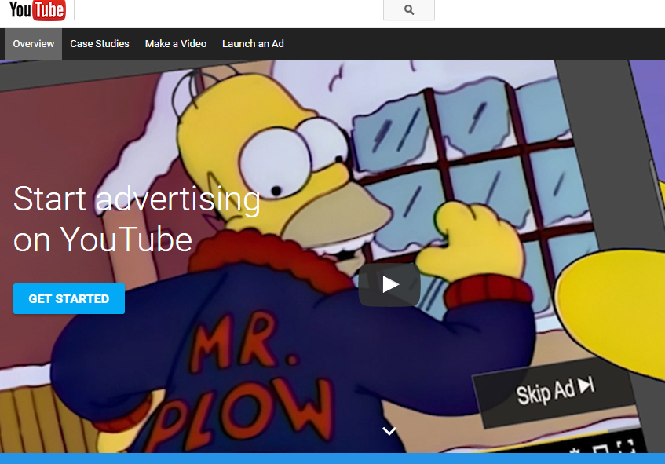
YouTube Advertising :-
Any video uploaded to YouTube can be an ad. Video ads appear before other videos on YouTube, beside playing videos and in search results.

Slide 20
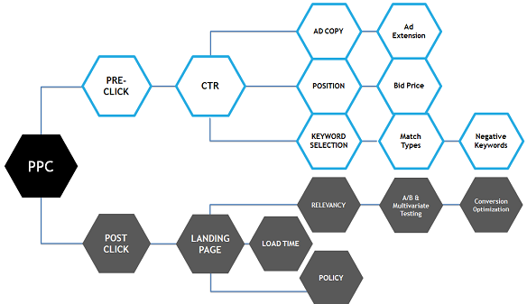
Strategies...
Quality Score :
We know that Quality Score has a direct correlation on your PPC success.
By optimizing your Quality Scores, you’ll be setting yourself up for higher return on investment (ROI).
That’s because higher Quality Scores correlate with lower cost per conversion & we will try to improve the quality score by analyzing Pre Click & Post Click activities.

Slide 21
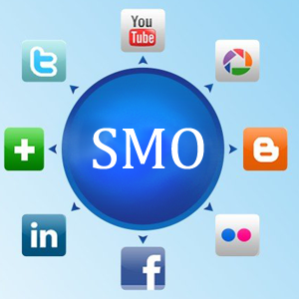

Slide 22
Example of a chart
This is an example of a chart

Slide 23
Table
 | 2021 | 2022 | 2023 | 2024 | 2025
Versione | 1.0 | 1.0 | 2.0 | 2.0 | 2.0
Numero Clienti | 10 | 100 | 250 | 390 | 450
Abbonamento mensile | 25€ | 25€ | 32€ | 32€ | 32€
Costi Totali (€) | 23 K | 61 K | 110 K | 138 K | 137.5 K
Ricavi (€) | 7.2 K | 68 K | 148 K | 257 K | 275 K
Utile/Perdita (€) | (14 K) | 3.5 K | 31 K | 89 K | 104 K
I dati esposti sono estratti da una Forecast Analysis effettuata in fase di progettazione del business model su base quinquennale

Slide 24
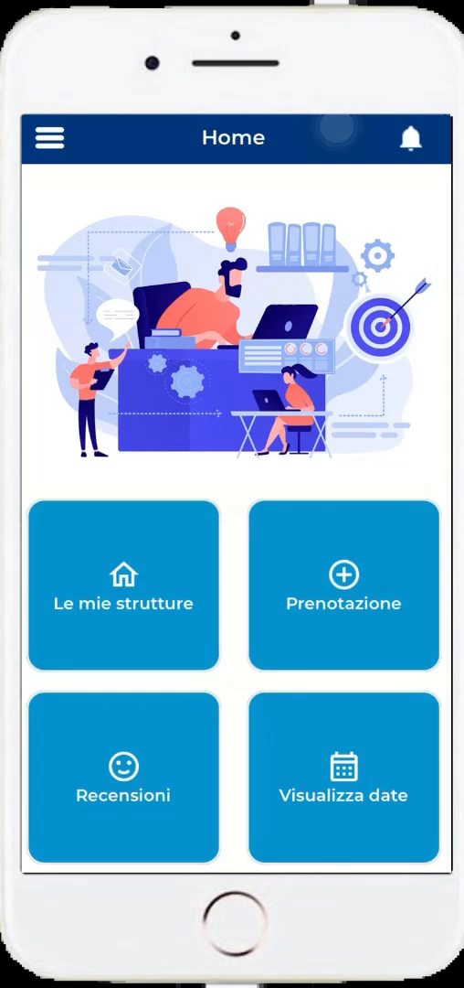
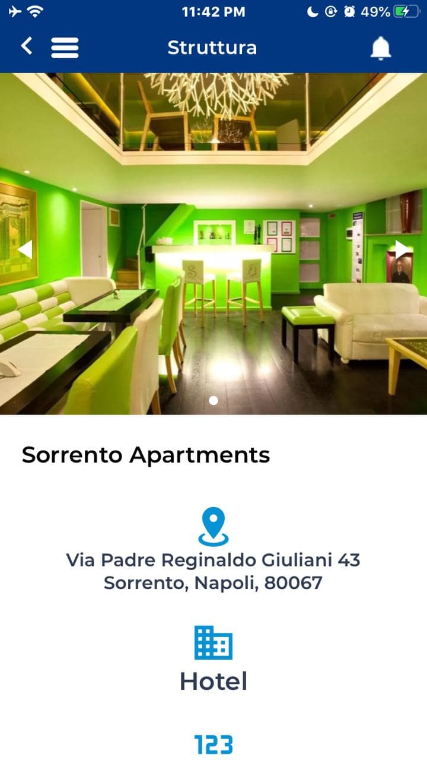
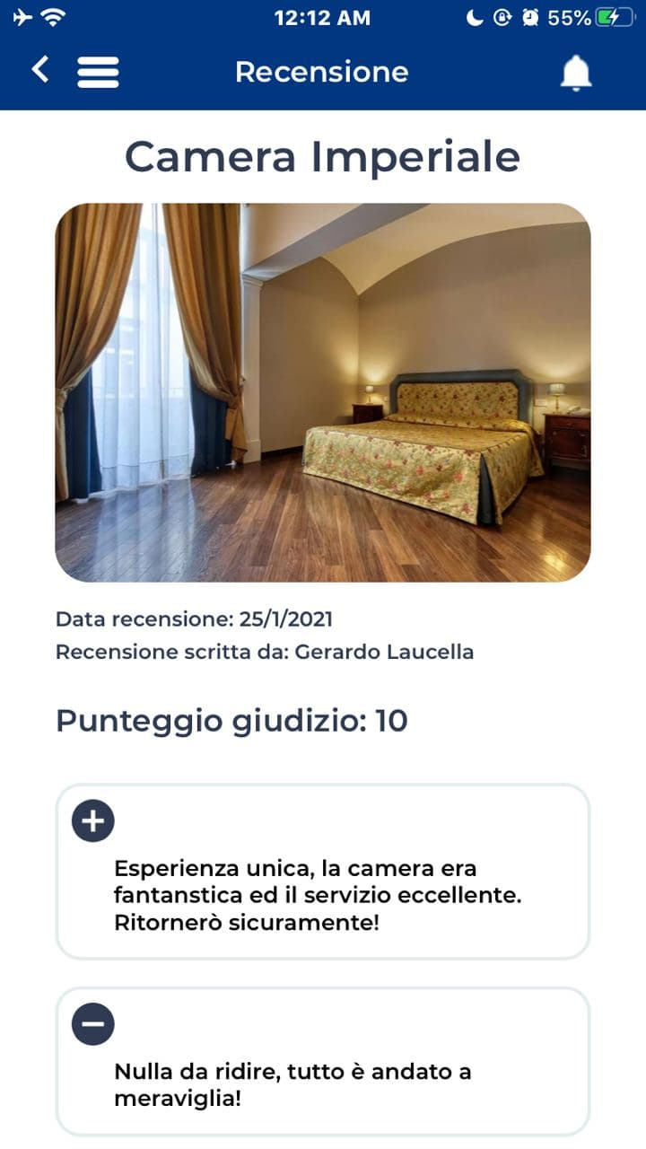
Video content example
(not insert by creator) – this is only an example

Slide 25
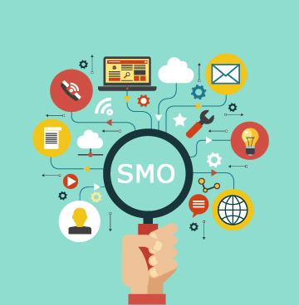
SMO
Social Media Optimization is the use of a number of social media outlets and communities to generate publicity to increase the awareness of a product, brand or event.

Slide 26

Organic Social Media By Facebook
Increase Facebook Like
2 composite posts a day
Cross link with other platforms
Interaction with fans
Rating and review
Create engagement by offering contests/quiz/events
Link to blog
Boost engagement on sectors where interaction is the most
Link to videos/blogs/images/links
Goal/Objective
Increase brand recognition
increase social engagement
Metric
Likes, talking about, referrals, comments, shares, review
Analysis
Facebook insights

Slide 27

Organic Social Media – BY Twitter
Increase Followers
Following different real estate developers
3-4 tweets a day
Interaction with followers
Compostion : tips/ products/ real estate news/ offers
Scale engagement by tweeting about all blogs/links/videos/ images
Purpose
Increase brand recognition,
Increase customer interaction
Promotion of events
Metric
Followers
Mentions
Tweets & Retweets
Analysis
Twitonomy / Tweetdeck

Slide 28

Organic social media By Linkedin
Populate the linkedin page with all the products
Build the community and add relevant/ prospective connections
Link to twitter/fb/blog/website
Singular post a day
Create a group
Identify other similar groups and post actively in discussions
Purpose
Brand Awareness/recognition
Metric
Connections
Group discussion participation, referrals

Slide 29

Organic Social Media – Google Plus
Populate the google+ page with all the products
Build the community and add relevant/ prospective connections in circles
Link to twitter/fb/blog/website
Trying to enter niche circles
Optimize for SEO
2 posts per day
Addition of +1 button
Share engaging content, videos, images, and relevant links
Comment on posts
Create and promote upcoming events
Purpose
Brand Awareness/recognition
SEO
Metric
Number of circles, followers, mentions
Analysis
Google analytics

Slide 30

Organic social media - Pinterest
Synchronizing of boards
Adding pinners
Adding pin it button
An image a day
Repining images of value to customers/brand
Crosslinking to other platforms
Pinning of videos
Growing the community by following other pinners
Purpose
Brand Awareness/recognition
Traffic
SEO
Metric
Pins,
repins,
likes

Slide 31
Thank You….

