Slide 1

Large-Scale Machine Learning: k-NN, Perceptron
Note to other teachers and users of these slides: We would be delighted if you found this our material useful in giving your own lectures. Feel free to use these slides verbatim, or to modify them to fit your own needs. If you make use of a significant portion of these slides in your own lecture, please include this message, or a link to our web site: http://www.mmds.org
Mining of Massive Datasets
Jure Leskovec, Anand Rajaraman, Jeff Ullman Stanford University
http://www.mmds.org

Slide 2
New Topic: Machine Learning!
High dim. data
Locality sensitive hashing
Clustering
Graph data
PageRank, SimRank
Community Detection
Infinite data
Filtering data streams
Web advertising
Dimensionality reduction
Spam Detection
Queries on streams
Machine learning
SVM
Decision Trees
Perceptron, kNN
Apps
Recommender systems
Association Rules
Duplicate document detection

Slide 3
Supervised Learning
Would like to do prediction:
estimate a function f(x) so that y = f(x)
Where y can be:
Real number: Regression
Categorical: Classification
Complex object:
Ranking of items, Parse tree, etc.
Data is labeled:
Have many pairs {(x, y)}
x … vector of binary, categorical, real valued features
y … class ({+1, -1}, or a real number)
X
Y
X’
Y’
Training and test set
Estimate y = f(x) on X,Y. Hope that the same f(x) also works on unseen X’, Y’

Slide 4
Large Scale Machine Learning
We will talk about the following methods:
k-Nearest Neighbor (Instance based learning)
Perceptron and Winnow algorithms
Support Vector Machines
Decision trees
Main question: How to efficiently train (build a model/find model parameters)?

Slide 5
Instance Based Learning
Instance based learning
Example: Nearest neighbor
Keep the whole training dataset: {(x, y)}
A query example (vector) q comes
Find closest example(s) x*
Predict y*
Works both for regression and classification
Collaborative filtering is an example of k-NN classifier
Find k most similar people to user x that have rated movie y
Predict rating y_{x} of x as an average of y_{k}

Slide 6
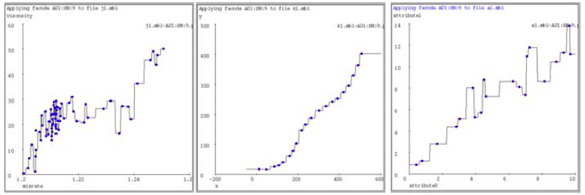
1-Nearest Neighbor
To make Nearest Neighbor work we need 4 things:
Distance metric:
Euclidean
How many neighbors to look at?
One
Weighting function (optional):
Unused
How to fit with the local points?
Just predict the same output as the nearest neighbor

Slide 7
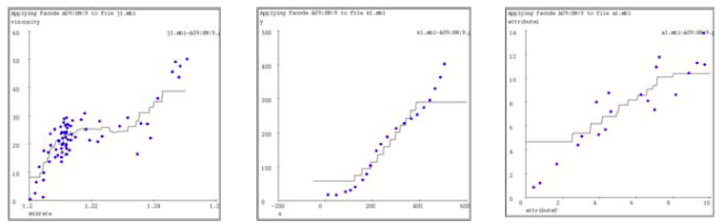
k-Nearest Neighbor
Distance metric:
Euclidean
How many neighbors to look at?
k
Weighting function (optional):
Unused
How to fit with the local points?
Just predict the average output among k nearest neighbors
k=9

Slide 8
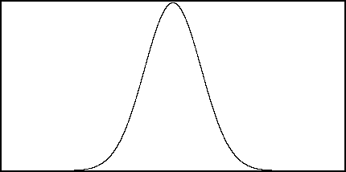
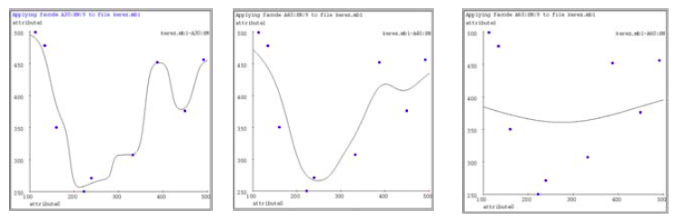
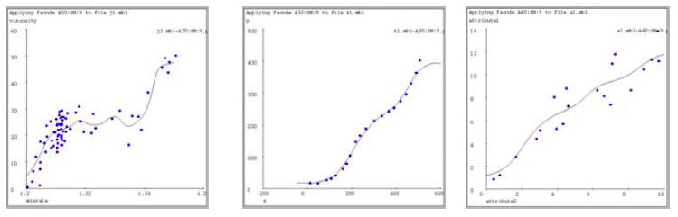
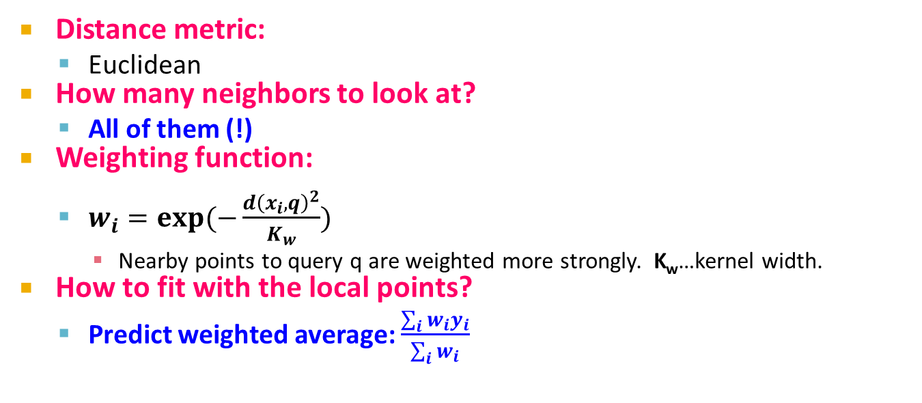
Kernel Regression
Distance metric:
Euclidean
How many neighbors to look at?
All of them (!)
Weighting function:
$w_{i}=exp⁡(−\frac{d{\left(x_{i},q\right)}^{2}}{K_{w}})$
Nearby points to query q are weighted more strongly. K_{w}…kernel width.
How to fit with the local points?
Predict weighted average: $\frac{\sum_{i}{w_{i}y_{i}}}{\sum_{i}{w_{i}}}$
w_{i}
d(x_{i}, q) = 0
K_{w}=10
K_{w}=20
K_{w}=80

Slide 9
How to find nearest neighbors?
Given: a set P of n points in R^{d}
Goal: Given a query point q
NN: Find the nearest neighbor p of q in P
Range search: Find one/all points in P within distance r from q
p
q

Slide 10
Algorithms for NN
Main memory:
Linear scan
Tree based:
Quadtree
kd-tree
Hashing:
Locality-Sensitive Hashing
Secondary storage:
R-trees

Slide 11
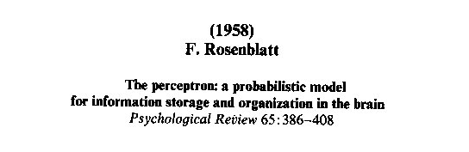
Perceptron

Slide 12
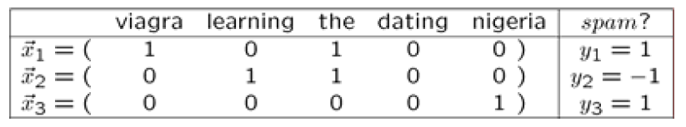
Linear models: Perceptron
Example: Spam filtering
Instance space x ∈ X (|X|= n data points)
Binary or real-valued feature vector x of word occurrences
d features (words + other things, d~100,000)
Class y ∈ Y
y: Spam (+1), Ham (-1)

Slide 13
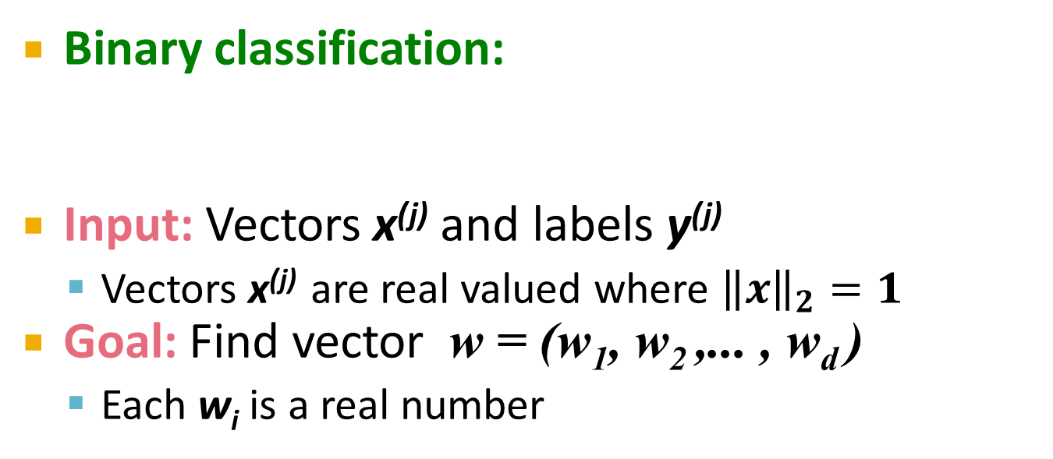
Linear models for classification
Binary classification:
Input: Vectors x^{(j)} and labels y^{(j)}
Vectors x^{(j)} are real valued where ${\left\|x\right\|}_{2}=1$
Goal: Find vector w = (w₁, w₂ ,... , w_{d} )
Each w_{i} is a real number
{
Decision boundary is linear
f (x) =
+1 if w₁ x₁ + w₂ x₂ +. . . w_{d} x_{d} ≥ θ
-1 otherwise
w ⋅ x = θ
-
-
-
-
-
-
-
Note:
w ⋅ x = 0
-
-
-
-
-
w
-
-
-

Slide 14
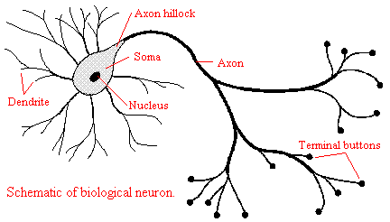
Perceptron [Rosenblatt ‘58]
(very) Loose motivation: Neuron
Inputs are feature values
Each feature has a weight w_{i}
Activation is the sum:
f(x) = Σ_{i} w_{i} x_{i} = w⋅ x
If the f(x) is:
Positive: Predict +1
Negative: Predict -1
w₁
w₂
w₃
w₄
x₁
x₂
x₃
x₄
∑
≥ 0?
w⋅x=0
nigeria
x⁽¹⁾
x⁽²⁾
Spam=1
w
Ham=-1
viagra

Slide 15
Perceptron: Estimating w
Note that the Perceptron is a conservative algorithm: it ignores samples that it classifies correctly.
Perceptron: y’ = sign(w⋅ x)
How to find parameters w?
Start with w₀ = 0
Pick training examples x^{(t)} one by one (from disk)
Predict class of x^{(t)} using current weights
y’ = sign(w^{(t)}⋅ x^{(t)})
If y’ is correct (i.e., y_{t} = y’)
No change: w^{(t+1)} = w^{(t)}
If y’ is wrong: adjust w^{(t)}
w^{(t+1)} = w^{(t)} + η ⋅ y ^{(t)} ⋅ x^{(t)}
η is the learning rate parameter
x^{(t)} is the t-th training example
y^{(t)} is true t-th class label ({+1, -1})
η⋅y^{(t)}⋅x^{(t)}
w^{(t)}
w^{(t+1)}
x^{(t)}, y^{(t)}=1

Slide 16
Perceptron Convergence
Perceptron Convergence Theorem:
If there exist a set of weights that are consistent (i.e., the data is linearly separable) the Perceptron learning algorithm will converge
How long would it take to converge?
Perceptron Cycling Theorem:
If the training data is not linearly separable the Perceptron learning algorithm will eventually repeat the same set of weights and therefore enter an infinite loop
How to provide robustness, more expressivity?

Slide 17
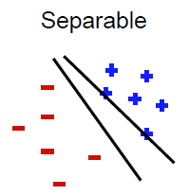
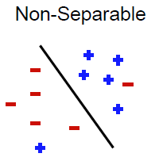
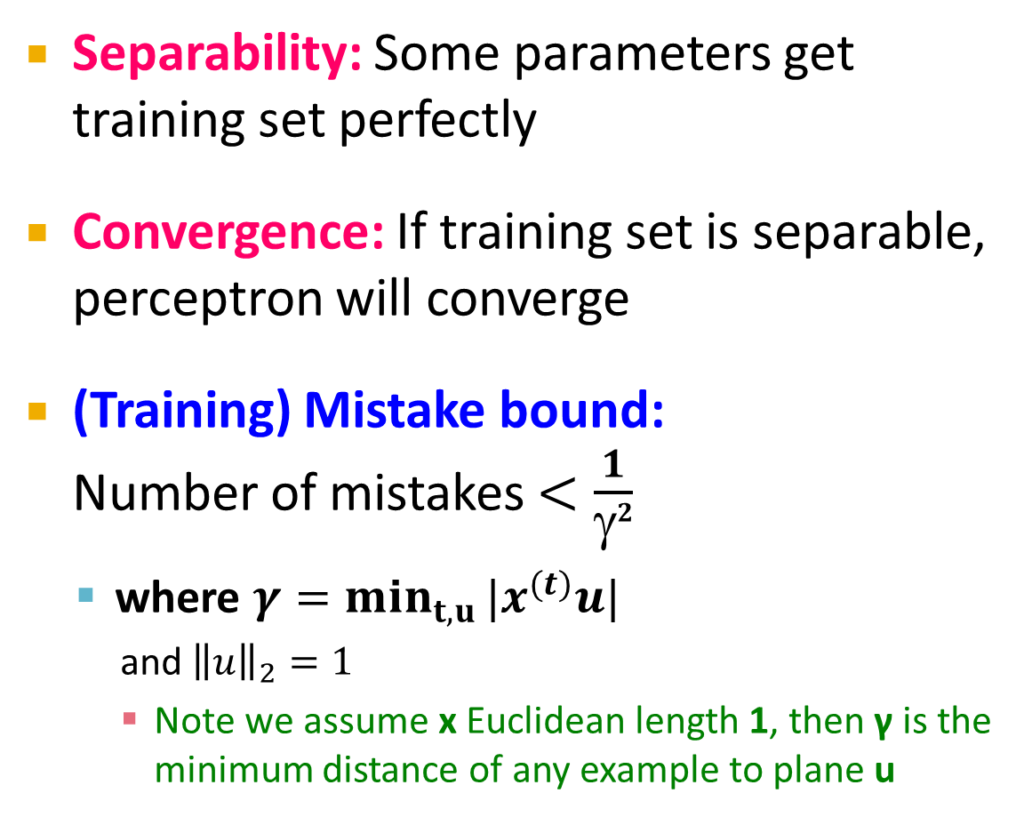
Properties of Perceptron
Separability: Some parameters get training set perfectly
Convergence: If training set is separable, perceptron will converge
(Training) Mistake bound: Number of mistakes $<\frac{1}{γ2}$
where $γ=\min_{t,u}{|x^{(t)}u|}$
and ${\left\|u\right\|}_{2}=1$
Note we assume x Euclidean length 1, then γ is the minimum distance of any example to plane u
Notes:
Gamma = margin
if we scale examples to have Euclidean length 1, then γ is the minimum distance of
any example to the plane

Slide 18
Updating the Learning Rate
Perceptron will oscillate and won’t converge
When to stop learning?
(1) Slowly decrease the learning rate η
A classic way is to: η = c₁/(t + c₂)
But, we also need to determine constants c₁ and c₂
(2) Stop when the training error stops chaining
(3) Have a small test dataset and stop when the test set error stops decreasing
(4) Stop when we reached some maximum number of passes over the data

Slide 19
Multiclass Perceptron
What if more than 2 classes?
Weight vector w_{c} for each class c
Train one class vs. the rest:
Example: 3-way classification y = {A, B, C}
Train 3 classifiers: w_{A}: A vs. B,C; w_{B}: B vs. A,C; w_{C}: C vs. A,B
Calculate activation for each class
f(x,c) = Σ_{i} w_{c,i} x_{i} = w_{c}⋅ x
Highest activation wins
c = arg max_{c} f(x,c)
w_{C}⋅x biggest
w_{C}
w_{B}
w_{B}⋅x biggest
w_{A}
w_{A}⋅x biggest

Slide 20
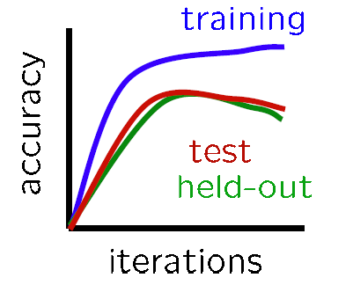
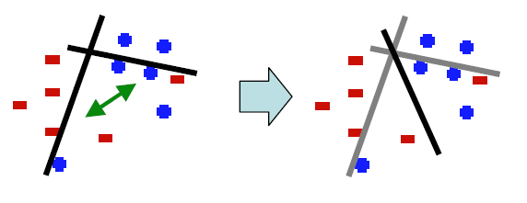
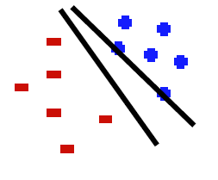
Issues with Perceptrons
Overfitting:
Regularization: If the data is not separable weights dance around
Mediocre generalization:
Finds a “barely” separating solution

Slide 21

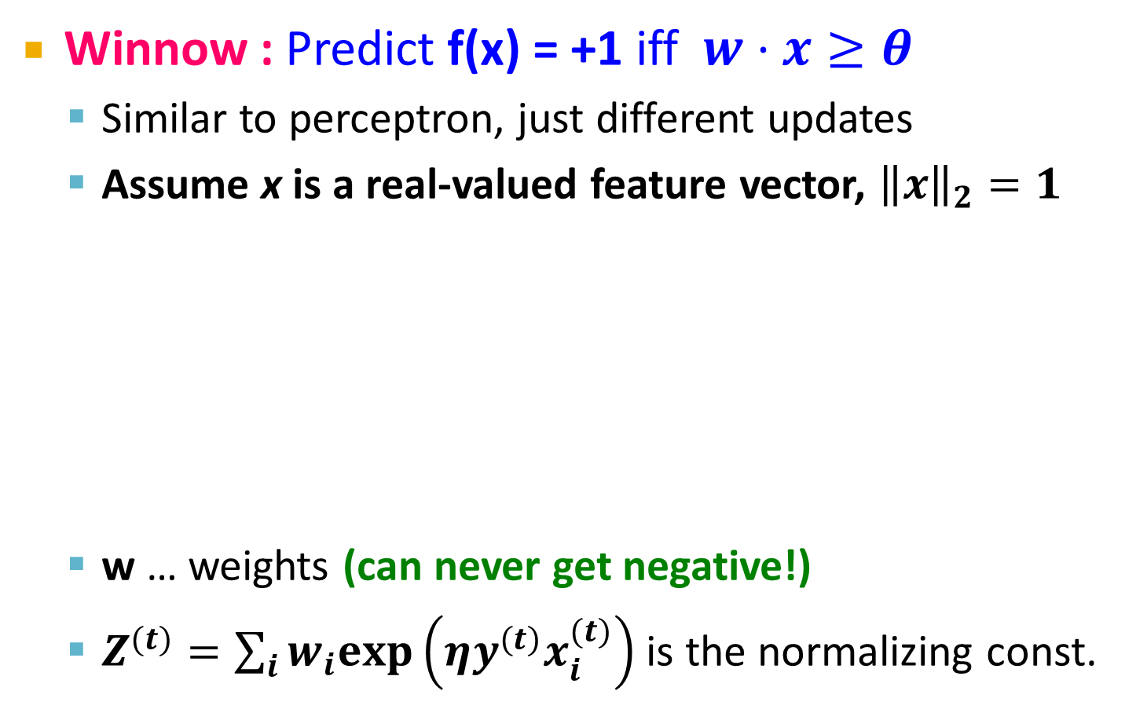
Improvement: Winnow Algorithm
Winnow : Predict f(x) = +1 iff $w⋅x≥θ$
Similar to perceptron, just different updates
Assume x is a real-valued feature vector, ${\left\|x\right\|}_{2}=1$
w … weights (can never get negative!)
$Z^{(t)}=\sum_{i}{w_{i}exp\left(ηy^{(t)}x_{i}^{(t)}\right)}$ is the normalizing const.
Initialize: $θ=\frac{d}{2}, w=\left[\frac{1}{d},…,\frac{1}{d}\right]$
For every training example $x^{(t)}$
Compute $y^{′} = f(x^{(t)})$
If no mistake ($y^{(t)}=y′$): do nothing
If mistake then: $w_{i}←w_{i}\frac{exp\left(ηy^{(t)}x_{i}^{(t)}\right)}{Z^{(t)}}$

Slide 22
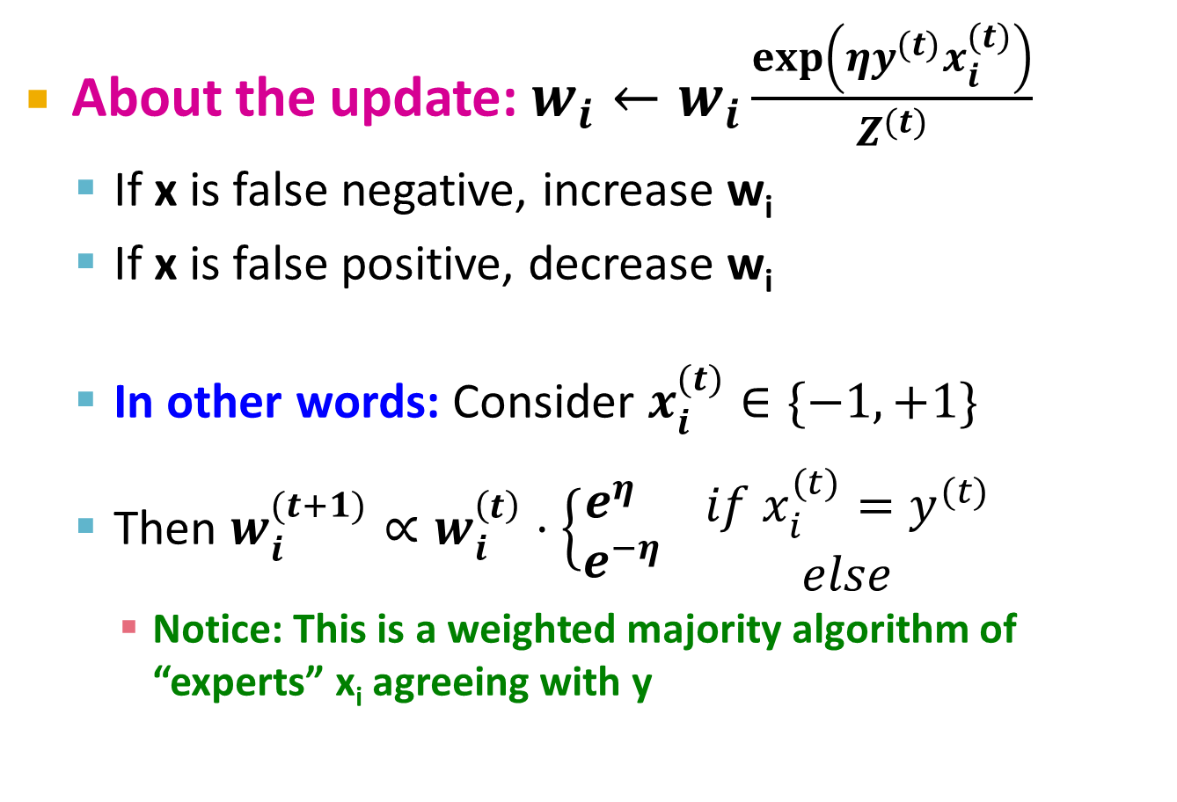
Improvement: Winnow Algorithm
About the update: $w_{i}←w_{i}\frac{exp\left(ηy^{(t)}x_{i}^{(t)}\right)}{Z^{(t)}}$
If x is false negative, increase w_{i}
If x is false positive, decrease w_{i}
In other words: Consider $x_{i}^{(t)}∈\{−1,+1\}$
Then $w_{i}^{(t+1)}∝w_{i}^{\left(t\right)}⋅\left\{\begin{matrix}e^{η} \\ e^{−η}\end{matrix}\right. \begin{matrix}if x_{i}^{(t)}=y^{(t)} \\ else\end{matrix}$
Notice: This is a weighted majority algorithm of “experts” x_{i} agreeing with y
(promote)
(demote)

Slide 23
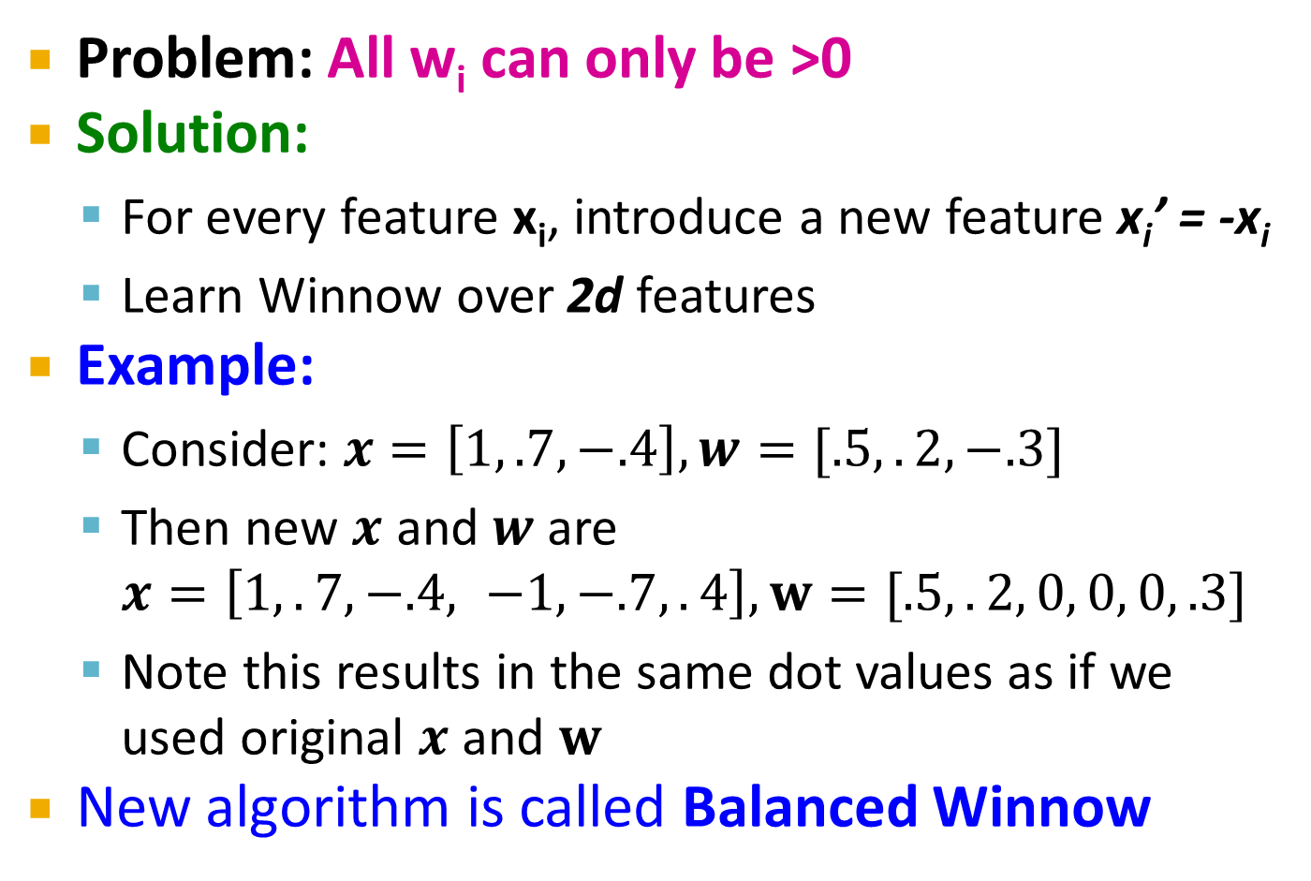
Extensions: Winnow
Problem: All w_{i} can only be >0
Solution:
For every feature x_{i}, introduce a new feature x_{i}’ = -x_{i}
Learn Winnow over 2d features
Example:
Consider: $x=\left[1, .7, −.4\right], w=[.5,.2,−.3]$
Then new $x$ and $w$ are $x=\left[1,.7,−.4, −1, −.7,.4\right], w=[.5,.2, 0, 0, 0, .3]$
Note this results in the same dot values as if we used original $x$ and $w$
New algorithm is called Balanced Winnow

Slide 24
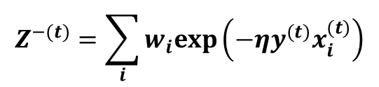
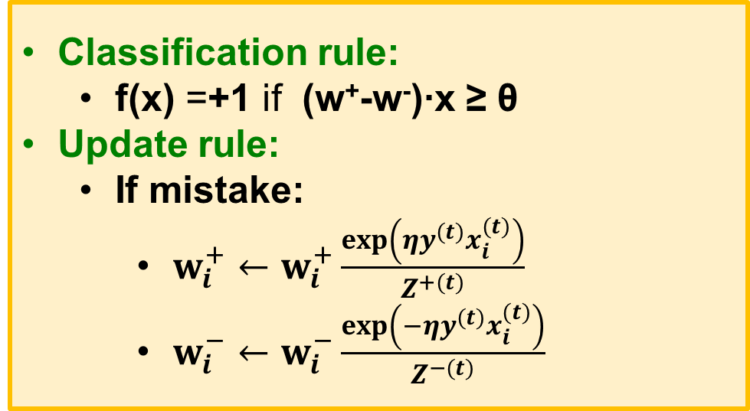
Extensions: Balanced Winnow
In practice we implement Balanced Winnow:
2 weight vectors w⁺, w⁻; effective weight is the difference
Classification rule:
f(x) =+1 if (w⁺-w⁻)∙x ≥ θ
Update rule:
If mistake:
$w_{i}^{+}←w_{i}^{+}\frac{exp\left(ηy^{(t)}x_{i}^{(t)}\right)}{Z^{+(t)}}$
$w_{i}^{−}←w_{i}^{−}\frac{exp\left(−ηy^{(t)}x_{i}^{(t)}\right)}{Z^{−(t)}}$
$$Z^{−(t)}=\sum_{i}{w_{i}exp\left(−ηy^{(t)}x_{i}^{(t)}\right)}$$

Slide 25
Extensions: Thick Separator
Thick Separator (aka Perceptron with Margin) (Applies both to Perceptron and Winnow)
Set margin parameter γ
Update if y=+1 but w ⋅ x < θ + γ
or if y=-1 but w ⋅ x > θ - γ
-
-
-
-
-
-
-
-
-
-
-
-
w ⋅ x = θ+γ
-
-
-
w ⋅ x = θ
w ⋅ x = 0
w
w ⋅ x = θ-γ
Note: γ is a functional margin. Its effect could disappear as w grows.
Nevertheless, this has been shown to be a very effective algorithmic addition.

Slide 26
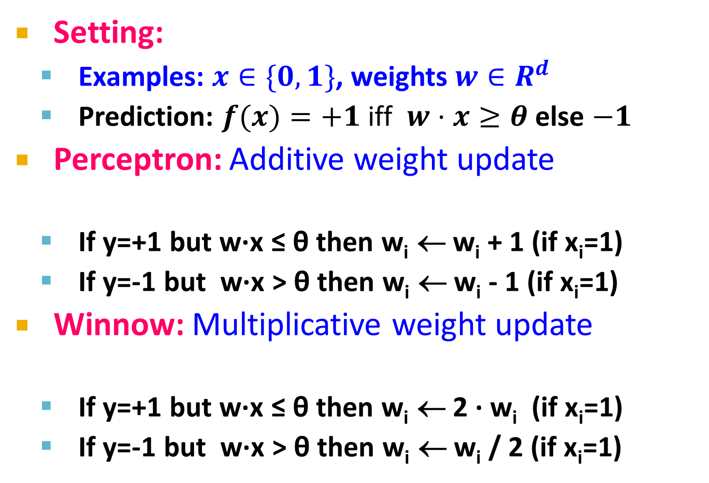
Summary of Algorithms
Setting:
Examples: $x∈\{0,1\}$, weights $w∈R^{d}$
Prediction: $f(x)=+1$ iff $w⋅x≥θ$ else $−1$
Perceptron: Additive weight update
If y=+1 but w∙x ≤ θ then w_{i} ← w_{i} + 1 (if x_{i}=1)
If y=-1 but w∙x > θ then w_{i} ← w_{i} - 1 (if x_{i}=1)
Winnow: Multiplicative weight update
If y=+1 but w∙x ≤ θ then w_{i} ← 2 ∙ w_{i} (if x_{i}=1)
If y=-1 but w∙x > θ then w_{i} ← w_{i} / 2 (if x_{i}=1)
w ← w + η y x
(promote)
(demote)
w ← w exp{η y x}
(promote)
(demote)

Slide 27
Perceptron vs. Winnow
How to compare learning algorithms?
Considerations:
Number of features d is very large
The instance space is sparse
Only few features per training example are non-zero
The model is sparse
Decisions depend on a small subset of features
In the “true” model on a few w_{i} are non-zero
Want to learn from a number of examples that is small relative to the dimensionality d

Slide 28
Perceptron vs. Winnow
Perceptron
Online: Can adjust to changing target, over time
Advantages
Simple
Guaranteed to learn a linearly separable problem
Advantage with few relevant features per training example
Limitations
Only linear separations
Only converges for linearly separable data
Not really “efficient with many features”
Winnow
Online: Can adjust to changing target, over time
Advantages
Simple
Guaranteed to learn a linearly separable problem
Suitable for problems with many irrelevant attributes
Limitations
Only linear separations
Only converges for linearly separable data
Not really “efficient with many features”

Slide 29
Online Learning
New setting: Online Learning
Allows for modeling problems where we have a continuous stream of data
We want an algorithm to learn from it and slowly adapt to the changes in data
Idea: Do slow updates to the model
Both our methods Perceptron and Winnow make updates if they misclassify an example
So: First train the classifier on training data. Then for every example from the stream, if we misclassify, update the model (using small learning rate)

Slide 30
Example: Shipping Service
Protocol:
User comes and tell us origin and destination
We offer to ship the package for some money ($10 - $50)
Based on the price we offer, sometimes the user uses our service (y = 1), sometimes they don't (y = -1)
Task: Build an algorithm to optimize what price we offer to the users
Features x capture:
Information about user
Origin and destination
Problem: Will user accept the price?

Slide 31
Example: Shipping Service
Model whether user will accept our price: y = f(x; w)
Accept: y =1, Not accept: y=-1
Build this model with say Perceptron or Winnow
The website that runs continuously
Online learning algorithm would do something like
User comes
She is represented as an (x,y) pair where
x: Feature vector including price we offer, origin, destination
y: If they chose to use our service or not
The algorithm updates w using just the (x,y) pair
Basically, we update the w parameters every time we get some new data

Slide 32
Example: Shipping Service
We discard this idea of a data “set”
Instead we have a continuous stream of data
Further comments:
For a major website where you have a massive stream of data then this kind of algorithm is pretty reasonable
Don’t need to deal with all the training data
If you had a small number of users you could save their data and then run a normal algorithm on the full dataset
Doing multiple passes over the data

Slide 33
Online Algorithms
An online algorithm can adapt to changing user preferences
For example, over time users may become more price sensitive
The algorithm adapts and learns this
So the system is dynamic

Slide 34
Large-Scale Machine Learning: SVM
Note to other teachers and users of these slides: We would be delighted if you found this our material useful in giving your own lectures. Feel free to use these slides verbatim, or to modify them to fit your own needs. If you make use of a significant portion of these slides in your own lecture, please include this message, or a link to our web site: http://www.mmds.org
Mining of Massive Datasets
Jure Leskovec, Anand Rajaraman, Jeff Ullman Stanford University
http://www.mmds.org

Slide 35
New Topic: Machine Learning!
High dim. data
Locality sensitive hashing
Clustering
Graph data
PageRank, SimRank
Community Detection
Infinite data
Filtering data streams
Web advertising
Dimensionality reduction
Spam Detection
Queries on streams
Machine learning
SVM
Decision Trees
Perceptron, kNN
Apps
Recommender systems
Association Rules
Duplicate document detection

Slide 36
Supervised Learning
Example: Spam filtering
Instance space x ∈ X (|X|= n data points)
Binary or real-valued feature vector x of word occurrences
d features (words + other things, d~100,000)
Class y ∈ Y
y: Spam (+1), Ham (-1)
Goal: Estimate a function f(x) so that y = f(x)

Slide 37
More generally: Supervised Learning
Would like to do prediction:
estimate a function f(x) so that y = f(x)
Where y can be:
Real number: Regression
Categorical: Classification
Complex object:
Ranking of items, Parse tree, etc.
Data is labeled:
Have many pairs {(x, y)}
x … vector of binary, categorical, real valued features
y … class ({+1, -1}, or a real number)

Slide 38

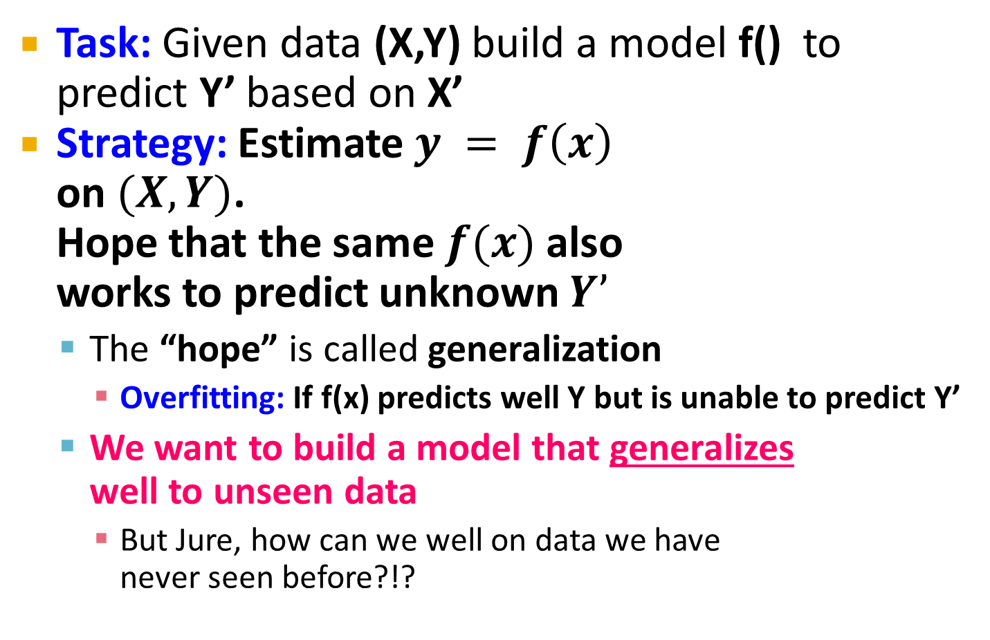
Supervised Learning
Task: Given data (X,Y) build a model f() to predict Y’ based on X’
Strategy: Estimate $y = f\left(x\right)$ on $(X,Y)$. Hope that the same $f(x)$ also works to predict unknown $Y’$
The “hope” is called generalization
Overfitting: If f(x) predicts well Y but is unable to predict Y’
We want to build a model that generalizes well to unseen data
But Jure, how can we well on data we have never seen before?!?
X
Y
Training data
Test data
X’
Y’

Slide 39
Supervised Learning
Idea: Pretend we do not know the data/labels we actually do know
Build the model f(x) on the training data See how well f(x) does on the test data
If it does well, then apply it also to X’
Refinement: Cross validation
Splitting into training/validation set is brutal
Let’s split our data (X,Y) into 10-folds (buckets)
Take out 1-fold for validation, train on remaining 9
Repeat this 10 times, report average performance
Training set
X
Y
Validation set
Test set
X’

Slide 40
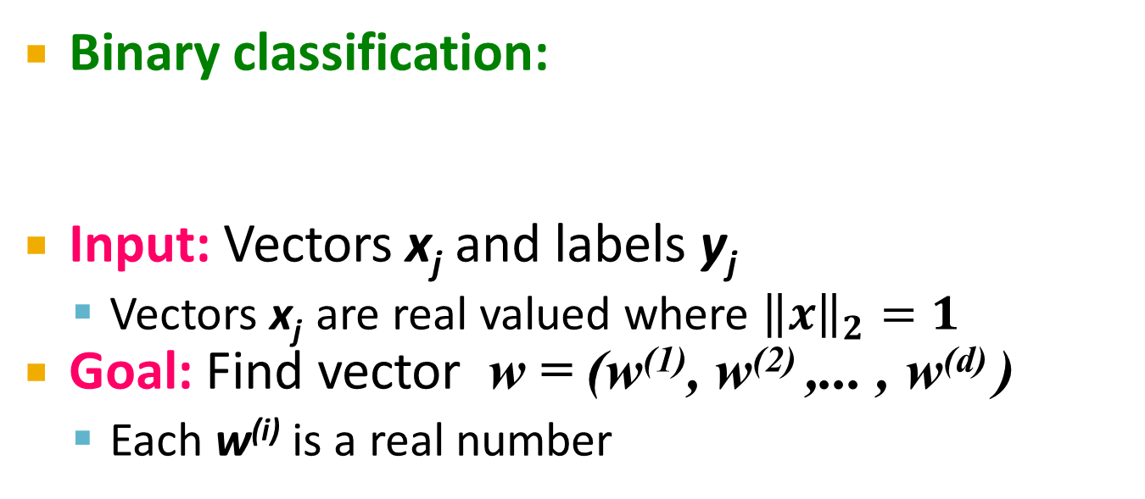
Linear models for classification
Binary classification:
Input: Vectors x_{j} and labels y_{j}
Vectors x_{j} are real valued where ${\left\|x\right\|}_{2}=1$
Goal: Find vector w = (w⁽¹⁾, w⁽²⁾ ,... , w^{(d)} )
Each w^{(i)} is a real number
{
f (x) =
+1 if w⁽¹⁾ x⁽¹⁾ + w⁽²⁾ x⁽²⁾ +. . .w^{(d)} x^{(d)} ≥ θ
-1 otherwise
Decision boundary is linear
w ⋅ x = θ
-
-
-
-
-
-
-
Note:
w ⋅ x = 0
-
-
-
-
-
w
-
-
-

Slide 41
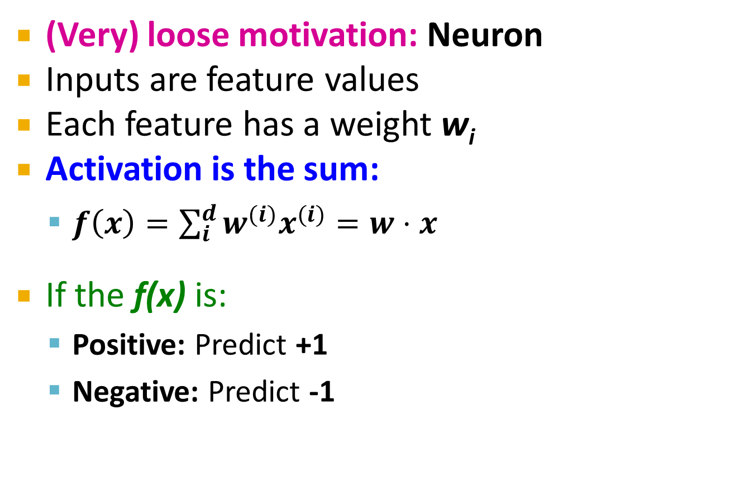
Perceptron [Rosenblatt ‘58]
(Very) loose motivation: Neuron
Inputs are feature values
Each feature has a weight w_{i}
Activation is the sum:
$f\left(x\right)=\sum_{i}^{d}{w^{(i)}x^{(i)}=w⋅x}$
If the f(x) is:
Positive: Predict +1
Negative: Predict -1
w⁽¹⁾
w⁽²⁾
w⁽³⁾
w⁽⁴⁾
x⁽¹⁾
x⁽²⁾
x⁽³⁾
x⁽⁴⁾
∑
≥ 0?
w⋅x=0
nigeria
x₁
x₂
Spam=1
w
Ham=-1
viagra

Slide 42
Perceptron
Note that the Perceptron is a conservative algorithm: it ignores samples that it classifies correctly.
Perceptron: y’ = sign(w⋅ x)
How to find parameters w?
Start with w₀ = 0
Pick training examples x_{t} one by one
Predict class of x_{t} using current w_{t}
y’ = sign(w_{t}⋅ x_{t})
If y’ is correct (i.e., y_{t} = y’)
No change: w_{t+1} = w_{t}
If y’ is wrong: Adjust w_{t}
w_{t+1} = w_{t} + η ⋅ y_{t} ⋅ x_{t}
η is the learning rate parameter
x_{t} is the t-th training example
y_{t} is true t-th class label ({+1, -1})
η⋅y_{t}⋅x_{t}
w_{t}
w_{t+1}
x_{t}, y_{t}=1

Slide 43
Perceptron: The Good and the Bad
Good: Perceptron convergence theorem:
If there exist a set of weights that are consistent (i.e., the data is linearly separable) the Perceptron learning algorithm will converge
Bad: Never converges: If the data is not separable weights dance around indefinitely
Bad: Mediocre generalization:
Finds a “barely” separating solution

Slide 44
Updating the Learning Rate
Perceptron will oscillate and won’t converge
So, when to stop learning?
(1) Slowly decrease the learning rate η
A classic way is to: η = c₁/(t + c₂)
But, we also need to determine constants c₁ and c₂
(2) Stop when the training error stops chaining
(3) Have a small test dataset and stop when the test set error stops decreasing
(4) Stop when we reached some maximum number of passes over the data

Slide 45
Support Vector Machines

Slide 46

Support Vector Machines
Want to separate “+” from “-” using a line
Data:
Training examples:
(x₁, y₁) … (x_{n}, y_{n})
Each example i:
x_{i} = ( x_{i}⁽¹⁾,… , x_{i}^{(d)} )
x_{i}^{(j)} is real valued
y_{i} ∈ { -1, +1 }
Inner product:
$w⋅x=\sum_{j=1}^{d}{w^{(j)}⋅x^{(j)}}$
+
+
+
-
+
+
-
+
-
-
-
-
-
Which is best linear separator (defined by w)?

Slide 47
Largest Margin
Distance from the separating hyperplane corresponds to the “confidence” of prediction
Example:
We are more sure about the class of A and B than of C
A
C
+
+
+
+
-
+
B
-
+
+
-
+
-
-
+
-
-
-
-

Slide 48
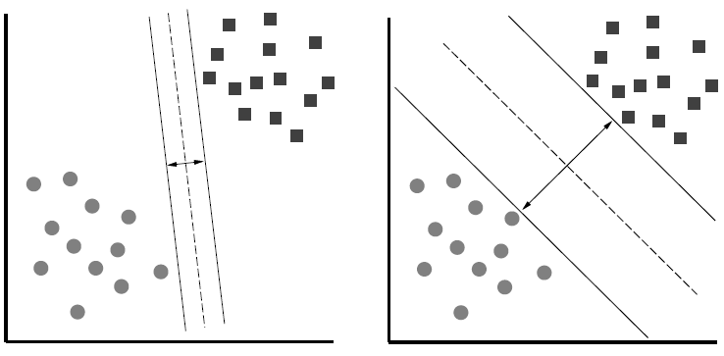
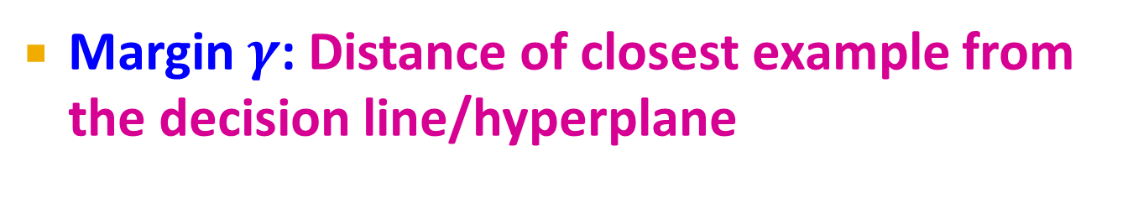
Largest Margin
Margin $γ$: Distance of closest example from the decision line/hyperplane
The reason we define margin this way is due to theoretical convenience and existence of generalization error bounds that depend on the value of margin.
Notes:
Why define margin as distance to the closest example, why not avg. or something else?
Purely theoretical

Slide 49
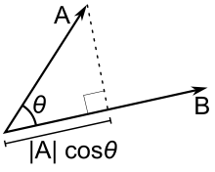



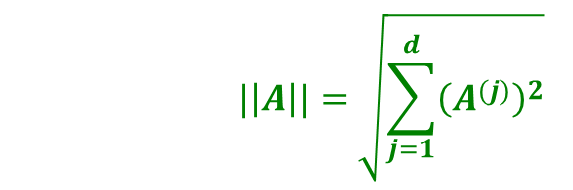
Why maximizing $γ$ a good idea?
Remember: Dot product $A⋅B=\left\|A\right\|⋅\left\|B\right\|⋅\cos{θ}$
$$\left\|A\right\|cosθ$$
$$|\left|A\right||=\sqrt{\sum_{j=1}^{d}{{\left(A^{(j)}\right)}^{2}}}$$

Slide 50

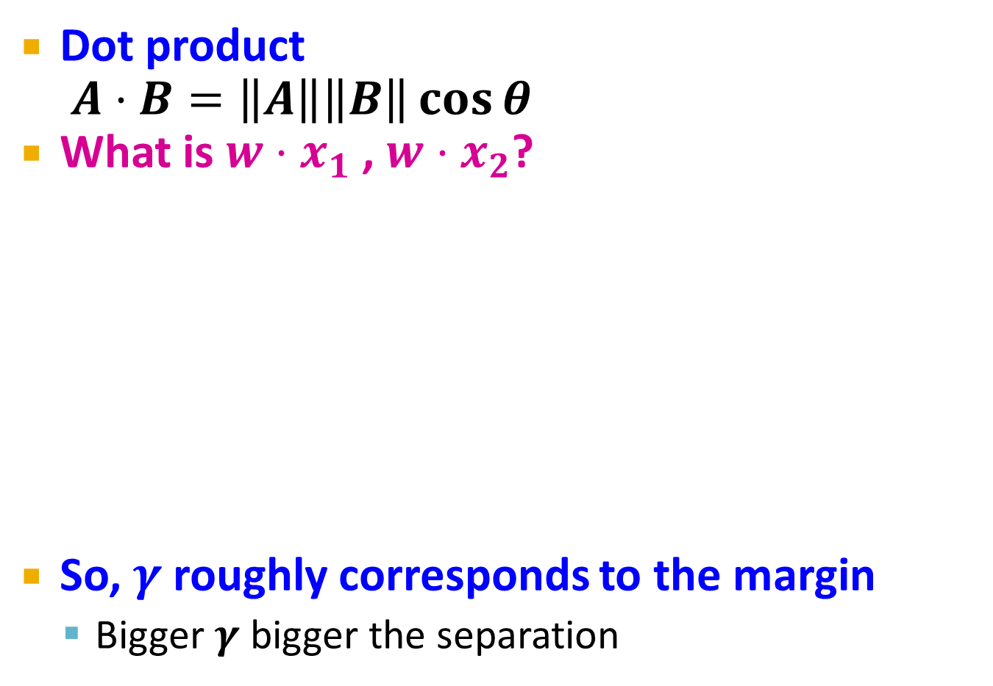


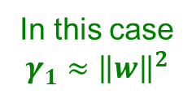

Why maximizing $γ$ a good idea?
Dot product $A⋅B=\left\|A\right\|\left\|B\right\|\cos{θ}$
What is $w⋅x_{1}$ , $w⋅x_{2}$?
So, $γ$ roughly corresponds to the margin
Bigger $γ$ bigger the separation
$$w$$
x₂
+
+
w ⋅ x + b = 0
x₁
x₂
x₂
+
+
+
+
x₁
x₁
$$w$$
$$w$$
In this case $$γ_{1}≈{\left\|w\right\|}^{2}$$
In this case
$$γ_{2}≈{2\left\|w\right\|}^{2}$$

Slide 51
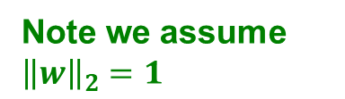
What is the margin?
Distance from a point to a line
L
Note we assume ${\left\|w\right\|}_{2}=1$
Let:
Line L: w∙x+b = w⁽¹⁾x⁽¹⁾+w⁽²⁾x⁽²⁾+b=0
w = (w⁽¹⁾, w⁽²⁾)
Point A = (x_{A}⁽¹⁾, x_{A}⁽²⁾)
Point M on a line = (x_{M}⁽¹⁾, x_{M}⁽²⁾)
w
A (x_{A}⁽¹⁾, x_{A}⁽²⁾)
w ∙ x + b = 0
+
d(A, L)
H
d(A, L) = |AH|
= |(A-M) ∙ w|
= |(x_{A}⁽¹⁾ – x_{M}⁽¹⁾) w⁽¹⁾ + (x_{A}⁽²⁾ – x_{M}⁽²⁾) w⁽²⁾|
= x_{A}⁽¹⁾ w⁽¹⁾ + x_{A}⁽²⁾ w⁽²⁾ + b
= w ∙ A + b
(0,0)
M (x₁, x₂)
Remember x_{M}⁽¹⁾w⁽¹⁾ + x_{M}⁽²⁾w⁽²⁾ = - b
since M belongs to line L

Slide 52
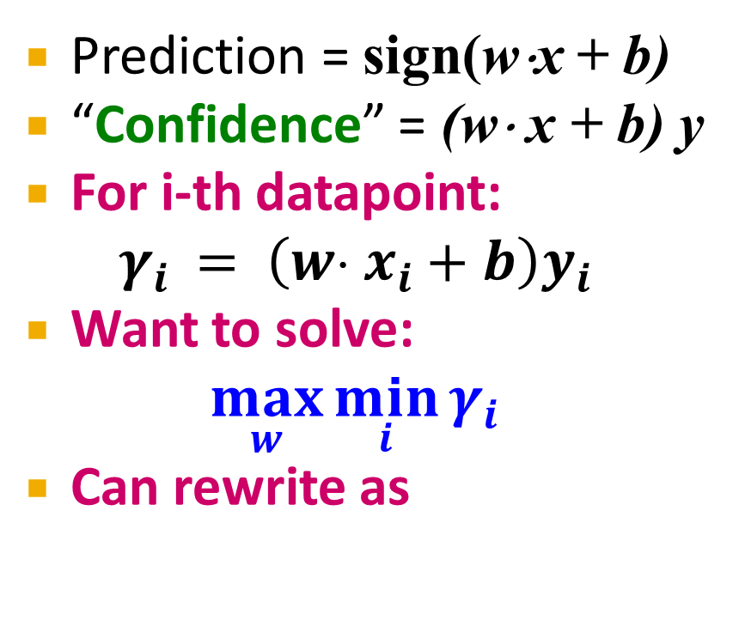

Largest Margin
Prediction = sign(w⋅x + b)
“Confidence” = (w⋅ x + b) y
For i-th datapoint: $γ_{i} = \left(w⋅ x_{i}+b\right)y_{i}$
Want to solve:
$$\max_{w}{\min_{i}{γ_{i}}}$$
Can rewrite as
$$w$$
+
+
+
+
w ⋅ x + b = 0
-
+
-
+
+
-
-
-
-
-

Slide 53

Support Vector Machine
Maximize the margin:
Good according to intuition, theory (VC dimension) & practice
$γ$ is margin … distance from the separating hyperplane
+
+
w⋅x+b=0
+
+
+
-
+
γ
+
γ
-
-
-
+
γ
-
-
-
Maximizing the margin

Slide 54
Support Vector Machines: Deriving the margin

Slide 55
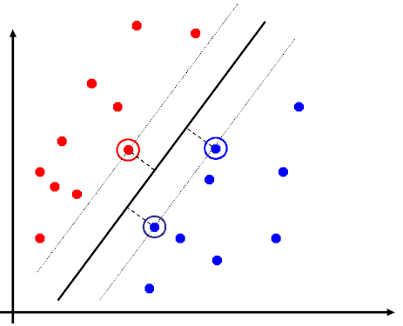
Support Vector Machines
Separating hyperplane is defined by the support vectors
Points on +/- planes from the solution
If you knew these points, you could ignore the rest
Generally, d+1 support vectors (for d dim. data)

Slide 56
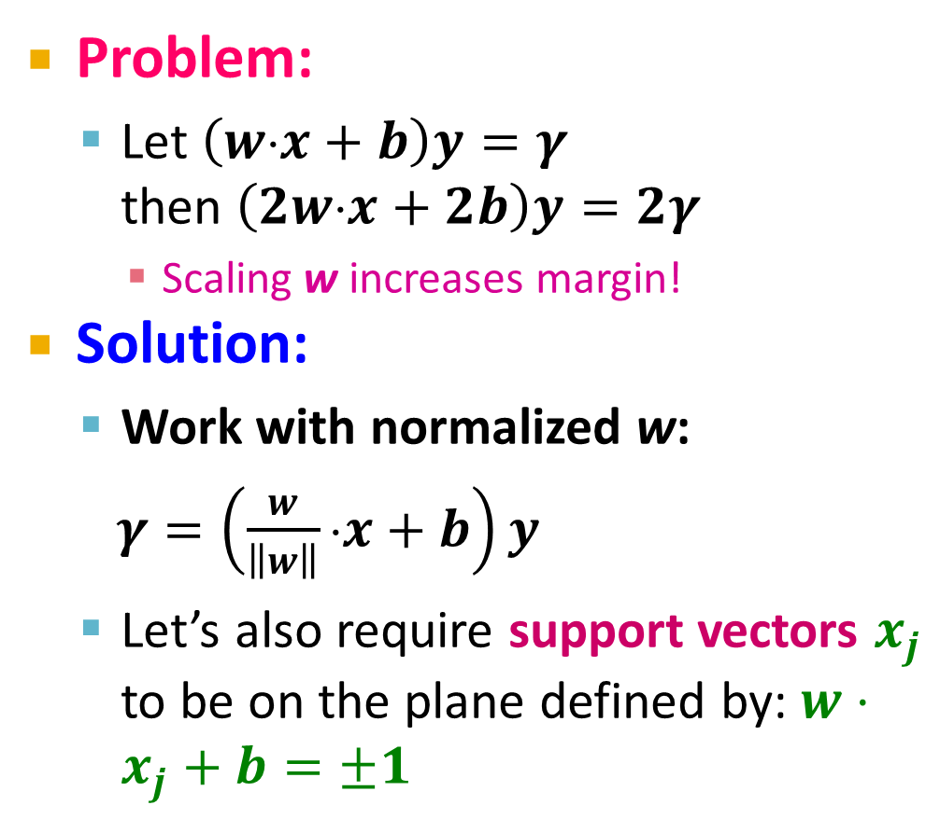
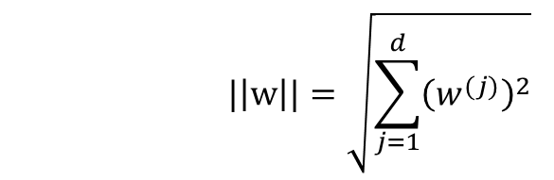
Canonical Hyperplane: Problem
Problem:
Let $\left(w⋅x+b\right)y=γ$ then $\left(2w⋅x+2b\right)y=2γ$
Scaling w increases margin!
Solution:
Work with normalized w:
$γ=\left(\frac{w}{\left\|w\right\|}⋅x+b\right)y$
Let’s also require support vectors $x_{j}$ to be on the plane defined by: $w⋅x_{j}+b=±1$
w⋅x+b=-1
w⋅x+b=0
w⋅x+b=+1
$$|\left|w\right||=\sqrt{\sum_{j=1}^{d}{{\left(w^{(j)}\right)}^{2}}}$$

Slide 57

Canonical Hyperplane: Solution
Want to maximize margin $γ$!
What is the relation between x₁ and x₂?
$x_{1}=x_{2}+2γ\frac{w}{||w||}$
We also know:
$w⋅x_{1}+b=+1$
$w⋅x_{2}+b=−1$
So:
$w⋅x_{1}+b=+1$
$w\left(x_{2}+2γ\frac{w}{||w||}\right)+b=+1$
$w⋅x_{2}+b+2γ\frac{w⋅w}{\left|\left|w\right|\right|}=+1$
w⋅x+b=-1
w⋅x+b=0
w⋅x+b=+1
2γ
Note:
-1

Slide 58
Maximizing the Margin
We started with
But w can be arbitrarily large!
We normalized and...
Then:
w⋅x+b=-1
w⋅x+b=0
w⋅x+b=+1
2γ
This is called SVM with “hard” constraints

Slide 59
Non-linearly Separable Data
If data is not separable introduce penalty:
Minimize ǁwǁ² plus the number of training mistakes
Set C using cross validation
How to penalize mistakes?
All mistakes are not equally bad!
+
+
w⋅x+b=0
+
-
+
+
-
+
-
-
+
-
+
-
-
-
-

Slide 60
Support Vector Machines
Introduce slack variables ξ_{i}
If point x_{i} is on the wrong side of the margin then get penalty ξ_{i}
+
w⋅x+b=0
+
+
-
+
ξ_{i}
+
+
ξ_{j}
-
-
+
+
-
-
-
For each data point:
If margin ≥ 1, don’t care
If margin < 1, pay linear penalty
Notes:
ksi

Slide 61

Slack Penalty $C$
What is the role of slack penalty C:
C=∞: Only want to w, b that separate the data
C=0: Can set ξ_{i} to anything, then w=0 (basically ignores the data)
small C
+
“good” C
+
+
+
+
big C
+
-
-
+
+
-
-
-
-
(0,0)

Slide 62
Support Vector Machines
SVM in the “natural” form
SVM uses “Hinge Loss”:
Margin
Empirical loss L (how well we fit training data)
Regularization parameter
penalty
0/1 loss
Hinge loss: max{0, 1-z}
-1 0 1 2

Slide 63
Support Vector Machines: How to compute the margin?

Slide 64
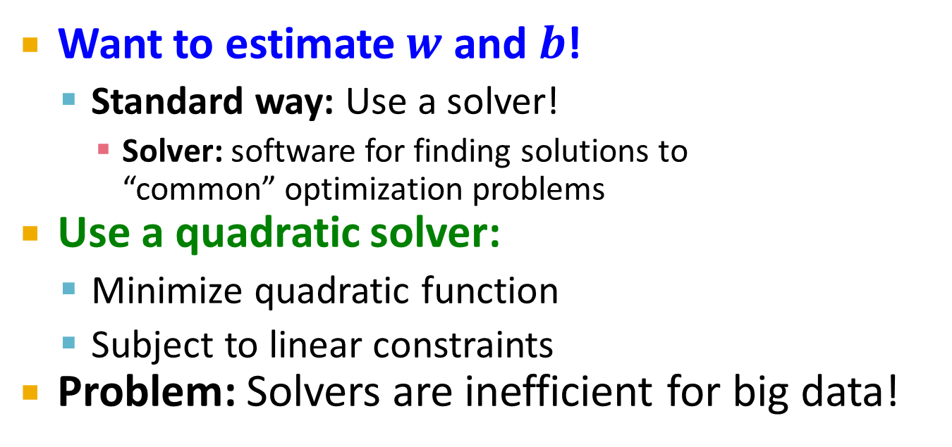
SVM: How to estimate w?
Want to estimate $w$ and $b$!
Standard way: Use a solver!
Solver: software for finding solutions to “common” optimization problems
Use a quadratic solver:
Minimize quadratic function
Subject to linear constraints
Problem: Solvers are inefficient for big data!

Slide 65
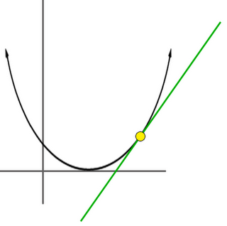

SVM: How to estimate w?
Want to estimate w, b!
Alternative approach:
Want to minimize f(w,b):
Side note:
How to minimize convex functions $g(z)$?
Use gradient descent: min_{z} g(z)
Iterate: z_{t+1} ← z_{t} – η ∇g(z_{t})
g(z)
z

Slide 66

SVM: How to estimate w?
Want to minimize f(w,b):
Compute the gradient ∇(j) w.r.t. w^{(j)}
Empirical loss $L(x_{i} y_{i})$

Slide 67
SVM: How to estimate w?
Gradient descent:
Problem:
Computing ∇f^{(j)} takes O(n) time!
n … size of the training dataset
Iterate until convergence:
For j = 1 … d
Evaluate:
Update: w^{(j)} ← w^{(j)} - η∇f^{(j)}
η…learning rate parameter C… regularization parameter

Slide 68
SVM: How to estimate w?
We just had:
Stochastic Gradient Descent
Instead of evaluating gradient over all examples evaluate it for each individual training example
Stochastic gradient descent:
Notice: no summation over i anymore
Iterate until convergence:
For i = 1 … n
For j = 1 … d
Compute: ∇f^{(j)}(x_{i})
Update: w^{(j)} ← w^{(j)} - η ∇f^{(j)}(x_{i})

Slide 69
Support Vector Machines: Example

Slide 70
Example: Text categorization
Example by Leon Bottou:
Reuters RCV1 document corpus
Predict a category of a document
One vs. the rest classification
n = 781,000 training examples (documents)
23,000 test examples
d = 50,000 features
One feature per word
Remove stop-words
Remove low frequency words

Slide 71
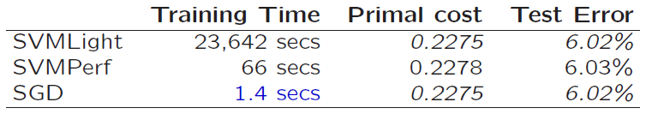
Example: Text categorization
Questions:
(1) Is SGD successful at minimizing f(w,b)?
(2) How quickly does SGD find the min of f(w,b)?
(3) What is the error on a test set?
Training time Value of f(w,b) Test error
Standard SVM “Fast SVM”
SGD SVM
(1) SGD-SVM is successful at minimizing the value of f(w,b)
(2) SGD-SVM is super fast
(3) SGD-SVM test set error is comparable

Slide 72
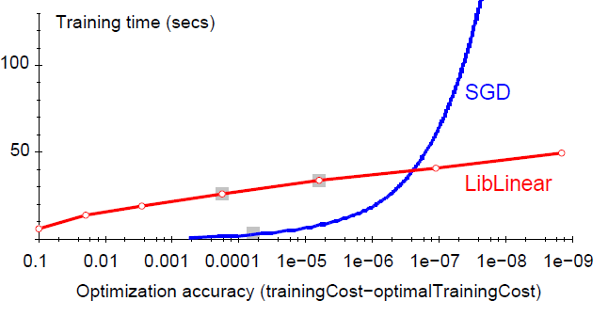
Optimization “Accuracy”
SGD SVM
Conventional SVM
Optimization quality: | f(w,b) – f (w^{opt},b^{opt}) |
For optimizing f(w,b) within reasonable quality SGD-SVM is super fast

Slide 73
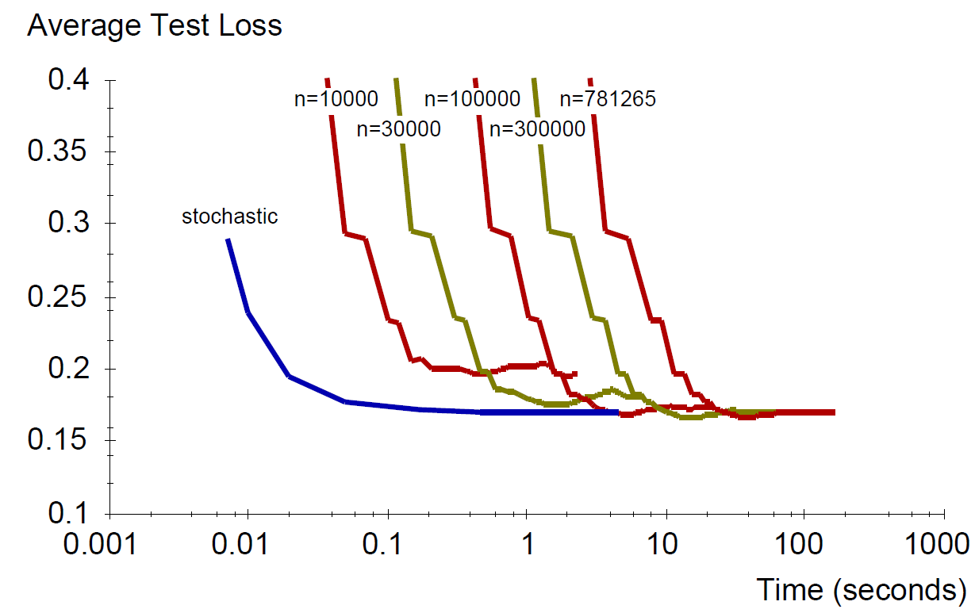
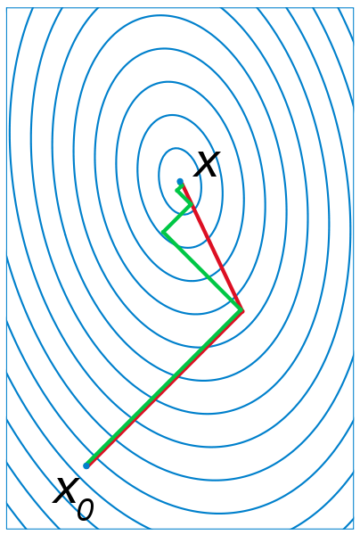
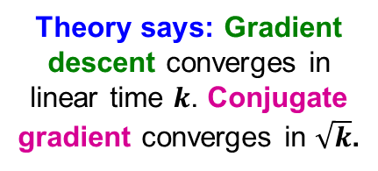

SGD vs. Batch Conjugate Gradient
SGD on full dataset vs. Conjugate Gradient on a sample of n training examples
Theory says: Gradient descent converges in linear time $k$. Conjugate gradient converges in $\sqrt{k}$.
Bottom line: Doing a simple (but fast) SGD update many times is better than doing a complicated (but slow) CG update a few times
$k$… condition number

Slide 74
Practical Considerations
Need to choose learning rate η and t₀
Leon suggests:
Choose t₀ so that the expected initial updates are comparable with the expected size of the weights
Choose η:
Select a small subsample
Try various rates η (e.g., 10, 1, 0.1, 0.01, …)
Pick the one that most reduces the cost
Use η for next 100k iterations on the full dataset

Slide 75
Practical Considerations
Sparse Linear SVM:
Feature vector x_{i} is sparse (contains many zeros)
Do not do: x_{i} = [0,0,0,1,0,0,0,0,5,0,0,0,0,0,0,…]
But represent x_{i} as a sparse vector x_{i}=[(4,1), (9,5), …]
Can we do the SGD update more efficiently?
Approximated in 2 steps:
cheap: x_{i} is sparse and so few coordinates j of w will be updated
expensive: w is not sparse, all coordinates need to be updated
Notes:
The two-step update is not equivalent!
Why does it work?
Since eta is close to 0 you can do this. You get one more eta^2 term that is low order

Slide 76

Practical Considerations
Solution 1: $w=s⋅v$
Represent vector w as the product of scalar s and vector v
Then the update procedure is:
(1) $v = v −ηC\frac{∂L\left(x_{i},y_{i}\right)}{∂w}$
(2) $s=s(1−η)$
Solution 2:
Perform only step (1) for each training example
Perform step (2) with lower frequency and higher η
Two step update procedure:
(1)
(2)

Slide 77
Practical Considerations
Stopping criteria:
How many iterations of SGD?
Early stopping with cross validation
Create a validation set
Monitor cost function on the validation set
Stop when loss stops decreasing
Early stopping
Extract two disjoint subsamples A and B of training data
Train on A, stop by validating on B
Number of epochs is an estimate of k
Train for k epochs on the full dataset

Slide 78

What about multiple classes?
Idea 1: One against all Learn 3 classifiers
+ vs. {o, -}
- vs. {o, +}
o vs. {+, -}
Obtain:
w₊ b₊, w₋ b₋, w_{o} b_{o}
How to classify?
Return class c arg max_{c} w_{c} x + b_{c}

Slide 79
Learn 1 classifier: Multiclass SVM
Idea 2: Learn 3 sets of weights simoultaneously!
For each class c estimate w_{c}, b_{c}
Want the correct class to have highest margin:
w_{yi} x_{i} + b_{yi} ≥ 1 + w_{c} x_{i} + b_{c} ∀c ≠ y_{i} , ∀i
(x_{i}, y_{i})

Slide 80
Multiclass SVM
Optimization problem:
To obtain parameters w_{c} , b_{c} (for each class c) we can use similar techniques as for 2 class SVM
SVM is widely perceived a very powerful learning algorithm

