Slide 1
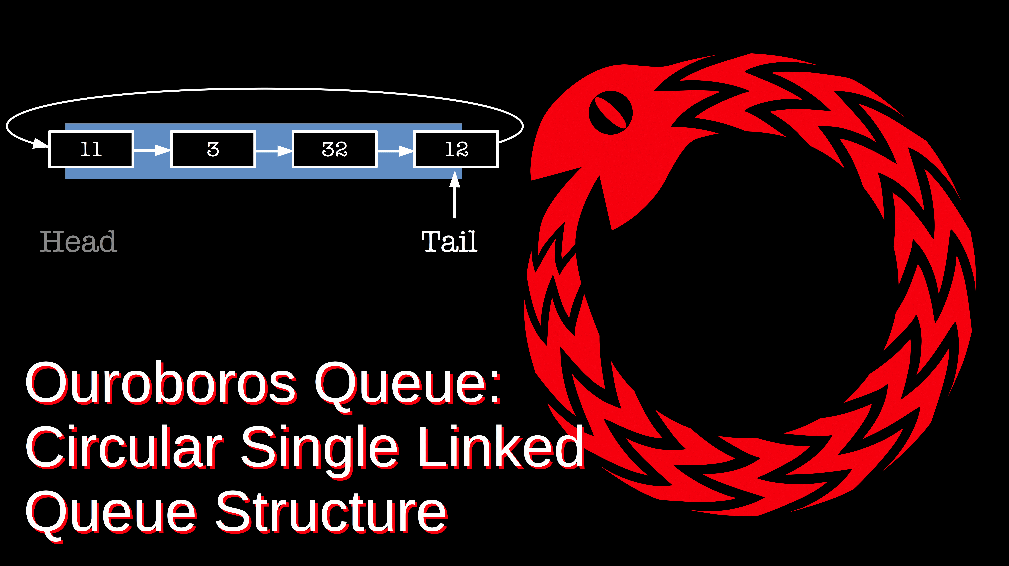

Slide 2
Queue is like a line at club, those first in the line get into the club first and the last ones in the line get in last.
Linked list structures are hard for many students to master.
This is a simple structure that uses a circular linked list:
a
Where the tail of the list points to the head (Ouroboros Serpent)
Diagram to left shows the queue has a line g, f, e, d, c, b, a where a is head of line and g is rear.
g
b
rear
f
c
e
d

Slide 3
a Node
# a Node class in python
class Node(object):
def __init__(self):
self.data = None
self.link = None
data link
a Queue
# a Queue class in python
class Queue(object):
def __init__(self):
self.rear = None
rear
You can also easily use structs in C/C++ or other means, python is give as example

Slide 4
q.enqueue(data): add data to rear of a Queue object q:
Case for empty Queue ( rear is None):
(b)
def enqueue(self,data)
if self.rear is None:
n = Node() # new node
n.data = data
n.link = n # self link
self.rear = n
q = Queue()
# (a)
q.enqueue(1)
# (b)
(a)
rear
rear
1

Slide 5
q.enqueue(data): add data to rear of a Queue object q:
Case for non-empty Queue:
def enqueue(self,data):
...
if self.rear is not None:
n = Node() # new node
n.data = data
n.link = self.rear.link
self.rear.link = n
self.rear = n
q = Queue()
q.enqueue(1)
q.enqueue(2)
# (a)
q.enqueue(3)
# (b)
(a)
rear
1
2
(b)
rear
1
2
3

Slide 6
q.dequeue(): remove and return head of Queue q
Case for empty Queue:
rear
def dequeue(self) # returns None or data
if self.rear is None:
return None
else: # one or more
n = self.rear.link
if n == self.rear:
self.rear = None
else:
self.rear.link = n.link
return n.data
General Case:
rear
1
2
3
rear
rear
after:
Single Node Case:
1
1
2
3

