Slide 1
LECTURE 2
Review last lecture
Address, location & memory operation
Instruction & sequence of instruction
Examples of instruction execution
Notes:
Supeno Djanali - Teknik Informatika-FTIf

Slide 2
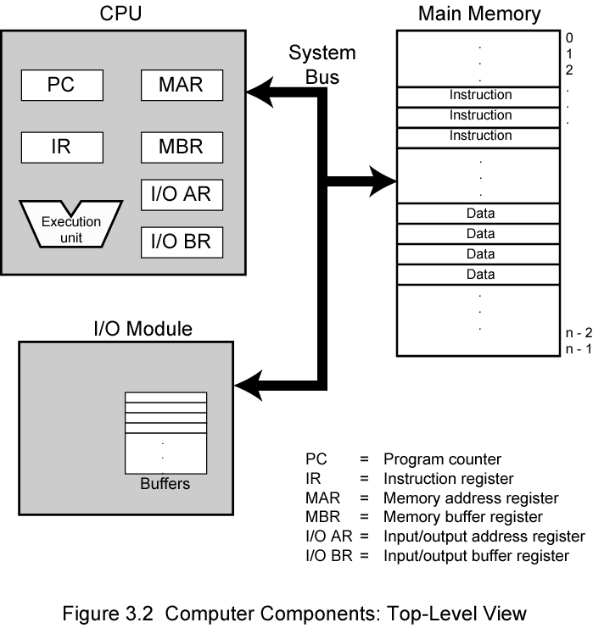
COMPUTER COMPONENTS

Slide 3
CPU ELEMENT
CPU
Memory
PC
MAR
IR
R0
MDR
:
Rn
MDR (Memory Data Register): sometimes is denoted MBR
R0, R1, … Rn : Registers

Slide 4
CPU ELEMENT
PC (Program Counter): contains address of instruction that will be executed (next instruction)
IR (Instruction Register): contains instruction that is being executed
MAR (Memory Address Register): contains address of memory that will be accessed
MBR/MDR (Memory Buffer/Data Register) contains data that has been READ from memory, or that will be WRITTEN to memory
R0, R1, …. , Rn: general registers that would be used in CPU

Slide 5

INSTRUCTION CYCLES
Two cycles :
  Fetch cycle
  Execute cycle

Slide 6
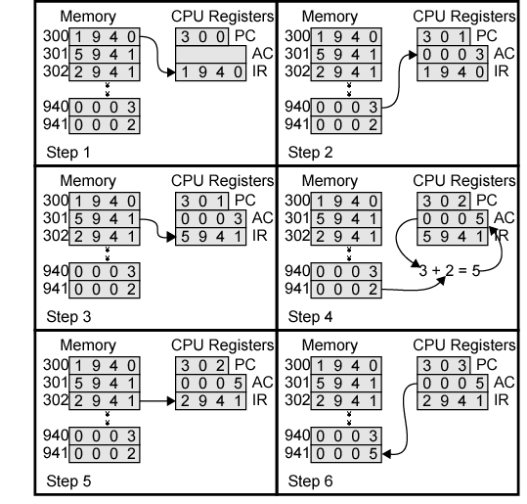
Examples of Program Execution

Slide 7
INSTRUCTION EXECUTION PROCESS
Fetch cycle:
  MAR ← [PC]
  Increment PC
  READ
  IR ← [MDR]
[put the content of PC to MAR]
} could be written in 1 line
destination
source
Execution cycle: (Example: Load R3,A)
  MAR ← [IR]_{ADDR} {Address part of IR}
  READ
  R3 ← [MDR]
sorce
destination
Other example: Store R3,A
  MAR ← [IR]_{ADDR} {Address part of IR}
  MDR ← [R3]
  WRITE

Slide 8
Memory location & address
n bit
word 0
word 1
word i
Last word

Slide 9
b31 | b30 |  |  | …. |  |  |  | b1 | b0
B31=0 for positif, 1 for negatif number
8 bit | 8 bit | 8 bit | 8 bit
ASCII code
ASCII code
ASCII code
ASCII code
OPCODE | dst | src
?
OPCODE | src | dst
?
src: source
dst: destination
10000100111000110000110110101000 ?

Slide 10
Word
address
Word
address
Byte address
Byte address
0
0 | 1 | 2 | 3
4 | 5 | 6 | 7
0
3 | 2 | 1 | 0
7 | 6 | 5 | 4
4
4
2^{k} -4
2^{k} -4
2^{k} -3
2^{k} -2
2^{k} -1
2^{k} -4
2^{k} -1
2^{k} -2
2^{k} -3
2^{k} -4
Big-endian
Little-endian

Slide 11
RISC & CISC
Two key characteristics of Reduced Instruction Set Computer (RISC) instruction sets are:
Each instruction ﬁts in a single word.
A load/store architecture is used, in which
  Memory operands are accessed only using Load and Store instructions.
  All operands involved in an arithmetic or logic operation must either be in processor registers, or one of the operands may be given explicitly within the instruction word.

Slide 12
RISC & CISC
Load instructions are of the form:
Load destination, source
or more speciﬁcally
Load processor_register, memory_location
The Store instruction is of the form
Store source, destination
Add is a three-operand, or a three-address, instruction of the form:
Add destination, source1, source2

Slide 13
RISC & CISC
An alternative to the RISC approach is to make use of more complex instructions which may span more than one word of memory, and which may specify more complicated operations.
Although the use of complex instructions was not originally identiﬁed by any particular label, computers based on this idea have been subsequently called Complex Instruction Set Computers (CISC).

Slide 14
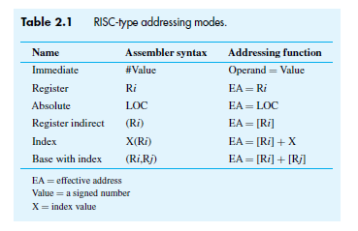

Slide 15
CISC-type addressing modes
Name | Assembler syntax | Addressing function
Immediate | #Value | Operand = Value
Register | Ri | EA = Ri
Absolute (Direct) | LOC | EA = LOC
Indirect | (Ri) | EA = [Ri]
 | (LOC) | EA = [LOC]
Index | X(Ri) | EA = [Ri] + X
Base with index | (Ri,Rj) | EA = [Ri] + [Rj]
Base with index and offset | X(Ri,Rj) | EA = [Ri] + [Rj] + X
Relative | X(PC) | EA = [PC] + X
Autoincrement | (Ri)+ | EA = [Ri] ; increment Ri
Autodecrement | -(Ri) | Decrement Ri ; EA = [Ri]
EA = Effective Address

Slide 16
INSTRUCTION
Data transfer between memory and register
Arithmetic & logic operation
Sequence of program and control
Input/output transfer

Slide 17
CPU Organization
Single Accumulator
  Result usually goes to the Accumulator
  Accumulator has to be saved to memory quite often
General Register
  Registers hold operands thus reduce memory traffic
  Register bookkeeping
Stack
  Operands and result are always in the stack

Slide 18
STACK
100
SP
112
100
SP
108
104
104
NEWITEM
DATA4
108
108
DATA4
112
DATA3
112
DATA3
Stack
116
DATA2
Stack
116
DATA2
120
DATA1
120
DATA1
124
124
128
128
Stack before PUSH
Stack after PUSH
SP TOS
SP : Stack Pointer
TOS : Top Of Stack

Slide 19
Instruction Formats
Three-Address Instructions
  ADD R1, R2, R3 R1 ← [R2] + [R3]
Two-Address Instructions
  ADD R1, R2 R1 ← [R1] + [R2]
One-Address Instructions
  ADD M AC ← [AC] + M[AR]
Zero-Address Instructions
  ADD TOS ← [TOS] + [(TOS – 1)]
RISC Instructions
  Lots of registers. Memory is restricted to Load & Store

Slide 20
Register transfer
content
Load R1,LOC ➔ R1 ← [LOC]
Add R3,R1,R2 ➔ R3 ← [R1] + [R2]
How about instruction for C = A + B
  Add C,A,B : C ← [A] + [B] ← 3 address instruction
  Add A,B
  Store A,C
  ← 2 address instruction
  3. Load A : ACC
  Add B : ACC
  Store C
←
[A]
1 address instruction
←
[ACC] +
[B]
←

Slide 21
Register transfer
Zero-Address
  Push A ; TOS [A]
  Push B ; TOS [B]
  Add ; TOS [A] + [B]
  Pop C ; M[C] [TOS]
←
←
←
←
TOS : Top Of Stack
RISC style
Load R1,A ; R1 [A]
Load R2,B ; R2 [B]
Add R3, R1,R2 ; R3 [R1] + [R2]
Store R3,C ; M[C] [R3]
←
←
←
←
Notes:
Supeno Djanali - Teknik Informatika-FTIf

Slide 22
PROGRAM FOR C=[A]+[B]
Address
Load R1,A
Load R2,B
Add R3,R1,R2
Store R3,C
…
…
…
i
i+4
Program segment
i+8
i+12
B
Data for
program
A
C

Slide 23
Example: Evaluate X = (A+B) ∗ (C+D)
Three-Address
  ADD R1, A, B ; R1 ← M[A] + M[B]
  ADD R2, C, D ; R2 ← M[C] + M[D]
  MUL X, R1, R2 ; M[X] ← [R1] ∗ [R2]
Two-Address
  MOV R1, A ; R1 ← M[A]
  ADD R1, B ; R1 ← [R1] + M[B]
  MOV R2, C ; R2 ← M[C]
  ADD R2, D ; R2 ← [R2] + M[D]
  MUL R1, R2 ; R1 ← [R1] ∗ [R2]
  MOV X, R1 ; M[X] ← [R1]

Slide 24
Example: Evaluate X = (A+B) ∗ (C+D)
One-Address
  Load A ; AC ← M[A]
  Add B ; AC ← [AC] + M[B]
  Store T ; M[T] ← [AC]
  Load C ; AC ← M[C]
  Add D ; AC ← [AC] + M[D]
  Mul T ; AC ← [AC] ∗ M[T]
  Store X ; M[X] ← [AC]
Zero-Address
  Push A ; TOS ← M[A]
  Push B ; TOS ← M[B]
  Add ; TOS ← (M[A] + M[B])
  Push C ; TOS ← M[C]
  Push D ; TOS ← M[D]
  Add ; TOS ← (M[C] + M[D])
  Mul ; TOS ← (C+D)∗(A+B)
  Pop X ; M[X] ← [TOS]

Slide 25
Example: Evaluate X = (A+B) ∗ (C+D)
RISC
  Load R1, A ; R1 ← M[A]
  Load R2, B ; R2 ← M[B]
  Load R3, C ; R3 ← M[C]
  Load R4, D ; R4 ← M[D]
  Add R1, R1, R2 ; R1 ← [R1] + [R2]
  Add R3, R3, R4 ; R3 ← [R3] + [R4]
  Mul R1, R1, R3 ; R1 ← [R1] ∗ [R3]
  Store R1, X ; M[X] ← [R1]

Slide 26
Program to calculate n numbers
Address
Load R0,NUM1
Add R0,NUM2
Add R0,Num3
…
…
Add R0,NUMn
Store R0,SUM
…
…
…
i
i+4
i+8
i+4n-4
i+4n
SUM
NUM1
NUM2
NUMn

Slide 27
Example: Load R2,A
Fetch cycle:
MAR ← [PC]
Increment PC, READ
IR ← [MDR]
Execution cycle:
MAR ← A
READ (MDR contains data ??)
R2 ← [MDR]

Slide 28
Example: Store R5,LOC
Fetch cycle:
MAR ← [PC]
Increment PC, READ
IR ← [MDR]
Execution cycle:
MDR ← [R5]
MAR ← LOC
WRITE

Slide 29
WHAT IS THE RESULT OF EXECUTION?
100 | 220
104 | -600
108 | 983
 | …
1000 | -1000
 | …
2000 | 450
2004 | -3001
 | …
 | …
3000 | -330
3004 | 12345
R1 | 1000
R2 | 2000
Add R2,#2000
Add R2,2000
Load R2,1000(R1)
Store R1,(R2)
Add R1,(R2)+
Load R2,(R1,R2)
Add R1,4(R1,R2)

Slide 30
Load (R1),(R2)
Fetch cycle :
MAR ← [PC]
Increment PC, READ
IR ← [MDR]
Execution cycle :
MAR ← [R2]
READ
MAR ← [R1]
WRITE

Slide 31
Load (R2)+,100(R1) ?
Fetch cycle:
MAR ← [PC]
Increment PC, READ
IR ← [MDR]
Execution cycle:
MAR ← 100 + [R1]
READ (MDR contains data ??)
MAR ← [R2]
WRITE
Increment R2

Slide 32
Add -(R2),100(R1) ?
Fetch cycle:
MAR ← [PC]
Increment PC, READ
IR ← [MDR]
Execution cycle:
MAR ← 100 + [R1]
READ
R0 ← [MDR]
Decrement R2
MAR ← [R2]
READ
MDR ← [R0] + [MDR]
WRITE

Slide 33
What is this program doing?
Load R1,N
Load R2,#NUM1
Clear R0
LOOP Add R0,(R2)
Add R2,#4
Decrement R1
Branch>0 LOOP
Store R0,SUM

Slide 34
CONDITION CODES
Processor always checks the result of every operation to be used for branching. This is done by storing the result in special bits as condition code flags. These flags are stored in special register: condition code register or status register.
Four flags that often used are:
N (Negative) = 1 if the result of operation is negative
Z (Zero) = 1 if the result of operation is 0
V (Overflow) = 1 if overflow
C (Carry) = 1 if there is carry

Slide 35
What is this program doing?
    Load R0,#LIST
    Clear R1
    Clear R2
    Clear R3
    Load R4,N
    LOOP Add R1,4(R0)
    Add R2,8(R0)
    Add R3,12(R0)
    Add R0,#16
    Decrement R4
    Branch >0 LOOP
    Store R1,SUM1
    Store R2,SUM2
    Store R3,SUM3
N | n
LIST | NRP Mhs
LIST+4 | Tes1
LIST+8 | Tes2
LIST+12 | Tes3
LIST+16 | NRP Mhs
 | Tes1
 | Tes2
 | Tes3
 | ……

Slide 36
HOMEWORK
Read Chapter 2 ref. 1 and do all problems. (Note: instruction format change)
Read Chapter I Hamacher book
Due next week

