Slide 1
LECTURE 4
Review last lecture
Subroutine & parameter passing
Basic Input/Output
Notes:
Supeno Djanali - Teknik Informatika-FTIf

Slide 2
Small Test
Prepare a piece of paper
On the above right, write your name, NRP and class.
Notes:
Supeno Djanali - Teknik Informatika-FTIf

Slide 3
15 minutes
Instruction ADD 8(R1),(A)
and some of the data are stored in memory as in the picture. The instruction will be executed. It is known also that the content of R1=1000 & A=2000.
What is the content of PC? Explain your answer (10 points)
Write the fetch and execution cycles. (50 points)
Write the end result after execution. (40 points)
796
800 | ADD A, 4(R1)
804 | ADD 8(R1), (A)
 | ……...
996 | 1000
1000 | 500
1004 | 3500
1008 | 2000
 | ……
2000 | 1000
2004 | 1050

Slide 4
Answer of the test question
1. The content of PC = 804, because the instruction that will be executed is in memory location 804
2. Fetch cycle:
MAR ← [PC]
Increment PC, READ
IR ← [MDR]
Execution cycle:
MAR ← A
READ
MAR ← [MDR]
READ
R2 ← [MDR]
MAR ← 8+[R1]
READ
MDR ← [R2] + [MDR]
WRITE

Slide 5
END RESULT
PC | 808
800 | ADD A, 4(R1)
804 | ADD 8(R1), (A)
 | ……...
996 | 1000
1000 | 500
1004 | 3500
1008 | 2500
 | ……
2000 | 1000
2004 | 1050

Slide 6
ASSEMBLY LANGUAGE
START | 100 | Load | R1,N
 | 104 | Move | R2,#NUM1
 | 108 | Clear | R0
LOOP | 112 | Add | R0,(R2)
 | 116 | Add | R2,#4
 | 120 | Decrement | R1
 | 124 | Branch >0 | LOOP
 | 128 | Store | R0,SUM
 | 132
 |  | …….
SUM | 200
N | 204 | 100
NUM1 | 208
NUM2 | 212
 |  | …….
NUMn | 604
SUM | EQU | 200
 | ORIGIN | 204
N | DATAWORD | 100
NUM1 | RESERVE | 400
 | ORIGIN | 100
START | LOAD | R1,N
 | MOVE | R2,#NUM1
 | CLR | R0
LOOP | ADD | R0,(R2)
 | ADD | R2,#4
 | DEC | R1
 | BGTZ | LOOP
 | STORE | R0,SUM
 | RETURN
 | END | START

Slide 7
PARAMETER PASSING
Calling Program
Load R2,N
Move R4,#NUM1
Call LISTADD
Store R3,SUM
Subroutine
LISTADD Clear R3
LOOP Add R3,(R4)+
Decrement R2
Branch>0 LOOP
Return
R2, R3, and R4 are called passing parameters.
If a lot of parameters are used, the possibility is run out of parameters.
Other alternative: passing parameter is put into stack

Slide 8
PARAMETER PASSING
Calling Program
Load R2,N
Move R4,#NUM1
Call LISTADD
Store R3,SUM
Subroutine
LISTADD Subtract SP, SP, #4
Store R5, (SP)
Clear R3
LOOP Load R5, (R4)
Add R3, R3, R5
Add R4, R4, #4
Subtract R2, R2, #1
Branch if_[R2]>0 LOOP
Load R5, (SP)
Add SP, SP, #4
Return
Calling Program
Load R2,N
Move R4,#NUM1
Call LISTADD
Store R3,SUM
Subroutine
LISTADD Clear R3
LOOP Add R3,(R4)+
Decrement R2
Branch>0 LOOP
Return

Slide 9
PARAMETER PASSING
Calling Program
Load R2,N
Move R4,#NUM1
Call LISTADD
Store R3,SUM
Subroutine
LISTADD Clear R3
LOOP Add R3,(R4)+
Decrement R2
Branch>0 LOOP
Return
 | Move | -(SP),#NUM1
 | Load | -(SP),N
 | Call | LISTADD
 | Store | 4(SP),SUM
 | Add | SP,#8
 | …
LISTADD | LoadMultiple | -(SP),R1-R3
 | Load | R1,16(SP)
 | Load | R2,20(SP)
 | Clear | R3
LOOP | Add | R3,(R2)+
 | Decrement | R1
 | Branch>0 | LOOP
 | Load | 20(SP),R3
 | LoadMultiple | R1-R3,(SP)+
 | Return
Notes:
Supeno Djanali - Teknik Informatika-FTIf

Slide 10
STACK FRAME (If Link_Reg is used)
 | Load | -(SP),#NUM1
 | Load | -(SP),N
 | Call | LISTADD
 | Store | 4(SP),SUM
 | Add | SP,#8
 | …
LISTADD | LoadMultiple | -(SP),R1-R3
 | Load | R1,12(SP)
 | Load | R2,16(SP)
 | Clear | R3
LOOP | Add | R3,(R2)+
 | Decrement | R1
 | Branch>0 | LOOP
 | Load | 16(SP),R3
 | LoadMultiple | R1-R3,(SP)+
 | Return
STACK
Level 1 =>
Level 3 =>
[R3]
[R2]
[R1]
Level 2 =>
n
NUM1
Initial SP
Notes:
Supeno Djanali - Teknik Informatika-FTIf

Slide 11
STACK FRAME (If Push_Stack is used)
 | Load | -(SP),#NUM1
 | Load | -(SP),N
 | Call | LISTADD
 | Store | 4(SP),SUM
 | Add | SP,#8
 | …
LISTADD | LoadMultiple | -(SP),R1-R3
 | Load | R1,16(SP)
 | Load | R2,20(SP)
 | Clear | R3
LOOP | Add | R3,(R2)+
 | Decrement | R1
 | Branch>0 | LOOP
 | Load | 20(SP),R3
 | LoadMultiple | R1-R3,(SP)+
 | Return
STACK
Level 1 =>
Level 3 =>
[R3]
[R2]
[R1]
Level 2 =>
Return Address
n
NUM1
Initial SP
Notes:
Supeno Djanali - Teknik Informatika-FTIf

Slide 12
What is this program doing?
With Subroutine & parameter passed through registers
Calling program
Load R2, N
Move R4, #NUM1
Call LISTADD
Store R3, SUM
Subroutine
LISTADD: Subtract SP, SP, #4
Store R5, (SP)
Clear R3
LOOP: Load R5, (R4)
Add R3, R3, R5
Add R4, R4, #4
Subtract R2, R2, #1
Branch_if_[R2]>0 LOOP
Load R5, (SP)
Add SP, SP, #4
Return
Load R2, N
Clear R3
Move R4, #NUM1
LOOP: Load R5, (R4)
Add R3, R3, R5
Add R4, R4, #4
Subtract R2, R2, #1
Branch_if_[R2]>0 LOOP
Store R3, SUM

Slide 13
Parameters passed on the stack
Main Program
2000 Load R2, PARAM2
2004 Subtract SP, SP, #4
2008 Store R2, (SP)
2012 Load R2, PARAM1
2016 Subtract SP, SP, #4
2020 Store R2, (SP)
2024 Call SUB1
2028 Load R2, (SP)
2032 Store R2, RESULT
2036 Add SP, SP, #8
2040 next instruction
First subroutine
2100 SUB1: Subtract SP, SP, #24
2104 Store LINK_reg,20(SP)
2108 Store FP, 16(SP)
2112 Store R2, 12(SP)
2116 Store R3, 8(SP)
2120 Store R4, 4(SP)
2124 Store R5, (SP)
2128 Add FP, SP, #16
 | [R3] from SUB1
 | [R2] from SUB1
FP ➔ | [FP] from SUB1
 | 2164
 | PARAM3
 | [R5] from Main
 | [R4] from Main
 | [R3] from Main
 | [R2] from Main
FP ➔ | [FP] from Main
 | 2028
 | PARAM1
 | PARAM2
⬅ Old TOS

Slide 14
What about this?
Main Program
2000 Load R2, PARAM2
2004 Subtract SP, SP, #4
2008 Store R2, (SP)
2012 Load R2, PARAM1
2016 Subtract SP, SP, #4
2020 Store R2, (SP)
2024 Call SUB1
2028 Load R2, (SP)
2032 Store R2, RESULT
2036 Add SP, SP, #8
2040 next instruction
First subroutine
2100 SUB1: Subtract SP, SP, #24
2104 Store LINK_reg,20(SP)
2108 Store FP, 16(SP)
2112 Store R2, 12(SP)
2116 Store R3, 8(SP)
2120 Store R4, 4(SP)
2124 Store R5, (SP)
2128 Add FP, SP, #16
2132 Load R2, 8(FP)
2136 Load R3, 12(FP)
Load R4, PARAM3
Subtract SP, SP, #4
Store R4, (SP)
Call SUB2
Load R4, (SP)
Add SP, SP, #4
Store R5, 8(FP)
Load R5, (SP)
Load R4, 4(SP)
Load R3, 8(SP)
Load R2, 12(SP)
Load FP, 16(SP)
Load LINK_reg,20(SP)
Add SP, SP, #24
Return

Slide 15
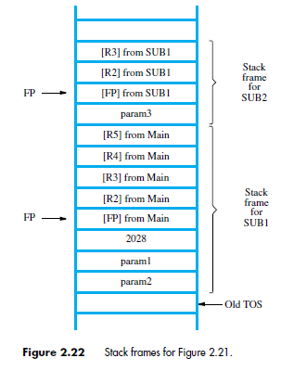
Second subroutine
3000 SUB2: Subtract SP,SP,#12
3004 Store FP,8(SP)
Store R2,4(SP)
Store R3,(SP)
Add FP,SP,#8
Load R2,4(FP)
Store R3,4(FP)
Load R3,(SP)
Load R2,4(SP)
Load FP,8(SP)
Add SP,SP,#12
Return

Slide 16
BASIC INPUT/OUTPUT
Notes:
Supeno Djanali - Teknik Informatika-FTIf

Slide 17
INPUT/OUTPUT ORGANIZATION
Processor
Memory
Interconecton
I/O device 1
I/O device n
……
Notes:
Supeno Djanali - Teknik Informatika-FTIf

Slide 18
I/O INTERFACE
Address Lines
Bus
Data Lines
Control Lines
Address
Decoder
Control
Circuit
Data and
Status Registers
Move R0,DATAIN
Move DATAOUT,R0
I/O Device
Notes:
Supeno Djanali - Teknik Informatika-FTIf

Slide 19
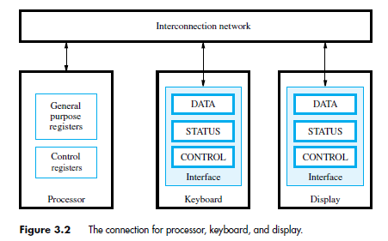
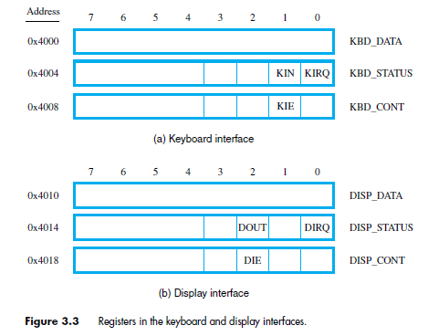
KIN : Keyboard Input
KIE : Keyboard Interrupt Enable
KIRQ : Keyboard Interrupt Request
DOUT : Display output
DIE : Display Interrupt Enable
DIRQ : Display Interrupt Request

Slide 20
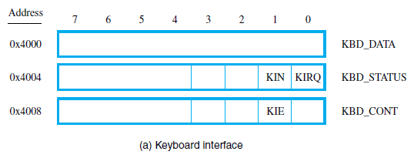
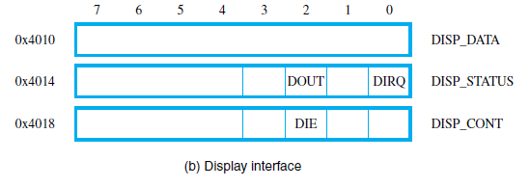
Basic Operation of Input,Output
In the beginning KIN=0 and DOUT=1
For the keyboard, KIN=0 means keyboard is ready. When data is in, KIN is Set (KIN=1) and as long as KIN=1 keyboard can not accept new data.
In the CPU side, KIN=0 means there is no data in the keyboard. If KIN=1 the data will be transferred to register and KIN is Reset (KIN=0).
How about the Display?

Slide 21
READWAIT Read the KIN ﬂag
Branch to READWAIT if KIN=0
Transfer data from KBD_DATA to R5
READWAIT: LoadByte R4, KBD_STATUS
And R4, R4, #2
Branch_if_[R4]=0 READWAIT LoadByte R5, KBD_DATA
WRITEWAIT Read the DOUT ﬂag
Branch to WRITEWAIT if DOUT=0
Transfer data from R5 to DISP_DATA
WRITEWAIT: LoadByte R4, DISP_STATUS
And R4, R4, #4
Branch_if_[R4]=0 WRITEWAIT StoreByte R5, DISP_DATA

Slide 22
Example I/O program (RISC)
Move R2, #LOC
MoveByte R3, #CR
READ: LoadByte R4, KBD_STATUS
And R4, R4, #2
Branch_if_[R4]=0 READ
LoadByte R5, KBD_DATA
StoreByte R5, (R2)
Add R2, R2, #1.
ECHO: LoadByte R4, DISP_STATUS
And R4, R4, #4
Branch_if_[R4]=0 ECHO
StoreByte R5, DISP_DATA
Branch_if_[R5] ≠ [R3] READ

Slide 23
Example I/O program (CISC)
Move R2, #LOC
READ: TestBit KBD_STATUS, #1
Branch=0 READ
MoveByte (R2), KBD_DATA
ECHO: TestBit DISP_STATUS, #2
Branch=0 ECHO
MoveByte DISP_DATA, (R2)
CompareByte (R2)+, #CR
Branch ≠ 0 READ

Slide 24
HOMEWORK
Read Chapter 4 reference 1.
Read Hamacher Chapter 3.

Slide 25
STACK FRAME
LoadMultiple -(SP),R1-R3
Load -(SP), R1
Load -(SP), R2
Load -(SP), R3
Level 1 =>
Level 3 =>
[R3]
[R2]
[R1]
Level 2 =>
n
NUM1
Initial SP

