Slide 1

Self Regulation of Alpha Waves as Difficulty Control In Video Games
CS 491-591: Brain-Computer Interface
Noah Gershmel | Jack Hawblitzel | Elysse Kimmel

Slide 2
Introduction
Create an engaging game while training your mind
Focus need for regulation around stressors
Remaining calm in high stress situations
Extend training beyond video games

Slide 3
Previous Work
BCI for Games: A ‘State of the Art’ Survey,
Nijholt, A. (2008)
Early adoption of BCI through games
EEG-based continuous control of a game using a 3 channel motor imagery BCI: BCI game
Coyle, D., Garcia, J., Satti, A. R., & McGinnity, T. M. (2011)
Use of normal distribution to smooth values
Experiencing BCI Control in a Popular Computer Game
H., Bose, D. P., Poel, M., & Nijholt, A. (2013)
Participants willing to use BCI for extended periods of time
Recognizing Frustration of Drivers From Face Video Recordings and Brain Activation Measurements With Functional Near-Infrared Spectroscopy
Ihme K, Unni A, Zhang M, Rieger JW and Jipp M (2018)
Games create recognizable frustration in EEG from video games

Slide 4
Approach
Alpha waves as relaxation state
EEG using FP1, FP2 with A1 and A2 as reference
Frontal Lobe targeted
Feedback through enemy movement and text display

Slide 5
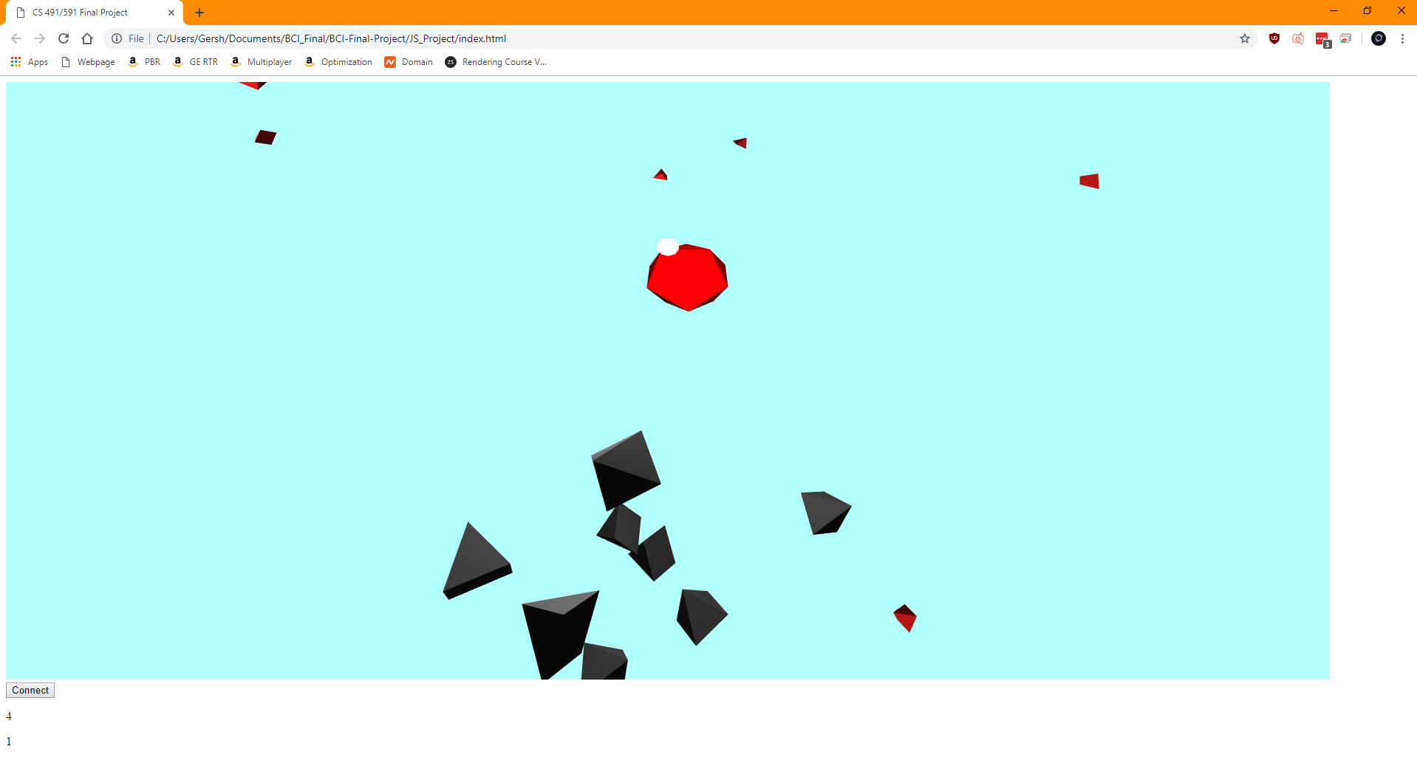
Approach

Slide 6
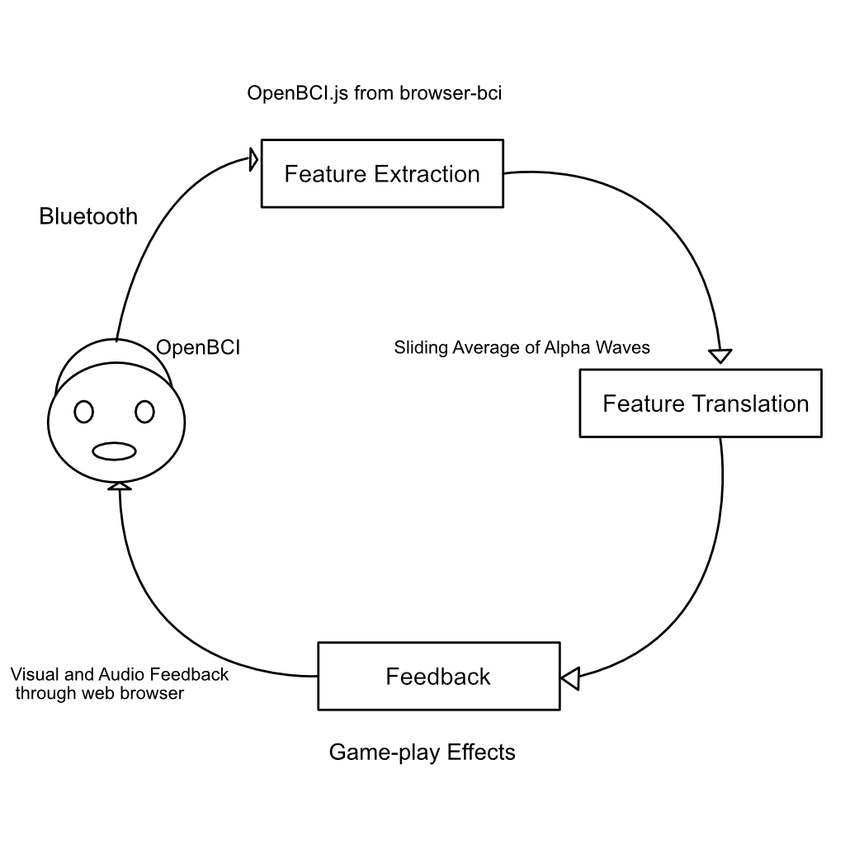
System Design
Used the browser-BCI
Sliding average
Chrome Bluetooth over web
OpenBCI Headset
WebGL

Slide 7
Challenges
Bluetooth on web limited to chrome
Smoothly changing the difficulty
Maintaining easy to read code for all the game systems

Slide 8
Future Work
Higher quality graphics and GUI for engagement
Selection of scenarios
Logging of self regulation skill
Support for other headsets

