Slide 1
AI-Powered Dialogue System for Diagnostic Quality Management
Reducing Errors | Enhancing Efficiency | Transforming Clinical Workflow
Peter Gershkovich MD, MHA Director Pathology Informatics and Cancer Data Science

Slide 2
The Problem – Inefficiency & Risk in Diagnostics
Sentinel Events caused by misaligned reports and missed discrepancies
Amended patient reports and errors in workflows delay care, increase cost, and erode trust
Manual document review is time-consuming and error-prone
Triage errors, improper scheduling, and inefficient care pathways persist

Slide 3
Our Solution – Dialogue Project
Real-time AI-based Quality Control for diagnostics and treatment documentation alignment
Detects errors and misalignments across pathology, radiology, clinical notes
Prevents incorrect treatments and improper scheduling
Minimizes the need for report amendments and streamlines reporting

Slide 4
Key Impact Areas
Prevent Sentinel Events by highlighting missed critical findings
Improve Pathology Quality by reducing report amendments
Enhance Radiology Alignment with pathology and clinical data
Enable Efficient Triage and resource allocation
Reduce Waste and administrative overhead in healthcare delivery

Slide 5
Technology Overview
Web-based AI Workspace built for Pathology Informatics
Java 17, Spring Boot 3.x, integrated with Yale AWS infrastructure
AI algorithms for report alignment, error detection, and workflow optimization
Scalable, secure, and adaptable across healthcare environments

Slide 6
Transforming Diagnostic Quality
Revolutionizing Diagnostic Quality with AI-driven tools
Integrated within Yale’s Enterprise development and innovation framework
DQMS (Diagnostic Quality Management System) to reduce errors at scale
Fewer misdiagnoses = better patient outcomes and safer healthcare
Positioned to set a new standard for pathology quality assurance

Slide 7
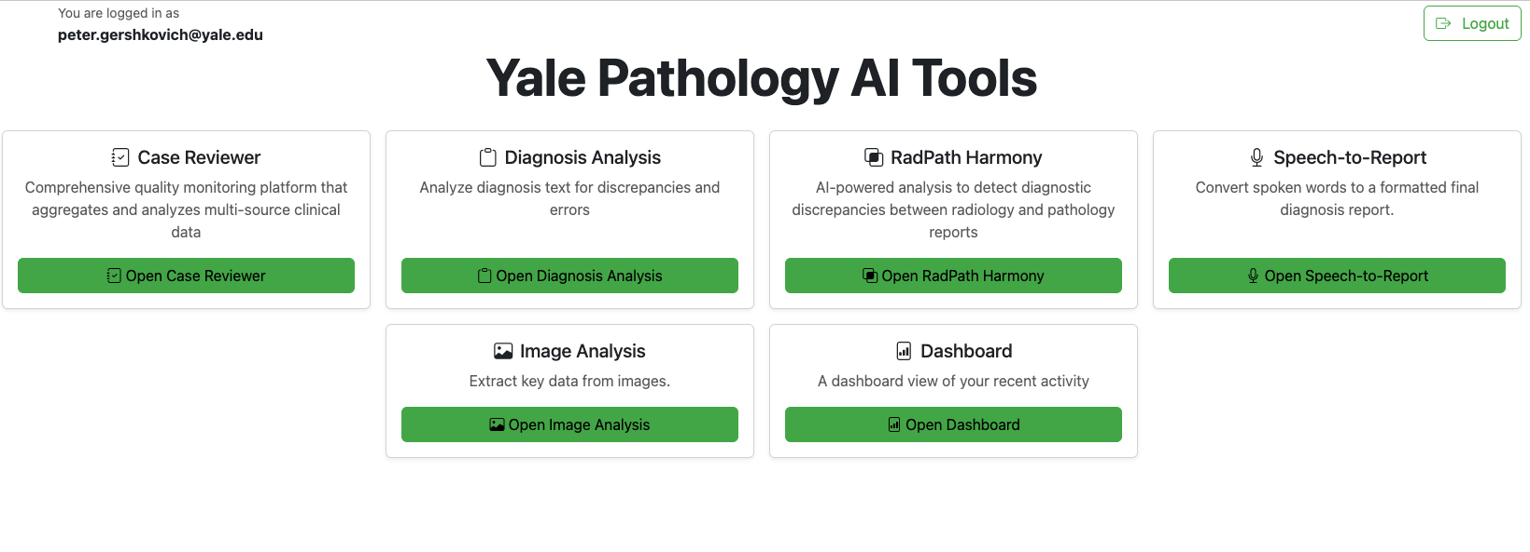

Slide 8
Traction & Next Steps
Prototype Ready: Real-time error detection and workflow enhancement
Next Milestones: Clinical environment hardening, pilot with teams
Secure funding for scale-up & market launch
Seeking Support: Resources, partnerships, and strategic input

