Slide 1
Why Now? Clinical-grade AI demands clinical-grade software
Independent AI decisions now inevitable (FDA, EU AI Act)
Traditional dev cycles too slow for model change
Regulated healthcare demands audit, security, traceability
Every software defect becomes a potential patient-safety event

Slide 2
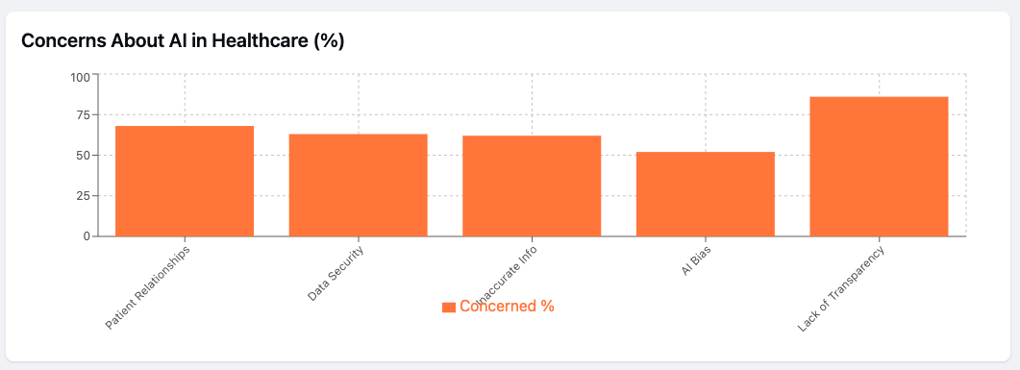
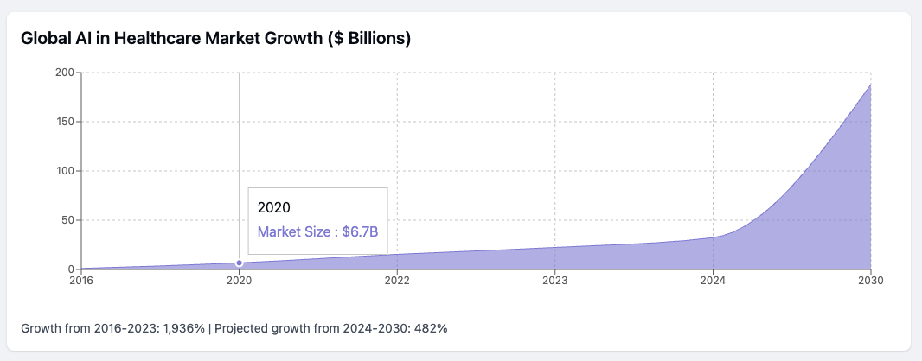
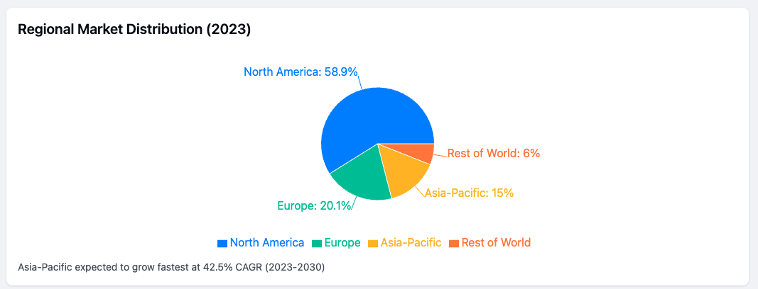
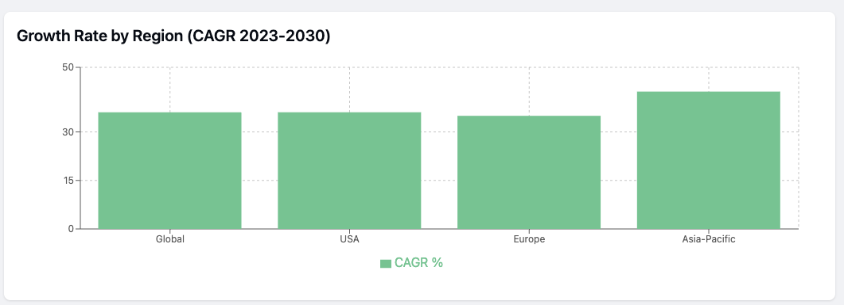
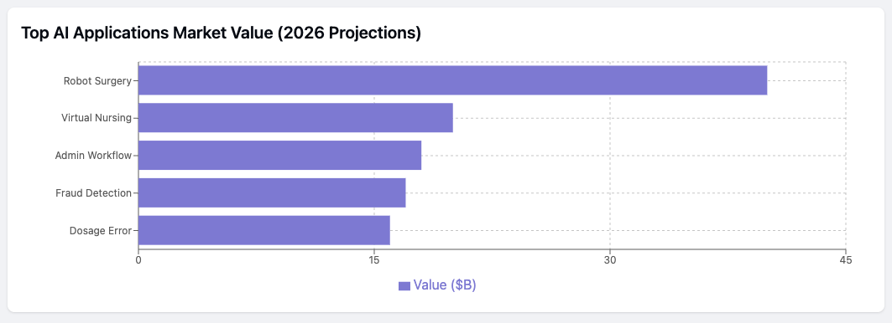
AI in Healthcare: Key Statistics Dashboard
The global AI in healthcare market has grown dramatically from $1.1 billion in 2016 to $22.4 billion in 2023, representing a 1,936% increase.
By 2030, the global AI healthcare market is projected to reach $188 billion.
North America holds the largest share of the AI healthcare.
Robot-assisted surgeries and virtual nursing assistants represent the largest projected market.
AI-assisted surgeries could shorten hospital stays by over 20%, with potential savings of $40 billion annually.
Patient concerns remain significant, with 86% worried about lack of transparency in AI information sources, 68% concerned about weakening patient-provider relationships, and 63% concerned about data security risks.

Slide 3

The Missing Piece: AI-Assisted SDLC
LLMs are not just engines—they're pit crews.
Pipeline: Code Commit → LLM Code Gen + Patch → Static/Dynamic Analysis → Human + LLM Review → Signed Artifact → Deploy → Monitor
- Auto-generate tests - Inline risk annotation - SBOM and dependency scan

Slide 4
Speed + Quality: Two Case Studies
Hedgehog (2024) vs Spot (2025):
Tooling: Cloud+ChatGPT vs Windsurf+IntelliJ AI
Time to MVP: 4w vs 6d
LOC:Test Ratio: 1:0.4 vs 1:1.1
Bugs found: 8 vs 31 (AI 18 + human 13)
Regulatory: Trace Matrix vs Trace+SBOM+Threat Model

Slide 5
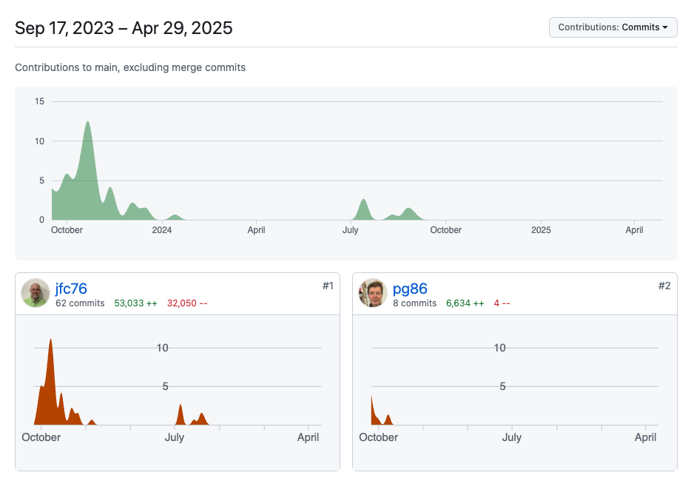
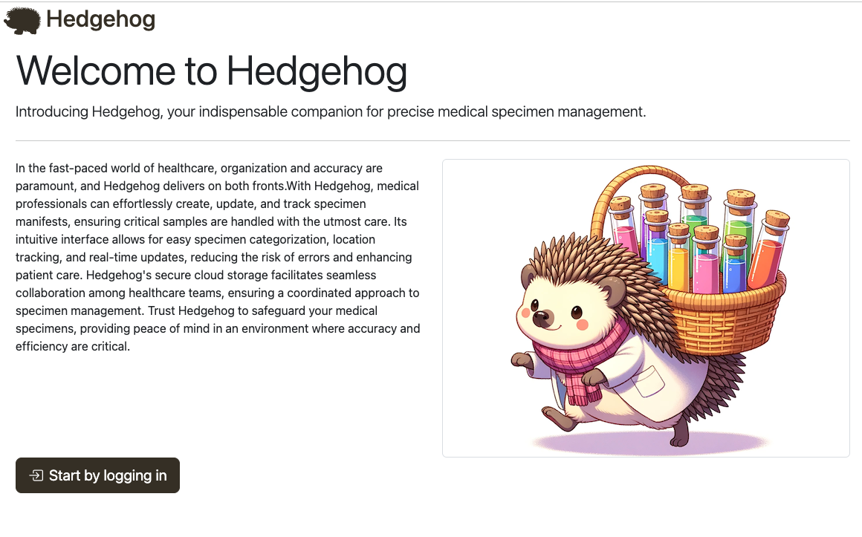
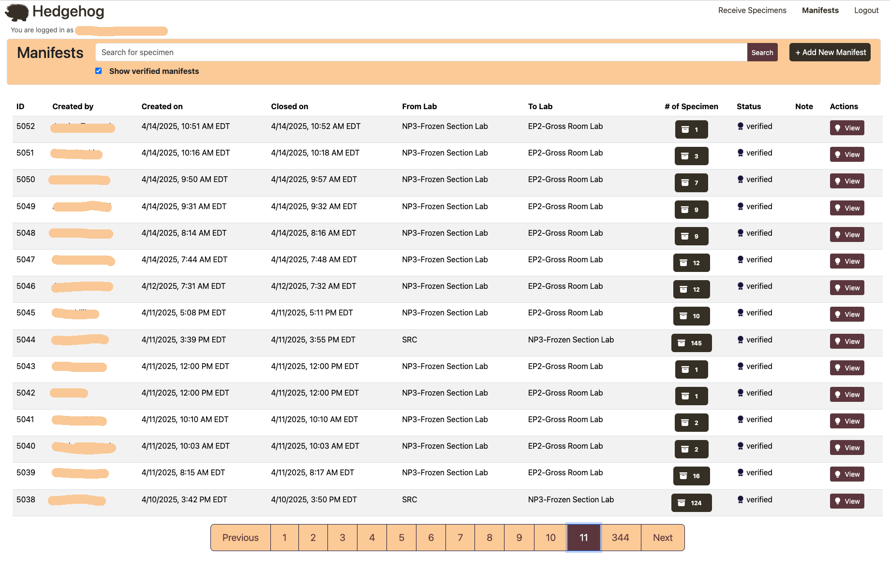
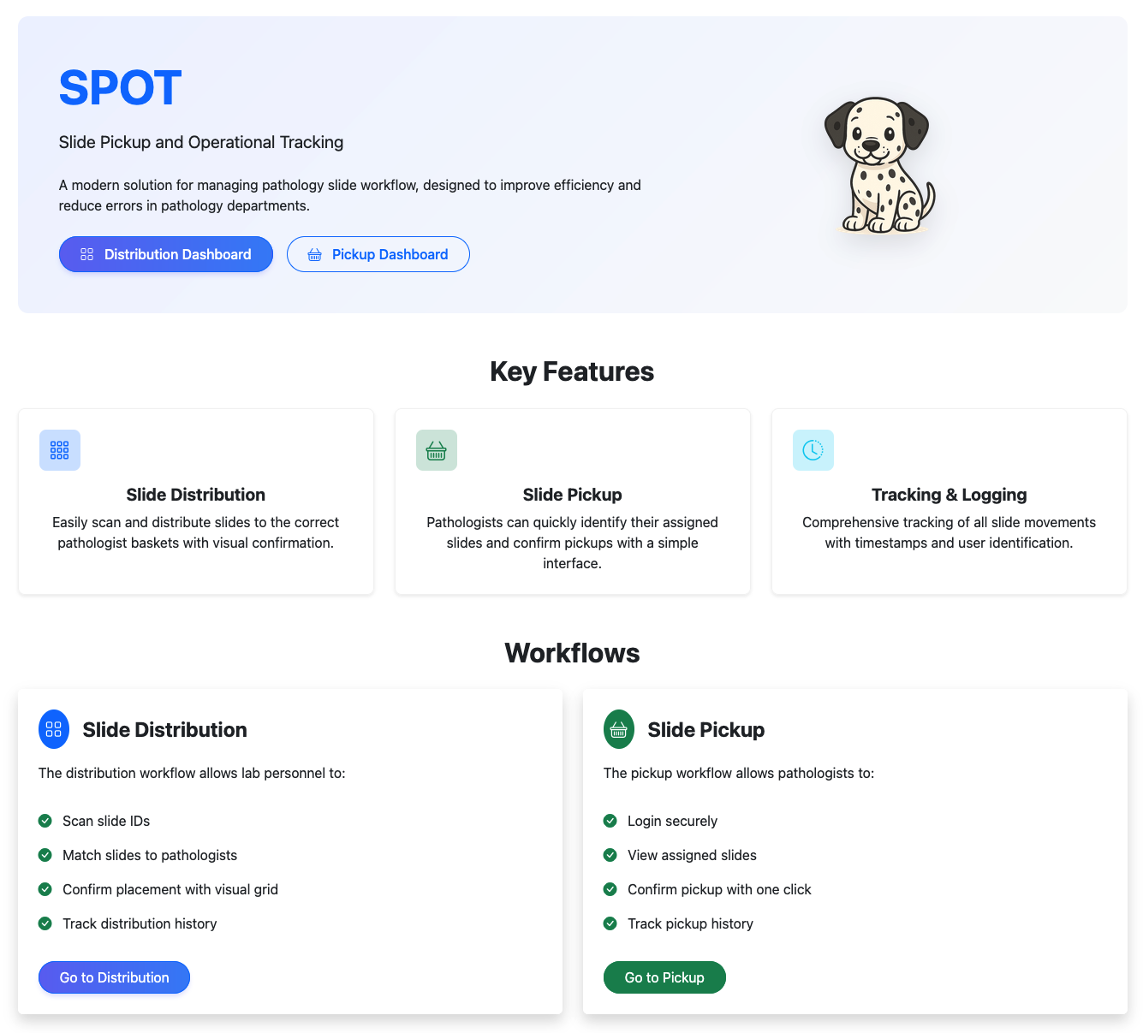

Slide 6
How AI Catches What Humans Miss
Hybrid Review = Amplified Vigilance
Security: Logic edge-case caught by GPT-4
Safety: Dependency CVE auto-flagged
Maintainability: Unsafe regex found, corrected by LLM
Performance: no evidence of latency after LLM optimization

Slide 7
Roadmap: From CI/CD to CQMS
Today: Automated tests, SCA, basic risk logging
Next: Live risk scoring, validation auto-gen
Future: Drift monitoring, self-updating IEC 62304 docs, AI-prepared FDA drafts
"14 days → 3 hours median change-to-production. 0 Sev-1 bugs in 12 months."

