Slide 1
Decoding Two Strike Pitch Sequencing in MLB
Advanced Sports Performance Analytics: Andrew Gerson & Trevor Shepherd

Slide 2
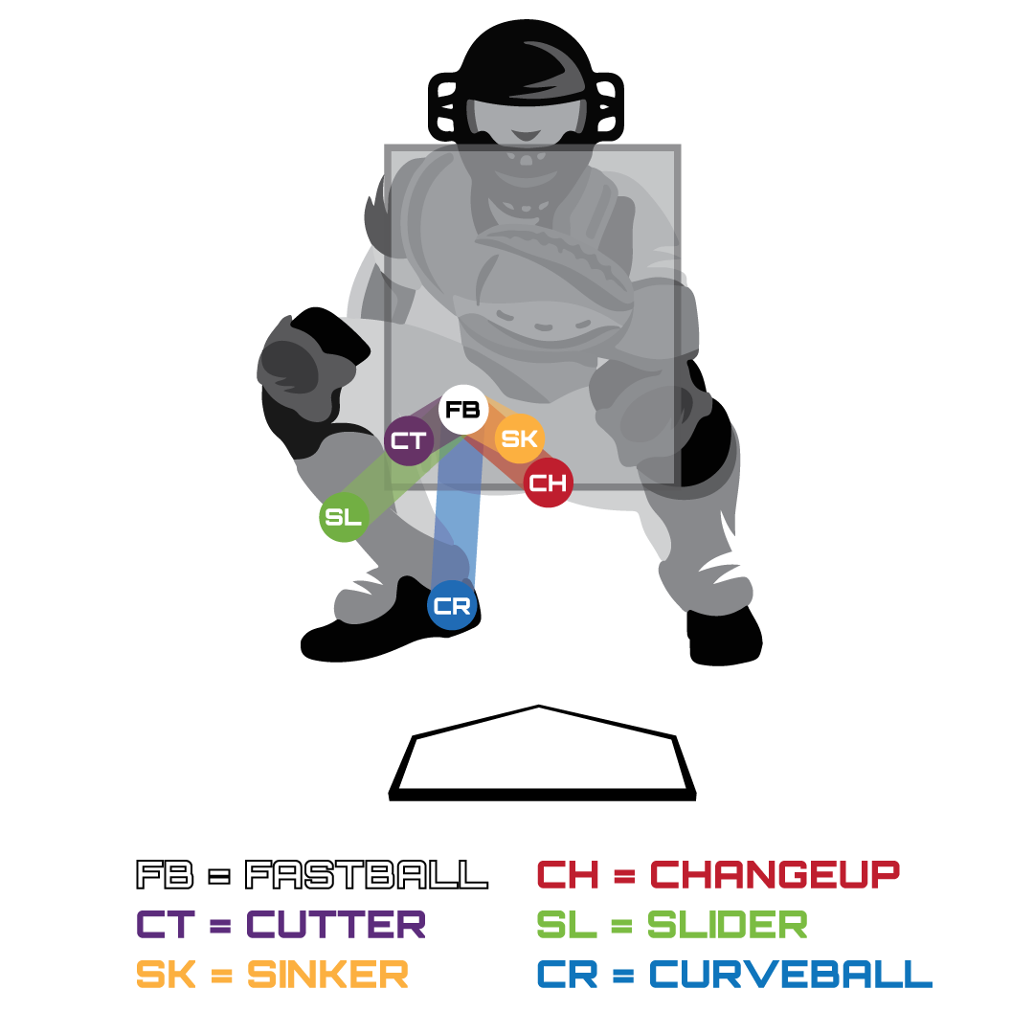
Background
2 strike counts represent most critical moments of a plate appearance.
The decision for what pitch to throw is often influenced by the previous pitch in the at-bat.
  Change in velocity, movement, spin rate, etc.
  Known as Pitch Tunneling.

Slide 3
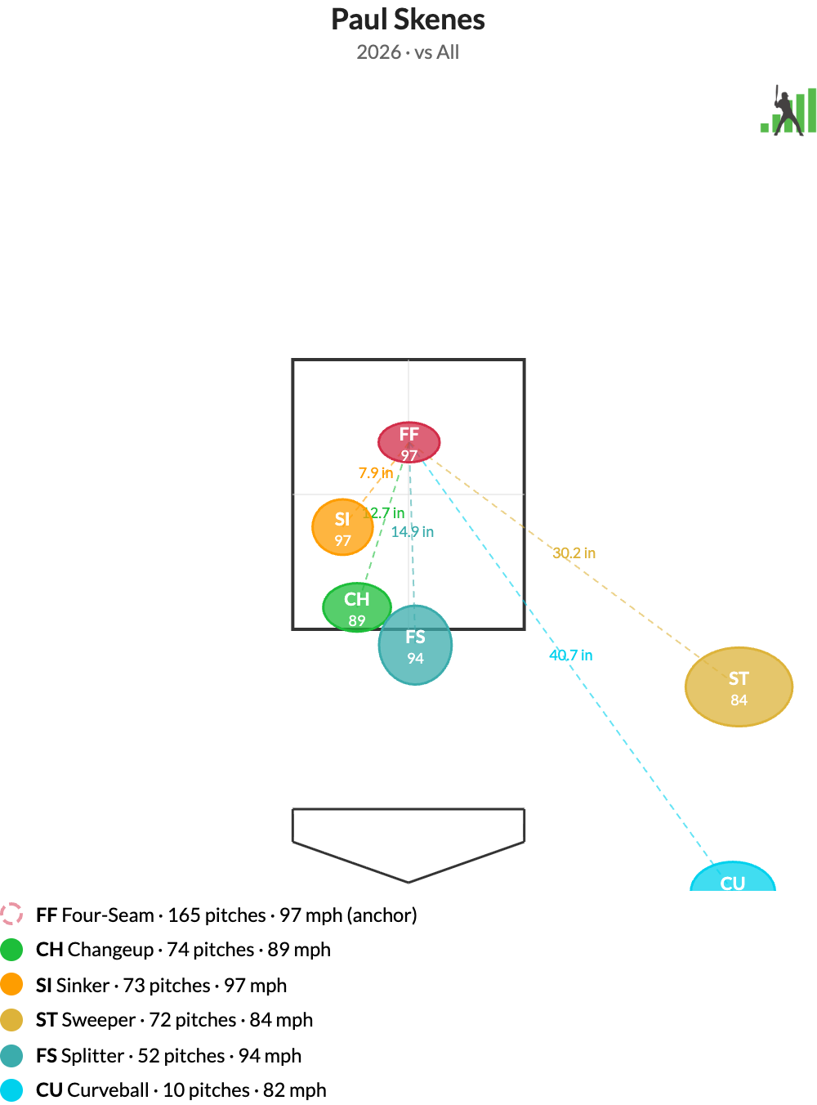
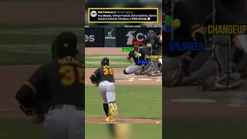
Tunneling at the Major League Level

Slide 4

Dude Perfect Tries to Hit MLB Pitcher

Slide 5

Objective
To identify and understand distinct pitch sequencing strategies in two-strike counts and evaluate how changes between pitches influence outcomes.

Slide 6

Research Question
What patterns exist in two-strike counts, and which sequencing strategies are most effective in producing successful outcomes?

Slide 7
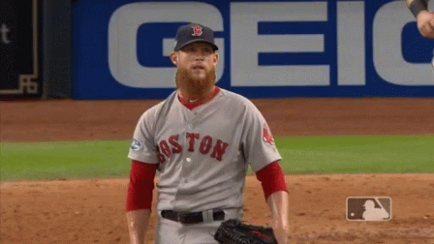
Hypothesis
Pitchers who create greater differences between consecutive pitches (velocity, movement, location, etc.) in two-strike counts will generate more successful outcomes.

Slide 8
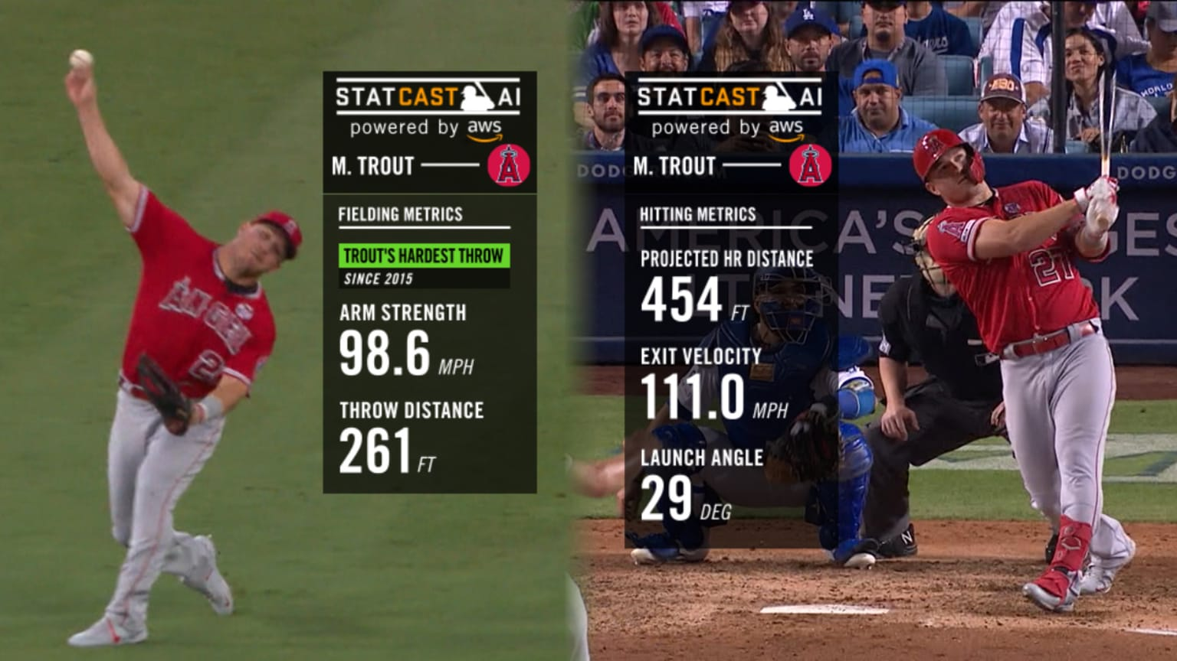
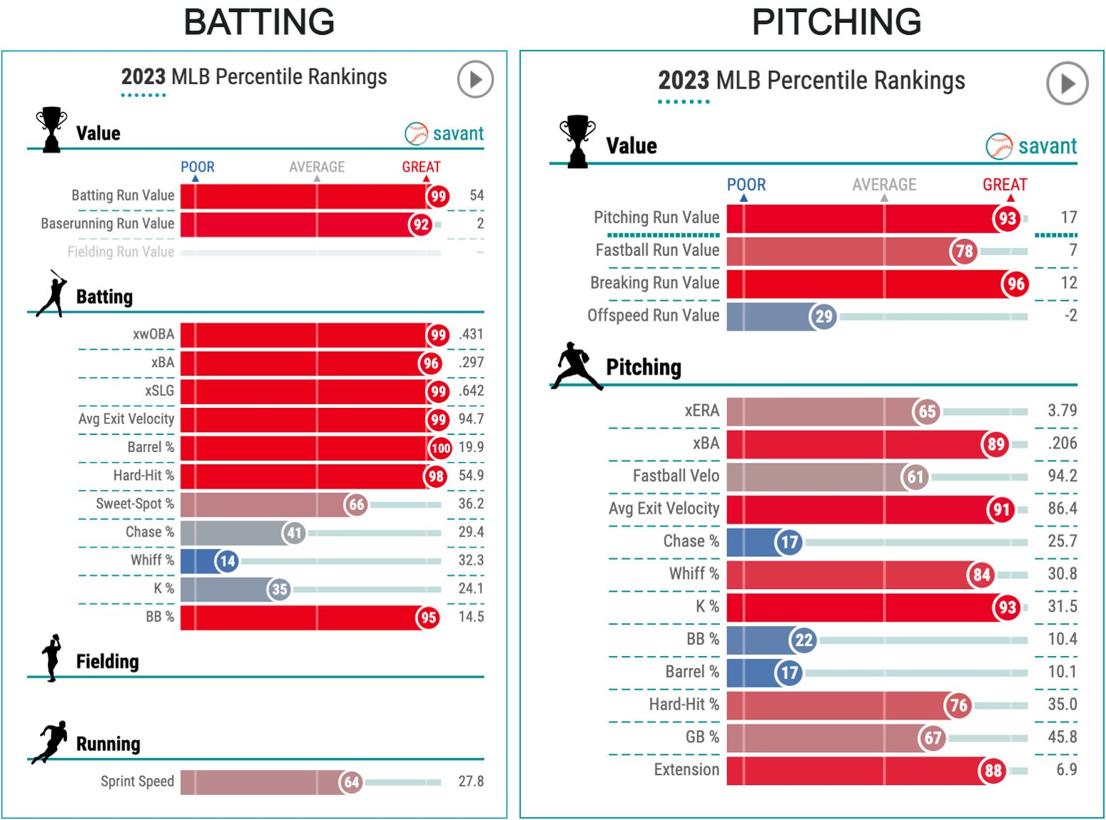
Data Sources: What is Statcast?
Tracking technology that allows for the collection and analysis of Major League Baseball data using 12 “Hawk-Eye” cameras in each stadium.
Data published by MLB publicly, can be collected using Python pybaseball package.

Slide 9
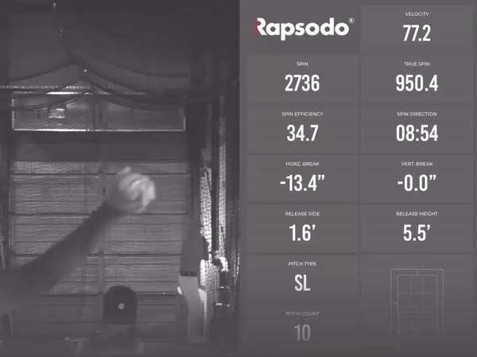
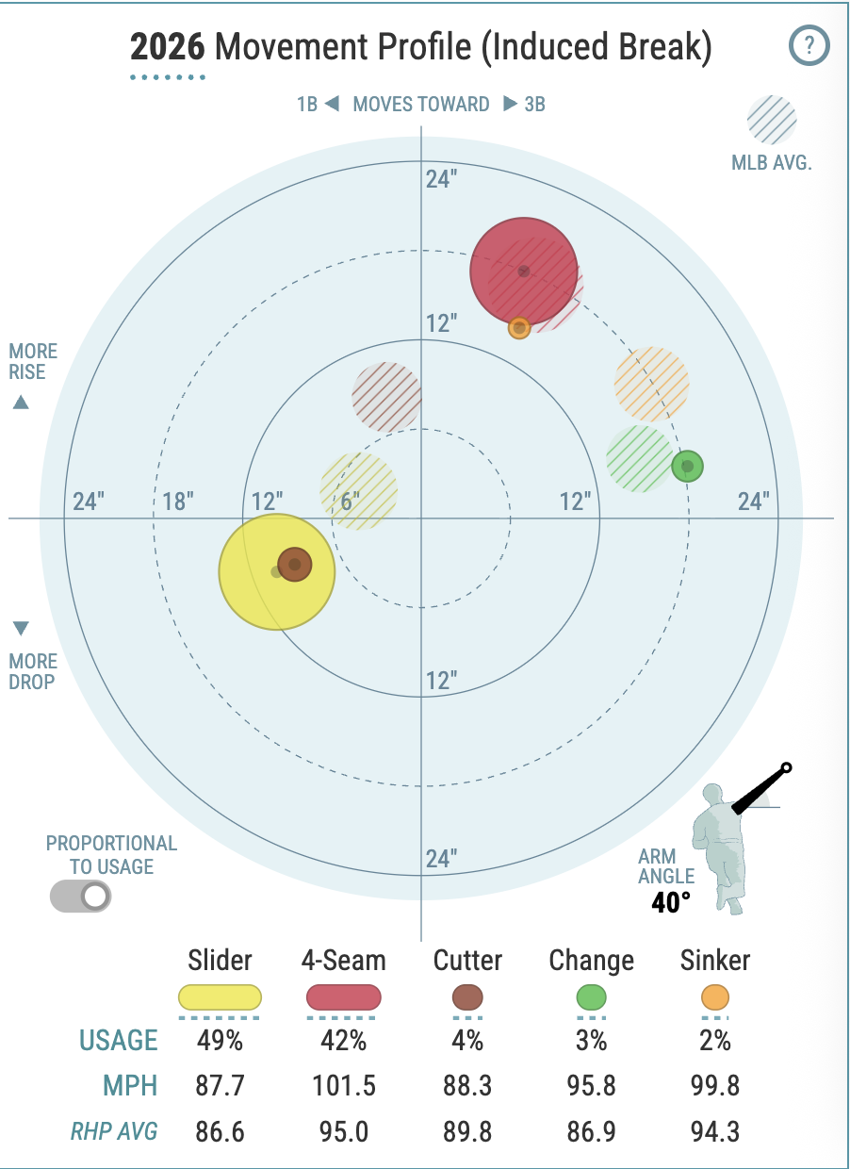
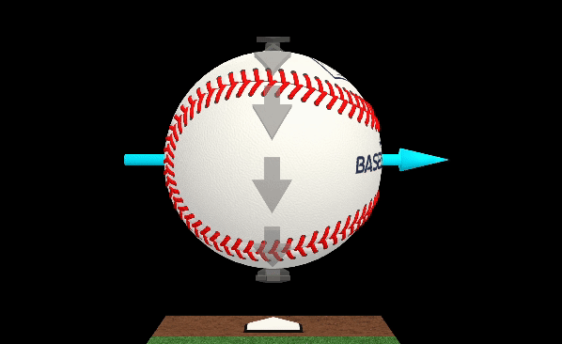
KPIs and Variables
Independent Variables (38):
Pitch velocity
Horizontal and vertical movement
Location in relation to home plate
Pitcher arm slot
Spin rate and axis
# of balls in at-bat
Pitcher times through batting order
Result of previous pitch
Differentials from previous pitch
Dependent Variable:
Whether or not the pitch resulted in a strikeout

Slide 10
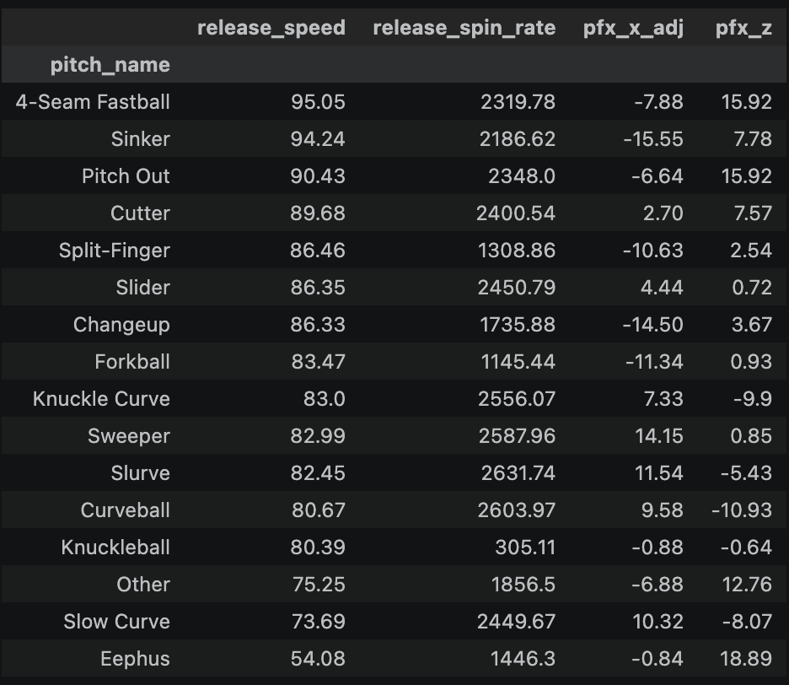
Data Processing & Descriptive Statistics
Individual pitch data collected for ~first month of 2026 (March 25 - April 20).
  Original, full dataset includes 100k+ rows and 118 features.
Filtered to pitches throw exclusively in 2 strike counts (28k+ rows).
  Added features to include differentials and results of previous pitch
  Strikeout rate across dataset: 19.4%
Standardized pitches thrown by lefties and seen by left-handed batters.
  Converted pfx_x and pfx_z to be represented in inches, not feet.

Slide 11
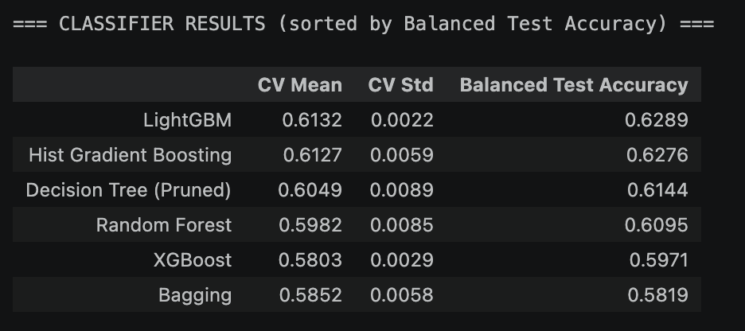
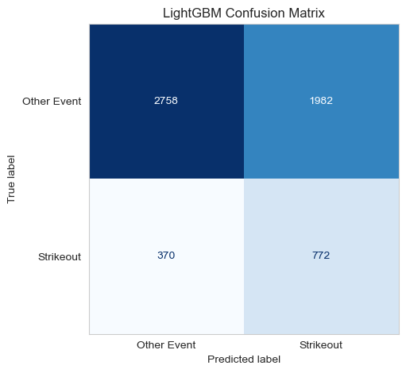
Classifier Model Results

Slide 12
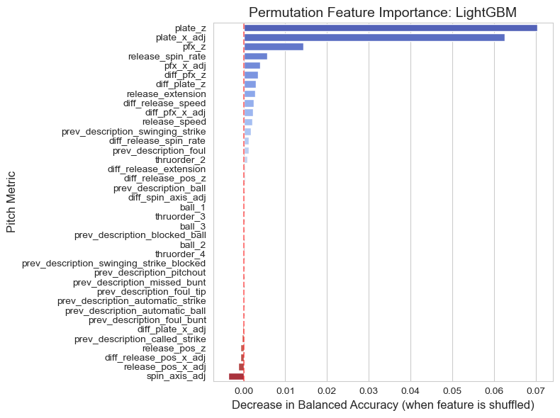
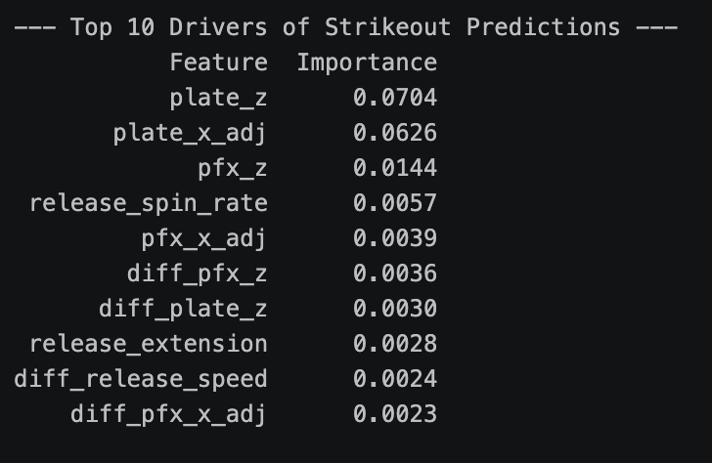
LightGBM Feature Importances

Slide 13
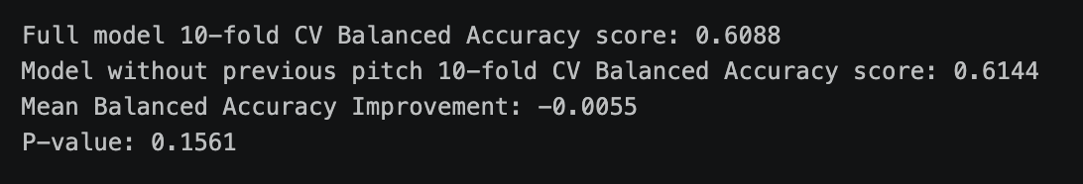
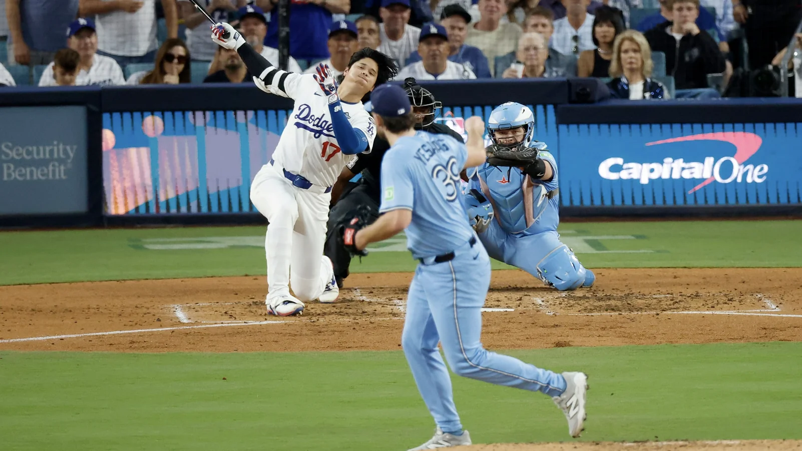
Statistical Significance (Paired t-test)

Slide 14
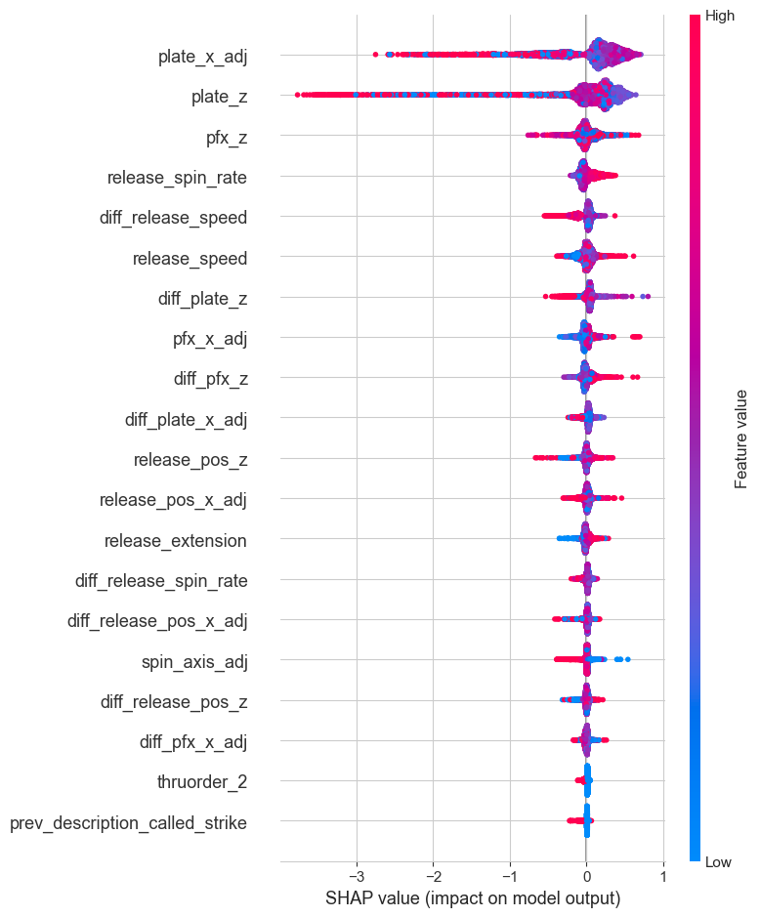
SHAP Values

Slide 15
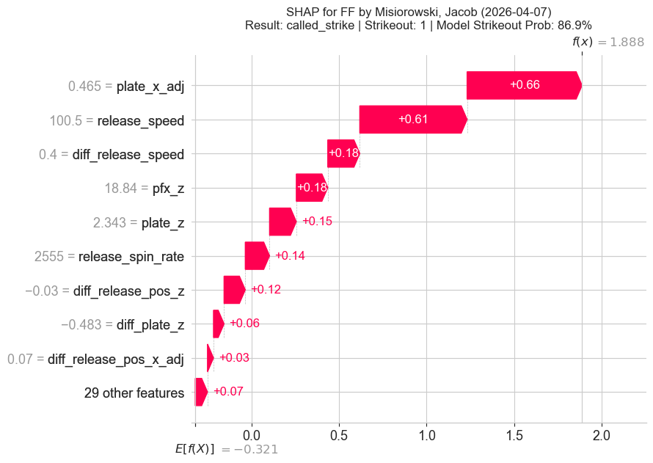
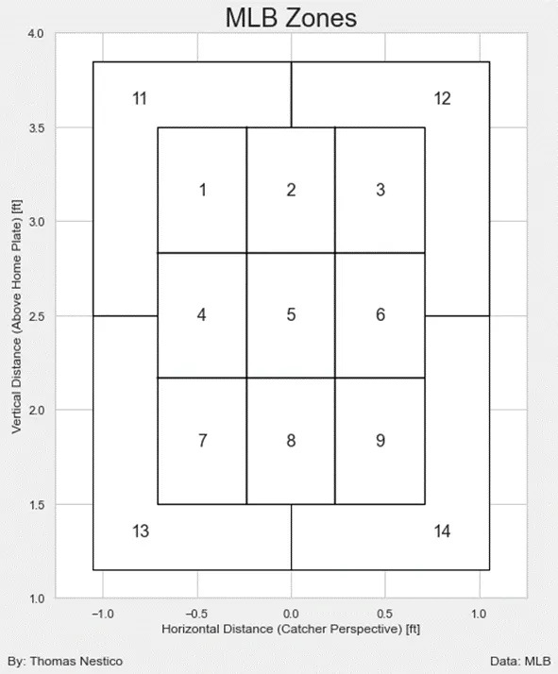
Highest Strikeout Probability in Test Data (video)
Previous pitch result: swinging strike

Slide 16
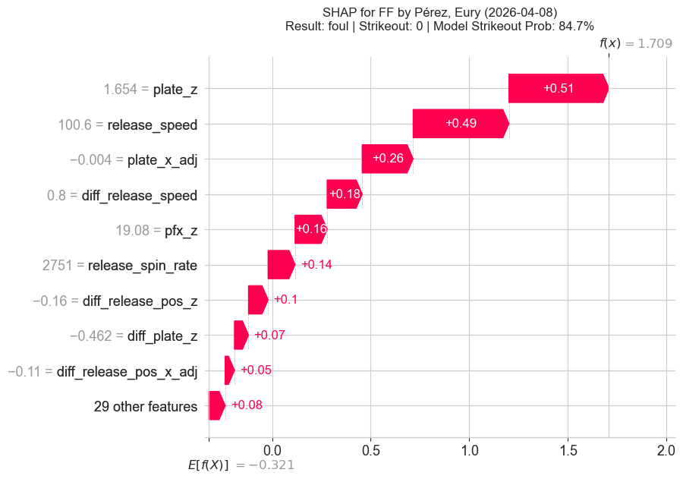
2nd Highest Strikeout Probability in Test Data (video)
Previous pitch result: ball (video)

Slide 17
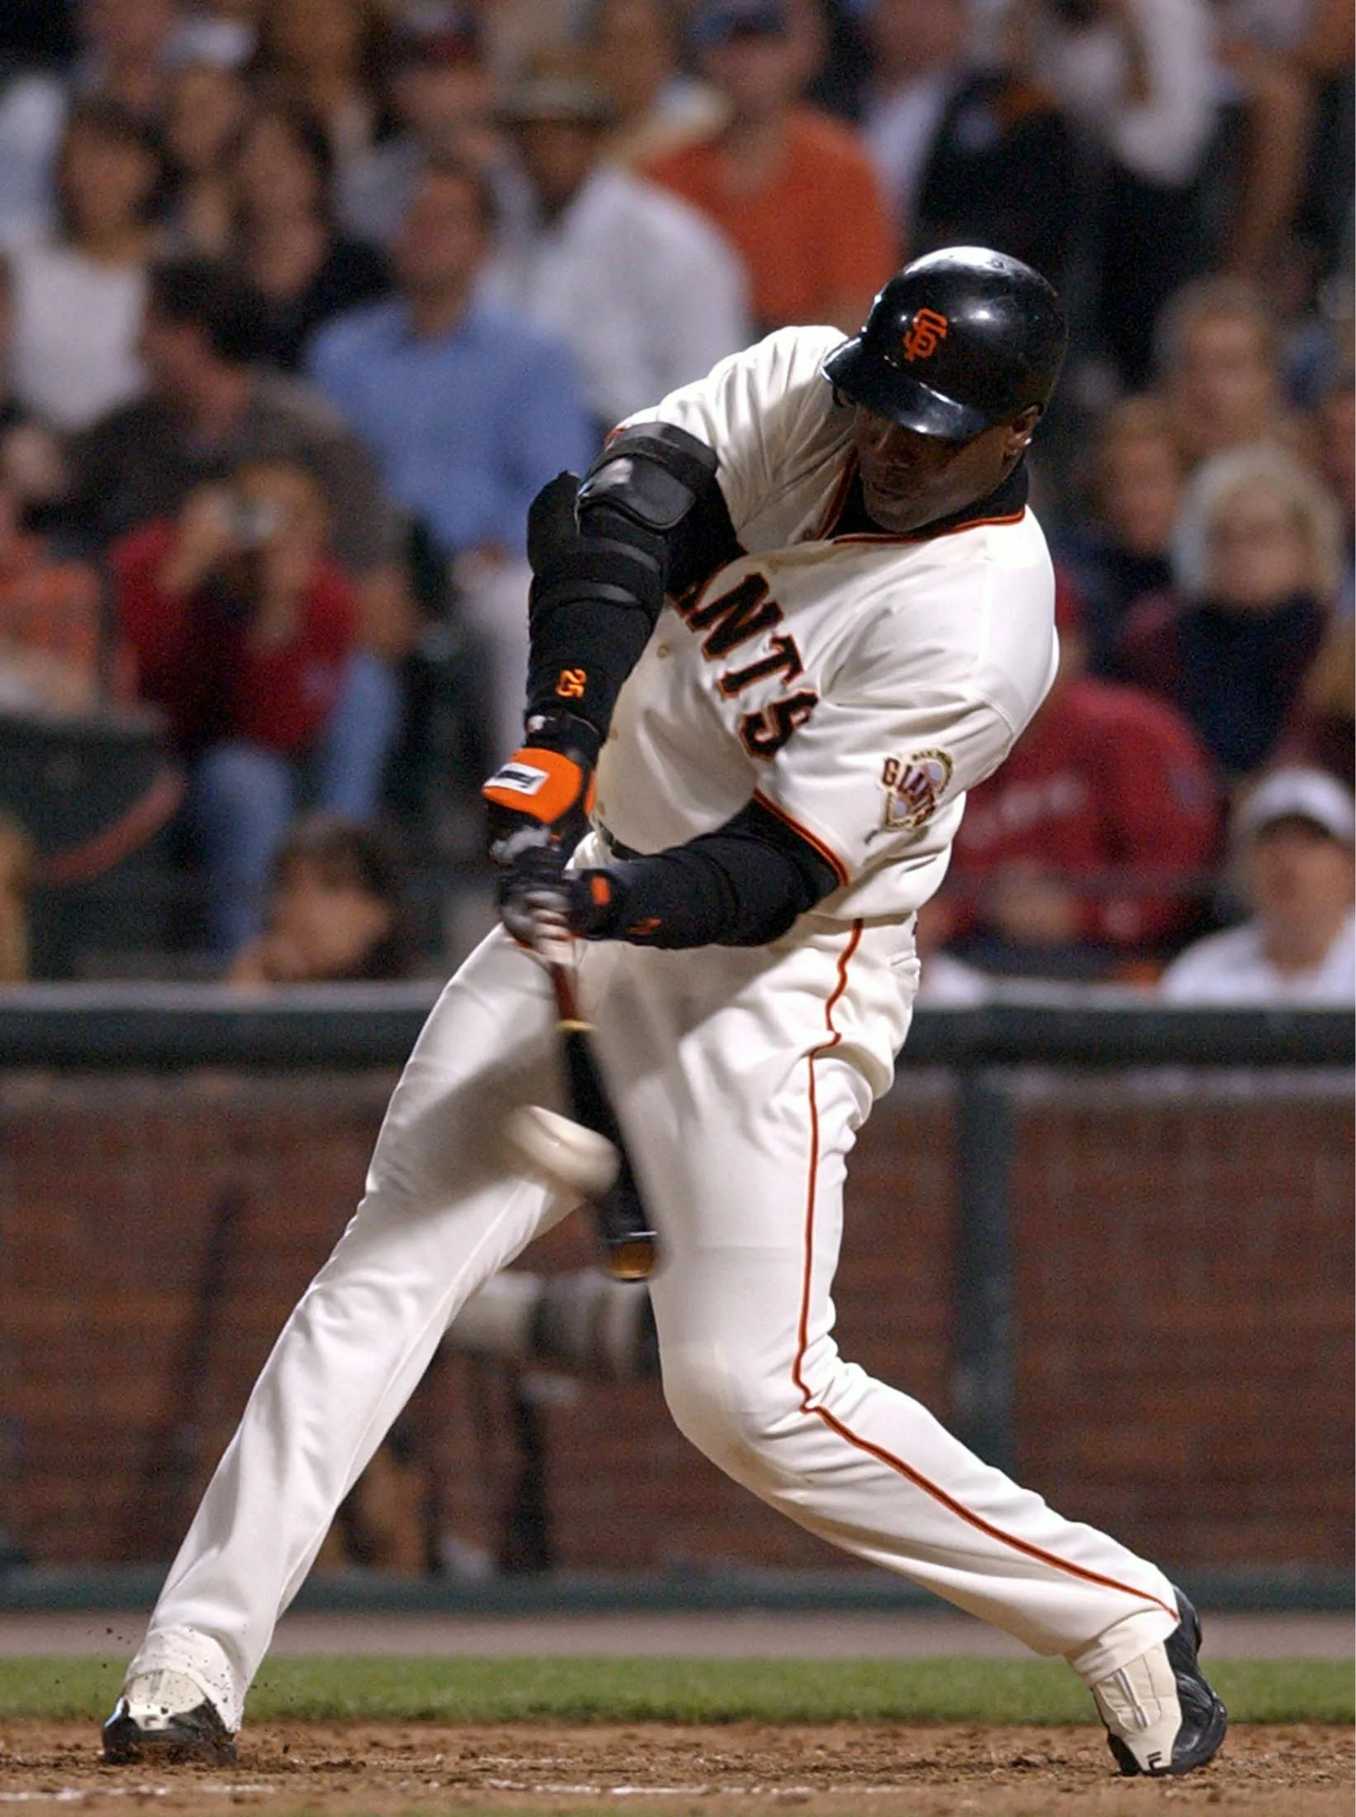
Limitations
Pitch level metrics may be better at predicting whiffs (swinging strikes) generally rather than strikeouts in 2-strike counts.
The hitter matchup is an huge confounder.
  The pitcher can do everything right, but a good hitter can spoil the pitch.
A pitcher’s goal is to prevent runs, not to collect strikeouts.
  The goal is to fool the hitter – weak contact on a 2-strike pitch is still a good outcome.

Slide 18
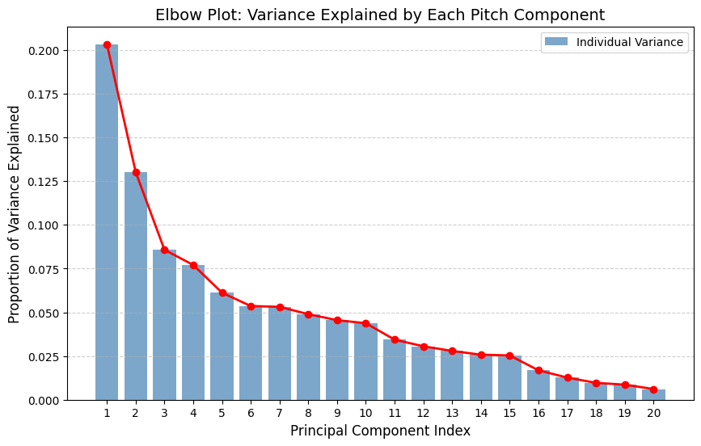
Principal Component Analysis (PCA)
Why is PCA useful here?
Simplified representation of data by reducing many pitch variables into a few key components
Captures main dimension of variation in pitch characteristics and sequencing
Helps visualize structure and patterns in future

Slide 19
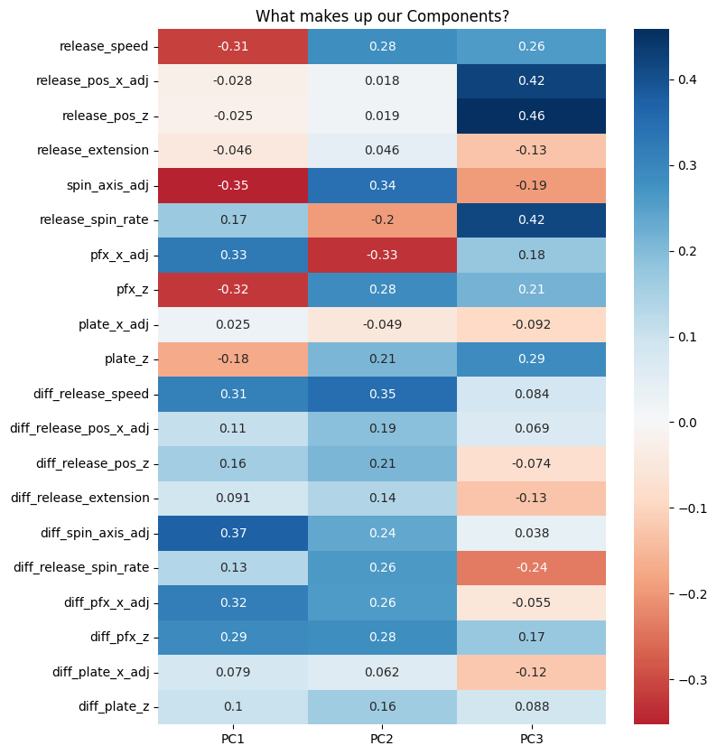
PCA Results
Principal Components
Look at heat map for loadings of variables in Principal Component Analysis
Elbow Plot has 20 possible components / looking at variance explained shows dataset is multidimensional

Slide 20
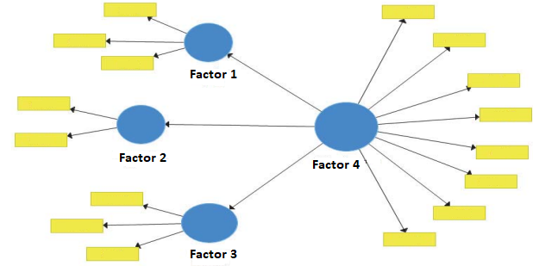
Factor Analysis (FA)
Why is FA useful here?
How # of Factors were Chosen
Structural Model to understand relationships between pitch variables
Hidden Latent Constructs identified in pitch characteristics / sequencing
Reveals underlying performance dimensions that drive pitcher behavior / choices
Kaiser Criterion: > 1
Diminishing returns in Explained Variance
Loading Threshold > Predetermined Value

Slide 21
Factor Analysis Results
Factor 1: Pitch Shape & Movement Profile
Factor 2: Pitch-to-Pitch Adjustments
9 Variables
5 Variables
Factor 3: Vertical Approach / Power Profile
Factor 4: Release Mechanics / Arm Slot
4 Variables
2 Variables

Slide 22
K Means Clustering
Why is K Means useful here?
Identifies natural groupings without needing pre made labels
Helps us uncover patterns in pitch sequencing / behavior that might not be obvious
Simplifies complex data into interpretable clusters for coaches/pitchers/hitters/catchers

Slide 23
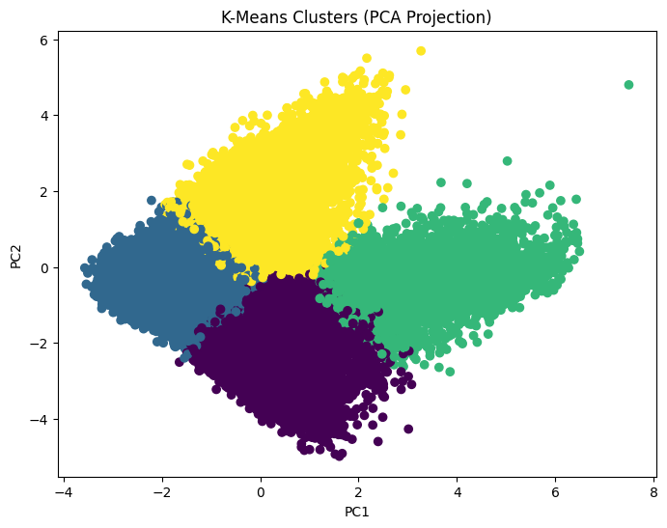
K Means Results
K Means
Used PCA to project data into 2D for visualization
Perform clustering on full feature set
Separation along PC1/2 shows key variation
Then can use FA to further interpret clusters

Slide 24
Recommendations
What were our results when combining all our findings?
Location, Fastball Shape, and Pitch Movement are KING.
So, what our our recommendations to coaching staff / GM / pitchers?

Slide 25
Recommendations
GM
Coaching Staff
Pitcher
Prioritize drafting and developing players with elite fastball velocity / shapes and develop command in minor leagues when players get around professional coaching staff / analytics team for the first time.
Focus on good pitch calling using all the data available, and make sure they drill it into the pitchers head that they just need to focus on hitting that target and trusting their stuff.
Focus on location execution. You need to have full confidence in trusting the coaching staff for whatever pitch they call. The offseason is the time to gain velocity, in game is the time to execute and trust your pitches.

Slide 26

Thank You!

