Slide 1
CRM MAJB
RESPLENDOR SOLAR

Slide 2
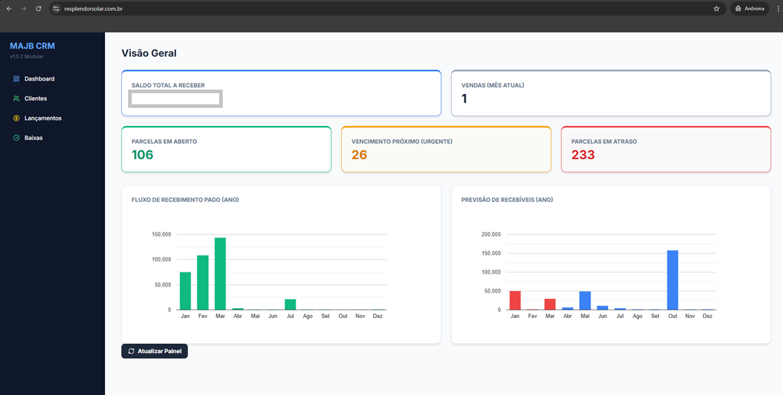

Slide 3
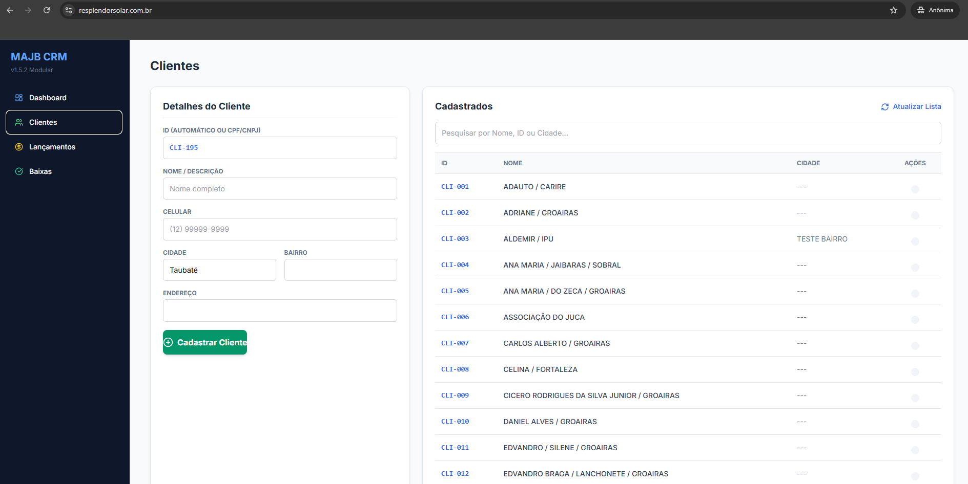

Slide 4
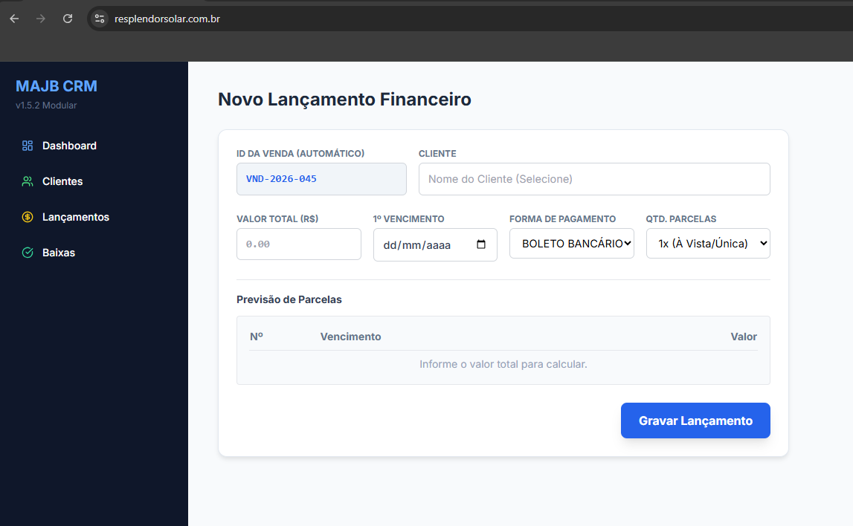

Slide 5
