Slide 1
Notas de aula
Introdução à Física Computacional
Prof. Gerson – UFU – 2019
Atendimento:
  Sala 1A225
  Email: gersonjferreira@ufu.br
  Webpage: http://gjferreira.wordpress.com
  Horário: sextas-feiras 16:00 – 16:50

Slide 2
Discrete Fourier Transform
Consider a function f(x) on a discrete lattice
The points are set as
with periodic boundaries
and size L
...
This give us →
Write f(x) as a Fourier series
with n = {0 … N}, such that
is the largest meaningful frequency,
as its wave-length matches the lattice spacing.
Now: use the plane-wave orthogonality to find cn.

Slide 3


Discrete Fourier Transform
Using the ‘Fourier trick’, we find … and transforming the integral back to a sum
Notice that
… and defining
we get the coefficients of
the discrete Fourier transform:
Only this part is typically
implemented on the
Fourier libraries

Slide 4


Discrete Fourier Transform (DFT)
… but in physics, we prefer to define the Fourier transform as
… such that the inverse Fourier transform reads

Slide 5
Fast Fourier Transform (FFT)
Numpy uses the FFT library [documentation here]
The implementation is “equivalent” (?) to the DFT from the previous page, but with x₀ = 0
To get the usual physics normalization with the N^{1/2}, use the option norm=‘ortho’
But the x₀ phases have to added by hand if you want to get the canonical Fourier transform
FFT and DFT are not really equivalent… FFT is much faster!
To understand why, please check the books and the class biblography: [Tao Pang] [Thijssen]
To take advantage of the FFT speed up, always use N as a power of 2, i.e. N = 2^{p}.
N = 128, 256, 512, 1024, 2048, ...
important detail: use the fftshift and ifftshift to change the FFT domain betweeen
k = [0, 2π[ and k = [-π, π[

Slide 6
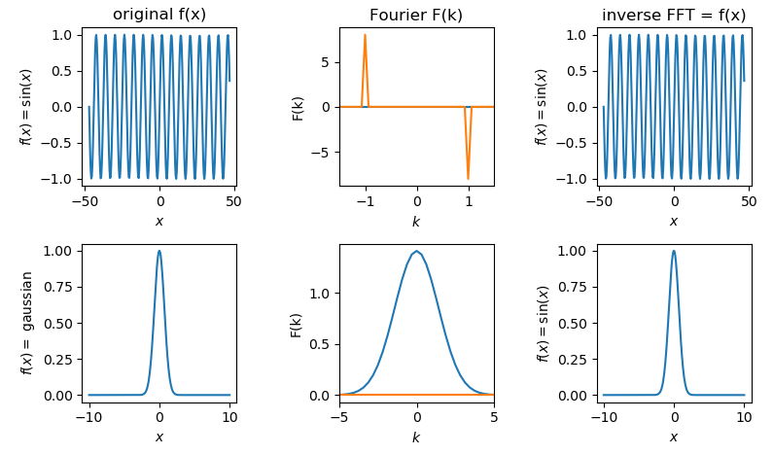
Exercise...
Implement the DFT sums to define your own the DFT and the iDFT.
→ they will be slow… in practice you should use the FFT library.
Compare your results with my numpy/FFT example [available at the course webpage]

