Slide 1


Input Data
General Code
Output Data
Dependency
Project Setup
Workflow
Application
Installation: install.R
Common Functions
Find Environment
Install Packages
Set Project Root
Numeric Data (Tabular)
Rows: Samples
Columns: Features
Metadata (Tabular)
Rows: Samples
Columns: Features
Preprocessing: preprocess.R
Row / Sample Subsets
Column / Feature Subsets
Scaling [Log2, Linear]
Normalization [Global Min Max, Local Min Max, Global Z-Score, Local Z-Score, Quartile]
App Initialization: app.R
Access: authentication.R
UI Functions: ui_functions.R
Interface Options: options.R
Connect Storage: storage.R
Workflows: workflows.R
Store Workflow Roots
Create Directories
Update Source Code
Run & Deploy App
Postprocessing
Import Reduced Datasets
Calculate Metadata Filters
Colors, Shapes, Labels
Apply User Parameters
Utility Functions: utils.R
Load Packages
Common Functions
Connect to AWS S3
Set Analysis Options
Reduction: red_methods.R
PCA [10D, Summary, tSNE]
VAE [10D, Summary, tSNE]
UMAP [10D, Summary, tSNE]
PHATE [2D, 3D]
Thresholding Sets [UpSetR]
Plotting: plotting.R
Static 2D: ggplot2
Interactive: plotly
Boxplots: beeswarm
Heatmaps: heatmaply
Intersections: VennDiagram
Data Tables: DT
Import Data: converter.R
Citations, Credentials
Datasets [Categories]
Row / Column Subsets
Numeric Data
Metadata
Local / AWS Storage: packaging.R
Load Visualization Data
Compartmentalize Tables
Create Keys (folders, file names)
Save to Folder / Bucket

Slide 2
authentication.R*: Manages user authentication for the application.
install.R*: Validates working directory / configuration, declares utility functions, installs packages.
converter.R*: Standardizes data for downstream processing and generates app configuration files.
bcrypt
find_replace.R*: Declares functions for finding / replacing fixed / regex expressions in text.
shiny, dplyr, BiocManager
storage.R*: Declares functions to list, find, read, and write files on operating systems / AWS.
validation.R*: Validates numeric data / metadata tables.
stringi
aws.s3
workflows.R*: Manage folders & app deployment for each workflow.
text_work.R*: Makes functions for identifying bookmarkable elements, manipulating menu text.
red_methods.R*: Implements PCA, VAE, UMAP, PHATE, Sets, and tSNE as reduction methods.
preprocess.R*: Names and initializes reduction parameters. Names, stores, and loads files.
reticulate, hash, tensorflow, keras, phateR, umap, Rtsne, Matrix
ui_functions.R*: Makes functions that generate interactive HTML widgets for Shiny applications.
red_requests.R*: Declares functions for efficiently performing and storing reduction requests.
make_requests.R*: Loads stored category / subset data. Declares functions for validating, creating, combining, and identifying reduction requests.
shinycssloaders, shinywidgets
sca_nor_fun.R*: Declares scaling / normalization functions.
options.R: Tests storage systems, generates menus, and assembles user interfaces for the application.
limma
packaging.R: Assembles a broad set of reduction requests, executes them, and syncs data to AWS.
plotting.R*: Makes visualizations (plots, tables) for the application.
shinyjs, shinydashboard
*Has unit tests.
viridis, ggplot2, plotly, beeswarm, DT, UpSetR, VennDiagram, heatmaply
app.R: Makes an interactive Shiny application capable of visualizing dimensionally reduced data.

Slide 3
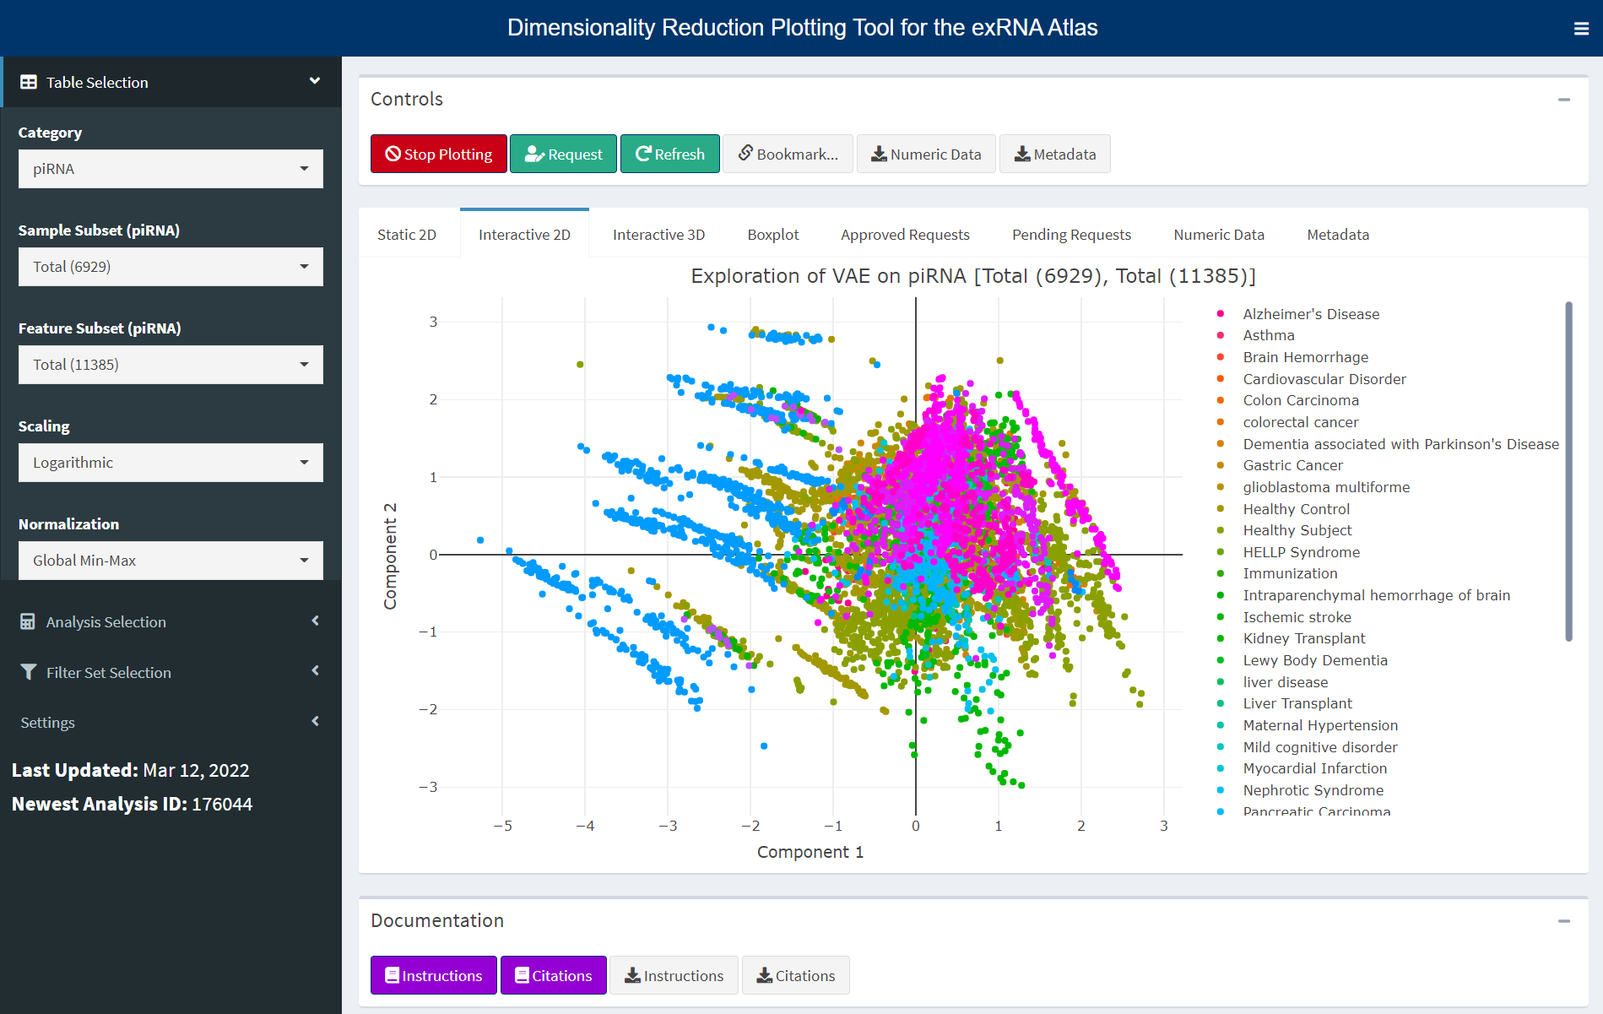
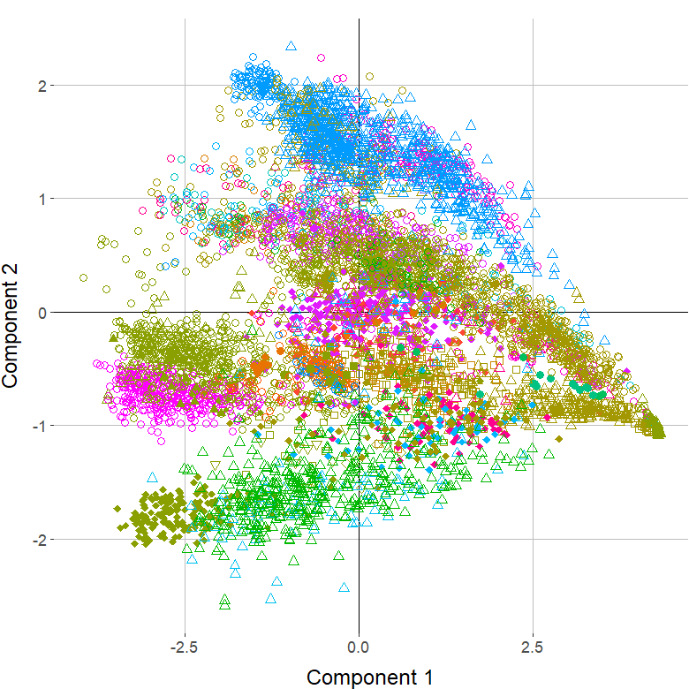
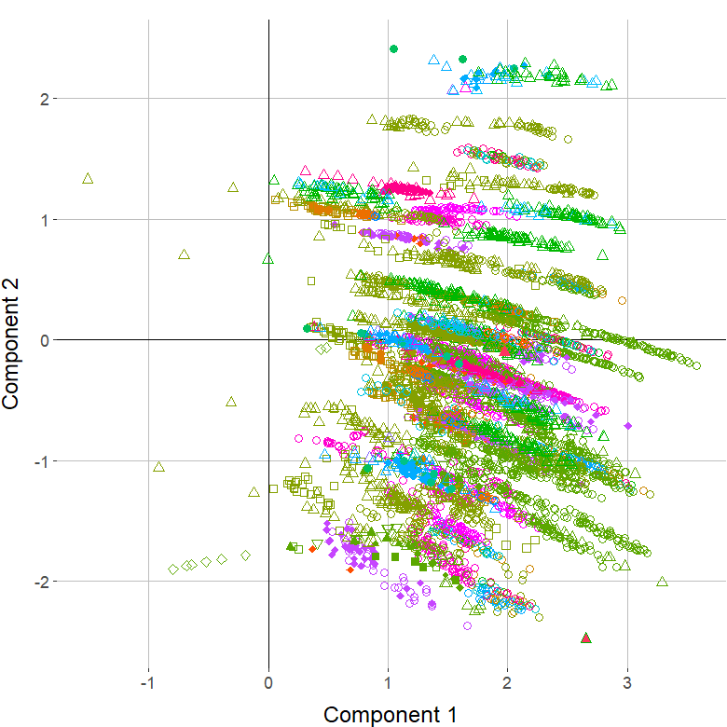
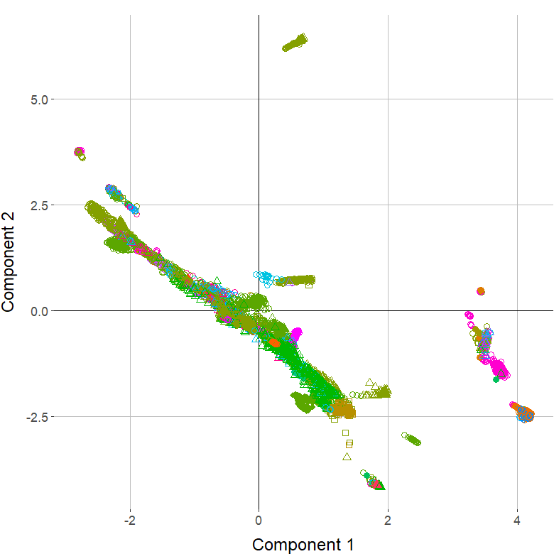
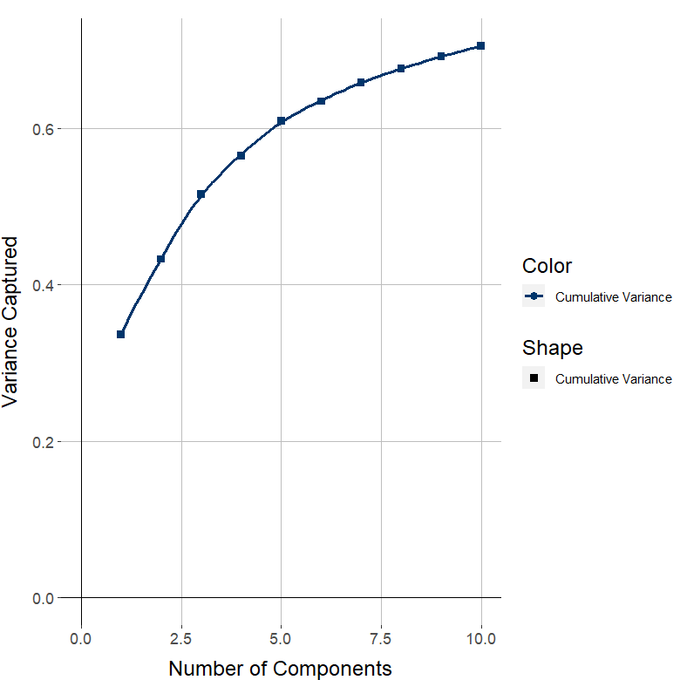
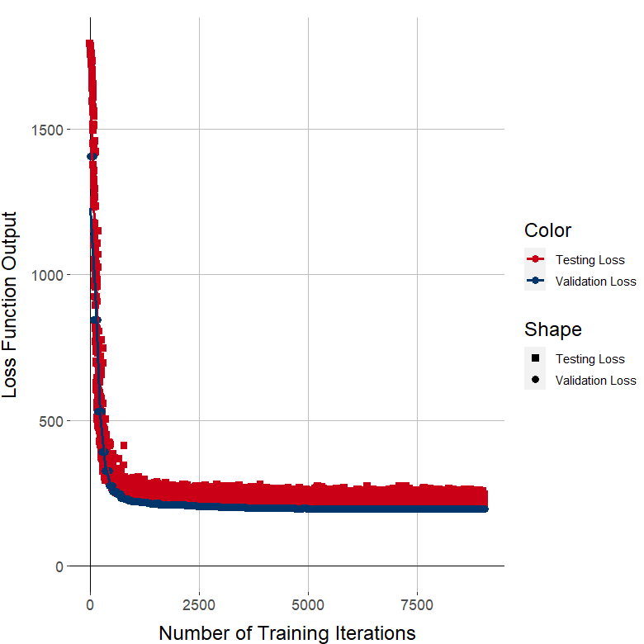
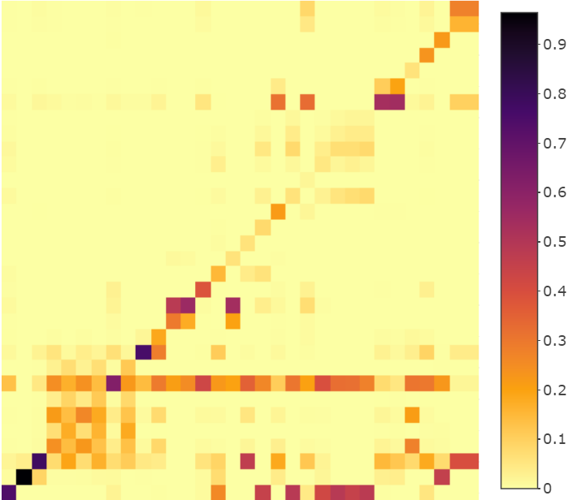
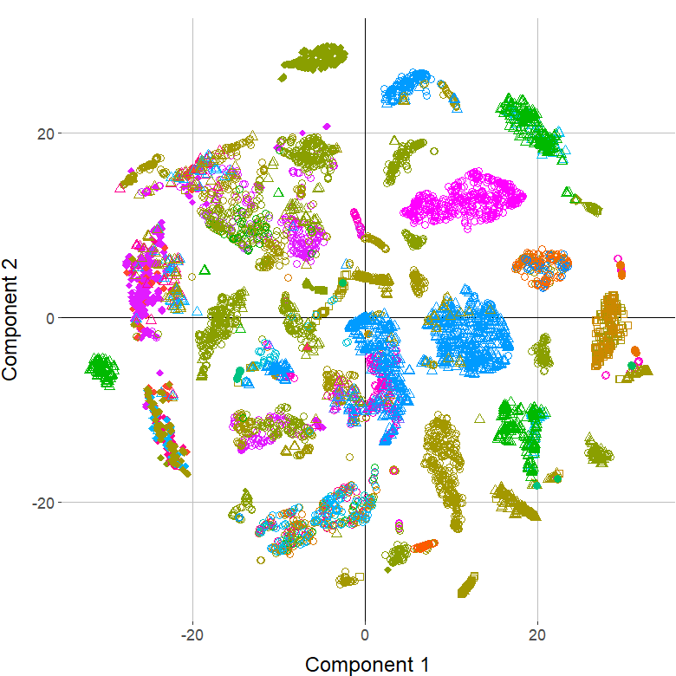
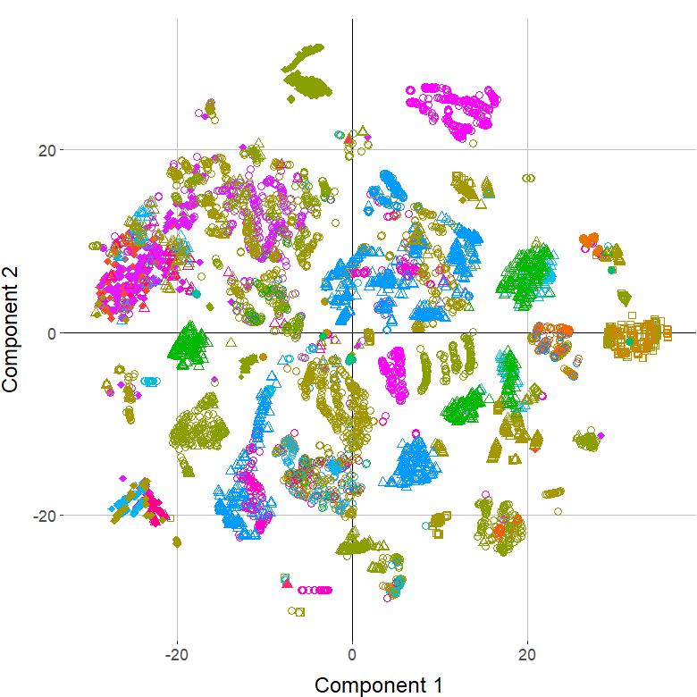
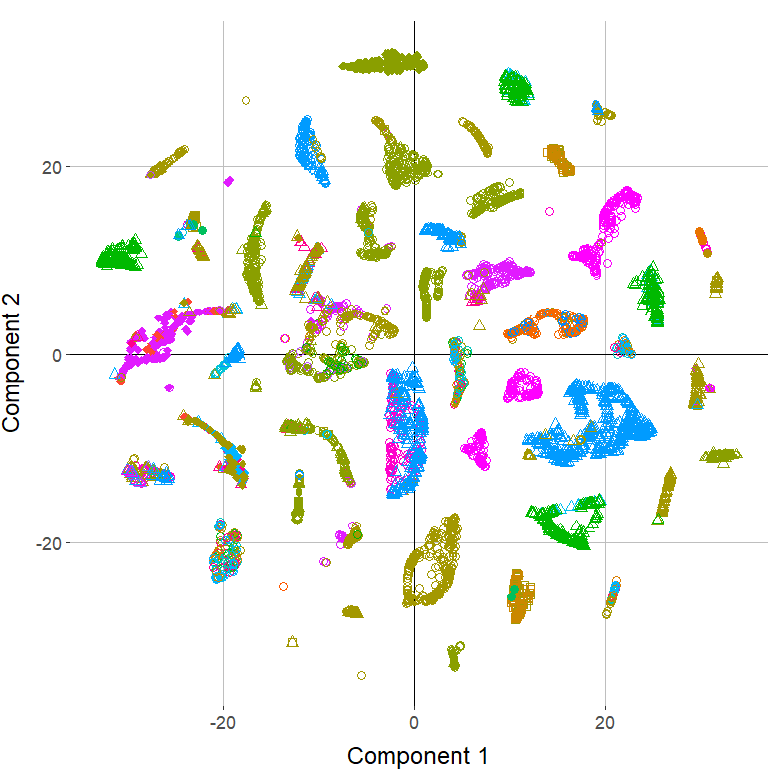
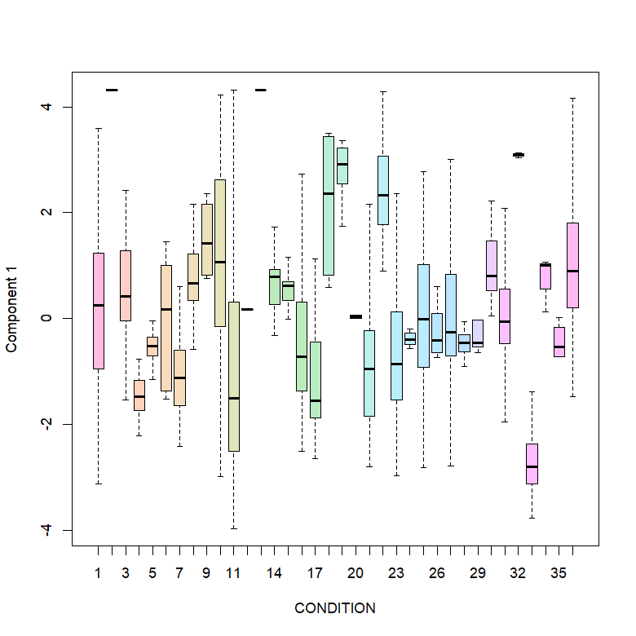
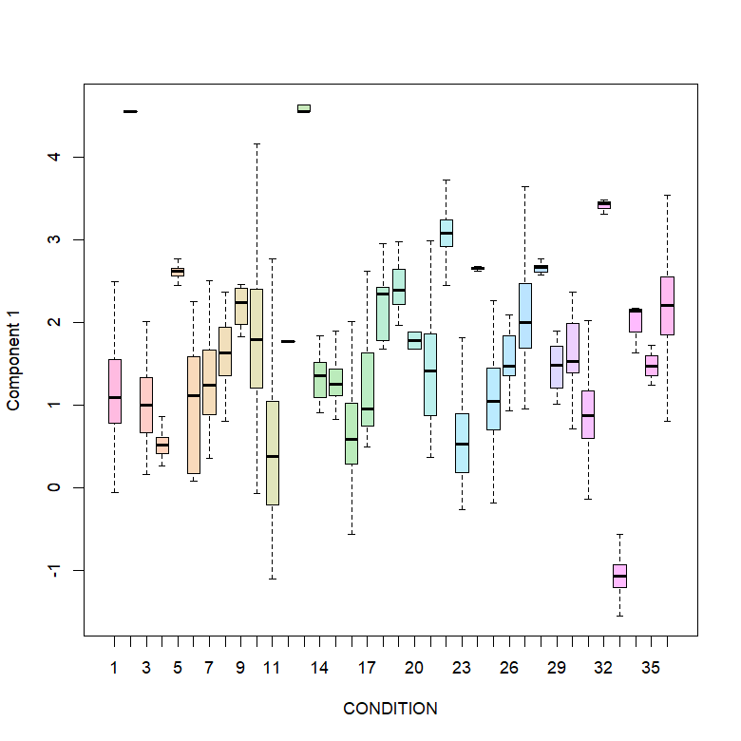
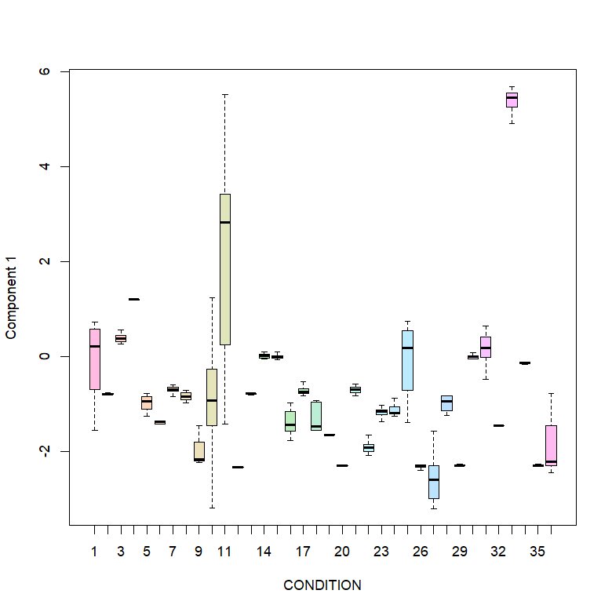
PCA
VAE
UMAP
Embedded Components
Reduction Statistics
tSNE After
Reduction
Analysis Settings
Custom Analyses
Grouped Boxplot
Plot Settings
Data Downloads

Slide 4
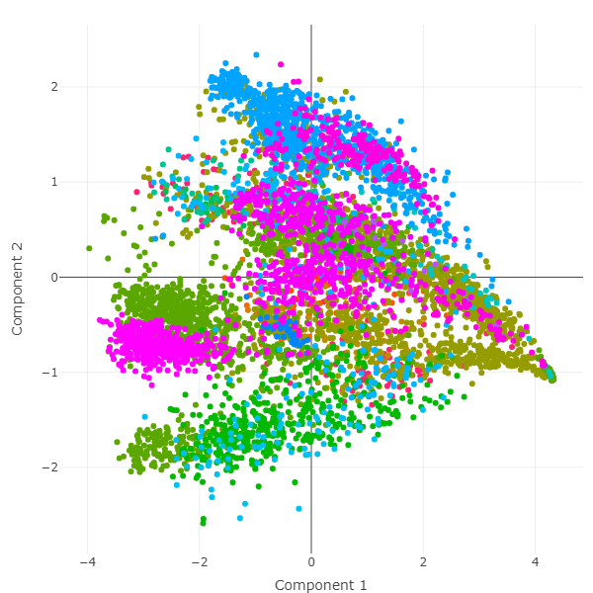
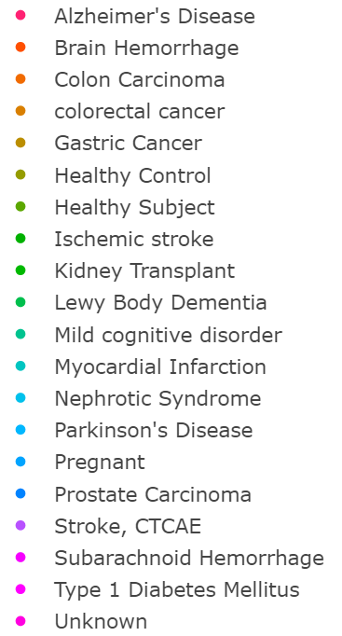
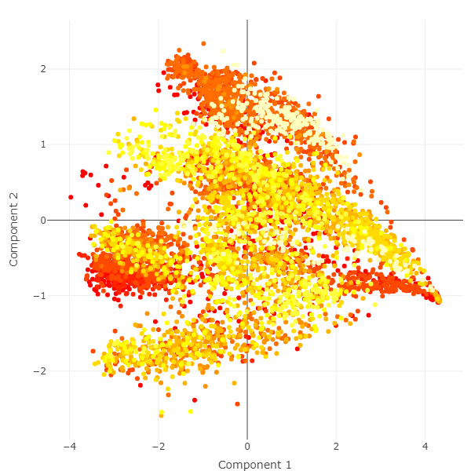
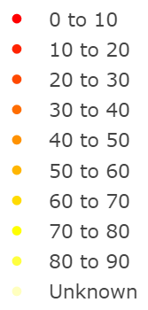
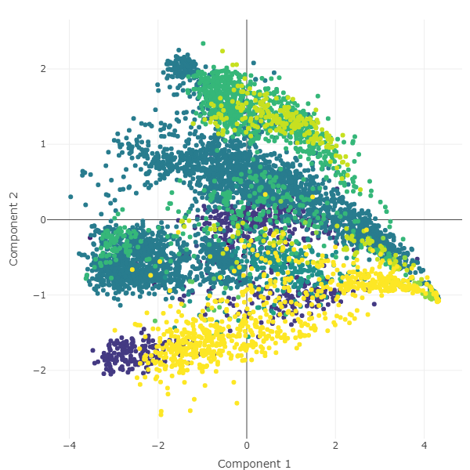
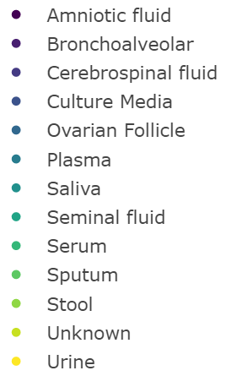
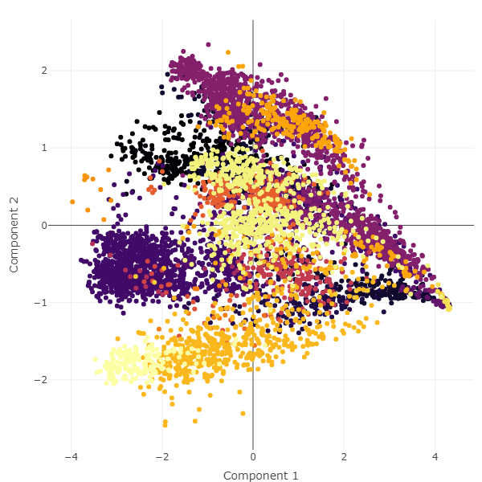
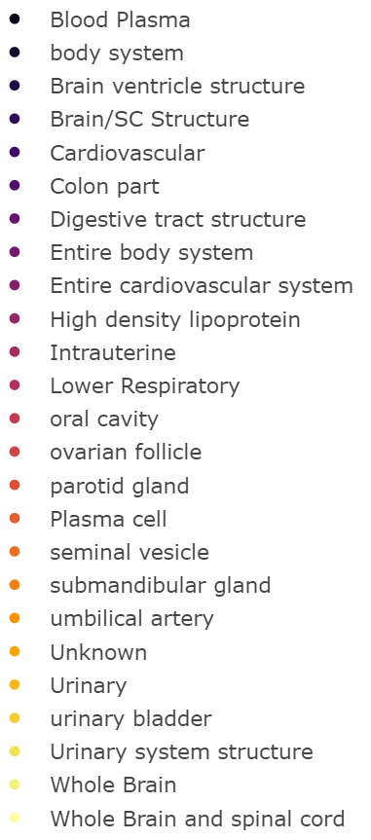
Label by Disease State
Label by Age Group
A
B
Label by Biofluid
Label by Tissue
C
D

Slide 5
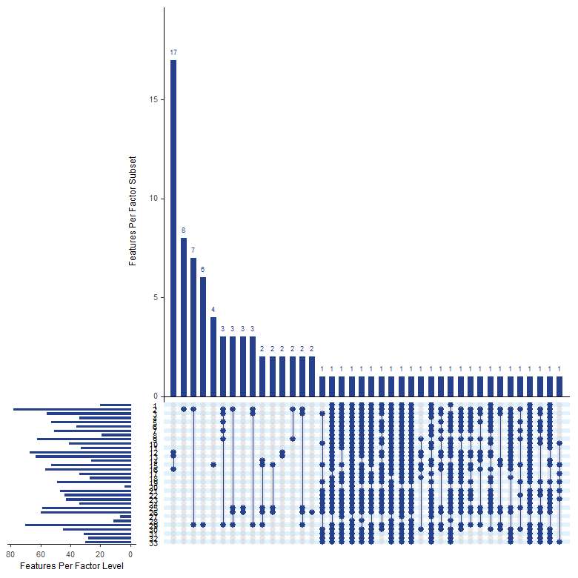
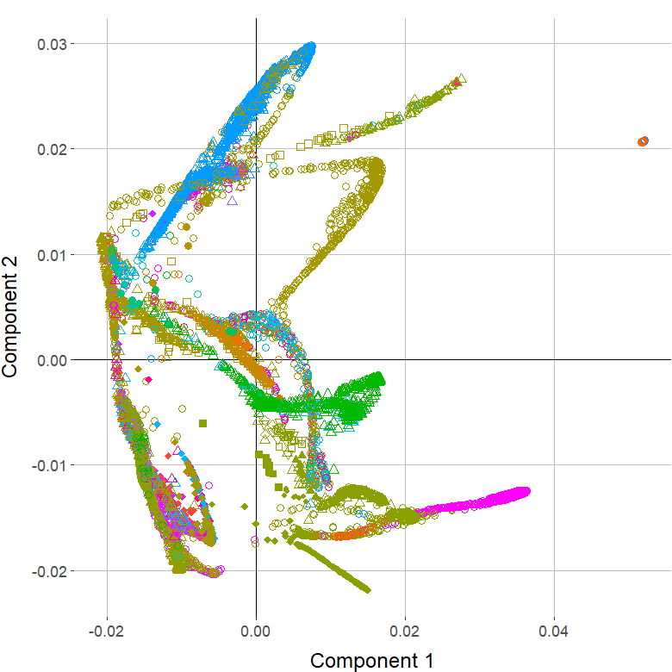
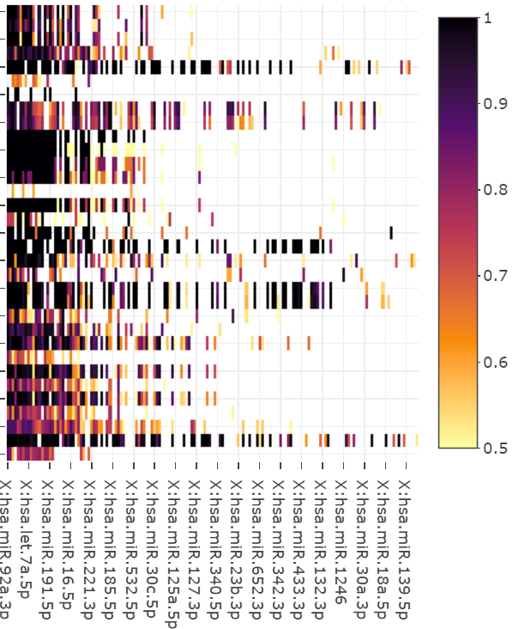
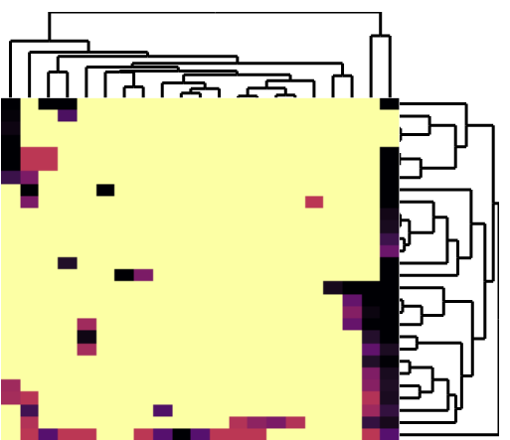
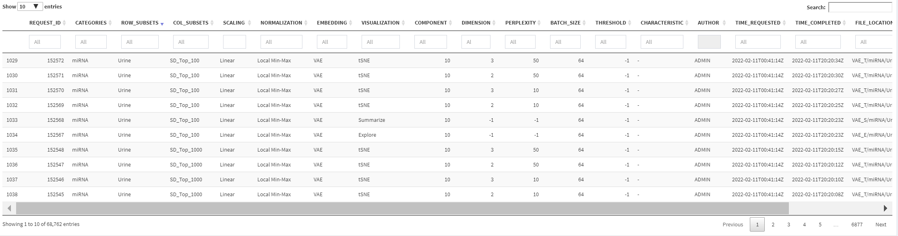
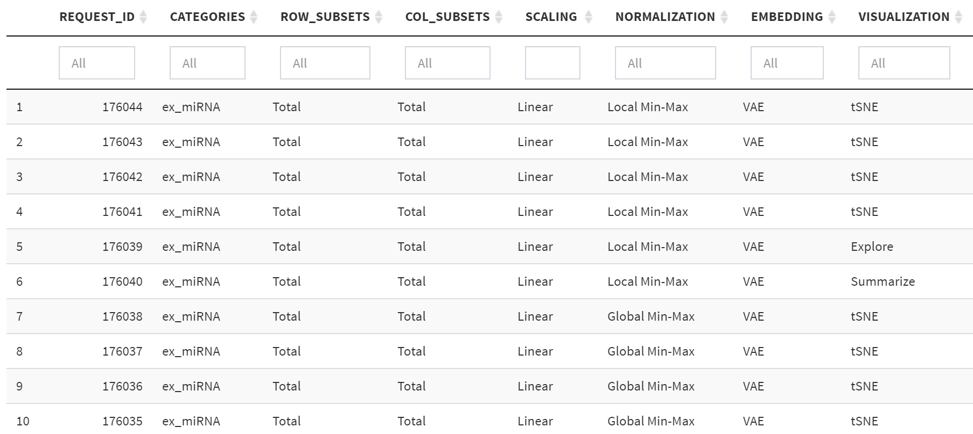
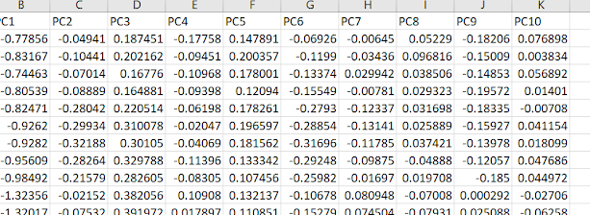
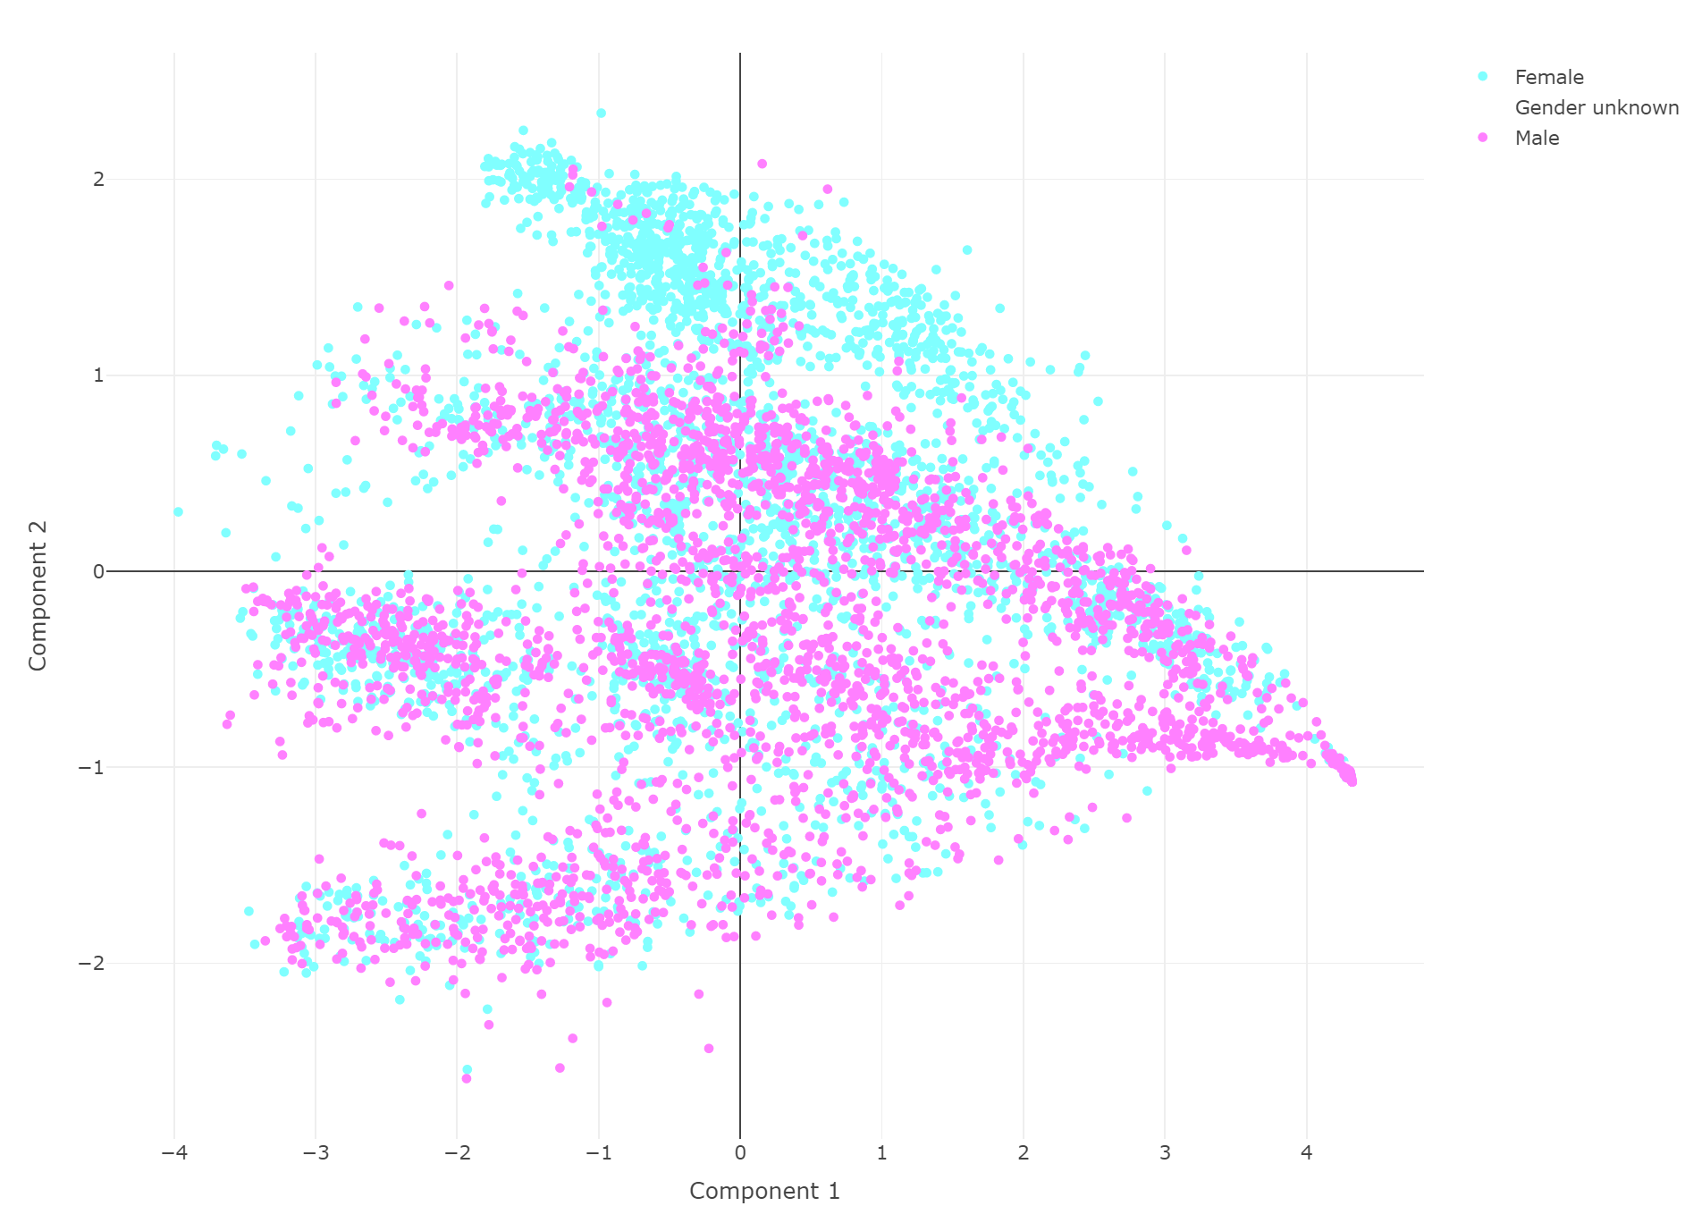
Supplemental Figure for Custom Analyses
Figure on Accessing the Tool?
Pipeline: Data → Subsets → Scaling → Normalization → Reduction → Plotting

Slide 6
Old Architecture
AWS S3
User
exRNA Cloud Storage
exRNA Local Storage
Repo
exRNA App
Interpreter
App Data 1
App
Code
App Data
App Code
App Data 2, …
Interpreter
App Code
EN-TEx App
EN-TEx Cloud Storage
EN-TEx Local Storage
App
Code
App Data
App Data
Pipeline
MNIST App
MNIST Cloud Storage
MNIST Local Storage
Pipeline Code (R, Python, C++)
App
Code
App Data
App Data

Slide 7
New Architecture
AWS S3
User
Repo
exRNA App
exRNA Cloud Storage
exRNA Local Storage
Interpreter
App
Code
App Data
App Data
App Data
App
App Data
App
Code
EN-TEx App
EN-TEx Cloud Storage
EN-TEx Local Storage
App
Code
App Data
App Data
App Data
Pipeline
MNIST App
MNIST Cloud Storage
MNIST Local Storage
Pipeline Code (R, Python, C++)
App
Code
App Data
App Data
App Data

