Slide 1
PhotoElectric
Experimental Collaboration From University of Colorado Denver
Kathryn Harris and Idriss Kacou
Associate Professor:

Slide 2
Light and matter
Light behaves both as a particle and a wave.
E = hf
Incident light transfers energy to matter as a particle
Electrons enter excited quantized states, allowing them to eject from the metal. This is what causes our observed current.
This contradicted early scientists’ expectations that light would transfer energy as a function of intensity. What we find is that intensity corresponds to current.
It will generally require the least amount of energy to excite a new electron instead of further exciting the first electron, so we see many electrons excited, inducing a current, rather than one electron in a higher state.

Slide 3
Work Functions
The overall accounting of energy exchange includes the existence of "work functions" that describe energy needed to free electrons from energy states within a metal. A complete interpretation of the experiment requires consideration of more than one work function. A deeper analysis would relate these work functions to band structures and density of states within the solid

Slide 4
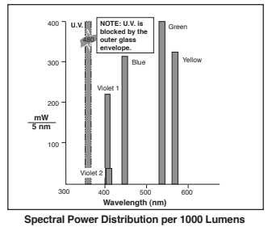
Light Source
We used a light source with a range of wavelengths and used filters to limit the incoming light to a single wavelength.
Convenient to only require one light source
Simple to set up – no angle calculations necessary and little room for error.
Rotating Prism and Slits
Can select any wavelength of light as long as it’s part of the light source. (Works with natural light)
Smaller angles than a diffraction grating
Grating Monochromator
Reflects wavelengths that prisms may not refract.
Set of collimated monochromatic light sources
No other wavelengths from the source removes room for wavelength-related error.

Slide 5
Picoammeter with built in capability to sweep biasing potentials.

Slide 6
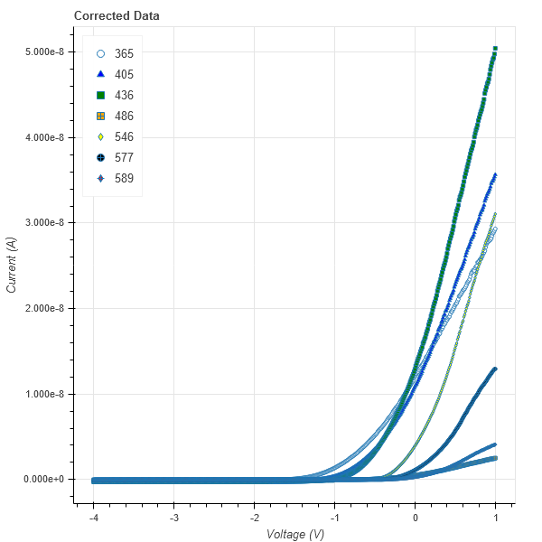
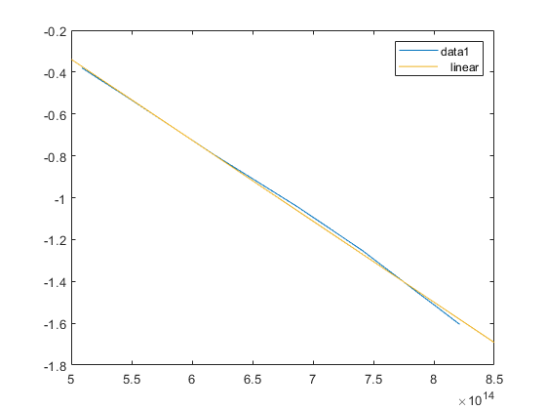
Data Analysis
 | Planck’s Constant | Work Function
Measured | 3.8673*10^-15[eVs] | 1.595[eV]
Expected | 4.1357*10^-15[eVs] | 2.29[eV]
%Difference | 6% | 30%

