Slide 1
N_armed_bandit_task

Slide 2
Contents
Introduction of Multi armed bandit task
Action Selection Problem
ε- greedy vs. softmax
Initial Optimistic Values
Reinforcement Comparison

Slide 3
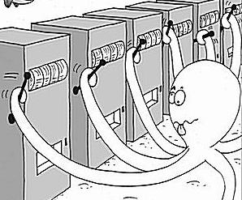
Multi armed bandit task
Imagine you are in a casino with a lot of slot machines
The aim of this task is to maximize your rewards in several trials.

Slide 4
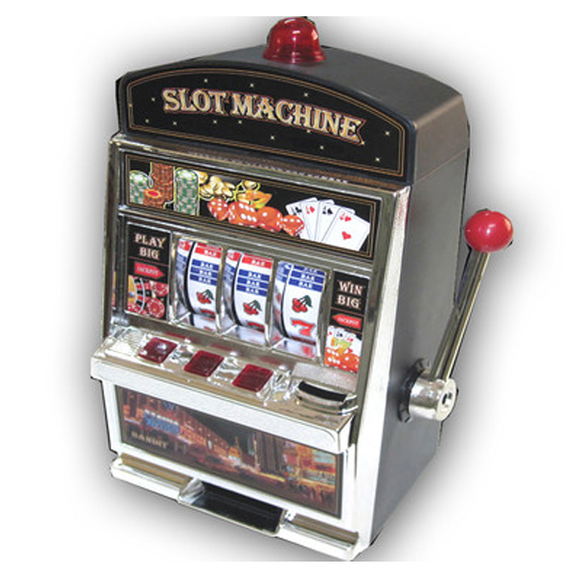

Multi armed bandit task
Your action is to start a bandit with action a_{k.}
Probability distribution p_{a} of rewards R_{n} is not known a priori.
R₁
R₂
R_{n}
• • •
a₂
a₁
a_{n}

Slide 5
ε-greedy

Slide 6
Softmax

Slide 7
ε-greedy vs. softmax

Slide 8
Optimistic initial values

Slide 9
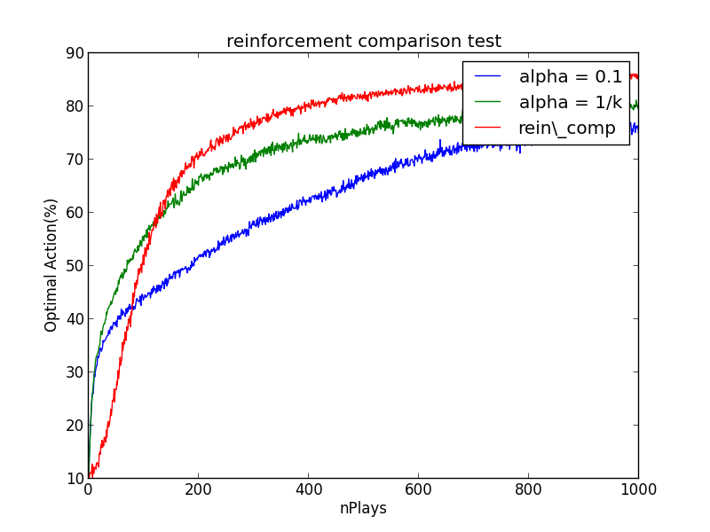


Reinforcement Comparison
Θ_{t}(a): preference of action a at time t
Policy: The probability to select an action a
Update the preference and reference reward

Slide 10
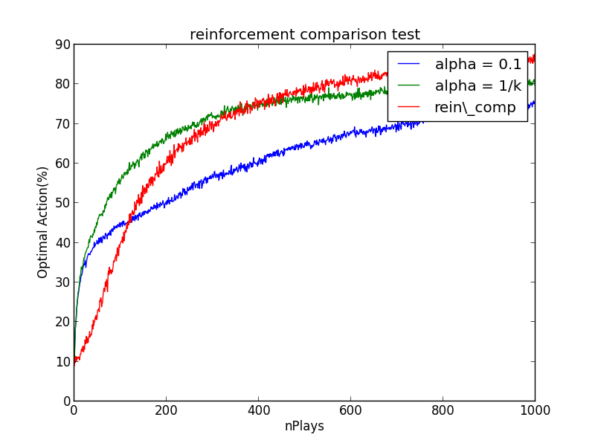
Reinforcement Comparison
Θ_{t}(a): preference of action a at time t
Policy: The probability to select an action a
Update the preference and reference reward

