Slide 1
Smart Event
Booking Pro
Full-Stack Web Application with Responsible AI Integration
PHP + MySQL
Secure Login
AI Help Assistant
Cheki Dorji (CIHE250699) | Sonam Dechen (CIHE231620) | Subodh Dhungel (CIHE231762)
ICT203 Web Application Development • Assessment 3
Notes:
Good morning everyone. Today we are presenting Smart Event Booking Pro, our ICT203 full-stack web application with responsible AI integration. The project is designed for a local event organiser. It allows users to browse events and request tickets, while administrators manage events, bookings, users and system records.

Slide 2
Project overview
Scenario, Problem and Users
Client scenario
A local events organiser needs a secure and responsive system to manage event listings and ticket requests.
Current challenge
Required solution
Main users
Manual bookings through emails or spreadsheets can cause duplicated records, slow updates and missing booking information.
A database-driven web application with login, CRUD, search/filter, validation and responsible AI support.
Standard users book tickets. Admins manage events and bookings. The organiser monitors activity and system records.
Project goal: planning → build → test → deploy
Smart Event Booking Pro
Notes:
This slide explains the scenario. We selected the local event organiser option because it clearly fits an event and booking workflow. The problem is that manual event booking can be slow and inaccurate. Our system solves this by keeping event data, user accounts, bookings and admin actions in a structured database.

Slide 3
Features
Final Solution Overview
The system provides two clear workflows
Standard User
Database
Admin
Register and login
Browse event list
Search/filter events
Request tickets
Check booking status
Users
Events
Bookings
Activity logs
AI suggestions
Manage events
Review bookings
Update status
Check activity
Maintain FAQ content
Must-have requirements covered: Authentication, role access, CRUD, search/filter, validation, responsive UI and auditability.
Smart Event Booking Pro
Notes:
Here we show the main solution. Standard users can register, log in, browse events and submit booking requests. The database stores users, events, bookings, activity logs and AI suggestions. Admin users manage the records and maintain the system. This directly covers the assessment's must-have requirements.

Slide 4
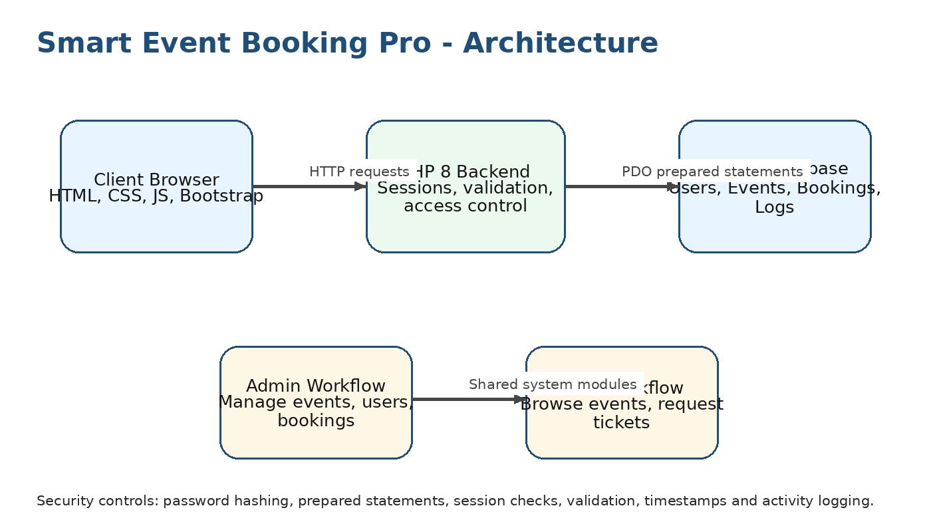
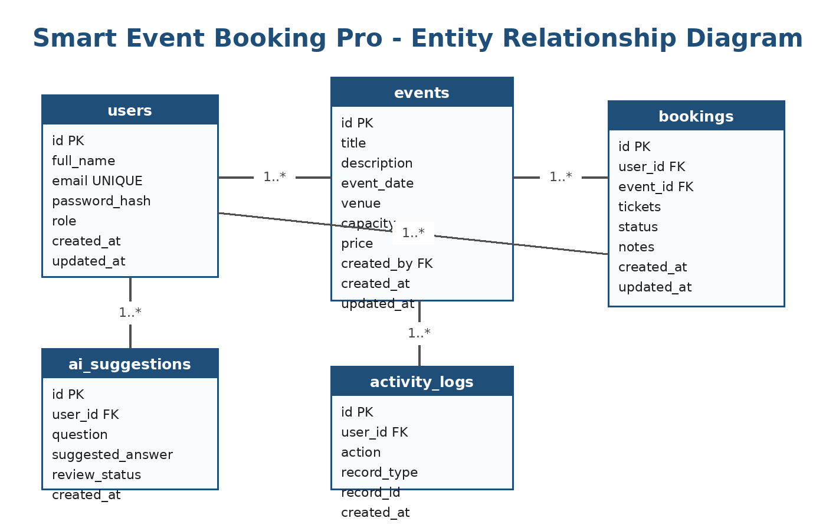
System design
Architecture and Database Design
Design logic
Client
Server
Database
Browser sends requests to PHP backend.
PHP validates input and uses PDO.
MySQL stores users, events and logs.
Smart Event Booking Pro
Notes:
This slide explains our technical design. The architecture has three main parts: the client browser, PHP backend and MySQL database. The ERD shows the main tables. Users can create bookings, events can receive many bookings, and logs provide auditability. This design keeps the system simple, maintainable and suitable for XAMPP deployment.

Slide 5
Live demo plan
Demo Flow and Key Pages
Recommended live demo order
1
Login
Show admin login with password_verify and session creation.
2
Admin Dashboard
Explain role-based access and protected admin pages.
3
Event CRUD
Create or edit an event and show validation messages.
4
User Booking
Login as user, search an event and submit ticket request.
5
AI Help
Ask a help question and show human review disclaimer.
Tip for class: open login.php first, then move to admin/events.php and booking pages.
Smart Event Booking Pro
Notes:
For the live demo, we should not click randomly. We should follow this order: login, admin dashboard, event management, user booking, and AI Help Assistant. While showing login, explain that passwords are not stored as plain text. While showing event CRUD, explain validation and prepared statements. While showing booking, explain the real business workflow.

Slide 6
Security
Security and Data Handling
Authentication
Access control
Database security
PHP sessions, password_hash and password_verify protect accounts and login workflow.
Admin-only pages check the logged-in user role before allowing actions.
PDO prepared statements reduce SQL injection risk in forms and search.
Validation
Auditability
AI safety
Client-side and server-side checks reduce incorrect or incomplete records.
created_at, updated_at, created_by and activity logs support accountability.
No sensitive data is sent to public AI tools; responses require human review.
Smart Event Booking Pro
Notes:
Security is a major marking area. Our system applies password hashing, session handling, admin role checks, prepared statements, validation and activity logs. The AI feature also has safety controls. We keep AI low-risk by using curated FAQ content and adding a human review disclaimer.

Slide 7
AI integration
Responsible AI Feature
Chosen AI option: Smart Assistant
The assistant answers common system-use questions using a curated FAQ/knowledge base.
Question
Curated FAQ
Review
Save
User asks how to use the system.
System matches safe local content.
User checks and edits the output.
Log accepted response.
Disclaimer shown to users: AI-generated content requires human review. Do not enter sensitive personal data.
Smart Event Booking Pro
Notes:
Our required AI integration is the Smart Help Assistant. It is low risk because it answers only system-use questions using curated FAQ content. The important governance points are human review, no sensitive data in public AI tools, clear disclaimer, logging of accepted suggestions and scope limitation.

Slide 8
Conclusion
Testing, Teamwork and Final Delivery
Testing evidence
Team contribution
Submission package
14 planned test cases cover login, role access, event CRUD, booking validation, search/filter, AI assistant, responsiveness and activity logging.
Cheki coordinated and documented. Sonam led front-end and UX. Subodh led back-end, database and security.
GitHub repository, working app, database.sql, README, documentation pack, test evidence and presentation slides.
Final message
Smart Event Booking Pro demonstrates a secure, maintainable and responsible full-stack solution for local event booking.
Smart Event Booking Pro
Notes:
To finish the presentation, explain the testing and teamwork evidence. We have a complete documentation pack and a clear submission structure. End by saying that the project meets the full-stack, security, testing and responsible AI requirements for ICT203 Assessment 3.

