Slide 2
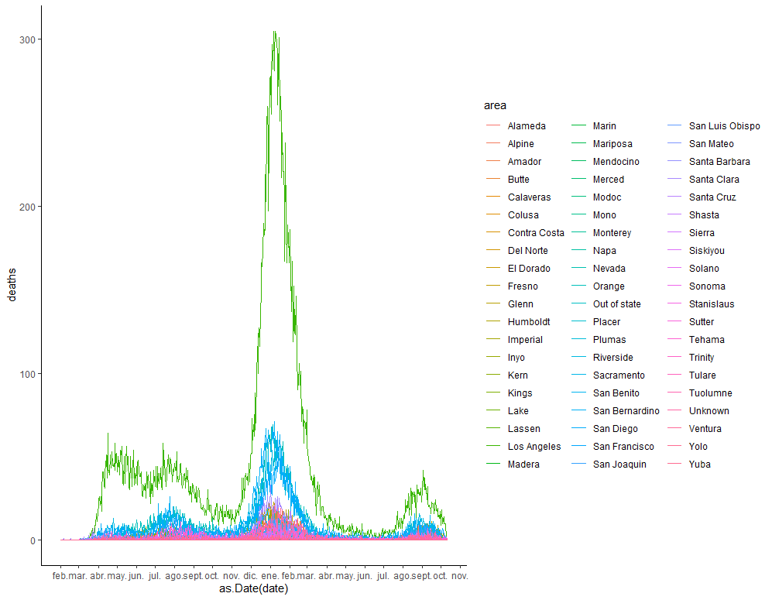
We need to pick a time frame to perform the models, we could focus on the last wave from August 2021-to today

Slide 3
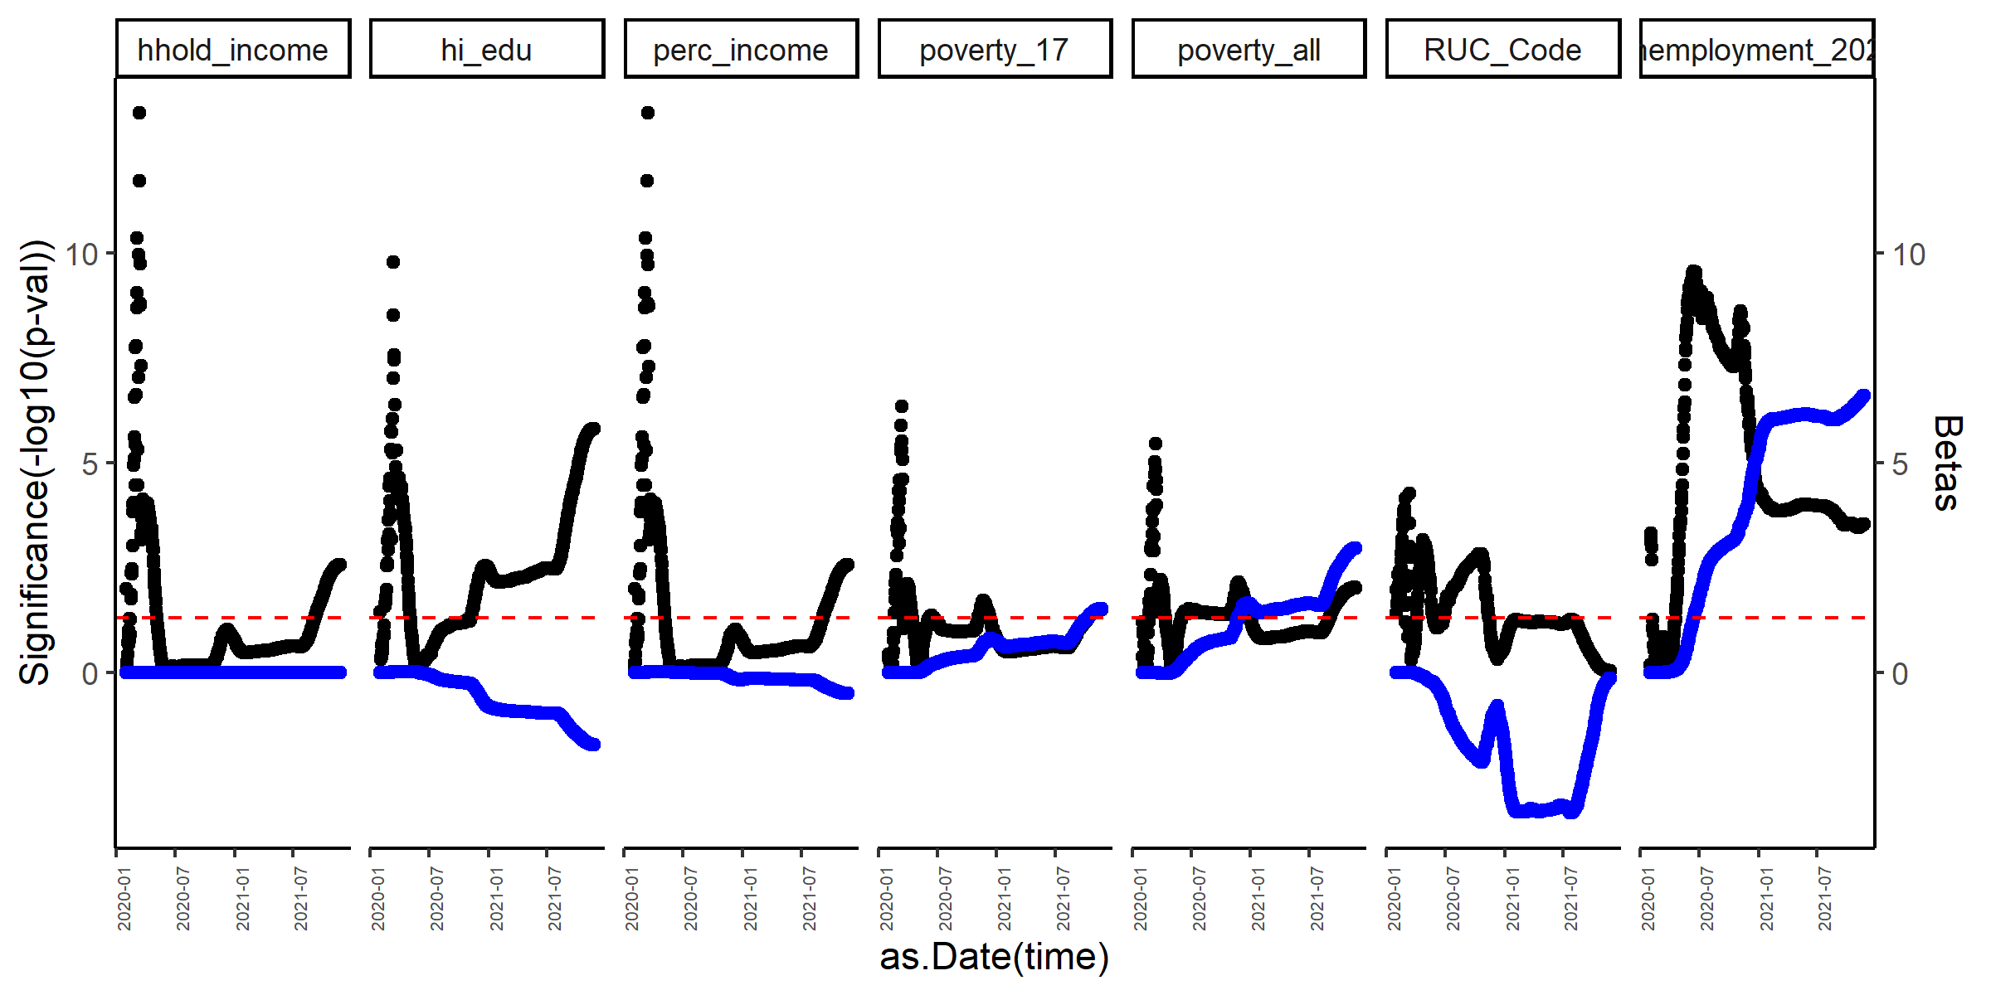
Graph of p-values and betas from Incidence of COVID-19 as a function of different demographic variables in the counties of CA over time
Beta blue, p-value black. Red line is p-value = 0.05
These variables change overtime.
From August 2021-to today (new wave of Covid), household income, percentage higher education and rurality (RUC codes) are negatively associated with incidence.
Percentage poverty from all populations and under 17, and percentage unemployment are positively associated with Incidence.
*We could include the R-squared.

Slide 4
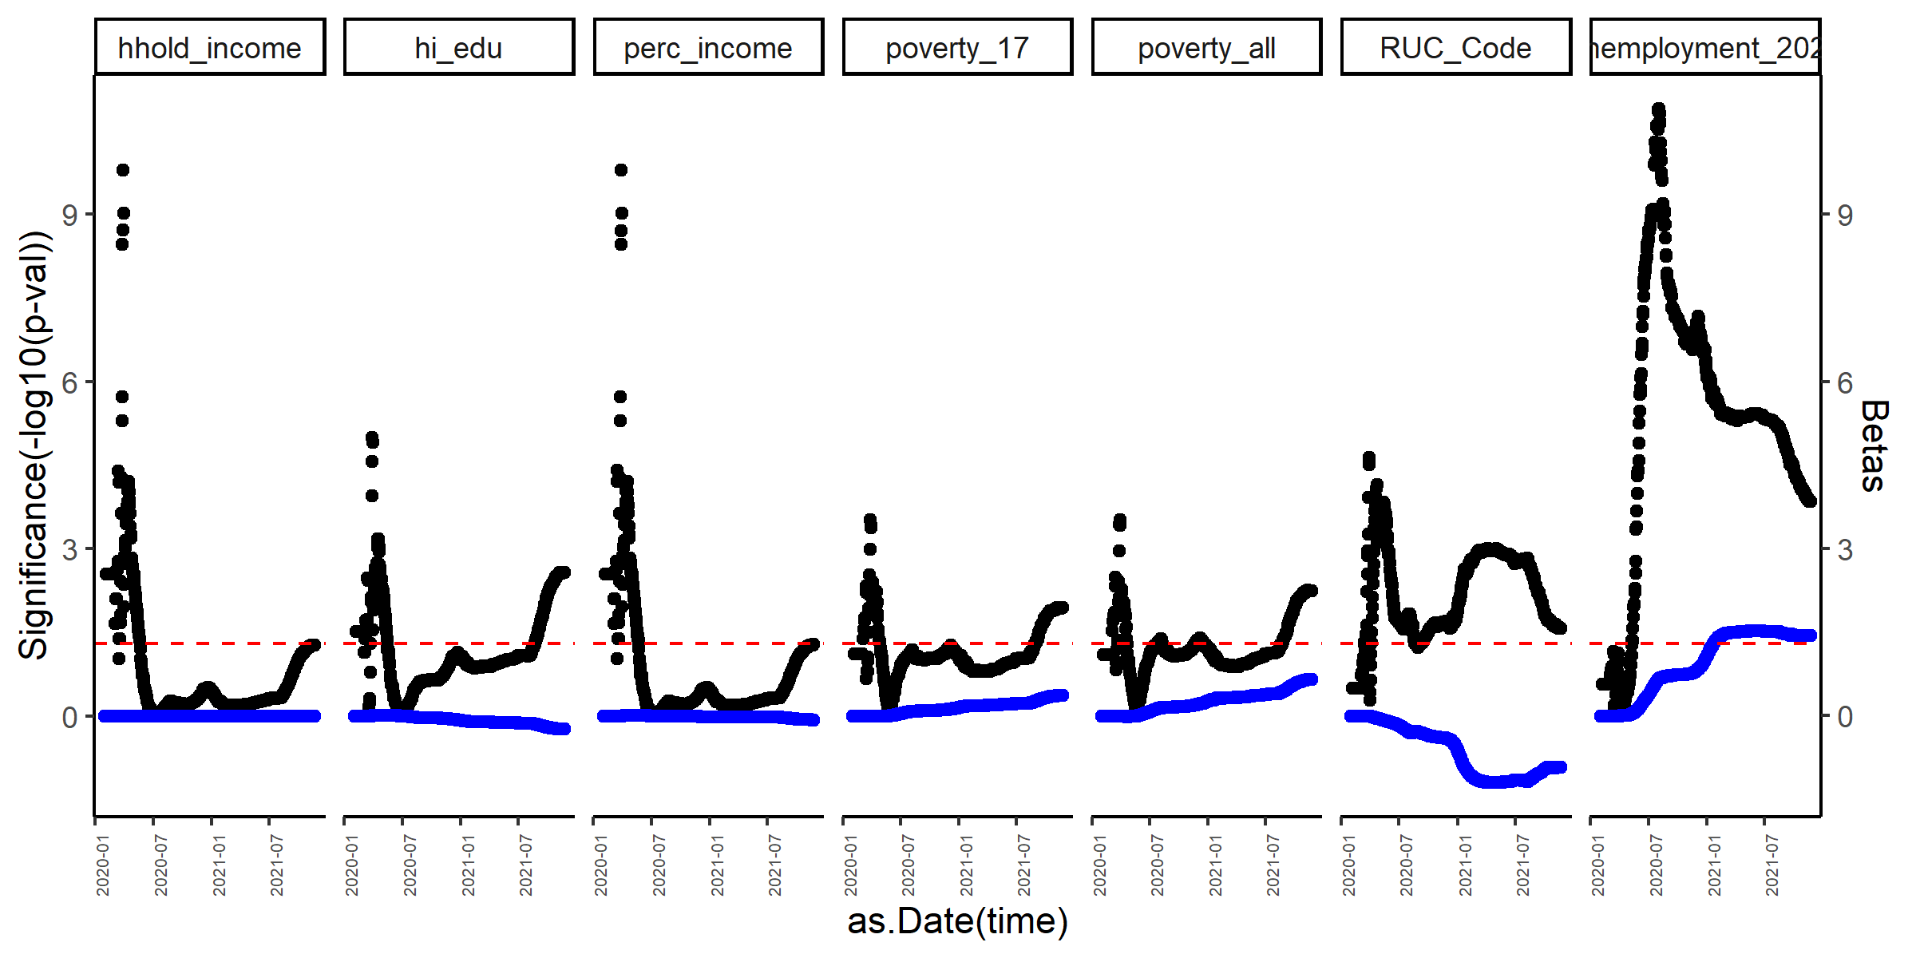
Graph of p-values and betas from Mortality of COVID-19 as a function of different demographic variables in the counties of CA over time
Beta blue, p-value black. Red line is p-value = 0.05
These variables change overtime.
Similar to Incidence: From August 2021-to today (new wave of Covid), household income, percentage higher education and rurality (RUC codes) are negatively associated with incidence.
Percentage poverty from all populations and under 17, and percentage unemployment are positively associated with Incidence.

Slide 5
Between Aug01- Today Univariate model for Incidence
 | beta | rsq | pval
diff_ntest | 0.007453 | 0.012856 | 0.19221
unemployment_2020 | 0.000546 | -0.00876 | 0.480285
perc_income | -0.00033 | 0.364076 | 3.21E-07
hhold_income | -4.06E-07 | 0.364199 | 3.20E-07
RUC_Code | 0.003179 | 0.258027 | 2.80E-05
poverty_all | 0.001347 | 0.130298 | 0.003127
poverty_17 | 0.000812 | 0.126325 | 0.003593
hi_edu | -0.00074 | 0.376452 | 1.83E-07
nfullyvacc | -0.08789 | 0.493267 | 4.86E-10
Household income, percentage of people with high education (college), and number of fully vaccinated people (normalized by population) are negatively associated with Incidence of COVID-19
Rurality and percentage of poverty are positively associated with COVID-19 incidence.

Slide 6
Between Aug01- Today Univariate model for Mortality
 | beta | rsq | pval
diff_ntest | 0.000108 | 0.001469 | 0.302312
unemployment_2020 | -7.28E-06 | -0.01306 | 0.608512
perc_income | -4.65E-06 | 0.211877 | 0.000164
hhold_income | -5.78E-09 | 0.212069 | 0.000163
RUC_Code | 2.42E-05 | 0.029548 | 0.103736
poverty_all | 2.63E-05 | 0.149553 | 0.001587
poverty_17 | 1.42E-05 | 0.113373 | 0.00564
hi_edu | -1.11E-05 | 0.241479 | 5.33E-05
nfullyvacc | -0.00142 | 0.377058 | 1.78E-07
Household income, percentage of people with high education (college), and number of fully vaccinated people (normalized by population) are negatively associated with mortality of COVID-19
Rurality and percentage of poverty are positively associated with COVID-19 mortality.

Slide 7
Multiple linear regression, Incidence outcome
Incidence ~ nfullyvacc + hi_edu + poverty_17 + poverty_all + RUC_Code + hhold_income + unemployment_2020 + ntest
Coefficients:
Estimate Std. Error t value Pr(>|t|)
(Intercept) 8.920e-02 1.956e-02 4.561 3.53e-05 ***
mtable$nfullyvacc -6.397e-02 2.627e-02 -2.435 0.01864 *
mtable$hi_edu -7.656e-05 3.112e-04 -0.246 0.80674
mtable$poverty_17 2.086e-04 6.353e-04 0.328 0.74413
mtable$poverty_all -1.572e-03 1.116e-03 -1.408 0.16554
mtable$RUC_Code 7.903e-04 8.135e-04 0.971 0.33620
mtable$hhold_income -8.929e-06 5.643e-05 -0.158 0.87495
mtable$perc_income 6.976e-03 4.534e-02 0.154 0.87838
mtable$unemployment_2020 3.269e-04 7.747e-04 0.422 0.67495
mtable$diff_ntest 1.346e-02 4.448e-03 3.026 0.00397 **
---
Signif. codes: 0 ‘***’ 0.001 ‘**’ 0.01 ‘*’ 0.05 ‘.’ 0.1 ‘ ’ 1
Residual standard error: 0.009422 on 48 degrees of freedom
Multiple R-squared: 0.6351, Adjusted R-squared: 0.5666
F-statistic: 9.281 on 9 and 48 DF, p-value: 5.483e-08
After adjusting the model, Normalized n of fully vaccinated people and normalized n of tests are significantly associated with lower incidence.
These are confounders of other demographic variables when using univariate models.

Slide 8
Multiple linear regression, Mortality outcome
Mortality ~ nfullyvacc + hi_edu + poverty_17 + poverty_all + RUC_Code + hhold_income + unemployment_2020 + ntest
Coefficients:
Estimate Std. Error t value Pr(>|t|)
(Intercept) 1.348e-03 4.249e-04 3.172 0.00264 **
mtable$nfullyvacc -8.572e-04 5.708e-04 -1.502 0.13971
mtable$hi_edu -4.321e-06 6.763e-06 -0.639 0.52595
mtable$poverty_17 5.905e-06 1.381e-05 0.428 0.67074
mtable$poverty_all -3.575e-06 2.425e-05 -0.147 0.88342
mtable$RUC_Code -2.641e-05 1.768e-05 -1.494 0.14176
mtable$hhold_income -9.379e-07 1.226e-06 -0.765 0.44813
mtable$perc_income 7.519e-04 9.853e-04 0.763 0.44912
mtable$unemployment_2020 -3.082e-05 1.683e-05 -1.831 0.07332 .
mtable$diff_ntest 1.639e-04 9.665e-05 1.696 0.09640 .
---
Signif. codes: 0 ‘***’ 0.001 ‘**’ 0.01 ‘*’ 0.05 ‘.’ 0.1 ‘ ’ 1
Residual standard error: 0.0002047 on 48 degrees of freedom
Multiple R-squared: 0.4881, Adjusted R-squared: 0.3921
F-statistic: 5.085 on 9 and 48 DF, p-value: 7.874e-05
After adjusting the model, only Normalized n of fully vaccinated people is negatively associated with lower mortality.
Percentage of unemployment and number of tests have a trend with the outcome of COVID-19 mortality.

Slide 9
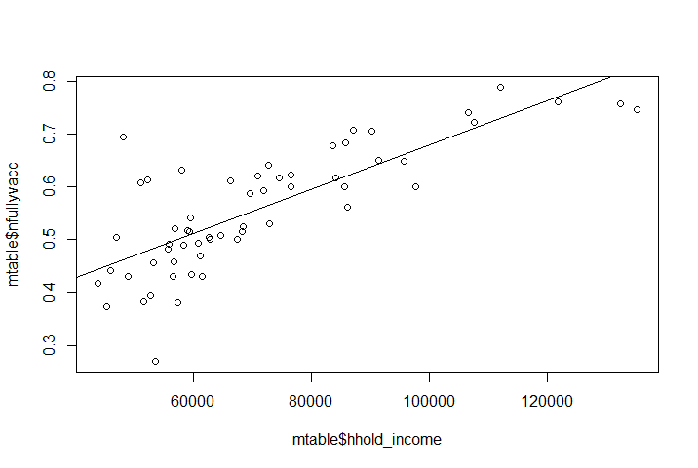
Vaccination status is a confounder of demographic variables like Household income
Coefficients:
Estimate Std. Error t value Pr(>|t|)
(Intercept) 2.588e-01 3.277e-02 7.897 1.14e-10 ***
mtable$hhold_income 4.204e-06 4.417e-07 9.518 2.66e-13 ***
---
Signif. codes: 0 ‘***’ 0.001 ‘**’ 0.01 ‘*’ 0.05 ‘.’ 0.1 ‘ ’ 1
Residual standard error: 0.07196 on 56 degrees of freedom
Multiple R-squared: 0.618, Adjusted R-squared: 0.6112
F-statistic: 90.59 on 1 and 56 DF, p-value: 2.655e-13

