Slide 2
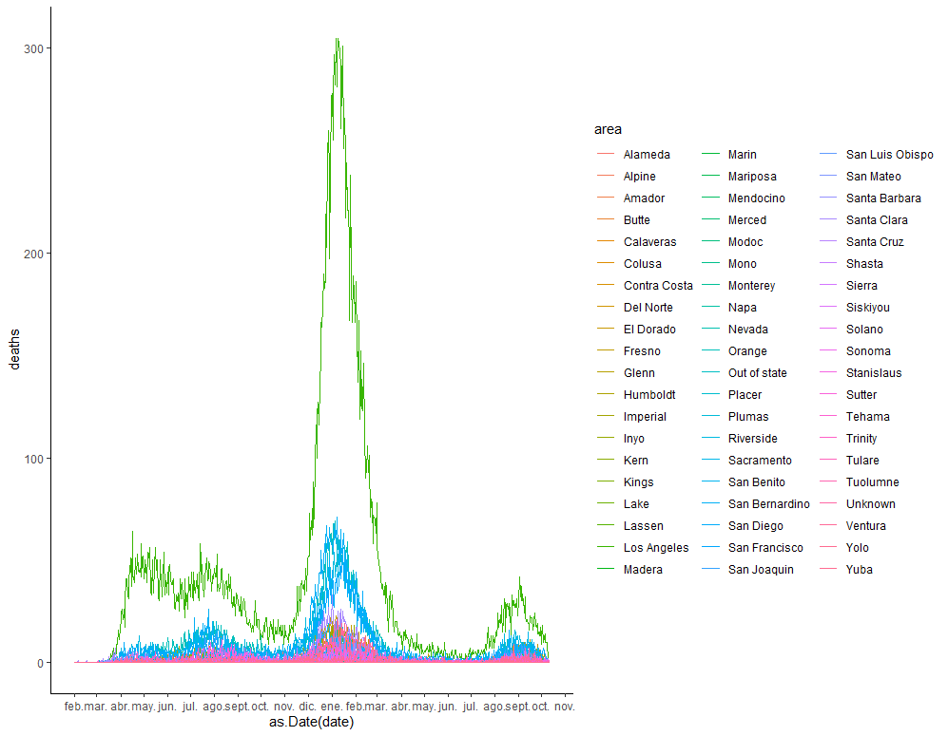
We need to pick a time frame to perform the models, we could focus on the last wave from August 2021-to today

Slide 3
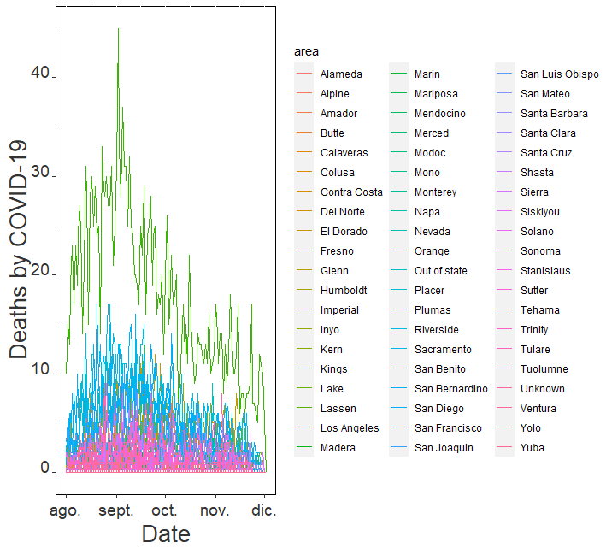
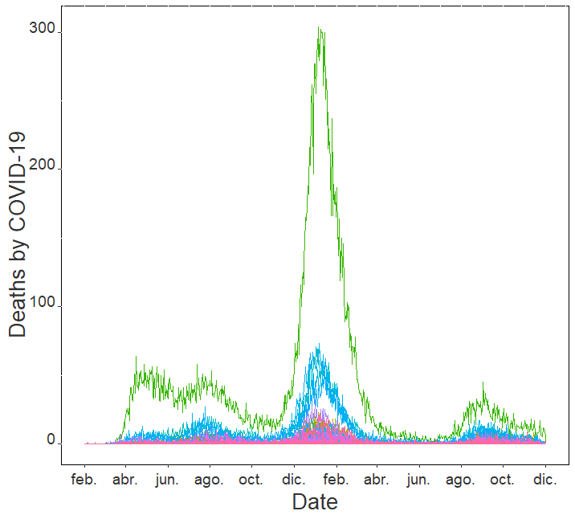
How is the pandemic changing overtime at the county level in CA?
Notes:
Before we decided to use this timeframe (from August to today). The first question we had was in which part of the pandemic we were going to focus on. To decide this, first we made a graph to evaluate how the pandemic was changing overtime at the county level in CA.
Here you can see the different waves blablabla
(Could mention some of the counties)

Slide 4
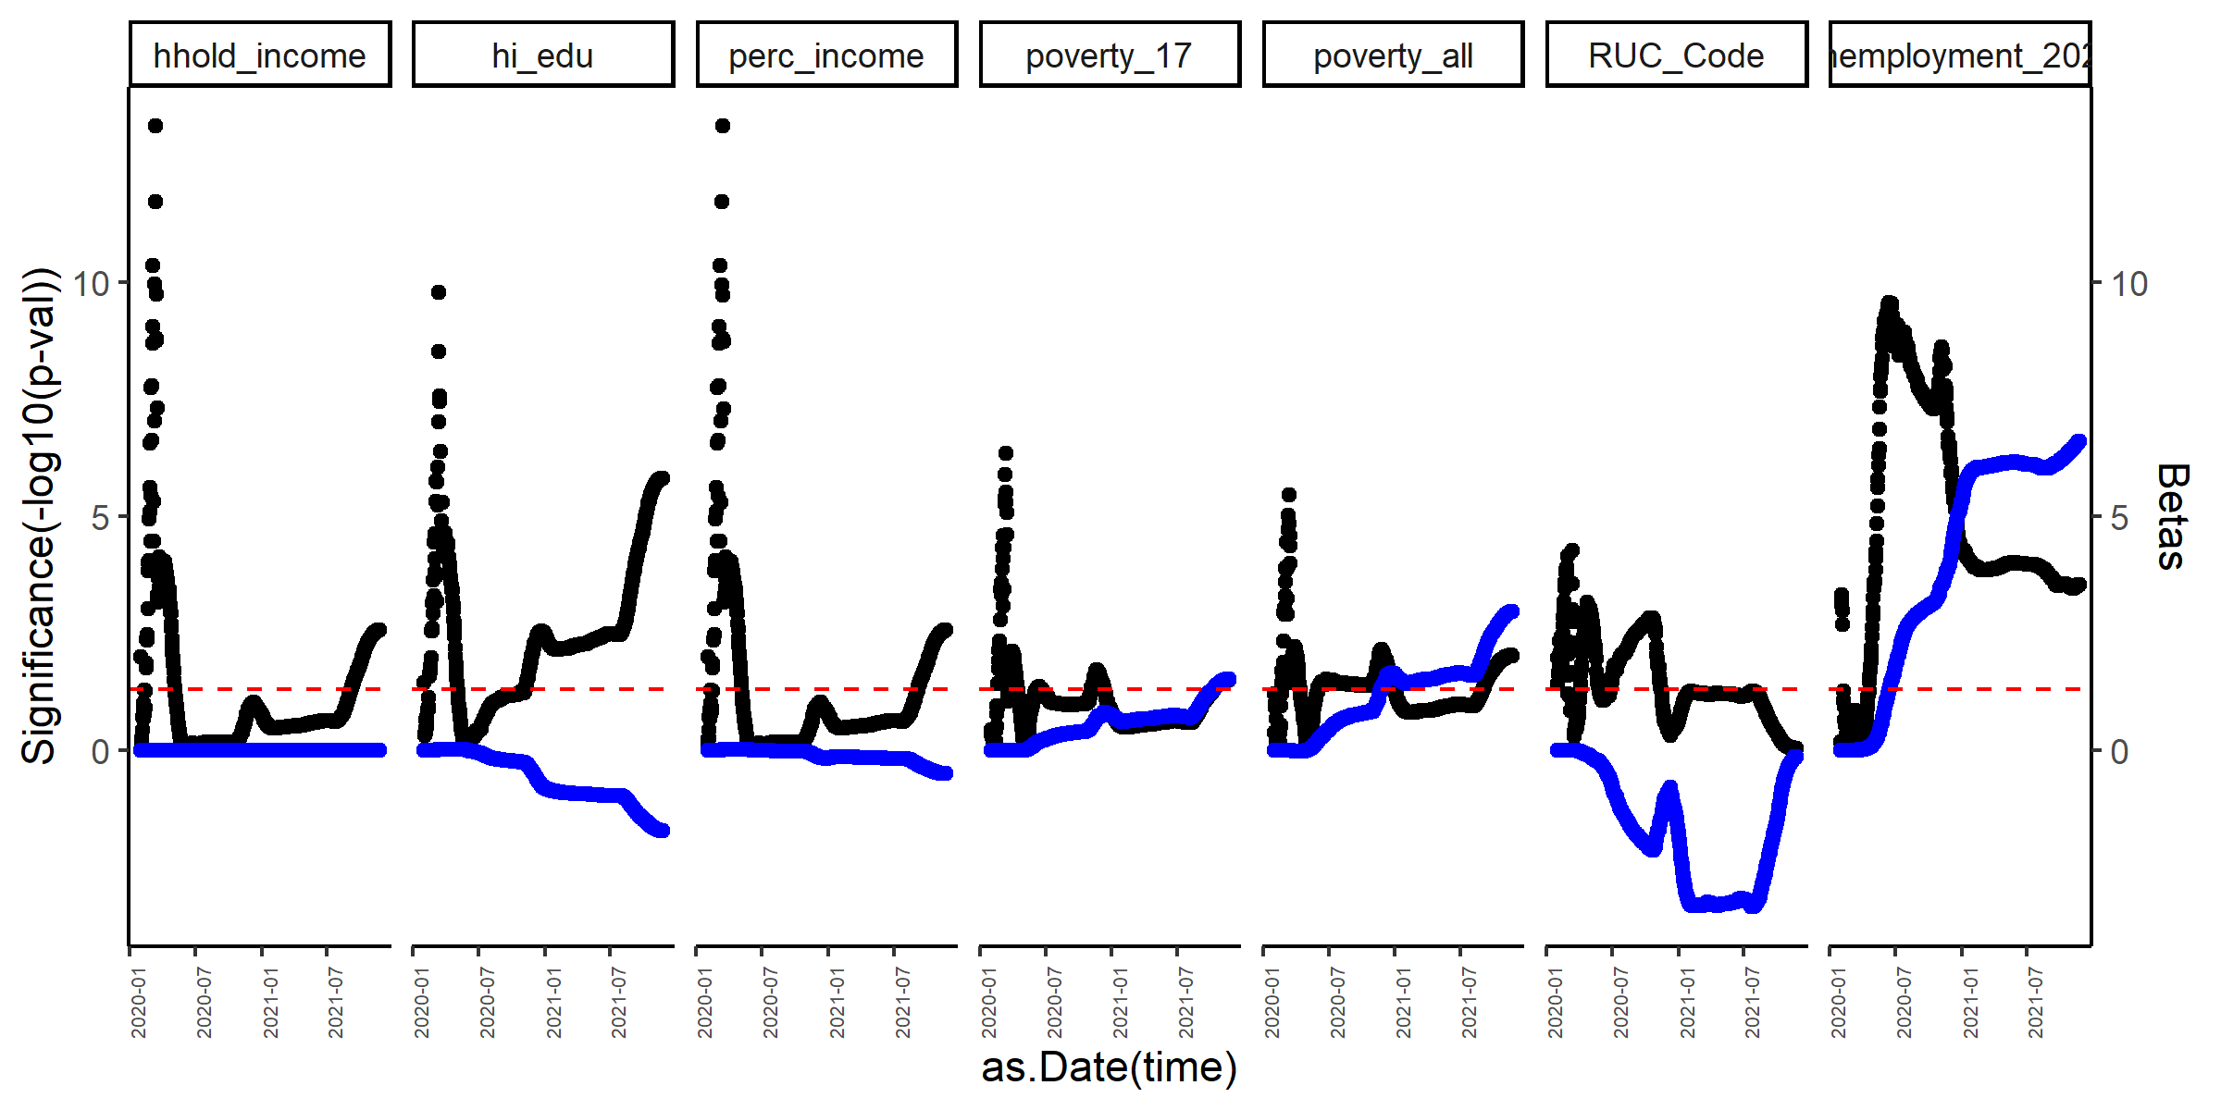
Graph of p-values and betas from Incidence of COVID-19 as a function of different demographic variables in the counties of CA over time: incidence ~ demographic variable
Beta blue, p-value black. Red line is p-value = 0.05
These variables change overtime.
From August 2021-to today (new wave of Covid), household income, percentage higher education and rurality (RUC codes) are negatively associated with incidence.
Percentage poverty from all populations and under 17, and percentage unemployment are positively associated with Incidence.
*We could include the R-squared.

Slide 5
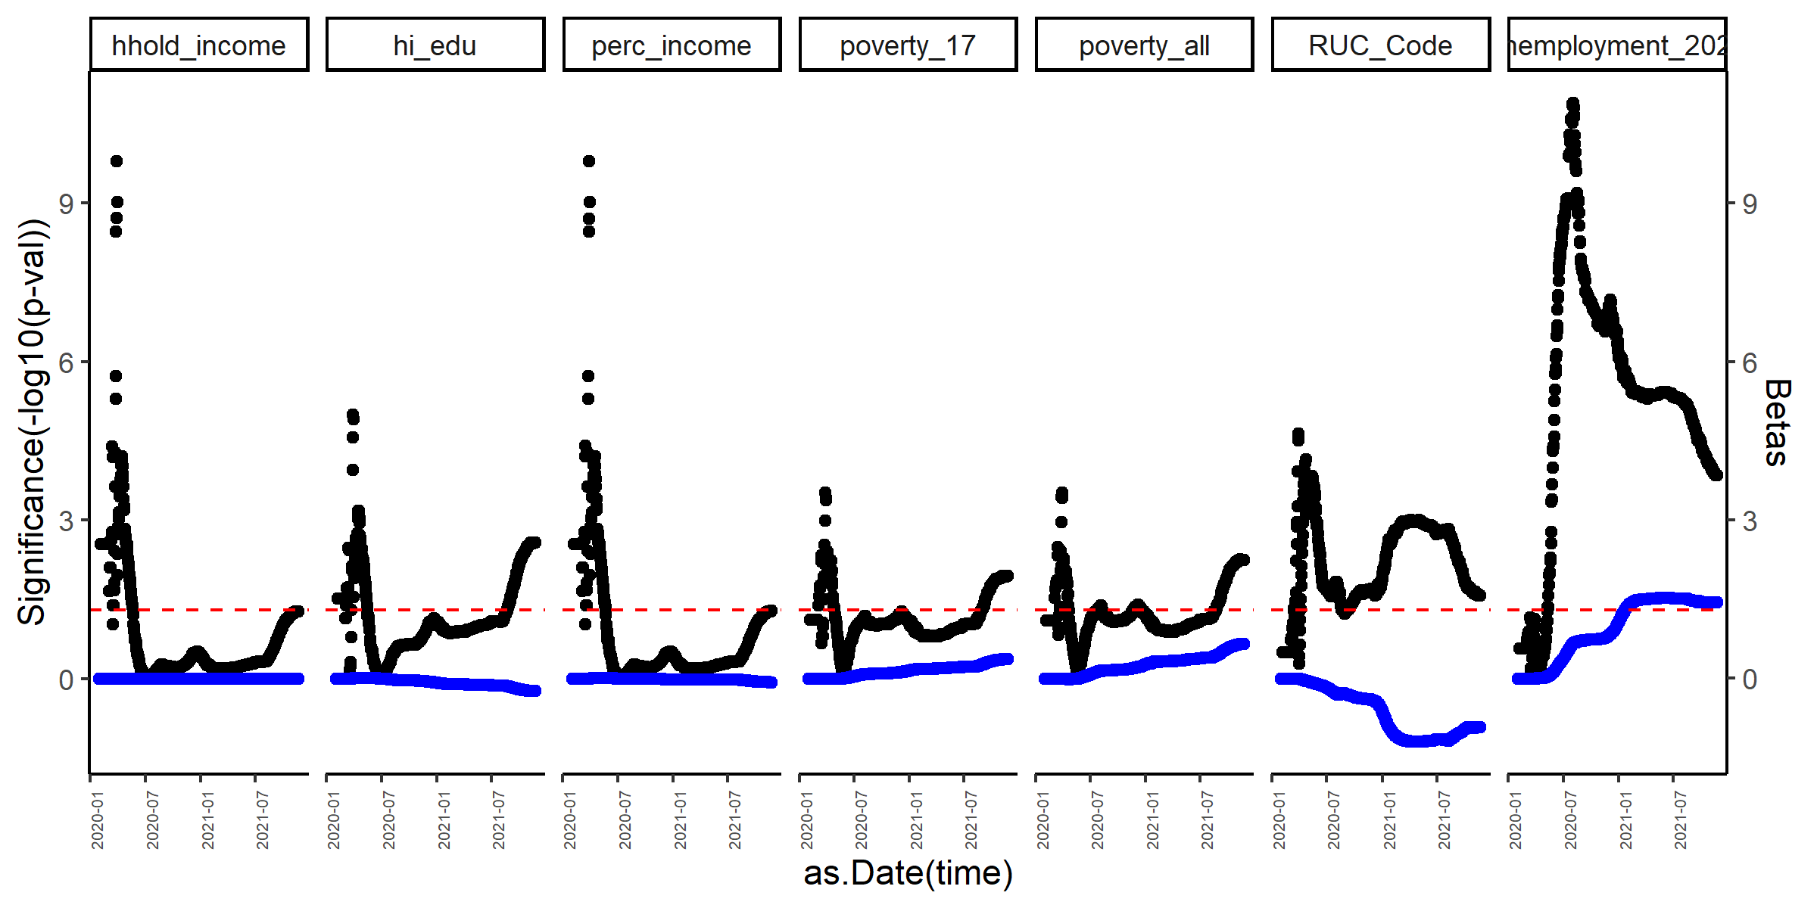
Graph of p-values and betas from Mortality of COVID-19 as a function of different demographic variables in the counties of CA over time
Beta blue, p-value black. Red line is p-value = 0.05
These variables change overtime.
Similar to Incidence: From August 2021-to today (new wave of Covid), household income, percentage higher education and rurality (RUC codes) are negatively associated with incidence.
Percentage poverty from all populations and under 17, and percentage unemployment are positively associated with Incidence.

Slide 6
Univariate model for Incidence (01Aug to 04Dec21)
Household income, percentage of people with high education (college), and number of fully vaccinated people (normalized by population) are negatively associated with Incidence of COVID-19
Rurality and percentage of poverty are positively associated with COVID-19 incidence.
 | Beta coefficient | R-squared | Significance (-LOG10(P-value))
% Unemployment | 0.001045 | 0.004936 | 0.581337
Household income | -4.24E-07 | 0.379571 | 6.800746
% Living in poverty (all population) | 0.001424 | 0.140629 | 2.662426
% Living in poverty (under 17) | 0.000863 | 0.138047 | 2.622942
% People with college completed | -0.00077 | 0.387562 | 6.962361

Slide 7
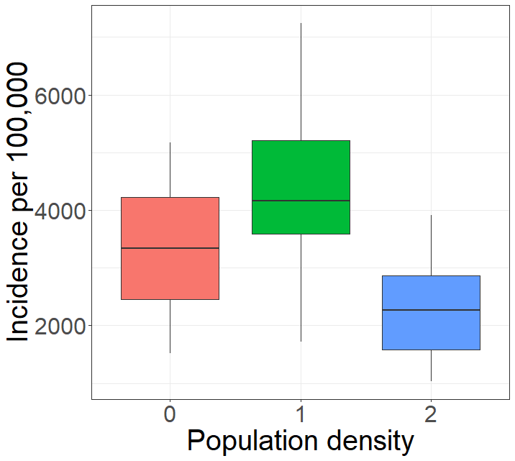
Univariate linear model for incidence of COVID-19 (01Aug to 04Dec21)
Incidence ~ variable | Beta coefficient | R-squared | Significance
% Unemployment | 104.502 | 0.005 | 0.581
% Household income | -34.060 | 0.379 | 6.799
% Living in poverty (all population) | 142.442 | 0.141 | 2.662
% Living in poverty (under 17) | 86.301 | 0.138 | 2.623
% People with college completed | -77.096 | 0.388 | 6.962
Significance = (-LOG10(P-value)), 1.30 = -LOG10(0.05)
Kruskal-Wallis rank sum test
p-value = 1.06e-05
%Household income and % people with high education (college), are negatively associated with Incidence of COVID-19
% living in poverty (total and <17) is positively associated with COVID-19 incidence.
Medium population density has significantly higher incidence of COVID-19 compared with population density
Pairwise comparisons using
Wilcoxon rank sum exact test
0 1
1 0.28 -
2 0.22 1.1e-06
P value adjustment method: BH

Slide 8
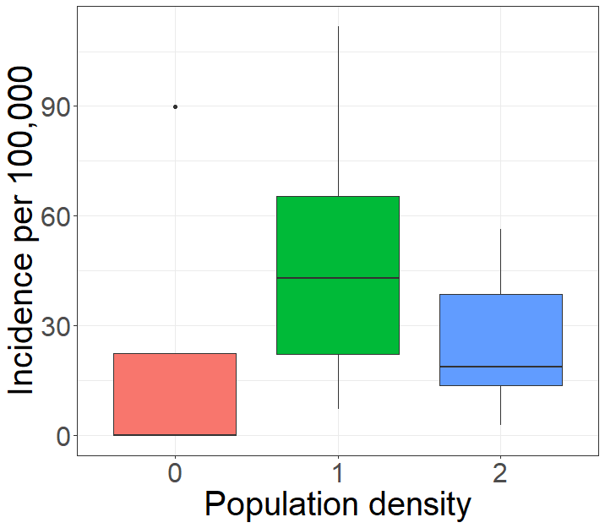
Univariate linear model for mortality by COVID-19 (01Aug to 04Dec21)
Mortality ~ variable | Beta coefficient | R-squared | Significance
% Unemployment | 0.691 | -0.015 | 0.158
% Household income | -0.508 | 0.231 | 4.106
% Living in poverty (all population) | 2.907 | 0.168 | 3.093
% Living in poverty (under 17) | 1.560 | 0.126 | 2.438
% People with college completed | -1.218 | 0.268 | 4.718
Significance = (-LOG10(P-value)), 1.30 = -LOG10(0.05)
Kruskal-Wallis rank sum test
p-value = 0.005455
%Household income and % people with high education (college), are negatively associated with Incidence of COVID-19
% living in poverty (total and <17) is positively associated with COVID-19 incidence.
Medium population density has significantly higher incidence of COVID-19 compared with population density
Pairwise comparisons using
Wilcoxon rank sum exact test
0 1
1 0.107 -
2 0.116 0.012
P value adjustment method: BH

Slide 9
Between Aug01- Today Univariate model for Mortality
 | median | IQR
diff_ntest | 0.000108 | 0.001469
unemployment_2020 | -7.28E-06 | -0.01306
perc_income | -4.65E-06 | 0.211877
hhold_income | -5.78E-09 | 0.212069
RUC_Code | 2.42E-05 | 0.029548
poverty_all | 2.63E-05 | 0.149553
poverty_17 | 1.42E-05 | 0.113373
hi_edu | -1.11E-05 | 0.241479
nfullyvacc | -0.00142 | 0.377058
Household income, percentage of people with high education (college), and number of fully vaccinated people (normalized by population) are negatively associated with mortality of COVID-19
Rurality and percentage of poverty are positively associated with COVID-19 mortality.

Slide 10
Multiple linear regression, Incidence outcome
Incidence ~ nfullyvacc + hi_edu + poverty_17 + poverty_all + RUC_Code + hhold_income + unemployment_2020 + ntest
Coefficients:
Estimate Std. Error t value Pr(>|t|)
(Intercept) 8.920e-02 1.956e-02 4.561 3.53e-05 ***
mtable$nfullyvacc -6.397e-02 2.627e-02 -2.435 0.01864 *
mtable$hi_edu -7.656e-05 3.112e-04 -0.246 0.80674
mtable$poverty_17 2.086e-04 6.353e-04 0.328 0.74413
mtable$poverty_all -1.572e-03 1.116e-03 -1.408 0.16554
mtable$RUC_Code 7.903e-04 8.135e-04 0.971 0.33620
mtable$hhold_income -8.929e-06 5.643e-05 -0.158 0.87495
mtable$perc_income 6.976e-03 4.534e-02 0.154 0.87838
mtable$unemployment_2020 3.269e-04 7.747e-04 0.422 0.67495
mtable$diff_ntest 1.346e-02 4.448e-03 3.026 0.00397 **
---
Signif. codes: 0 ‘***’ 0.001 ‘**’ 0.01 ‘*’ 0.05 ‘.’ 0.1 ‘ ’ 1
Residual standard error: 0.009422 on 48 degrees of freedom
Multiple R-squared: 0.6351, Adjusted R-squared: 0.5666
F-statistic: 9.281 on 9 and 48 DF, p-value: 5.483e-08
After adjusting the model, Normalized n of fully vaccinated people and normalized n of tests are significantly associated with lower incidence.
These are confounders of other demographic variables when using univariate models.

Slide 11
Multiple linear regression, Mortality outcome
Mortality ~ nfullyvacc + hi_edu + poverty_17 + poverty_all + RUC_Code + hhold_income + unemployment_2020 + ntest
Coefficients:
Estimate Std. Error t value Pr(>|t|)
(Intercept) 1.348e-03 4.249e-04 3.172 0.00264 **
mtable$nfullyvacc -8.572e-04 5.708e-04 -1.502 0.13971
mtable$hi_edu -4.321e-06 6.763e-06 -0.639 0.52595
mtable$poverty_17 5.905e-06 1.381e-05 0.428 0.67074
mtable$poverty_all -3.575e-06 2.425e-05 -0.147 0.88342
mtable$RUC_Code -2.641e-05 1.768e-05 -1.494 0.14176
mtable$hhold_income -9.379e-07 1.226e-06 -0.765 0.44813
mtable$perc_income 7.519e-04 9.853e-04 0.763 0.44912
mtable$unemployment_2020 -3.082e-05 1.683e-05 -1.831 0.07332 .
mtable$diff_ntest 1.639e-04 9.665e-05 1.696 0.09640 .
---
Signif. codes: 0 ‘***’ 0.001 ‘**’ 0.01 ‘*’ 0.05 ‘.’ 0.1 ‘ ’ 1
Residual standard error: 0.0002047 on 48 degrees of freedom
Multiple R-squared: 0.4881, Adjusted R-squared: 0.3921
F-statistic: 5.085 on 9 and 48 DF, p-value: 7.874e-05
After adjusting the model, only Normalized n of fully vaccinated people is negatively associated with lower mortality.
Percentage of unemployment and number of tests have a trend with the outcome of COVID-19 mortality.

Slide 12
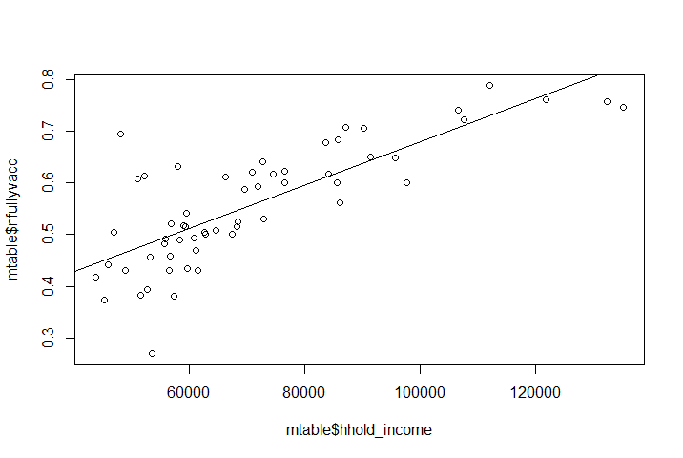
Vaccination status is a confounder of demographic variables like Household income
Coefficients:
Estimate Std. Error t value Pr(>|t|)
(Intercept) 2.588e-01 3.277e-02 7.897 1.14e-10 ***
mtable$hhold_income 4.204e-06 4.417e-07 9.518 2.66e-13 ***
---
Signif. codes: 0 ‘***’ 0.001 ‘**’ 0.01 ‘*’ 0.05 ‘.’ 0.1 ‘ ’ 1
Residual standard error: 0.07196 on 56 degrees of freedom
Multiple R-squared: 0.618, Adjusted R-squared: 0.6112
F-statistic: 90.59 on 1 and 56 DF, p-value: 2.655e-13

Slide 13
Household income
Incidence
Proxies:
%poverty_17
%poverty_all
Confounder:
RUC_Code
%High education
%unemployment (2020)

Slide 14
Metropolitan Counties*
Code | Description
1 | Counties in metro areas of 1 million population or more
2 | Counties in metro areas of 250,000 to 1 million population
3 | Counties in metro areas of fewer than 250,000 population
Nonmetropolitan Counties
Code | Description
4 | Urban population of 20,000 or more, adjacent to a metro area
5 | Urban population of 20,000 or more, not adjacent to a metro area
6 | Urban population of 2,500 to 19,999, adjacent to a metro area
7 | Urban population of 2,500 to 19,999, not adjacent to a metro area
8 | Completely rural or less than 2,500 urban population, adjacent to a metro area
9 | Completely rural or less than 2,500 urban population, not adjacent to a metro area

