Slide 1

Machine Learning-Based Evaluation of Climate Influences on National Crop Production
Sarina Tripmacker, Lea Budde, Tom Strauß and Sten Heimbrodt

Slide 2
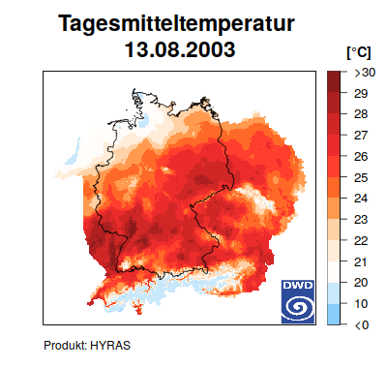
The Dataset
HYRAS from the Deutscher Wetterdienst
→ 5 x 5 km Resolution
→ 1951 – 2020 timespan
→ lots of datafields
We will use:
→ Precipitation
→ Mean air temperature
→ Max air temperature
→ Min air temperature
(less is more)
And a yet to be determined crop yield dataset per year

Slide 3

The Model
Want to build an estimation model for crop yields
→ could be used in agriculture
Explorative kind of analysis
Deep Neural Network
→ Input vector: temperature, precipation over a year
→ Output: crop yield in tons for a year
Implementation using PyTorch

Slide 4
Possible Research Questions
How does weather impact crop yields?
Is an accurate yield estimation with a trained model possible?
Is the effect of climate change visible through the data view?

Slide 5
Pipeline Setup
Gitlab centered Workflow
Reference custom Gitlab Runner
→ big GPU computational power
→ easy to integrate
→ Uni Potsdam only has a whimpy runner (usally hosted by Gitlab)

Slide 6
Tooling and Languages
As much as possible in Python
Gitlab CI for everything else
Easy Reproduction via the Repository itself

