Slide 1
CS111
Computer Programming
INTRODUCTION TO PROGRAMMING ENVIRONMENT

Slide 2
Outline
Quick Recap
Computers and its Components
Operating System
Linux
Commands and Controls

Slide 3
Recap
Base
Poisitional Number System
Signed, Unsigned, Floating Point
Interconversion between Number Systems
Arithmatic on Number Systems

Slide 4
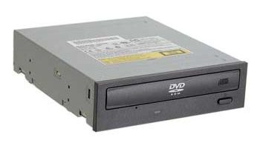
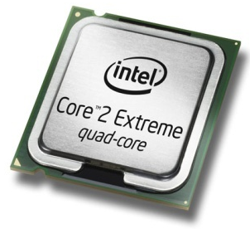
Hardware & Software
Hardware
All of the electronic and mechanical equipment in a computer is called the hardware. Examples include:
  Motherboard
  Hard disk
  RAM
  Power supply
  Processor
  Case
  Monitor
  Keyboard
  Mouse

Slide 5
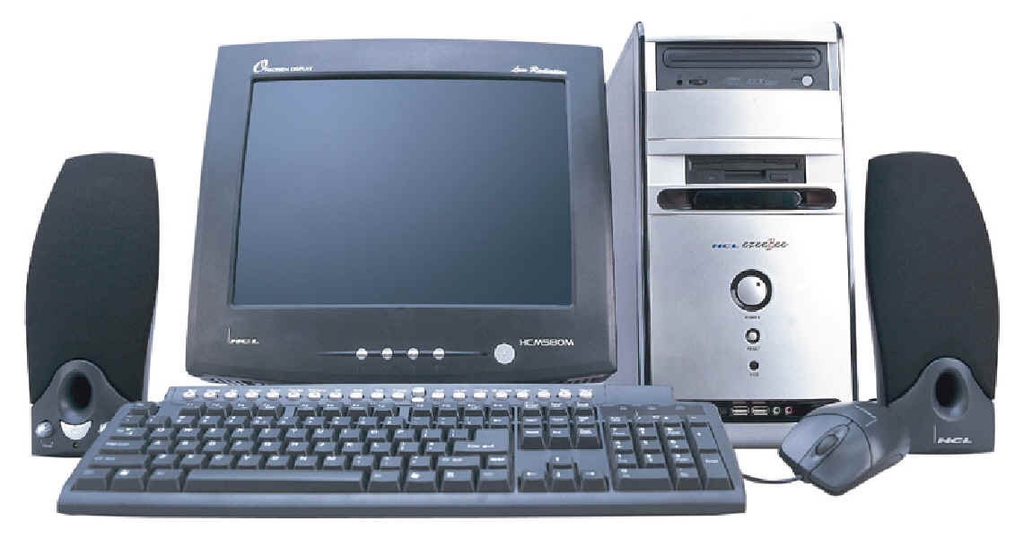
PC Components
Computer system - collection of electronic and mechanical devices operating as a unit. The main parts are:
  System unit
  Monitor
  Keyboard
  Mouse
  Speakers
2
1
5
3
4

Slide 6
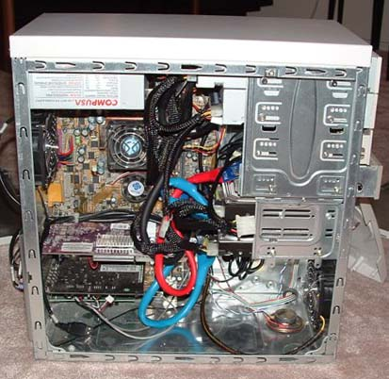
System Unit
The main container for system devices. It protects the delicate electronic and mechanical devices from damage.
  Motherboard
  CPU (Processor)
  Memory
  Disk drives
  Ports - USB etc.
  Power supply
  Expansion cards - sound card, network card, graphics card etc.

Slide 7
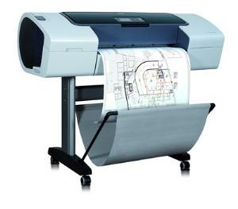
Peripherals
Peripherals are devices that connect to the system unit using cables or wireless technologies. Typical peripherals include:
  Monitor
  Keyboard
  Printer
  Plotter
  Scanner
  Speakers
Plotter

Slide 8
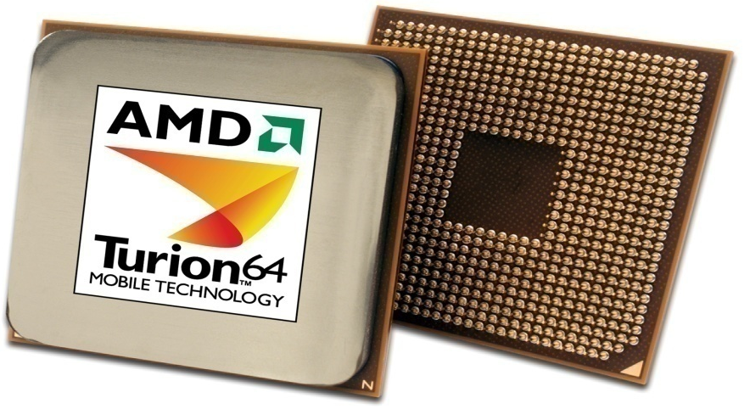
System Devices
Processor
An integrated circuit (IC) supplied on a single silicon chip. It’s function is to control all the computers functions. The main processor manufacturers are:
  AMD - Athlon and Turion (mobile)
  Intel - Pentium and Centrino (mobile)
AMD
Processor

Slide 9
System Devices
Computer program - a series of instructions. When a program is run, the processor carries out these instructions in an orderly fashion. Typical instructions include:
  Arithmetic - addition, subtraction etc
  Logical - comparing data and acting according to the result
  Move - move data from place to place within the computer system - memory to the processor for addition - memory to a printer or disk drive etc.

Slide 10
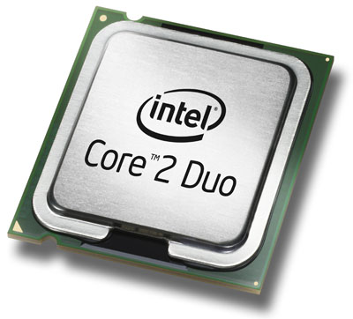
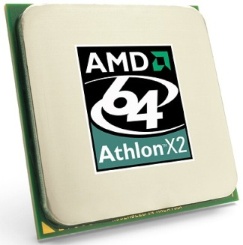
System Devices
Processor speed - measured in megahertz (MHz) or Gigahertz (GHz)
  1 MHz - 1 million clock ticks every second
  1 GHz - 1 billion clock ticks every second
Latest trend - multi-core processors

Slide 11
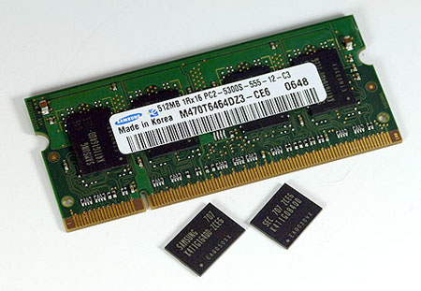
System Devices
Random Access Memory (RAM)
Primary storage - main computer memory. Data, programs currently in use are held in RAM
Volatile - contents of memory are lost if the computer is turned off
Module - memory IC’s on a circuit board
Memory
Module
IC’s

Slide 12
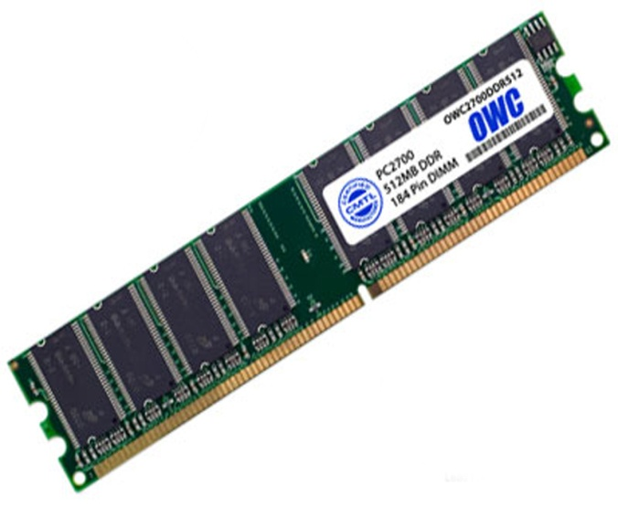
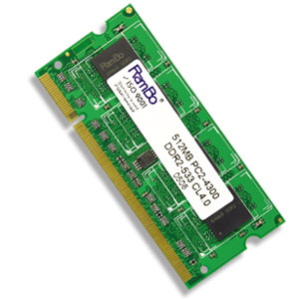
System Devices
Memory is sold in modules:
  DIMM’s (dual inline memory module) for desktop computers
  SODIMM’s (small outline dual inline memory module) for notebook computers.
DIMM
Module
SODIMM
Module

Slide 13
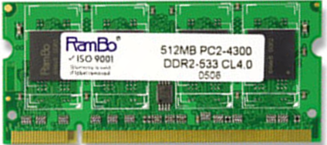
System Devices
DIMM’s and SODIMM’s are available in modules of 256MB, 512MB, 1GB, 2GB
The current technology is called DDR (double data RAM) and there are three types: DDR3, DDR4
Any particular computer system is only compatible with one type.
Module capacity
Module name
Module type
Module speed

Slide 14
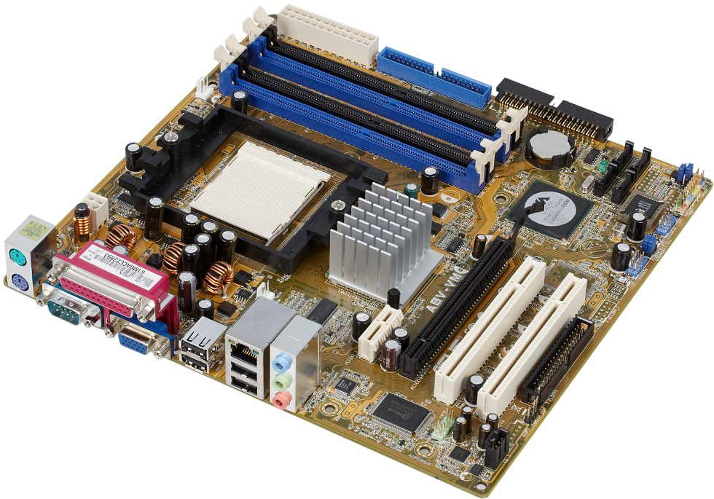
System Devices
Motherboard
Mainboard or system board - the main circuit board for the computer system.
Memory Sockets
Processor Socket
Chipset
PCI Slots
Ports
Graphics Slot

Slide 15
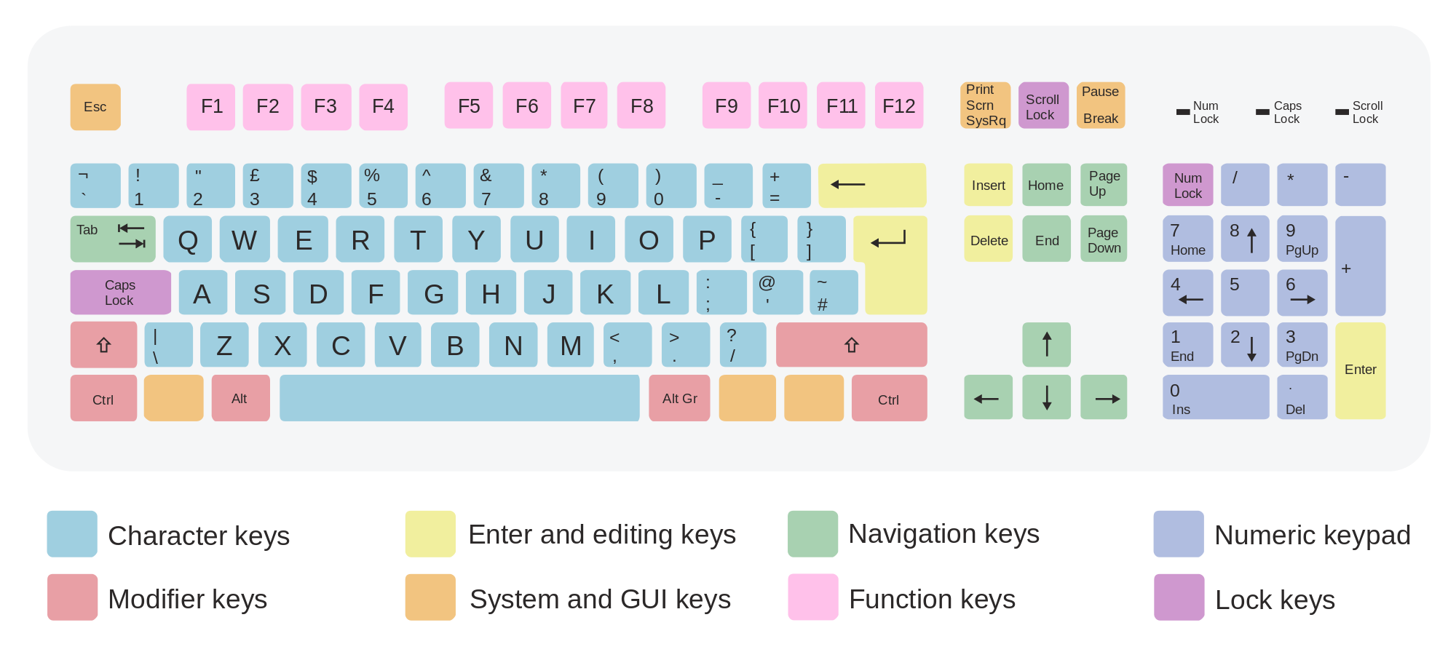
System Devices

Slide 16
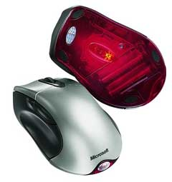
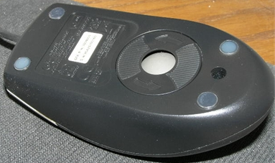
System Devices
Input device - uses point and click technology
There are two main types:
  Ball mouse - uses a ball to roll across the surface and move rollers attached to sensors inside
  Optical mouse - camera takes thousands of images per second and sends them for digital processing.
Ball mouse
Optical
mouse

Slide 17
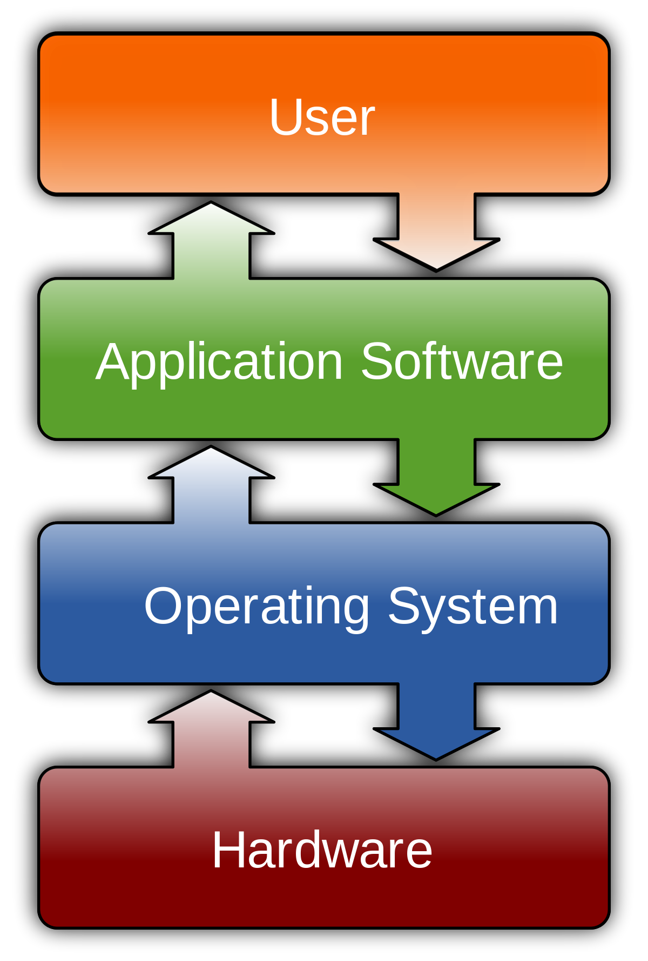
Software Systems
Editors, IDE, Entertaintment
Windows, Linux, iOS

