Slide 1
CS111
Computer Programming
INTRODUCTION TO PROBLEM SOLVING

Slide 2
ALGORITHMS AND FLOWCHARTS
A typical programming task can be divided into two phases:
Problem solving phase
  produce an ordered sequence of steps that describe solution of problem
  this sequence of steps is called an algorithm
Implementation phase
  implement the program in some programming language

Slide 3
Steps in Problem Solving
First produce a general algorithm (one can use pseudocode)
Refine the algorithm successively to get step by step detailed algorithm that is very close to a computer language.
Pseudocode is an artificial and informal language that helps programmers develop algorithms. Pseudocode is very similar to everyday English.

Slide 4
Pseudocode & Algorithm
Example 1: Write an algorithm to determine a student’s final grade and indicate whether it is passing or failing. The final grade is calculated as the average of four marks.

Slide 5
Pseudocode & Algorithm
Pseudocode:
Input a set of 4 marks
Calculate their average by summing and dividing by 4
if average is below 50
Print “FAIL”
else
Print “PASS”

Slide 6
Pseudocode & Algorithm
Detailed Algorithm
Step 1: Input M1,M2,M3,M4
Step 2: GRADE ← (M1+M2+M3+M4)/4
Step 3: if (GRADE < 50) then
Print “FAIL”
else
Print “PASS”
endif

Slide 7
The Flowchart
(Dictionary) A schematic representation of a sequence of operations, as in a manufacturing process or computer program.
(Technical) A graphical representation of the sequence of operations in an information system or program.
Program flowcharts show the sequence of instructions in a single program or subroutine.
Different symbols are used to draw each type of flowchart.

Slide 8
The Flowchart
A Flowchart
  shows logic of an algorithm
  emphasizes individual steps and their interconnections
  e.g. control flow from one action to the next

Slide 9
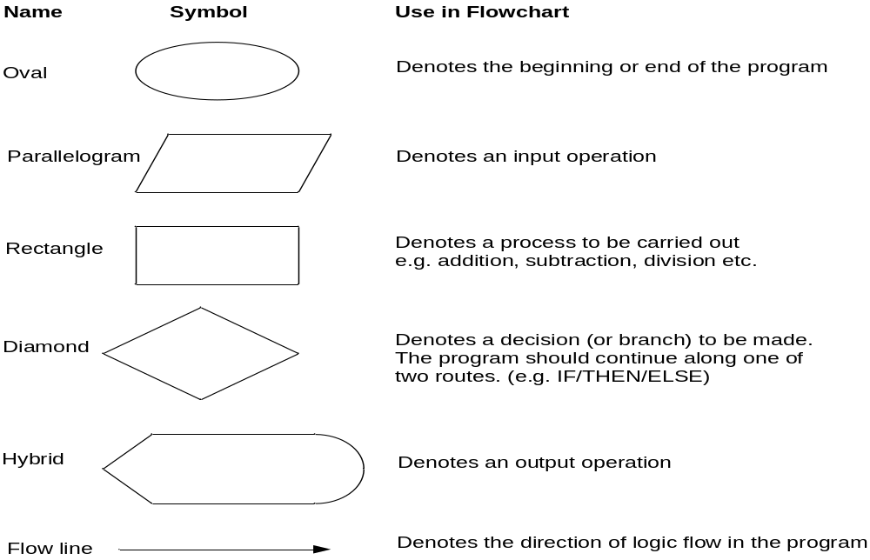
Flowchart Symbols

Slide 10
Example
START
Step 1: Input M1,M2,M3,M4
Step 2: GRADE ← (M1+M2+M3+M4)/4
Step 3: if (GRADE <50) then
Print “FAIL”
else
Print “PASS”
endif
Input
M1,M2,M3,M4
GRADE←(M1+M2+M3+M4)/4
IS
GRADE<50
N
Y
PRINT
“PASS”
PRINT
“FAIL”
STOP

Slide 11
Example 2
Write an algorithm and draw a flowchart to convert the length in feet to centimeter.
Pseudocode:
Input the length in feet (Lft)
Calculate the length in cm (Lcm) by multiplying LFT with 30
Print length in cm (LCM)

Slide 12
Example 2
Algorithm
Step 1: Input Lft
Step 2: Lcm ← Lft x 30
Step 3: Print Lcm
START
Input
Lft
Lcm ← Lft x 30
Print
Lcm
Flowchart
STOP

Slide 13
Example 3
Write an algorithm and draw a flowchart that will read the two sides of a rectangle and calculate its area.
Pseudocode
Input the width (W) and Length (L) of a rectangle
Calculate the area (A) by multiplying L with W
Print A

Slide 14
Example 3
START
Algorithm
Step 1: Input W,L
Step 2: A ← L x W
Step 3: Print A
Input
W, L
A ← L x W
Print
A
STOP

Slide 15

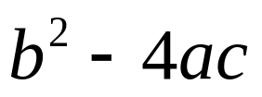
Example 4
Write an algorithm and draw a flowchart that will calculate the roots of a quadratic equation
Hint: d = sqrt ( ), and the roots are: x1 = (–b + d)/2a and x2 = (–b – d)/2a

Slide 16
Example 4
Pseudocode:
Input the coefficients (a, b, c) of the quadratic equation
Calculate d
Calculate x1
Calculate x2
Print x1 and x2

Slide 17

Example 4
START
Input
a, b, c
Algorithm:
Step 1: Input a, b, c
Step 2: d ← sqrt ( )
Step 3: x1 ← (–b + d) / (2 x a)
Step 4: x2 ← (–b – d) / (2 x a)
Step 5: Print x1, x2
d ← sqrt(b x b – 4 x a x c)
x₁ ←(–b + d) / (2 x a)
X₂ ← (–b – d) / (2 x a)
Print
x₁ ,x₂
STOP

