Slide 1
CS111
Computer Programming
C VARIABLES AND INSTRUCTIONS

Slide 2
A tiny program
A comment
/* A first program in C */
#include <stdio.h>
main( )‏
{
printf(“Hello, World! \n”);
}
Library of standard input output functions
Every C program starts execution with this function.
Statement & terminator
Escape sequence - newline
Body of the function - enclosed in braces
printf - a function from C Standard library stdio.h
- prints a char string on the standard output

Slide 3
Programming Basics
A variable – changes value during the execution of a program.
A variable has a name, e.g. – name, value, speed, revsPerSec etc.
Always referred to by its name
Note: physical address changes from one run of the program to another.

Slide 4
Variables and Constants
Names
  - made up of letters, digits and ‘_’
    case sensitive: classSize and classsize are different
    maximum size: 31 chars
  - first character must be a letter
  - choose meaningful and self-documenting names
    MAX_PILLAR_RADIUS a constant
    pillarRadius a variable
  keywords are reserved:
    if, for, else, float, …

Slide 5
Assignments and variables
The value of a variable is modified due to an assignment.
The LHS is the variable to be modified and the RHS is the value to be assigned.
So RHS is evaluated first and then assignment performed.
a = 1
a = c
a = MAX_PILLAR_RADIUS
a = a*b + d/e

Slide 6
Variable Declaration
Need to declare variables.
A declaration: type variablename;
Types: int, float, char
int x; contents of the location corresponding to x is treated as an integer. Number of bytes assigned to a variable depends on its type.
Assigning types helps write more correct programs. Automatic type checking can catch errors like integer = char +char;

Slide 7
Valid Variable declaraation
Characters Allowed :
  Underscore(_)
  Capital Letters ( A – Z )
  Small Letters ( a – z )
  Digits ( 0 – 9 )
Blanks & Commas are not allowed
No Special Symbols other than underscore(_) are allowed
First Character should be alphabet or Underscore
Variable name Should not be Reserved Word

Slide 8
Variables need Declaration
Another simple C program
#include<stdio.h>
main()
{
int int_size;
int chr_size;
int flt_size;
int_size = sizeof(int); chr_size =sizeof(char);
flt_size = sizeof(float);
printf(“int, char, and float use %d %d and %d bytes\n”, int_size, chr_size, flt_size);
}
1
2
3
4
5
6
7
8
9
An operator in C

Slide 9
Order of evaluation (operator precedence)‏
First parenthesized sub-expessions
- innermost first
Second *, / and % - left to right
Third + and – - left to right
a + b * c * d % e – f / g
a + ((( b * c ) * d ) % e ) – (f / g )
Good practice -- use parentheses rather than rely on precedence rules -- better readability

Slide 10
Precedence – another example
Value = a * (b+c) % 5 + x / (3 + p) – r - j
Evaluation order –
(b+c) and (3+p) : due to parenthesis
* and % and / have same precedence: a(b+c) is evaluated first, then mod 5. Also, x/(3+p).
Then, the additions and subtractions are done from the left to right.
Finally, the assignment of the RHS to LHS is done.

Slide 11
Primary Data Type
Integral Type
Integer
Character
Signed | Unsigned
int, short int, long int | --
Signed
Unsigned
Floating Point Type
float | double | long Double

Slide 12
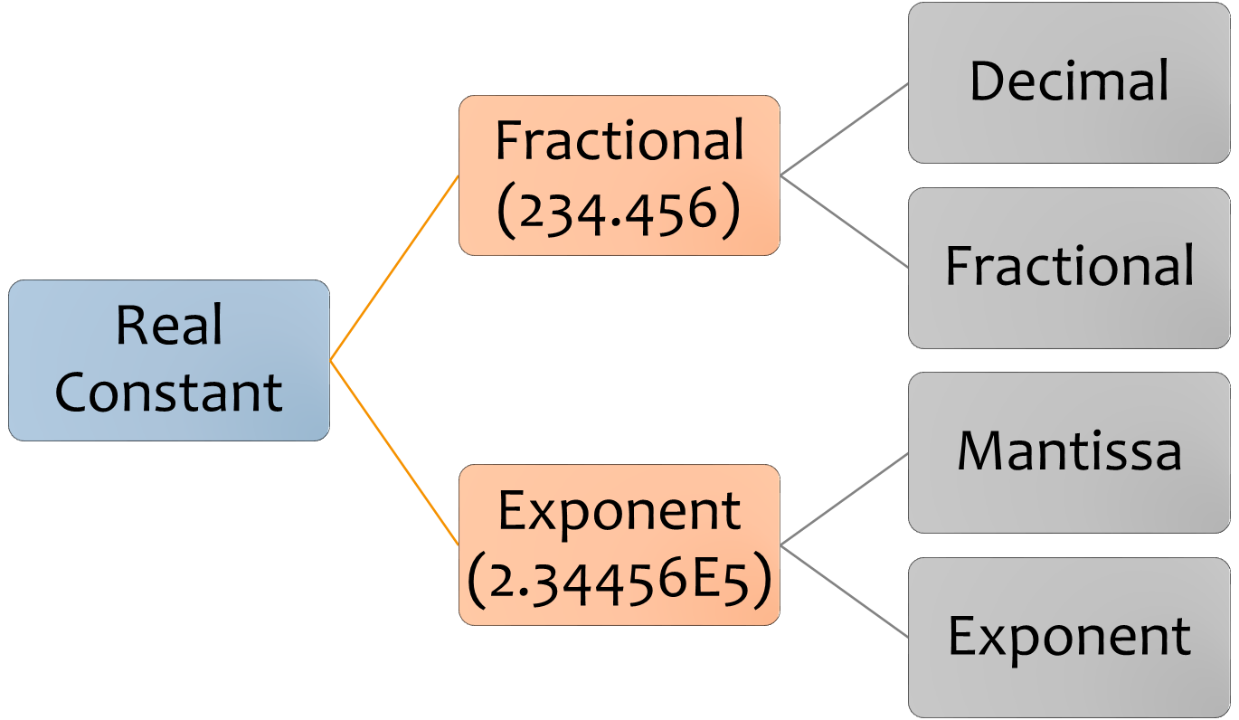

Slide 13
Temperature Conversion Problem
Algorithm
Start
Prompt user to enter temperature in F
Store Fahrenheit temperature in [a variable] F
Calculate Centigrade C = (F-32) * 5 / 9
Print C
Stop
1. Start
2. Input Temperature in Fahrenheit in F variable.
3. Calculate Centigrade C = (F-32) x 5 / 9
4. Print temperature in centigrade
5. Stop

Slide 14
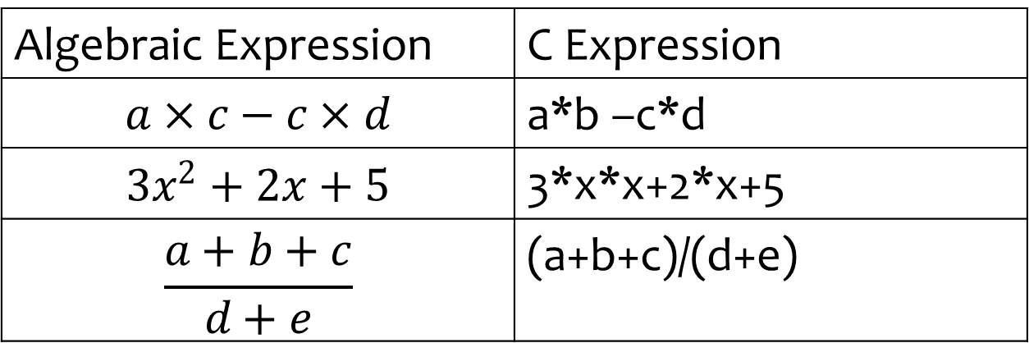
C Expressions

