Slide 1
CS111
Computer Programming
FILE MANAGEMENT IN C

Slide 2
Input/Output in C
C has no built-in statements for input or output
A library of functions is supplied to perform these operations. The I/O library functions are listed the “header” file <stdio.h>
You do not need to memorize them, just be familiar with them

Slide 3
Streams
All input and output is performed with streams
A "stream" is a sequence of characters organized into lines
Each line consists of zero or more characters and ends with the "newline" (‘\n’) character
ANSI C standard specifies that the system must support lines that are at least 254 characters in length (including the newline character)

Slide 4
Types of Streams in C
Every C program has 3 standard streams:
Standard input stream is called stdin and is normally connected to the keyboard
Standard output stream is called stdout and is normally connected to the display screen.
Standard error stream is called stderr and is also normally connected to the screen

Slide 5
Standard Streams in C
Input functions normally read from stdin
  scanf(), gets(), getchar()
Output functions normally write to stdout
  printf(), putchar()
I/O Redirection: connect stdin or stdout to a file instead of keyboard or display
  Type command: myprog
  scanf reads from keyboard, printf writes to display
  Type command with file names:
  myprog < input.dat > output.dat
  scanf reads from input.dat, printf writes to output.dat

Slide 6
Motivation
Handling large volume of data is cumbersome
Data lost when program is closed

Slide 7
Basic operations
Naming
Opening
Reading
Writing
Closing
Internally a file is referred to using a file pointer
Points to a structure that contains info about the file

Slide 8
Defining and opening a file
Filename
Data Structure
Purpose

Slide 9
Filename
It may contain two parts
1. Primary name
2. Optional period with the extension
E.g.
Input.data
Store
Prog.c
Student.out

Slide 10
Data Structure
Defined as FILE in the stdio.h
All files should be declared as type FILE before they are used
FILE is a defined data type
E.g.
FILE *fp;
Fp = fopen(“filename”, “mode”);

Slide 11
Opening a file
Declare a file pointer and open a file using the function fopen()
FILE *fp; /* FILE is a typename, like int */
fp = fopen(name, mode);
example : fp = fopen(“data.txt”, “r”);
name of file
what is the file going to be used for?

Slide 12
Basic modes for opening files
“r”
  Open an existing file for reading only.
“w”
  Open the file for writing only. If the file already exists, it is truncated to zero length. Otherwise a new file is created.
“a”
  Open a file for append access; that is,
    writing at the end of file only.
    If the file already exists, its initial contents are unchanged and output to the stream is appended to the end of the file.
    Otherwise, a new, empty file is created.

Slide 13
More file modes
“r+”
  Open an existing file for both reading and writing. The initial contents of the file are unchanged and the initial file position is at the beginning of the file
“w+”
  Open a file for both reading and writing. If the file already exists, it is truncated to zero length. Otherwise, a new file is created
“a+”
  Open or create file for both reading and appending. If the file exists, its initial contents are unchanged. Otherwise, a new file is created. The initial file position for reading is at the beginning of the file, but output is always appended to the end of the file

Slide 14
An example
FILE *ifp, *ofp; char *mode = "r";
char inFilename[] = “in.list”; char outFilename[] = "out.list";
ifp = fopen(inFilename, mode);
if (ifp == NULL) {
fprintf(stderr, "Can't open input file %s!\n”, inFilename);
exit(1);
}
ofp = fopen(outFilename, "w");
if (ofp == NULL) {
fprintf(stderr, "Can't open output file %s!\n", outFilename);
exit(1);
}
fopen returns NULL if it cannot open a file

Slide 15
Formatted Reading and Writing
fscanf(filepointer, “…”, args)
fprintf(filepointer, “…”, args)
Format string and arguments same as with scanf() and printf()
Example:
  fscanf(fp1, “%d”, &myMarks);
  fscanf(fp1, “%d”, &myRollNumber);
  fprintf(fp2, “%d\t%d\n”, myMarks, myRollNumber);

Slide 16
Closing a file
When done with a file, it must be closed using the function fclose()
fclose(ifp); fclose(ofp);
Closing a file is very important, especially with output files.
The reason is that output is often buffered.
This means that when you tell C to write something out, it doesn't necessary get written to disk right away, but may be stored in a buffer in memory.
  This output buffer holds the text temporarily
  When the buffer fills up (or when the file is closed), the data is finally written to disk

Slide 17
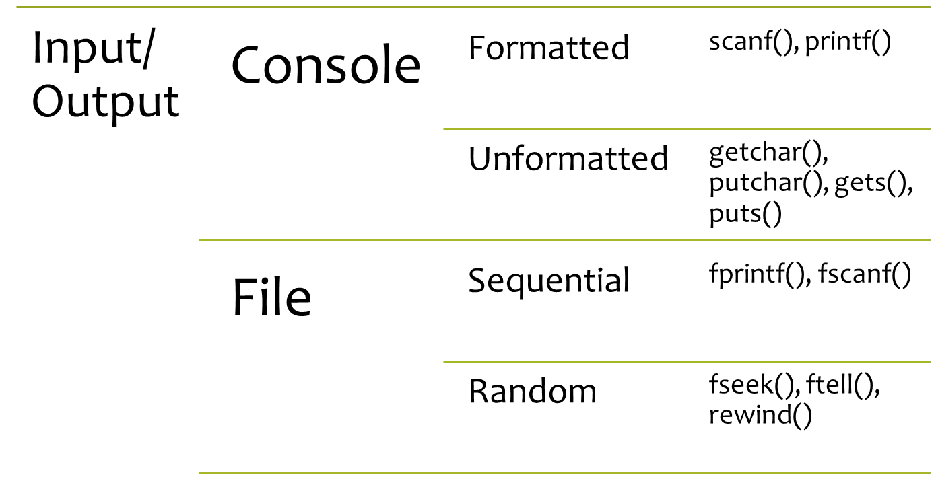

Slide 18


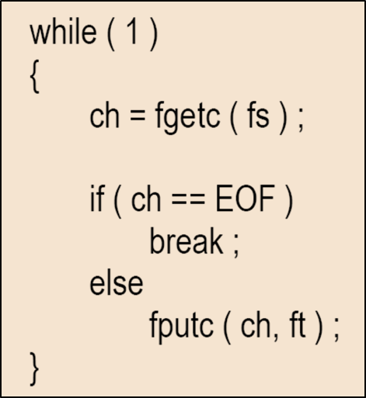
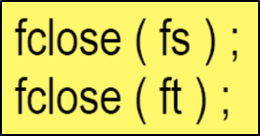
Binary file I/O Mode
Binary file is merely a collection of bytes
Read mode: “rb”
Write mode: “wb”

Slide 19
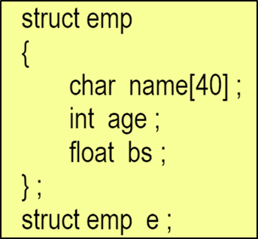
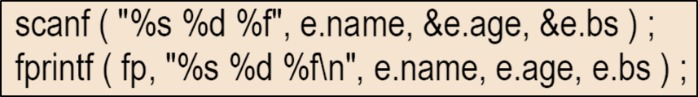
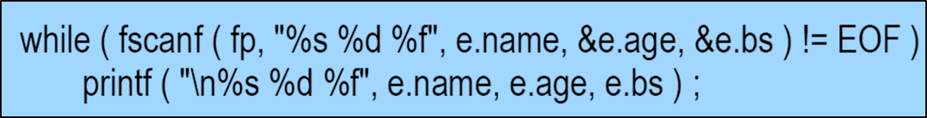
Writing a record
Writing
Reading

Slide 20
Record I/O Revisited
The numbers (basic salary) would occupy more number of bytes, since the file has been opened in text mode.
This is because when the file is opened in text mode, each number is stored as a character string.
If the number of fields in the structure increase (say, by adding address, house rent allowance etc.), writing structures is cumbersome

Slide 21
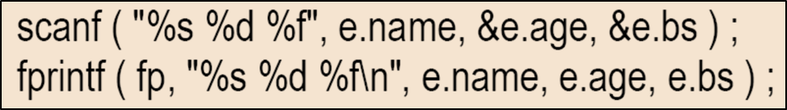

fwrite()
Address of the structure
Size of the structure in bytes
Number of records to be written
Pointer to the file we want to write to

Slide 22


fread()
Address of the structure
Size of the structure in bytes
Number of records to be written
Pointer to the file we want to write to

Slide 23
Manipulating data record
Add record
Read record
Search for a record
Delete Record
Edit Record

Slide 24
fseek(), rewind(), ftell()
int fseek(FILE *stream, long int offset, int whence)
void rewind(FILE *stream)
long int ftell(FILE *stream)
SEEK_SET: Beginning of file
SEEK_CUR: Current position of the file pointer
SEEK_END: End of file

Slide 25
Command line arguments
Parameters can be passed to C programs by giving arguments when the program is executed
examples
> echo hello, world
prints the output
hello, world
> cat file1 file2
prints contents of file1 followed by file2

Slide 26
main(int argc, char *argv[])
The main program in C is called with two implicit arguments argc and argv
argc is an integer value for the number of arguments in the command line
  if none then argc =1
  the program name is the only argument
*argv[] is a pointer to a pointer
  an array of strings
  argv[0] is the name of the program
  argv[1] is the first argument.
  argv[2] is the next … and so on…
  argv[argc] is a null pointer

Slide 27
echo hello world
argv:
echo\0
hello\0
world\0
0
a two dimensional array of characters
argc = 3, argv is a pointer to pointers

Slide 28
implementing echo
#include <stdio.h>
/* echo comand line arguments: 1st version */
main(int argc, char *argv[])
{
int i;
for (i = 1; i < argc; i++)
printf(“%s ”, argv[i]);
printf(“\n”);
return 0;
}

Slide 29
implementing echo
#include <stdio.h>
/* echo comand line arguments: 1st version */
main(int argc, char *argv[]){
int i;
for (i = 1; i < argc; i++)
printf(“%s%s”, argv[i], (i < argc - 1) ? “ ” : “”);
printf(“\n”);
return 0;
}

Slide 30
echo – pointer version
#include <stdio.h>
/* echo comand line arguments: 2nd version */
main(int argc, char *argv[])
{
while (--argc > 0)
printf(“%s%s”, *++argv, (argc > 1) ? “ ” : “”);
printf(“\n”);
return 0;
}

Slide 31
copying a file
/* filecopy: copy file ifp to file ofp */
void filecopy(FILE *ifp, FILE *ofp)
{
int c;
while ((c = getc(ifp)) != EOF)
putc(c, cfp);
}
copy everything, blanks, tabs, endofline, till the file ends

Slide 32
Program name in error message
…
char *prog = argv[0];
…
if ((fp = fopen(*++argv, “r”)) == NULL) {
fprint(stderr, “%s: can’t open %s\n”, prog, *argv);
…

