Slide 1
CS111
Computer Programming
STRINGS

Slide 2
Strings
A string is a sequence of characters treated as a group
We have already used some string literals:
  “filename”
  “output string”
Strings are important in many programming contexts:
  names
  other objects (numbers, identifiers, etc.)

Slide 3
Declaration
No explicit type, instead strings are maintained as arrays of characters
Representing strings in C
  stored in arrays of characters
  array can be of any length
  end of string is indicated by a delimiter, the zero character ‘\0’
char name[16];
Declares a char name of maximum length 15 characters
(elements 0 to 14, element 15 stores the null character)
0 | 1 | 2 | 3 | 4 | 5 | 6 | 7 | 8 | 9 | 10 | 11 | 12 | 13 | 14 | 15
 |  |  |  |  |  |  |  |  |  |  |  |  |  |  | \0

Slide 4
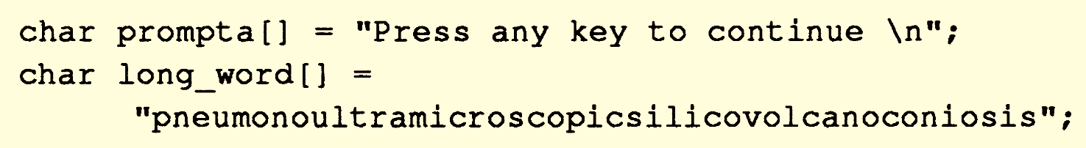
Initialization
Like other arrays it is possible to do assignment

Slide 5
‘c’ vs “c”
At first sight, a string consisting of a single character might be thought to be identical to a char variable.
However this is not the case.
“c”
c | \0
‘c’
c

Slide 6
Taking Input from Keyboard
scanf can be used to take input a string from the keyboard
Format specifier for a string is %s
Example:
char address[15];
scanf(“%s”,address);
Issue:
Space is a delimiter
Scanf terminates its input on the first white space

Slide 7
Taking Input from Keyboard
How to read a line of text?
Alternatives?
  Repeatedly check for the user input
  Use standard library function
Input a character
Assign to the array of character
Increment the Index
Check if the character was ‘\n’
If not, then go to step 1
Go one index back in the array
Assign ‘\0’ to that location
Any issue in this? →

Slide 8
Repeatedly check for the user input
Input a character
Assign to the array of character
Increment the Index
Check if the character was ‘\n’
If not, then go to step 1
Go one index back in the array
Assign ‘\0’ to that location
← scanf() … ?
A new function
int getchar(void);
Reads the next character from stdin.

Slide 9
#include<stdio.h>
int main() {
char myArr[20],ch; int ind = 0;
do
{
ch = getchar();
myArr[ind] = ch;
ind++;
}while(ch!='\n');
myArr[ind-1] = '\0';
…

Slide 10
Not so common approach
int main()
{
char name[20];
printf("\nEnter your name: ");
scanf("%[^\n]",name);
printf("\n Welcome %s",name);
}

Slide 11
Accessing string elements
It is a character array
Stored in contiguous memory location
0 | 1 | 2 | 3 | 4 | 5 | 6 | 7 | 8 | 9 | 10 | 11
I | I | T |  | J | O | D | H | P | U | R | \0
ind = 0;
while(ind<11){
…
ind++;
}
ind = 0;
while(myArr[ind]!=‘\0’){
…
ind++;
}

Slide 12
Library Functions
To get input from the user
gets()
To print string on the screen
puts()

Slide 13
String and pointer
char name[] = {‘I’, ‘I’, ‘T’, ‘J’, ‘O’, ‘D’, ‘H’, ‘P’, ‘U’, ‘R’, ‘\0’};
I | I | T | J | O | D | H | P | U | R | \0
int i=0;
while(name[i]){
printf(“\n %c %c %c %c”, name[i], *(name+i), *(i+name), i[name]);
}

Slide 14
String variable (Pointer)
…
char name[] = “IIT Jodhpur”;
char *myName = name;
while( *myPtr != ‘\0’)
{
printf(“\n %c”, *ptr);
ptr++;
}
…

Slide 15
Standard Library Functions
Calculate the length of a string : strlen()
Copy a string to another string : strcpy()
Concatenate two strings : strcat()
Compare a pair of strings: strcmp()

Slide 16
Example
str1
I | I | T | \0
J | O | D | H | P | U | R | \0
str2
str3
I | I | T | \0
I | I | T | J | O | D | H | P | U | R | \0
strlen(str1) = 3; strlen(str2) = 7; strlen(str3) = 0;
strcpy(str3, str1)
strcat(str3, str2)

Slide 17
STRCMP(STR1,STR2)
str1
J | A | I | P | U | R | \0
J | A | I | P | U | R | \0
0
str2
str1
J | A | I | P | U | R | \0
J | A | I | G | A | R | \0
1
str2
str1
J | A | I | P | U | R | \0
J | A | I | G | A | R | \0
-1
str2

Slide 18
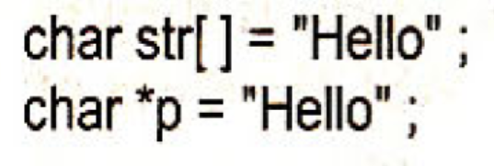
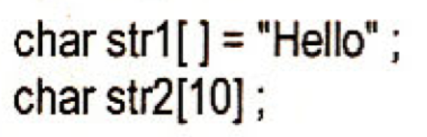
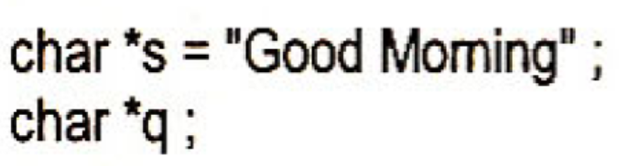


Pointers and Strings
We can not assign one string to another string
We can assign one character pointer to another

Slide 19
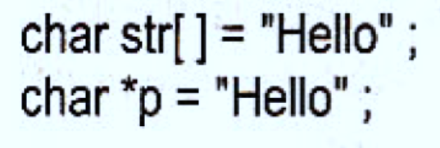
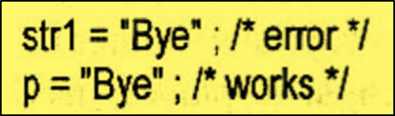
Pointers and Strings
Once a string is defined it can’t be reinitialized
Such operations are perfectly fine with pointers

Slide 20
Constant Pointer and String
Variable Pointer, Variable String | Variable Pointer, Constant String
Constant Pointer, Variable String | Constant Pointer, Constant String

Slide 21
2D Array of Characters
char cfti[6][10]= {
M | A | D | R | A | S | \0
K | H | A | R | G | P | U | R | \0
B | O | M | B | A | Y | \0
G | U | W | A | H | A | T | I | \0
K | A | N | P | U | R | \0
R | O | O | R | K | E | Y | \0
}

Slide 22
Assign value through Keyboard
…
char cfti[6][10];
for (i=0; i<6; i++)
scanf(“%s”, &cfti[i][0]);
…

Slide 23
Memory allocation
M | A | D | R | A | S | \0
K | H | A | R | G | P | U | R | \0
B | O | M | B | A | Y | \0
G | U | W | A | H | A | T | I | \0
K | A | N | P | U | R | \0
R | O | O | R | K | E | Y | \0
Waste of memory !!

Slide 24
Array of pointers to strings
char *cfti[6]= {
M | A | D | R | A | S | \0
K | H | A | R | G | P | U | R | \0
B | O | M | B | A | Y | \0
G | U | W | A | H | A | T | I | \0
K | A | N | P | U | R | \0
R | O | O | R | K | E | Y | \0
}

Slide 25
Memory Allocation
char *cfti[6]={
}
K | H | A | R | G | P | U | R | \0
K | A | N | P | U | R | \0
B | O | M | B | A | Y | \0
G | U | W | A | H | A | T | I | \0
M | A | D | R | A | S | \0
R | O | O | R | K | E | Y | \0

Slide 26
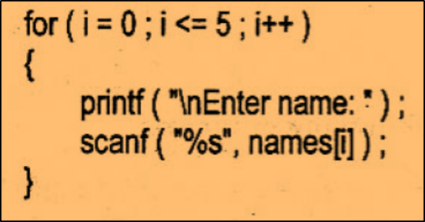
Limitation of Array of Pointers to Strings
In 2D char array
  we can either initialize at time of declaration or
  take input through scanf()
In case of array of pointers to strings:
  We can not take input through keyboard

Slide 27
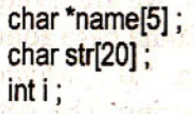
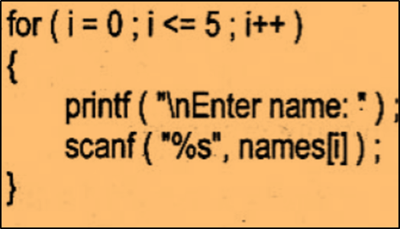
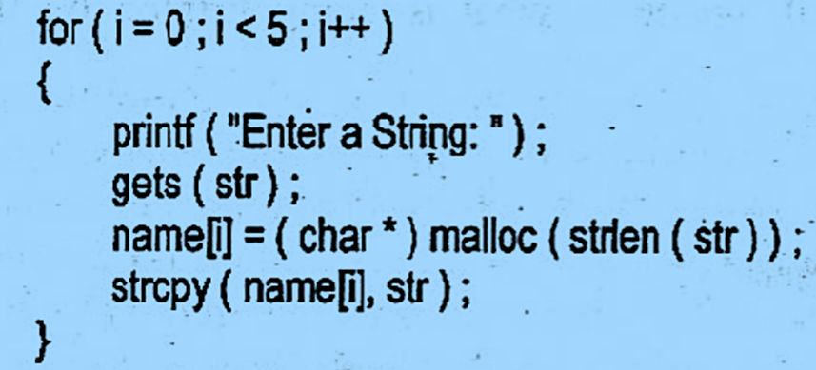
Solution
…
…

