Slide 1

CS212: Object Oriented Analysis and Design
Classes and Objects
(Using C++)

Slide 2
Recap of Week 1
Programming recap in C++
Syntax and Semantics
Various programming constructs
Data type
Statements
Operators
Function (Recursion)
Structure

Slide 3
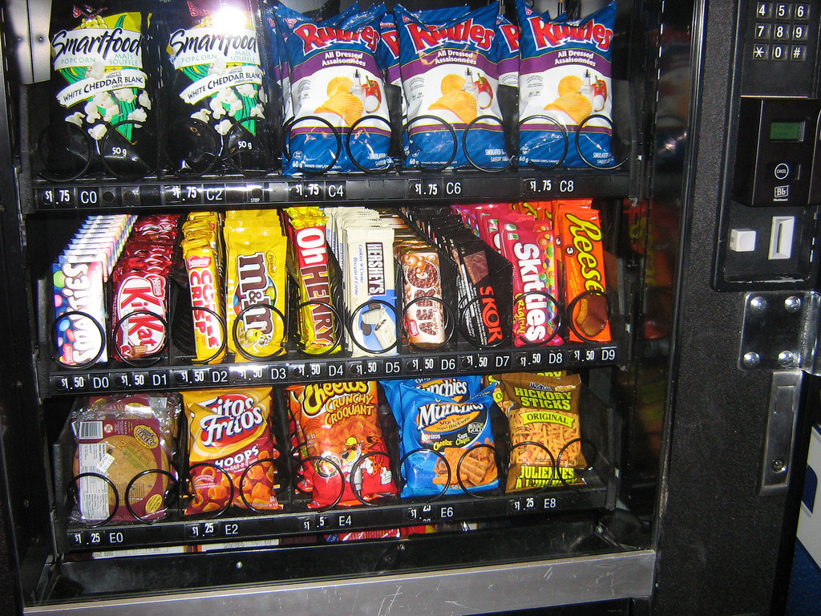
Case study-Vending Machine
Vending Machine that allows users to buy snack items. In addition, a user can find out the caloric content of her choice.

Slide 4
Specification
A Vending machine holds a number of snack items and displays the list of snack items and their prices through an user interface with a display screen and buttons for making selections. In addition, the vending machine has a receptacle for money and an item dispenser.
A user can make a selection and query for the number of calories of a snack item. The calories are displayed on pressing a button. A user can place the money in the receptacle and select an item.

Slide 5
Step 1
A Vending machine holds a number of snack items and displays the list of snack items and their prices through an user interface with a display screen and buttons for making selections. In addition, the vending machine has a receptacle for money and an item dispenser.
A user can make a selection and query for the number of calories of a snack item. The calories are displayed on pressing a button. A user can place the money in the receptacle and select an item.

Slide 6
Step 1
A Vending machine holds a number of snack items and displays the list of snack items and their prices through an user interface with a display screen and buttons for making selections. In addition, the vending machine has a receptacle for money and an item dispenser.
A user can make a selection and query for the number of calories of a snack item. The calories are displayed on pressing a button. A user can place the money in the receptacle and select an item.

Slide 7
Example-Vending Machine
Most of the nouns are objects/classes.
Some nouns are attributes of these classes.
The verbs are actions that can be attached to these objects.
In order to focus on the problem-domain objects, let us separate the object/classes into presentation-specific (user-interface related) and problem-specific classes.
Write the CRC cards for wo problem specific classes.

Slide 8
Example-Vending Machine
Problem-specific
Presentation-specific
Vending Machine
Snack item
Price
Calories
Selection
User
Display screen
Selection Buttons
Item Dispenser
Money receptacle

Slide 9
Two Programming Paradigms
Structural (Procedural) PROGRAM
Object-Oriented PROGRAM
FUNCTION
OBJECT
Operations
Data
FUNCTION
OBJECT
OBJECT
FUNCTION
Operations
Data
Operations
Data
Function calls
Messages passing
Notes:
A list of tasks to perform.
Viewed as a collection of interacting objects. Each object can be viewed as an independent machine with a distinct role or responsibility. Operations are closely associated with the objects, carry their own operators around with them .

Slide 10
Classes & Objects
The class is the cornerstone of C++
It gives the C++ its identity from C
It makes possible encapsulation, data hiding and inheritance
Class:
Consists of both data and methods
Defines properties and behavior of a set of entities
Object:
An instance of a class
A variable identified by a unique name
Notes:
Aim of class: a) provide the programmer with a tool for creating new types that can be used as conveniently as the built-in types (like float) b) user-defined type
why? Separate the incidental details of the implementation from the properties essential to the correct use of it
2. Derived class, templates: organizing related classes that allow the programmer to take advantage of their relationships.

Slide 11
Classes & Objects
class Rectangle
{
private:
int width;
int length;
public:
void set(int w, int l);
int area();
}
Rectangle r1;
Rectangle r2;
Rectangle r3;
……
int a;
Notes:
1. Now, still concrete, don’t differ much from built-in types. (actually no difference when used, only in the way they are created)
3. Class definition: class X {…}
3. Declaration vs. Definition

Slide 12
Define a Class Type
Header
class Rectangle
{
private:
int width;
int length;
public:
void set(int w, int l);
int area();
};
class class_name
{
permission_label:
member;
permission_label:
member;
...
};
Body

Slide 13
Class Definition-Data Members
Abstract the common attributes of a group of entities, their values determine the state of an object
Can be of any type, built-in or user-defined
non-static data member
Each class object has its own copy
Cannot be initialized explicitly in the class body
Can be initialized with member function, or class constructor
static data member
Acts as a global object, part of a class, not part of an object of that class
One copy per class type, not one copy per object
Can be initialized explicitly in the class body
Notes:
WHY? a) Sometimes, some constraints can cause a class to be useless outside the context. Users will be annoyed by using such context-dependent classes b) machine becomes messy. c) public permission is not willing to be given.
Allocated in static memory, constructed once and persists to the end of the program, always has the same address.
All objects belonging to the same class share these ( data or functions)
We are going to talk one application of this next time when we talk about construction of an object.

Slide 14
Static Data Member
class Rectangle
{
private:
int width;
int length;
static int count;
public:
void set(int w, int l);
int area();
}
Rectangle r1;
Rectangle r2;
Rectangle r3;
count
r1
r2
width
length
width
length
width
length
r3

Slide 15
Memory Allocation for Objects
Common for all objects
 |  | Member function 1
 |  | Member function 2
Object 1 |  | Object 2 |  | Object 3
Member variable 1 |  | Member variable 1 |  | Member variable 1
Member variable 2 |  | Member variable 2 |  | Member variable 2
Memory created when functions defined
Memory created when objects defined

Slide 16
Class Definition – Member Functions
Used to
access the values of the data members (accessor)
perform operations on the data members (implementor)
Are declared inside the class body, in the same way as declaring a function
Their definition can be placed inside the class body, or outside the class body
Can access both public and private members of the class
Can be referred to using dot or arrow member access operator
Notes:
1. Functions declared within a class definition are member functions.

Slide 17
Member Function (Definition)
class Rectangle {
private:
int width, length;
public:
void set (int w, int l);
int area() {return width*length; }
}
class name
member function name
inline
r1.set(5,8);
rp->set(8,10);
void Rectangle :: set (int w, int l) {
width = w;
length = l;
}
scope resolution
operator
Notes:
1.Different structures can have member functions with the same name.
2. If defined outside, the structure name when defining a member function must be specified. (::)
3.In a member function, member names can be used without explicit reference to an object (non member fuctions). In this case, the name refers to the member of the object for which the function was invoked. Always know for which object it was invoked.
4. Inline function: the compiler is requested to insert the complete body of the function in every place that the function is called, rather than generation code to call the function in the one place it is defined

Slide 18
Member Functions
static member function
const member function
declaration
return_type func_name (para_list) const;
definition
return_type func_name (para_list) const { … }
return_type class_name :: func_name (para_list) const { … }
Makes no modification about the data members
Ensures safety of the member variables
Notes:
A static member can be referred to without mentioning an object ( function call outside of the class, but need to be with the name of it’s class.
Usage: let the compiler help you find errors, fast and lass expensive.
3. A const member function can be invoked for both const and non-const objects, but a non-const member function can be invoked only for non-const objects.
F( const type& m)

Slide 19
Member Function: Can be constant also
class Time
{
private :
int hrs, mins, secs ;
public :
void Write ( ) const ;
} ;
function declaration
function definition
void Time :: Write( ) const
{
cout <<hrs << “:” << mins << “:” << secs << endl;
}

Slide 20
Class Definition: Access Control
Information hiding
To prevent the direct access from outside the class
Access Specifiers (optional, repeatable, not ordered)
Public (Class Interface)
may be accessible from anywhere within a program
Private (default access specifier)
may be accessed only by the member functions, and friends of this class, not open for nonmember functions
protected
acts as public for derived classes (virtual)
behaves as private for the rest of the program
Difference between classes and structs in C++
Notes:
Here is the difference between struct and class. Struct is one kind of class. Struct is a class whose members are public by default. (simple examples here)
WHY? Generally, any change to the behavior of the class type can and must be effected by changes to its members. Usage: a) For example: Debugging. Illegal value must be caused by code in a member function. b) if we want to change the representation of a class, we need only change the member functions. User code directly depends only on the public interface and need not be rewritten. c) a potential user need examine only the definition of the member functions in order to learn to use a class because other functions cannot deal with the data.

Slide 21
Example: Time Class
class Time {
public :
void Set ( int hours , int minutes , int seconds ) ;
void Increment ( ) ;
void Write ( ) const ;
Time ( int initHrs, int initMins, int initSecs ) ; // constructor
Time ( ) ; // default constructor
private :
int hrs ;
int mins ;
int secs ;
} ;
Notes:
Constructor. When you initialize for class objects, some functions need writing to do the tasks.
Default: basic initialize float, int, some basic ones.

Slide 22
What is an object?
OBJECT (Instance of a class)
set of methods
(public member functions)
internal state
(values of private data members)
Operations
Data

Slide 23
Getters and Setters
Private access specifier facilitates data hiding
Public set and get function allows clients to access data, but not indirectly
Class may store data in one way, however shows to the client in a different way
Get and set function helps the client to interact with the object
The private data member remains safely encapsulated

Slide 24
Class Interface
Header files supports reusability
Interface: standardized way of interaction between a pair of objects (e.g. people, systems)
Defines what services a client can use and how to request those services
However, NOT how the class carry out those services
A classes interface consists of the public member functions

Slide 25
Class Interface Diagram
Time class
Set
Private data:
hrs
mins
secs
Increment
Write
Time
Time

Slide 26
Separating Interface from Implementation
It is better software engineering to define member functions outside the class definition
Their implementation can be hidden from the clients code
Client code independent of class’s implementation

Slide 27
In a nutshell
Class can be considered as a user-defined data type
An object is just a variable of certain class.
There are three parts in the definition of a class:
data members,
member functions, and
access control.

Slide 28
Thank you
Next Lecture: Constructor and Destructors

