Slide 1

CS212: Object Oriented Analysis and Design
Managing Input Output

Slide 2
Streams
Input Stream
Extraction from input stream
Input device
Output Stream
Program
Output device
Insertion into output stream

Slide 3
C++ stream class
ios
C++ provides various standard classes for I/O management
File stream classes allows easy file handling
File stream classes are declared in the fstream header file
An object that belongs to a file stream class is known as a file stream
istream
ostream
iostream
ifstream
ofstream
fstream

Slide 4
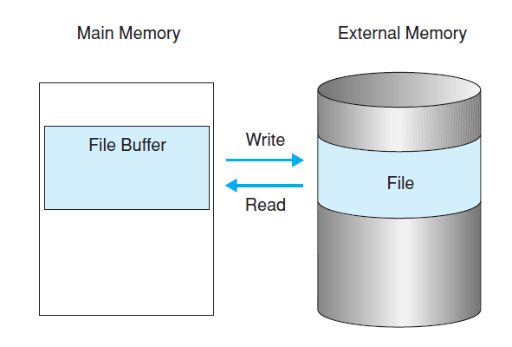
Introduction

Slide 5
Opening and Closing a File
Open a file by linking it to a stream (must first obtain a stream)
Input stream: declare the stream to be of class ifstream
Output stream: declare it as class ofstream
I/O stream: declared as class fstream
ifstream in; // input
ofstream out; // output
fstream io; // input and output

Slide 6
Opening a File from Disk
Associate a stream with a file is by using open()
void ifstream::open(const char *filename,
ios::openmode mode = ios::in);
void ofstream::open(const char *filename,
ios::openmode mode = ios::out | ios::trunc);
void fstream::open(const char *filename,
ios::openmode mode = ios::in | ios::out);

Slide 7
Opening a File from Disk
void open ( const char *filename , ios::openmode mode);
1. The name and location of the file to be opened
2. The mode in which the file should be opened (optional).
Mode Flag | Description
ios::app | Append mode. All output to that file to be appended to the end.
ios::ate | Open a file for output and move the read/write control to the end of the file.
ios::in | Open a file for reading.
ios::out | Open a file for writing.
ios::trunc | If the file already exists, its contents will be truncated before opening the file.

Slide 8
Default mode of streams
Open member functions of classes ofstream, ifstream and fstream has a default mode
That is used if the file is opened without a second argument
Class | Default mode parameter
ofstream | ios::out
ifstream | ios::in
fstream | ios::in | ios::out

Slide 9
Combining I/O Mode
Two or more of flags can be combined by ORing them together.
ofstream outfile;
outfile.open("file.dat", ios::out | ios::trunc );
Open a file in write mode, and
Truncate it in case it already exists.
fstream afile;
afile.open("file.dat", ios::out | ios::in );
Open a file in reading, and
Writing.

Slide 10
To check if File is Open
To check if a file stream was successful opening a file
Calling to member is_open.
This member function returns a bool value
True in the case that indeed the stream object is associated with an open file
False otherwise.
if (myfile.is_open()) {
/* ok, proceed with output */
}

Slide 11
Closing a File (already opened !!)
When a C++ program terminates
It automatically closes flushes all the streams,
Release all the allocated memory and
Close all the opened files.
But it is always a good practice that
A programmer should close all the opened files before program termination.
Standard syntax for close() function
A member of fstream, ifstream, and ofstream objects.
mystream.close();

Slide 12
Read line by line from Data File
Function that performs input is getline()
istream &getline(char *buf, streamsize num);
Reads characters into the array pointed to by buf until either num−1
The end of the file has been encountered
istream &getline(char *buf, streamsize num, char delim);
Reads characters into the array pointed to by buf until either num−1 characters have been read
The character specified by delim has been found
The end of the file has been encountered

Slide 13
Customized I/O and Files
Insertion and extraction operators were overloaded relative to user defined classes
The same overloaded inserter or extractor function to perform I/O on a file
Demonstration

Slide 14
Processing Text Files
Text file streams are those where
The ios::binary flag is not included in their opening mode.
These files are designed to store text
All values that are input or output from/to them can suffer some formatting transformations
Values do not necessarily correspond to their literal binary value.

Slide 15
Error Handling
Member functions of the stream object to check for specific states of a stream
All of them return a bool value.
Function | Return Value and Meaning
 | True | False
eof() | End of file is encountered while reading. | Otherwise
fail() | I/O operation failed.
bad() | Invalid operation is attempted or any unrecoverable error has occurred.
good() | No error has occurred.

Slide 16
Positioning the File Pointer
I/O stream objects keeps internal stream position
ifstream → get, ofstream→ put, fstream → get and put
Positions can be read and modified

Slide 17
tellp() and tellg()
tellp()
Get position in output sequence
tellg()
Get position in input sequence
streampos tellp();
streampos tellg();

Slide 18
seekp() and seekg()
Overloaded function
(1) ostream& seekp (streampos pos);
(2) ostream& seekp (streamoff off, ios_base::seekdir way);
(1) ostream& seekg (streampos pos);
(2) ostream& seekg (streamoff off, ios_base::seekdir way);
Value | Offset relative to
ios_base::beg | Beginning of the stream
ios_base::cur | Current position in the stream
ios_base::end | End of the stream

Slide 19
Binary Files
Reading and writing data with the extraction and insertion operators
Functions like getline is inefficient
We do not need to format any data and data is likely not formatted in lines.
write ( memory_block, size );
read ( memory_block, size );
Type char* (pointer to char),
Represents the address of an array of bytes where the read data elements are stored or from where the data elements to be written are taken.
It is an integer value.
Specifies the number of characters to be read or written from/to the memory block.

