Slide 1

CS212: Object Oriented Analysis and Design
Iterators and Algorithms

Slide 2
STL Components
Container
Algorithm
Iterator
STL

Slide 3
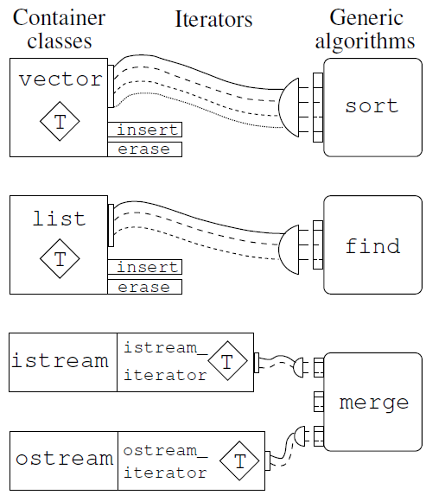
Plug compatible
For assigning an algorithm to a container
Some algorithms are good with some data structure
Input
Output

Slide 4
Storing objects
Accessing objects
Manipulate the objects
Container(s)
Iterator(s)
Algorithm
Container classes
Iterators
Generic Algorithms
Random Access
+=, -=,+,-,>,<,>=,<=
random_shuffle(), sort(), …
Vector, deque
Bidirectional
++,--
reverse(), partition(), …
List, Multiset, Set, Multimap, Map
Forward ++,!=,==,*
accumulate(), copy(), count(), …
Input
Output

Slide 5
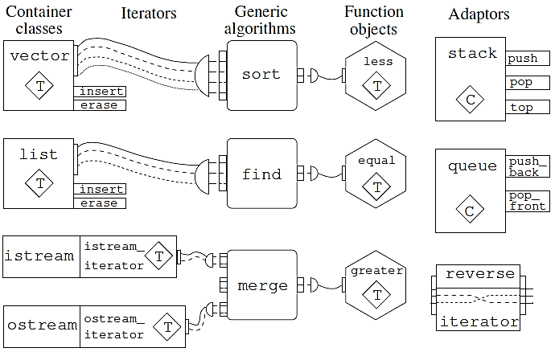
Major categories of STL

Slide 6
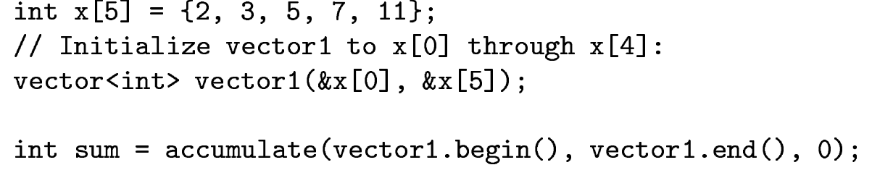
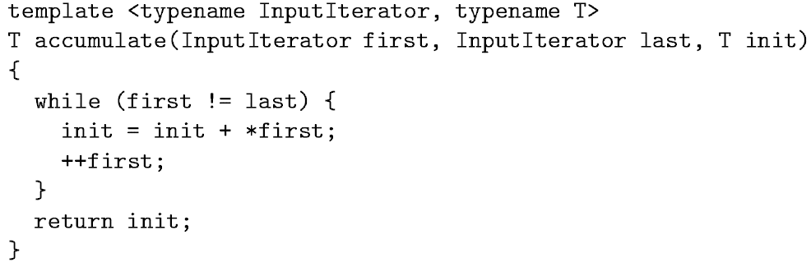
Accumulate

Slide 7
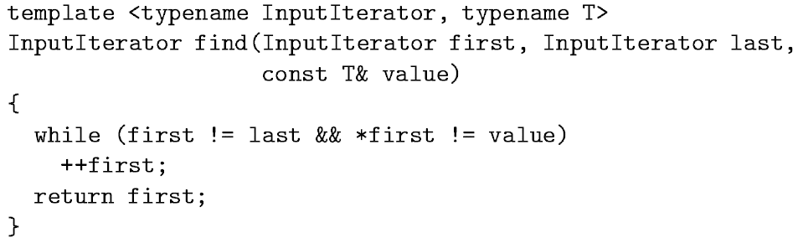
Input Iterator
Reads from a input sequence (built-in type, user-defined type, stream)
It refers to a family of types
++, *, == operator to be defined for the type on which to iterate

Slide 8
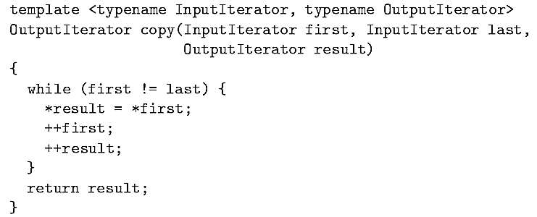
Output iterators
Allow us to write values to a sequence
Do not guarantee that we can read from the sequence
==, != need not be defined for the output iterator

Slide 9
Forward iterators
Input operator writes value to a sequence, output iterator reads from a sequence
Forward iterator allows both reading, writing and traverse in one direction
It is possible to save a forward iterator
Later start from the same position (multipass algorithm)

Slide 10
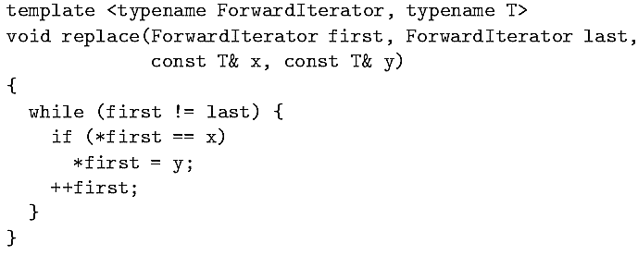
Forward iterator
One example where forward iterator is used, STL replace

Slide 11
Bidirectional Iterator
Forward iterators allow traverse in a single direction
Bidirectional iterator allows traversal in either direction
Both prefix and postfix version of operator-- is required
STL reverse algorithm can be used

Slide 12
Using Iterators
Pointer like objects in STL
STL algorithms uses them to traverse through the container
An array can be accessed either through subscripting or through a pointer
The members of a vector using subscripting or through the use of an iterator
Demonstration

Slide 13
Insert and Delete
Insert element at a given location
Delete element from a given location
Demonstration

Slide 14
Storing Class Objects
Vectors are not limited for built-in types
Can store any type of objects (user defined types)
It must also define the < and == operations
Demonstration

Slide 15
Random access iterator
To support algorithms with greater constraints
Any position in a sequence be reachable from any other in constant time
Similar to bidirectional iterator, plus
Addition and subtraction of an integer
Use of Offset
Bi-directional “Big-jumps”
Iterator subtraction
Comparison operator >, >=, < , <=

Slide 16
STL Iterator Hierarchy
Why it is useful to classify iterators into categories
Classification is an iterator hierarchy
Iterator categories are used in the specification of the container and the algorithm
e.g. List provides bidirectional iterators, and find requires input iterator.
So, find can be used with lists
Input, Output
Forward
Bidirectional
Random Access
What about sort??

Slide 17
Insert Iterator
Insert iterators are special output iterators
Prevents overwrite at a particular location
Insert new elements at a specific position in the container
The container needs to have an insert member function

