Slide 1

CS212: Object Oriented Analysis and Design
Introduction to Modelling

Slide 2
Models we may have seen …
Physics
Time-Distance Equation
Chemistry
Valency-Bond Structures
Mathematics
All about models …
Geography
Maps
Projections
Electrical Circuits
Kirchoff’s Loop Equations
Time Series Signals & FFT
Transistor Models
Building & Bridges
Drawings
Finite Element Models
Machine Design
Differential Equations

Slide 3
Why do we need models?
Solutions Method: Real Systems may not be available, accessible, affordable …
Represent the System as a Model
Solve problems on the Model
Map the solutions back to the System
Human Cognition Mechanism is limited
Short Term & Long Term Memory
Ability to track only up to 7 entities
Models are Abstractions that help track complexity

Slide 4
The Model as an Abstraction of the Reality
We are not able to comprehend a complex system in its entirety - a single model is not enough
different perspectives are required, which in turn require different models being independent from each other
each model must exist on different levels of granularity
Good models are necessary ...
for making complex systems more understandable
for visualizing the essential aspects of a system
for communication among project members and with the customer
for ensuring architectural soundness

Slide 5
Abstraction
Several abstractions of the same problem possible:
Focus on some specific aspect and ignore the rest.
Different types of models help understand different aspects of the problem.

Slide 6
Abstraction
Suppose you are asked to develop an overall understanding of some country.
Would you:
Meet all the citizens of the country, visit every house, and examine every tree of the country?
You would possibly only refer to various types of maps for that country.

Slide 7
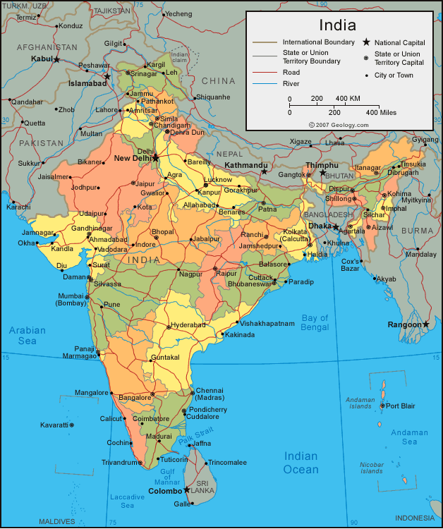

Abstraction
A map is: An abstract representation.

Slide 8
Abstraction - Views
Maps
Physical
Political
Road Network
Rivers
Electrical Design
Schematic
Layout
Timing
Building Design
Physical
Plan
Elevation
Water Supply
Electrical Distribution
Sewage

Slide 9
Abstraction
For complex problems:
A single level of abstraction is inadequate.
A hierarchy of abstractions needs to be constructed.
Hierarchy of models:
A model in one layer is an abstraction of the lower layer model.
An implementation of the model at the higher layer.

Slide 10
Hierarchical Abstraction Example
Suppose you are asked to understand the life forms that inhabit the earth.
If you start examining each living organism:
You will almost never complete it.
Also, get thoroughly confused.
You can build an abstraction hierarchy.

Slide 11
Living Organisms
Kingdom
Animalia
Plantae
Fungae
Mollusca
Chordata
Ascomycota
Zygomycota
Phyllum
Species
Homo Sapien
Solanum Tuberosum
Coprinus Comatus

Slide 12
Decomposition
Decompose a problem into many small independent parts.
The small parts are then taken up one by one and solved separately.
The idea is that each small part would be easy to grasp and can be easily solved.
The full problem is solved when all the parts are solved.

Slide 13
Decomposition
A popular use of decomposition principle:
Try to break a bunch of sticks tied together versus breaking them individually.
Any arbitrary decomposition of a problem may not help.
The decomposed parts must be more or less independent of each other.

Slide 14
Decomposition Example
Example use of decomposition principle:
You understand a book better when the contents are organized into independent chapters.
Compared to when everything is mixed up.

Slide 15
Decomposition is Hierarchical
Decompose the WHOLE into PARTs
Decompose each PART into SUB-PARTs
Decompose each SUB-PART into SUB-SUB-PARTs

Slide 16
Decomposition Hierarchy Examples
Books
Chapters
Sections
Paragraphs
Sentences
…
Cars
Engine
Piston
Cylinders
Wheels
Tyre
Tube
Steering
Brakes
AC
Seats
…

Slide 17
Modelling Relations for Hierarchies
Abstraction Hierarchy
IS-A
Decomposition Hierarchy
HAS-A

Slide 18
What is the UML? Goals
Provide users with an expressive modeling language
for the specification, construction, visualization and documentation of the artifacts of a software system
for the construction of different kinds of models
for the exchange of models
Provide users with ready-to-use core concepts
however, extensibility and specialization mechanisms are available

Slide 19
UML Goals
Provide a formal basis for understanding the modeling language
metamodel in terms of a UML class diagram
“Semantics” is part of the official UML documentation
Support higher-level development concepts
such as collaborations, patterns, and components
Integrate best practices

Slide 20
What is the UML not?
It is the explicit intention of the UML developers not to prescribe
a certain process
a certain modeling tool
any modeling guidelines
a certain programming language
Dedicated Goal: Openness!

Slide 21
Objects – Core to S/W Models
Defines object-orientation
Has multiple viewpoints
Modeling / Conceptual
Philosophical
Software Engineering
Implementation
Formal
Fundamental and most widely used UML model

Slide 22
Objects – Number Example
Complex Numbers
Variables
Real Part
Imaginary Part
Operations
Create
Norm
Add / Subtract

Slide 23
Objects – Geometry Examples
Points
Variables
X Coordinate
Y Coordinate
Operations
GetX / SetX
GetY / SetY
FindQuadrant
Lines
Variables
Point 1
Point 2
Operations
GetPt1 / SetPt1
GetPt2 / SetPt2
FindLength

Slide 24
Objects – Geometry Examples
Triangles
Variables
Point 1
Point 2
Point 3
Operations
GetPt1 / SetPt1
GetPt2 / SetPt2
GetPt3 / SetPt3
FindPerimeter
FindArea
Polygon
Variables
Number of Points
Array of Points
Operations
GetPtCount
GetPt(int i)
FindPerimeter
FindArea

Slide 25
Objects – Library Example 1
Books
Variables
Acc_no
Title
Author
Publisher
Status // Issued, Available
Borrower // Member
Operations
Get
Acc_no, Title, Author, Publisher, Status
Issue(Member)
Return
Members
Variables
Member_ID
Name
Address
Books_Issued // Array of Books
Operations
Get
Member_ID, Name, Address, Books_Issued, FreeCards

Slide 26
Objects – Library Example 2
Books
Variables
Acc_no, Title, Author, Publisher, Status
Operations: Get
Members
Variables
Member_ID, Name, Address, Count of Books_Issued
Operations: Get
Borrow_Register
Variables
Borrow_ID
Acc_no
Member_ID
Borrow_Date
Operator_ID
Operations
Borrow(Books, Members)
Return(Books)

Slide 27
Relations between Objects
Relation | Example
Specialization-Generalization, IS-A | Book is-a Publication Journal is-a Periodical Periodical is-a Publication
Whole-Part, HAS-A | Book has-a Title Book has-a Publisher Publisher has-a Address
Member-of, HAS | Library has Member

Slide 28
Relations between Objects
IS-A
Class or Type Hierarchy
HAS-A
Composition
Uniquely contains the component
Aggregation (called ‘Weak’ Aggregation)
Multiple containments possible
Member-of
Special case of HAS-A
Does not support transitivity

Slide 29
History of UML
Industrialization
Standardization
Unification
Fragmentation
June `99
OMG accepts the UML as the official
industrial standard for software modeling
notations on 17th Nov. ‘97
Submission to OMG, Sept ‘97
Submission to OMG, Jan ‘97
Beta Version OOPSLA ‘96
WWW-June ‘96
OOPSLA ‘95
UML 1.3
UML 1.1
Public
Feedback
UML 1.0
UML 0.9
Unified Method 0.8
Booch’93
OMT-2
“Method Wars”
Various Methods
Booch’91
OMT-1
OOSE
Notes:
OMT - Object Modeling Technique (James Rumbaugh et al.)
especially suited for analysis of data intensive information systems
among others, employment of extended Entity-Relationship diagrams
Booch-Method (Grady Booch)
particularly suited for modeling real-time systems and concurrent systems
strong relationship to programming languages (Ada)
OOSE - Object-Oriented Software Engineering (Ivar Jacobson)
use case-oriented approach
excellent support for business engineering and requirements analysis
modeling and simulation of telecommunication systems by means of Message Sequence Charts and SDL (Specification and Description Language)
UML unifies many of their concepts and introduces new ones

Slide 30
Diagrams of UML
(1) Use Case Diagram
(2) Class Diagram
(3) Sequence Diagram
(4) Collaboration Diagram
(5) Statechart Diagram
(6) Activity Diagram
(7) Component Diagram
(8) Deployment Diagram
Interaction
Diagrams
Behavior
Diagrams
Implementation
Diagrams

Slide 31
Views supported by UML
Use Case View
Use Case Diagram
Statechart Diagram
Interaction Diagrams
Activity Diagram
Logical/Design View
Class Diagram
Statechart Diagram
Interaction Diagrams
Activity Diagram
Process/Concurrency View
Class Diagram
Statechart Diagram
Interaction Diagrams
Activity Diagram
System
Component / Impl. View
Component Diagram
Statechart Diagram
Interaction Diagrams
Activity Diagram
Deployment View
Deployment Diagram
Statechart Diagram
Interaction Diagrams
Activity Diagram
[after Booch et al., 1999]

Slide 32
Process for Introducing UML Phases (1/2)
Requirements Specification
Contract
Analysis
Requirements Model
[Requirements Model
complete]
Analysis Model
[else]
Design
[Analysis Model
complete]
Design Model
[else]
Implementation
[else]
[Design Model
complete]
Code
Test

Slide 33
Process for Introducing UML Phases (2/2)
Test
[else]
[Test successful]
[incremental development necessary]
[else]
Start of Operation
[else]
[Start of operation successful]
Employment
[Maintenance necessary]
[additional functionality required]

Slide 34


Books

