Slide 1

CS212: Object Oriented Analysis and Design
Standard Template Library

Slide 2
Introduction
Templates facilitates generic programming
STL (Standard Template Library) is a powerful set of C++ template classes
Provides general-purpose templatized classes and functions
Implements many popular and commonly used algorithms and data structures

Slide 3
STL Components
Container
Algorithm
Iterator
STL

Slide 4
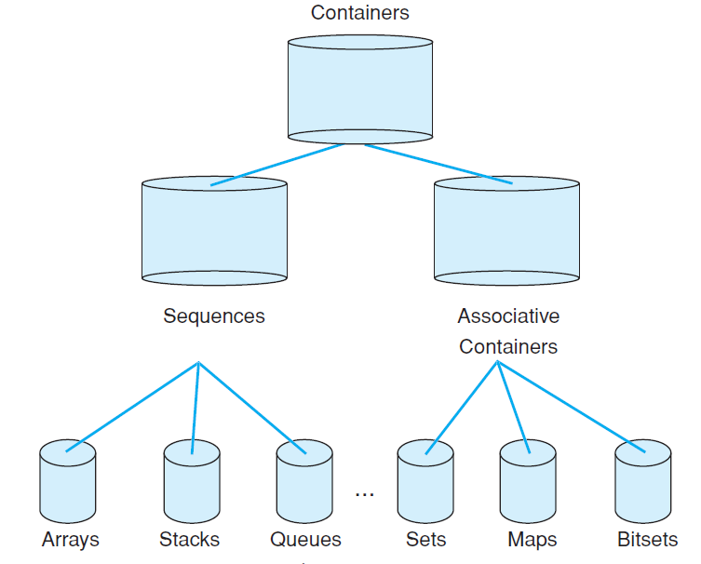
Containers

Slide 5
Algorithms
Algorithms act on containers
Provide the means by which contents of containers can be modified
Initialization, sorting, searching, and transforming the contents of containers
Many algorithms operate on a range of elements within a container.

Slide 6
Iterators
Iterators are objects that are, more or less, pointers
Ability to cycle through the contents of a container
Iterator | Access Allowed
Random Access | Store and retrieve values. Elements may be accessed randomly.
Bidirectional | Store and retrieve values. Forward and backward moving.
Forward | Store and retrieve values. Forward moving only.
Input | Retrieve, but not store values. Forward moving only.
Output | Store, but not retrieve values. Forward moving only.

Slide 7
Other STL Elements
Allocators : manage memory allocation for a container
Predicates : returns true/ false
Comparison functions
Function objects

Slide 8
General Theory of Operation
Decide on the type of container to use
Use its member functions to add elements to the container, access or modify those elements, and delete elements
Access the elements within a container is through an iterator

Slide 9
Allocator
Encapsulates a memory allocation and deallocation strategy
Used by every standard library component
All standard library containers and other allocator-aware classes access the allocator
Demonstration

Slide 10
Vectors
The most general-purpose of the containers
Supports a dynamic array
Standard array subscript notation to access its elements
template <class T, class Allocator = allocator<T>> class vector

Slide 11
Vector: Constructors
Constructs an empty vector
explicit vector(const Allocator &a = Allocator( ) );
explicit vector(size_type num, const T &val = T ( ),
const Allocator &a = Allocator( ));
vector(const vector<T, Allocator> &ob);
template <class InIter> vector(InIter start, InIter end,
const Allocator &a = Allocator( ));
Constructs a vector that has num elements with the value val
Constructs a vector that contains the same elements as ob
Constructs a vector that contains the elements in the range specified by the iterators start and end

Slide 12
Constraints
Any object that will be stored in a vector must define a default constructor
It must also define the < and == operations
All of the built-in types automatically satisfy these requirements.
Implementation is compiler dependent

Slide 13
Instantiating vectors
// create zero-length int vector
vector<int> iv;
vector<char> cv(5);
vector<char> cv(5, 'x');
vector<int> iv2(iv);
// create 5-element char vector
// initialize a 5-element char vector
// create int vector from an int vector

Slide 14
Common functions
Member | Description
size() | Returns the current size of the vector
begin() | Returns an iterator to the start of the vector
end() | Returns an iterator to the end of the vector
push_back() | Puts a value onto the end of the vector
insert() | Add elements to the middle
erase() | Remove elements from a vector

Slide 15
Using Iterators
Pointer like objects in STL
STL algorithms uses them to traverse through the container
An array can be accessed either through subscripting or through a pointer
The members of a vector using subscripting or through the use of an iterator
Demonstration

Slide 16
Insert and Delete
Insert element at a given location
Delete element from a given location
Demonstration

Slide 17
Storing Class Objects
Vectors are not limited for built-in types
Can store any type of objects (user defined types)
It must also define the < and == operations
Demonstration

Slide 18
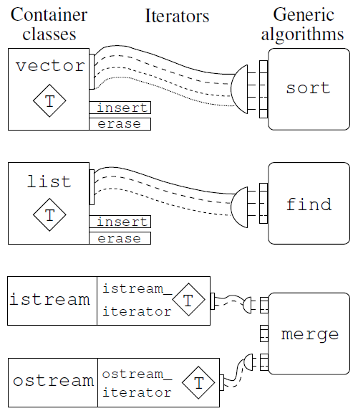
Plug compatible

Slide 19
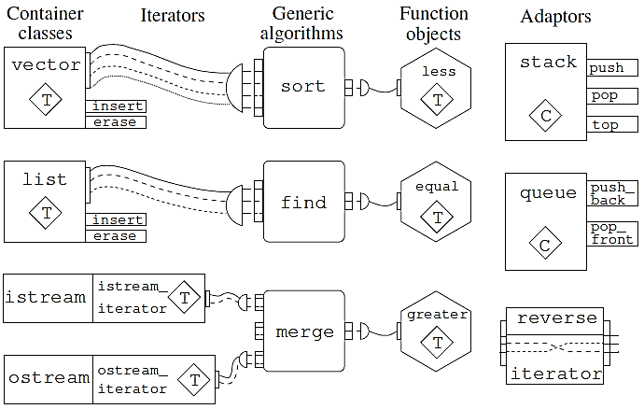
Major categories of STL

Slide 20
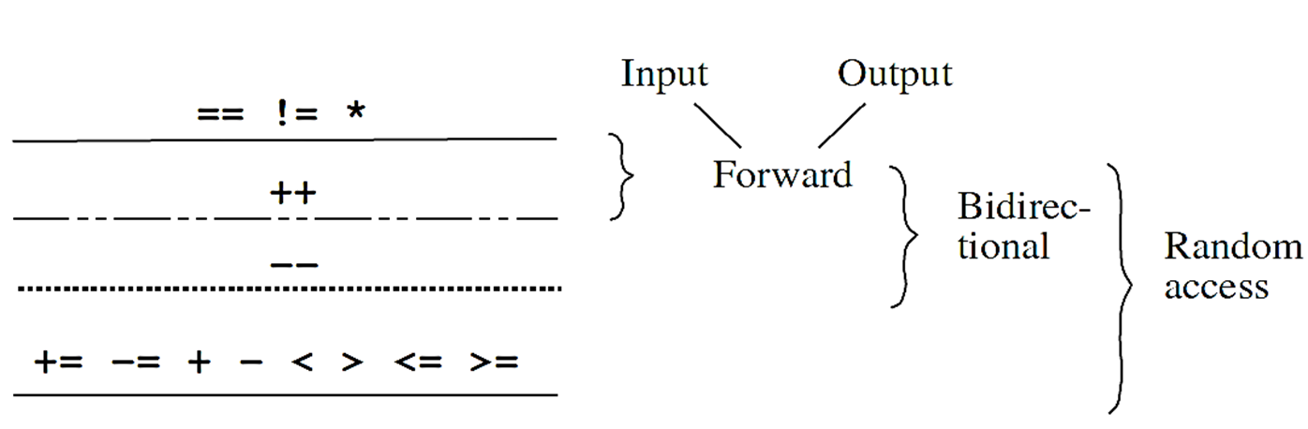
Hierarchical relationship between STL iterator categories

Slide 21
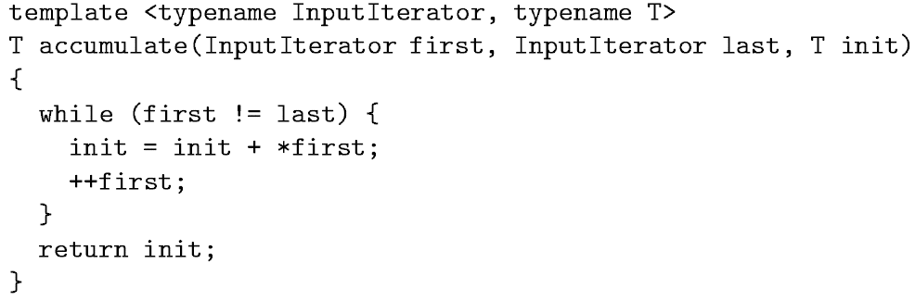
Accumulate

Slide 22
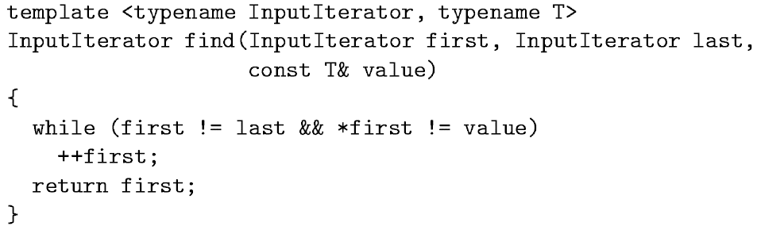
Input Iterator
Reads from a input sequence (built-in type, user-defined type, stream)
It refers to a family of types
++, *, == operator to be defined for the type on which to iterate

Slide 23
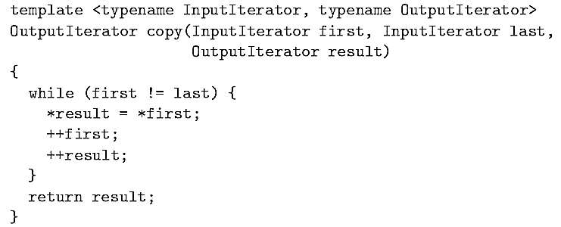
Output iterators
Allow us to write values to a sequence
Do not guarantee that we can read from the sequence
==, != need not be defined for the output iterator

Slide 24
Forward iterators
Input operator writes value to a sequence, output iterator reads from a sequence
Forward iterator allows both reading, writing and traverse in one direction
It is possible to save a forward iterator
Later start from the same position (multipass algorithm)

Slide 25
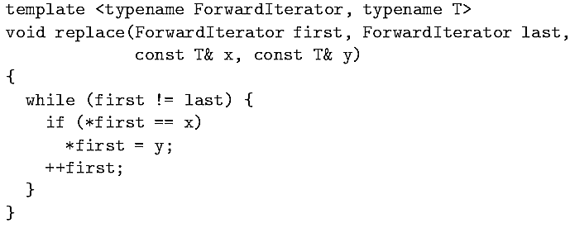
Forward iterator
One example where forward iterator is used, STL replace

Slide 26
Bidirectional Iterator
Forward iterators allow traverse in a single direction
Bidirectional iterator allows traversal in either direction
Both prefix and postfix version of operator-- is required
STL reverse algorithm can be used

Slide 27
Random access iterator
To support algorithms with greater constraints
Any position in a sequence be reachable from any other in constant time
Similar to bidirectional iterator, plus
Addition and subtraction of an integer
Use of Offset
Bi-directional “Big-jumps”
Iterator subtraction
Comparison operator >, >=, < , <=

Slide 28
STL Iterator Hierarchy
Why it is useful to classify iterators into categories
Classification is an iterator hierarchy
Iterator categories are used in the specification of the container and the algorithm
e.g. List provides bidirectional iterators, and find requires input iterator.
So, find can be used with lists
Input, Output
Forward
Bidirectional
Random Access
What about sort??

Slide 29
Insert Iterator
Insert iterators are special output iterators
Prevents overwrite at a particular location
Insert new elements at a specific position in the container
The container needs to have an insert member function

