Slide 1

CS212: Object Oriented Analysis and Design
Generic Programming

Slide 2
Outline
Introduction to Templates
Function Templates
Class Templates

Slide 3
Generic Programming
A style of computer programming
Algorithms are written in terms of types to-be-specified-later
Instantiated when needed for specific types provided as parameters.
C++ ➔ Templates

Slide 4
Introduction
Sophisticated programming feature
It allows to construct both functions and classes based on types that have not yet been stated
Powerful tool for automating program code generation
One function or class can be used with several different types of data without having to explicitly recode specific versions for each data type.
Provide a simple way to represent a wide range of general concepts and simple ways to combine them.

Slide 5
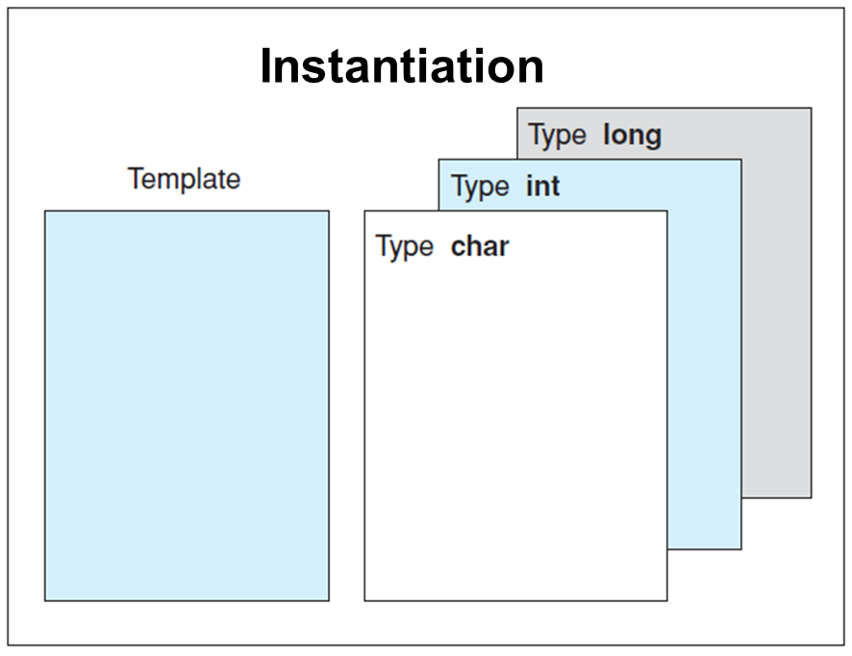
Templates
A function template defines a group of statements for a function using a parameter
instead of a concrete type (Algorithm)
A class template specifies a class definition using a parameter instead of a concrete type (parameterized type)

Slide 6
Advantages of Templates
A template need only be coded once. Individual functions or classes are automatically generated when needed.
A template offers a uniform solution for similar problems
Allows type-independent code to be tested early in the development phase.
Errors caused by multiple encoding are avoided.
Policy-Based Class Design

Slide 7
Function Template
A function template definition (or declaration) is always preceded by a template clause
template <class T> T Max (T, T);
Declares a function template
template <class T>
T Max (T val1, T val2)
{
return val1 > val2 ? val1 : val2;
}
Defines the function

Slide 8
Type parameter
It is an arbitrary identifier whose scope is limited to the function itself
Type parameters always appear inside <>
Each type parameter consists of the keyword class followed by the parameter name
Multiple type parameters should be separated by commas
Each specified type parameter must be referred to in the function prototype

Slide 9
Type parameter: Example
template <class T1, class T2, class T3>
T3 Relation(T1, T2); // ok
template <class T1, class T2>
int Compare (T1, T1); // illegal!
template <class T1, T2> // illegal!
int Compare (T1, T2);
template <class T>
inline T Max (T val1, T val2); // ok
inline template <class T> // illegal!
T Max (T val1, T val2);

Slide 10
Function Template Instantiation
A function template represents an algorithm
Functions are generated by the compiler by binding its type parameters to concrete (built-in or user-defined) types
The compiler does not attempt any implicit type conversions to ensure a match.
Demonstration

Slide 11
Overloading a Generic Function
Function templates can be overloaded in exactly the same way as normal functions
This is formally called explicit specialization
Overloaded function overrides (or "hides") the generic function relative to that specific version
Allows tailoring of a version of a generic function to accommodate a unique situation
Use overloaded functions rather than templates

Slide 12
Generic Function Restrictions
Similar to overloaded functions except that they are more restrictive
Overloading: different actions performed within the body of each function
Generic function: generic function must perform the same general action for all versions
Demonstration

Slide 13
Compacting an Array
This function compacts the elements in an array
Remove unused elements from the middle of an array
All unused elements are at the end
compact()
Demonstration

Slide 14
Class templates (Generic classes)
A class template definition (or declaration) is always preceded by a template clause
template <class Type> class Stack;
Declares a class template named Stack

Slide 15
Class template definition
template <class Type>
class Stack {
private:
Type *stack; // stack array
int top; // index of top stack entry
const int maxSize; // max size of stack
public:
Stack (int max) : stack(new Type[max]),
top(-1), maxSize(max) {}
~Stack (void) {delete [] stack;}
void Push (Type &val);
void Pop (void) {if (top >= 0) --top;}
Type& Top (void) {return stack[top];}
friend ostream& operator << (ostream&, Stack&);
};

Slide 16
Member function definition
template <class Type>
void Stack<Type>::Push (Type &val)
{
if (top+1 < maxSize)
stack[++top] = val;
}
template <class Type>
ostream& operator << (ostream& os, Stack<Type>& s)
{
for (int i = 0; i <= s.top; ++i)
os << s.stack[i] << " ";
return os;
}

Slide 17
Class Template Instantiation
A class template represents a generic class
Executable implementations of the class can be generated by binding its type parameters
Stack<int> s1(10); // stack of integers
Stack<double> s2(10); // stack of doubles
Stack<Point> s3(10); // stack of points
Demonstration

Slide 18
A Generic Array Class
Overload the [ ] operator for "safe arrays" that provide run-time boundary checking
Combining operator overloading with a template class
Create a generic safe-array type
Creating safe arrays of different data types
Demonstration

Slide 19
Non-Type Arguments
It is also possible to specify non-type arguments
Specify what is a standard argument such as an integer or a pointer
Include the type and name of the argument
Non-type parameters are restricted to integers, pointers, or references
Demonstration

Slide 20
Default Arguments
A template class can have a default argument
Also permissible for non-type arguments to take default arguments
No explicit value is specified when the class is instantiated
Demonstration
template <class X=int> class myclass { //...

Slide 21
Explicit Class Specializations
It possible to create an explicit specialization of a generic class
Use the template<> construct
Works the same as it does for explicit function specializations
Demonstration

