Slide 1

CS212: Object Oriented Analysis and Design
Run Time Polymorphism

Slide 2
Polymorphism
Polymorphism in C++
Compile Time
Runtime
Function overloading
Operator overloading
Virtual Function
The provision of a single interface to entities of different types.
Methods with same name but different implementations.
Operators have different implementations depending on their arguments
A member function that you expect to be redefined in derived classes.

Slide 3
Introduction
Encapsulation
Access control
Inheritance
Virtual function
An object as its own type or its base type
Separates the interface from the implementation
Creates new data types

Slide 4
Paradigm shift in programming
Better C
Enhanced version of C
Object Based
Grouping a data structure together (Encapsulation)
Constructor and destructors
Object oriented
Virtual function
Intimately bound with the concept of type
Structure → Class
Variable declaration
Inheritance
Understood only from a design viewpoint

Slide 5
Pointers to Derived Types
A pointer of one type cannot point to an object of a different type
An important exception to this rule that relates only to derived classes
B
A base class pointer can point to any derived classes object
D
Demonstration

Slide 6
Virtual Function
A virtual function is a member function
Declared within a base class
Redefined by a derived class
“one interface, multiple methods”

Slide 7
Binding
Connecting a function call to a function body is called binding.
Types of Bindings
Early
Late
Dynamic binding
or
Runtime binding
Before the program is run (by the compiler and linker)
Binding occurs at runtime, based on the type of the object

Slide 8
Virtual functions
To cause late binding to occur for a particular function
Use the virtual keyword when declaring the function
When a virtual function is redefined, all aspects of its prototype must be the same.
Constructor functions cannot be virtual, but destructor functions can.
Overriding : virtual function redefinition by a derived class.
Demonstration

Slide 9
How C++ implements late binding
Compiler takes care of the virtual function mechanism
Run-time polymorphism is achieved when access is through a base-class pointer (or reference)
Compiler creates a single table (called the VTABLE) for each class
Compiler places the addresses of the virtual functions
Pointer to the VTABLE for an object: VPTR (vpointer)

Slide 10
Storing type information
No explicit type information stored in any of the classes.
How the type is determined at run time?
The type information is hidden.
Demonstration

Slide 11
An Example
Instrument; play(), what(), adjust()
Wind
Percussion
Stringed
Brass
Woodwind
Demonstration

Slide 12
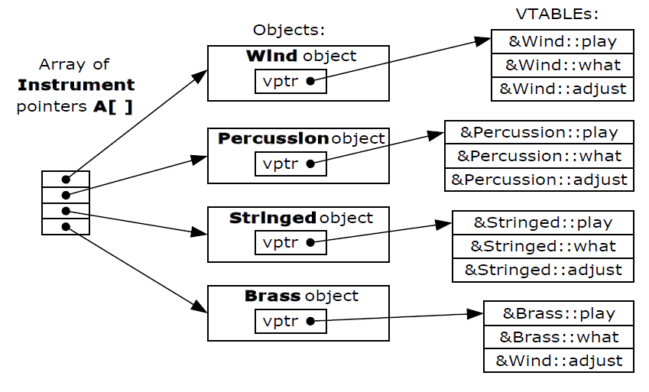
Visualizing virtual functions

Slide 13
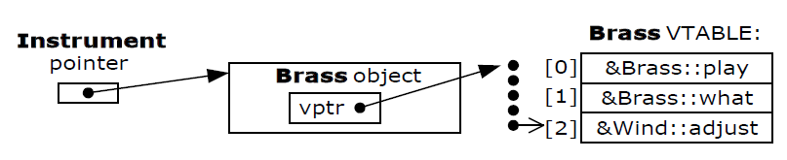
Visualizing virtual functions
Begins with the Instrument pointer
Compiler can pick the VPTR of that object
VPTR points to the starting address of the VTABLE
Compiler knows adjust( ) function is at the location VPTR+2
“Call the function at VPTR+2”

Slide 14
The Virtual Attribute Is Inherited
When a virtual function is inherited, its virtual nature is also inherited.
Base class
Virtual function
No matter how many times a virtual function is inherited, it remains virtual
Derived class 1
Virtual function
Derived class 2
Virtual function

Slide 15
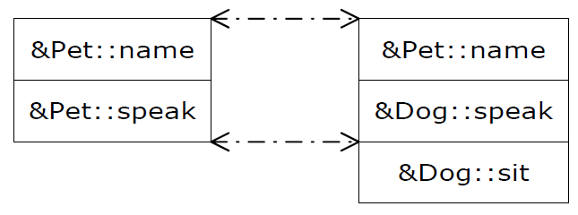
Inheritance and the VTABLE
Compiler creates a new VTABLE for your new class
For non-overridden virtual functions, inserts the addresses using the base-class function addresses
What happens when you inherit and add new virtual functions in the derived class? (Demonstration)
RTTI: Run Time Type Identification

Slide 16
Hierarchical Virtual Functions
Base class
Base class
Base class
Virtual function
Virtual function
Virtual function
Derived class 1
Derived class 1
Derived class 1
Virtual function
Virtual function
Virtual function
Derived class 2
Derived class 2
Derived class 2
Virtual function
Case 1
Case 2
Case 3

Slide 17
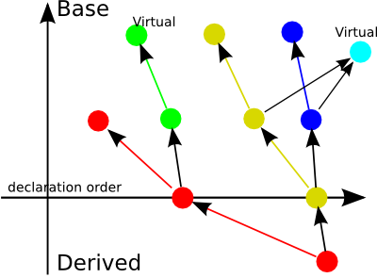
Overheads of virtual functions
https://www.cs.ucsb.edu/~urs/oocsb/papers/oopsla96.pdf

