Slide 1

CS212: Object Oriented Analysis and Design
Polymorphism
(Using C++)

Slide 2
Recap
Class and Objects
Identification
Design of attributes and functionalities
Getter and Setters
Class Interface
Constructor and Destructor

Slide 3
Automated Gardner
On a hydroponics farm, plants are grown in a nutrient solution, without sand, gravel, or other soils. Maintaining the proper greenhouse environment is a delicate job and depends on the kind of plant being grown and its age. One must control diverse factors such as temperature, humidity, light, pH, and nutrient concentrations. On a large farm, it is not unusual to have an automated system that constantly monitors and adjusts these elements. Simply stated, the purpose of an automated gardener is to efficiently carry out, with minimal human intervention, growing plans for the healthy production of multiple crops.

Slide 4
Automated Gardner
On a hydroponics farm, plants are grown in a nutrient solution, without sand, gravel, or other soils. Maintaining the proper greenhouse environment is a delicate job and depends on the kind of plant being grown and its age. One must control diverse factors such as temperature, humidity, light, pH, and nutrient concentrations. On a large farm, it is not unusual to have an automated system that constantly monitors and adjusts these elements. Simply stated, the purpose of an automated gardener is to efficiently carry out, with minimal human intervention, growing plans for the healthy production of multiple crops.

Slide 5
Automated Gardner
On a hydroponics farm, plants are grown in a nutrient solution, without sand, gravel, or other soils. Maintaining the proper greenhouse environment is a delicate job and depends on the kind of plant being grown and its age. One must control diverse factors such as temperature, humidity, light, pH, and nutrient concentrations. On a large farm, it is not unusual to have an automated system that constantly monitors and adjusts these elements. Simply stated, the purpose of an automated gardener is to efficiently carry out, with minimal human intervention, growing plans for the healthy production of multiple crops.

Slide 6
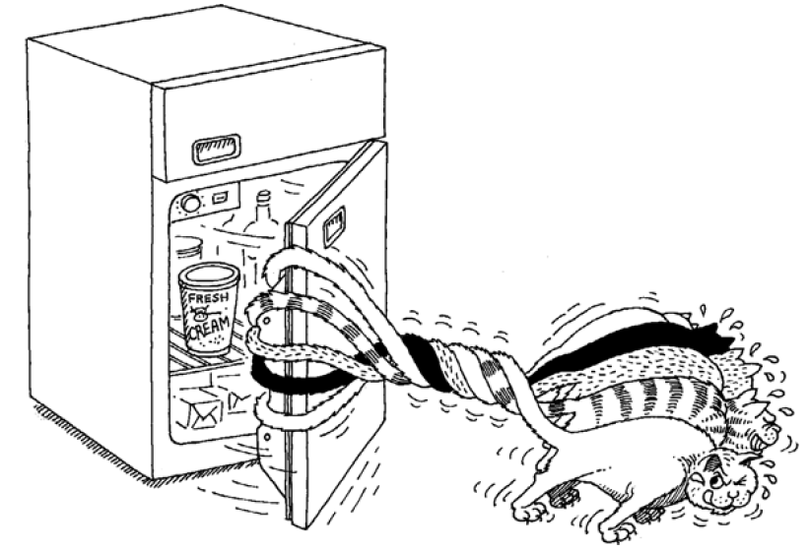
Objects collaborate with other objects to achieve a task
How objects cooperate with one another define the boundaries of each abstraction and thus the responsibilities and protocol of each object.

Slide 7
Meaning of Modularity
The act of partitioning a program into individual components can reduce its complexity to some degree
It creates a number of well-defined, documented boundaries within the program.
Classes and objects form the logical structure of a system
Abstractions are kept in modules to produce the system’s physical architecture.

Slide 8
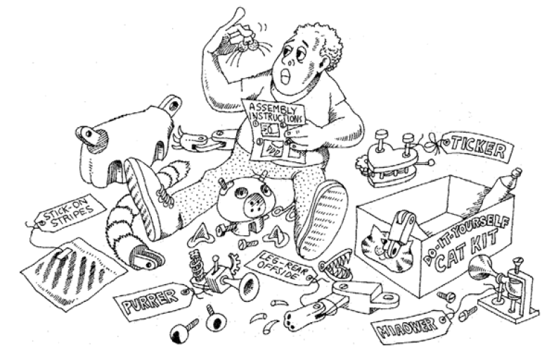
Deciding on the right set of modules for a given problem is almost as hard a problem as deciding on the right set of abstractions.
Modularity is the property of a system that has been decomposed into a set of cohesive and loosely coupled modules

Slide 9
GRASP
Name chosen to suggest the importance of grasping fundamental principles to successfully design object-oriented software
Acronym: General Responsibility Assignment Software Patterns
Describe fundamental principles of object design and responsibility
General principles, may be overruled by others

Slide 10
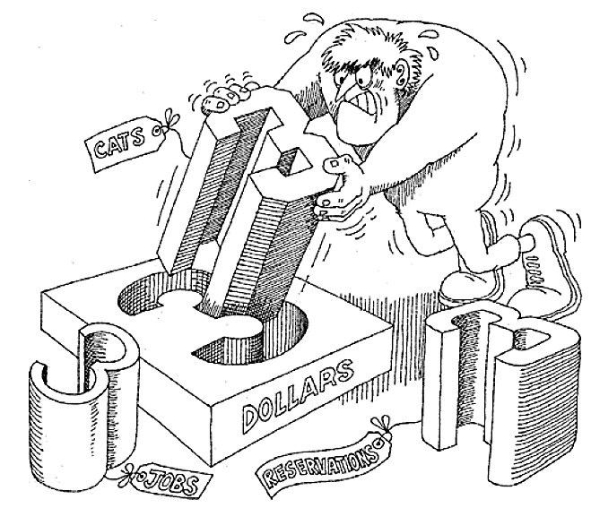
Nine GRASP Principles
Principle |  | Meaning
Creator |  | Creation of objects
Information Expert |  | Delegation of responsibility
Low Coupling |  | Model View Controller Design
Controller |  | A non-user interface design
High Cohesion |  | Less Inter-class dependencies
Polymorphism |  | Variation in behavior
Indirection |  | Focused, manageable, understandable
Pure fabrication |  | Artificial class, Open-close principle
Protected variation |  | Avoid impact between objects

Slide 11
Refers to ‘one name having many forms’
‘Different behaviour of an instance depending upon the situation’.
An ‘overloaded function’ refers to a function having (one name and) more than one distinct meanings.
Polymorphism in C++
Compile Time
Runtime
Function overloading
Operator overloading
Virtual Function
Not only does it provide support for compile-time polymorphism, it also adds flexibility and convenience.

Slide 12
Function overloading
A function name having several definitions that are differentiable by the number or types of their arguments.
OR
Function Overloading not only implements polymorphism but also reduces number of comparisons in a program and thereby makes the program run faster.
For example;
float add (int a, int b);
float add (float x, float y);

Slide 13
Function signature/ Extended name
The key to function overloading is a function’s argument list
This is also known as the function signature/ extended name.
It is the signature, not the function type that enables function overloading.
Two functions with same number and types of arguments in the same order are said to have the same signature.
int myfunc(int i)
int myfunc(int i, float j)
void myfunc(int x, float y)

Slide 14
Overloading → Different signature
To overload a function name
Declared and defined with the same name
Characterized by different signatures.
For instance, following code fragment overloads a function name add( ).
int add(int a, int b)
int add(int a, int b, int c)
double add(double x, double y)
double add(double p, int q)

Slide 15
Task of a compiler
Signatures of two functions are identical, and the return types are same, then the second is treated as a re-declaration of the first.
Signatures of two functions are identical, however the return type differ, the second is an erroneous re-declaration
Signature of the two functions differ in either the number or type of their arguments, the two functions are considered to be overloaded

Slide 16
C++ compiler model
Pre-processor
Compiler
Assembly code
Assembler
Object code
Linker
Executable code

Slide 17
Name Mangling/ Name Decoration
Technique used to resolve unique names for programming entities
It provides a way of encoding additional information – function, structure, class, and other data type
The need arises where the language allows different entities to be named with the same
To correctly link a function it needs its name, the number of arguments and their types

Slide 18
Name mangling in C++
C++ allows overloading, however linker does not
Each function name must be unique
Generates a new name for each function – mangling/ decoration
The process of name mangling is compiler dependent.
The name mangled by a compiler may not be same as mangled by other compilers.
The mangled name contains all the necessary information that the linker needs
Linkage type, scope, calling convention, number of arguments, type of arguments.

Slide 19
Mangled name for g++ compiler
Mangling pattern
_Z N OriginalFunctionName parameter-names-encoded
N = Number Of Chars In Original Function Name
Original Name | Mangled Name
void myFun(); | _Z5myFunv
void myFun(int a, char c); | _Z5myFunic

Slide 20
Restrictions
Any two functions in a set of overloaded functions must have different argument lists.
Overloading functions with argument lists of the same types, based on return type alone, is an error.
Member functions cannot be overloaded solely on the basis of one being static and the other non-static.
Typedef declaration do not define new types; they introduces synonyms for existing types.

Slide 21
Steps involved in finding match
Argument matching
A match: A match is found for the function call
No match: No match is found for the function call
Ambiguous match: More than one defined instance for the function call

Slide 22
Function selection flow-chart
Start
Exact match?
No
Match by promotion?
No
Yes
Match by conversion?
Call that function
Error!!
Stop

Slide 23
Search for an Exact Match
The compiler first tries to find an exact match
Types of actual arguments are exactly same
1. int add(int a, int b)
2. int add(int a, int b, int c)
3. double add(double x, double y)
4. double add(double p, int q)
1. cout << add(5,10)
2. cout << add(6,-5,15)
3. cout << add(12.5,7.5)
4. cout << add(0.145, 2)

Slide 24
A match through promotion
If exact match is not found
Compiler uses integral promotion to the actual arguments
int add(int a, int b)
cout << add(10, ‘A’);

Slide 25
A match through application of standard C++ conversion rules
Compiler attempts built-in conversion
Implicit assignment conversion
Then finds a unique match for the function
If conversion results multiple match – compiler error !!
void aFunc(char);
void aFunc(double);
void aFunc(long);
void aFunc(double);
aFunc(10);
aFunc(10);
C++ standard conversion rules
Error !! Ambiguous match

Slide 26
A match through application of a user-defined conversion
If all the three methods fails
Then the compiler will try the user-defined conversion in the combinations to find a unique match.
This technique is used to handle class objects

Slide 27
Copy Constructors
One of the more important forms of an overloaded constructor is the copy constructor.
Defining a copy constructor can help you prevent problems that might occur when one object is used to initialize another.
When we copy?
Initialize
Pass as argument
Return as parameter

Slide 28
Pointers in C++
Pointers in C++ is a more strongly typed language
C doesn’t let you casually assign a pointer of one type to another
It does allow you to accomplish this through a void*
bird* b;
rock* r;
void* v;
v = r;
b = v;

Slide 29
Recap of reference
A reference must be initialized when it is created.
Once a reference is initialized to an object, it cannot be changed to refer to another object.
You cannot have NULL references.
Must be careful while returning reference from a function !!
Should not refer to unknown memory.

Slide 30
Constant Reference
The function does modify the outside argument.
Making the argument a const reference will allow the function to be used in all situations.
For built-in types, the function will not modify the argument
For user-defined types, the function will call only const member functions, won’t modify any public data members.
Temporary objects are always constant

Slide 31
Argument-passing guidelines
Normal habit when passing an argument to a function should be to pass by const reference.
There are concerns other than efficiency
To pass an argument by value requires a constructor and destructor call
If the arguments are not going to be modified : pass by const reference

Slide 32
Passing and returning by value
Declare a function and make a function call,
how does the compiler know how to pass and return those variables?
Equivalent assembly code
int f(int x, char c);
int g = f(a, b);
push b
push a
call f()
add sp,4
mov g, register a

Slide 33
Passing and returning large objects
struct Big {
char buf[100];
int i;
long d;
} B, B2;
The entire contents of B is pushed on the stack
The address of B2 is pushed before making the call
Constraints on the compiler when it’s making a function call.
Big bigfun(Big b) {
b.i = 100; // Do something
return b;
}
int main() {
B2 = bigfun(B);
}

Slide 34
Function-call stack frame
Pushes all the arguments on the stack
Makes the call
Provide storage for the function’s local variables
Function arguments
Return address
Local variables
Re-entrancy

Slide 35
Re-entrancy
Functions in C and C++ support interrupts: re-entrant
They also support recursive calls
Return values on the stack??
Allocating the extra storage on the stack for the return values before calling the function.
Push the address of the return value’s destination on the stack as one of the function arguments,
The function copy the return information directly into the destination.

Slide 36
Bitwise copy and its issue
A
Class: Student
Name | Roll | Marks
Sumit | 9 | 25
B= A
Class: Student
Name | Roll | Marks
Sumit | 9 | 25

Slide 37
Bitwise copy and its issue
A
Class: Student
Name | Roll | M1 | M2 | M3 | M4
Sumit | 9 | 25 | 35 | 40 | 38
B= A
Class: Student
Name | Roll | M1 | M2 | M3 | M4
Sumit | 9 | 25 | 35 | 40 | 38

Slide 38
Bitwise copy and its issue
A
Class: Student
Name | Roll | *Marks
Sumit | 9 | 0xABC
B= A
Class: Student
Name | Roll | *Marks
Sumit | 9 | 0xABC

Slide 39
Create object from an existing object
One of the more important forms of an overloaded constructor is the copy constructor.
Defining a copy constructor can help you prevent problems that might occur when one object is used to initialize another.
When we copy?
Initialize
Pass as argument
Return as parameter

Slide 40
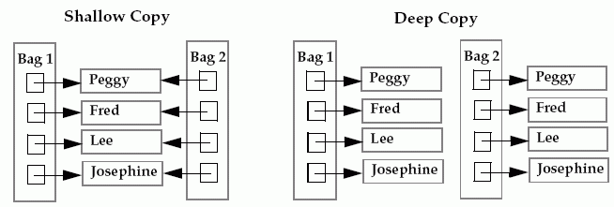
Deep vs Shallow copy
Copy constructor is called only for initializations
For assignment ? Operator overload ??

Slide 41
Operator overloading
Compiler sees an expression consisting of an argument followed by an operator followed by an argument, it simply calls a function.
An operator is simply a function call with a different syntax.
There must be a previously declared function to match that operator
Operator overloading is just “syntactic sugar,” which means it is simply another way for you to make a function call.

Slide 42
Is the knowledge about operator wrong ?
Maybe everything they know about operators in C is suddenly wrong
Operators for built-in types won’t suddenly start working differently
Overloaded operators can be created only where new data types are involved
1 << 4;
won’t suddenly change its meaning
1.414 << 1;
won’t suddenly start working.

Slide 43
Thank you
Next Lecture: Polymorphism

