Slide 1

CS223: Software Engineering
The Agile Methodology

Slide 2
Recap
Programming best practices

Slide 3
Objective
After completing this lecture students will be able to
Describe principles of Agile methods
Use agile development in their term project

Slide 4
Rapid software development
Rapid development and delivery is now often the most important requirement for software systems
Businesses operate in a fast –changing requirement
Hard to produce a set of stable software requirements
Software has to evolve quickly to reflect changing business needs.
Rapid software development
Specification, design and implementation are inter-leaved
System is developed as a series of versions with stakeholders involved in version evaluation
User interfaces are often developed using an IDE and graphical toolset.

Slide 5
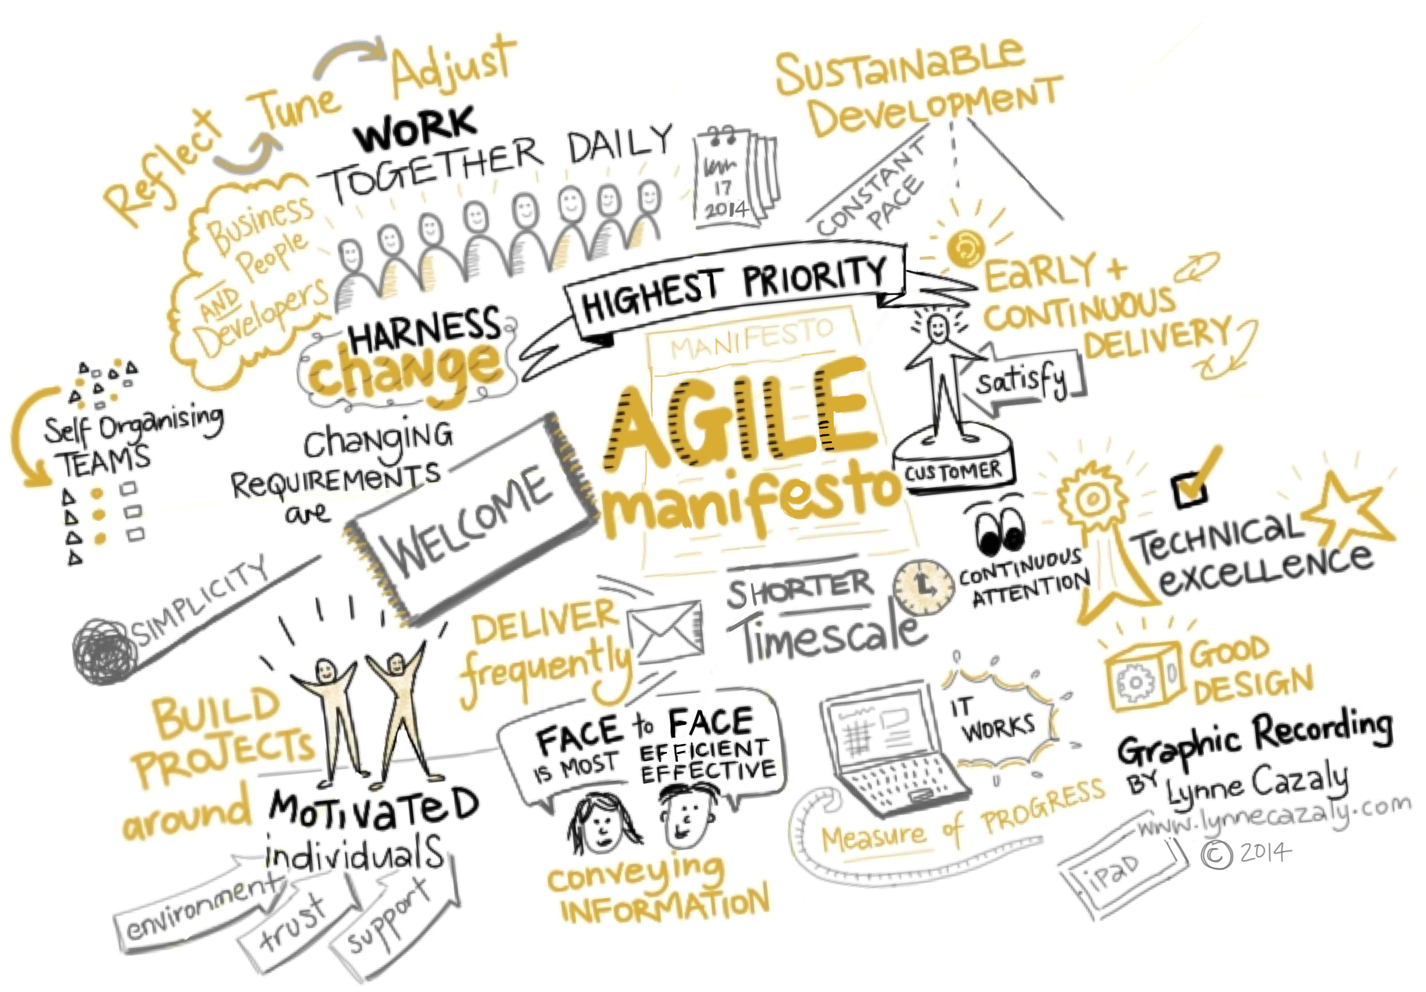

Slide 6
Agile method
Developing a small or medium-sized product for sale.
Custom system development within an organization
Not a lot of external rules and regulations that affect the software.
Because of their focus on small, tightly-integrated teams
There are problems in scaling agile methods to large systems.

Slide 7
Problems with agile methods
Engage the customers involved in the process.
Team members may not be “agile” enough.
Prioritizing changes can be difficult (?)
Maintaining simplicity requires extra work.
Legal issue as compared to other approaches of iterative model.

Slide 8
Agile methods and software maintenance
Most organizations spend more on maintaining existing software
If agile methods are to be successful,
Support maintenance as well as original development.
Two key Questions:
Are systems that are developed using an agile approach maintainable, given the emphasis in the development process of minimizing formal documentation?
Can agile methods be used effectively for evolving a system in response to customer change requests?
Problems may arise if original development team cannot be maintained.

Slide 9
Plan-driven and agile development
Plan-driven development
Separate development stages with the outputs to be produced at each of these stages planned in advance.
Not necessarily waterfall model – plan-driven, incremental development is possible
Iteration occurs within activities.
Agile development
Specification, design, implementation and testing are inter-leaved
Outputs from the development process are decided through a process of negotiation during the software development process.

Slide 10
Plan-driven and agile specification
Plan-driven
Requirement Engineering
Requirement Specification
Design and Implementation
Requirement change request
Agile
Requirement Engineering
Design and Implementation

Slide 11
Technical, human, organizational issues
Deciding on the balance depends on:
Is it important to have a very detailed specification and design before moving to implementation?
Is an incremental delivery strategy, where you deliver the software to customers and get rapid feedback from them, realistic?
How large is the system that is being developed?
Agile methods are most effective when the system can be developed with a small co-located team
For large systems that require larger development teams, a plan-driven approach may have to be used.

Slide 12
Technical, human, organizational issues
What type of system is being developed?
Plan-driven approaches may be required for systems that require a lot of analysis before implementation
What is the expected system lifetime?
Long-lifetime systems may require more design documentation to communicate the original intentions of the system developers to the support team.
What technologies are available to support system development?
Agile methods rely on good tools to keep track of an evolving design
How is the development team organized?
If the development team is distributed or if part of the development is being outsourced,
You may need to develop design documents to communicate across the development teams.

Slide 13
Organizational issues
Are there cultural or organizational issues that may affect the system development?
Traditional engineering organizations have a culture of plan-based development, as this is the norm in engineering.
How good are the designers and programmers in the development team?
It is sometimes argued that agile methods require higher skill levels than plan-based approaches in which programmers simply translate a detailed design into code
Is the system subject to external regulation?
If a system has to be approved by an external regulator
Required to produce detailed documentation as part of the system safety case.

Slide 14
Key points
Agile methods are incremental development methods that focus on
Rapid development,
Frequent releases of the software,
Reducing process overheads and
Producing high-quality code.
They involve the customer directly in the development process.
Choice of an approach depend on the
Type of software being developed,
Capabilities of the development team and
Culture of the company developing the system.
XP is a well-known agile method that integrates a range of good programming practices

Slide 15
Extreme programming
Perhaps the best-known and most widely used agile method
Extreme Programming (XP) takes an ‘extreme’ approach to iterative development.
New versions may be built several times per day;
Increments are delivered to customers every 2 weeks;
All tests must be run for every build and the build is only accepted if tests run successfully.

Slide 16
XP and agile principles
Incremental development is supported through small, frequent system releases.
Customer involvement means full-time customer engagement with the team.
People not process through pair programming, collective ownership and a process that avoids long working hours.
Change supported through regular system releases.
Maintaining simplicity through constant refactoring of code.

Slide 17
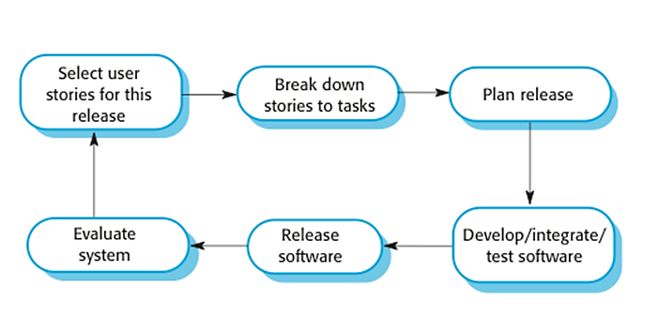
The XP release cycle

Slide 18
Extreme programming practices (a)
Principle or practice | Description
Incremental planning | Requirements are recorded on story cards and the stories to be included in a release are determined by the time available and their relative priority.
Small releases | The minimal useful set of functionality that provides business value is developed first.
Simple design | Enough design is carried out to meet the current requirements and no more.
Test-first development | An automated unit test framework is used to write tests for a new piece of functionality before that functionality itself is implemented.
Refactoring | All developers are expected to refactor the code continuously as soon as possible code improvements are found. This keeps the code simple and maintainable.

Slide 19
Extreme programming practices (b)
Pair programming | Developers work in pairs, checking each other’s work and providing the support to always do a good job.
Collective ownership | The pairs of developers work on all areas of the system, so that no islands of expertise develop.
Continuous integration | As soon as the work on a task is complete, it is integrated into the whole system.
Sustainable pace | Large amounts of overtime are not considered acceptable.
On-site customer | A representative of the end-user of the system (the customer) should be available full time for the use of the XP team

Slide 20
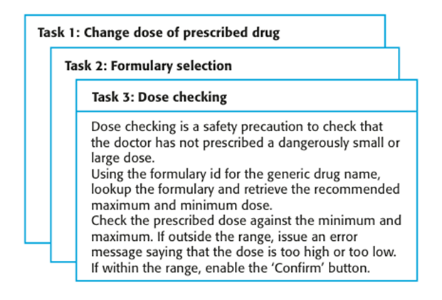
Examples of task cards

Slide 21
Refactoring
Programming team look for possible software improvements
Make these improvements even where there is no immediate need for them.
This improves the understandability of the software
Changes are easier to make because the code is well-structured and clear.
However, some changes requires architecture refactoring
This is much more expensive.

Slide 22
Examples of refactoring
Re-organization of a class hierarchy to remove duplicate code.
Tidying up and renaming attributes and methods to make them easier to understand.
The replacement of inline code with calls to methods that have been included in a program library.

Slide 23
Testing in XP
Testing is central to XP
XP has developed an approach where
The program is tested after every change has been made.
XP testing features:
Test-first development.
Incremental test development from scenarios.
User involvement in test development and validation.
Automated test harnesses are used to run all component tests each time that a new release is built.

Slide 24
Test-first development
Writing tests before code clarifies the requirements to be implemented.
Tests are written as programs rather than data so that they can be executed automatically.
The test includes a check that it has executed correctly.
Usually relies on a testing framework such as Junit.
All previous and new tests are run automatically when new functionality is added
Checking that the new functionality has not introduced errors.

Slide 25
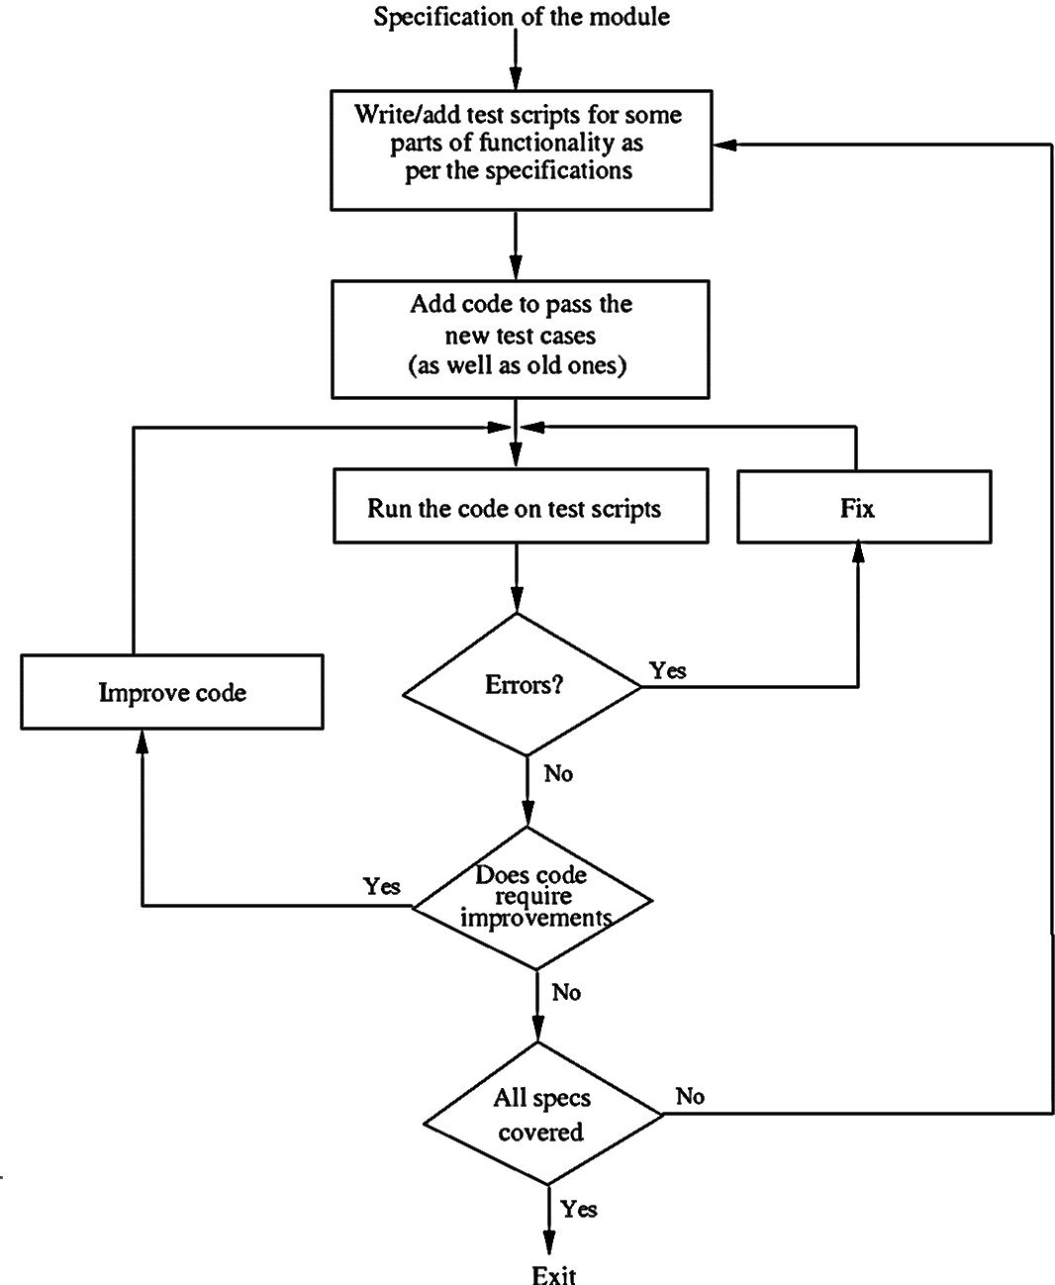


Slide 26
Customer involvement
The role of the customer in the testing process is to
Help develop acceptance tests for the stories that are to be implemented in the next release of the system.
The customer who is part of the team writes tests as development proceeds.
All new code is validated to ensure that it is what the customer needs.
However, people adopting the customer role have limited time available and so cannot work full-time with the development team.

Slide 27
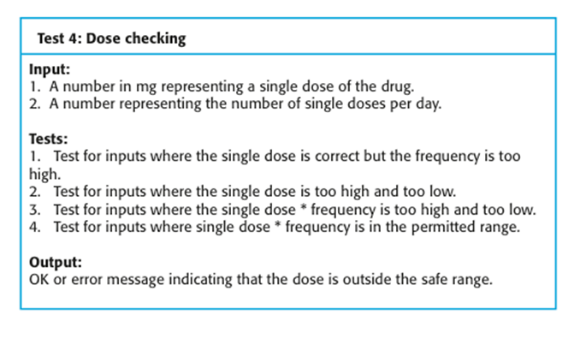
Test case description example

Slide 28
XP testing difficulties
Programmers prefer programming to testing and sometimes they take short cuts when writing tests.
E.g. they may write incomplete tests that do not check for all possible exceptions that may occur.
Some tests can be very difficult to write incrementally.
E.g., in a complex user interface, it is often difficult to write unit tests for the code that implements the ‘display logic’ and workflow between screens.
It difficult to judge the completeness of a set of tests.
Test set may not provide complete coverage.

Slide 29
Pair programming
In XP, programmers work in pairs.
This helps develop common ownership of code and spreads knowledge across the team.
It serves as an informal review process as each line of code is looked at by more than 1 person.
It encourages refactoring as the whole team can benefit from this.
Development productivity with pair programming is similar to that of two people working independently.

Slide 30
Agile project management
The principal responsibility is to manage the project so that
The software is delivered on time and
Within the planned budget for the project.
The standard approach to project management is plan-driven.
Managers draw up a plan for the project showing
what should be delivered,
when it should be delivered and
who will work on the development of the project deliverables.
Agile project management requires a different approach
adapted to incremental development and the particular strengths of agile methods.

Slide 31
Thank you
Next Lecture: Testing

