Slide 1

CS223: Software Engineering
Software Development Processes

Slide 2
Introduction
It is concerned with
Elicitation,
Analysis,
Specification, and
Validation of software requirements
Management of requirements during the whole life cycle of the software product
Software projects are critically vulnerable when the requirements related activities are poorly performed

Slide 3
Topics of discussion
Software Requirement
Process
Elicitation
Analysis
Specification
Validation
Considerations
Model
Management
Quality
Classification
Design
Negotiation
Analysis
SRS
Review
Verification
Test
Change management
Tracing
Measurement

Slide 4
The requirements elicitation and analysis process
Requirement classification and organization
Requirement prioritization and negotiation
Requirement specification
Requirement discovery

Slide 5
Definition
It is a property that must be exhibited by something
To solve some problem in the real world
A complex combination from various people at different levels of an organization
Objects connected with this feature from the environment in which the software will operate

Slide 6
Few important terminologies
Product and process requirement
Functional and Nonfunctional Requirements
Emergent requirement
Quantifiable requirement
Avoid vague and unverifiable requirements

Slide 7
System and Software requirement
International Council on Software and Systems Engineering (INCOSE)
Software (user) requirements
Statements, in a natural language plus diagrams
Services the system is expected to provide to system users and the constraints under which it must operate.
System requirements
Detailed descriptions of the software system’s functions, services, and operational constraints.
Define exactly what is to be implemented (Functional specification)

Slide 8
Example
User requirement specification
Generate monthly report
System requirement specification
On the last working day of the month
Automatically generate after 17.30 hrs.
Created for each office
Restricted access to valid user

Slide 9
Different Users
User
Requirements
Client managers
System end-users
System Requirements
System end-users
System architects
Client engineers
Contractor managers
System Architects
Client engineers
Software developers

Slide 10
Functional and Non-functional requirements
Functional
statements of services the system should provide
System reaction to a particular input
System behaviour at a particular situation
What a system should not do (optional)
Non-Functional
Constraints on the services or functions offered by the system
timing constraints,
constraints on the development process,
constraints imposed by standards
Applicable to the entire system, not on parts

Slide 11
Functional requirements
Describe functionality or system services.
Depend on the type of software, expected users and the type of system where the software is used.
Functional user requirements may be high-level statements of what the system should do.
Functional system requirements should describe the system services in detail.

Slide 12
A case study
A user shall be able to search the appointments lists for all clinics.
The system shall generate each day, for each clinic, a list of patients who are expected to attend appointments that day.
Each staff member using the system shall be uniquely identified by his or her 8-digit employee number.

Slide 13
Requirements imprecision
Problems arise when requirements are not precisely stated.
Ambiguous requirements may be interpreted in different ways by developers and users.
Consider the term ‘search’ in requirement 1
User intention – search for a patient name across all appointments in all clinics;
Developer interpretation – search for a patient name in an individual clinic. User chooses clinic then search.

Slide 14
Requirements completeness and consistency
Requirements should be both complete and consistent.
Complete
They should include descriptions of all facilities required.
Consistent
There should be no conflicts or contradictions in the descriptions of the system facilities.
It is a challenging task to meet both the conditions

Slide 15
Non-functional requirements
These define system properties and constraints
E.g. reliability, response time and storage requirements.
Constraints are I/O device capability, system representations, etc.
Process requirements may also be specified mandating a particular IDE, programming language or development method.
Non-functional requirements may be more critical than functional requirements.
If these are not met, the system may be useless.

Slide 16
Types of nonfunctional requirement
Non-functional Requirement
Product
Organizational
External
Usability
Efficiency
Dependability
Security
Environmental
Operational
Development
Performance
Space
Regulatory
Ethical
Legislative
Accounting
Safety/
Security

Slide 17
Non-functional requirements implementation
Non-functional requirements may affect the overall architecture of a system rather than the individual components.
Minimize communications between components.
A single non-functional requirement may generate a number of related functional requirements that define system services that are required.
It may also generate requirements that restrict existing requirements.

Slide 18
Non-functional classifications
Product requirements
Delivered product must behave in a particular way
e.g. execution speed, reliability, etc.
Organisational requirements
Consequence of organisational policies and procedures
e.g. process standards used, implementation requirements, etc.
External requirements
Requirements which arise from factors which are external to the system and its development process
e.g. interoperability requirements, legislative requirements, etc.

Slide 19
Examples of nonfunctional requirements
Product requirement
The MHC-PMS shall be available to all clinics during normal working hours (Mon–Fri, 0830–17.30).
Downtime within normal working hours shall not exceed five seconds in any one day.
Organizational requirement
Users of the MHC-PMS system shall authenticate themselves using their health authority identity card.
External requirement
The system shall implement patient privacy provisions as set out in HStan-03-2006-priv.

Slide 20
Goals and requirements
Non-functional requirements may be very difficult to state precisely
Imprecise requirements may be difficult to verify.
Goal
A general intention of the user such as ease of use.
Verifiable non-functional requirement
A statement using some measure that can be objectively tested.
Goals are helpful to developers as they convey the intentions of the system users.

Slide 21
Usability requirements
Should be easy to use by medical staff
Should be organized in such a way that user errors are minimized. (Goal)
Medical staff shall be able to use all the system functions
After four hours of training.
The average number of errors should be less
Shall not exceed two per hour of system use.
Testable non-functional requirement

Slide 22
Metrics for specifying nonfunctional requirements
Property | Measure
Speed | Processed transactions/second User/event response time Screen refresh time
Size | Mbytes Number of ROM chips
Ease of use | Training time Number of help frames
Reliability | Mean time to failure Probability of unavailability Rate of failure occurrence Availability
Robustness | Time to restart after failure Percentage of events causing failure Probability of data corruption on failure
Portability | Percentage of target dependent statements Number of target systems

Slide 23
Domain requirements
The system’s operational domain imposes requirements on the system.
For example, a train control system has to take into account the braking characteristics in different weather conditions.
Domain requirements be new functional requirements, constraints on existing requirements or define specific computations.
If domain requirements are not satisfied, the system may be unworkable.

Slide 24
Train protection system
This is a domain requirement for a train protection system:
The deceleration of the train shall be computed as:
Dtrain = Dcontrol + Dgradient
Dgradient is 9.81ms2 * compensated gradient/ alpha
The values of 9.81ms2 /alpha are known for different types of train.
It is difficult for a non-specialist to understand the implications of this and how it interacts with other requirements.

Slide 25
Domain requirements problems
Understandability
Requirements are expressed in the language of the application domain;
This is often not understood by software engineers developing the system.
Implicitness
Domain specialists understand the area so well that they do not think of making the domain requirements explicit.

Slide 26
The software requirements document
The software requirements document is the official statement of what is required of the system developers.
Include both
A definition of user requirements
A specification of the system requirements.
It is NOT a design document.
As far as possible, it should set of WHAT the system should do rather than HOW it should do it.

Slide 27
Requirements document variability
Information in requirements document depends on
type of system and
the approach to development used.
Systems developed incrementally will
have less detail in the requirements document.
Requirements documents standards have been designed
IEEE standard.
These are mostly applicable to the requirements for large systems engineering projects.

Slide 28
Characteristics
Correctness
Each requirement accurately represents some desired feature in the final system
Completeness
All desired features/characteristics specified
Hardest to satisfy
Completeness and correctness strongly related
Unambiguous
Each requirement has exactly one meaning
Without this errors will creep in
Important as natural languages often used

Slide 29
Characteristics
Verifiability
There must exist a cost effective way of checking if sw satisfies requirements
Consistent
Two requirements don’t contradict each other
Traceable
The origin of the requirement, and how the requiremetn relates to software elements can be determined
Ranked for importance/stability
Needed for prioritizing in construction
To reduce risks due to changing requirements

Slide 30
The structure
Chapter | Description
Preface | This should define the expected readership of the document and describe its version history, including a rationale for the creation of a new version and a summary of the changes made in each version.
Introduction | This should describe the need for the system. It should briefly describe the system’s functions and explain how it will work with other systems. It should also describe how the system fits into the overall business or strategic objectives of the organization commissioning the software.
Glossary | This should define the technical terms used in the document. You should not make assumptions about the experience or expertise of the reader.
User requirements definition | Here, you describe the services provided for the user. The nonfunctional system requirements should also be described in this section. This description may use natural language, diagrams, or other notations that are understandable to customers. Product and process standards that must be followed should be specified.
System architecture | This chapter should present a high-level overview of the anticipated system architecture, showing the distribution of functions across system modules. Architectural components that are reused should be highlighted.

Slide 31
The structure
Chapter | Description
System requirements specification | This should describe the functional and nonfunctional requirements in more detail. If necessary, further detail may also be added to the nonfunctional requirements. Interfaces to other systems may be defined.
System models | This might include graphical system models showing the relationships between the system components and the system and its environment. Examples of possible models are object models, data-flow models, or semantic data models.
System evolution | This should describe the fundamental assumptions on which the system is based, and any anticipated changes due to hardware evolution, changing user needs, and so on. This section is useful for system designers as it may help them avoid design decisions that would constrain likely future changes to the system.
Appendices | These should provide detailed, specific information that is related to the application being developed; for example, hardware and database descriptions. Hardware requirements define the minimal and optimal configurations for the system. Database requirements define the logical organization of the data used by the system and the relationships between data.
Index | Several indexes to the document may be included. As well as a normal alphabetic index, there may be an index of diagrams, an index of functions, and so on.

Slide 32
Requirements specification
The process of writing down the user and system requirements in a requirements document.
User requirements have to be understandable by end-users and customers who do not have a technical background.
System requirements are more detailed requirements and may include more technical information.
The requirements may be part of a contract for the system development
It is therefore important that these are as complete as possible.

Slide 33
How to write?
Notation | Description
Natural language | The requirements are written using numbered sentences in natural language. Each sentence should express one requirement.
Structured natural language | The requirements are written in natural language on a standard form or template. Each field provides information about an aspect of the requirement.
Design description languages | This approach uses a language like a programming language, but with more abstract features to specify the requirements by defining an operational model of the system. This approach is now rarely used although it can be useful for interface specifications.
Graphical notations | Graphical models, supplemented by text annotations, are used to define the functional requirements for the system; UML use case and sequence diagrams are commonly used.
Mathematical specifications | These notations are based on mathematical concepts such as finite-state machines or sets. Although these unambiguous specifications can reduce the ambiguity in a requirements document, most customers don’t understand a formal specification. They cannot check that it represents what they want and are reluctant to accept it as a system contract

Slide 34
Requirements and design
In principle, requirements should state what the system should do and the design should describe how it does this.
In practice, requirements and design are inseparable
A system architecture may be designed to structure the requirements;
The system may inter-operate with other systems that generate design requirements;
The use of a specific architecture to satisfy non-functional requirements may be a domain requirement.
This may be the consequence of a regulatory requirement.

Slide 35
Natural language specification
Requirements are written as natural language sentences supplemented by diagrams and tables.
Used for writing requirements because it is expressive, intuitive and universal.
This means that the requirements can be understood by users and customers.

Slide 36
Guidelines for writing requirements
Follow a standard format and use it for all requirements.
Use language in a consistent way. Use shall for mandatory requirements, should for desirable requirements.
Use text highlighting to identify key parts of the requirement.
Avoid the use of computer jargon.
Include an explanation (rationale) of why a requirement is necessary.

Slide 37
Problems with natural language
Lack of clarity
Precision is difficult without making the document difficult to read.
Requirements confusion
Functional and non-functional requirements tend to be mixed-up.
Requirements amalgamation
Several different requirements may be expressed together.

Slide 38
Example requirements for the insulin pump software system
3.2 The system shall measure the blood sugar and deliver insulin, if required, every 10 minutes. (Changes in blood sugar are relatively slow so more frequent measurement is unnecessary; less frequent measurement could lead to unnecessarily high sugar levels.) 3.6 The system shall run a self-test routine every minute with the conditions to be tested and the associated actions defined in Table 1. (A self-test routine can discover hardware and software problems and alert the user to the fact the normal operation may be impossible.)

Slide 39
Structured specifications
An approach to writing requirements where the freedom of the requirements writer is limited and requirements are written in a standard way.
This works well for some types of requirements e.g.
Requirements for embedded control system but is sometimes too rigid for writing business system requirements.

Slide 40
Form-based specifications
Definition of the function or entity.
Description of inputs and where they come from.
Description of outputs and where they go to.
Information about the information needed for the computation and other entities used.
Description of the action to be taken.
Pre and post conditions (if appropriate).
The side effects (if any) of the function.

Slide 41
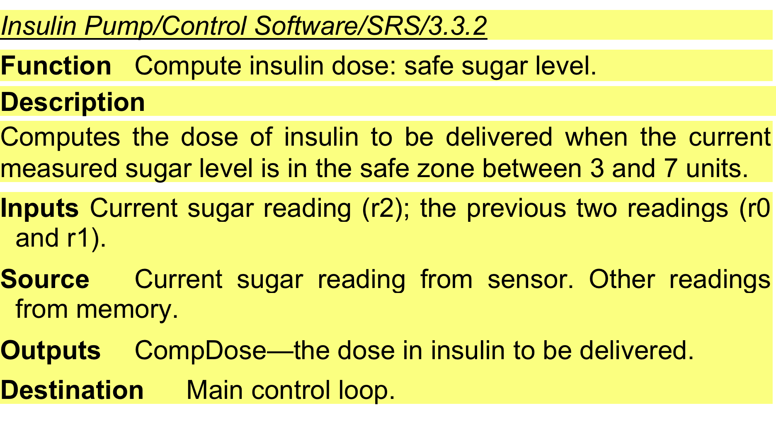
A structured specification of a requirement for an insulin pump

Slide 42
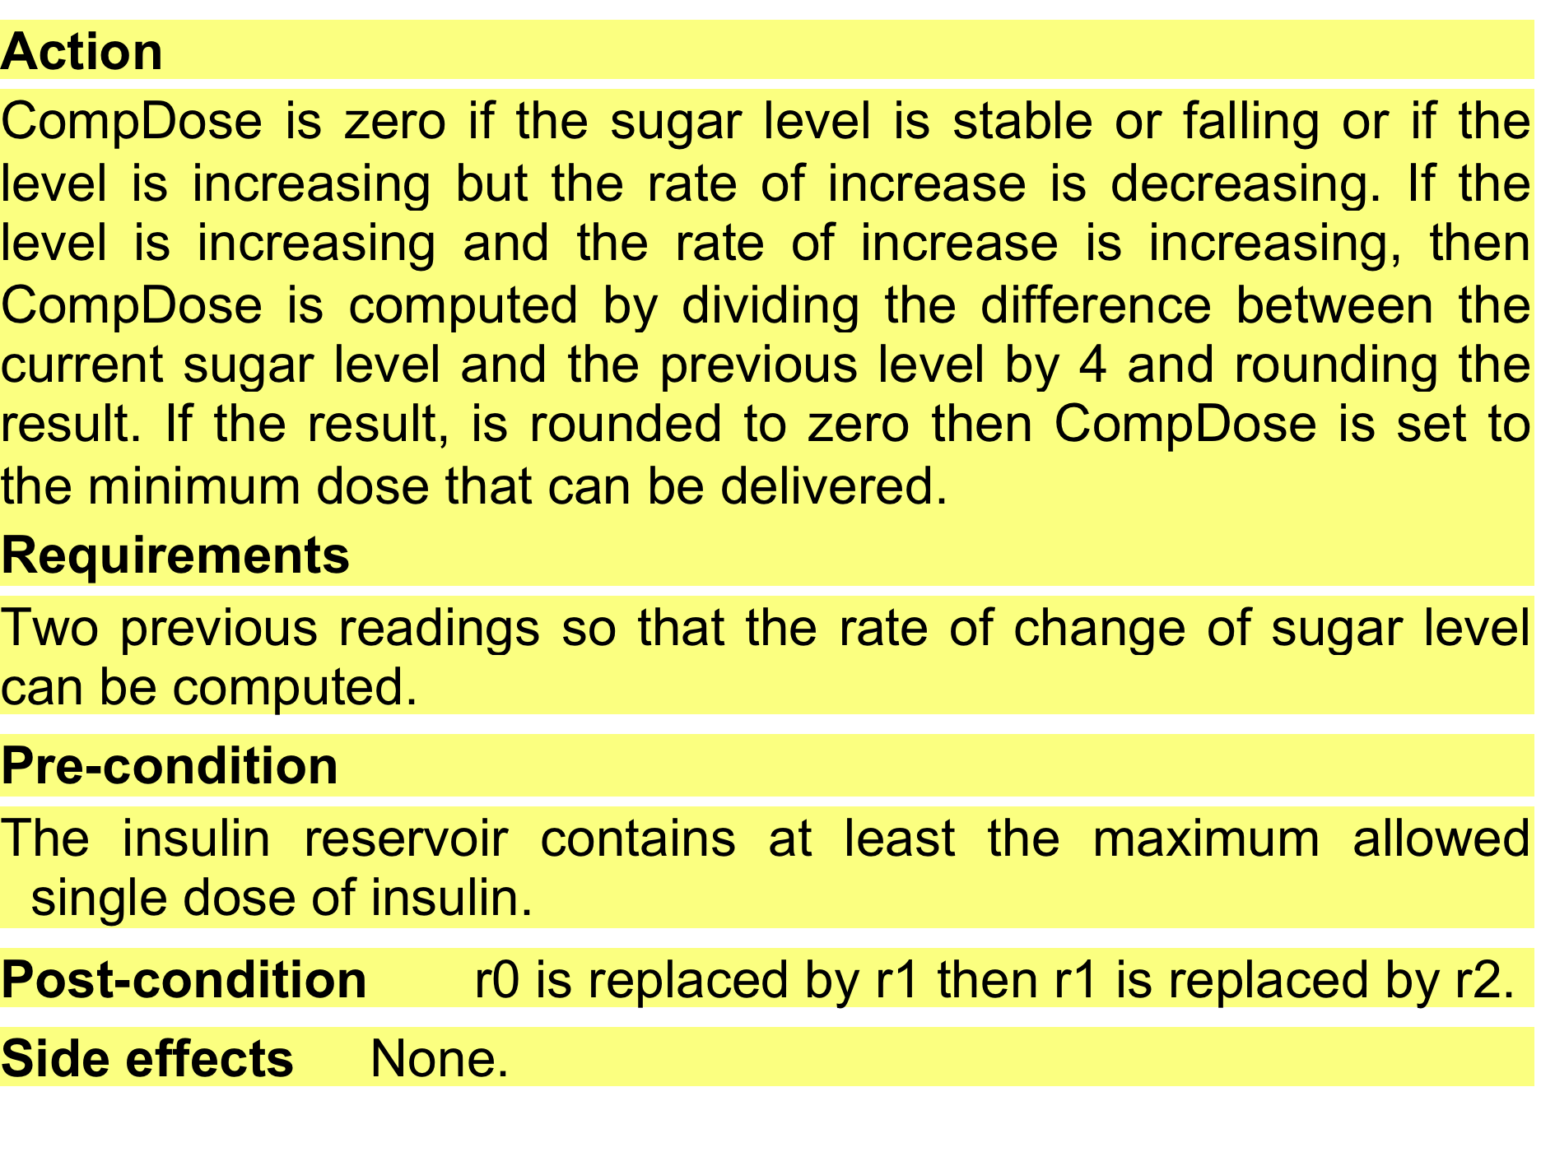
A structured specification of a requirement for an insulin pump

Slide 43
Tabular specification
Used to supplement natural language.
Particularly useful when you have to define a number of possible alternative courses of action.
For example,
the insulin pump systems bases its computations on the rate of change of blood sugar level and the tabular specification explains how to calculate the insulin requirement for different scenarios.

Slide 44
Tabular specification of computation for an insulin pump
Condition | Action
Sugar level falling (r2 < r1) | CompDose = 0
Sugar level stable (r2 = r1) | CompDose = 0
Sugar level increasing and rate of increase decreasing ((r2 – r1) < (r1 – r0)) | CompDose = 0
Sugar level increasing and rate of increase stable or increasing ((r2 – r1) ≥ (r1 – r0)) | CompDose = round ((r2 – r1)/4) If rounded result = 0 then CompDose = MinimumDose

Slide 45
Requirements engineering processes
The processes used for RE vary widely depending on the application domain, the people involved and the organisation developing the requirements.
However, there are a number of generic activities common to all processes
Requirements elicitation;
Requirements analysis;
Requirements validation;
Requirements management.
In practice, RE is an iterative activity in which these processes are interleaved.

Slide 46
Requirements elicitation and analysis
Sometimes called requirements elicitation or requirements discovery.
Involves technical staff working with customers to find out about the application domain,
The services that the system should provide and the system’s operational constraints.
May involve end-users, managers, engineers involved in maintenance, domain experts, trade unions, etc. These are called stakeholders.

Slide 47
Issues in requirements analysis
Stakeholders don’t know what they really want.
Stakeholders express requirements in their own terms.
Different stakeholders may have conflicting requirements.
Organisational and political factors may influence the system requirements.
The requirements change during the analysis process. New stakeholders may emerge and the business environment may change.

Slide 48
Requirements elicitation and analysis
Software engineers work with a range of system stakeholders to find out about the application domain
The services that the system should provide, the required system performance, hardware constraints, other systems, etc.
Stages include:
Requirements discovery,
Requirements classification and organization,
Requirements prioritization and negotiation,
Requirements specification.

Slide 49
Key points
Requirements for a software system set out what the system should do and define constraints on its operation and implementation.
Functional requirements are
statements of the services that the system must provide or are descriptions of how some computations must be carried out.
Non-functional requirements
Constrain the system being developed and the development process being used.
They often relate to the emergent properties of the system and therefore apply to the system as a whole.

Slide 50
Thank you
Next : Software Modeling using UML

