Slide 1

CS223: Software Engineering
Software Architecture

Slide 2
Recap
Requirement Engineering
Object oriented design
SRS writing
UML based modeling

Slide 3
Objective
After completing this lecture the students will be able to
Explain the importance of software architecture
Identify the type of architecture to be used in their projects

Slide 4
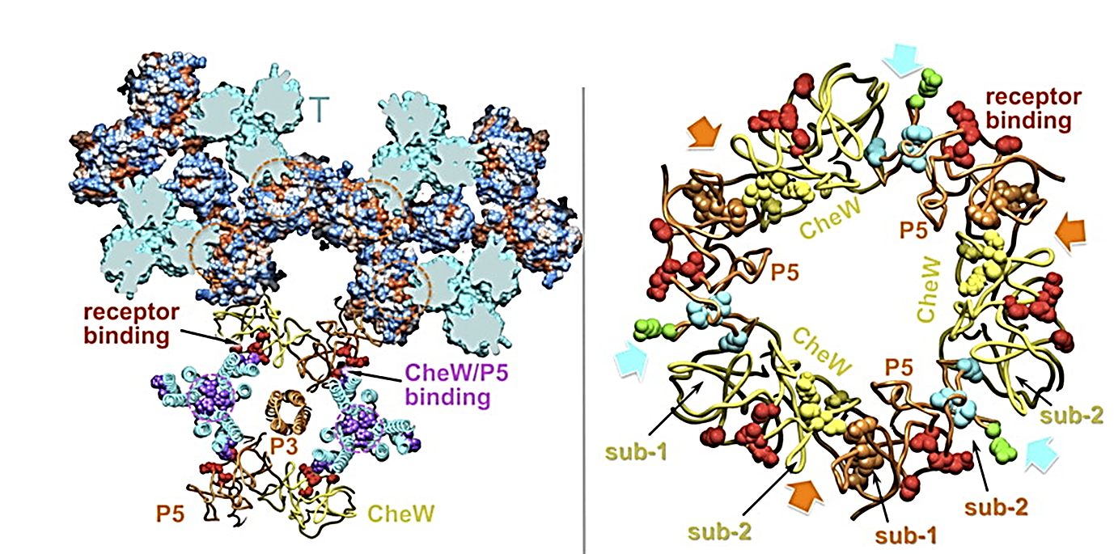
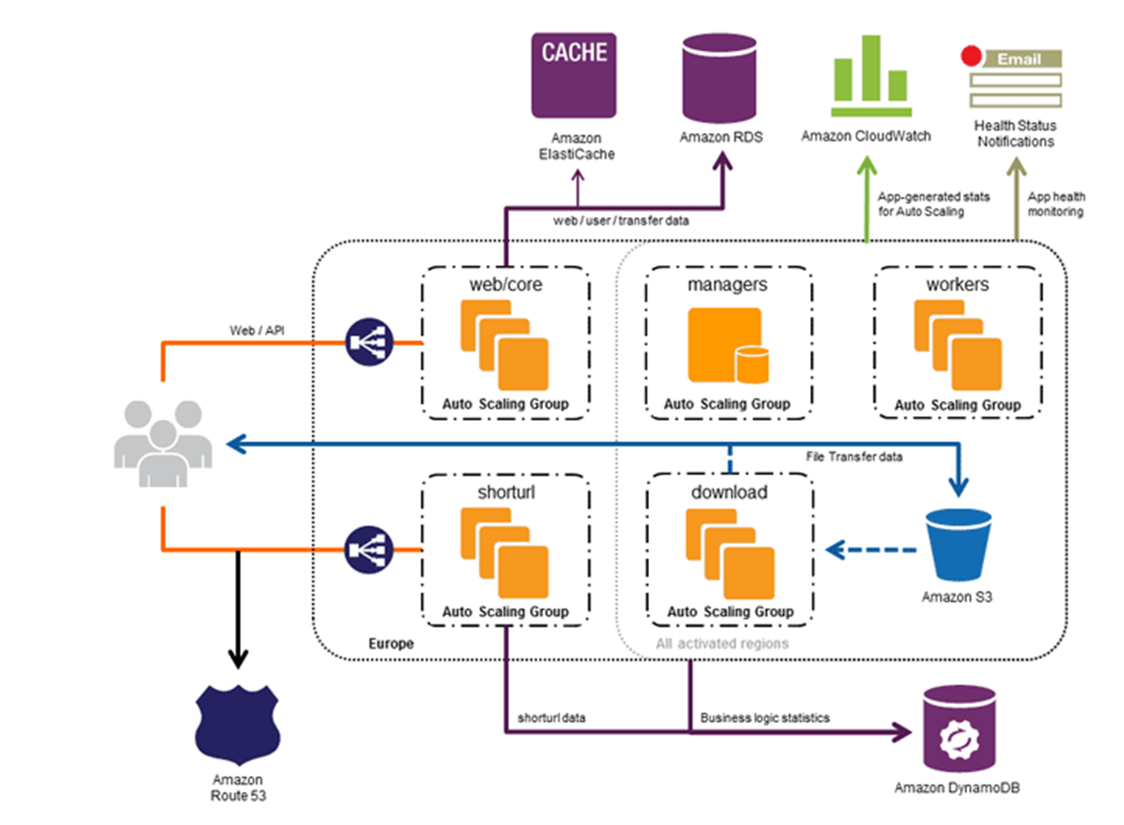
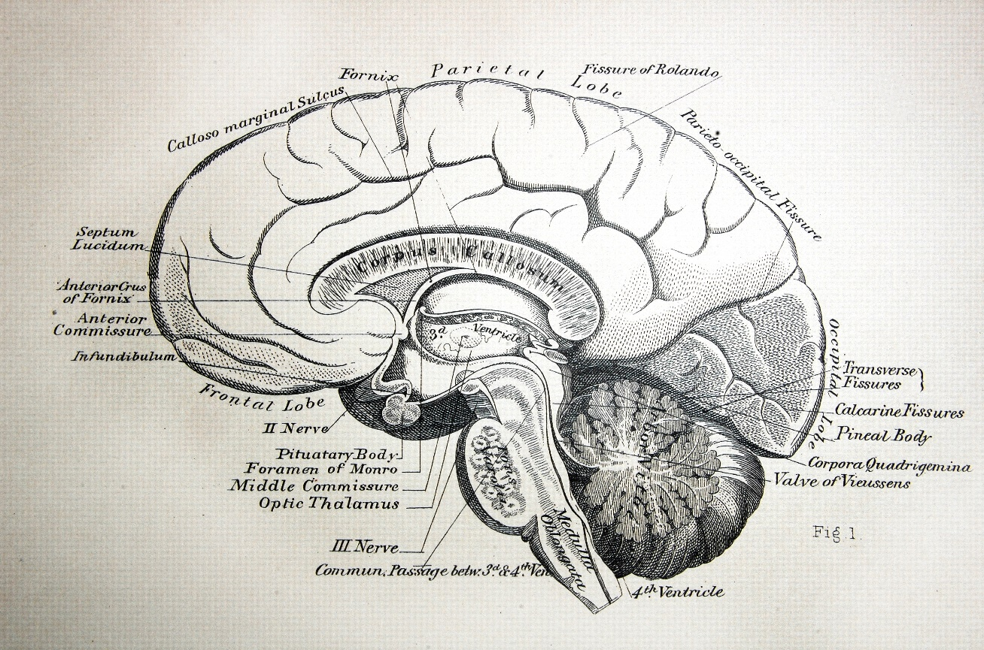
Definition
The complex or carefully designed structure of something.

Slide 5
Architecture
It is a design of the software that gives a very high level view of parts and they relate to form the whole
Partitions the system in parts such that each part can be comprehended independently
And describes relationship between parts
A complex system can be partitioned in many different ways
Each providing a useful view
Same holds true of software also
There is no unique structure; many possible

Slide 6
Architecture
The structure or structures which comprise
Elements,
Their externally visible properties, and
Relationships among them
For elements only interested in
External properties needed for relationship specification
Details on how the properties are supported is not important
Does not say whether an arch is good or not
Analysis needed for it
Describes the different structures of the system

Slide 7
Key Uses of Arch Descriptions
Understanding and communication
By showing a system at a high level and hiding complexity of parts, arch describes facilitates communication
To get a common understanding between the diff stakeholders (users, clients, architect, designer,…)
For negotiation and agreement
Arch descr can also aid in understanding of existing systems

Slide 8
Uses…
Reuse
A method of reuse is to compose systems from parts and reuse existing parts
This model is facilitated by reusing components at a high level providing complete services
To reuse existing components, arch must be chosen such that these components fit together with other components
Hence, decision about using existing components is made at arch design time

Slide 9
Uses..
Construction and evolution
Some structures in arch description will be used to guide system development
Partitioning at arch level can also be used for work allocation to teams as parts are relatively independent
During s/w evolution, arch helps decide what needs to be changed to incorporate the new changes/features
Arch can help decide what is the impact of changes to existing components on others

Slide 10
Uses…
Analysis
If properties like performance, reliability can be determined from design, alternatives can be considered during design to reach the desired perf levels
S/w arch opens such possibilities for software (other engg. disciplines usually can do this)
E.g. Performance of a system can be predicted from its arch, if estimates for params. like load etc. is provided
Will require precise description of arch, as well as properties of the elements in the description

Slide 11
Architectural Views
There is no unique arch of a sys
There are different views of a s/w sys
A view consists of elements and relationships between them, and describes a structure
The elements of a view depends on what the view wants to highlight
Diff views expose diff properties
A view focusing on some aspects reduces its complexity

Slide 12
Views…
Many types of views have been proposed
Most belong to one of these three types
Module
Component and Connector
Allocation
The diff views are not unrelated – they all represent the same system
There are relationships between elements of diff views; this relation may be complex

Slide 13
Views…
Module view
A sys is a collection of code units i.e. they do not represent runtime entities
I.e. elements are modules, eg. Class, package, function, procedure,…
Relationship between them is code based, e.g. part of, depends on, calls, generalization-specialization,..

Slide 14
Views…
Component and Connector (C&C)
Elements are run time entities called components
I.e. a component is a unit that has identity in executing sys, e.g. objects, processes, .exe, .dll
Connectors provide means of interaction between components, e.g. pipes, shared memory, sockets

Slide 15
Views…
Allocation view
Focuses on how sw units are allocated to resources like hw, file system, people
I.e. specifies relationship between sw elements and execution units in the env
Expose structural properties like which process runs on which processor, which file resides where, …

Slide 16
Views…
An arch description consists of views of diff types, each showing a diff structure
Diff sys need diff types of views depending on the needs
E.g. for perf analysis, allocation view is necessary; for planning, module view helps
The C&C view is almost always done, and has become the primary view
We focus primarily on the C&C view
Module view is covered in high level design, whose focus is on identifying modules

Slide 17
Component and Connector View
Two main elements – components and connectors
Components: Computational elements or data stores
Connectors: Means of interaction between comps
A C&C view defines the comps, and which comps are connected through which connector
The C&C view describes a runtime structure of the system – what comps exist at runtime and how they interact during execution
Is a graph; often shown as a box-and-line drawing
Most commonly used structure

Slide 18
Components
Units of computations or data stores
Has a name, which represents its role, and provides it identity
A comp may have a type; diff types rep by diff symbols in C&C view
Comps use ports (or interfaces) to communicate with others
An arch can use any symbols to rep components; some common ones are shown

Slide 19
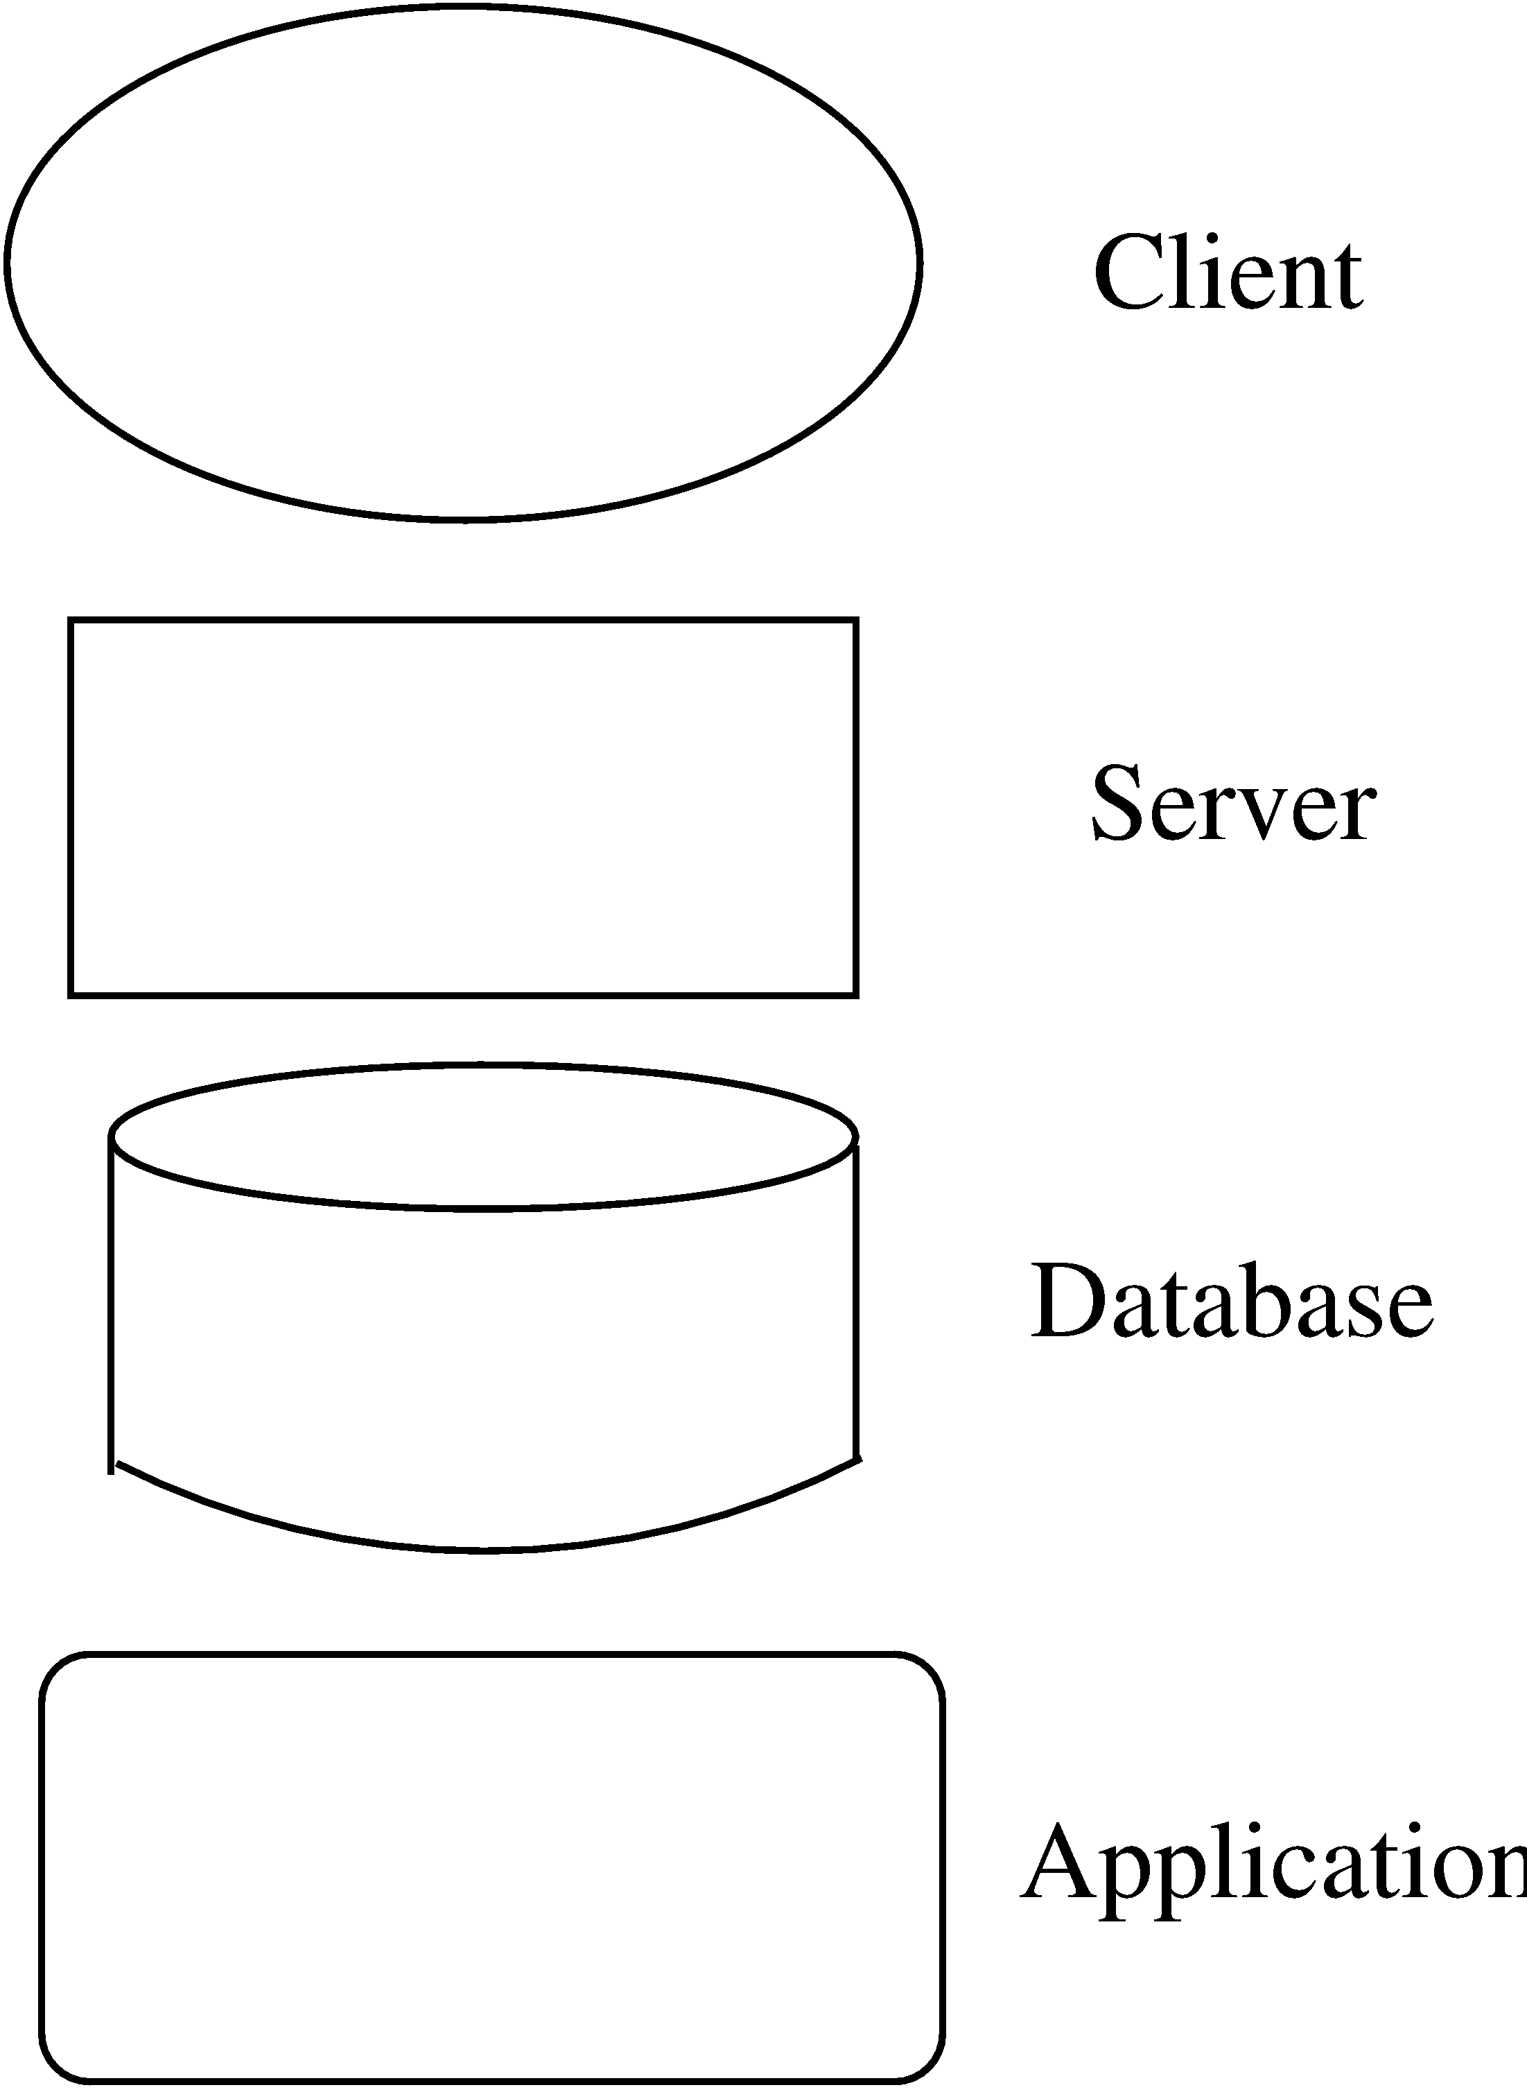
Some Component examples…

Slide 20
Connectors
Interaction between components happen through connectors
A connector may be provided by the runtime environment, e.g. procedure call
But there may be complex mechanisms for interaction, e.g http, tcp/ip, ports,…; a lot of sw needed to support them
Important to identify them explicitly; also needed for programming comps properly

Slide 21
Connectors…
Connectors need not be binary, e.g. a broadcast bus
Connector has a name (and a type)
Often connectors represented as protocol – i.e. comps need to follow some conventions when using the connector
Best to use diff notation for diff types of connectors; all connectors should not be shown by simple lines

Slide 22
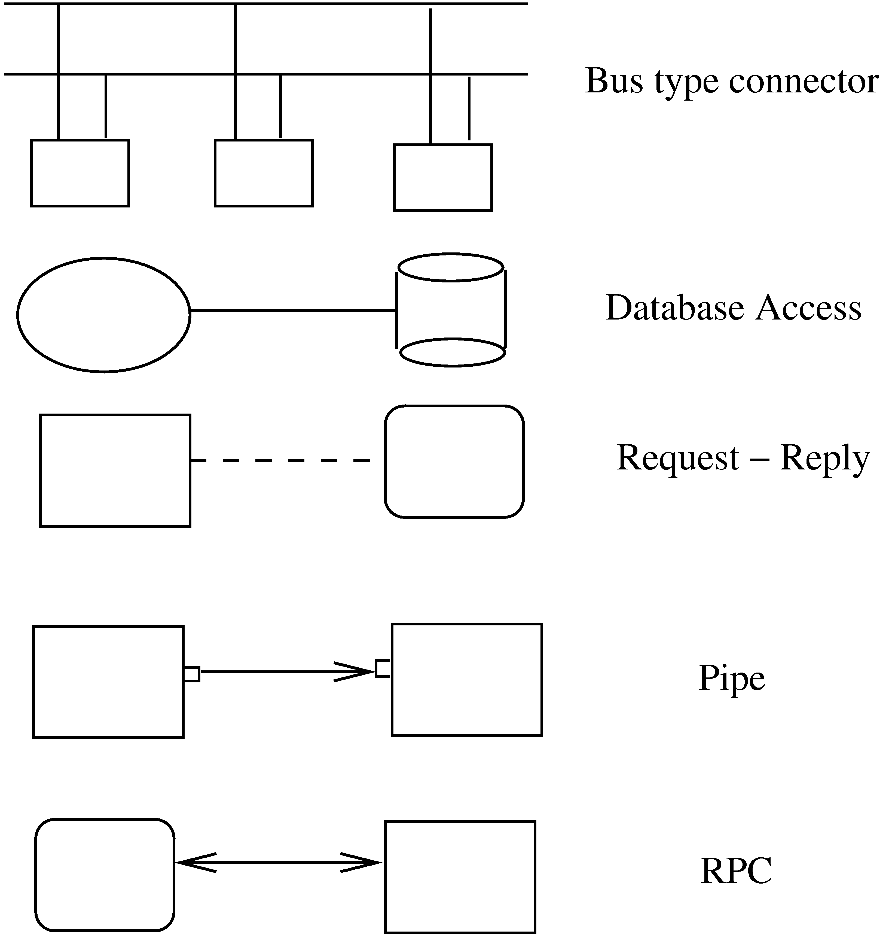
Connector examples

Slide 23
An Example
Design a system for taking online survey of students on campus
Multiple choice questions, students submit online
When a student submits, current result of the survey is shown
Is best built using web; a 3-tier architecture is proposed
Has a client, server, and a database components (each of a diff type)
Connector between them are also of diff types

Slide 24
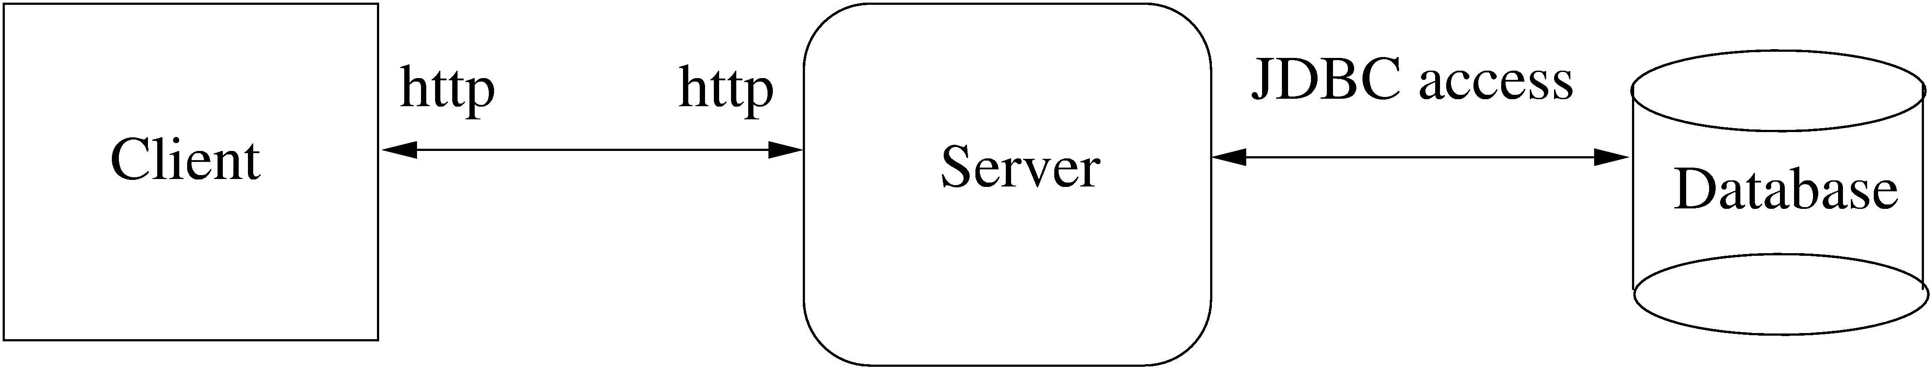
Example…

Slide 25
Example…
At arch level, details are not needed
The connectors are explicitly stated, which implies that the infrastructure should provide http, browser, etc.
The choice of connectors imposes constraints on how the components are finally designed and built

Slide 26
Extension 1
This arch has no security – anyone can take the survey
We want that only registered students can take the survey (at most once)
To identify students and check for one-only submission, need a authentication server
Need to use cookies, and server has to be built accordingly (the connector between server and auth server is http with cookies)

Slide 27
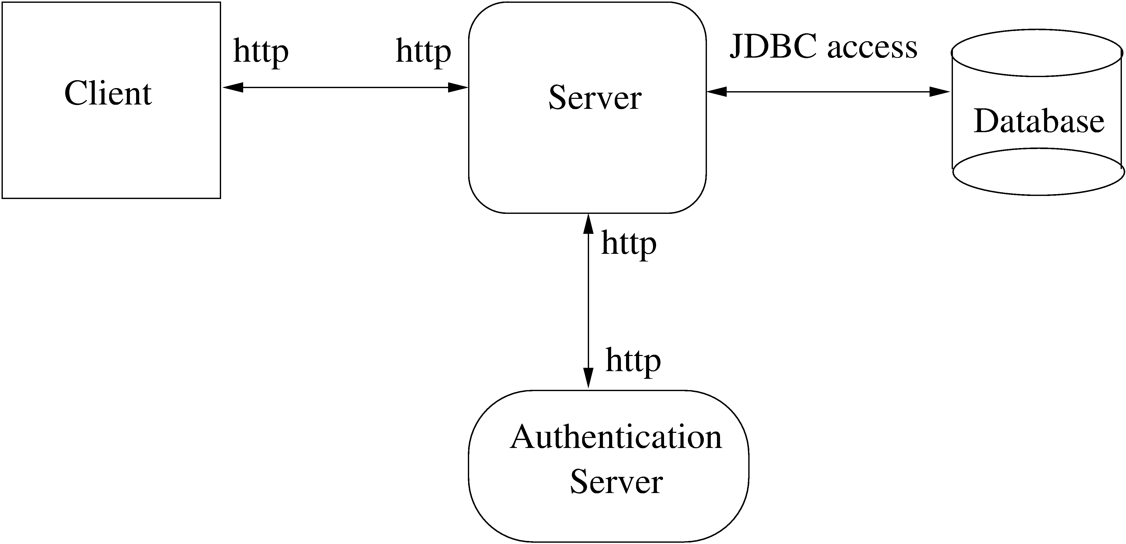
Extension 1…

Slide 28
Extension 2
It was found that DB is frequently down
For improving reliability, want that if DB is down, student is given an older survey result and survey data stored
The survey data given can be outdated by at most 5 survey data points
For this, will add a cache comp, which will store data as well as results

Slide 29
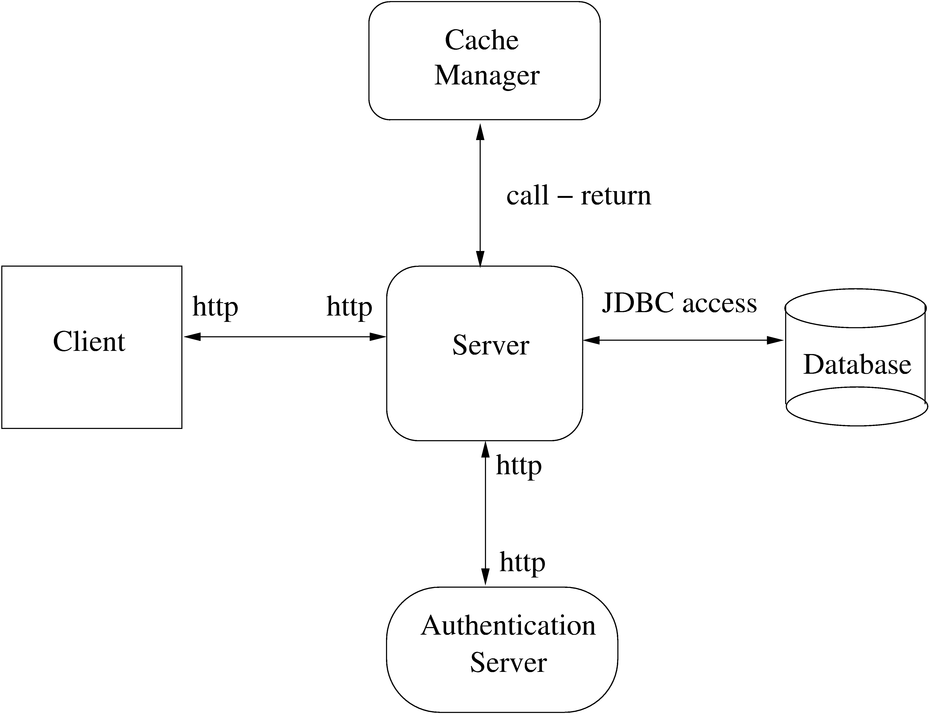
Extension 2…

Slide 30
Example…
One change increased security, 2nd increased performance and reliability
I.e. Arch level choices have a big impact on system properties
That is why, choosing a suitable arch can help build a good system

Slide 31
Architectural design
Represents the link between specification and design processes.
Carried out in parallel with some specification activities.
Identifies major system components and their communications.
Advantage of explicit architecture design ?
Ref: Ian Sommerville, Software Engineering, Ninth Edition, Addison-Wesley, 2011

Slide 32
The architecture of a packing robot control system
Vision System
Object Identification System
Gripper Controller
Arm Controller
Packaging selection system
Packing system
Conveyor controller

Slide 33
Architectural abstraction
Architecture in the small
architecture of individual programs.
how an individual program is decomposed into components.
Architecture in the large
architecture of complex enterprise systems
include other systems, programs, and program components.
These systems are distributed over different computers
may be owned and managed by different companies.

Slide 34
Architectural design decisions
Is there a generic application architecture that can be used?
How will the system be distributed?
What architectural styles are appropriate?
What approach will be used to structure the system?
How will the system be decomposed into modules?
What control strategy should be used?
How will the architectural design be evaluated?
How should the architecture be documented?

Slide 35
Architecture and system characteristics
Performance
Localize critical operations and minimize communications. Use large rather than fine-grain components.
Security
Use a layered architecture with critical assets in the inner layers.
Safety
Localize safety-critical features in a small number of sub-systems.
Availability
Include redundant components and mechanisms for fault tolerance.
Maintainability
Use fine-grain, replaceable components.

Slide 36
Architectural patterns
Means of representing, sharing and reusing knowledge.
Stylized description of good design practice
Tried and tested in different environments.
Information about when they are and when the are not useful.
Represented using tabular and graphical descriptions.

Slide 37
Model-View-Controller (MVC)
Name | MVC (Model-View-Controller)
Description | Separates presentation and interaction from the system data. The system is structured into three logical components The Model component manages the system data and associated operations on that data. The View component defines and manages how the data is presented to the user. The Controller component manages user interaction
When used | There are multiple ways to view and interact with data. The future requirements for interaction and presentation of data are unknown.
Advantages | Allows the data to change independently of its representation. Supports presentation of the same data in different ways
Disadvantages | Can involve additional code and code complexity when the data model and interactions are simple.

Slide 38
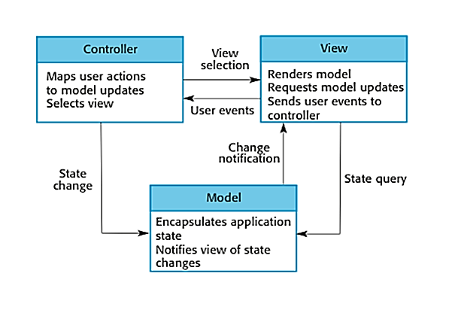
The organization of the Model-View-Controller

Slide 39
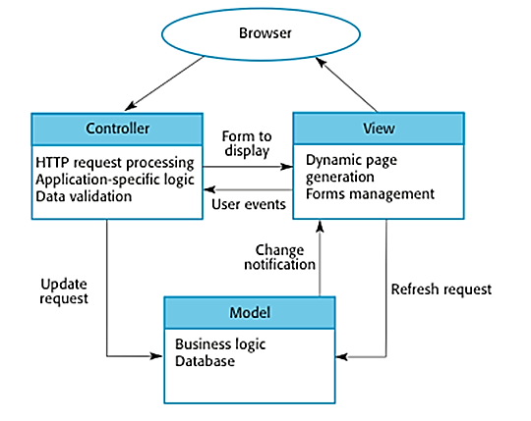
Web application architecture using the MVC pattern

Slide 40
Layered architecture
Used to model the interfacing of sub-systems.
Organises the system into a set of layers (or abstract machines)
Each of which provide a set of services.
Supports the incremental development of sub-systems in different layers.
When a layer interface changes, only the adjacent layer is affected.
Often artificial to structure systems in this way.

Slide 41
The Layered architecture pattern
Name | Layered architecture
Description | Organizes the system into layers with related functionality associated with each layer. A layer provides services to the layer above it
When used | Building new facilities on top of existing systems; The development is spread across several teams There is a requirement for multi-level security.
Advantages | Allows replacement of entire layers so long as the interface is maintained. Redundant facilities can be provided in each layer to increase the dependability of the system.
Disadvantages | Providing a clean separation between layers is often difficult and a high-level layer may have to interact directly with lower-level layers rather than through the layer immediately below it.

Slide 42
A generic layered architecture
User Interface
User interface management (Authentication and authorization)
Business logic/ application utilities
System support
(OS, database, etc.)

Slide 43
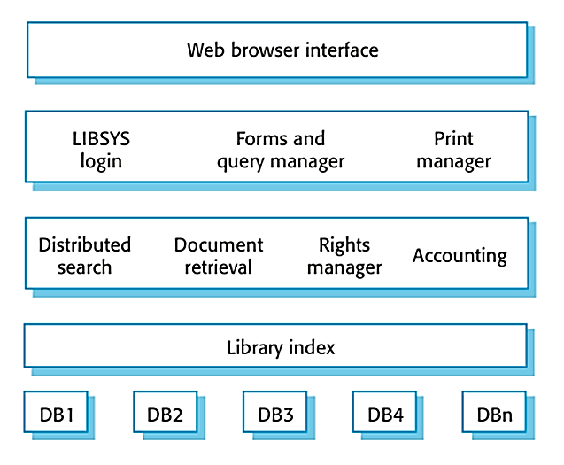
The architecture of the LIBSYS system

Slide 44
Repository architecture
Sub-systems must exchange data.
This may be done in two ways:
Shared data is held in a central database or repository and may be accessed by all sub-systems;
Each sub-system maintains its own database and passes data explicitly to other sub-systems.
When large amounts of data are to be shared,
The repository model of sharing is most commonly used
This is an efficient data sharing mechanism.

Slide 45
The Repository pattern
Name | Repository
Description | All data in a system is managed in a central repository Accessible to all system components. Components interact only through the repository.
When used | Large volumes of information are generated that has to be stored for a long time. The inclusion of data in the repository triggers an action or tool.
Advantages | Components can be independent Changes made by one component can be propagated to all components. All data can be managed consistently (e.g., backups done at the same time) as it is all in one place.
Disadvantages | The repository is a single point of failure so problems in the repository affect the whole system. Distributing the repository across several computers may be difficult.

Slide 46
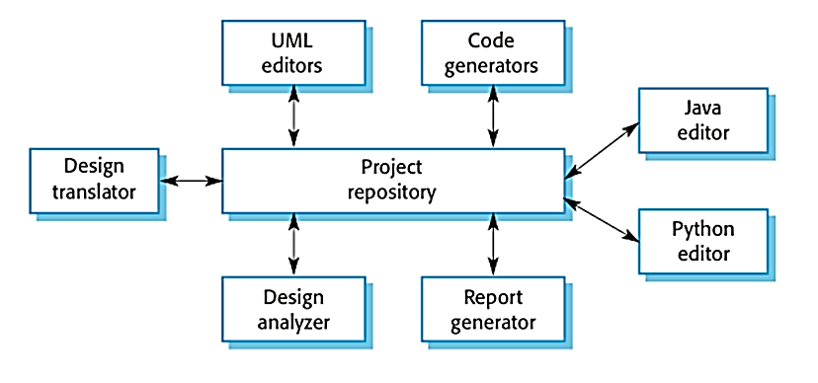
A repository architecture for an IDE

Slide 47
Client-server architecture
Distributed system model
It shows how data and processing is distributed across a range of components.
Can be implemented on a single computer.
Set of stand-alone servers which provide specific services such as printing, data management, etc.
Set of clients which call on these services.
Network which allows clients to access servers.

Slide 48
The Client–server pattern
Name | Client-server
Description | The functionality of the system is organized into services Each service delivered from a separate server. Clients are users of these services and access servers
When used | Used when data in a shared database has to be accessed from a range of locations. The load on a system is variable.
Advantages | Servers can be distributed across a network. General functionality can be available to all clients and does not need to be implemented by all services.
Disadvantages | Each service is a single point of failure so susceptible to denial of service attacks or server failure. Performance may be unpredictable because it depends on the network as well as the system. May be management problems if servers are owned by different organizations.

Slide 49
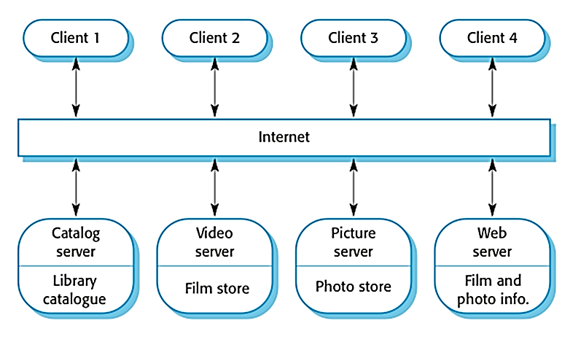
A client–server architecture for a film library

Slide 50
Pipe and filter architecture
Functional transformations process their inputs to produce outputs.
May be referred to as a pipe and filter model (as in UNIX shell).
Variants of this approach are very common.
Transformations are sequential,
this is a batch sequential model
extensively used in data processing systems.
Not really suitable for interactive systems.

Slide 51
The pipe and filter pattern
Name | Pipe and filter
Description | The processing of the data in a system is organized so that each processing component (filter) is discrete and carries out one type of data transformation. The data flows (as in a pipe) from one component to another for processing.
When used | Data processing applications (both batch- and transaction-based).
Advantages | Easy to understand and supports transformation reuse. Workflow style matches the structure of many business processes. Evolution by adding transformations is straightforward. Can be implemented as either a sequential or concurrent system.
Disadvantages | The format for data transfer has to be agreed upon between communicating transformations. Each transformation must parse its input and un-parse its output to the agreed form.

Slide 52
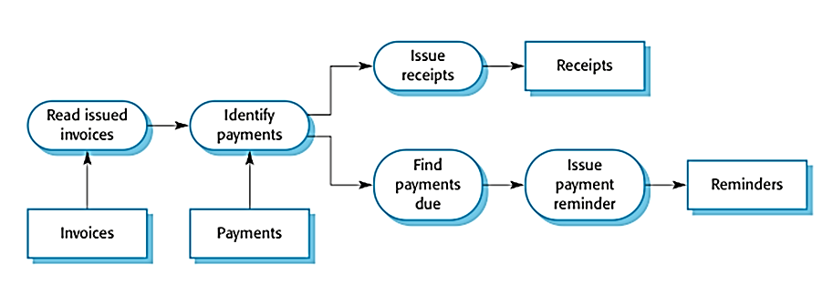
An example of the pipe and filter architecture

Slide 53
Application architectures
Application systems are designed to meet an organizational need.
As businesses have much in common, their application systems also tend to have a common architecture that reflects the application requirements.
A generic application architecture is
An architecture for a type of software system
that may be configured and
adapted to create a system that meets specific requirements.

Slide 54
Use of application architectures
As a starting point for architectural design.
As a design checklist.
As a way of organizing the work of the development team.
As a means of assessing components for reuse.
As a vocabulary for talking about application types.

Slide 55
Examples of application types
Data processing applications
Data driven applications that process data in batches without explicit user intervention during the processing.
E.g. payroll, billing, accounting, and publicity
Transaction processing applications
Data-centred applications that process user requests and update information in a system database.
E.g. e-commerce systems, information systems and booking systems.

Slide 56
Examples of application types
Event processing systems
Applications where system actions depend on from the system’s environment. interpreting events
E.g. games, editing systems, real time systems.
Language processing systems
Applications where the users’ intentions are specified in a formal language that is processed and interpreted by the system.
E.g. compilers

Slide 57
Transaction processing systems
Process user requests for information
from a database
to update the database.
From a user perspective a transaction is:
Any coherent sequence of operations that satisfies a goal;
For example - find the times of flights from London to Paris.
Users make asynchronous requests for service
Processed by a transaction manager.

Slide 58
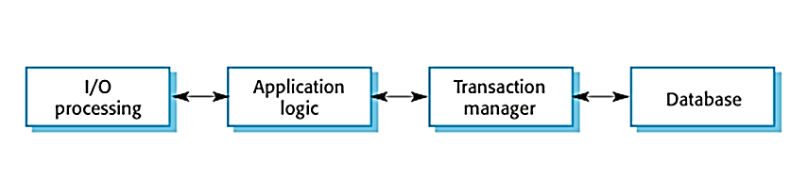
Transaction processing applications
input-process-output structure

Slide 59
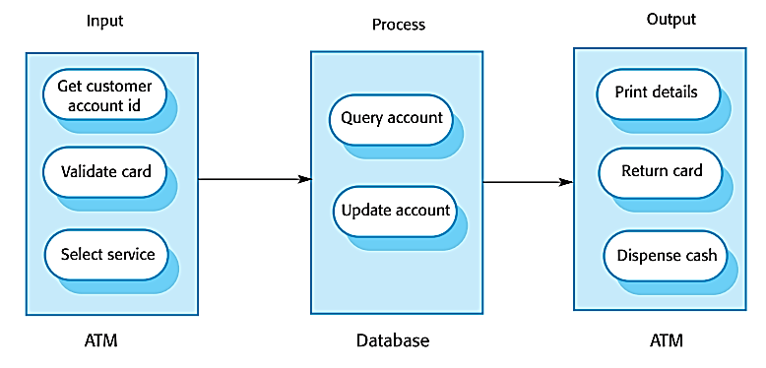
The software architecture of an ATM system

Slide 60
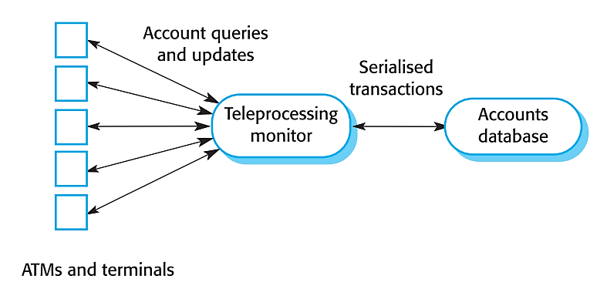
Middleware for transaction management

Slide 61
Language processing systems
Accept a natural or artificial language as input and generate some other representation of that language.
May include an interpreter to act on the instructions in the language that is being processed.
Used in situations where the easiest way to solve a problem is to describe an algorithm or describe the system data
Meta-case tools process tool descriptions, method rules, etc and generate tools.

Slide 62
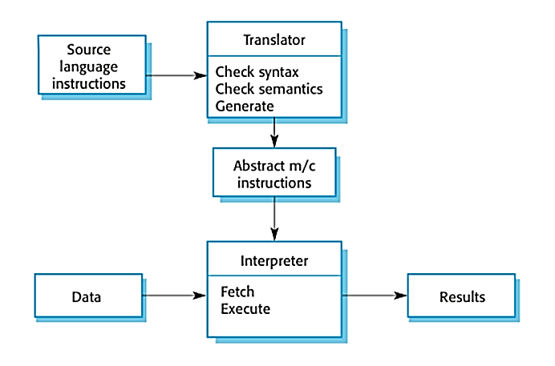
The architecture of a language processing system

Slide 63
Compiler components
A lexical analyzer
takes input language tokens and converts them to an internal form.
A symbol table
holds information about the names of entities (variables, class names, object names, etc.) used in the text that is being translated.
A syntax analyzer
checks the syntax of the language being translated.
A syntax tree
an internal structure representing the program being compiled.

Slide 64
Compiler components
A semantic analyzer
uses information from the syntax tree and the symbol table
to check the semantic correctness of the input language text.
A code generator
walks’ the syntax tree and generates abstract machine code.

Slide 65
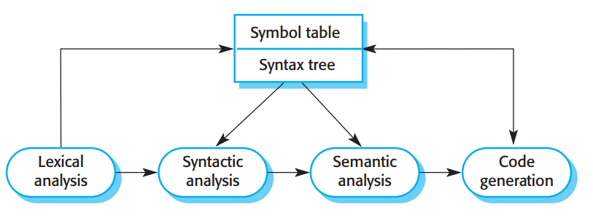
A pipe and filter compiler architecture

Slide 66
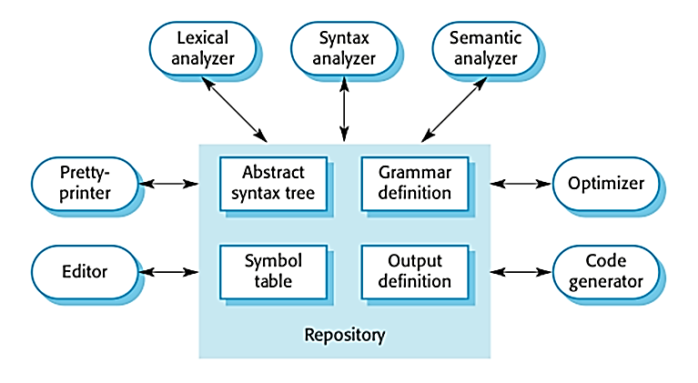
A repository architecture for a language processing system

Slide 67
Key points
Models of application systems architectures help us
understand and compare applications,
validate application system designs and
assess large-scale components for reuse.
Transaction processing systems are interactive systems that
allow information in a database to be remotely accessed
modified by a number of users.
Language processing systems are used to
translate texts from one language into another
to carry out the instructions specified in the input language.
They include a translator and an abstract machine that executes the generated language.

Slide 68
Thank you
Next Lecture: Software Construction

