Slide 1

CS223: Software Engineering
Lecture : Software construction

Slide 2
Introduction
Middleware is connectivity software that
provides a mechanism for processes to interact with other processes
running on multiple networked machines.
Middleware Application Programming Interfaces provide
a more functional set of capabilities than the OS
network services provide on their own.
Notes:
Middleware provides functionality that the network and operating system API’s (Application Programming Interfaces) do not provide. Some of the advantages that middleware could provide are:
- independence from network services
- independence from operating system calls
- reliability
- availability
- scalability

Slide 3
Middleware Architecture
Application
Application
API’s
Middleware (Distributed Systems Services)
Platform Interface
Platform Interface
Platform
OS
Platform
OS
Network Interface
Network Interface
Notes:
The application uses the API’s to integrate the functionality that the middleware provides into the client or server application. The middleware has it’s own interface to the OS.

Slide 4
Types of Middleware
There are four basic types of middleware
Transaction Processing Monitor (TP)
Remote Procedure Call (RPC)
Message-Oriented Middleware (MOM)
Object Request Broker (ORB)
Notes:
As you can see, middleware is very acronym oriented (AO).
The following slides will explain each type of middleware.

Slide 5
Transaction Processing (TP)
TP can provide the following
control transaction applications
provide business logic/rules
database updates
Notes:
TP monitor technology is not a new idea. This model has been used for many years in areas such as data management, network access, and customer service, to name a few. This is your basic three tier architecture with a fancy name within the context frame of middleware.

Slide 6
Transaction Processing Architecture
Processing
Routines
Transaction
Requests
Data
Client
TP Monitor
Notes:
Note: this model supports many clients. The business logic and routines that provide connectivity to the data source reside on the TP monitor.

Slide 7
Remote Procedure Call (RPC)
RPC is a client/server mechanism
allows the program to be distributed across multiple platforms.
RPC’s reduce the complexity of a system
that spans multiple operating systems and network protocols
Hiding OS and network interface details from the programmer.
Notes:
RPC is also a very old technology. The first full scale implementations date back to the late 1970’s. RPC provides a means to make the invocation of a routine on a server by a client application on a different machine look like any function invocation within the client application (well almost, issues such as marshalling data structures into serialized representations make total transparency impossible). This is done by embedding special function calls, RPC’s into the client or server application. Because these special calls are embedded, RPC’s do not constitute stand alone middleware
Portability is increased by minimizing the amount of client code and making network communications transparent to the application. This makes it possible to port the code to a new platform without having to change network or OS system calls
The flexibility of architecture increases by allowing client applications to invoke remote server components without ever knowing what network and OS API’s are used.

Slide 8
Remote Procedure Call (cont’d)
RPC’s are usually implemented by:
proprietary products
proprietary development tools that create client server stubs
Most RPC implementations use a synchronous (call/wait) protocol to communicate between client and server.
Notes:
Since there is no standard for RPC implementation, all RPC development environments are the result of private proprietary systems.
RPC compilers are used to create client/server stubs, the embedded code that implements OS and network interface specific functions, hiding these details from the developer.
The problem with synchronous communication is that it is a blocking protocol. For example, if a client makes a request to the server, the client blocks until it receives a reply from the server.

Slide 9
RPC Architecture
T
R
A
N
S
P
O
R
T
T
R
A
N
S
P
O
R
T
N
E
T
W
O
R
K
N
E
T
W
O
R
K
Client
App
Server
App
Application Specific
procedure invocations
and returns
RPC
STUB
RPC
STUB
Notes:
The RPC compiler for a given operating system provides client/server stubs which are interfaces to the operating systems transport layer, which is in turn an interface to the network layer implementation to the system. For this reason, the application developer does not need to worry about OS specific system calls.

Slide 10
Message Oriented Middleware (MOM)
Message-oriented middleware
functionality similar to RPC
provides asynchronous communication between client and server applications by queueing messages temporarily when one or the other is busy or not connected.
Notes:
MOM architecture has one-upped RPC by providing a queuing mechanism. This is simply a means to accomplish asynchronous communication by saving messages for target nodes when they are busy, slow, or even dead.

Slide 11
MOM Architecture
T
R
A
N
S
P
O
R
T
T
R
A
N
S
P
O
R
T
MOM
N
E
T
W
O
R
K
N
E
T
W
O
R
K
MOM
Client
App
Server
App
With
message
queue
With
message
queue
Application specific
proprietary messages
Notes:
MOM makes asynchronous communication possible by queueing messages between the transport and application layers so that client and server processes do not have to sit around waiting on each other. Isn’t that nice of her?

Slide 12
Object Request Broker (ORB)
ORB’s overcome; machine, software and vendors are no boundaries for the ORB.
Major functionality includes:
interface definition
location and activation of remote objects
communication between clients and objects
Notes:
I like to think of an object request broker as a name service for objects. The server process registers it’s service with the ORB. The client contacts the ORB asking where it can find the service (resolving the location). But then the ORB takes us one step further, and actually sets up the client-server connection.
The best part is that the developer never has to worry about any of this. To the programmer, the call looks like it is local to the client.

Slide 13
ORB Architecture
ORB!
Request
Service
activate
Service
Establish
connection
Client
Remote Service
(object)
communicate
Notes:
The client makes a request to the ORB to find and bind to the needed service. The ORB finds the service, establishes a connection between the client and server processes and finally activates the service.
The ORB allows the server to hide implementation details from the client. The client never has to know what programming language was used, what operating system the process is running on, what hardware architecture the host has, or even the location of the object.

Slide 14
Software Construction
The term software construction refers to the detailed creation of working software through a combination of
coding,
verification,
unit testing,
integration testing, and
debugging.
Boundaries between design, construction, and testing (if any) will vary depending on the software life cycle processes that are used in a project.

Slide 15
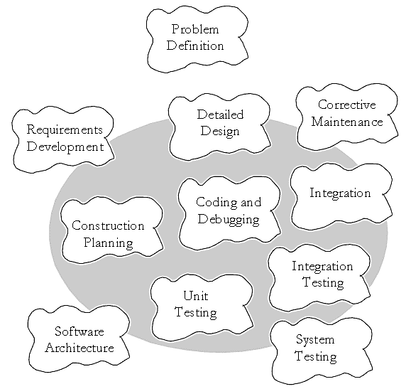

Slide 16
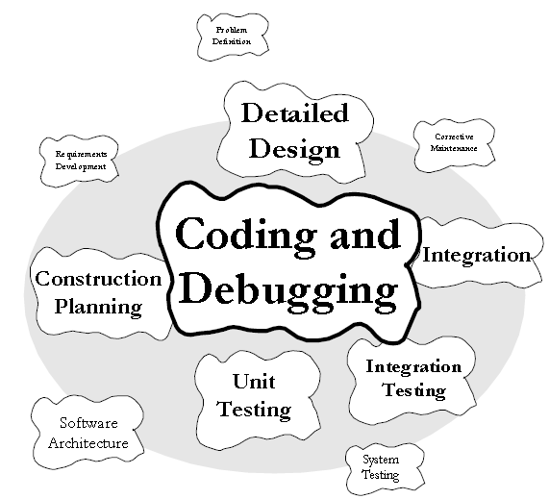

Slide 17
Software Construction
Fundamentals
Managing Construction
Practical considerations
Technologies
Tools
Complexity
Anticipating change
Verification
Reuse
Follow standards
Life cycle model
Planning
Measurement
Design
Language
Coding
Testing
Reuse
Quality
Integration
API
OOAD
Parameterization
Design by Contract
Executable
Platform
Heterogeneity
…
Development environment
GUI
Unit testing tool
Profiling
Performance analysis
Slicing tool

Slide 18
Software Construction Fundamentals
Software construction fundamentals include
minimizing complexity
anticipating change
constructing for verification
reuse
standards in construction

Slide 19
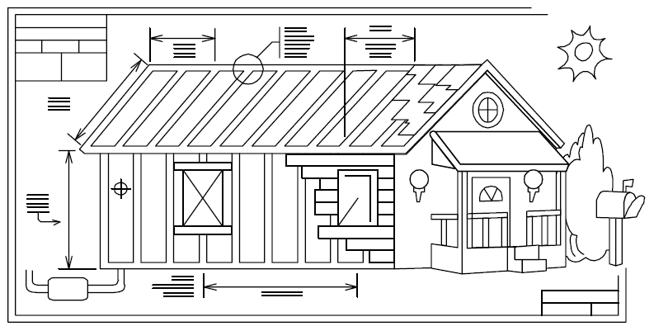
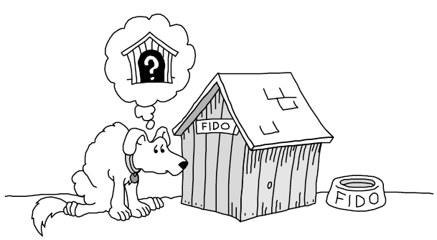
Metaphors

Slide 20
Minimizing Complexity
The need to reduce complexity applies to
essentially every aspect of software construction
particularly critical to testing of software constructions.

Slide 21
How to Attack Complexity
The primary sources of overly costly, ineffective designs
A complex solution to a simple problem
A simple, incorrect solution to a complex problem
An inappropriate, complex solution to a complex problem
How to manage it?
Minimize the amount of essential complexity that anyone’s brain has to deal with at any one time.
Keep accidental complexity from needlessly proliferating.

Slide 22
Anticipating change
Anticipation of change drives many aspects of software construction
Helps software engineers build extensible software
Anticipating change is supported by many specific techniques

Slide 23
Constructing for Verification
Building software in such a way that faults can be readily found
software engineers writing the software
testers
users during independent testing
How to do that?
Following coding standards to support code reviews and unit testing
Organizing code to support automated testing
Restricting the use of complex or hard-to-understand language structures

Slide 24
Reuse
Using existing assets in solving different problems
libraries,
modules,
components,
source code, and
commercial off-the-shelf (COTS) assets
Systematic reuse can enable significant software productivity, quality, and cost improvements.

Slide 25
Standards in Construction
Applying external or internal development standards
Helps achieve a project’s objectives for efficiency, quality, and cost.
Communication methods
Programming languages
Coding standards
Platforms
Tools

Slide 26
Key Construction Decisions
Several early choices greatly impact the quality of the results.

Slide 27
Key Construction Decisions
Choice of Programming Language
Programming Conventions
Your Location on the Technology Wave
Major Construction Practices

Slide 28
Coding Practices
How much design will be done, and when?
Have you defined coding conventions for names, comments, and layout?
Have you defined specific coding practices?
How error conditions will be handled
How security will be addressed
what conventions will be used for class interfaces
standards for reused code
performance considerations
Location on the technology?

Slide 29
Teamwork Practices
Integration procedures
Are there specific steps a programmer must go through before checking code into the master sources?
Will programmers program in pairs, or individually, or some combination of the two?

Slide 30
Coding Practices
Test first programming?
Who creates unit tests code?
Will programmers step through their code in the debugger before they check it in?
Will programmers integration-test their code before they check it in?
Will programmers review or inspect each other's code?

Slide 31
Tools
Have you selected a revision control tool?
Have you selected a language and language version or compiler version?
Have you selected a framework such as J2EE or Microsoft .NET or explicitly decided not to use a framework?
Have you decided whether to allow use of nonstandard language features?
Have you identified and acquired other tools you'll be using—editor, refactoring tool, debugger, test framework, syntax checker, and so on?

Slide 32
Kernighan Quotations
"Where there are two bugs, there is likely to be a third.“
“Don't patch bad code - rewrite it."
"Don't stop with your first draft."

Slide 33
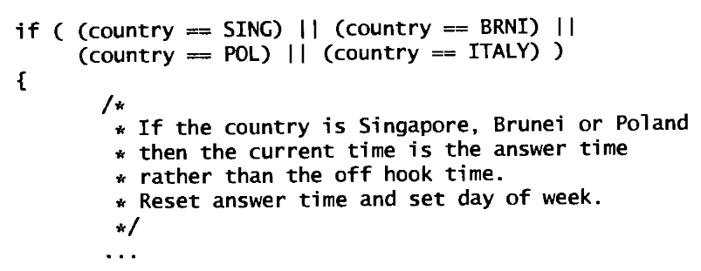
Comments

Slide 34
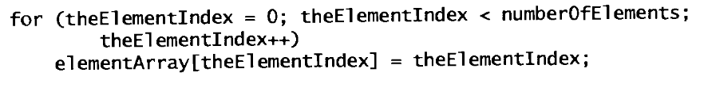
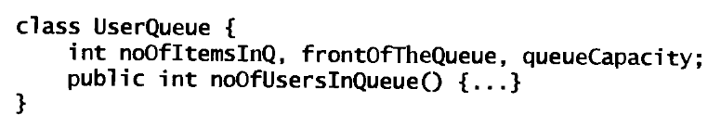
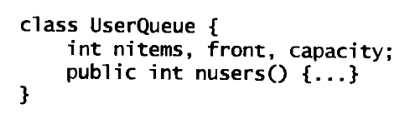
Names
Use descriptive names for global, short names for locals.
Be consistent.

Slide 35
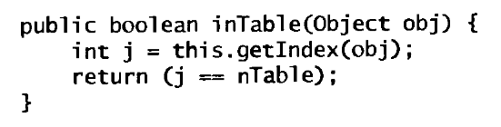
Names
Be accurate
Vs.

Slide 36

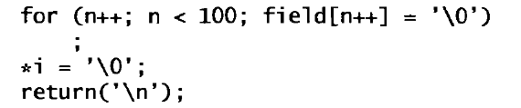
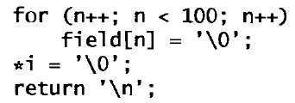
Expressions and Statements
Indent to show structure.

Slide 37
Expressions and Statements
Use the natural form for expressions.
Conditional expressions with negations are always hard to understand.
Vs.

Slide 38



Expressions and Statements
Parenthesize to resolve ambiguity.
Careful about precedence
Vs.
Vs.

Slide 39
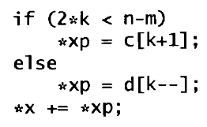
Expressions and Statements
Break up complex expressions.
Vs.

Slide 40

Expressions and Statements
Goal is to write clear code, not clever code.

Slide 41
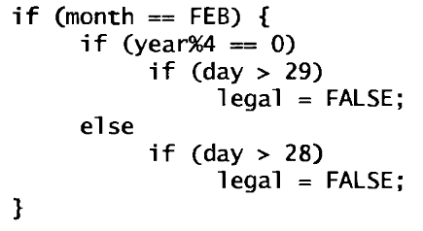
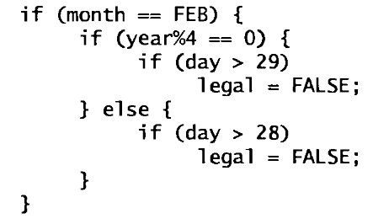
Consistency and Idioms
Use a consistent indentation and brace style.
If you work on a program you didn't write, preserve the style you find there.

Slide 42
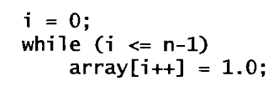
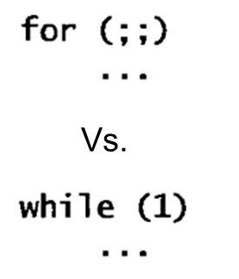



Idioms
Standard (common) way of writing programs

