Slide 1

CS223: Software Engineering
Software Design
Reading: Pressman, 7e; Mall, 4e

Slide 2
Objective
After completing this lecture students will be able to
Model software design
Data Flow Diagram

Slide 3
Software design
Design Fundamentals
Key Issues
Structure and Architecture
UI Design
QA
Strategies
Tools
Concepts
Context
Process
Principles
Concurrency
Events
Data
Components
Errors and Exceptions
Interaction
Security
Structure
View-point
DP
Programs
Principles
Issues
Modality
Presentation
Process
Localization
Metaphor
Modeling
Attributes
Measure
Static view
Dynamic view
Notations
FO
OO
DS
CBD

Slide 4
Requirement to Design Transition
C
o
m
p
o
n
e
n
t
-
s
c
e
n
a
r
i
o
-
b
a
s
e
d
f
l
o
w
-
o
r
i
e
n
t
e
d
L
e
v
e
l
D
e
s
i
g
n
e
l
e
m
e
n
t
s
e
l
e
m
e
n
t
s
u
s
e
-
c
a
s
e
s
-
t
e
x
t
d
a
t
a
f
l
o
w
d
u
s
e
-
c
a
s
e
d
i
a
g
r
a
m
s
i
a
g
r
a
m
s
c
o
n
t
r
o
l
-
f
l
o
w
d
a
c
t
i
v
i
t
y
d
i
a
g
r
a
m
s
s
w
i
a
g
r
a
m
s
p
r
o
c
e
s
s
i
n
g
n
a
r
r
a
t
i
v
e
s
i
m
l
a
n
e
d
i
a
g
r
a
m
s
I
n
t
e
r
f
a
c
e
D
e
s
i
g
n
A
n
a
l
y
s
i
s
M
o
d
e
l
c
l
a
s
s
-
b
a
s
e
d
b
e
h
a
v
i
o
r
a
l
A
r
c
h
i
t
e
c
t
u
r
a
l
D
e
s
i
g
n
e
l
e
m
e
n
t
s
e
l
e
m
e
n
t
s
c
l
a
s
s
d
i
a
g
r
a
m
s
s
t
a
t
e
d
a
n
a
l
y
s
i
s
p
a
c
k
a
g
e
s
s
e
q
u
e
n
i
a
g
r
a
m
s
c
e
d
C
R
C
m
o
d
e
l
s
i
a
g
r
a
m
s
D
a
t
a
/
C
l
a
s
s
D
e
s
i
g
n
c
o
l
l
a
b
o
r
a
t
i
o
n
d
i
a
g
r
a
m
s
D
e
s
i
g
n
M
o
d
e
l

Slide 5
Outcome of Design Process
Different Modules Required
Control Relationship among Modules
Interface among different modules
Data structures of the individual modules
Algorithms required to implement the modules

Slide 6
Standards
Architectural design
Detailed design
Software design
Software life cycle process standard: ISO/IEC/IEEE Std. 12207
Top-level / High Level structure and organization
Specify components in sufficient detail (Data Structure and Algorithm)

Slide 7
A Good Software Design
Correctness
Understandability
Efficiency
Maintainability
Consistent and meaningful names
Abstraction
Modular
Layered

Slide 8
Modularity (Separation of Concerns)
A concept closely tied to abstraction
Modularity supports independence of models
Supports hierarchical structuring of programs
Modularity enhances design clarity, eases implementation
Reduces cost of testing, debugging and maintenance
Cannot simply chop a program into modules to get modularly
Need some criteria for decomposition

Slide 9
Modularity: Trade-offs
What is the "right" number of modules
for a specific software design?
module development cost
cost of
software
module
integration
cost
optimal number
number of modules
of modules

Slide 10
Sizing Modules: Two Views

Slide 11
Coupling
Modules can function completely without the presence of other
Independence between modules is desirable
Modules can be modified separately
Can be implemented and tested separately
Programming cost decreases
In a system all modules cannot be independent
Modules must cooperate with each other
More connections between modules
More dependent they are
More knowledge about one module is required to understand the other module.
Coupling captures the notion of dependence

Slide 12
Coupling
Coupling between modules is the
Strength of interconnections between modules
The more we must know about module A in order to understand module B the more closely connected is A to B
"Highly coupled" modules are joined by strong interconnection
"Loosely coupled" modules have weak interconnections

Slide 13
Coupling
Goal: modules as loosely coupled as possible
Where possible, have independent modules
Coupling is inter-module concept
Major factors influencing coupling
Type of connection between modules
Complexity of the interface
Type of information flow between modules

Slide 14
Coupling
Complexity and obscurity of interfaces increase coupling
Minimize the number of interfaces per module
Minimize the complexity of each interface
Coupling is minimized if
Only defined entry of a module is used by others
Information is passed exclusively through parameters
Coupling increases if
Indirect and obscure interface are used
Internals of a module are directly used
Shared variables employed for communication

Slide 15
Coupling and Information Flow
Coupling depends on type of information flow
Two kinds of information: data or control.
Transfer of control information
Action of module depends on the information
Makes modules more difficult to understand
Transfer of data information
Module can be treated as input-output function

Slide 16
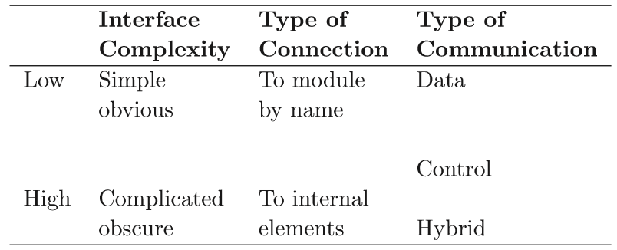
Factors aﬀecting coupling

Slide 17
Types of coupling
Content
One module directly references content of another
Common
Both Modules have access to same global data
Control
One module passes an element of control to another
Stamp
One module passes a data structure to another; which only uses part of the passed information
Data
One module passes only homogeneous data items

Slide 18





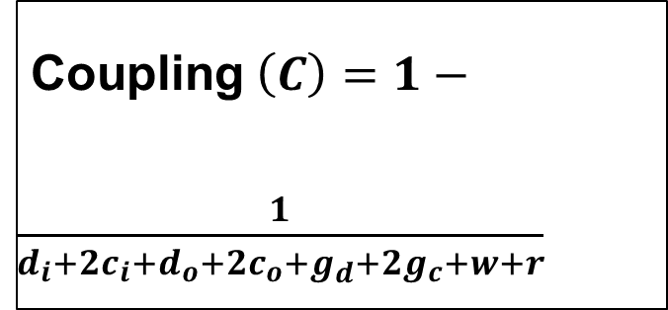


Metric for Coupling
For data and control flow
$d_{i}=$ number of input data parameters
Coupling$\left(C\right)=1−\frac{1}{d_{i}+2c_{i}+d_{o}+2c_{o}+g_{d}+2g_{c}+w+r}$
$c_{i}=$ number of input control parameters
$d_{o}=$ number of output data parameters
$c_{o}=$ number of output control parameters
For global coupling:
$g_{d}=$ global variable used as data
$g_{c}=$ number of global variables used as control
For environmental coupling:
$w=$ fan-out
$r =$ fan-in

Slide 19
Cohesion
Coupling characterized the inter-module bond
How to reduce ?
Minimize relationship between elements of different modules
Maximize relationship between elements of same module
Cohesion considers this relationship
Interested in determining
How closely the elements of a module are related to each other

Slide 20
Cohesion
Cohesion of a module represents
How tightly bound are the elements of the module
Identifies the bonding among different elements of a module
High cohesion is the goal
Cohesion and coupling are interrelated
Greater cohesion of modules, lower coupling between module

Slide 21
Levels of Cohesion
Coincidental
Multiple, completely unrelated actions
Logical
Series of related actions, often selected by parameters
Temporal
Series of actions related in time
Procedural
Series of actions sharing sequence of steps
Communicational
Procedural cohesion but on the same data
Informational/ Sequential
Series of independent actions on the same data
Functional: Exactly One Action

Slide 22
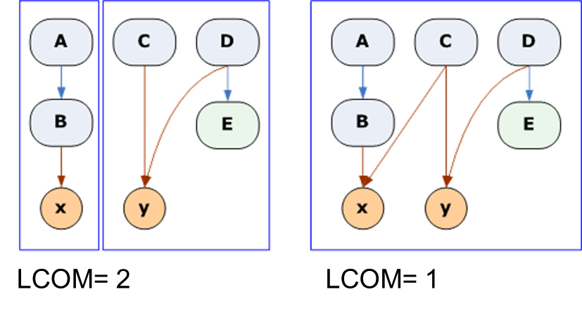
Measuring coupling and Cohesion
Hitz M., Montazeri B.: Measuring Coupling and Cohesion In Object-Oriented Systems. Proc. Int. Symposium on Applied Corporate Computing, Oct. 25-27, Monterrey, Mexico, 75-76, 197, 78-84.
Lack of
Cohesion
Of
Module

Slide 23
Some Terminologies
Functional Independence
Error Isolation
Scope of Reuse
Understandability

Slide 24
Introduction
Definition:
The process of defining the architecture, components, interfaces, and other characteristics of a system or component
The result of [that] process
Creates the blueprint of the solution to be implemented

Slide 25
Data Flow Modeling
Widely used; focuses on functions performed in the system
Views a system as a network of data transforms through which the data flows
Uses data flow diagrams (DFDs) and functional decomposition in modeling
The SSAD methodology uses DFD to organize information, and guide analysis

Slide 26
DFD: Course Registration System
Consider a course registration system. When a student provides a prioritized list of courses and other information to the system, this information is transformed into a list of preferences. The list of preferences is used to verify the eligibility of the students using the student records and the course prerequisites. If the student is eligible to register for the courses he/she desires, then the student is enrolled in those courses, and the class schedule is communicated back to the student. In addition, the system also compiles the list of students enrolled in each class using the registration information for each student. This list is then given to the faculty. The list is also forwarded to the registrar so that a classroom of an appropriate capacity can be allocated depending on the number of students enrolled.

Slide 27
DFD: Course Registration System
Consider a course registration system. When a student provides a prioritized list of courses and other information to the system, this information is transformed into a list of preferences. The list of preferences is used to verify the eligibility of the students using the student records and the course prerequisites. If the student is eligible to register for the courses he/she desires, then the student is enrolled in those courses, and the class schedule is communicated back to the student. In addition, the system also compiles the list of students enrolled in each class using the registration information for each student. This list is then given to the faculty. The list is also forwarded to the registrar so that a classroom of an appropriate capacity can be allocated depending on the number of students enrolled.

Slide 28
Thank you
Next Lecture: System Modeling

