Slide 1

CS223: Software Engineering
Software Development Processes

Slide 2
Recap
Software engineering as a bridge between customer and developer
Different misconceptions about software developments
Legacy software
Software developments phases

Slide 3
Objective
After the end of the class students should be able to
State professional responsibilities of a software engineer
Explain the need of software processes
Describe ETVX model
Differentiate between different properties of software processes

Slide 4
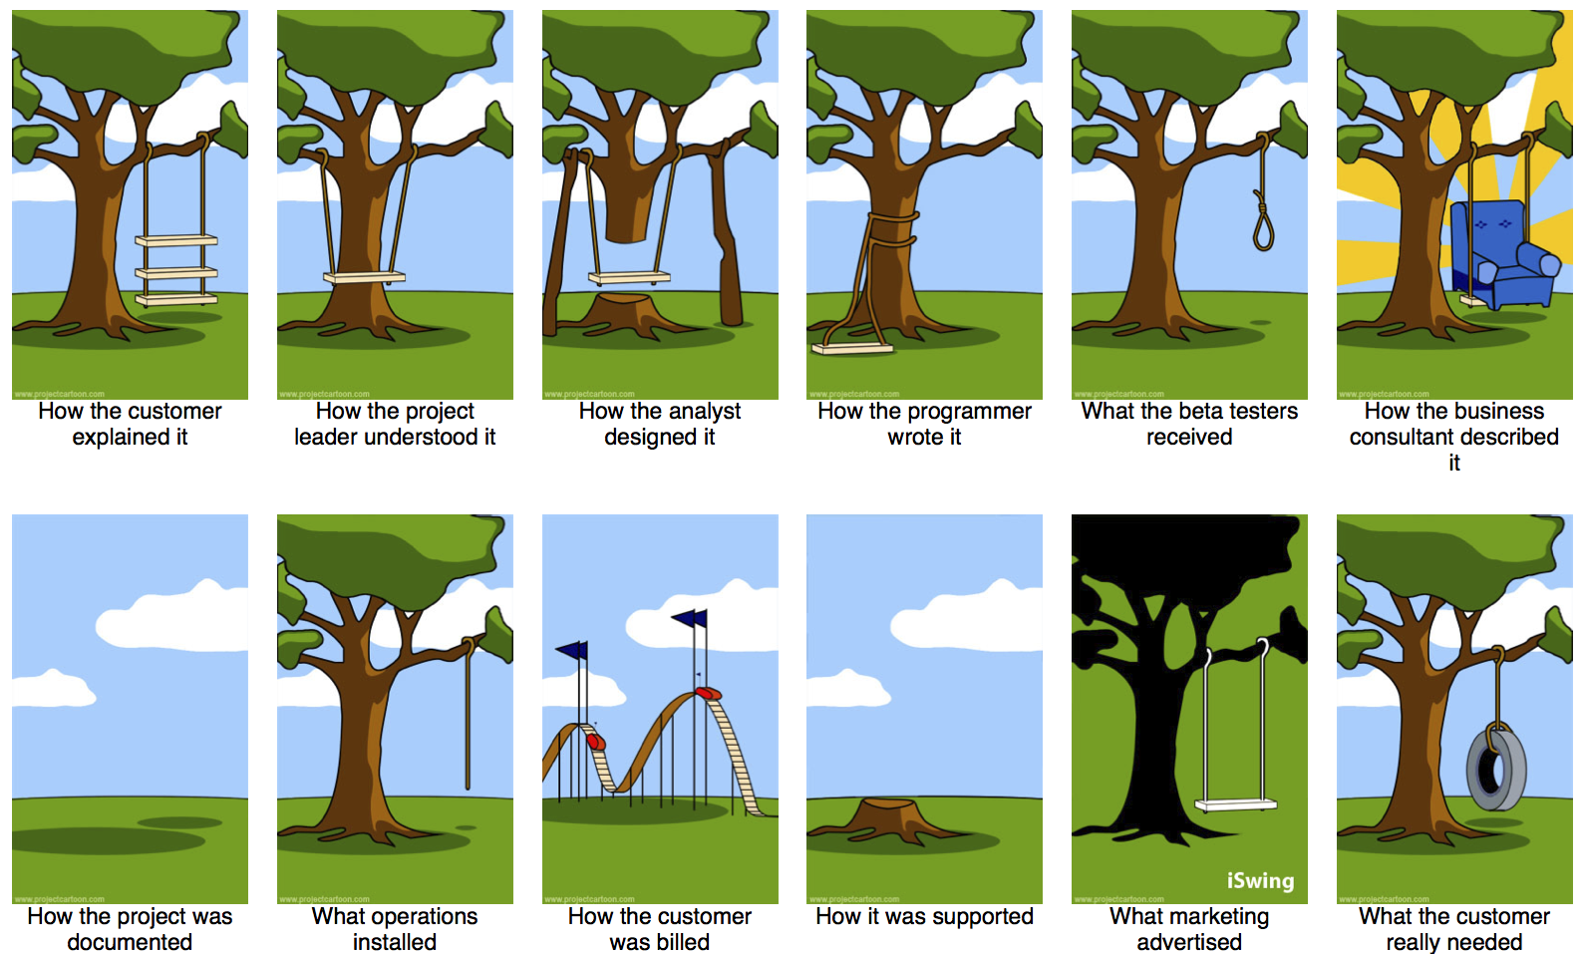

Slide 5
What is a software process?
A set of ordered tasks to produce indented output of some kind
Involving activates,
Constraints; and
Resources
The process of building a software product
Life cycle
Describes the life of the software from conception through
implementation,
delivery,
use and
maintenance.

Slide 6
Component Software Processes
Two major processes
Development
focuses on development and quality steps needed to engineer the software
Project management
focuses on planning and controlling the development process
Development process is the heart of software process; other processes revolve around it
These are executed by different people
Developers execute engineering process
Project manager executes the management processes

Slide 7
Component Processes…
Other processes
Configuration management process
manages the evolution of artifacts
Change management process
how changes are incorporated
Process management process
management of processes themselves
Inspection process
How inspections are conducted on artifacts

Slide 8
Process Specification
Process is generally a set of phases
Each phase performs a well defined task and produces an output
Intermediate outputs – work products
At top level, typically few phases in a process
How to perform a particular phase
Methodologies have been proposed

Slide 9
ETVX Specification
ETVX approach to specify a step
Entry criteria: conditions to be satisfied for initiating this phase
Task: what is to be done in this phase
Verification: the checks done on the outputs of this phase
eXit criteria: when can this phase be considered done successfully
A phase also produces info for management

Slide 10
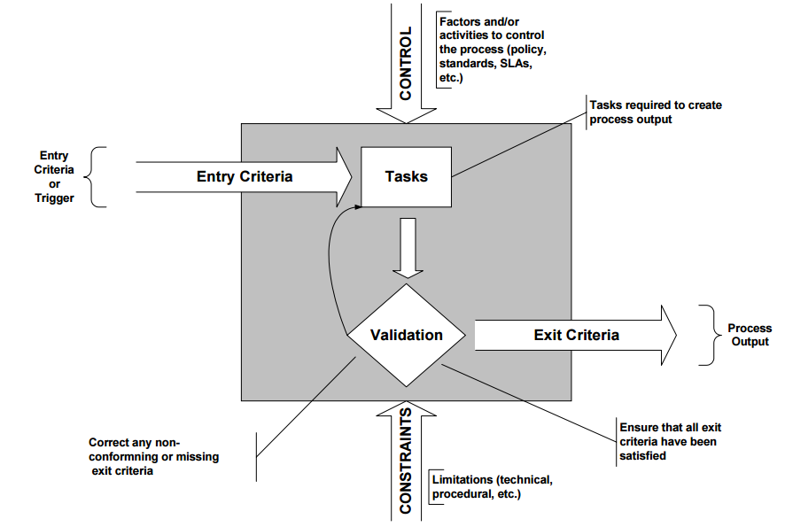
ETVX approach
A
B
D
C

Slide 11
Desired Process Properties
Provide high quality and productivity (Q & P)
Support testability as testing is the most expensive task
Testing can consume 30 to 50% of total development effort
Support maintainability
Maintenance can be more expensive than development;
Over life up to 80% of total cost
Remove defects early
As cost of removing defects increases with latency

Slide 12
High Q&P: Early Defect Removal…
Cost of a defect increases with latency
Fixing a defect in operation can cost a 100 times the cost of fixing it in requirements itself
For high Q&P, the process must support early defect removal
That is why there is a V in ETVX, and quality control tasks in the software process

Slide 13
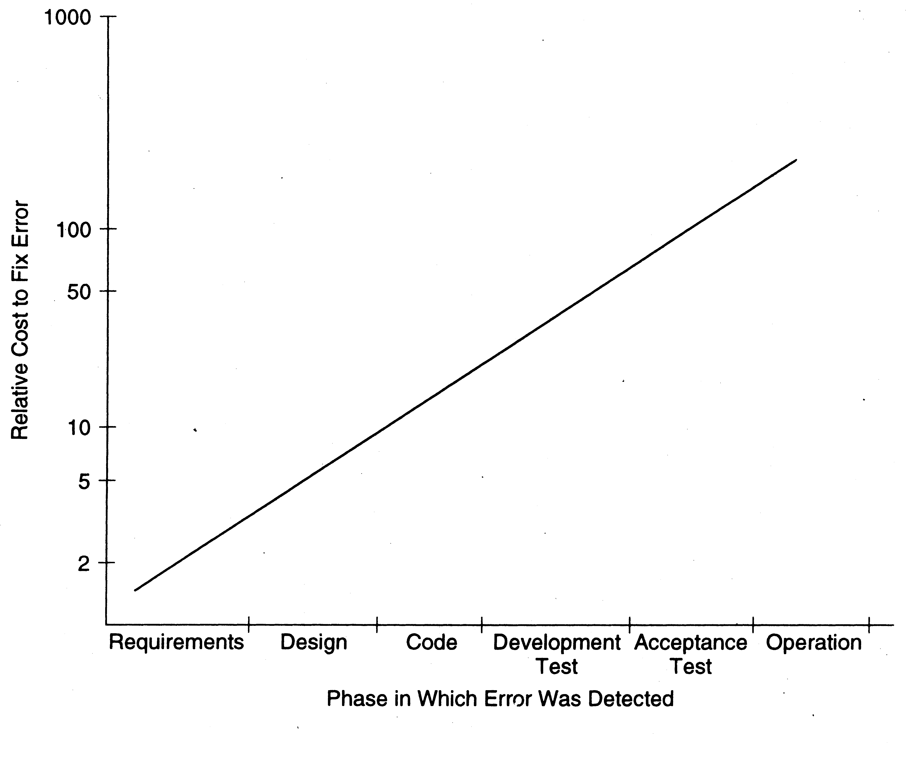
Early Defect Removal…

Slide 14
Desired Properties…
Predictability and repeatability
Process should repeat its performance when used on different projects
Outcome of using a process should be predictable
Past performance can be used to predict future performance
Without predictability, cannot estimate, or say anything about quality or productivity

Slide 15
Predictability…
Predictable process is said to be under statistical control
Repeatedly using the process produces similar results
Results – properties of interest like quality, productivity, …
To consistently develop software with high Q&P
Process must be in control

Slide 16
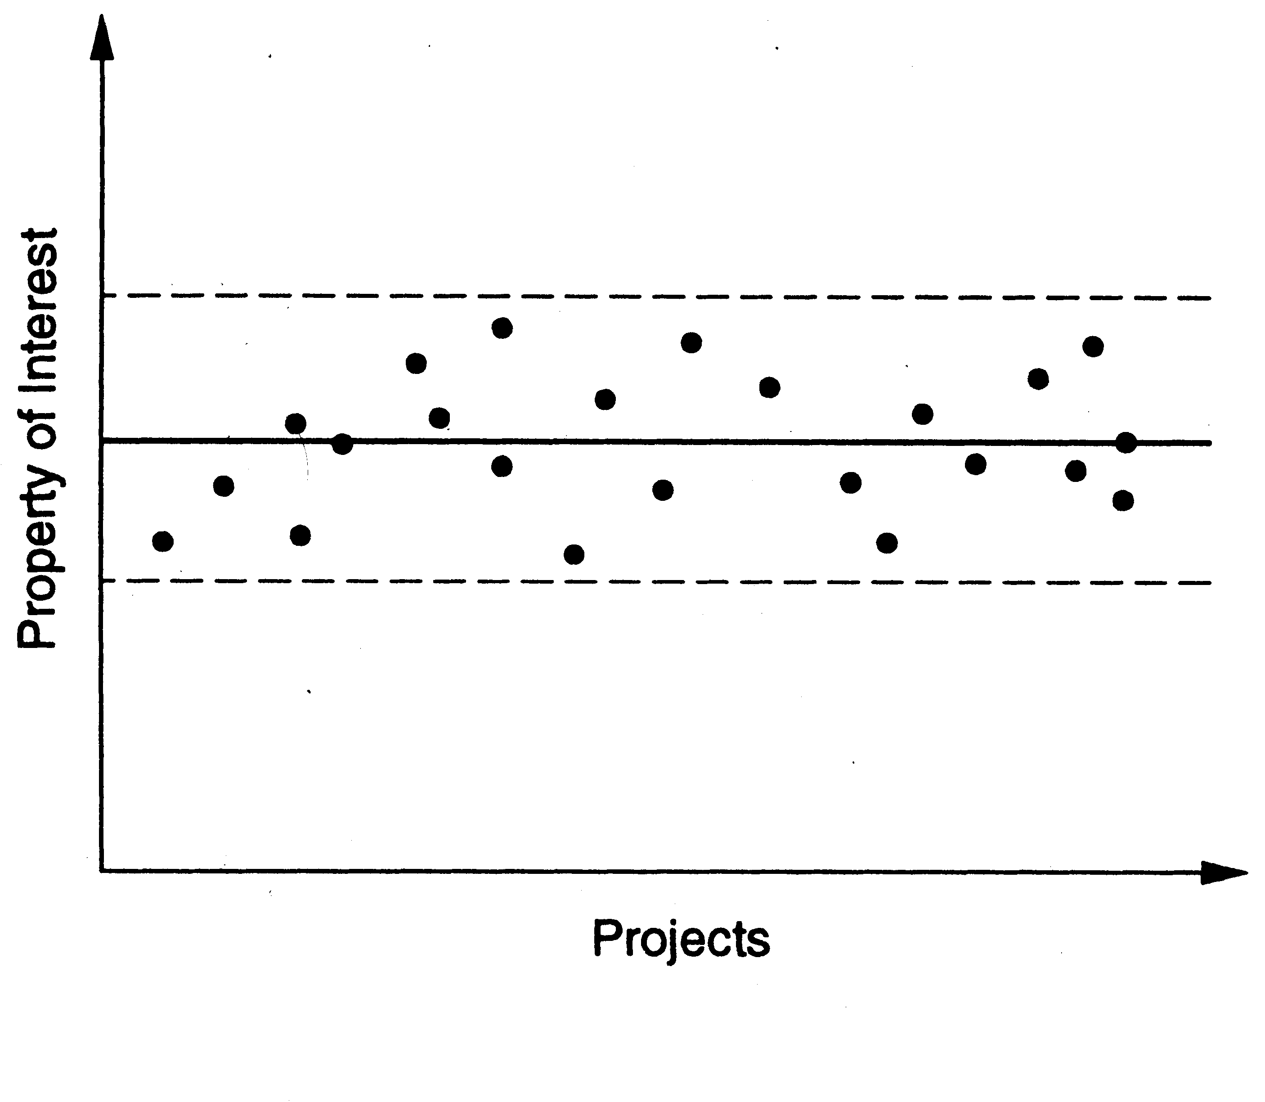
Predictability…
Expected value of the property
Allowable error bound

Slide 17
Support Change
Software changes for various reasons
Requirements change is a key reason
Requirement changes cannot be wished away or treated as “bad”
They must be accommodated in the process for software development

Slide 18
Software Project
Project
To build a software system within cost
Schedule and with high quality which satisfies the customer
Project goals – high Q and high P
Suitable process needed to reach goals
For a project
The process to be followed is specified during planning

Slide 19
Projects Process
If a project chooses a model
It will generally tailor it to suit the project
This produces the spec for the projects process
This process can then be followed in the project
Process is what is actually executed
Process specification is plan about what should be executed
Process model is a generic process specification
Many models have been proposed for the development process

Slide 20
Development Process
A set of phases and each phase being a sequence of steps
Sequence of steps for a phase - methodologies for that phase.
Why have phases
To employ divide and conquer
Each phase handles a different part of the problem
Helps in continuous validation

Slide 21
Development Process
Commonly has these activities:
Requirements analysis, architecture,
Design, coding,
Testing, delivery
Different models perform them in different manner

Slide 22
Generic software process models
The waterfall model
Separate and distinct phases of specification and development.
Evolutionary development
Specification, development and validation are interleaved.
Component-based software engineering
The system is assembled from existing components.

Slide 23
Waterfall Model
Linear sequence of stages/ phases
Requirements – HLD – DD – Code – Test – Deploy
A phase starts only when the previous has completed
No feedback
The phases partition the project
Each addressing a separate concern

Slide 24
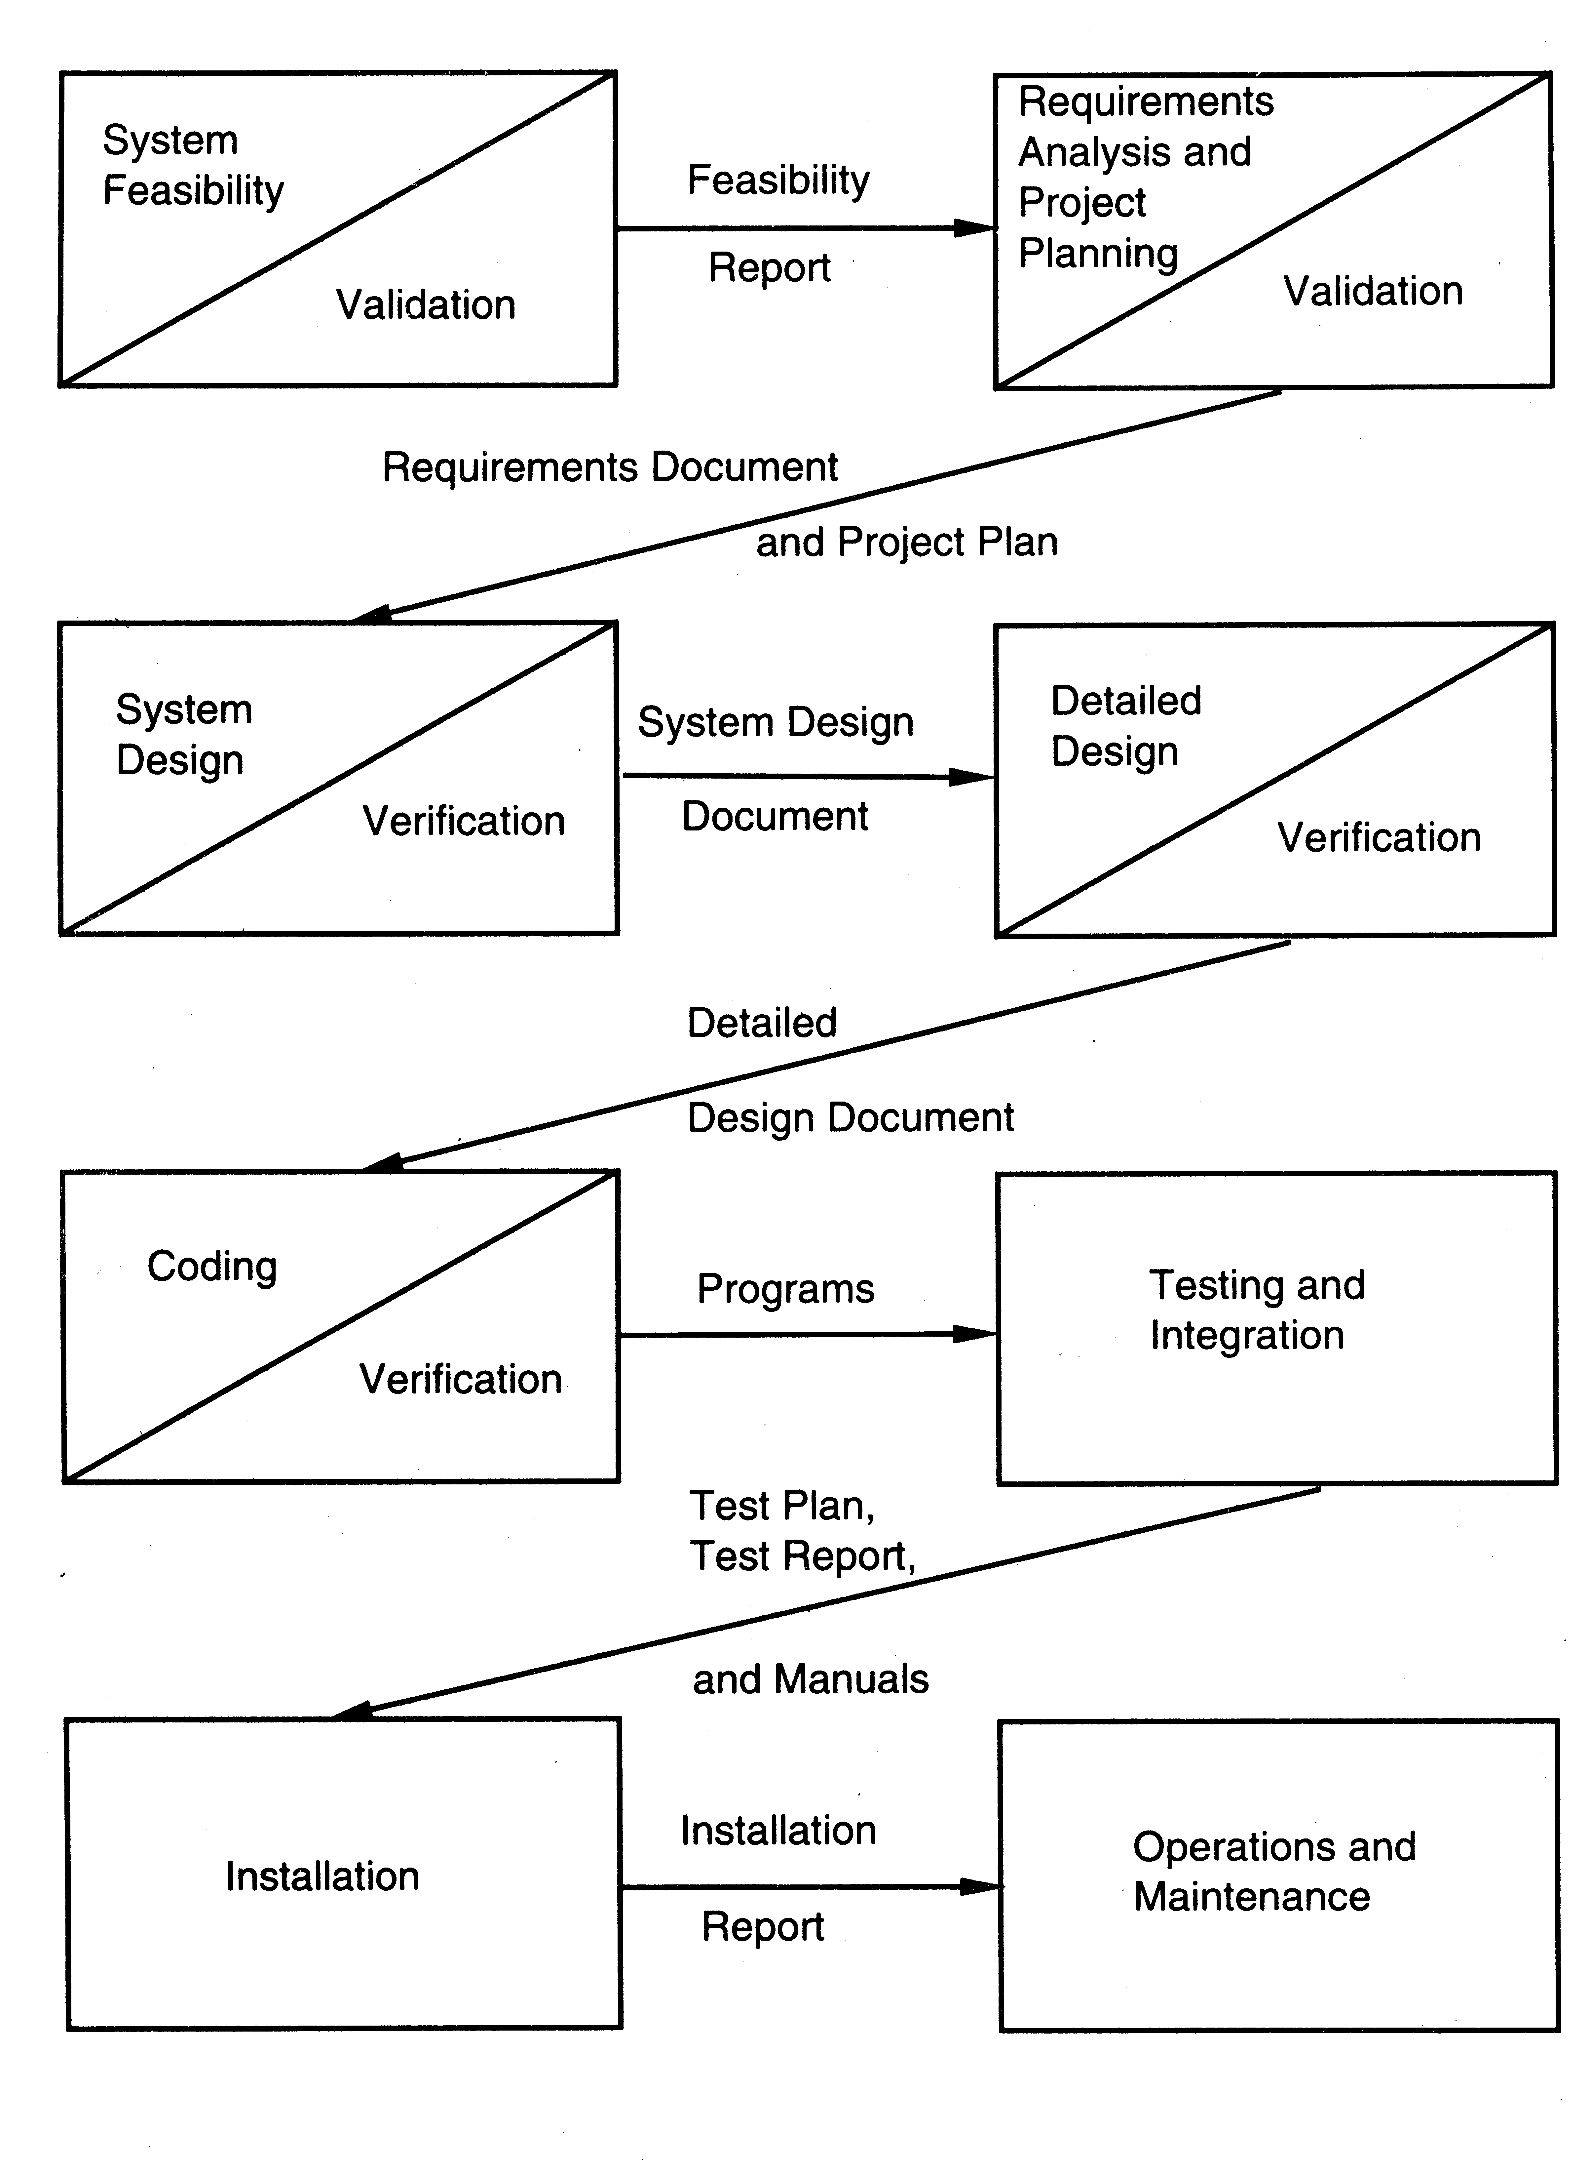
Flow of Waterfall Model

Slide 25
Properties of Waterfall Model
Linear ordering implies each phase should have some output
The output must be validated/certified
Outputs of earlier phases: work products
Common outputs of a waterfall:
SRS, project plan, design docs, test plan and reports, final code, supporting docs

Slide 26
Waterfall Advantages
Conceptually simple
Cleanly divides the problem into distinct phases
Phases can be performed independently
Natural approach for problem solving
Easy to administer in a contractual setup
Each phase is a milestone

Slide 27
Waterfall disadvantages
Assumes that requirements can be specified and frozen early
May fix hardware and other technologies too early
Follows the “big bang” approach
All or nothing delivery
Too risky
Requirement bloating
Very document oriented
Requiring docs at the end of each phase

Slide 28
Waterfall Usage
Has been used widely
Well suited for projects where
Requirements can be understood easily
Technology decisions are easy
For familiar type of projects it still may be the most optimum

Slide 29
Prototyping
It addresses the requirement specification limitation of waterfall
Do not finalize requirements only by discussions
A prototype is built to understand the requirements
Helps reduce the requirements risk
A small waterfall model replaces the requirements stage

Slide 30
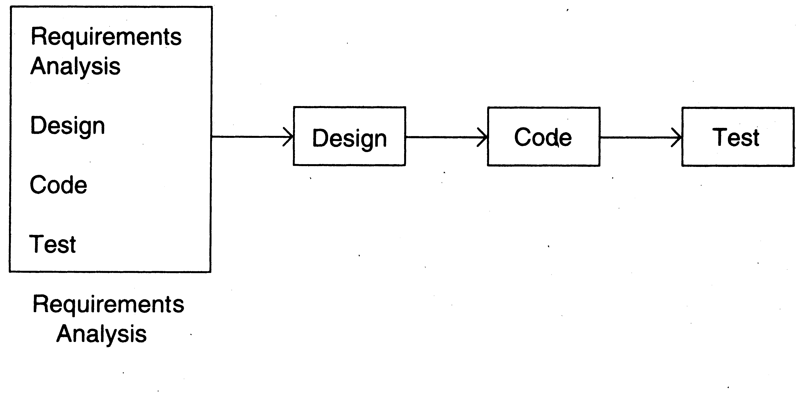
Prototyping: Typical flow

Slide 31
Developing A Prototype
Starts with initial requirements
Only key features which need better understanding are included in prototype
No point in including those features that are well understood
Feedback from users taken to improve the understanding of the requirements

Slide 32
How to minimize the cost?
Build only features needing clarification
“Quick and dirty”
Quality not important, scripting etc. can be used
Things like exception handling, recovery, standards are omitted
Cost can be a few % of the total
Learning in prototype building will help in
Building the software
Besides improved requirements

Slide 33
Pros and Cons of Prototyping
Advantages:
Requirement will be more stable
Requirement frozen later
Experience helps in the main development
Disadvantages:
Potential hit on cost and schedule
Applicability:
When requirements are hard to elicit
Confidence in requirements is low
Requirements are not well understood

Slide 34
Iterative Development
Counters the “all or nothing” drawback of the waterfall model
Combines benefit of prototyping and waterfall
Develop and deliver software in increments
Each increment is complete in itself
Can be viewed as a sequence of waterfalls
Feedback from one iteration is used in the future iterations

Slide 35
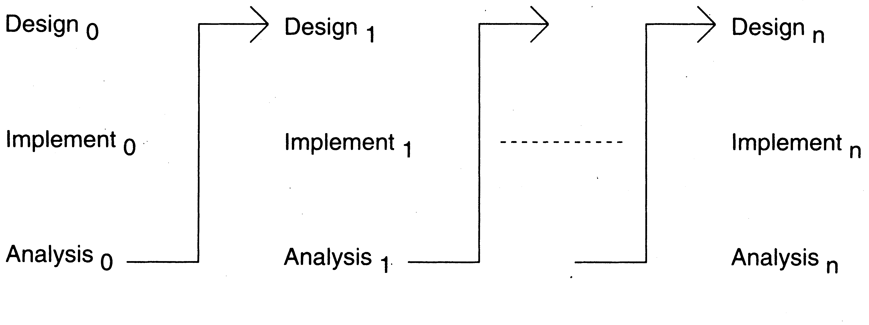
Typical Flow of Iterative Enhancement

Slide 36
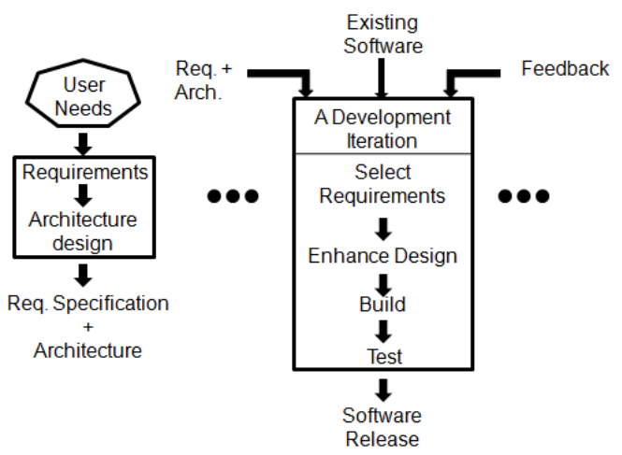
Iterative delivery approach

Slide 37
Properties of Iterative Development
Products almost always follow it
Used commonly in customized development also
Businesses want quick response for software
Cannot afford the risk of all-or-nothing
Newer approaches like XP, Agile,… all rely on iterative development

Slide 38
Pros and Cons of Iterative Development
Benefits:
Get-as-you-pay
Feedback for improvement,
Drawbacks:
Architecture/ design may not be optimal,
Rework may increase, total cost may be more
Applicability:
Response time is important, risk of long projects cannot be taken,
All requirements are not known

Slide 39
Timeboxing
Iterative is linear sequence of iterations
Each iteration is a mini waterfall
Decide the specs, then plan the iteration
Time boxing
Fix an iteration duration, then determine the specs
Divide iteration in a few equal stages
Use pipelining concepts to execute iterations in parallel

Slide 40
Time Boxed Iterations
General iterative development
Fix the functionality for each iteration,
Then plan and execute it
In time boxed iterations
Fix the duration of iteration
Adjust the functionality to fit it
Completion time is fixed
The functionality to be delivered is flexible

Slide 41
Characteristics of Time boxed Iteration
This itself very useful in many situations
Has predictable delivery times
Overall product release and marketing can be better planned
Makes time a non-negotiable parameter and helps focus attention on schedule
Prevents requirements bloating
Overall development time is still unchanged

Slide 42
Timeboxing – Taking Time Boxed Iterations Further
What if we have multiple iterations executing in parallel
Can reduce the average completion time by exploiting parallelism
For parallel execution,
Can borrow pipelining concepts from hardware
This leads to Timeboxing Process Model

Slide 43
Timeboxing Model – Basics
Development is done iteratively in fixed duration time boxes
Each time box divided in fixed stages
Each stage performs a clearly defined task that can be done independently
Each stage approximately equal in duration
There is a dedicated team for each stage
When one stage team finishes, it hands over the project to the next team

Slide 44
Properties of Timeboxing
With this type of time boxes,
Can use pipelining to reduce cycle time
Like hardware pipelining
View each iteration as an instruction
As stages have dedicated teams
Simultaneous execution of different iterations is possible

Slide 45
Example
An iteration with three stages – Analysis, Build, Deploy
These stages are approximately equal in many situations
Can adjust durations by determining the boundaries suitably
Can adjust duration by adjusting the team size for each stage
Have separate teams for A, B, and D

Slide 46
Pipelined Execution
AT starts executing it-1
AT finishes, hands over it-1 to BT, starts executing it-2
AT finishes it-2, hands over to BT; BT finishes it-1, hands over to DT; AT starts it-3, BT starts it-2 (and DT, it-1)

Slide 47
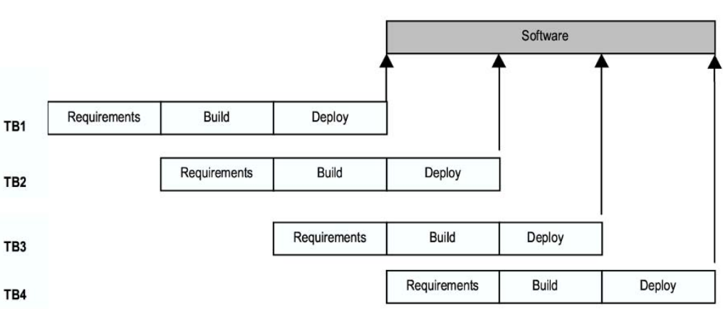
Timeboxing Execution

Slide 48
Timeboxing execution
First iteration finishes at time T
Second finishes at T+T/3; third at T+2 T/3, and so on
In steady state, delivery every T/3 time
If T is 3 weeks, first delivery after 3 weeks, 2nd after 4 weeks, 3rd after 5 weeks,…
In linear execution, delivery times will be 3 weeks, 6 weeks, 9 weeks,…

Slide 49
Timeboxing execution
Duration of each iteration still the same
Total work done in a time box is also the same
Productivity of a time box is same
Yet, average cycle time or delivery time has reduced to a third

Slide 50
Team Size
In linear execution of iterations, the same team performs all stages
If each stage has a team of S, in linear execution the team size is S
In pipelined execution, the team size is three times (one for each stage)
The total team size in timeboxing is larger; and this reduces cycle time

Slide 51
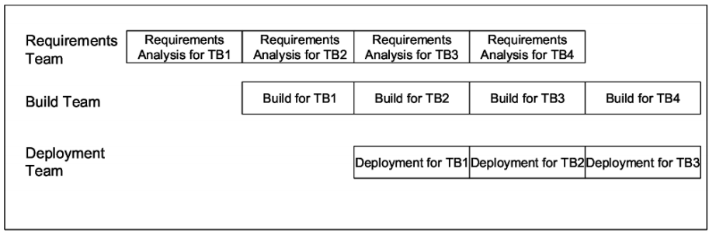
Tasks of different teams

Slide 52
Timeboxing
Advantages:
Shortened delivery times,
Other advantages of iterative, distributed execution
Disadvantages:
Larger teams,
Project management is harder,
High synchronization needed, CM is harder
Applicability:
When short delivery times very important
Architecture is stable
Flexibility in feature grouping

Slide 53
Summary – Waterfall
Strength | Weakness | Types of Projects
Simple Easy to execute Intuitive and logical Easy contractually | All or nothing – too risky Requirements are frozen early May chose outdated hardware/tech Disallows changes No feedback from users Encourages req bloating | Well understood problems, Short duration projects, Automation of existing manual systems

Slide 54
Summary – Prototyping
Strength | Weakness | Types of Projects
Helps requirement elicitation Reduces risk Better and more stable final system | Front heavy Possibly higher cost and schedule Encourages requirement bloating Disallows later change | Systems with novice users Areas with requirement uncertainty. Heavy reporting based systems can benefit from UI proto

Slide 55
Summary – Iterative
Strength | Weakness | Types of Projects
Regular deliveries, leading to biz benefit Can accommodate changes naturally Allows user feedback Avoids requirement bloating Naturally prioritizes requirement Allows reasonable exit points Reduces risks | Overhead of planning each iteration Total cost may increase System arch and design may suffer Rework may increase | For businesses where time is imp; risk of long projects cannot be taken; req not known and evolve with time

Slide 56
Summary – Timeboxing
Strength | Weakness | Types of Projects
All benefits of iterative Planning for iterations somewhat easier Very short delivery times | PM becomes more complex Team size is larger Complicated – lapses can lead to losses | Where very short delivery times are very important Where flexibility in grouping features Arch is stable

Slide 57
Thank you
Next : Requirement Engineering

