Slide 1
CS223: Software Engineering
Measuring Functionality

Slide 2
Function Point Analysis
Function Point Analysis (FPA) was invented as an indirect measure for the functional size of a system.

Slide 3
Problem
Assume you work for a company that currently makes home safety and security monitoring devices and controllers. Now your company wants to sell home safety systems. You need to design and build the software part of the system. The available components are:
Controller (with associated monitoring devices) for door and window alarms
Controller (with associated monitoring devices) for motion detectors
Controller (with associated monitoring devices) for panic buttons
Controller (with associated monitoring devices) for fire detector
Controller (with associated devices) for light activator and deactivator
Controller/monitor for key device (to turn system on and off)
Wireless dial-out device with controller
Estimate the effort to build the system. Assume a productivity of 10 FPs per staff month, with a standard deviation of ±1 staff month.

Slide 4
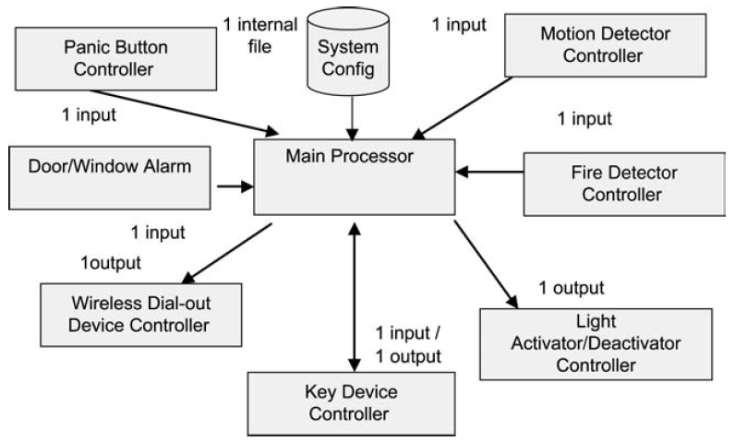
Home security architecture

Slide 5
Solution (One Approach)
Input
Output
Database
Type of complexity
Calculate UFP
VAF
AFPs = UFPs(0.65+0.01*VAF)
Effort = AFPs/ Productivity

Slide 6
Extension to the problem
Now you are told that your company can only afford 75% of the estimated staff months to build the system. What do you do now?

Slide 7
Pros and Cons
Technology Independent,
Effective Early (Requirements Phase) In The Software Life Cycle,
Well-documented And Specified,
Supported By Standards And An International Users Group,
Backed By Substantial Data That Supports The Methodology,
Reasonably Reliable And Accurate,

Slide 8
Cyclomatic Complexity
McCabe’s cyclomatic complexity (CC), which is a measure of the number of control flows within a module
The greater the number of paths through a module, the higher the complexity
Cyclomatic number of a graph, denoted by V(g), by counting the number of linearly independent paths within a program
Allows you to also determine the minimum number of unique tests that must be run to execute every executable statement.
V(g) = e – n + 2
V(g) = bd + 1
If there is a n-way decision, it is counted as n-1 binary decisions

Slide 9
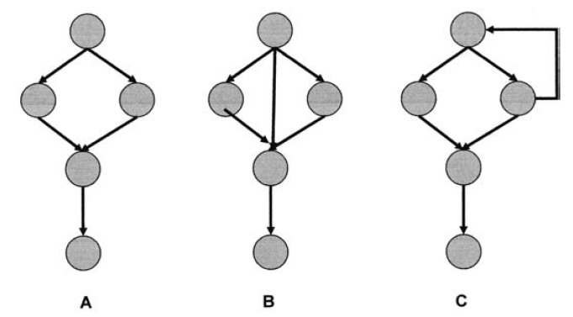
Example

Slide 10
Exercise
/ * The strncat() function appends up to count characters
from string src to string dest, and then appends a terminating null character. If copying takes place
between objects that overlap, the behavior is undefined.
* /
char *strncat(char *dest, const char *src, size_t count)
{
char *temp=dest;
if (count) {
while (*dest)
dest++;
while ((*dest++=*src++)) {
if (--count==0) {
*dest=‘\0’;
break;
}
}
} return temp;
}

Slide 11
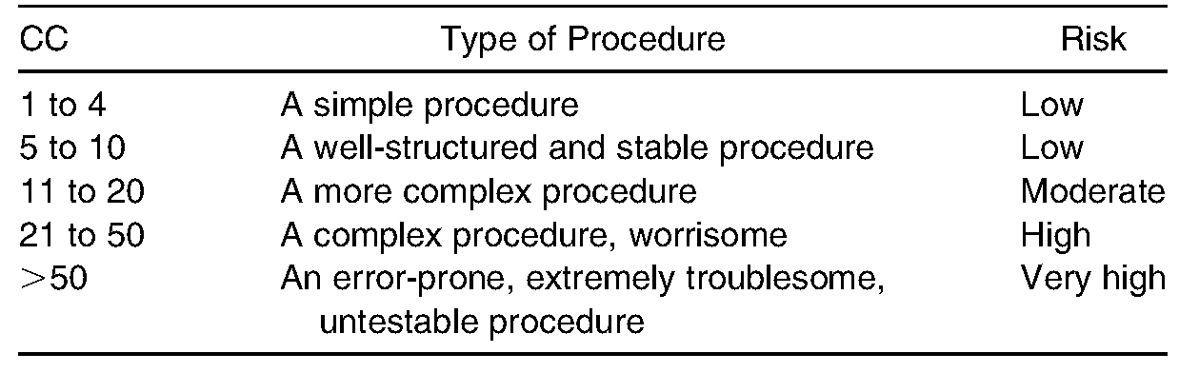
Cyclomatic Complexity Recommendations

Slide 12
Halstead’s Metrics
Halstead introduced complexity metrics based on the number of operators and operands in a program
He developed equations for difficulty, effort, and volume, which he called “software science.”
Operands were tokens with a value, such as variables and constants.
Operators were everything else, including commas, parentheses, and arithmetic operators.

Slide 13
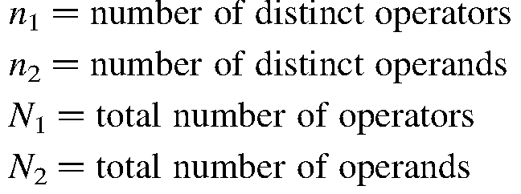
Metrics
Halstead’s metrics are defined as:
Length: N= N₁ + N₂
Vocabulary: n = n₁ + n₂
Volume: V = N(log₂ (n))
Difficulty: D = (n₁/2) * (N₂/n₂)
Effort: E = D * V

Slide 14
Determining operators and operands
The determination of the number of operators is neither completely clear nor unambiguous.
One working definition is that operands are variables, constants, and strings, and operators are everything else.
Operators that are paired (such as while do or {}) only count as one.
Again, it is typically more important to decide how you will count and to be consistent, rather than worrying about the details of the specific rules.

Slide 15
Exercise
/ * The strncat() function appends up to count characters
from string src to string dest, and then appends a terminating null character. If copying takes place
between objects that overlap, the behavior is undefined.
* /
char *strncat(char *dest, const char *src, size_t count)
{
char *temp=dest;
if (count) {
while (*dest)
dest++;
while ((*dest++=*src++)) {
if (--count==0) {
*dest=‘\0’;
break;
}
}
} return temp;
}

Slide 16
Information Flow Metrics
Information flow metrics measure the information flow into and out of modules
The underlying theory is that a high amount of information flow indicates a lack of cohesion in the design, which causes higher complexity
Information Flow Complexity (IFC) = (fanin * fanout)²
Fanin = number of local flows into a module plus the number of data structures that are used as input.
Fanout = number of local flows out of a module plus the number of data structures that are used as output

Slide 17
IEEE 982.2
IFC = (fanin * fanout)²
Weighted IFC = length * (fanin * fanout)²
Fanin = local flows into a procedure + number of data structures from which the procedure retrieves data
Fanout = local flows from a procedure + number of data structures that the procedure updates
Length = number of source statements in a procedure (excluding comments in a procedure)

Slide 18
Local flow between procedures
A local flow between procedures A and B exists if:
A calls B
B calls A and A returns a value to B that is used by B
Both A and B are called by another module (procedure) that passes a value from A to B
High information complexity of a procedure may indicate:
More than one function (lack of cohesion)
A potential choke point for the system (too much information traffic)
Excessive functional complexity (lack of cohesion)
A good candidate for redesign/simplification or extensive testing

Slide 19
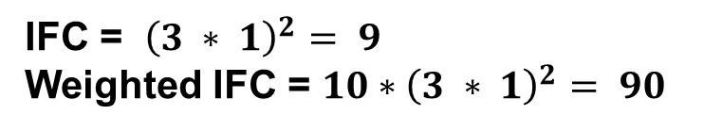
Exercise
/ * The strncat() function appends up to count characters
from string src to string dest, and then appends a terminating null character. If copying takes place between objects that overlap, the behavior is undefined. * /
char *strncat (char *dest, const char *src, size_t count){
char *temp=dest;
if (count) {
while (*dest)
dest++;
while ((*dest++=*src++)) {
if (--count==0) {
*dest=‘\0’;
break;
}
}
}
return temp;
}
IFC = ${\left(3 ∗ 1\right)}^{2}= 9$
Weighted IFC = $10∗{\left(3 ∗ 1\right)}^{2}= 90$

Slide 20
Object-Oriented Design Metrics
OOD programs are structurally different
OOD programs are structured around objects, which encapsulate the state, the characteristics, and the possible set of actions for that object
We would like them to measure classes, modularity, encapsulation, inheritance, and abstraction
Chidamber and Kemerer (CK) metrics

Slide 21
CK Metric
WMC—Weighted Methods per Class
the number of methods per class
DIT—Depth of Inheritance Tree
how many inheritance layers make up a given class hierarchy
NOC—Number of Children
number of immediate successors of the class
CBO—Coupling Between Object Classes
how many other classes rely on the class and vice versa
RFC—Response for Class
It is calculated as the sum of the number of methods plus the number of methods called by local methods
LCOM—Lack of Cohesion on Methods
number of different methods within a class that reference a given instance variable

Slide 22
//Initiate an instance IEEval of class ESieveEval
public class ESieveEval implements IEEval{
private EFilterEval EFilterEval;
private integer newVal=new Integer(2);
//initiate the class ESieveEval
public ESieveEval() {
LRStruct src=(new EIncEval(2,1)).makeELRS (); // src=2,3,4,5,. .
EFilterEval¼new EFilterEval(newVal, src); //filter out numbers
}
//inherit predefined class LRStruct,
public LRStruct nextLRS() {
newVal=(Integer)EFilterEval.nextLRS().getFirst();
EFilterEval= new EFilterEval (newVal, EFilterEval.makeELRS ());
return makeELRS();
}
//use the design pattern Singleton to define method makeELRS()
public LRStruct makeELRS() {
return LRSFactory.Singleton().makeLRS (newVal, this);
}
}

Slide 23
Thank you
Next Lecture: Software Quality

