Slide 1

CS223: Software Engineering
Software Maintenance

Slide 2
Recap
Software development life cycle
Requirement analysis
Design
Coding
Testing
Deployment

Slide 3
Objective
After completing this lecture students will be able to
Explain the importance of software maintenance
Follow standard software maintenance principles
Practice software maintenance in a structure manner

Slide 4
Fundamentals
Introduces the concepts and terminology
That form an underlying basis to understanding
The role and scope of software maintenance.
Definitions and Terminology
Nature of Maintenance
Need for Maintenance
Evolution of Software
Categories of Maintenance

Slide 5
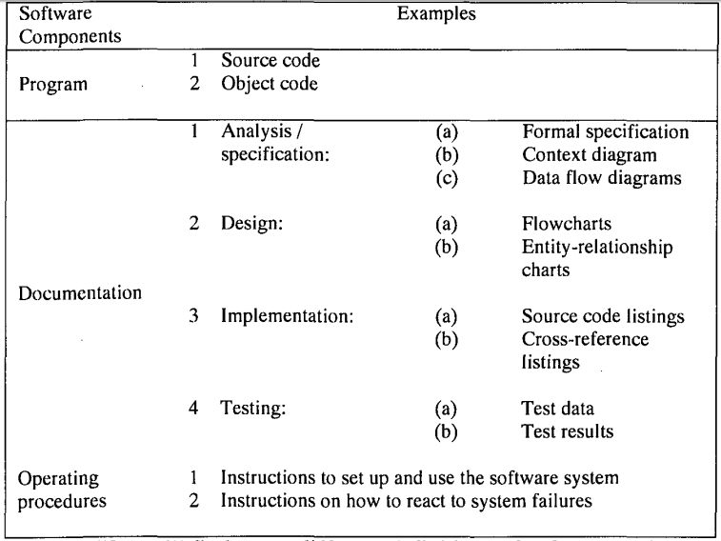
Components of a software

Slide 6
How New Development and Maintenance Activities Differ?
"The architect and the builders must take care not to weaken the existing structure when additions are made. Although the costs of the new room usually will be lower than the costs of constructing an entirely new building, the costs per square foot may be much higher because of the need to remove existing walls, reroute plumbing and electrical circuits and take special care to avoid disrupting the current site " -- Jones

Slide 7
Software Evolution
It is impossible to produce system of any size which do not need to be changed.
Once software is put into use, new requirements emerge and existing requirements changes as the business running that software changes.
Parts of the software may have to be modified to correct errors that are found in operation,
Improve its performance or other non-functional characteristics.
After delivery, software systems always evolve in response to demand for change.

Slide 8
Program Evolution Dynamic
Program evolution dynamic is the study of system change (Lehman and Belady).
Law | Description
Continuing change | A program that is used in real-world environment necessarily must change or become progressively less useful in that environment.
Increasing complexity | As an evolving program changes, its structure tends to become more complex. Extra resources must be devoted to preserving and simplify the structure.

Slide 9
Program Evolution Dynamic (cont’d)
Law | Description
Large program evolution | Program evolution is self-regulation process. System attributes such as size, time between release and the number of report errors are approximately invariant for each system release
Organizational stability | Over a program’s lifetime, its rate of development is approximately constant and independent of the resources devoted to the system development
Conservation of familiarity | Over the lifetime of system, the incremental change in each release is approximately constant.

Slide 10
Software Evolution Approaches
There are a number of different strategies for software change
Software maintenance
Architectural transformation
Software re-engineering.

Slide 11
Software Evolution Approaches
Architectural transformation
Radical approach to software change then maintenance
Making significant change to the architecture of the system.
Software re-engineering
No new functionality is added to the system.
Involve some structural modifications
Does not usually involves major architectural change.

Slide 12
Software Maintenance
Fundamentals
Key Issues
Process
Techniques
Tools
Definition
Need
Cost
Evolution
Categories
Technical
Management
Cost Estimation
Measurement
Activities
Comprehension
Reengineering
Reverse Engineering
Migration
Retirement

Slide 13
Software maintenance
Changes to the software are made
In response to changed requirements
The fundamental structure of the software remains stable.
This is most common approach used to system change.
The Maintenance Process contains the activities and tasks
Necessary to modify an existing software product
Preserving its integrity

Slide 14
Purpose of Maintenance
Correct faults
Improve the design
Implement enhancements
Interface with other software
Adapt programs so that different hardware, software, system features, and telecommunications facilities can be used
Migrate legacy software
Retire software.

Slide 15
Characteristics of Maintenance Activities
Maintaining control over the software’s day-to-day functions
Maintaining control over software modification
Perfecting existing functions
Identifying security threats and fixing security vulnerabilities
Preventing software performance from degrading to unacceptable levels.

Slide 16
Categories of Maintenance
Modification Request
Correction
Corrective
Preventive
Enhancement
Adaptive
Perfective
A generic term used to identify proposed modifications to a software product that is being maintained

Slide 17
Corrective Maintenance
Reactive modification (or repairs) of a software product
Performed after delivery to correct discovered problem
Emergency maintenance
Unscheduled modification performed
To temporarily keep a software product operational pending corrective maintenance

Slide 18
Adaptive Maintenance
Modification of a software product performed after delivery
To keep a software product usable in a changed or changing environment.
E.g. Operating system

Slide 19
Perfective maintenance
Modification of a software product after delivery
To provide enhancements for users,
Improvement of program documentation, and
Recoding to improve software performance, maintainability, or other software attributes.

Slide 20
Preventive maintenance
Modification of a software product after delivery
To detect and correct latent faults in the software product before they become operational faults.
 | Correction | Enhancement
Proactive
Reactive
Preventive | Perfective
Corrective | Adaptive

Slide 21
Issues
Issues must be dealt with to ensure the effective maintenance of software
E.g., trying to find a fault in software containing a large number of lines of code that another software engineer developed.
Technical issues
Management issues
Cost estimation
Measurement

Slide 22
Technical Issues
Limited Understanding
Testing
Impact Analysis
Maintainability
Half of the total maintenance effort
The cost of repeating full testing
IEEE 14764 (Impact analysis)
analyze MRs/PRs;
replicate or verify the problem;
develop options for implementing the modification;
document the MR/PR, the results, and the execution options;
obtain approval for the selected modification option.
MR- PR analysis
Capability of the software product to be modified

Slide 23
Management Issues
Alignment with Organizational Objectives
Staffing
Process
Organizational Aspects of Maintenance
Outsourcing
How to demonstrate the return on investment
To attract and keep software maintenance staff
Unique set of activities for maintenance

Slide 24
Software Maintenance Phases
Changes to the software process through a defined maintenance
Problem/modification identification, classification, and prioritization;
Analysis;
Design;
Implementation;
Regression/system testing;
Acceptance testing;
Delivery.

Slide 25
Categories of Software Change
Adaptive Change
Perfective Change
Corrective Change
Preventive Change

Slide 26
Categories of Software Change
Adaptive Change
Perfective Change
Corrective Change
Preventive Change

Slide 27
Details of each activity
Problem identification | Details
Input
Process
Control
Output
Modification Request (MR)
Assign change number Classify Accept or reject change Preliminary magnitude estimate Prioritize
Uniquely identify MR Enter MR into repository
Validated MR Process determinations

Slide 28
Details of each activity
Analysis | Details
Input
Process
Control
Output
Project/system document Repository information Validated MR
Feasibility Analysis Detailed Analysis Re-document (if required)
Conduct technical review Verify
Feasibility report (FR) Detailed analysis report Updated requirements Preliminary modification list Implementation plan Test strategy

Slide 29
Details of each activity
Design | Details
Input
Process
Control
Output
Project/ system document Source code Databases Analysis phase output
Create test cases Revise Requirements Implementation plan
Software inspection/review Verify design
Revised Modification list Detail analysis Implementation plan Updated Design baseline Test plans

Slide 30
Details of each activity
Implementation | Details
Input
Process
Control
Output
Source code Product/system document Results of design phase
Code Unit test Test-readiness review
Software inspection/ review Verify CM control of software Traceability of design
Updated Software Design documents Test documents User documents Training material Test-readiness review report

Slide 31
Details of each activity
System Test | Details
Input
Process
Control
Output
Updated software documentation Test-readiness review report Updated system
Functional test Interface testing Regression testing Test-readiness review
CM control of Code Listings MR Test documentation
Tested system Test reports

Slide 32
Details of each activity
Acceptance Test | Details
Input
Process
Control
Output
Test-readiness review report Fully integrated system Acceptance test Plans Cases Procedures
Acceptance test Interoperability test
Acceptance test Functional audit Establish baseline
New system baseline Acceptance test report FCA report

Slide 33
Details of each activity
Delivery | Details
Input
Process
Control
Output
Tested/ accepted system
PCA Install Training
PCA VDD
PCA report VDD

Slide 34
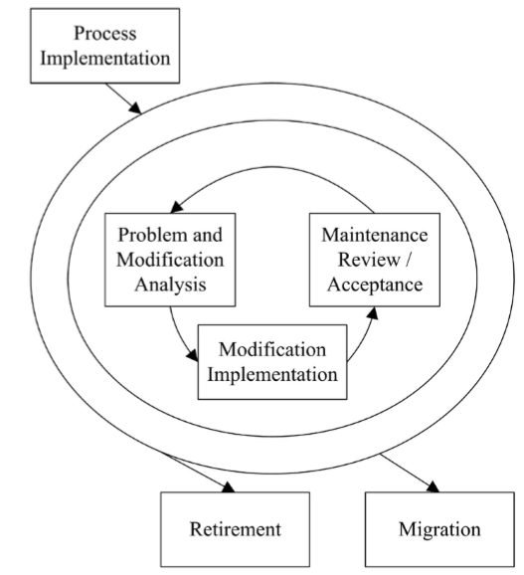
Software Maintenance Process

Slide 35
Unique Activities
Program understanding
Transition
Modification request acceptance/rejection
Maintenance help desk
Impact analysis
Maintenance Service-Level Agreements (SLAs)
Maintenance licenses and contracts

Slide 36
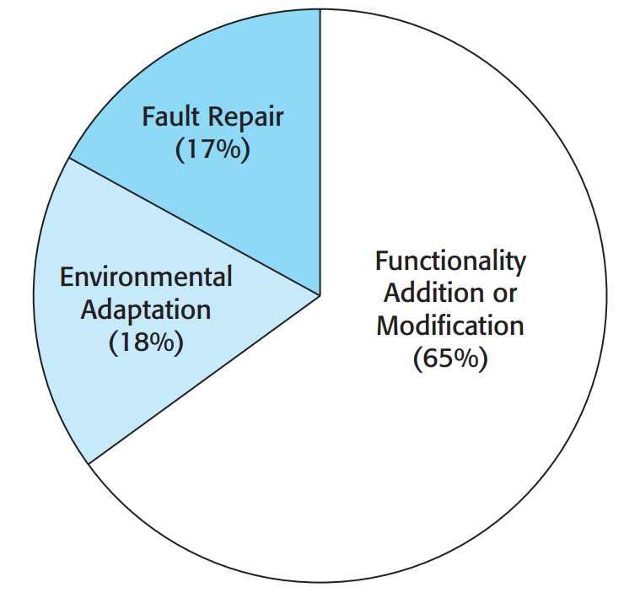
Maintenance effort distribution
Coding Error
Design Error
Requirement Error
Organizational
Business
Hardware
Operating System
Support Software

Slide 37
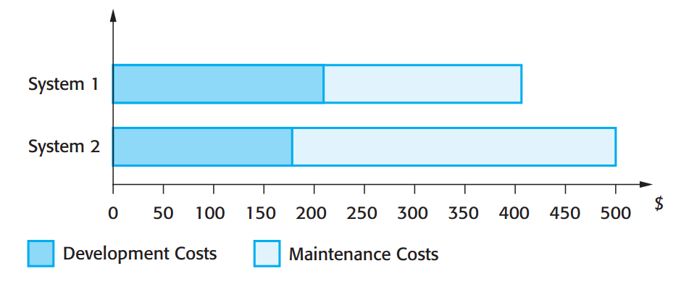
Development and Maintenance costs

Slide 38
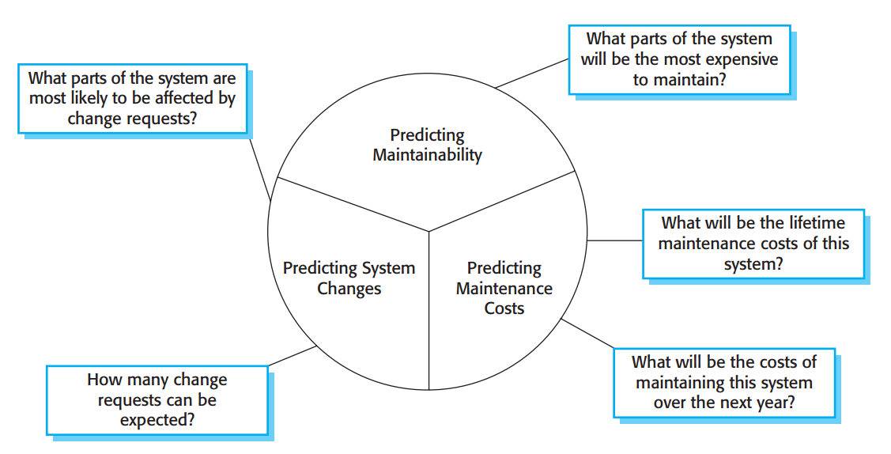
Maintenance Prediction

Slide 39
Metrics
Number of requests for corrective maintenance
Average time required for impact analysis
Average time taken to implement a change request
Number of outstanding change requests

Slide 40
Software re-engineering
Reorganising and modifying existing software systems to make them more maintainable

Slide 41
System re-engineering
Re-structuring or re-writing part or all of a legacy system without changing its functionality
Applicable where some but not all sub-systems of a larger system require frequent maintenance
It involves adding effort to make them easier to maintain.
The system may be re-structured and re-documented

Slide 42
When to re-engineer
When system changes are mostly confined to part of the system then re-engineer that part
When hardware or software support becomes obsolete
When tools to support re-structuring are available

Slide 43
Re-engineering advantages
Reduced risk
There is a high risk in new software development.
There may be development problems, staffing problems and specification problems
Delay lead to business impact
Reduced cost
The cost of re-engineering is often significantly less than the costs of developing new software

Slide 44
Business process re-engineering
Concerned with re-designing business processes to make them more responsive and more efficient
Often reliant on the introduction of new computer systems to support the revised processes
May force software re-engineering as the legacy systems are designed to support existing processes

Slide 45
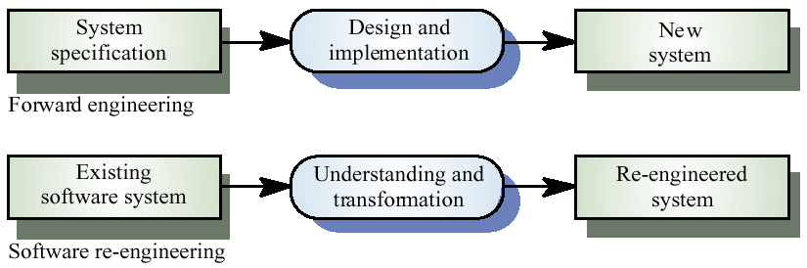
Forward engineering and re-engineering

Slide 46
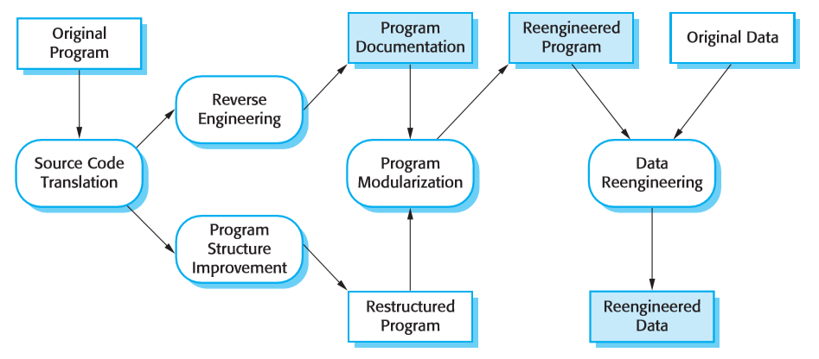
The re-engineering process
Using a translation tool, the program is converted from an old programming language to a more modern version of the same language or to a different language.

Slide 47
The re-engineering process
The program is analyzed and information extracted from it. This helps to document its organization and functionality

Slide 48
The re-engineering process
The control structure of the program is analysed and modified to make it easier to read and understand.

Slide 49
The re-engineering process
Related parts of the program are grouped together and, where appropriate, redundancy is removed. In some cases, this stage may involve architectural refactoring

Slide 50
The re-engineering process
The data processed by the program is changed to reflect program changes. This may mean redefining database schemas and converting existing databases structure.

Slide 51
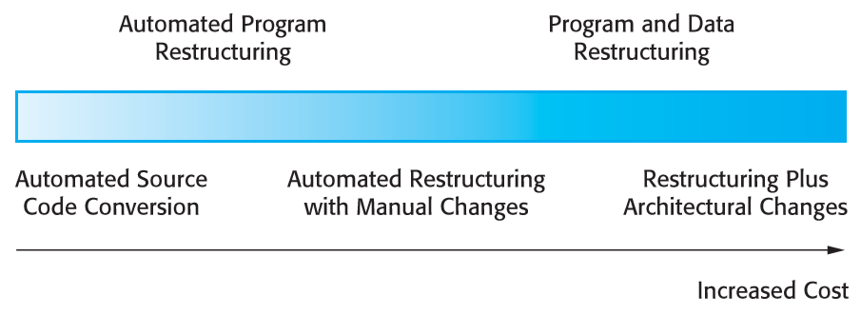
Re-engineering approaches

Slide 52
Source code translation
Involves converting the code from one language (or language version) to another e.g. FORTRAN to C
May be necessary because of:
Hardware platform update
Staff skill shortages
Organisational policy changes
Only realistic if an automatic translator is available

Slide 53
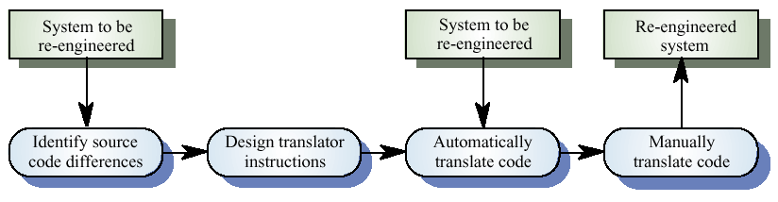
The program translation process

Slide 54
Reverse engineering
Analysing software with a view to understanding its design and specification
May be part of a re-engineering process but may also be used to re-specify a system for re-implementation
Builds a program data base and generates information from this
Program understanding tools (browsers, cross-reference generators, etc.) may be used in this process

Slide 55
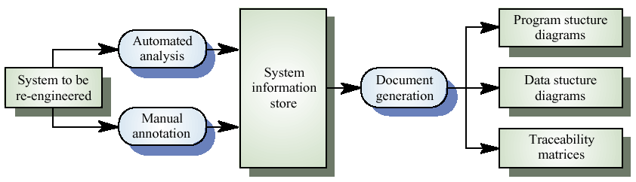
The reverse engineering process

Slide 56
Reverse engineering
Reverse engineering often precedes re-engineering but is sometimes worthwhile in its own right
The design and specification of a system may be reverse engineered so that
They can be an input to the requirements specification process for the system’s replacement
To support program maintenance

Slide 57
Program structure improvement
Maintenance tends to corrupt the structure of a program.
It becomes harder and harder to understand
The program may be automatically restructured to remove unconditional branches
Conditions may be simplified to make them more readable

Slide 58
Example
10 i = 0
20 i = i + 1
30 PRINT i; " squared = "; i * i
40 IF i >= 10 THEN GOTO 60
50 GOTO 20
60 PRINT "Program Completed."
70 END
← Spaghetti code
10 FOR i = 1 TO 10
20 PRINT i; " squared = "; i * i
30 NEXT i
40 PRINT "Program Completed."
50 END
← Structured programming style

Slide 59
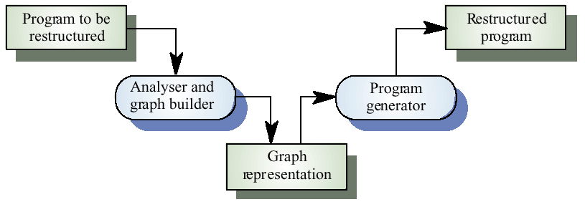
Automatic program restructuring

Slide 60
Restructuring problems
Problems with re-structuring are:
Loss of comments
Loss of documentation
Heavy computational demands
Restructuring doesn’t help with poor modularisation where related components are dispersed throughout the code
The understandability of data-driven programs may not be improved by re-structuring

Slide 61
Program modularisation
The process of re-organising a program
Related program parts are collected together in a single module
Usually a manual process
Carried out by program inspection and re-organisation

Slide 62
Recovering data abstractions
Many legacy systems use shared tables and global data to save memory space
Causes problems because changes have a wide impact in the system
Shared global data may be converted to objects or ADTs
Analyse common data areas to identify logical abstractions
Create an ADT or object for these abstractions
Use a browser to find all data references and replace with reference to the data abstraction

Slide 63
Data re-engineering
Involves analysing and reorganising the data structures (and sometimes the data values) in a program
May be part of the process of migrating from a file-based system to a DBMS-based system or changing from one DBMS to another
Objective is to create a managed data environment

Slide 64
Data problems
End-users want data on their desktop machines rather than in a file system.
They need to be able to download this data from a DBMS
Systems may have to process much more data than was originally intended by their designers
Redundant data may be stored in different formats in different places in the system

Slide 65
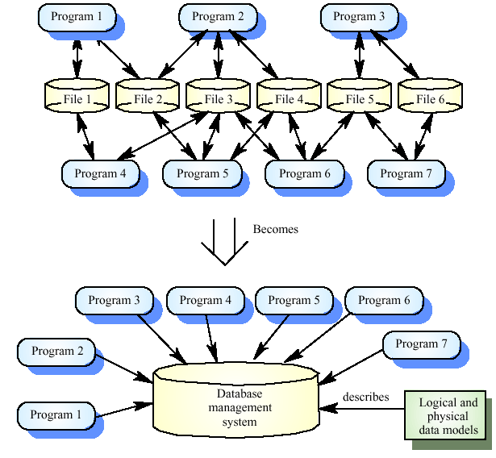
Data migration

Slide 66
Data problems
Data naming problems
Names may be hard to understand. The same data may have different names in different programs
Field length problems
The same item may be assigned different lengths in different programs
Record organisation problems
Records representing the same entity may be organised differently in different programs
Hard-coded literals
No data dictionary

Slide 67
Data conversion
Data re-engineering may involve changing the data structure organisation without changing the data values
Data value conversion is very expensive.
Special-purpose programs have to be written to carry out the conversion

Slide 68
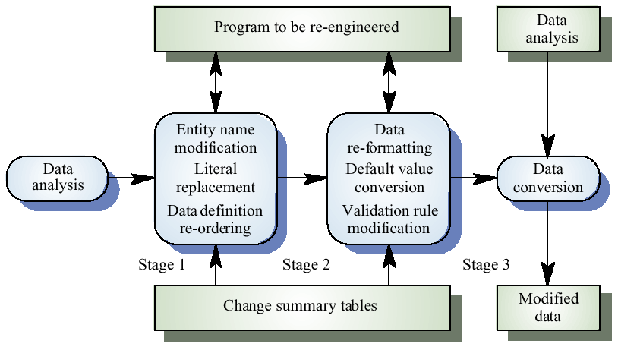
The data re-engineering process

Slide 69
Preventative maintenance by refactoring
Making improvements to a program to slow down degradation through change
Modifying a program to improve its structure, to reduce its complexity, or to make it easier to understand
Limited to object-oriented development
Should not add functionality but should concentrate on program improvement
Preventive Maintenance

Slide 70
Code Smell
Application
Class
Method
Duplicate Code
Contrived complexity
Large class
Lazy Class
Cyclomatic Complexity
Data Clump
Feature Envy
Too many parameters
Long method
God line
Naming standard
Fowler et al. (1999) suggest that there are stereotypical situations in which the code of a program can be improved.

Slide 71
Key points
The objective of re-engineering is to improve the system structure to make it easier to understand and maintain
The re-engineering process involves source code translation, reverse engineering, program structure improvement, program modularisation and data re-engineering
Source code translation is the automatic conversion of program in one language to another

Slide 72
Key points
Reverse engineering is the process of deriving the system design and specification from its source code
Program structure improvement replaces unstructured control constructs with while loops and simple conditionals
Program modularisation involves reorganisation to group related items
Data re-engineering may be necessary because of inconsistent data management

Slide 73
Thank you
Next Lecture: Software Estimation

