Slide 1

CS223: Software Engineering
Software Testing
(System, Integration and Acceptance)

Slide 2
Hierarchy of Testing
Testing
Ad Hoc
Program Testing
System Testing
Acceptance
Testing
Unit Testing
Integration Testing
Function
Benchmark
Black Box
Properties
Top Down
Performance
Pilot
Equivalence
Bottom Up
Boundary
Reliability
Alpha
Big Bang
Decision Table
Availability
Beta
State Transition
Sandwich
Security
Use Case
Usability
Domain Analysis
Documentation
White Box
Portability
Control Flow
Data Flow
Capacity

Slide 3
The idea of integration
A software module, or component, is a self-contained element of a system.
A module can be
a subroutine,
function,
procedure,
class, or
collection of those basic elements
A system is a collection of modules interconnected in a certain way to accomplish a tangible objective

Slide 4
Why integration is important?
Different modules are generally created by groups of different developers.
Inherent limitations of unit testing
It is essential to identify the ones causing most failures.

Slide 5
Objective of Integration Testing
Putting the modules together in an incremental manner
Ensuring that the additional modules work as expected without disturbing the functionalities of the modules already put together.
Unit-tested modules operate correctly when they are combined together as dictated by the design
Integration testing is said to be complete when the system is fully integrated together, all the test cases have been executed, all the severe and moderate defects found have been ﬁxed, and the system is retested.

Slide 6
Advantage
Defects are detected early
It is easier to fix defects detected earlier
We get earlier feedback on the health and acceptability of the individual modules and on the overall system
Scheduling of defect fixes is flexible, and it can overlap with development

Slide 7
Types of Interfacing
Procedure Call Interface
A procedure in one module calls a procedure in another module.
Shared Memory Interface
A block of memory is shared between two modules.
Data are written into the memory block by one module and are read from the block by the other.
Message Passing Interface
One module prepares a message by initializing the ﬁelds of a data structure and sending the message to another module.
e.g. Client server architecture

Slide 8
Types of Interface Error
Construction
Inappropriate use of header files
Inadequate Functionality
Implicit assumption of the system
Location of Functionality
Improper design methodology
Inexperienced personnel
Changes in Functionality
Change in requirement

Slide 9
Types of Interface Error
Added Functionality
Introduction of new functionality
Misuse of Interface
Wrong parameter type,
Wrong parameter order,
Wrong number of parameters passed
Misunderstanding of Interface
A calling module may misunderstand the interface speciﬁcation of a called module.
Data Structure Alteration
Capacity of the data structure to store the data

Slide 10
Types of Interface Error
Inadequate Error Processing
Calling module may fail to handle the error code
Additions to Error Processing
Changes to other modules
Inadequate Post processing
Release resources no longer required.
Inadequate Interface Support
Actual functionality supplied was inadequate

Slide 11
Types of Interface Error
Initialization/ Value Errors
Failure to initialize, or assign, the appropriate value to a variable data
Violation of Data Constraints
Specified relationship among data items was not supported
Timing/Performance Problems
Synchronization problem.
Coordination of Changes
failure to communicate changes
Hardware/Software Interfaces
Inadequate software handling of hardware devices.

Slide 12
Granularity
Intra-system Testing
Low-level integration testing
Combining the modules together to build a cohesive system
Client-Server system
Inter-system Testing
High-level testing phase
End-to-end testing is performed among the modules
Telecom domain
Pairwise testing
Only two interconnected systems in an overall system are tested at a time.

Slide 13
System Integration techniques
It can begin as soon as the relevant modules are available.
Some common approaches to performing system integration are:
Incremental
Top down
Bottom up
Sandwich
Big bang

Slide 14
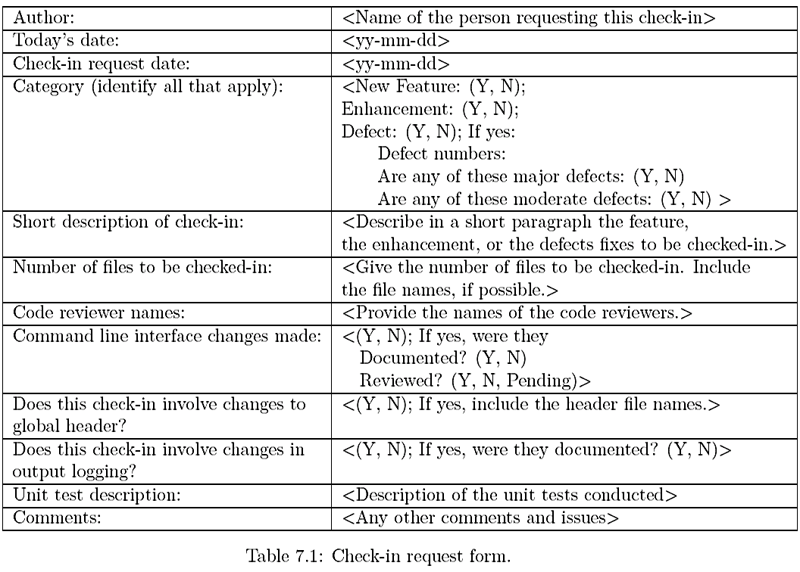

Slide 15
Incremental
A software image is a compiled software binary
A build is an interim software image for internal testing within an organization
Constructing a build is a process by which individual modules are integrated to form an interim software image.
The final build is a candidate for system testing
Constructing a software image involves a set of activities

Slide 16
Software Image Construction
Gathering the latest unit tested, authorized versions of modules
Compiling the source code of those modules
Checking in the compiled code to the repository
Linking the compiled modules into sub-assemblies
Verifying that the sub-assemblies are correct
Exercising version control

Slide 17
Incremental
Integration testing is conducted in an incremental manner as a series of test cycles
In each test cycle, a few more modules are integrated with an existing and tested build to generate larger builds
The complete system is built, cycle by cycle until the whole system is operational for system-level testing.
The number of SIT cycles and the total integration time are determined by a set of parameters.

Slide 18
Parameters affecting Incremental SIT
Number of modules in the system
Relative complexity of the module (cyclomatic complexity)
Relative complexity of the interfaces between the modules
Number of modules needed to be clustered together in each test cycle
Whether the modules to be integrated have been adequately tested before
Turn-around time for each test-debug-fix cycle

Slide 19
Incremental
A release note containing the following information accompanies a build.
What has changed since the last build?
What outstanding defects have been fixed?
What are the outstanding defects in the build?
What new modules, or features, have been added?
What existing modules, or features, have been enhanced, modified, or deleted?
Are there any areas where unknown changes may have occurred?

Slide 20
Issues to be addressed
A test strategy is created for each new build and the following issues are addressed while planning a test strategy
What test cases need to be selected from the SIT test plan?
What previously failed test cases should now be re-executed in order to test the fixes in the new build?
How to determine the scope of a partial regression tests?
What are the estimated time, resource domain, and cost to test this build?

Slide 21
Incremental: Build frequency
Creating a daily build is very popular among many organization
It facilitates to a faster delivery of the system
It puts emphasis on small incremental testing
It steadily increases number of test cases
The system is tested using automated, re-usable test cases
An effort is made to fix the defects that were found within 24 hours
Prior version of the build are retained for references and rollback
A typical practice is to retain the past 7-10 builds

Slide 22
Top Down Approach
It is primarily considering as an approach where
Modules are developed
Testing starts at the finest level of the programming hierarchy
Continues towards the lower levels.
Top down strategy of integration testing is an incremental approach because
We proceed one level at a time.
It can be determine either in
“depth first search” and in
“breadth first search” manner.

Slide 23
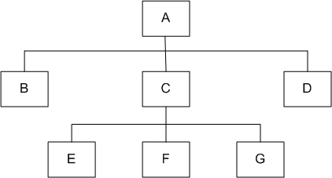
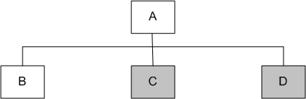
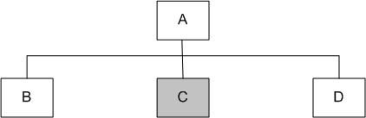
Top-down
Module A has been decomposed into modules B, C, and D
Modules B, D, E, F, and G are terminal modules
First integrate modules A and B using stubs C` and D` (represented by grey boxes)
Next stub D` has been replaced with its actual instance D
Two kinds of tests are performed:
Test the interface between A and D
Regression tests to look for interface defects between A and B in the presence of module D
A module hierarchy with three levels and seven modules
Top-down integration of modules A and B
Top-down integration of modules A, B and D

Slide 24
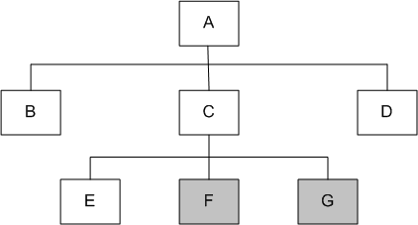
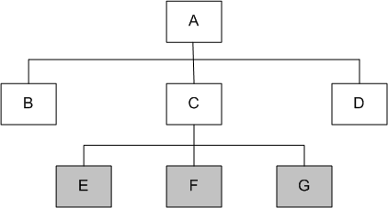
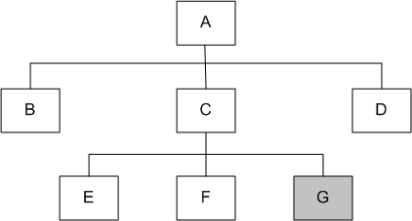
Top-down
Stub C’ has been replaced with the actual module C, and new stubs E`, F`, and G`
Perform tests as follows:
Test the interface between A and C;
Test the combined modules A, B, and D in the presence of C
The rest of the process depicted in the right hand side figures.
Top-down integration of modules A, B, C, D and E
Top-down integration of modules A, B, C, D, E and F
Top-down integration of modules A, B, D and C

Slide 25
Top-down
Advantages
The SIT engineers continually observe system-level functions as the integration process continue
Isolation of interface errors becomes easier because of the incremental nature of the top-down integration
Test cases designed to test the integration of a module M are reused during the regression tests performed after integrating other modules
Disadvantages
It may not be possible to observe meaningful system functions because of an absence of lower level modules and the presence of stubs.
Test case selection and stub design become increasingly difficult when stubs lie far away from the top-level module.

Slide 26
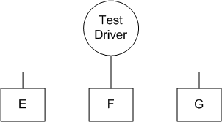
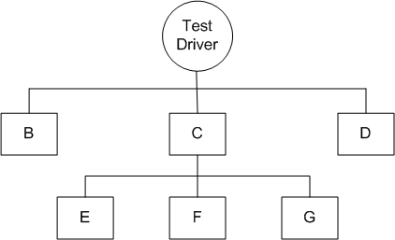
Bottom-up
A test driver is designed to integrate lowest-level modules E, F, and G
Return values generated by one module is likely to be used in another module
The test driver mimics module C to integrate E, F, and G in a limited way.
The test driver is replaced with actual module , i.e., C.
A new test driver is used
At this moment, more modules such as B and D are integrated
The new test driver mimics the behavior of module A
Finally, the test driver is replaced with module A and further test are performed
Bottom-up integration of module E, F, and G
Bottom-up integration of module B, C, and D with F, F, and G

Slide 27
Bottom-up
Advantages
One designs the behavior of a test driver by simplifying the behavior of the actual module
If the low-level modules and their combined functions are often invoked by other modules, then
It is useful to test them first so that meaningful effective integration of other modules can be done
Disadvantages
Discovery of major faults are detected towards the end of the integration process
Major design decision are embodied in the top-level modules
Test engineers can not observe system-level functions from a partly integrated system.
They can not observe system-level functions until the top-level test driver is in place

Slide 28
Top-down vs. Bottom-up
Criteria | Top-Down | Bottom-up
Detection of Major Design Decisions | Detected early | Detected toward the end of the integration process
Observation of System-Level Functions | Observe system-level functions early in the integration process | Only at the end of system integration
Difficulty in Designing Test Cases | Increasingly difficult to design stub behavior and test input | One designs the behavior of a test driver by simplifying the behavior of the actual module
Reusability of Test Cases | Test cases are reused as system-level test cases | All the test cases incorporated into test drivers, except for the top-level test driver, cannot be reused

Slide 29
Big-bang and Sandwich
Big-bang Approach
First all the modules are individually tested
Next all those modules are put together to construct the entire system which is tested as a whole
Sandwich Approach
In this approach a system is integrated using a mix of top-down, bottom-up, and big-bang approaches
A hierarchical system is viewed as consisting of three layers
The bottom-up approach is applied to integrate the modules in the bottom-layer
The top layer modules are integrated by using top-down approach
The middle layer is integrated by using the big-bang approach after the top and the bottom layers have been integrated

Slide 30
Software and Hardware Integration
Integration is often done in an iterative manner
A software image with a minimal number of core modules is loaded on a prototype hardware
A small number of tests are performed to ensure that all the desired software modules are present in the build
Next, additional tests are run to verify the essential functionalities
The process of assembling the build, loading on the target hardware, and testing the build continues until the entire product has been integrated

Slide 31
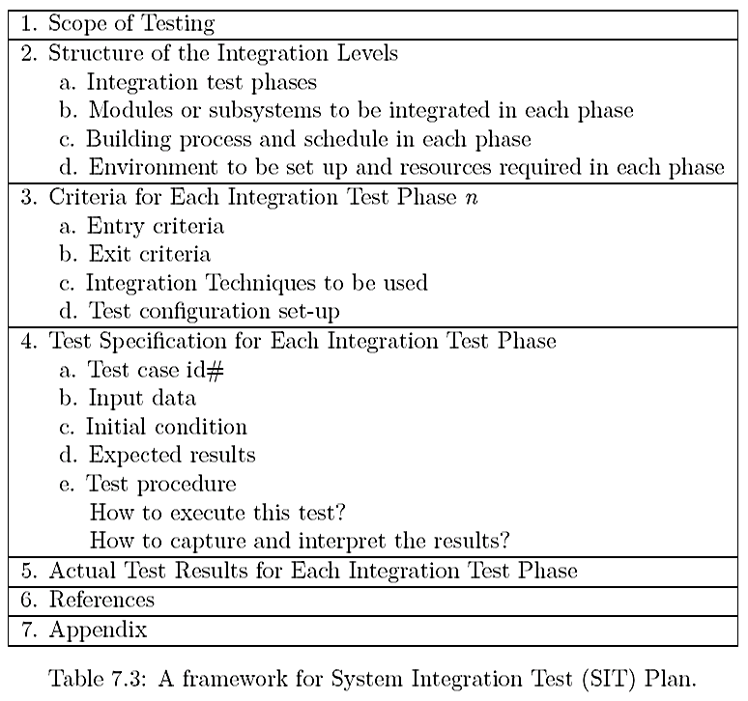
Test Plan for SIT

Slide 32
Test Plan for System Integration
Interface integrity
Internal and external interfaces are tested as each module is integrated
Functional validity
Tests to uncover functional errors in each module after it is integrated
End-to-end validity
Tests are designed to ensure that a completely integrated system works together from end-to-end
Pairwise validity
Tests are designed to ensure that any two systems work properly when connected by a network
Interface stress
Tests are designed to ensure that the interfaces can sustain the load
System endurance
Tests are designed to ensure that the integrated system stay up for weeks

Slide 33
Off-the-self Component Integration
Organization occasionally purchase off-the-self (OTS) components from vendors and integrate them with their own components
Useful set of components that assists in integrating actual components:
Wrapper: It is a piece of code that one builds to isolate the underlying components from other components of the system
Glue: A glue component provides the functionality to combine different components
Tailoring: Components tailoring refers to the ability to enhance the functionality of a component
Done by adding some elements to a component to enrich it with a functionality not provided by the vendor
Does not involve modifying the source code of the component

Slide 34
Off-the-shelf Component Testing
OTS components produced by the vendor organizations are known as commercial off-the-shelf (COTS) components
A COTS component is defined as:
A unit of composition with contractually specified interfaces and explicit context dependencies only. A software component can be deployed independently and is subject to composition by third parties
Black-box component testing: This is used to determine the quality of the component
System-level fault injection testing: This is used to determine how well a system will tolerate a failing component
Operational system testing: This kind of tests are used to determine the tolerance of a software system when the COTS component is functioning correctly

Slide 35
Built-in Testing
Testability is incorporated into software components
Testing and maintenance can be self-contained
Normal mode
The built-in test capabilities are transparent to the component user
The component does not differ from other non-built-in testing enabled components
Maintenance mode
The component user can test the component with the help of its built-in testing features
The component user can invoke the respective methods of the component, which execute the test, evaluate autonomously its results, and output the test summary.

Slide 36
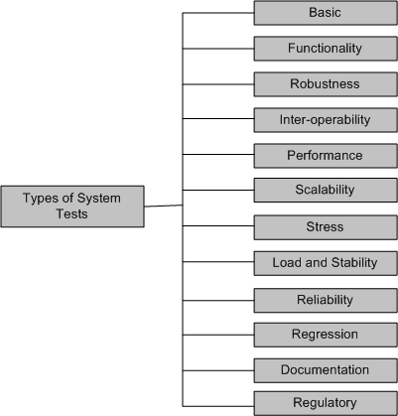
Taxonomy of System Testing

Slide 37
Taxonomy of System Tests
Basic tests provide an evidence that the system can be installed, configured and be brought to an operational state
Functionality tests provide comprehensive testing over the full range of the requirements, within the capabilities of the system
Robustness tests determine how well the system recovers from various input errors and other failure situations
Inter-operability tests determine whether the system can inter-operate with other third party products
Performance tests measure the performance characteristics of the system, e.g., throughput and response time, under various conditions

Slide 38
Taxonomy of System Tests
Scalability tests determine the scaling limits of the system, in terms of user scaling, geographic scaling, and resource scaling
Stress tests put a system under stress in order to determine the limitations of a system and, when it fails, to determine the manner in which the failure occurs
Load and Stability tests provide evidence that the system remains stable for a long period of time under full load
Reliability tests measure the ability of the system to keep operating for a long time without developing failures
Regression tests determine that the system remains stable as it cycles through the integration of other subsystems and through maintenance tasks
Documentation tests ensure that the system’s user guides are accurate and usable

Slide 39
Acceptance testing
Acceptance testing consists of
Comparing a software system to its initial requirements and to the current needs of its end-users
In the case of a contracted program, to the original contract
It is a crucial step that decides the fate of a software system.
Its visible outcome provides an important quality indication for the customer to determine whether to accept or reject the software product

Slide 40
Goals of Acceptance Testing
Verify the man-machine interactions
Validate the required functionality of the system
Verify that the system operates within the speciﬁed constraints
Check the system’s external interfaces

Slide 41
Types of Acceptance Testing
Acceptance testing is a formal testing conducted to determine whether a system satisfies its acceptance criteria
There are two categories of acceptance testing:
User Acceptance Testing (UAT)
It is conducted by the customer
To ensure that system satisfies the contractual acceptance criteria before being signed-off as meeting user needs.
Business Acceptance Testing (BAT)
It is undertaken within the development organization of the supplier
To ensure that the system will eventually pass the user acceptance testing.

Slide 42
Acceptance Criteria
The acceptance criteria are defined on the basis of the following attributes:
Functional Correctness and Completeness
Accuracy
Data Integrity
Data Conversion
Backup and Recovery
Competitive Edge
Usability
Performance
Start-up Time
Stress
Reliability and Availability
Maintainability and Serviceability
Robustness
Timeliness
Confidentiality and Availability
Compliance
Installability and Upgradability
Scalability
Documentation

Slide 43
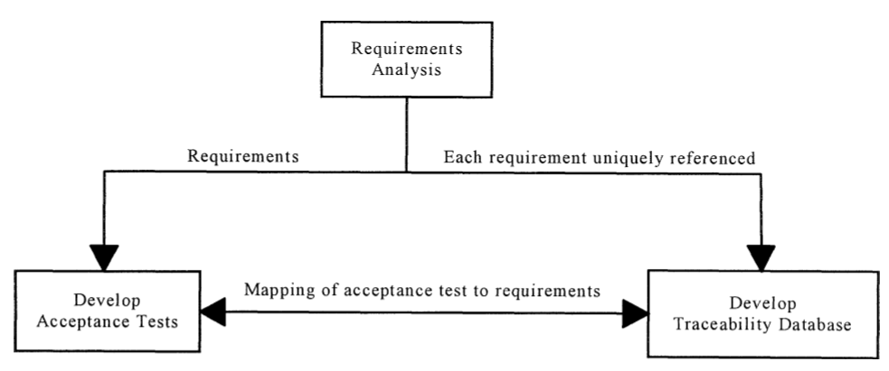
Functional Correctness and Completeness
Does the system do what we want it to do?
All the features which are described in the requirements speciﬁcation must be present in the delivered system.
How to show the functional correctness of a system?
Requirement traceability matrix

Slide 44
Accuracy
Does the system provide correct results?
Measures the extent to which a computed value stays close to the expected value
False positive, false negative

Slide 45
Data Integrity
Data integrity mechanisms detect changes in a data set.
Preservation of the data while it is transmitted or stored

Slide 46
Data Conversion
How can we undo a conversion and roll back to the earlier database version(s) if necessary?
How much human involvement is needed to validate the conversion results?
How are the current data being used and how will the converted data be used?
Will the data conversion software conduct integrity checking as well?

Slide 47
Selection of Acceptance Criteria
The acceptance criteria discussed are too many and very general
The customer needs to select a subset of the quality attributes
The quality attributes are prioritize them to specific situation
IBM used the quality attribute list CUPRIMDS for their products
– Capability, Usability, Performance, Reliability, Installation, Maintenance, Documentation, and Service
Ultimately, the acceptance criteria must be related to the business goals of the customer’s organization

Slide 48
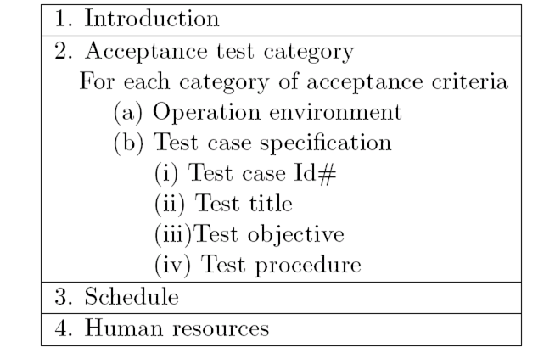
Acceptance Test Plan

Slide 49
Acceptance Test Execution
The acceptance test cases are divided into two subgroups
The first subgroup consists of basic test cases, and
The second consists of test cases that are more complex to execute
The acceptance tests are executed in two phases
First phase, the test cases from the basic test group are executed
If the test results are satisfactory then the second phase, in which the complex test cases are executed, is taken up.
In addition to the basic test cases, a subset of the system-level test cases are executed by the acceptance test engineers to independently confirm the test results

Slide 50
Activities in Acceptance Testing
Acceptance test execution activity includes the following detailed actions:
The developers train the customer on the usage of the system
The developers and the customer co-ordinate the fixing of any problem discovered during acceptance testing
The developers and the customer resolve the issues arising out of any acceptance criteria discrepancy

Slide 51
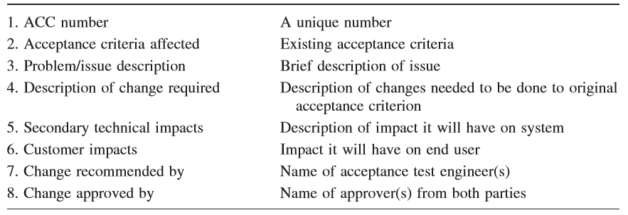
Acceptance Test Execution
The acceptance test engineer may create
An Acceptance Criteria Change (ACC) document
To communicate the deficiency in the acceptance criteria
To the supplier
Given to the supplier’s marketing department through the on-site system test engineers

Slide 52
Acceptance Test Report
The acceptance test activities are designed to reach at a conclusion:
Accept the system as delivered
Accept the system after the requested modifications have been made
Do not accept the system
Intermediate decisions are made before making the final decision.
Continuation of acceptance testing if the results of the first phase of acceptance testing is not promising
Changes be made to the system before acceptance testing can proceed to the next phase
The acceptance team prepares a test report on a daily basis

Slide 53
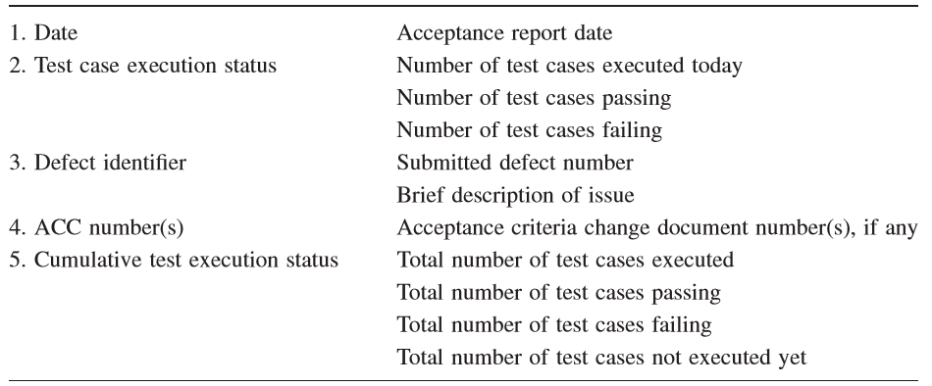
Acceptance Test Status Report

Slide 54
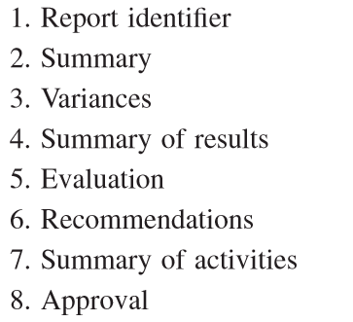
Acceptance Test Summary Report
Uniquely identiﬁes the report
What acceptance testing activities took place
Difference between planned and executed testing
Total number of test cases executed,
Number of passing test cases,
Number of failing test cases,
Identiﬁes all the defects,
Summarizes the acceptance criteria to be changed
The deviations of the acceptance criteria that are captured in the ACC during the acceptance testing are discussed.
Accept as delivered
Accept after the modifications
Do not accept the system

Slide 55
Acceptance Testing in eXtreme Programming
In XP framework the user stories are used as acceptance criteria
The user stories are written by the customer as things that the system needs to do for them
Several acceptance tests are created to verify the user story has been correctly implemented
The customer is responsible for verifying the correctness of the acceptance tests and reviewing the test results
A story is incomplete until it passes its associated acceptance tests
Ideally, acceptance tests should be automated, either using the unit testing framework, before coding
The acceptance tests take on the role of regression tests

Slide 56
State-of-Practice of Acceptance Testing
Study the requirements document,
Obtain help from a domain expert,
Develop a set of test cases, and
Demonstrate to the customer, by using the test cases, that the software indeed possesses the required functionality as formally or informally speciﬁed.

Slide 57
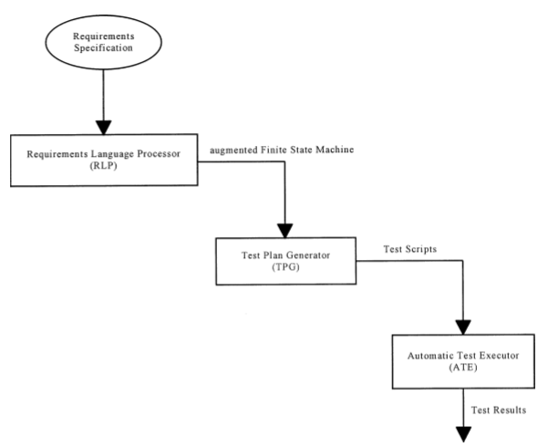
Other Approaches: FSM
Requirement Specification
Augmented Finite State Machine (FSM)
Requirement Language Processor (RLP)
Test Plan Generator (TPG)
Test Scripts
Automatic Test Execution (ATE)
Test Results

Slide 58
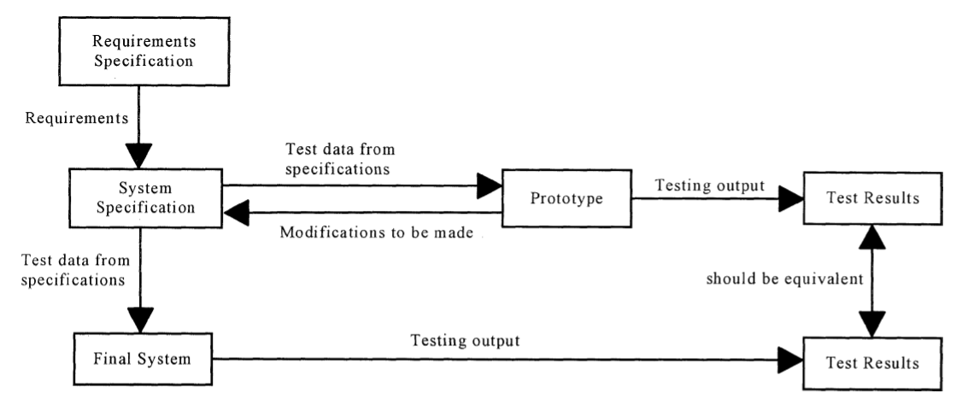
Other Approaches: FSM

Slide 59
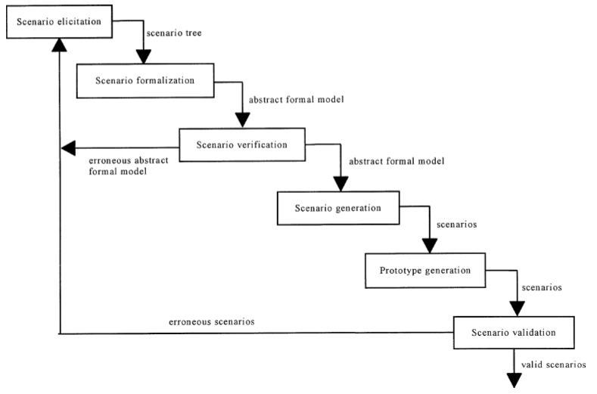
Scenario Analysis

Slide 60

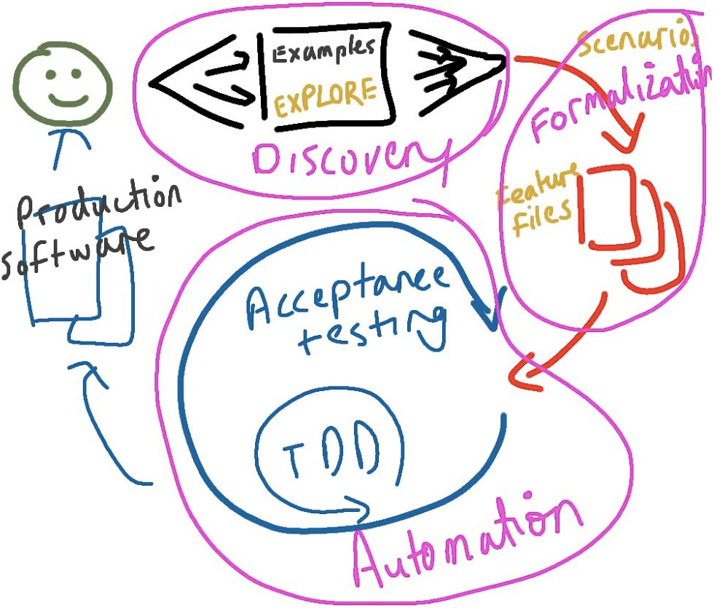
Tools
It runs automated acceptance tests written in a behavior-driven development (BDD) style

Slide 61


Tools
Protractor is an end-to-end test framework for AngularJS applications.
Protractor runs tests against your application running in a real browser, interacting with it as a user would.
AngularJS extends HTML with new attributes.

Slide 62

Tools
Selenium WebDriver
Selenium is a portable software testing framework for web applications.
WebDriver is the name of the key interface against which tests should be written

Slide 63


Tools
Jasmine is an open source testing framework for JavaScript
It is heavily influenced by other unit testing frameworks
Automated checks run as JUnit or NUnit tests, providing easy integration to your current development, build and Continuous Integration tools.

Slide 64
Thank you
Next Lecture: Software Maintenance

