Slide 1

CS223: Software Engineering
Software Testing

Slide 2
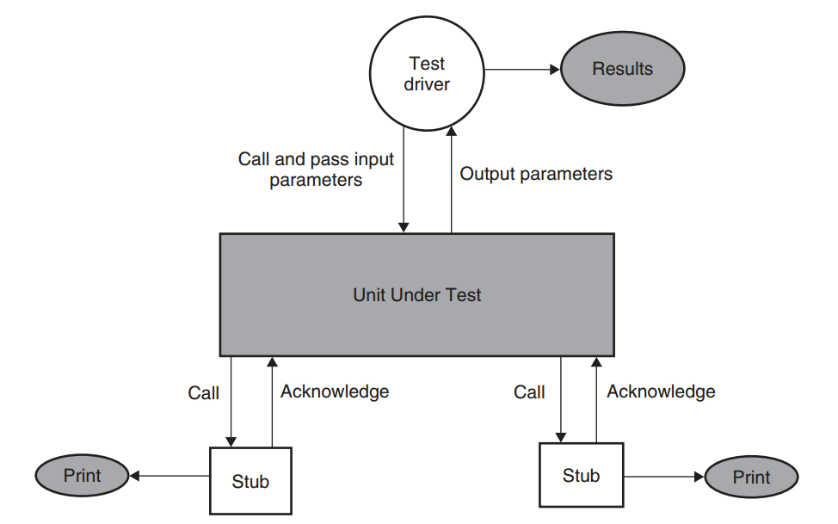
Dynamic Unit Testing
A test driver is a program that invokes the unit under test.
The test driver and stubs are tightly coupled with the unit under test and
should accompany the unit throughout its life cycle.
A stub is a “dummy subprogram” that replaces a unit that is called by the unit under test (Does two things…)

Slide 3
Testing vs. Debugging
After a program failure, identify the corresponding fault and fixes it.
Debugging : The process of determining the cause of a failure.
Debugging occurs as a consequence of a test revealing a failure.
Approaches to Debugging
Brute Force
Cause Elimination
Back Tracking
“Let the computer find the error”
“Induction and deduction”

Slide 4
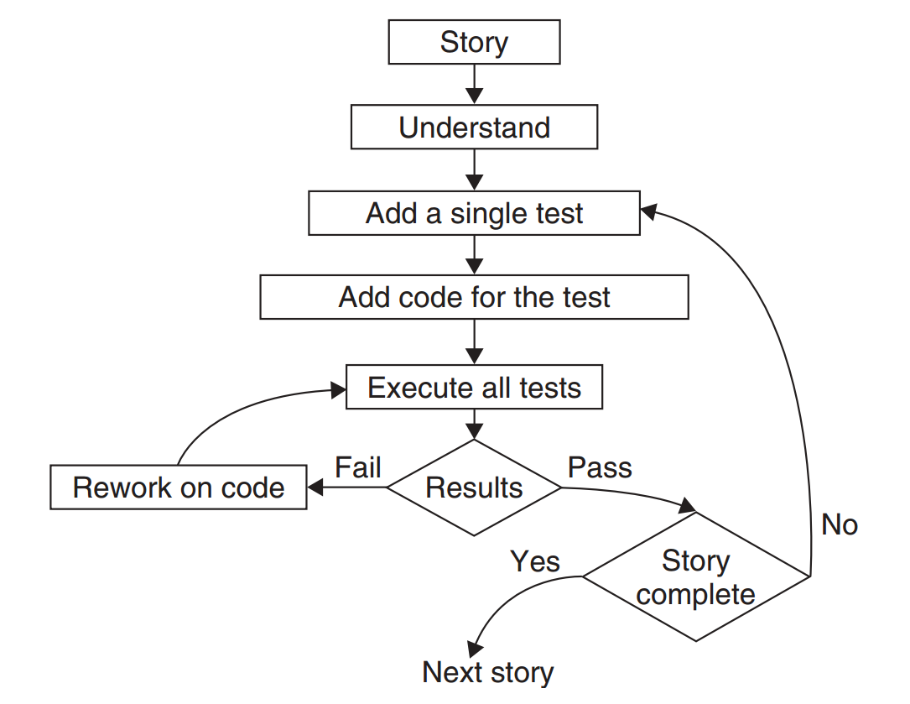
Extreme Programming and Testing

Slide 5
Test planning and design
To get ready and organized for test execution
Provides a framework, scope, details of resource needed, effort required, schedule of activities, and a budget
During test plan
The system requirements are critically studied,
System features to be tested are thoroughly identiﬁed,
The objectives of test cases and the detailed behavior of test cases are deﬁned

Slide 6
Selection of Test Data
Control Flow
Control Flow Graph
Data Flow
Data Flow Graph
Domain
Domain Error
Functional Program
Special values from i/o domain

Slide 7
Control Flow Testing
Program instructions are executed in a sequential manner
In the absence of conditional statements
Unless a function is called
The execution of a sequence of instructions from the entry point to the exit point of a program unit is called a program path.
Ideally, one must strive to execute fewer paths for better effectiveness.

Slide 8
Outline of control flow testing
Inputs
The source code of a program unit
A set of path selection criteria
Examples of path selection criteria
Select paths such that every statement is executed at least once
Select paths such that every conditional statement evaluates to true and false at least once on different occasions

Slide 9
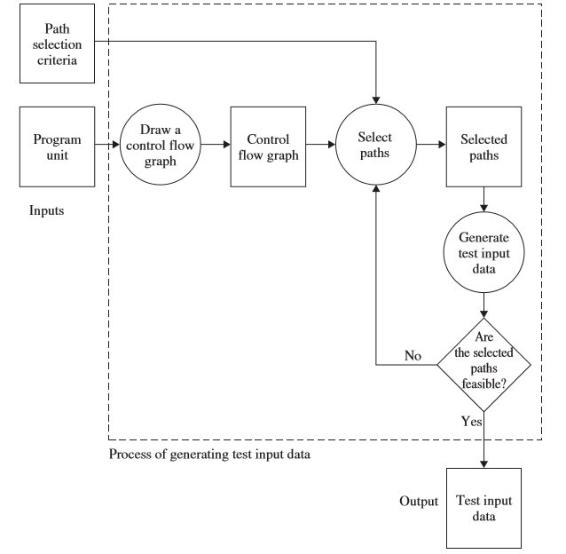
Control Flow Graph (CFG)
The idea behind checking the feasibility of a
selected path is to meet the path selection criteria

Slide 10
Control Flow Graph (CFG)
FILE *fptr1, *fptr2, *fptr3; /* These are global variables.*/
int openfiles(){
/* This function tries to open files "file1", "file2", and "file3" for read access, and returns the number of files successfully opened. The file pointers of the opened files are put in the global variables. */
int i = 0;
if(
((( fptr1 = fopen("file1", "r")) != NULL) && (i++) &&
(0)) ||
((( fptr2 = fopen("file2", "r")) != NULL) && (i++) && (0)) ||
((( fptr3 = fopen("file3", "r")) != NULL) && (i++))
);
return(i);
}

Slide 11
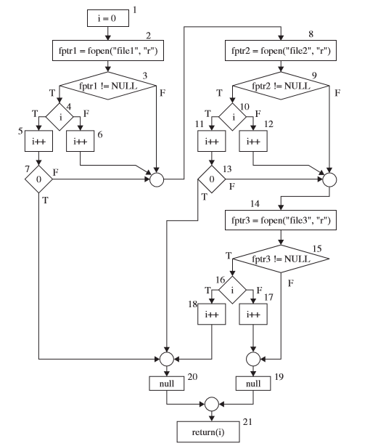
Control Flow Graph (CFG)

Slide 12
What paths do I select for testing?
Select all paths.
Select paths to achieve complete statement coverage.
Select paths to achieve complete branch coverage.
Select paths to achieve predicate coverage.

Slide 13
What paths do I select for testing?
Select all paths.
Select paths to achieve complete statement coverage.
Select paths to achieve complete branch coverage.
Select paths to achieve predicate coverage.

Slide 14
Path selection criteria
FILE *fptr1, *fptr2, *fptr3; /* These are global variables.*/
int openfiles(){
/* This function tries to open files "file1", "file2", and "file3" for read access, and returns the number of files successfully opened. The file pointers of the opened files are put in the global variables. */
int i = 0;
if(
((( fptr1 = fopen("file1", "r")) != NULL) && (i++) &&
(0)) ||
((( fptr2 = fopen("file2", "r")) != NULL) && (i++) && (0)) ||
((( fptr3 = fopen("file3", "r")) != NULL) && (i++))
);
return(i);
}

Slide 15
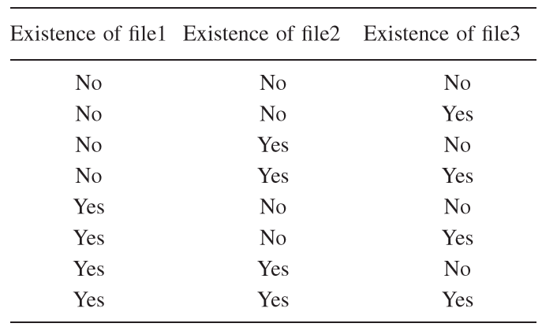
Input Domain

Slide 16
Paths executed by the test inputs
1. <No, No, No>
2. <Yes, No, No>
3. <Yes, Yes, Yes >

Slide 17
What paths do I select for testing?
Select all paths.
Select paths to achieve complete statement coverage.
Select paths to achieve complete branch coverage.
Select paths to achieve predicate coverage.

Slide 18
Statement Coverage
It refers to
Executing individual program statements and
Observing the outcome.
100% statement coverage has been achieved if
All the statements have been executed at least once
Covering a statement in a program means
Visiting one or more nodes in a CFG

Slide 19
What paths do I select for testing?
Select all paths.
Select paths to achieve complete statement coverage.
Select paths to achieve complete branch coverage.
Select paths to achieve predicate coverage.

Slide 20
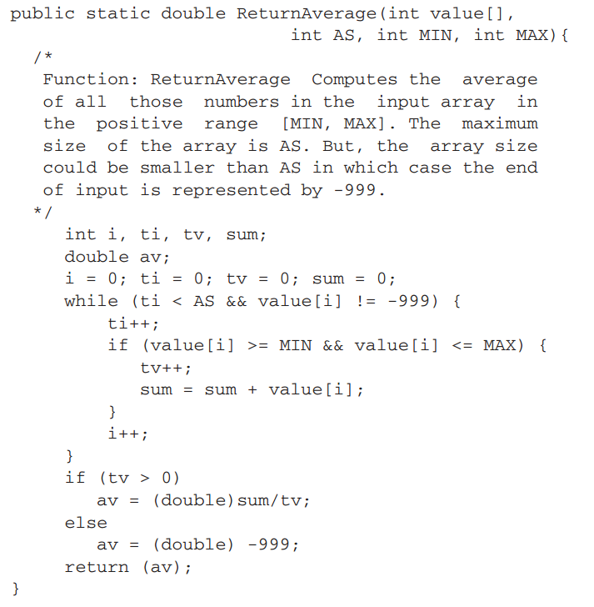
Example

Slide 21
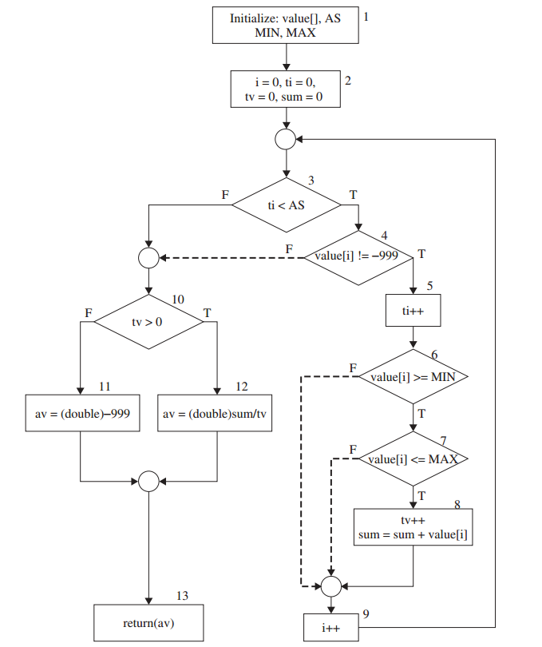
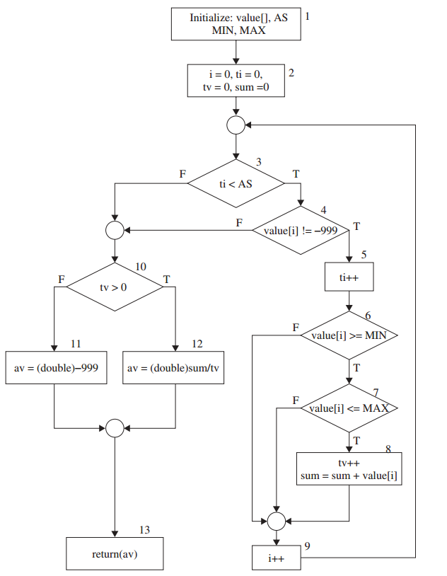
P1
P2
P1
P2
CFG
P2
P1
P2
P2
P1
P2
P2
P2
P1
P2
P2
P1
P2
P2
P1
P2
P2
P2
P2
P2
P1
P2
P2

Slide 22
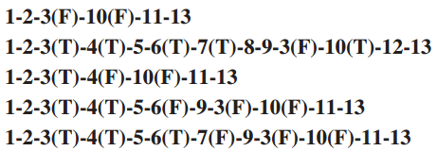

Slide 23
What paths do I select for testing?
Select all paths.
Select paths to achieve complete statement coverage.
Select paths to achieve complete branch coverage.
Select paths to achieve predicate coverage.

Slide 24
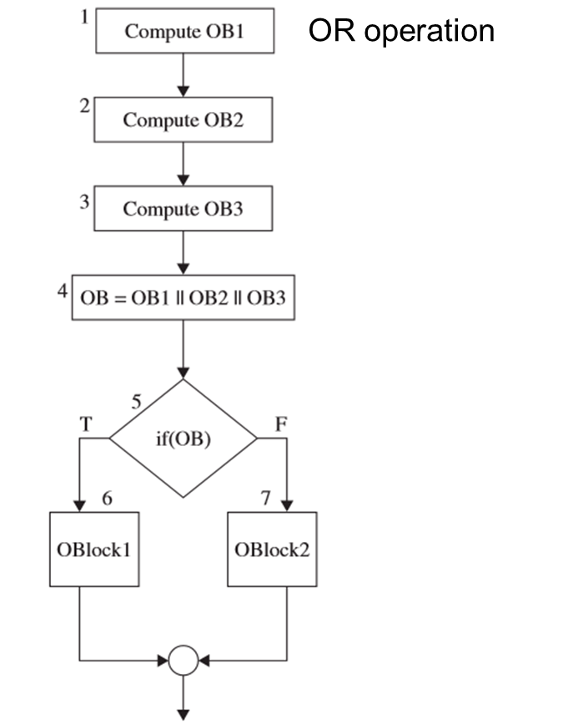
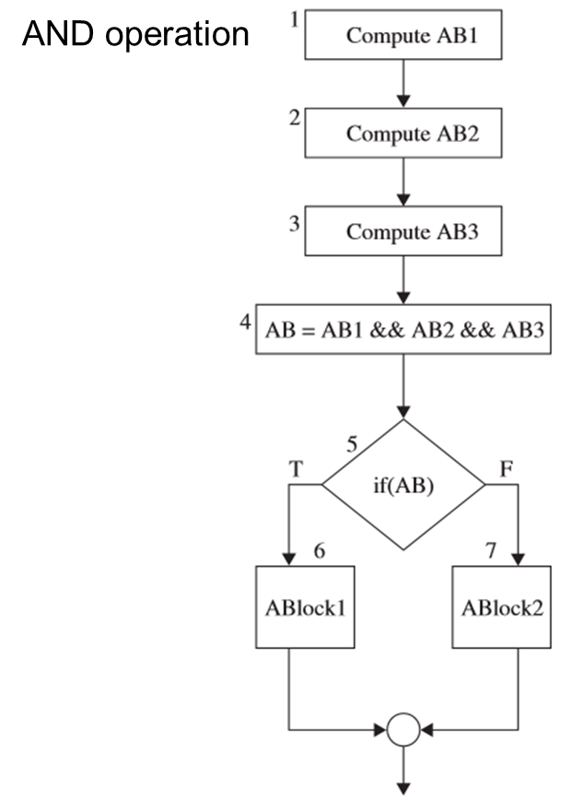
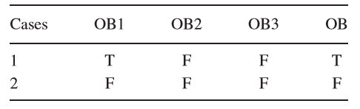
Example: Predicate coverage

Slide 25
Generating test input
How to select input values, such that
When the program is executed with the selected inputs
The chosen paths get executed
Input Vector
Predicate
Path Predicate
Predicate Interpretation
Path Predicate Expression
Generating Input Data from Path Predicate Expression

Slide 26
Input Vector
It is a collection of all data entities
Members of an input vector of a routine can take different forms
Global variables and constants
Files
Contents of registers

Slide 27
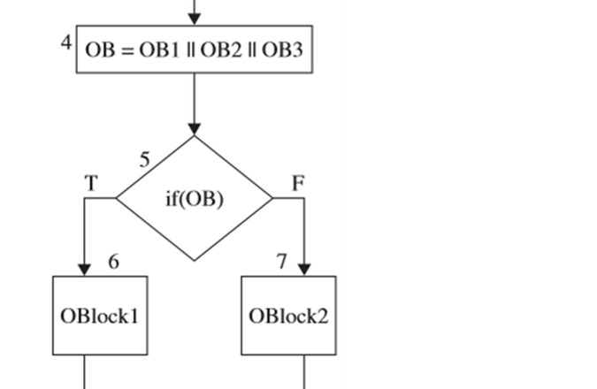
Predicate
A predicate is a logical function evaluated at a decision point
The construct OB is the predicate in decision node 5

Slide 28
Path Predicate
A path predicate is the set of predicates associated with a path.
We must know whether the individual component predicates of a path predicate evaluate to true or false in order to generate path forcing inputs.

Slide 29
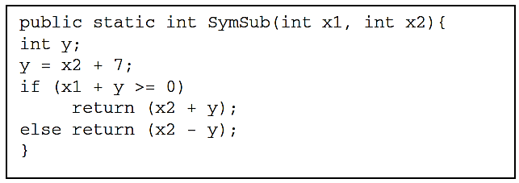
Predicate Interpretation
The local variables are not visible outside a function
We can easily substitute all the local variables in a predicate with the elements of the input vector
The process of symbolically substituting operations along a path in order to express the predicates solely in terms of the input vector and a constant vector.

Slide 30
Path Predicate Expression
An interpreted path predicate is called a path predicate expression
It is void of local variables
Path forcing input values can be generated by solving the set of constraints in a path predicate expression.
If the constraints can not be solved: infeasible path

Slide 31
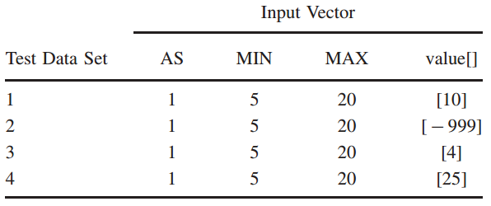

Slide 32
CFG Testing
Input Vector
Predicate
Path Predicate
Predicate Interpretation
Path Predicate Expression
Generating Input Data from Path Predicate Expression

Slide 33

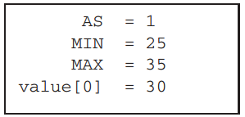
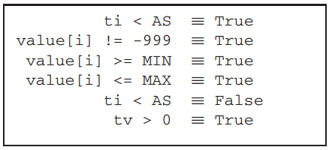
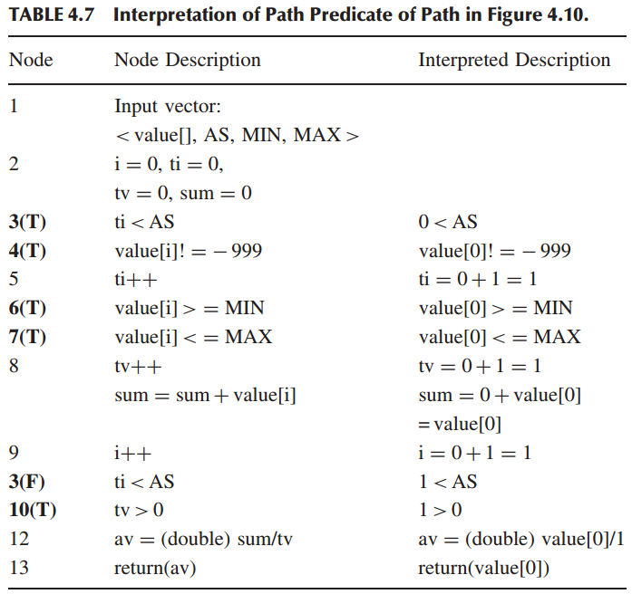

Slide 34

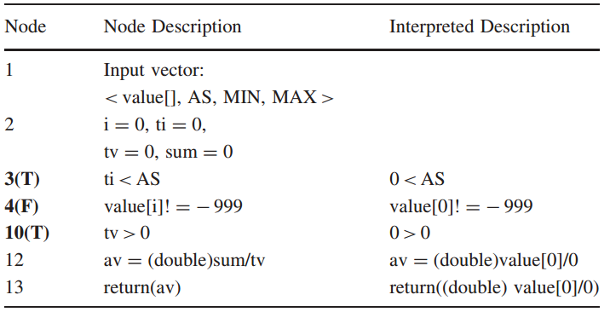

Slide 35
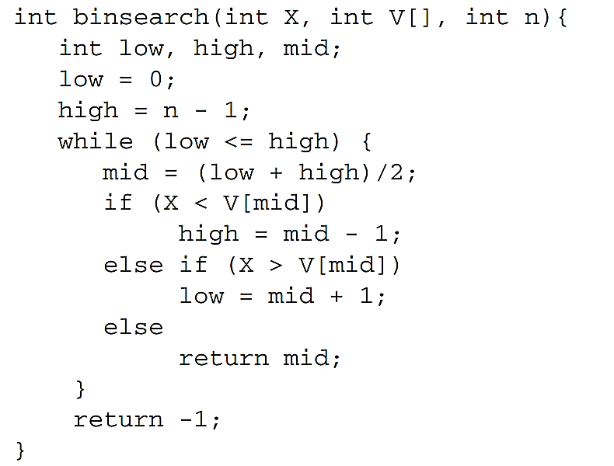
1. Draw a CFG for binsearch(). 2. From the CFG, identify a set of entry–exit paths to satisfy the complete statement coverage criterion. 3. Identify additional paths, if necessary, to satisfy the complete branch coverage criterion.
4. For each path identified above, derive their path predicate expressions. 5. Solve the path predicate expressions to generate test input and compute the corresponding expected outcomes. 6. Are all the selected paths feasible? If not, select and show that a path is infeasible, if it exists. 7. Can you introduce two faults in the routine so that these go undetected by your test cases designed for complete branch coverage?

Slide 36
Data Flow Testing
A memory location corresponding to a program variable is accessed in a desirable way
It is desirable to verify the correctness of a data value generated for a variable
Programmer can perform a number of tests on data values
Two types: Static, and Dynamic

Slide 37
Data flow anomaly
A deviant or abnormal way of doing something
The three abnormal situations
Type 1: Deﬁned and Then Deﬁned Again
Type 2: Undeﬁned but Referenced
Type 3: Deﬁned but Not Referenced

Slide 38
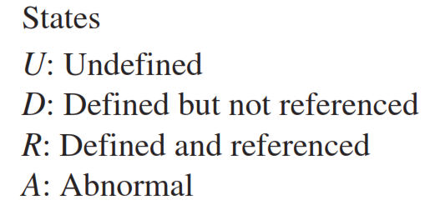
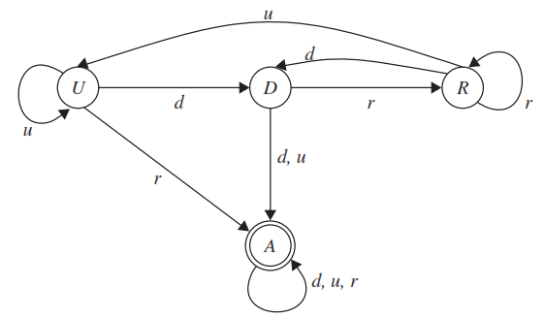
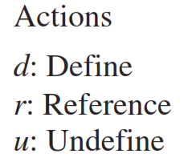
State transition diagram of a variable

Slide 39
Dynamic data flow testing
Draw a data ﬂow graph from a program.
Select one or more data ﬂow testing criteria.
Identify paths in the data ﬂow graph satisfying the selection criteria.
Derive path predicate expressions from the selected paths and solve those expressions to derive test input.

Slide 40
Data flow graph (DFG)
It is drawn with the objective of identifying data deﬁnitions and their uses
Each occurrence of a data variable is classiﬁed as follows:
Deﬁnition
Undeﬁnition or Kill
Use
Computation use (c-use)
Predicate use (p-use)

Slide 41
Example

Slide 42
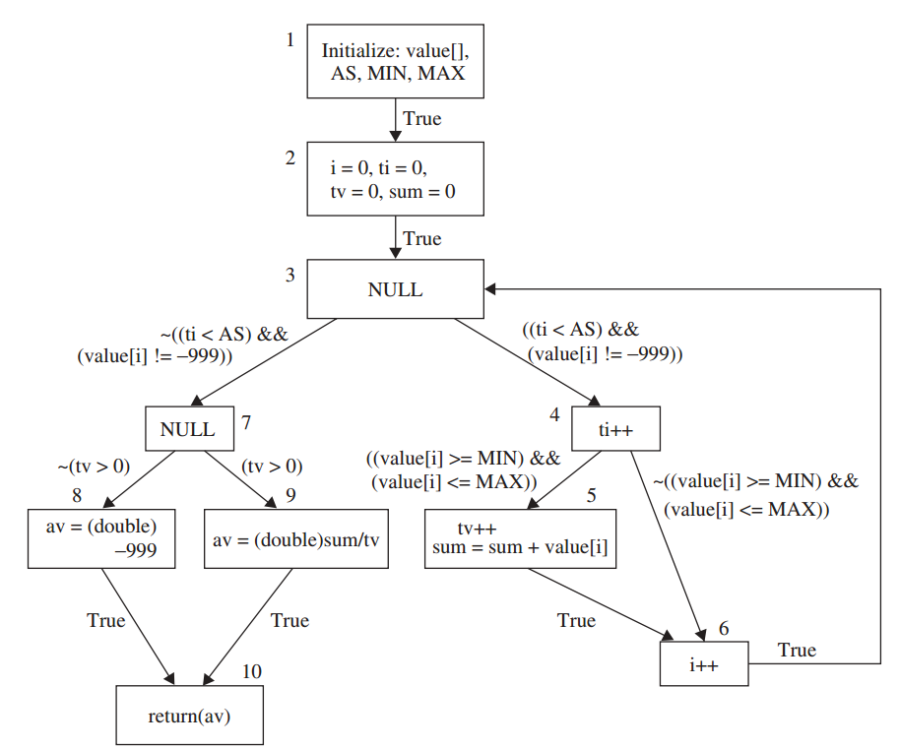

Slide 43
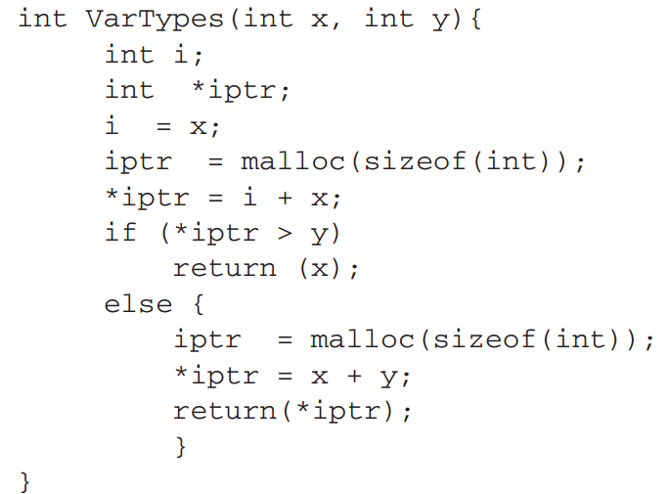
Terminologies
Definition
Undefinition or Kill
Use
Computation use (c-use)
Predicate use (p-use)

Slide 44
DFG Rule
A sequence of definitions and c-uses is associated with each node of the graph.
A set of p-uses is associated with each edge of the graph.
The entry node has a definition of each parameter and each nonlocal variable which occurs in the subprogram.
The exit node has an undefinition of each local variable.

Slide 45
Terminologies
Global c-use
Deﬁnition Clear Path
Global Deﬁnition
Loop free path
Complete path
Du-Path (Definition use path)

Slide 46
Global c-Use
A c-use of a variable x in node i is said to be a global c-use if x has been defined before in a node other than node i.
The c-use of variable tv in node 9

Slide 47
Definition Clear Path
A path (i - n1 - · · · - n_{m} - j ), m ≥ 0, is called a definition clear path (def-clear path) with respect to variable x
if x has been neither defined nor undefined in nodes n1, . . . ,nm
Definition of a def-clear path is unconcerned about the status of x in nodes i and j.
2-3-4-6-3-4-6-3-4-5

Slide 48
Global Definition
A node i has a global definition of a variable x, if
Node i has a definition of x and
there is a def-clear path with respect to x from node i to some
Node containing a global c-use or
Edge containing a p-use of variable x

Slide 49
Various Types of Path
Simple Path: A simple path is a path in which all nodes, except possibly the first and the last, are distinct.
Loop-Free Path: A loop-free path is a path in which all nodes are distinct.
Complete Path: A complete path is a path from the entry node to the exit node.
Definition use (du)-path: A path (n1 - n2 -···- nj - nk) is a du-path w.r.t variable x if node n1 has a global definition of x and either
node nk has a global c-use of x and (n1 - n2 -···- nj - nk) is a def-clear simple path w.r.t. x or
Edge (nj ,nk) has a p-use of x and (n1 - n2 -···- nj ) is a def-clear, loop-free path w.r.t. x.

Slide 50
Example

Slide 51
Anomalies
~u first use Bug. Data is used without definition.
~k first kill Bug. Data is killed without defining it.
dd define–define Bug. Redefinition of data.
dk define –> kill Bug. Data is killed without using it.
kk kill – kill Bug. Destroying already killed data.
ku kill – use Bug. Data is used after destroying it.
d~ define last Bug. Defining but not using it.

Slide 52
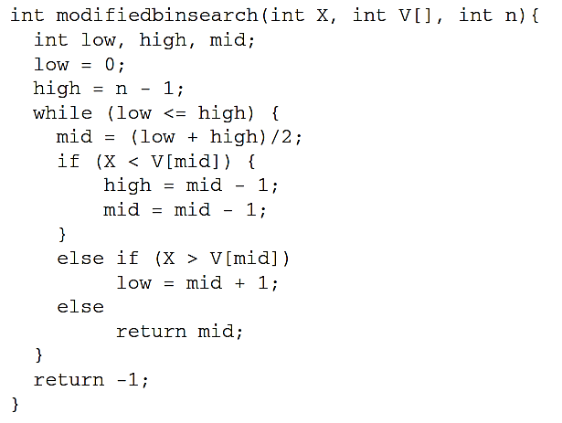
Example
Draw a DFG for this code
Identify a data flow anomaly in the code given

Slide 53
Example

Slide 54
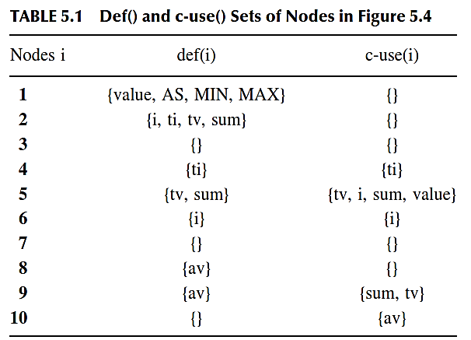
Definition and c-use set

Slide 55
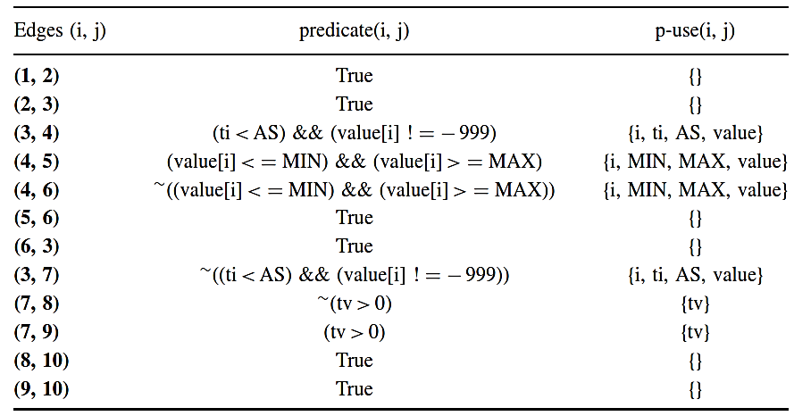
Predicate and p-use set

Slide 56
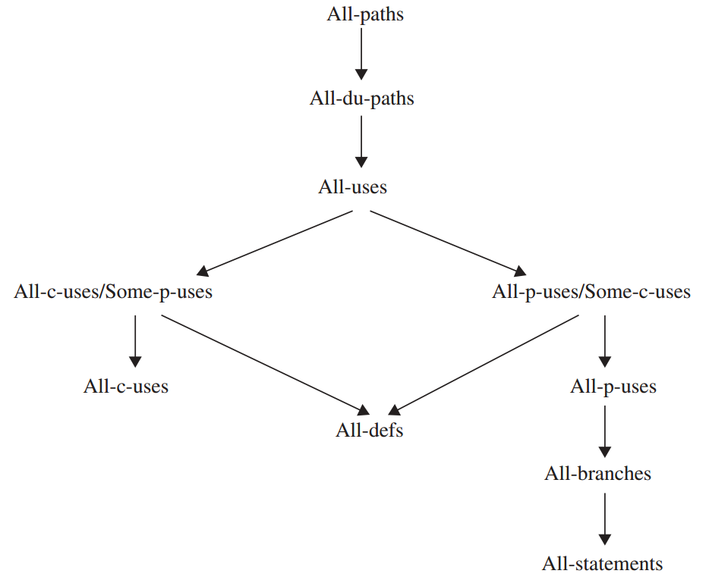
Data Flow Testing Criteria
The Rapps-Weyuker Metrics
All-defs
All c-Uses
All p-Uses
All p-Uses/ Some c-Uses
All c-Uses/ Some p-Uses
All-uses
All-du-paths

Slide 57
All-defs
For each variable x and for each node i such that x has a global deﬁnition in node i ,
Select a complete path which includes a def-clear path
From node i to node j having a global c-use of x or
From node i to edge (j ,k) having a p-use of x.

Slide 58
Example variable = tv
COMPLETE PATH
A DEF-CLEAR PATH
GLOBAL C-USE
A P-USE
1-2-3-4-5-6-3-7-9-10

Slide 59
All-c-uses
For each variable x and for each node i , such that
x has a global deﬁnition in node i ,
select complete paths which include
def-clear paths from node i to all nodes j
Such that there is a global c-use of x in j .

Slide 60
Example variable = ti
COMPLETE PATH
A DEF-CLEAR PATH
GLOBAL C-USE
1-2-3-4-5-6-3-7-8-10

Slide 61
All-p-uses
For each variable x and for each node i , such that
x has a global deﬁnition in node i ,
select complete paths which include
def-clear paths from node I to all edges (j ,k)
Such that there is a p-use of x on edge (j ,k).

Slide 62
Example variable = tv
COMPLETE PATH
A DEF-CLEAR PATH
GLOBAL C-USE
1-2-3-4-5-6-3-7-8-10

Slide 63
All-p-uses/Some-c-uses
This criterion is identical to the all-p-uses criterion except
When a variable x has no p-use.
Some-c-uses:
For each variable x and for each node i such that
x has a global deﬁnition in node i ,
select complete paths which include def-clear paths from node i to some nodes j
such that there is a global c-use of x in node j .

Slide 64
Example variable = i
COMPLETE PATH
A DEF-CLEAR PATH
No P-USE
GLOBAL C-USE
1-2-3-4-5-6-3-7-9-10

Slide 65
All-c-uses/Some-p-uses
This criterion is identical to the all-c-uses criterion except when a variable x has no global c-use.
If x has no global c-use,
then this criterion reduces to the some-p-uses criterion
For each variable x and for each node i such that x has a global deﬁnition in node i ,
select complete paths which include def-clear paths from node i to some edges (j ,k) such that
There is a p-use of x on edge (j ,k).

Slide 66
Example variable = AS
COMPLETE PATH
A DEF-CLEAR PATH
No Global C-USE
P-USE
1-2-3-4-5-6-3-7-9-10

Slide 67
All use
This criterion is the conjunction of the all-p-uses criterion and the all-c-uses criterion

Slide 68
All-du-path
For each variable x and for each node i such that x has a global deﬁnition in node i ,
Select complete paths which include all du-paths from node i
to all nodes j such that there is a global c-use of x in j and
to all edges (j ,k) such that there is a p-use of x on (j ,k).

Slide 69
Feasible paths
Complete Path
Executable/ Feasible path
If there exists an assignment of values to input variables and global variables such that all the path predicates evaluate to true
Infeasible/ Inexecutable Path
If no such assignment of values to input variables and global variables exists

Slide 70
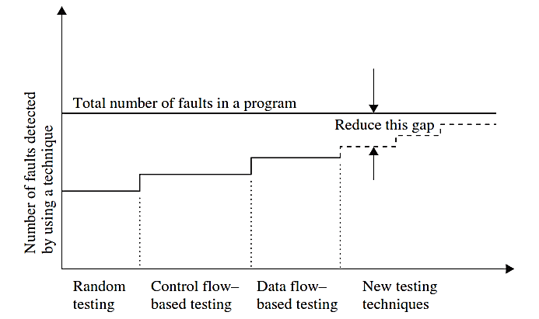
Comparison of Testing Techniques

Slide 71
Testing for domain errors
Difference with flow graph testing
Coverage criteria
Domain errors
Sources of Domains
Types of Domain Errors
Selecting Test Data to Reveal Domain Errors

Slide 72
Sources of domains
Domains can be identiﬁed from both speciﬁcations and programs
int codedomain(int x, int y){
int c, d, k
c = x + y;
if (c> 5)
d = c - x/2;
else
d = c + x/2;
if (d>=c+2)
k=x + d/2;
else
k = y + d/4;
return(k);
}
Draw a CFG for this code
Identify the domain boundaries

Slide 73
Domain boundaries
A domain is deﬁned, from a geometric perspective, by a set of constraints called boundary inequalities.
Properties of a domain are discussed in terms of the properties of its boundaries
Closed Boundary
Open Boundary
Depending upon the type of boundaries
Closed Domain, Open domain, Extreme point, Adjacent domains

Slide 74
Types of domain errors
Closure Error
If a boundary is open when the intention is to have a closed boundary
Shifted-Boundary Error
Implemented boundary is parallel to the intended boundary
Constant term of the inequality
Tilted-Boundary Error
If the constant coefﬁcients of the variables in a predicate deﬁning a boundary take up wrong values

Slide 75
Thank you
Next Lecture: Domain Testing

